Slide 1
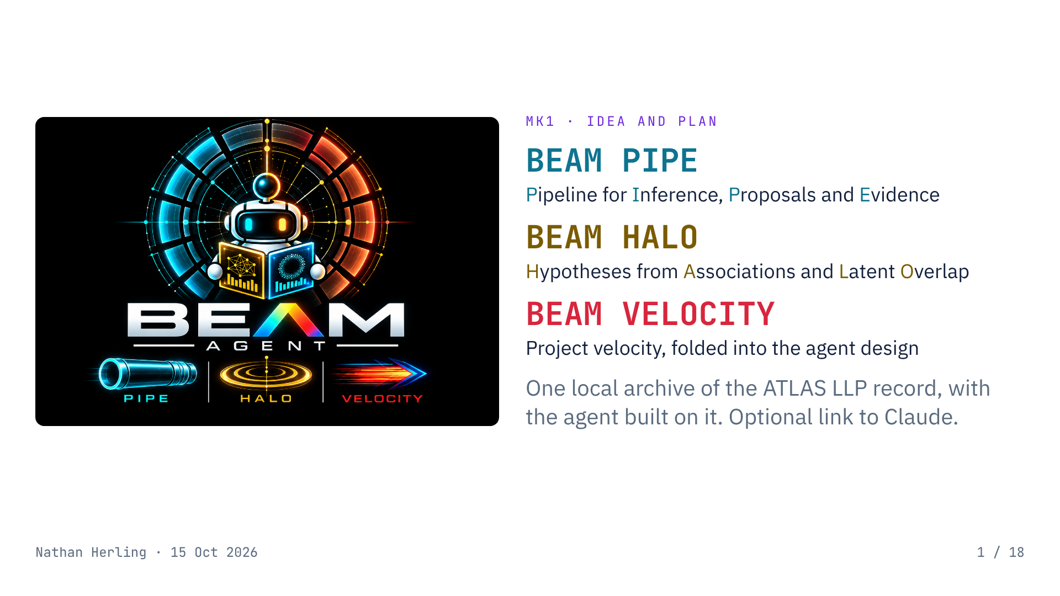
Notes:
BEAM is the archive. BEAM PIPE is the agent that works through it; BEAM HALO is the batch synthesis stage; BEAM VELOCITY folds Project Velocity into the agent design. Nothing is built yet; estimates are rough.

Slide 2
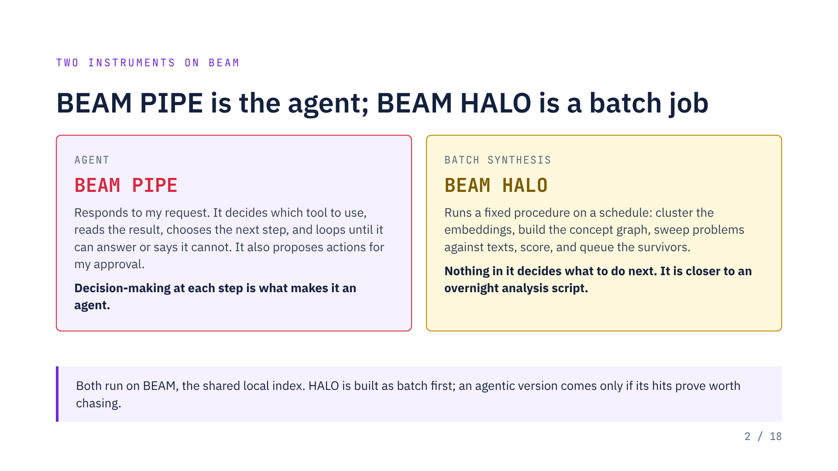
Notes:
An agentic HALO would pick a promising link, read the sources behind it, and decide whether to dig deeper or drop it. Open-ended exploration is where small local models fail most, so it would likely need Claude as planner and be limited to public-tier material.

Slide 3
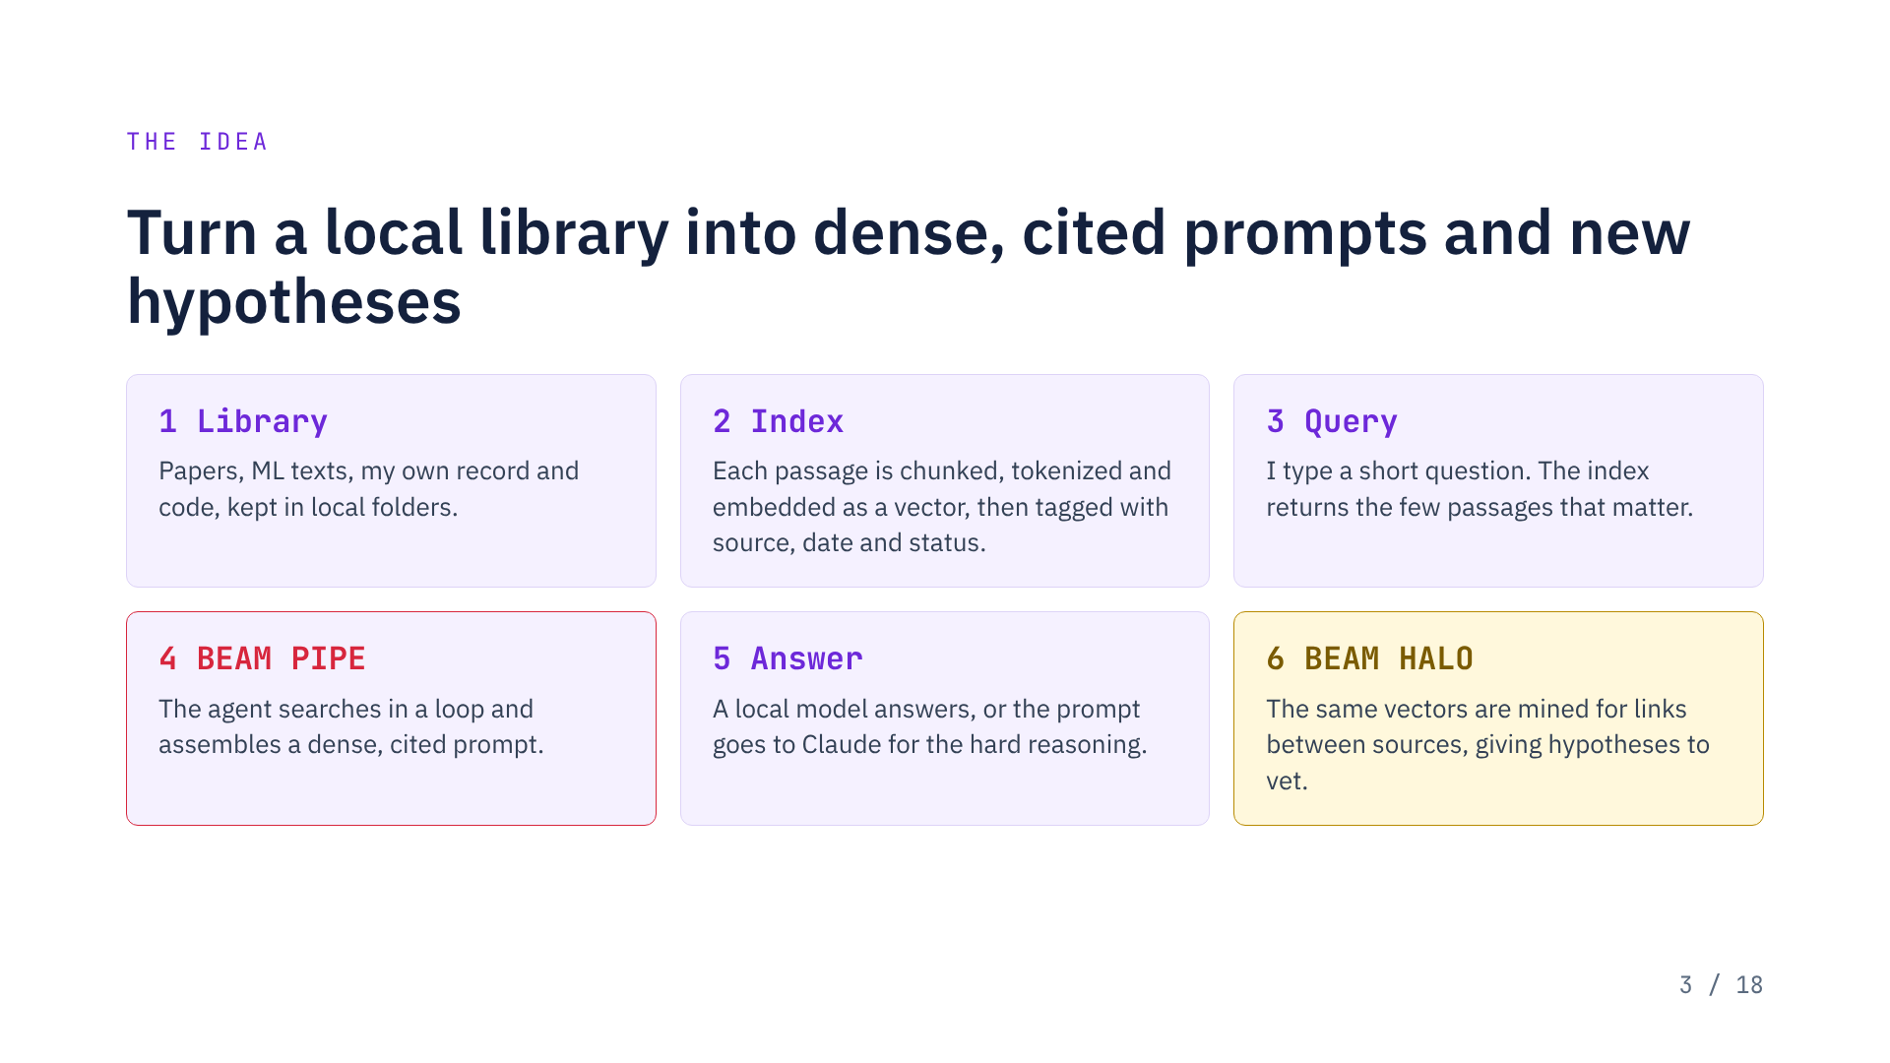
Notes:
Steps 1 to 3 are BEAM, the archive. What I approve goes back into the library, so the archive grows with the work. The embeddings stay local and are only used to find passages; what reaches any LLM is plain text.

Slide 4
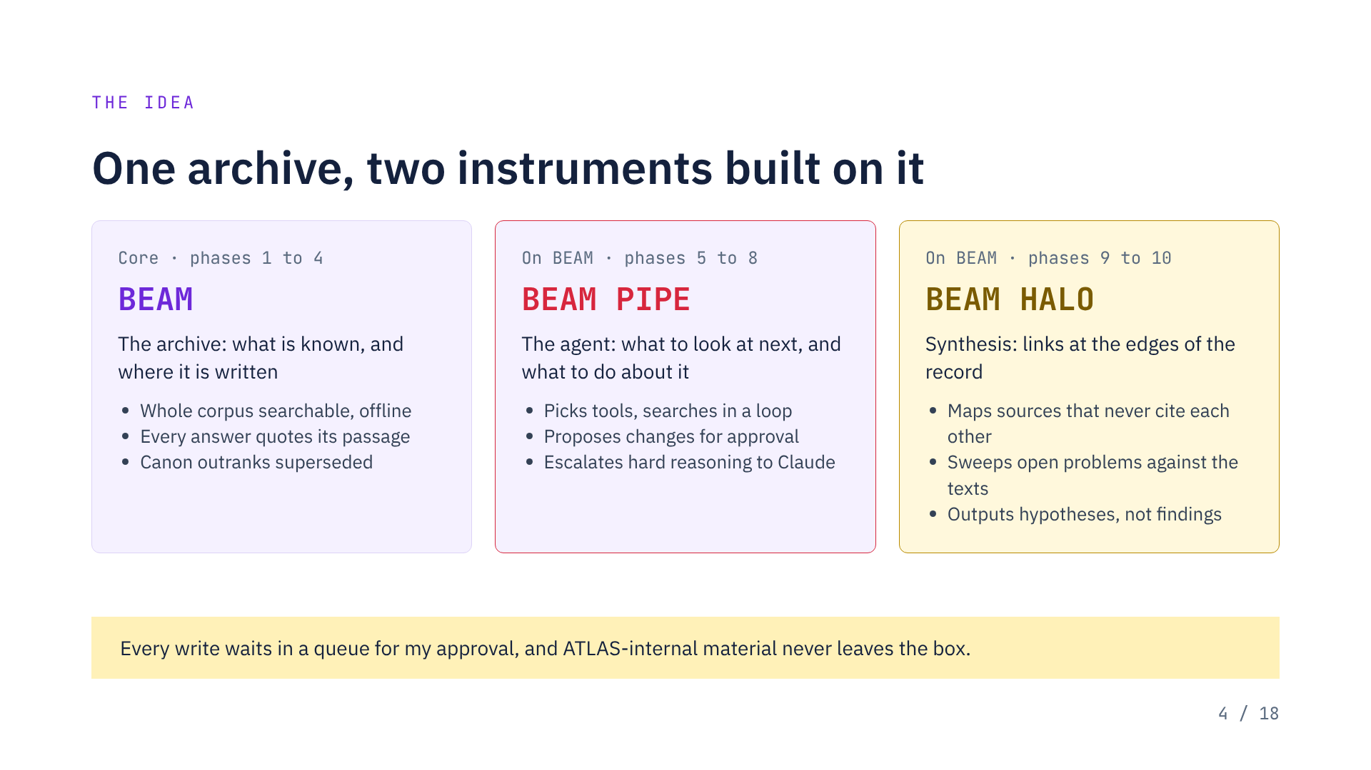
Notes:
BEAM must pass the retrieval eval before either instrument is built. BEAM HALO files its hypotheses into the proposal queue that BEAM PIPE provides. HALO expansion proposed: Hypotheses from Associations and Latent Overlap. This is the design; nothing is built yet.

Slide 5
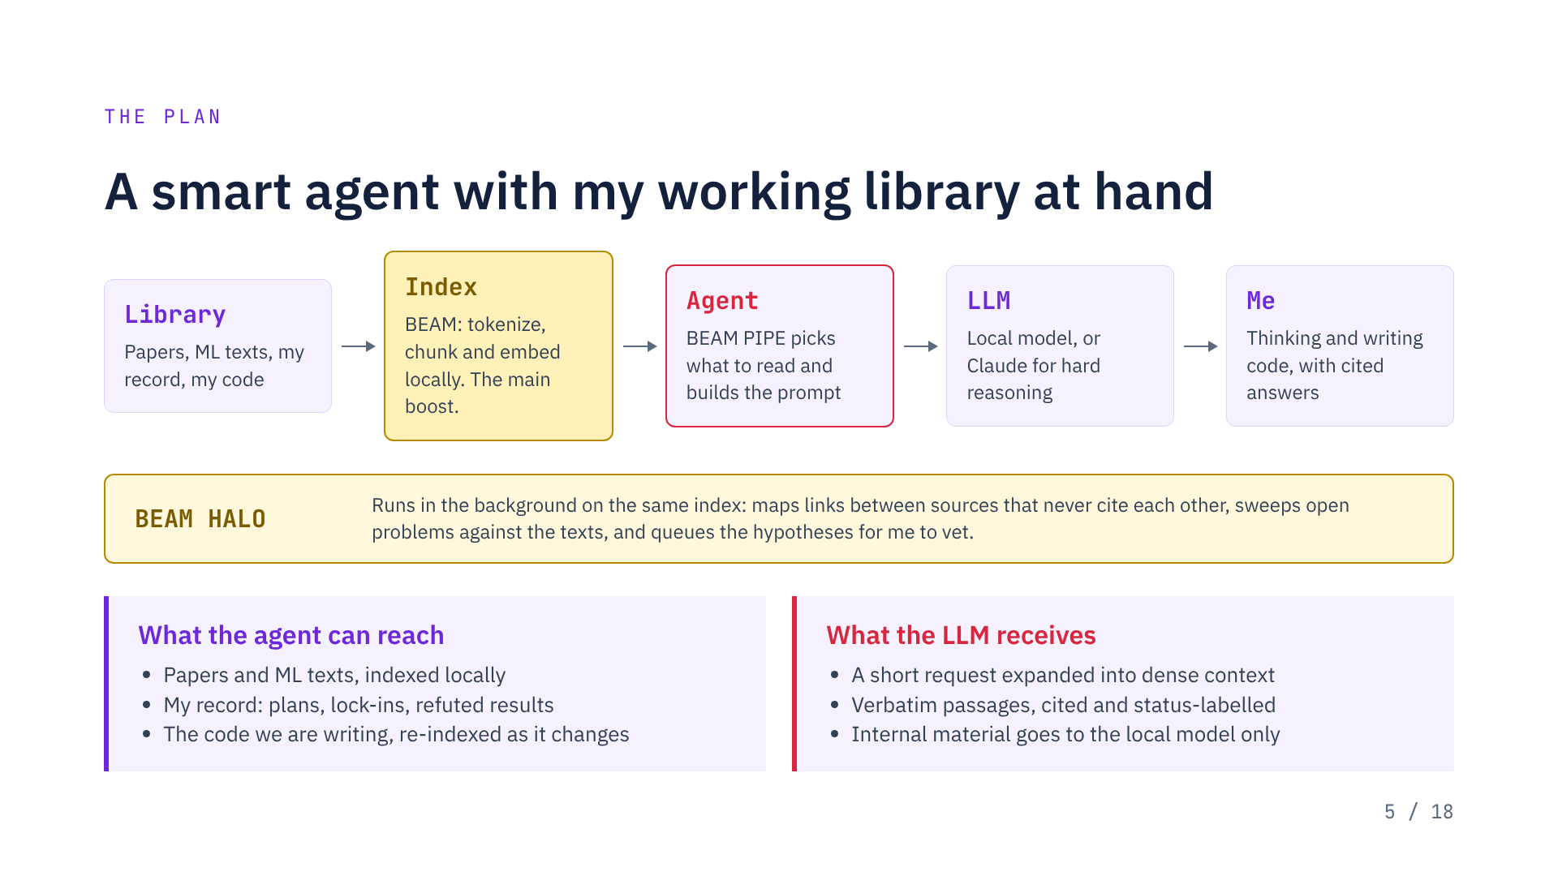
Notes:
The index is where the gain comes from: tokenizing and embedding the library locally is what lets a short request become a dense, on-point prompt. The LLM receives plain text and tokenizes it again on its side. The agent loop and the LLM are swappable; the index is the durable part.

Slide 6
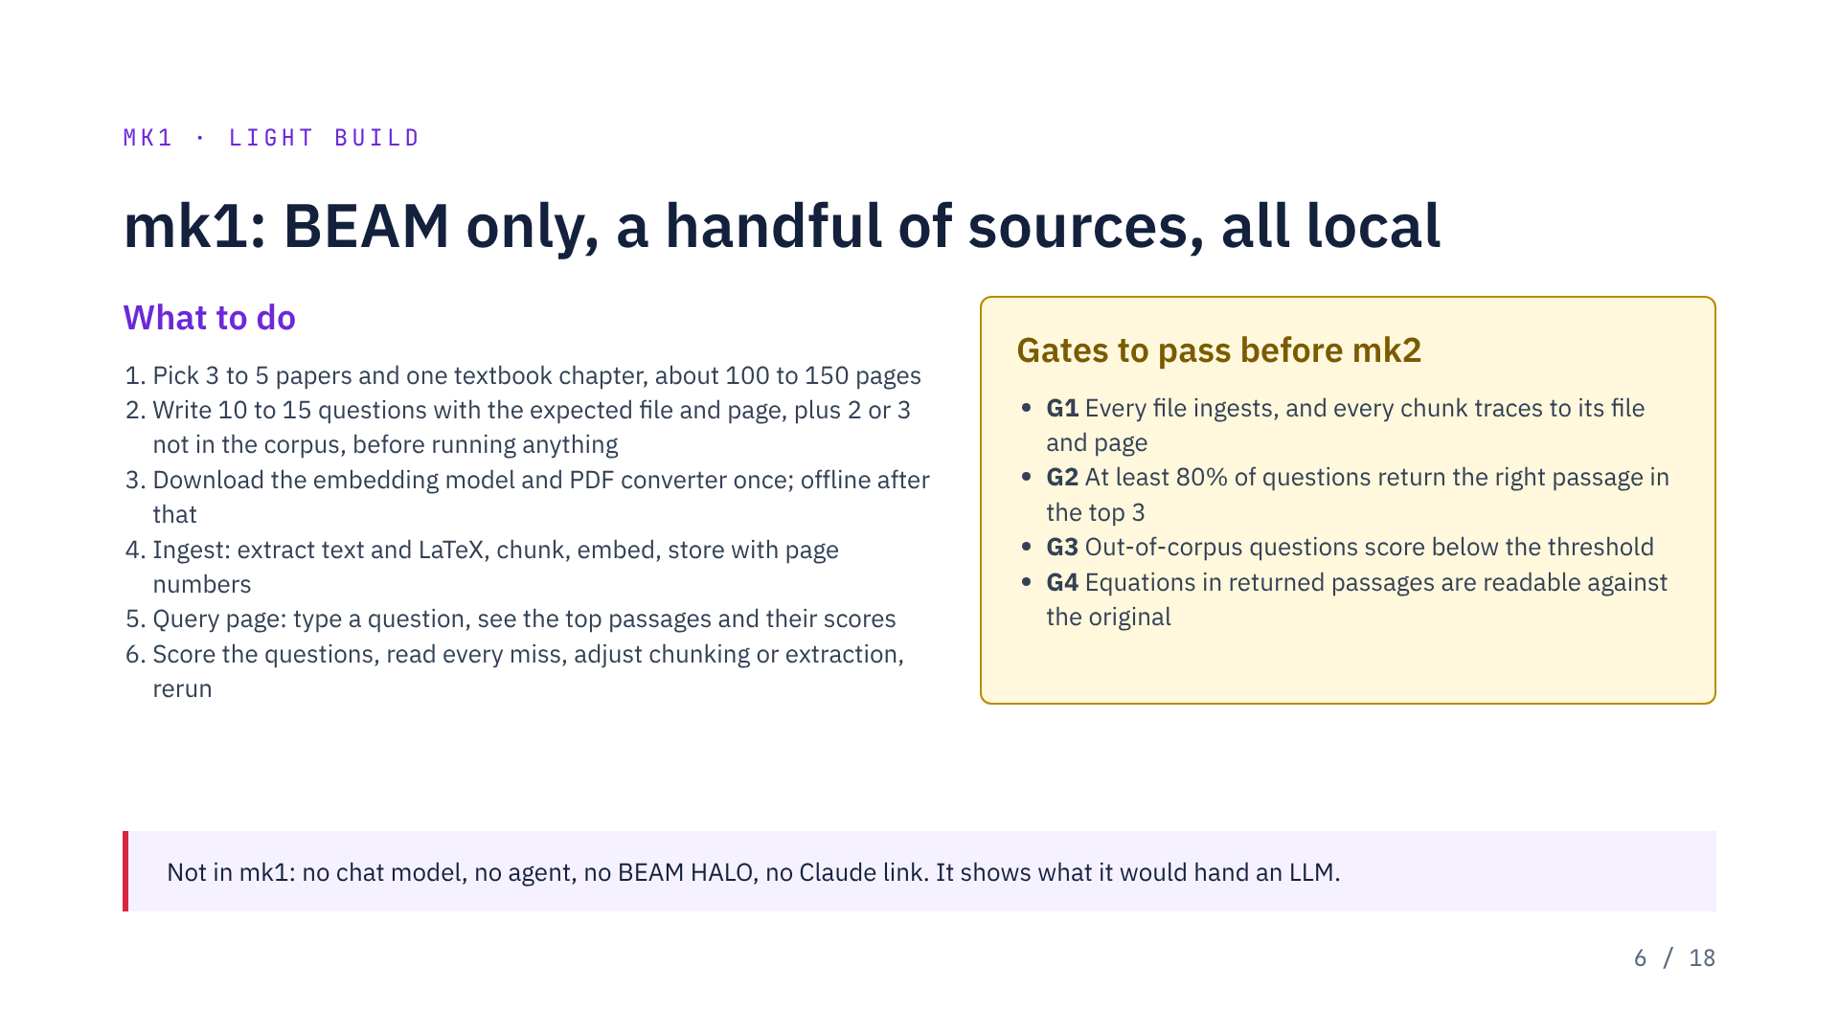
Notes:
Suggested mix: one equation-heavy paper such as DisCo, one PDF-only two-column paper, one of my own markdown lock-in files, optionally the TEC paper, and one chapter such as the Gaussian-process chapter of Rasmussen and Williams. The 80% bar in G2 is a proposal, not settled. A miss is usually a split chunk, a mangled equation, or a wording mismatch.

Slide 7
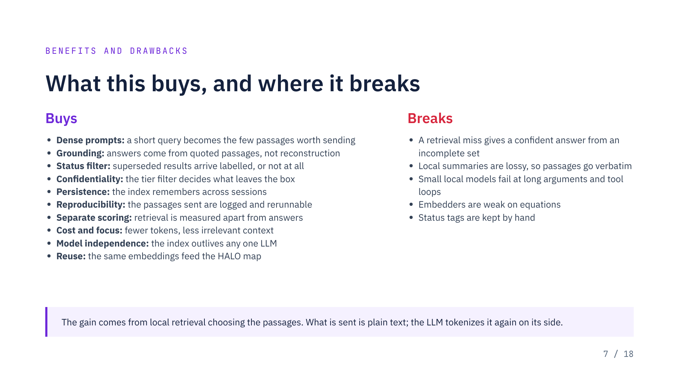
Notes:
Buys: all ten follow from the BEAM layer. Breaks: the first two are why prompts carry slightly more than the minimum and never a local-model paraphrase. The third is the risk to PIPE, the fourth the limit on HALO.

Slide 8
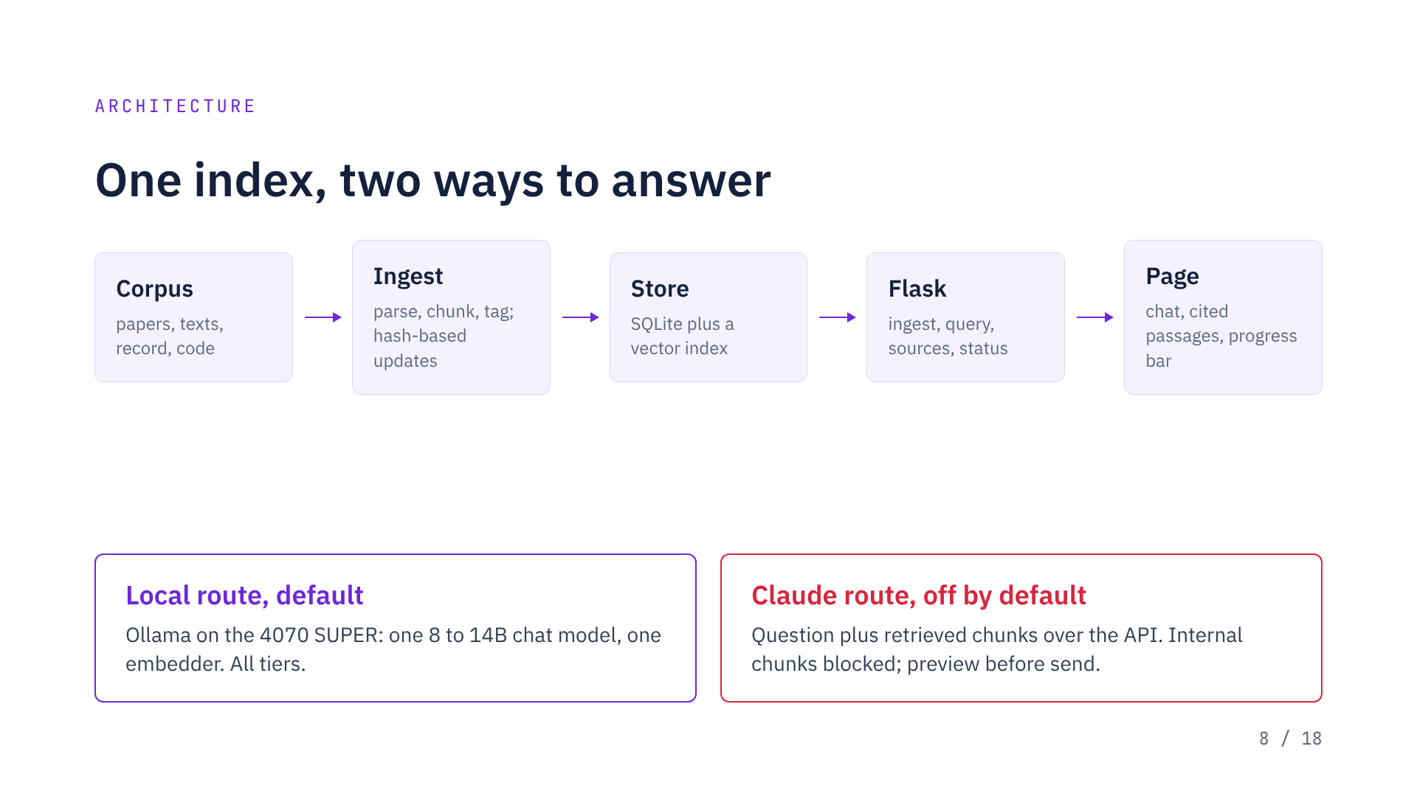
Notes:
The Claude route needs an API key, billed separately from the claude.ai plan. Ollama versus llama.cpp is still an open choice.

Slide 9
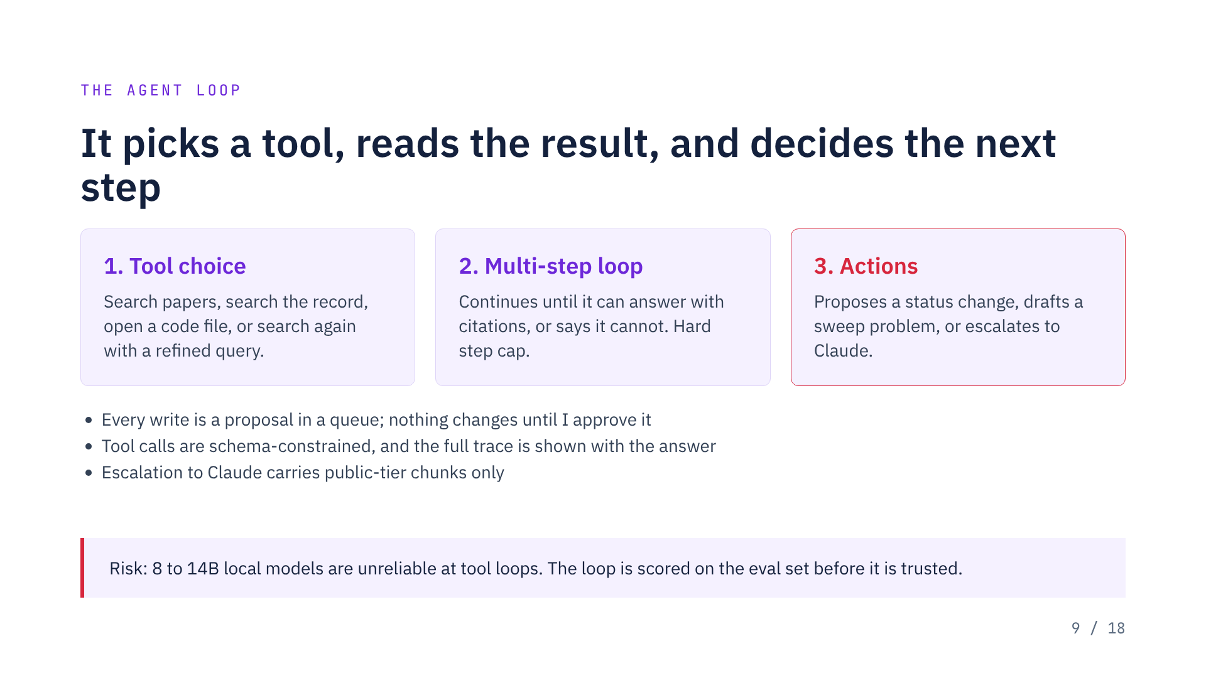
Notes:
If the local planner fails the eval, the fallback is Claude as planner with local retrieval as its tool, which works for public-tier material only.

Slide 10
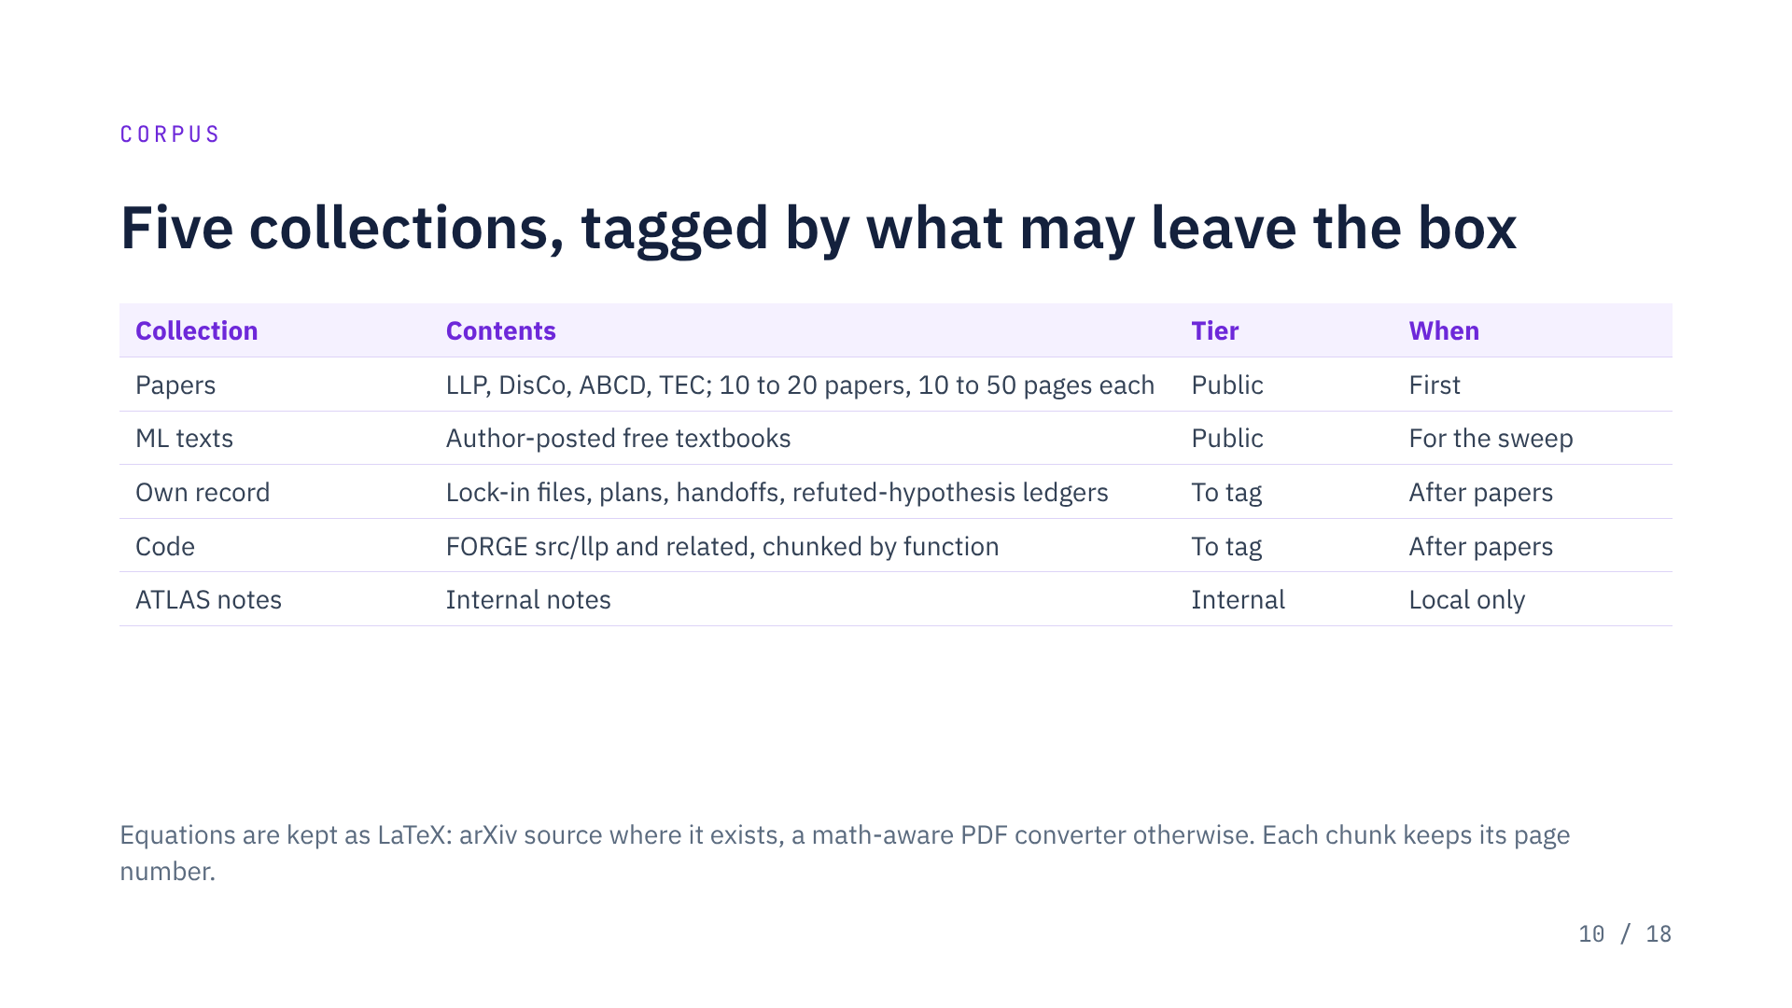
Notes:
Papers alone are roughly 100 to 1,000 pages. About 15 textbooks would add an estimated 5 to 10 million tokens, still easy for retrieval. Check collaboration policy before any internal excerpt goes to an external service.

Slide 11
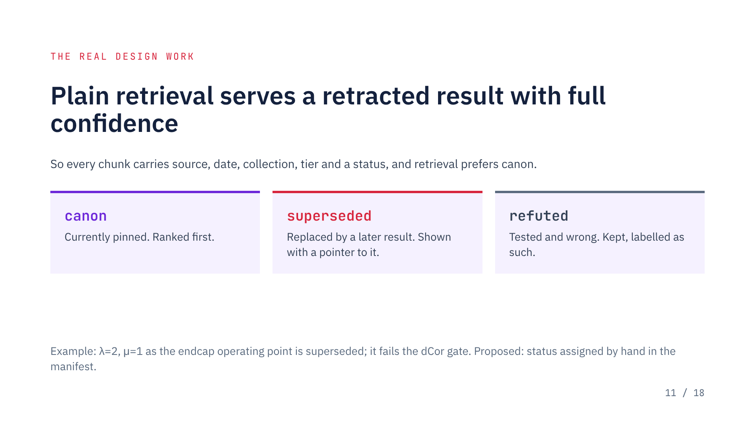
Notes:
Inferring "superseded" automatically would be wrong often enough to hurt, hence the hand-edited manifest. That choice is still to be confirmed.

Slide 12
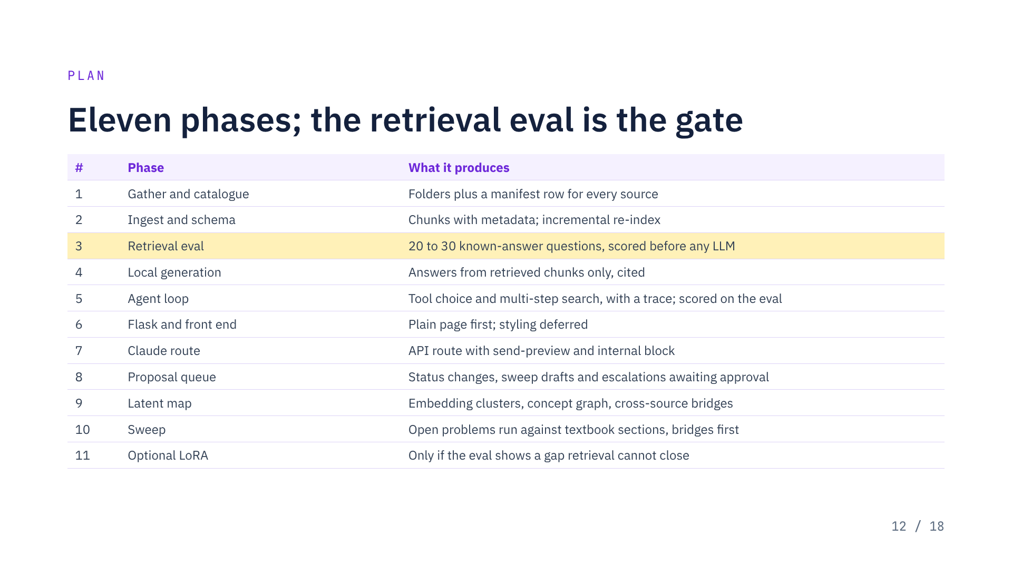
Notes:
If retrieval fails at phase 3, nothing downstream is worth building. The eval also has to show canon outranking superseded.

Slide 13
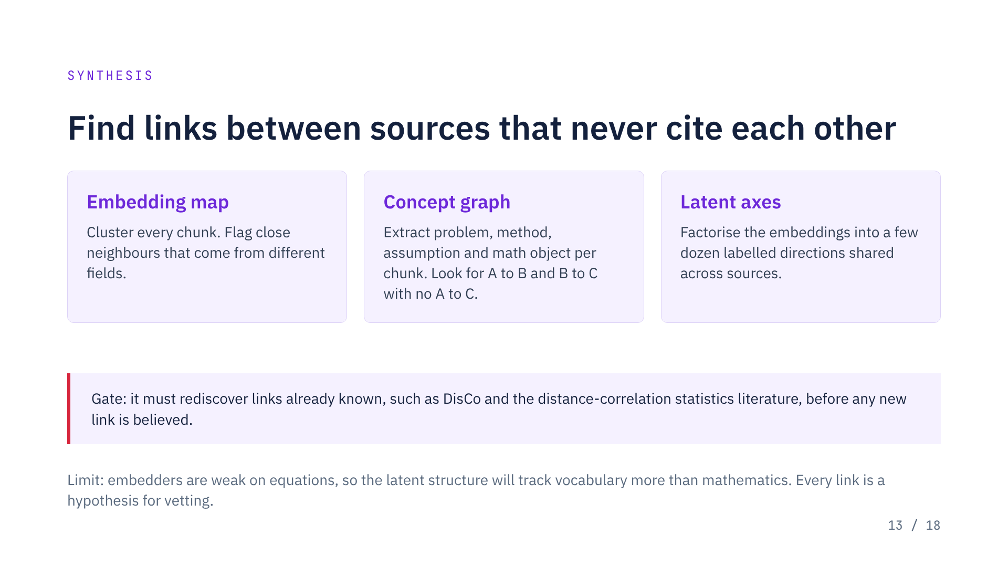
Notes:
The bridges found here seed the sweep, so it runs on promising pairs first and not only the full cross product. Whether this yields anything non-obvious is unproven.

Slide 14
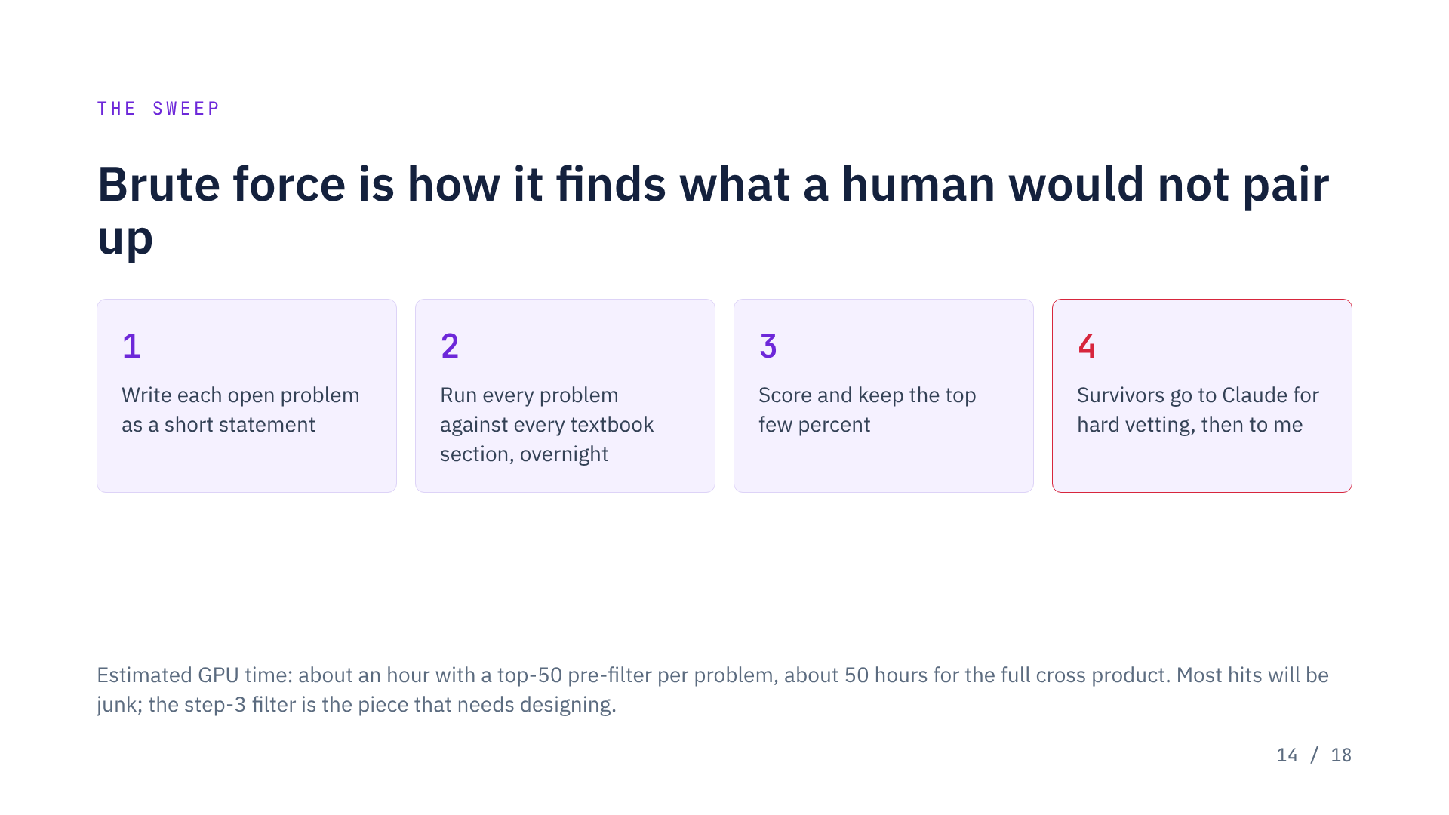
Notes:
This is the one job where local beats Claude: unlimited calls at no cost per query. Runtime assumes 5 to 8 seconds per call, which is a guess until measured.

Slide 15
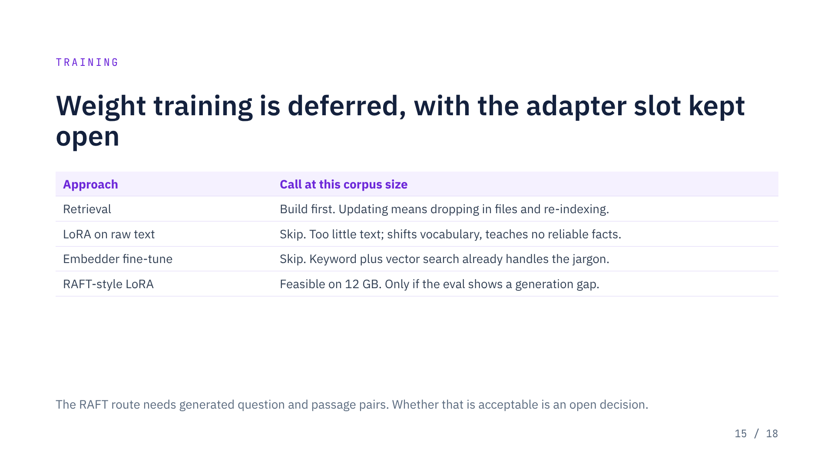
Notes:
The standard free ML textbooks are already in every base model's training data, so fine-tuning on them adds little. Their value here is retrieval tied to a chapter and equation.

Slide 16
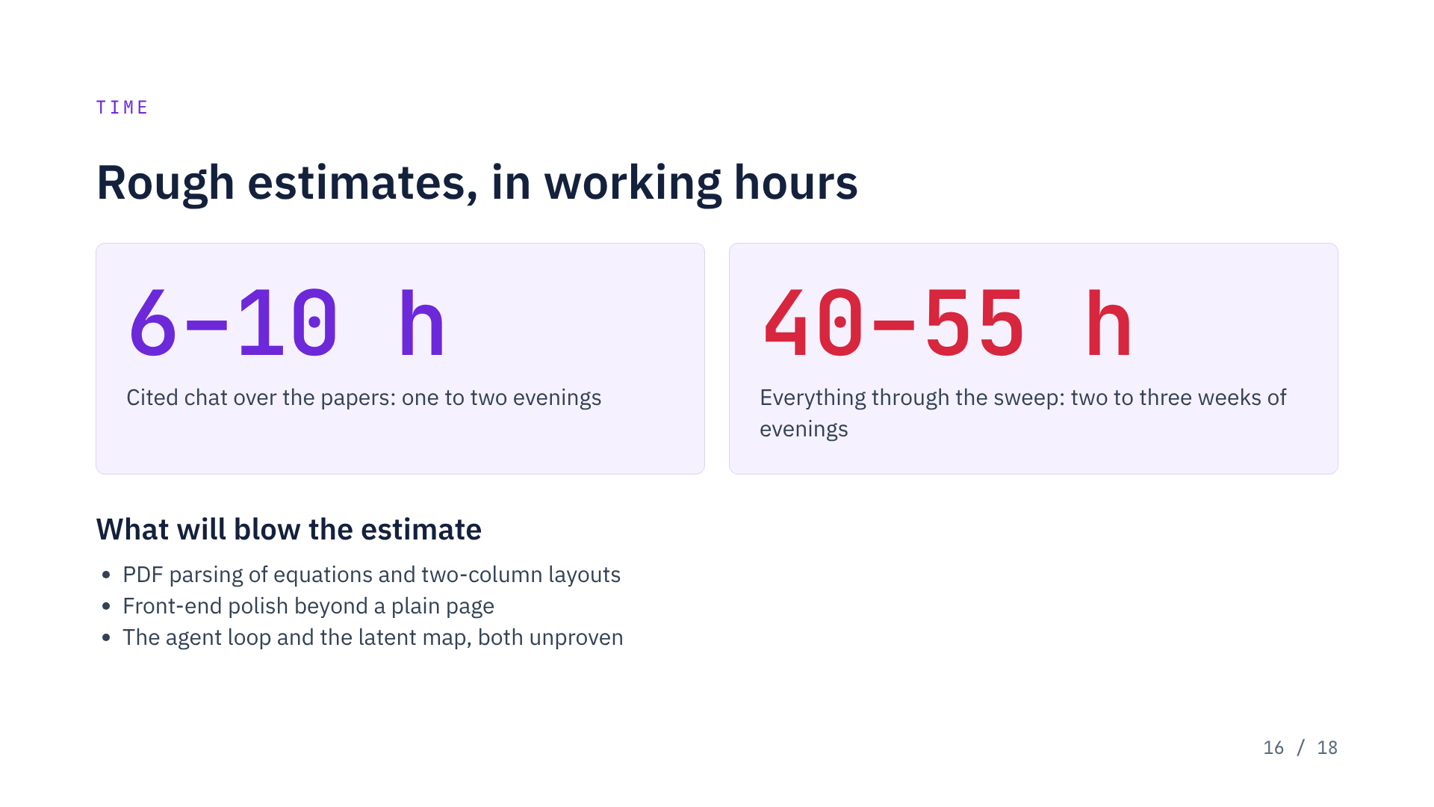
Notes:
Estimates assume Claude writes the code and I run and debug on the home box. None of this is measured yet.

Slide 17
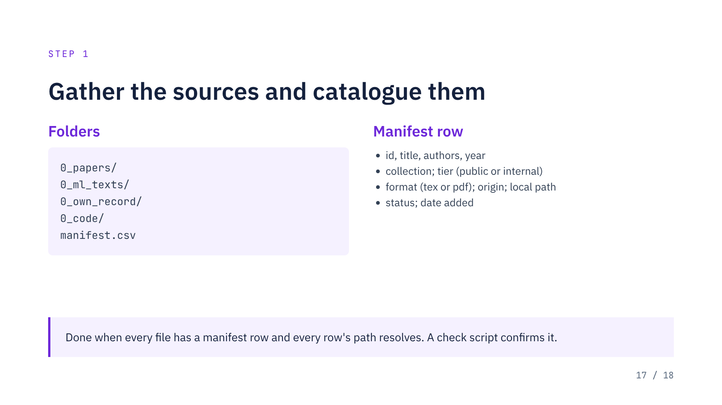
Notes:
Papers first, with arXiv LaTeX source where it exists plus the PDF for page references. Textbooks trail behind. Install Ollama and pull models in parallel.

Slide 18
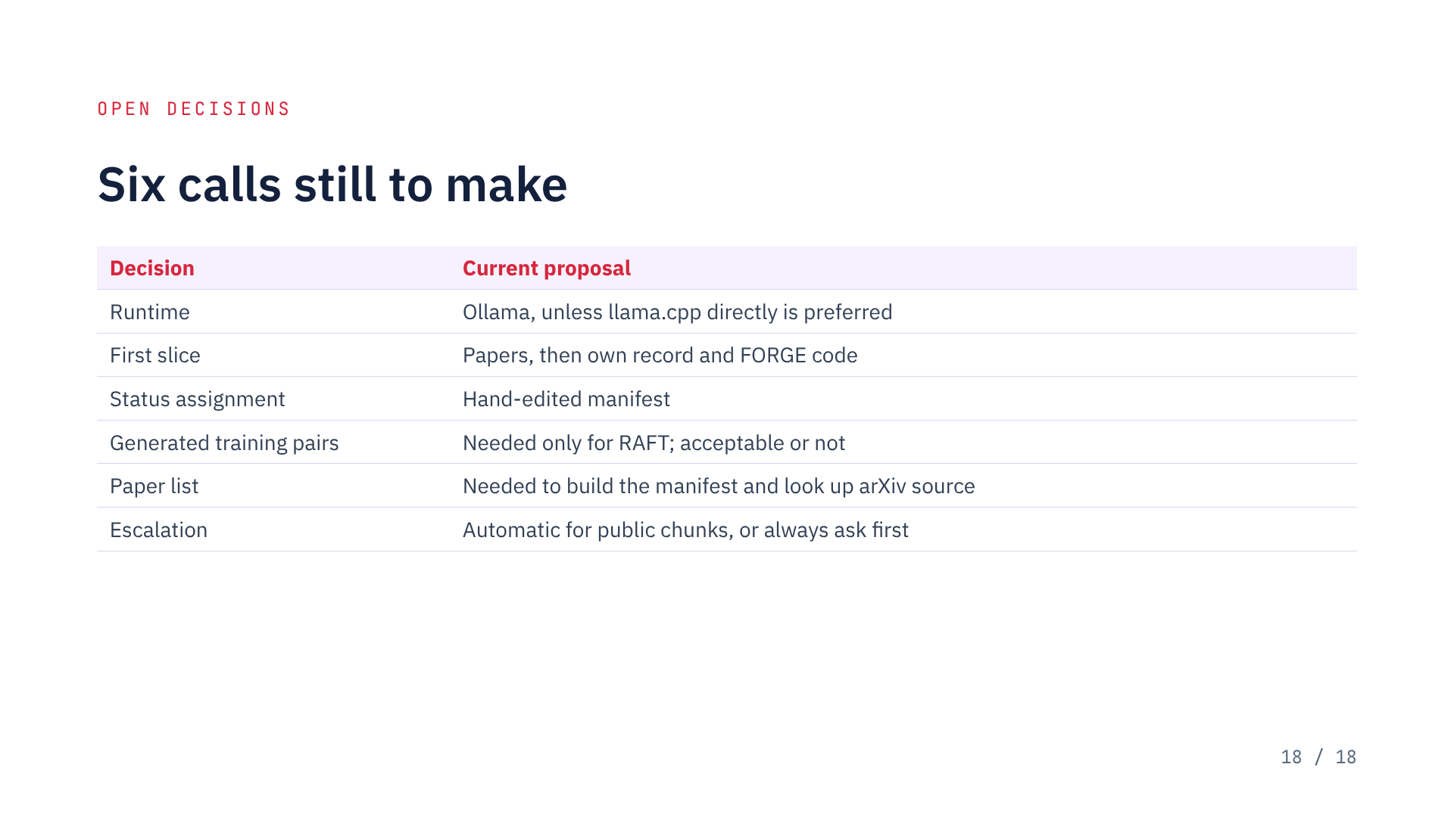
Notes:
The paper list is what unblocks step 1.

