Slide 1

Notes:
Slide 1 of 49. Title. LEXICON = Lexical Encoding of eXperiment Information as Checked Observable tokeNs, the tokenization line under HELIX. mk_1 joins material that has not been sewn together yet: the private progress record (R0–R15, 19 Oct), Addendum 4 (2 Nov), the goal set mk2 (4 Nov) and the feature-selection theory notes (5 Nov).

Slide 2
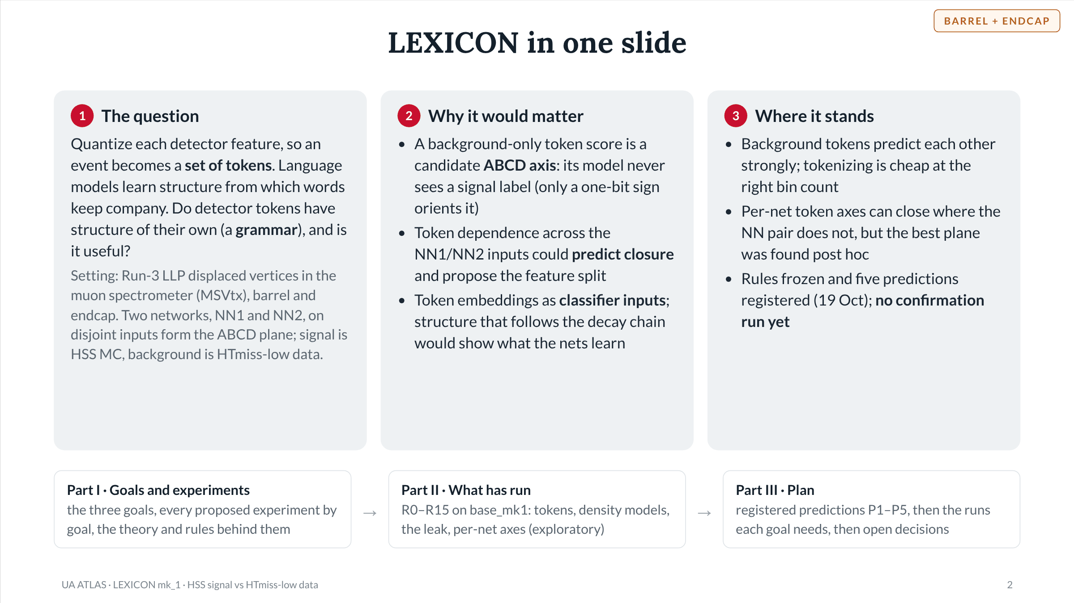
Notes:
Slide 2 of 49. Overview. Front of the deck is the goal set, because that is the part not yet agreed: three framings exist (public page, Addendum 4, goal set mk2) and this deck proposes one spine with a crosswalk. Middle is the exploratory record. Back is what is registered and what each goal needs.

Slide 3
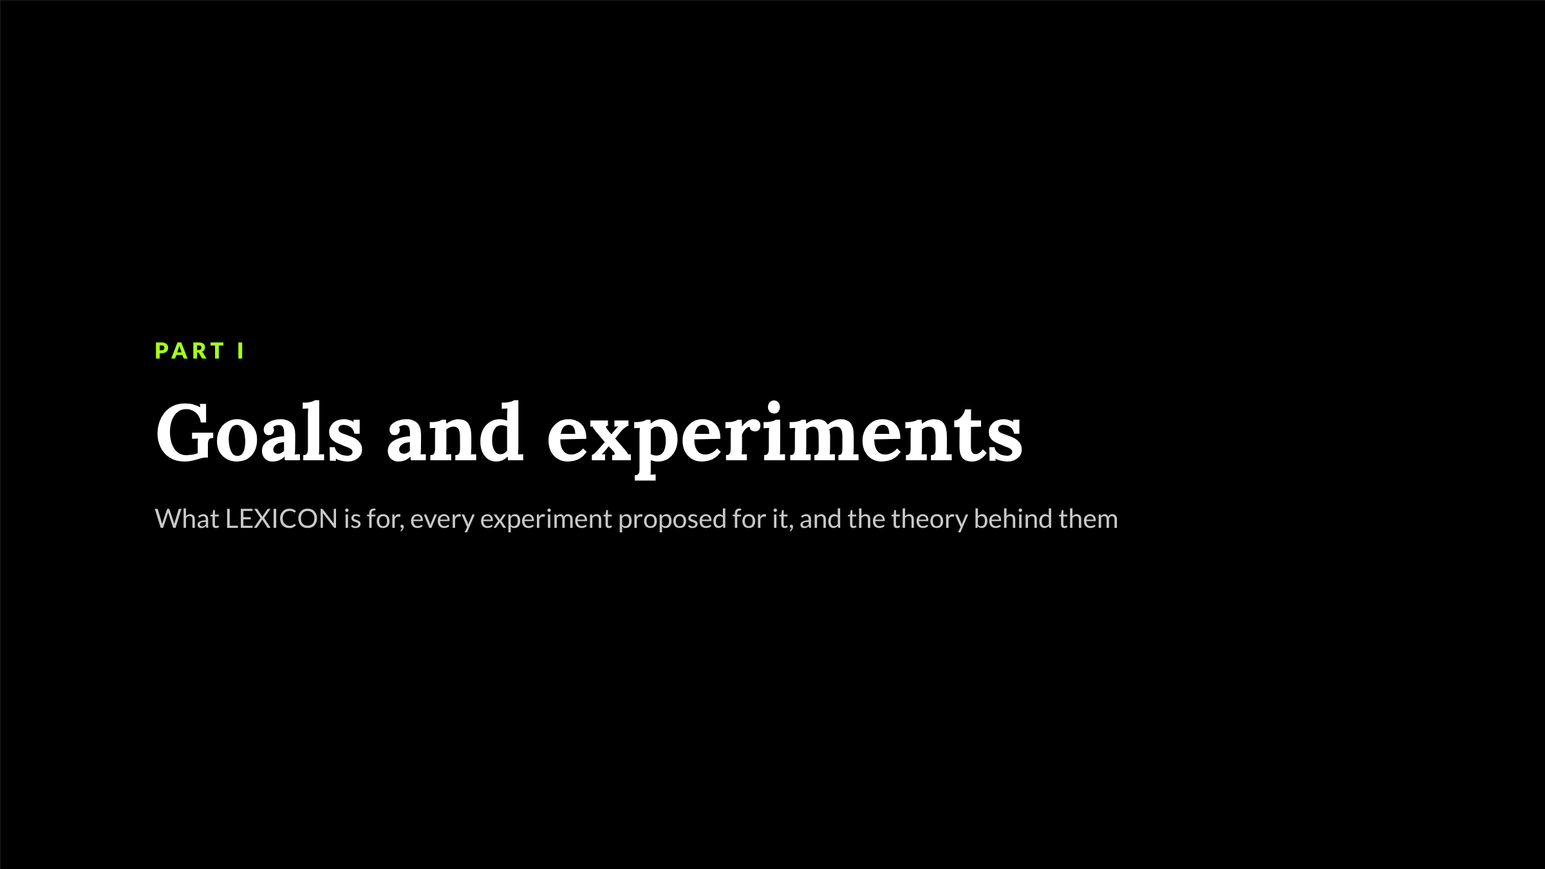
Notes:
Slide 3 of 49. Section divider: goals and the theory behind them.

Slide 4
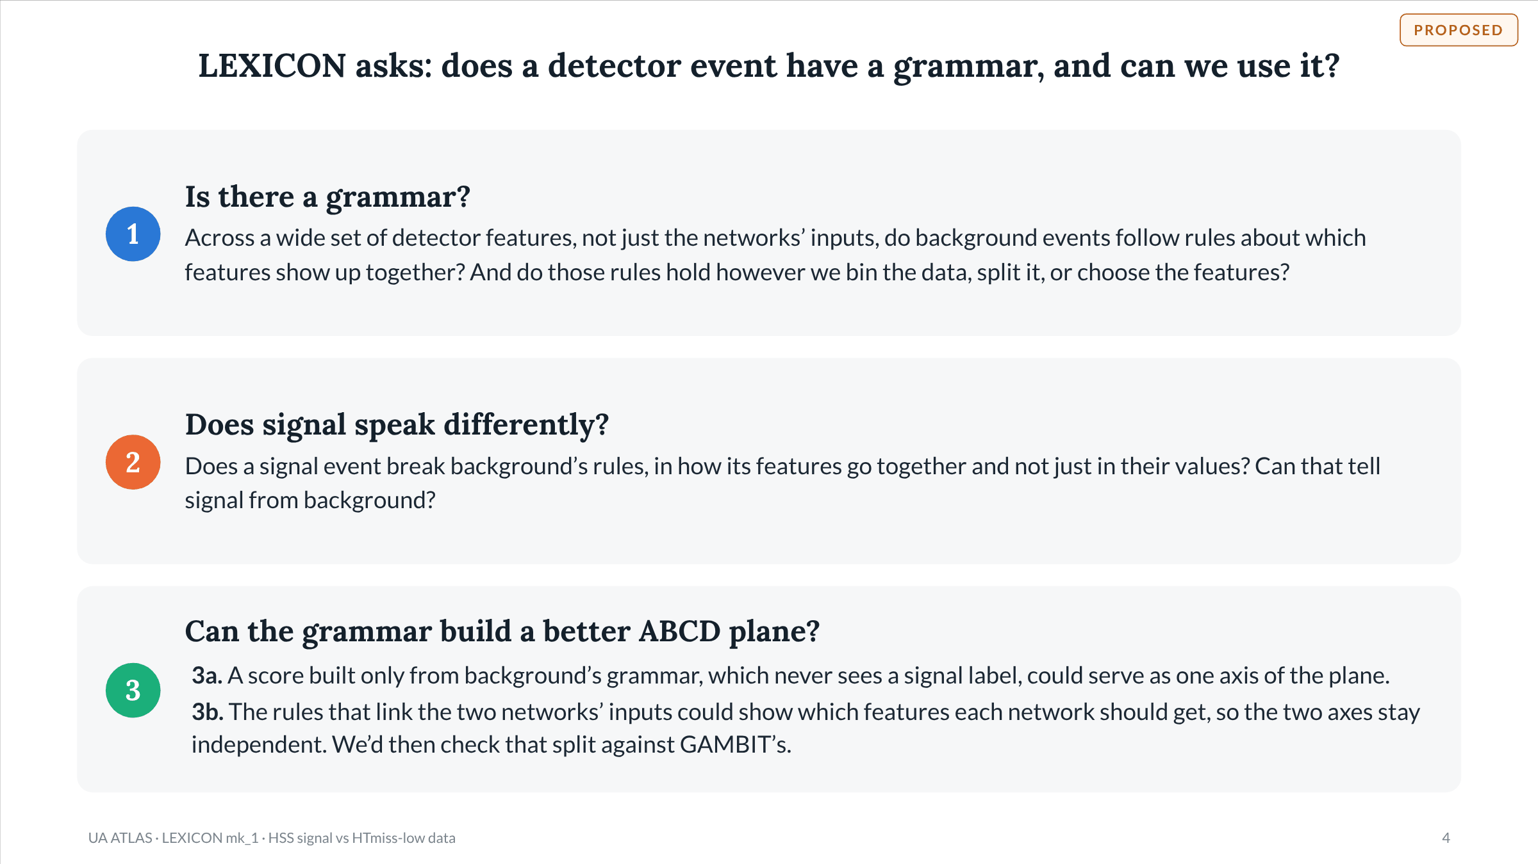
Notes:
Slide 4 of 49. The three goals in plain words; the next slides say how each is tested. Goal 1 = G1 (background grammar, no labels), goal 2 = G2 (signal vs background), goal 3a = G3a (label-free token axis), goal 3b = G3b (feature partitions, Addendum 4 verdict 4, cross-checked against GAMBIT). Goal 1 is the precondition: if background tokens share no information beyond independence, goals 2 and 3 reduce to per-feature effects.

Slide 5
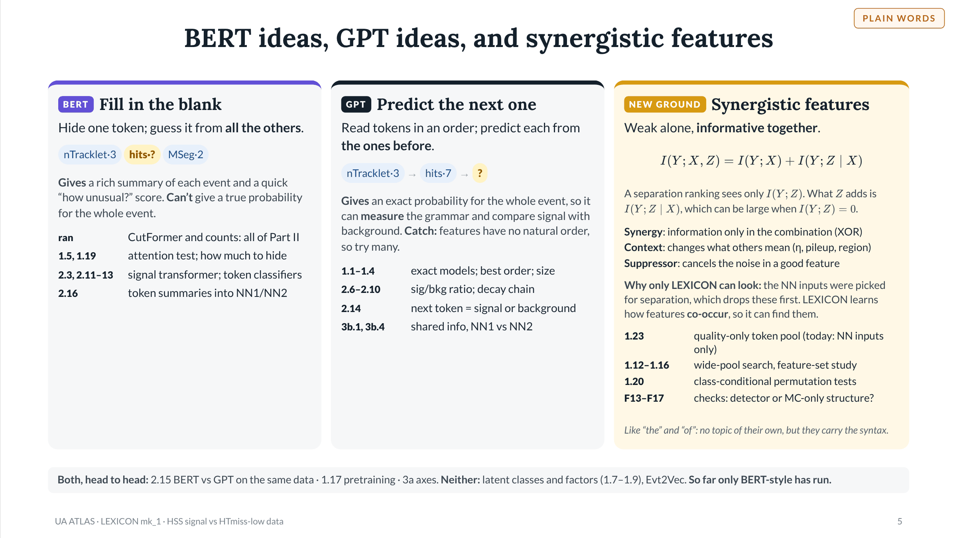
Notes:
Slide 5 of 49. BERT = masked language model: predict a hidden token from both sides; scored by pseudo-likelihood. GPT = autoregressive (causal) model: predict each token from those before it in a chosen order; the chain rule gives an exact likelihood for any order. The two share no intrinsic metric, so they are compared only on downstream results (closure, AUC after fine-tuning, gain as NN inputs). Labels follow goal set mk2 §2: count models report a pseudo-likelihood (BERT-like scoring); the Chow–Liu tree is autoregressive with one parent per token. Synergistic features (feature-selection notes, 5 Nov): by the chain rule, a feature with I(Y;Z) = 0 can still add I(Y;Z|X) > 0. Three mechanisms: synergy (information only in the joint distribution, the synergy term of a partial information decomposition), context or conditioning variables, and suppressor variables (Guyon and Elisseeff, JMLR 3 (2003) 1157). The current NN1/NN2 lists keep features with strong or medium separation, so the selection removes synergistic and context features first; a grammar is structure in p(x), the relations among features, which LEXICON models directly. Such features also bring detector and MC-only structure, so any gain needs the nuisance and data/MC checks (F13–F17). A positive finding (a significant held-out drop under class-conditional permutation) can be established; a negative only as 'no effect above epsilon'.

Slide 6
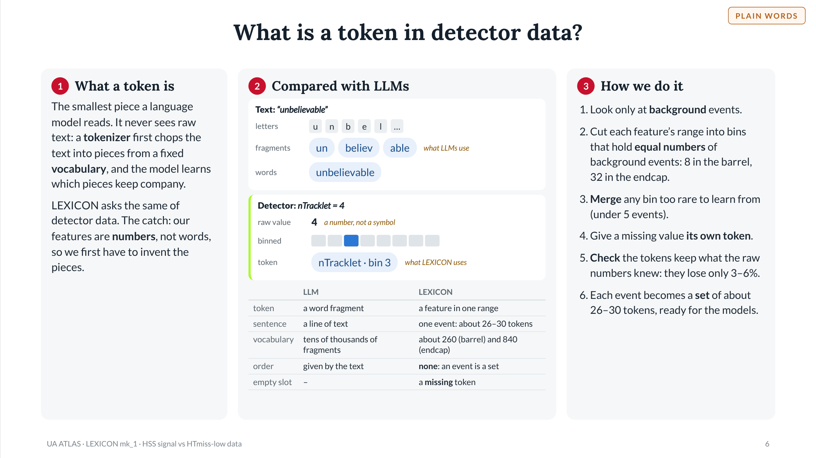
Notes:
Slide 6 of 49. Plain-language token slide. LLM tokenizers (byte-pair encoding and similar) use sub-word fragments learned from text frequency; LEXICON tokens are (feature, level) pairs with bin edges fitted on background only, per fold. Vocabulary sizes are fold 0: barrel T0_b8 263 tokens, endcap T0_b32 836 (progress §3.2). Merge-to-floor at 5 training-background events, missing token exempt. Tokenization cost 4.9% of raw gain (barrel, 8 bins, 3-seed mean) and 3.3% (endcap, 32 bins, upper bound). nTracklet = 4 and its bin are an illustration, not a quoted edge. The next slide has the technical detail.

Slide 7
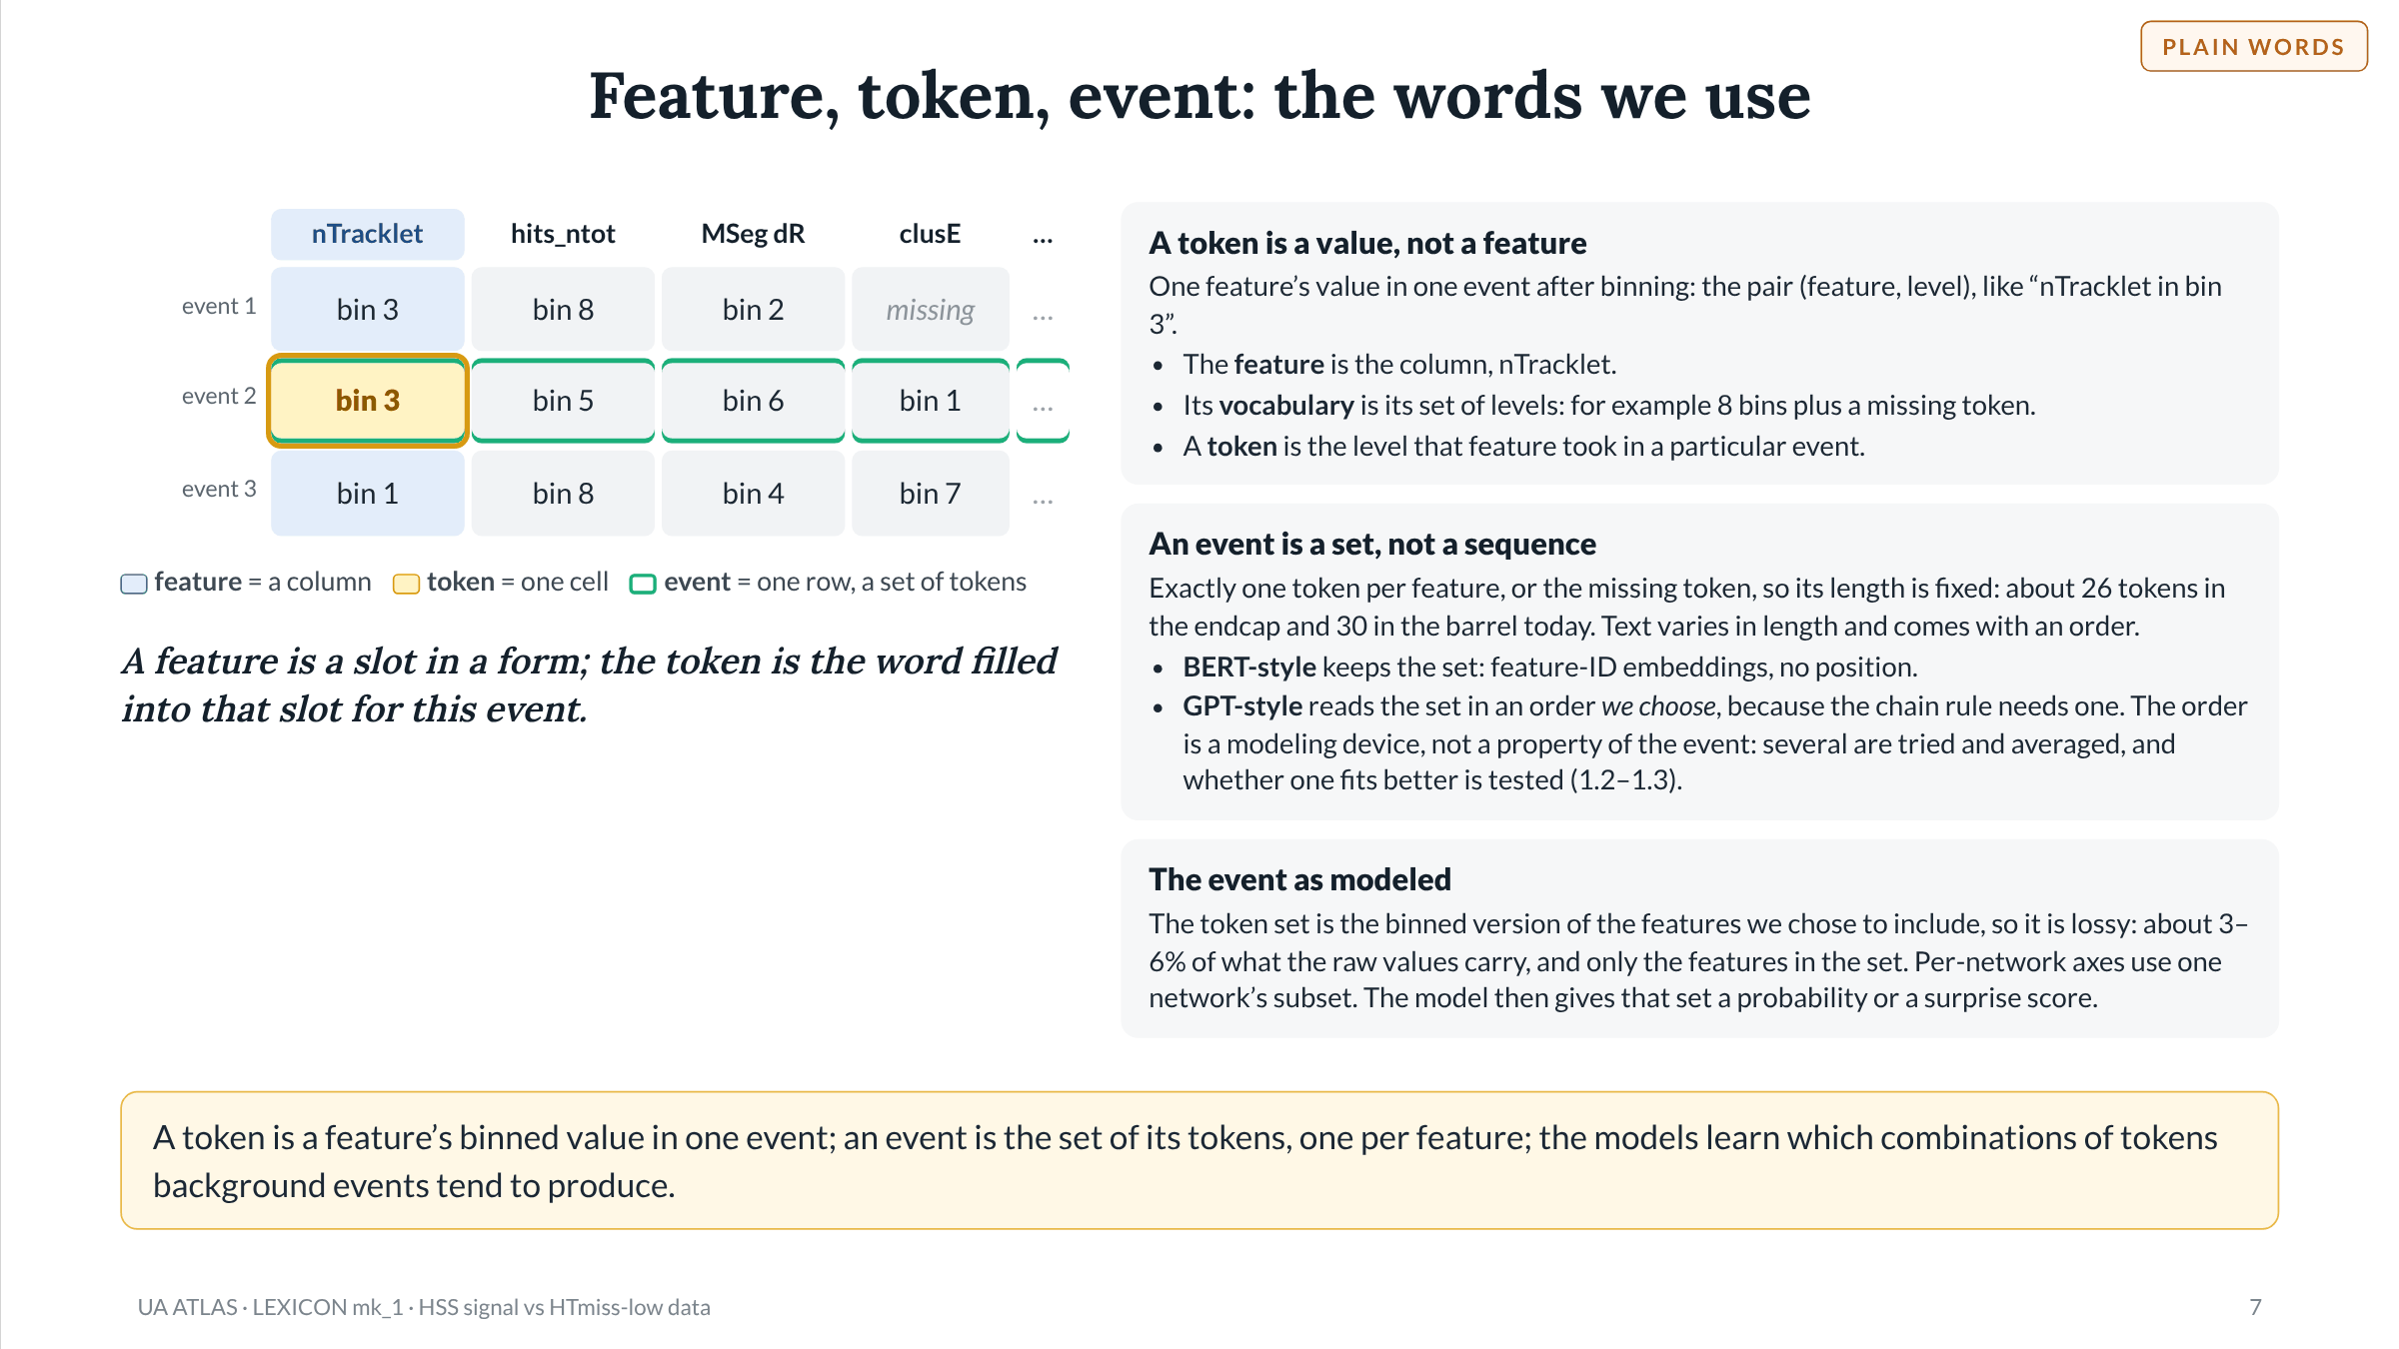
Notes:
Slide 7 of 49. Definitions used throughout the deck. The grid is an illustration: the bin values are made up, not data. Feature counts per event are the registry mk4 NN inputs: endcap 16 + 10 = 26, barrel 20 + 10 = 30. Tokenization cost 4.9% of raw gain (barrel, 8 bins, 3-seed mean) and 3.3% (endcap, 32 bins, upper bound). Per-network axes (D6) score only one network's features.

Slide 8
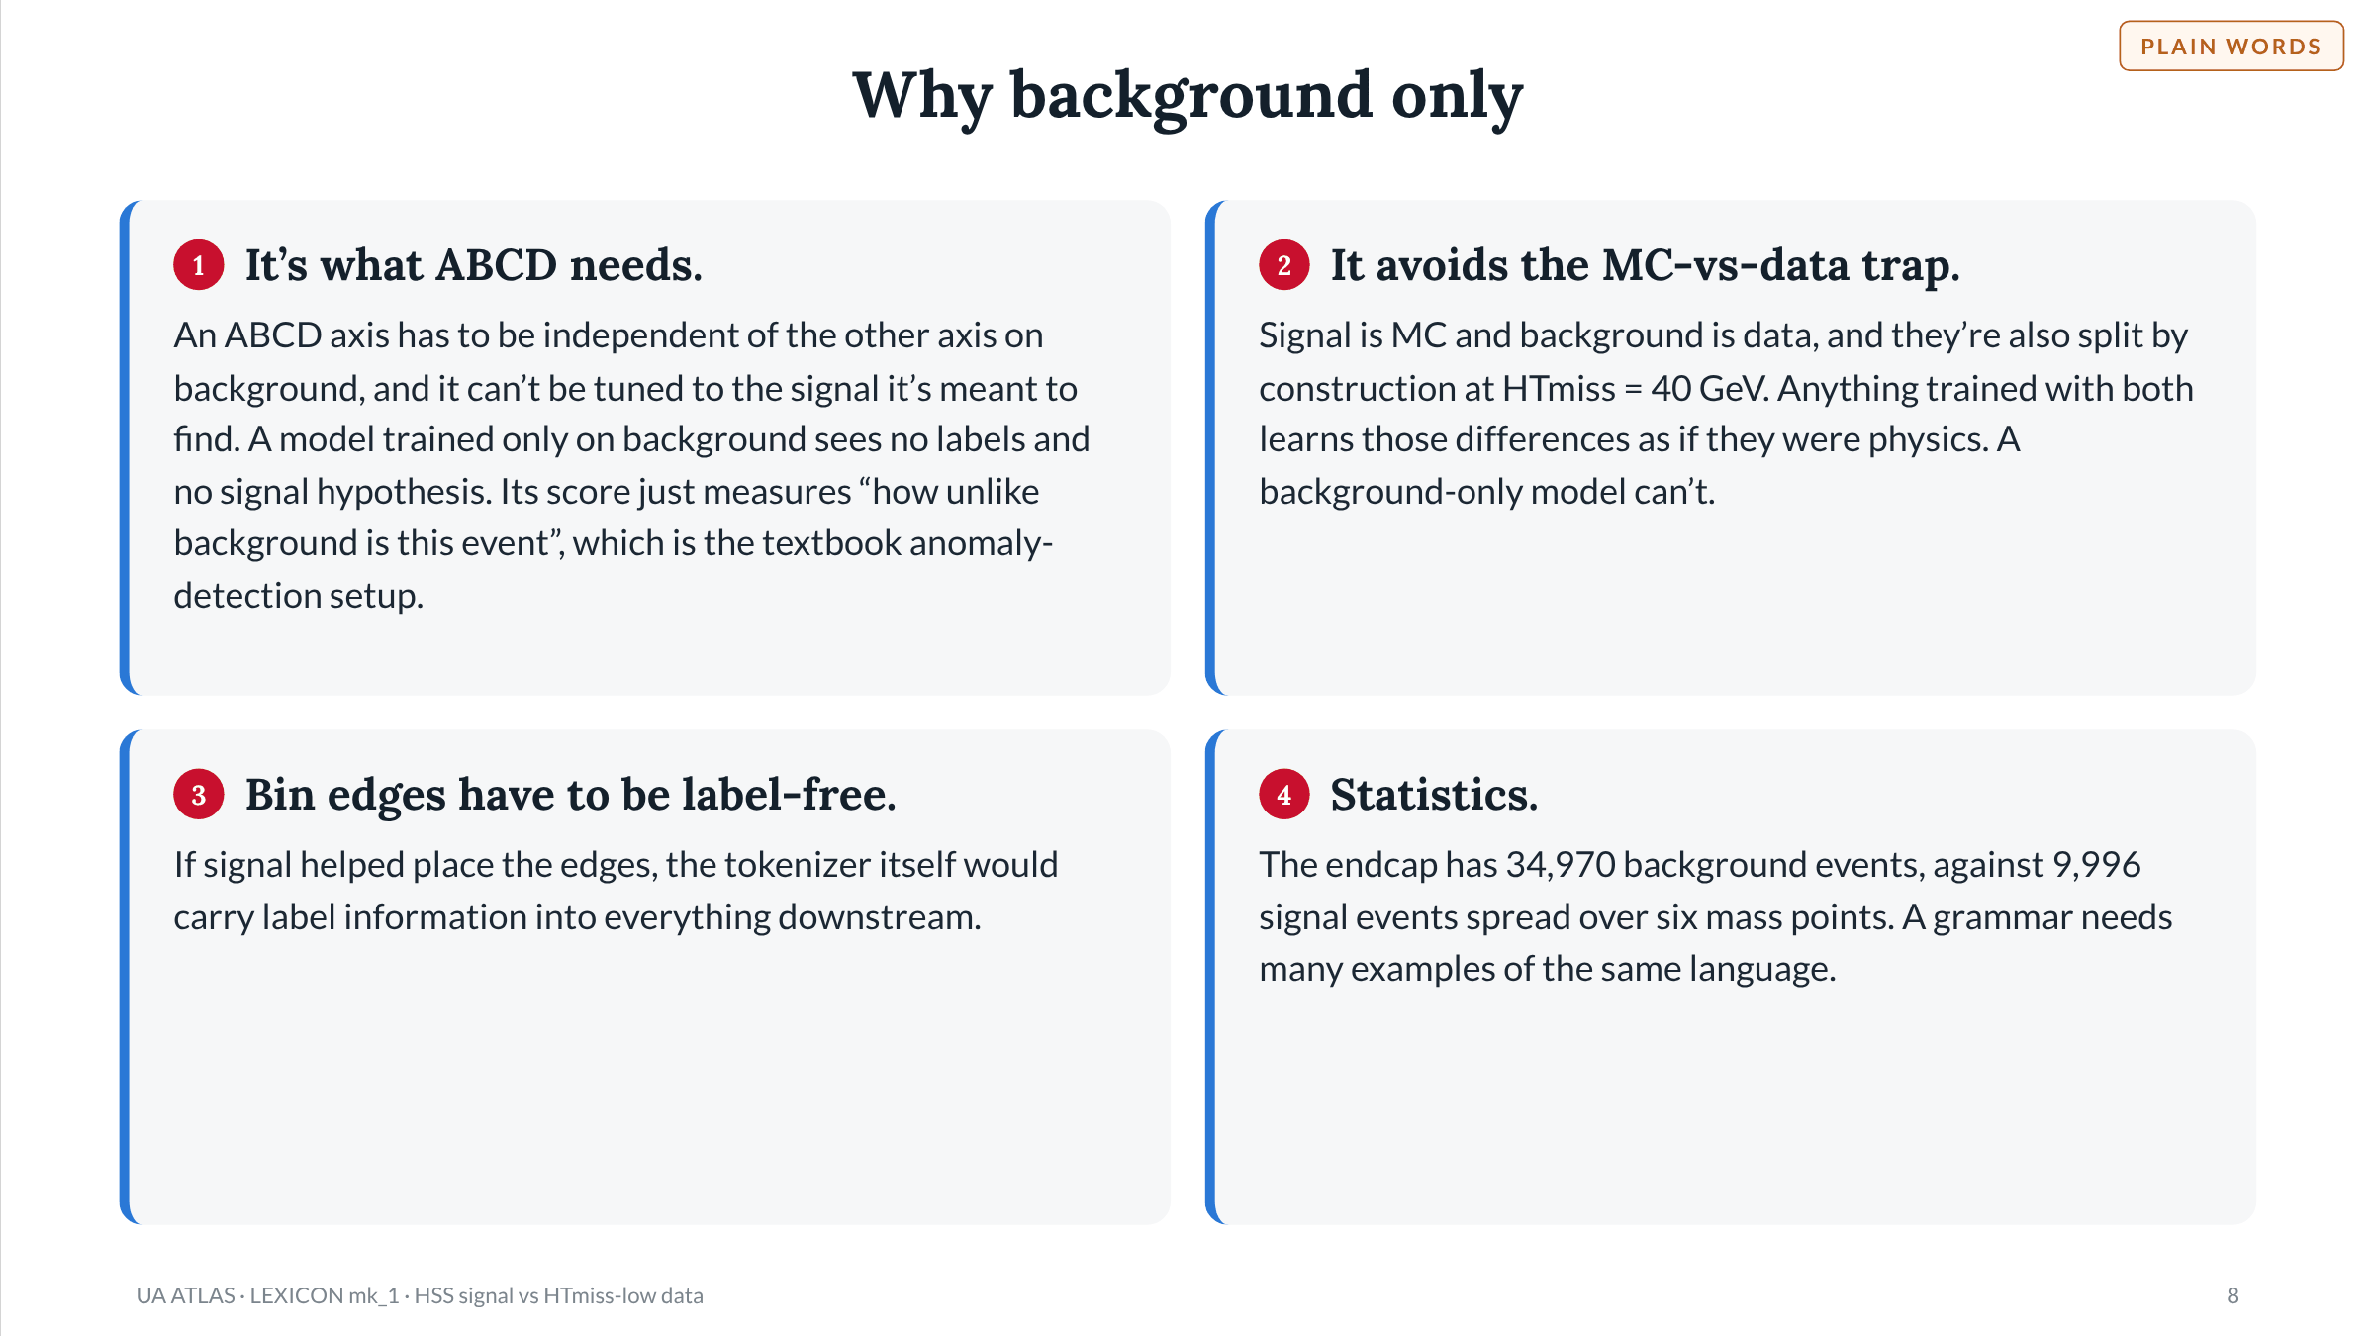
Notes:
Slide 8 of 49. Why LEXICON's token models and bin edges use background only. Costs, not on the slide: background-only checks are blind to where signal lives (the open top bin: 85% of signal hits_ntot in background's cheapest barrel token); the grammar learned is that of the HTmiss < 40 GeV data selection, so using it at HTmiss >= 40 GeV assumes it carries over (the same kind of assumption ABCD makes); and it says nothing about signal's own structure, which is why goal 2 uses signal on purpose after the data/MC audit (F13). Event counts: base_mk1 endcap, out of fold (34,970 background, 9,996 signal across six mass points).

Slide 9
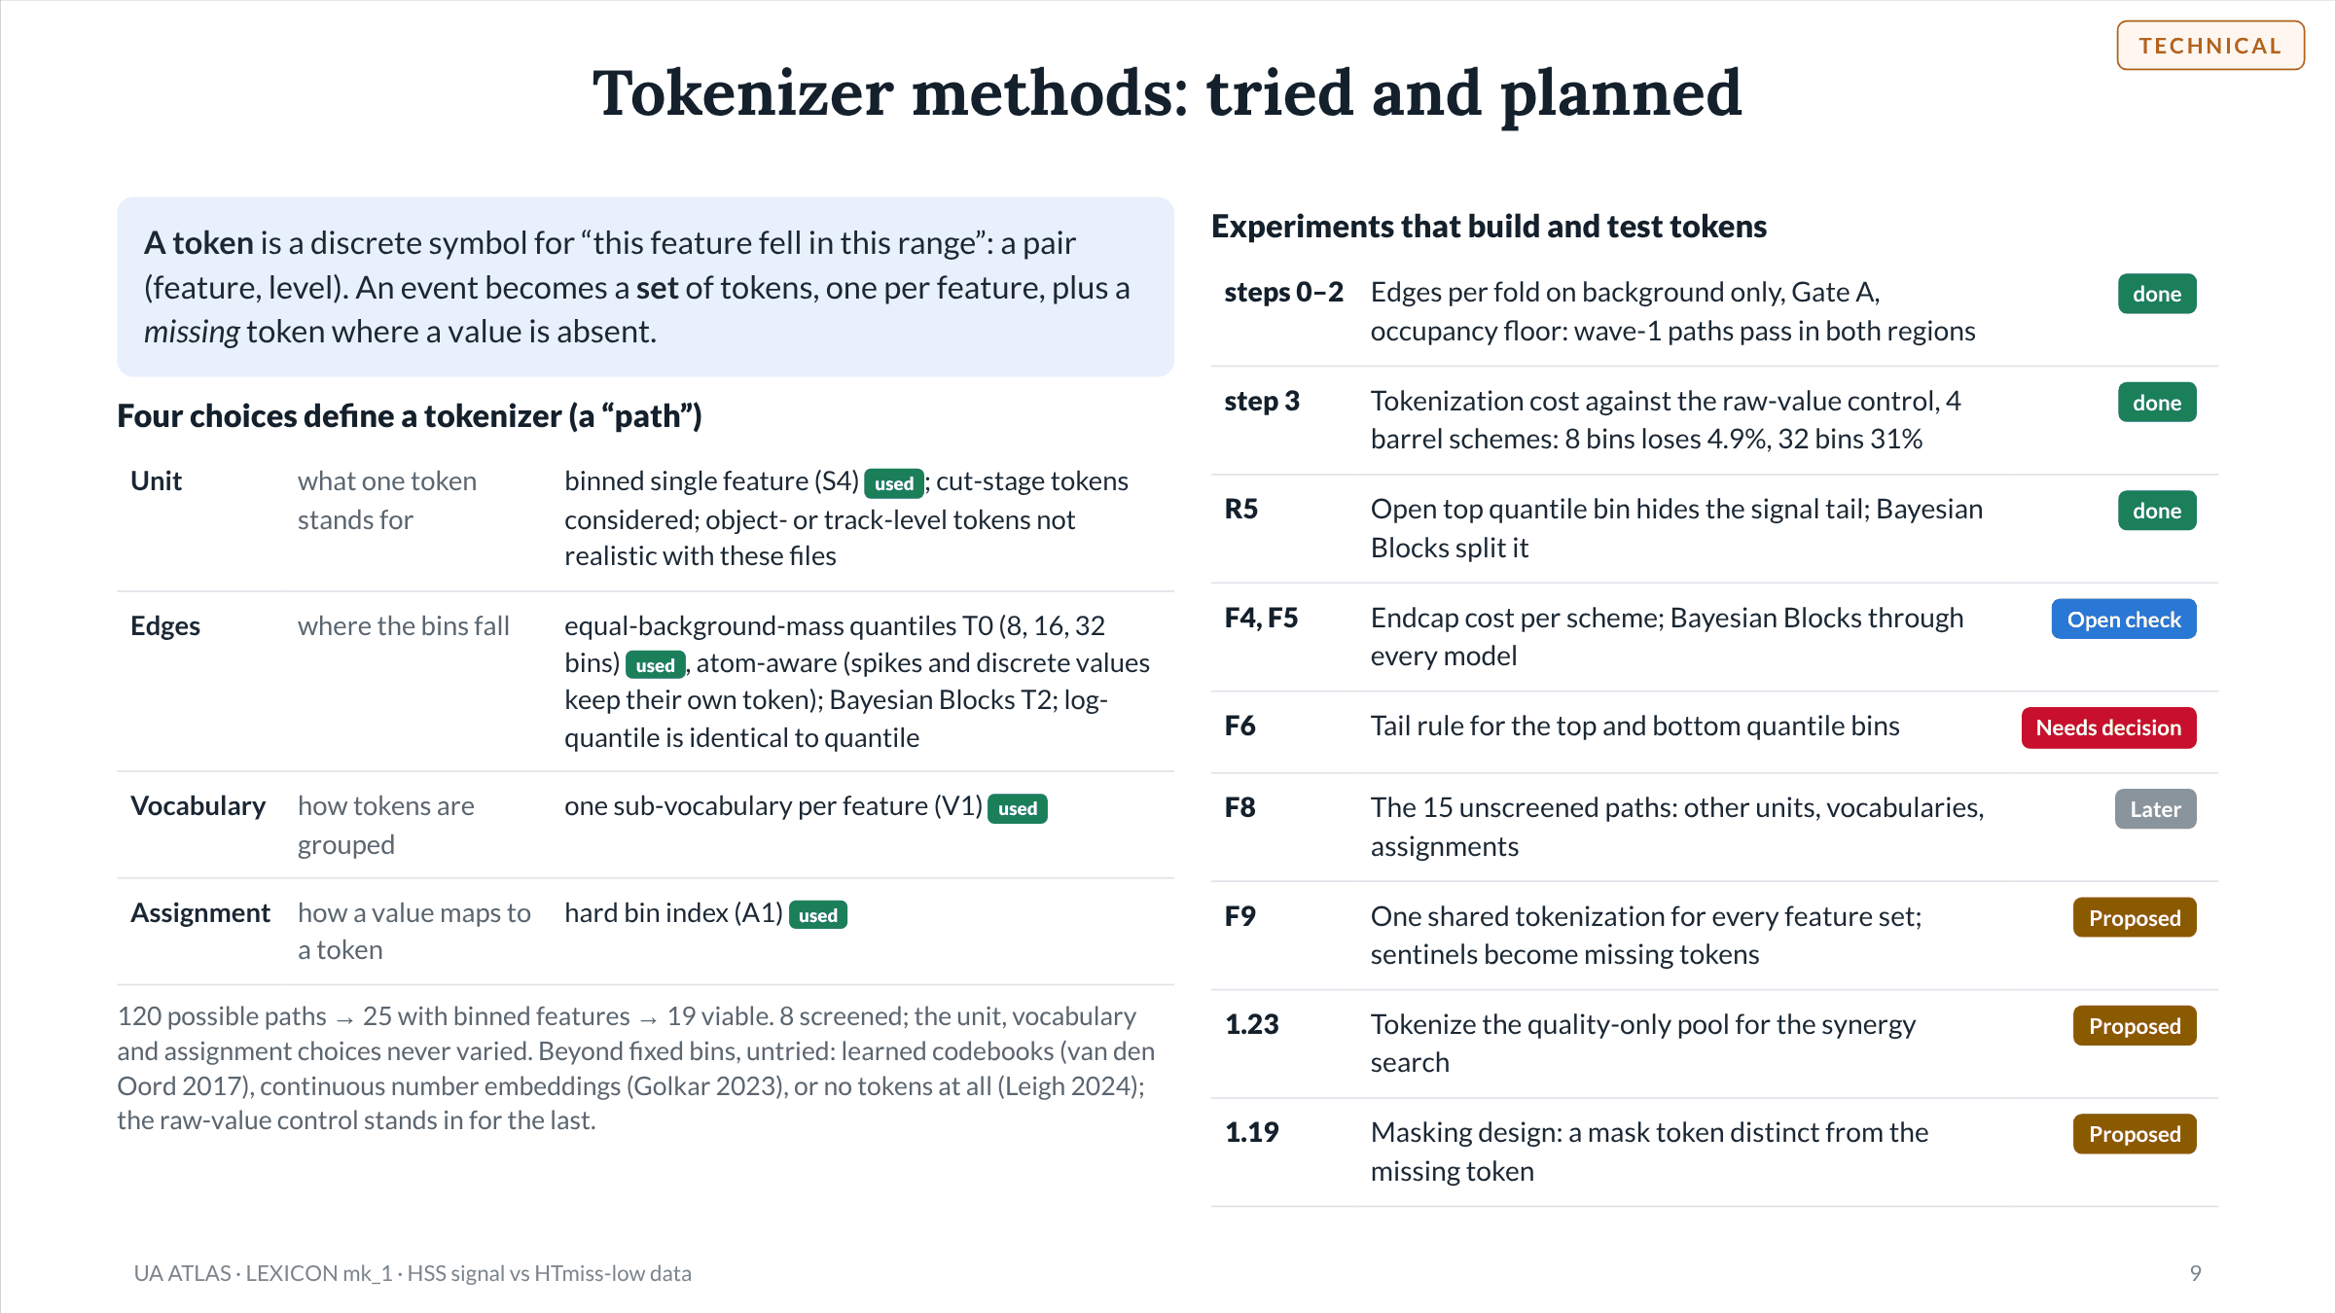
Notes:
Slide 9 of 49. Token definition and the tokenizer path axes as named in lexicon_screen_mk1.py: S4 = binned features, V1 = one sub-vocabulary per feature, A1 = hard bin index; T0 = quantile edges at each bin count, T2 = Bayesian Blocks (p0 0.05), T1 (log-quantile) equals T0 because quantile edges are equivariant under a monotone transform. Path space 120 → 25 on S4 → 19 after T1 = T0; 8 paths screened (4 schemes x 2 regions); step 3 trained on the endcap wave-1 path and all 4 barrel schemes. Other token units come from the October tokenization plan: cut-stage and binned-feature tokens are realistic at this data level, object- and track-level are not. Literature on the public page: vandenoord2017 (VQ-VAE), golkar2023 (xVal), leigh2024 (Is tokenization needed for masked particle modelling?).

Slide 10
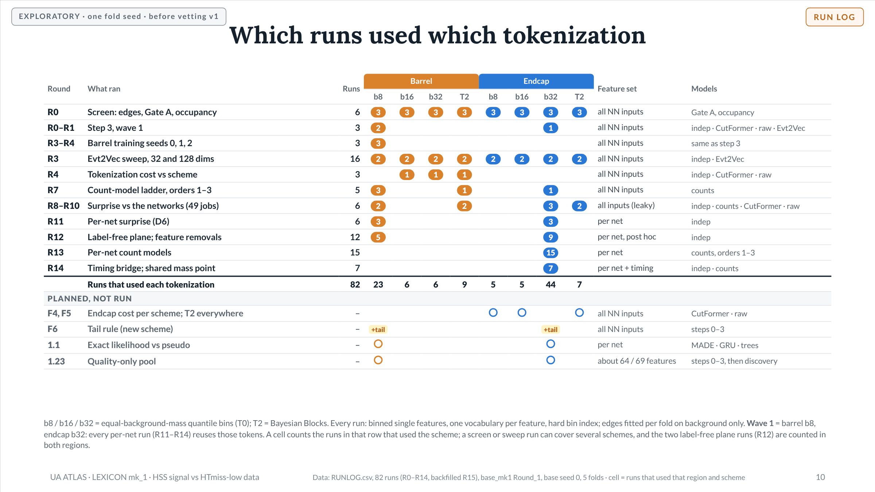
Notes:
Slide 10 of 49. Built from RUNLOG.csv: each row groups the logged runs of one round by purpose, with the tokenization (scheme and region) each used, read from the run notes and run_config/pernet_meta files. R0: 6 screen runs (3 per region: v1–v4 era, cross-fitted Gate A, v5), each over the 4 schemes. R0–R1: lex_barrel_train (superseded), lex_barrel_train_v2 (T0_b8), lex_endcap_train_v2 (T0_b32). R3–R4: barrel seeds 1 and 2 plus the formal seed report. R3: Evt2Vec sweep, 4 schemes x 2 regions x d32/d128 = 16 runs. R4: barrel step 3 at T0_b16, T0_b32, T2_p0.05. R7: n-gram ladder barrel s0/s1/s2 (T0_b8), barrel T2, endcap T0_b32. R8–R10: lex_barrel_compare, lex_endcap_compare, lex_endcap_compare_T2 (vanilla s0), lex_barrel_compare_all (49 jobs), lex_endcap_compare_smoke and lex_endcap_compare_all (49 jobs; endcap T2 independence from the Evt2Vec sweep run); all-feature, the leaky baseline under D6. R11–R14 per-net runs all read lex_barrel_train_v2 or lex_endcap_train_v2 (pernet_meta.json source_run), so they share the wave-1 tokens; R13 includes lex_endcap_compare_ngram, marked INVALID for orders 2–3 and superseded by _split. Planned rows are from the inventory: F4/F5, F6 (tail rule, a new scheme on top of T0), 1.1 (exact-likelihood models, per net, barrel first per the public page), 1.23 (quality-only pool, about 64 barrel and 69 endcap features). DATA: Data: RUNLOG.csv, 82 runs (R0–R14, backfilled R15), base_mk1 Round_1, base seed 0, 5 folds · cell = runs that used that region and scheme

Slide 11
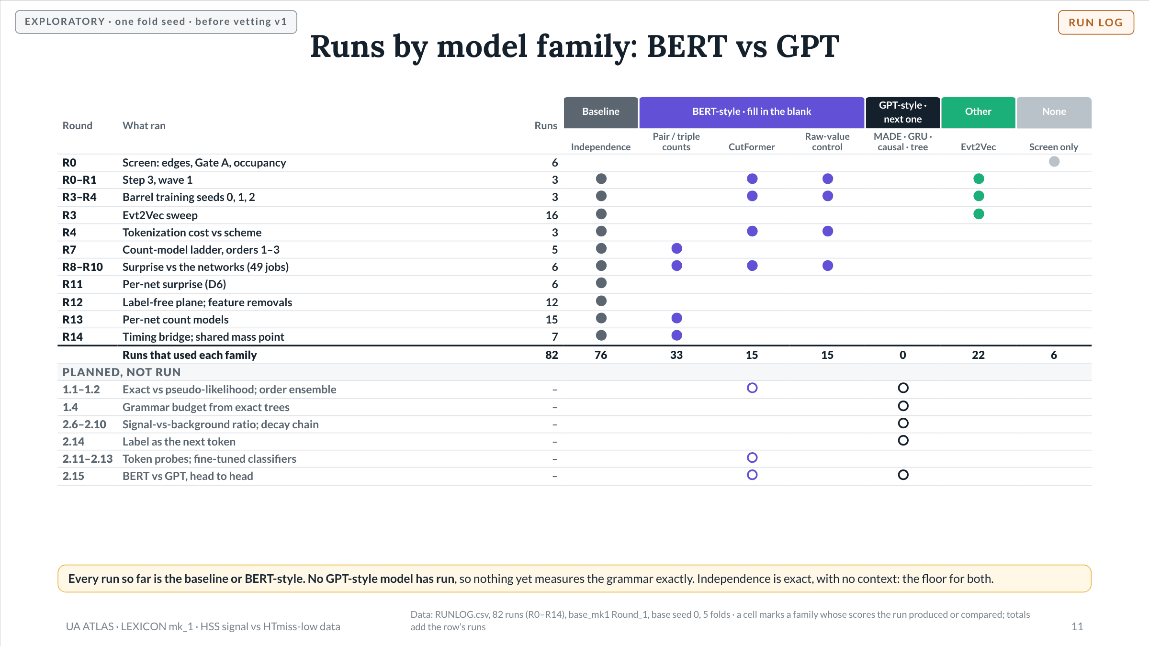
Notes:
Slide 11 of 49. Model-family labels follow goal set mk2 §2: CutFormer (masked-token transformer, scored by pseudo-log-likelihood) and the pair/triple count models (pseudo-likelihood) are BERT-style; the raw-value control is scored the same way (each feature predicted from the raw values of the others), so it is grouped with them; MADE, GRU, causal or any-order transformer and the Chow–Liu tree are GPT-style (exact chain-rule likelihood); Evt2Vec is a skip-gram (other). The independence model is autoregressive with no conditioning, so its likelihood is exact; it is the baseline every model must beat. Rows: R0 screens use a per-token count model and a kNN raw model for Gate A, not a language model. Step 3 (R0–R1) and the seed runs trained independence, CutFormer, raw control and Evt2Vec; the formal seed report (R4) compares those runs. R7 and R13 are count-model ladders (order 1 = independence). R8–R10 compare the surprise scores of independence, CutFormer, raw and orders 2–3 against the networks. R11–R12 use independence only; R14 adds an order-2 count run. Planned rows from the inventory: 1.1–1.2 (exact-likelihood variants against CutFormer, same folds), 1.4 (grammar budget from exact Chow–Liu tree models), 2.6–2.10 (likelihood ratio, decay-chain test), 2.14 (label as the final token), 2.11–2.13 (probes on frozen CutFormer embeddings, fine-tuned transformer), 2.15 (BERT vs GPT on the same features, folds, seeds and size, compared on downstream results with a uniform-attention control). DATA: Data: RUNLOG.csv, 82 runs (R0–R14), base_mk1 Round_1, base seed 0, 5 folds · a cell marks a family whose scores the run produced or compared; totals add the row’s runs

Slide 12
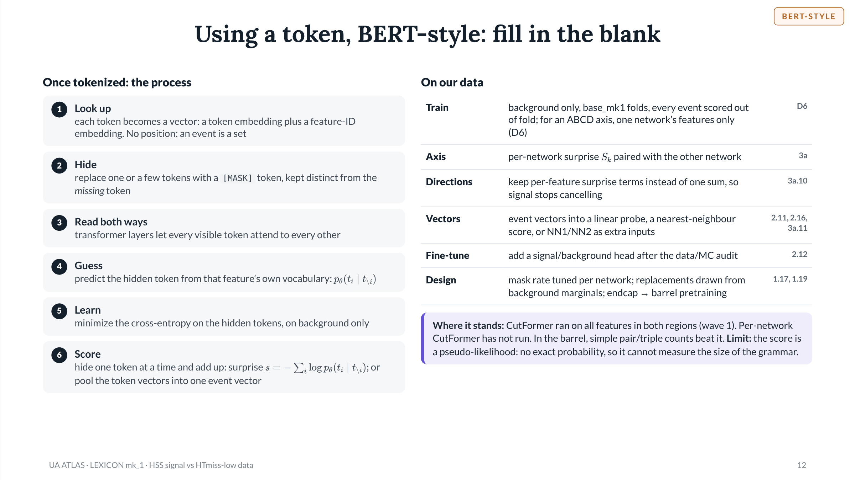
Notes:
Slide 12 of 49. CutFormer as built (lexicon_models_mk2): masked-token transformer with feature-ID embeddings and no positional encoding; each feature predicts only its own sub-vocabulary; trained on background only on the base folds; surprise = negative pseudo-log-likelihood in nats per event, scored out of fold. Masking design from goal set mk2 §6: the training mask rate is a recorded run-spec parameter; replacements drawn from each feature's background marginal rather than uniform; [MASK] distinct from the missing/sentinel token; scoring masks one token at a time. Event vectors: mean pooling, an [EVT] slot, or a learned query (Set Transformer, lee2019). Status: wave-1 CutFormer runs R1 (barrel T0_b8, endcap T0_b32, all features); per-net runs R11–R14 used independence and count models only. Barrel counts (order 3) beat CutFormer by about 2 nats/event; endcap CutFormer beats order 3 by 3.7. Pseudo-likelihood cannot give entropy, mutual information or total correlation, and undercounts redundant features.

Slide 13
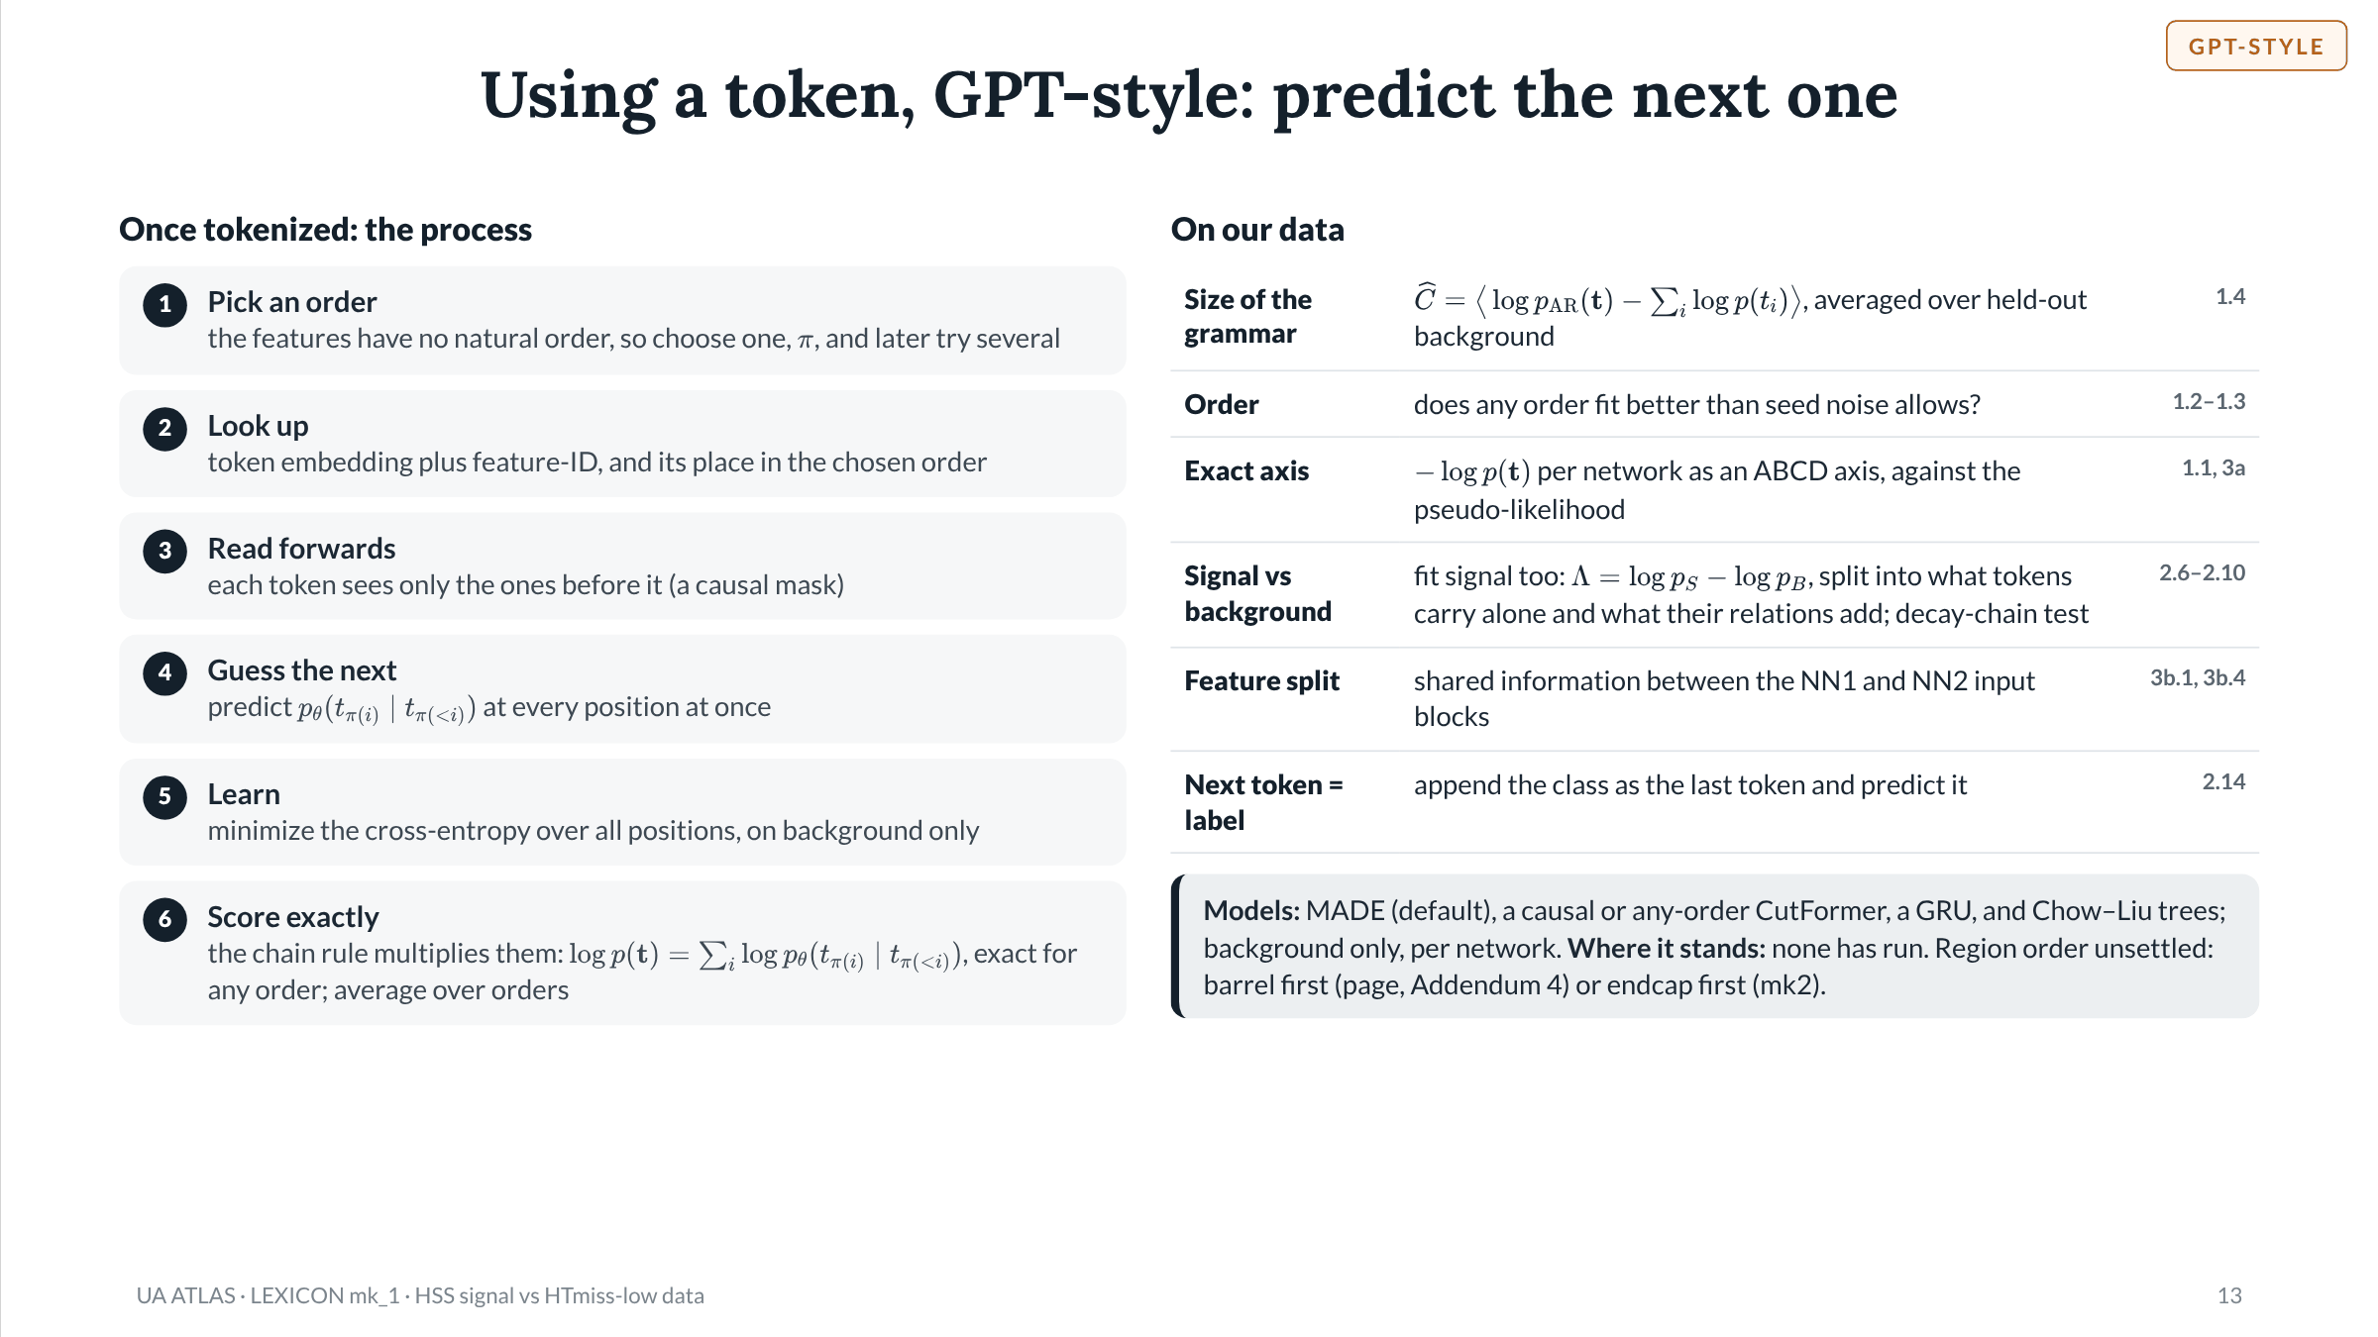
Notes:
Slide 13 of 49. Autoregressive models as planned (exact-likelihood variant plan and goal set mk2 App. A): one network for every conditional; a causal mask lets all positions train in parallel (teacher forcing). The chain rule is exact for any feature order; a finite model is not order-invariant, so K random orders (K = 5 proposed) are averaged as mean of p, and the spread across orders is a per-event uncertainty; each order's held-out likelihood is kept to test whether some orders fit better. Models: MADE (masked autoregressive MLP, default), causal or any-order CutFormer (same architecture, only the masking changes), GRU over a fixed order within one network's features, Chow–Liu tree (exact, one parent per token, no training seed). Uses: total correlation C-hat as the held-out gap to the independence model (goal 1a); per-order likelihoods (1b); exact surprise as an ABCD axis compared with PLL on the same folds (3a-iii); likelihood ratio and its exact marginal + relational split on a tree skeleton (Route A3); decay-chain conditional MI; block mutual information I(T1;T2) for the feature split, which by the data-processing inequality bounds the dependence of any cut on the two networks' outputs; label appended as the final token, p(y | t_1..n) (discriminative reading of the 4 Nov goal). Guard: an exact model must beat the independence baseline on held-out background before any closure or AUC number is read.

Slide 14
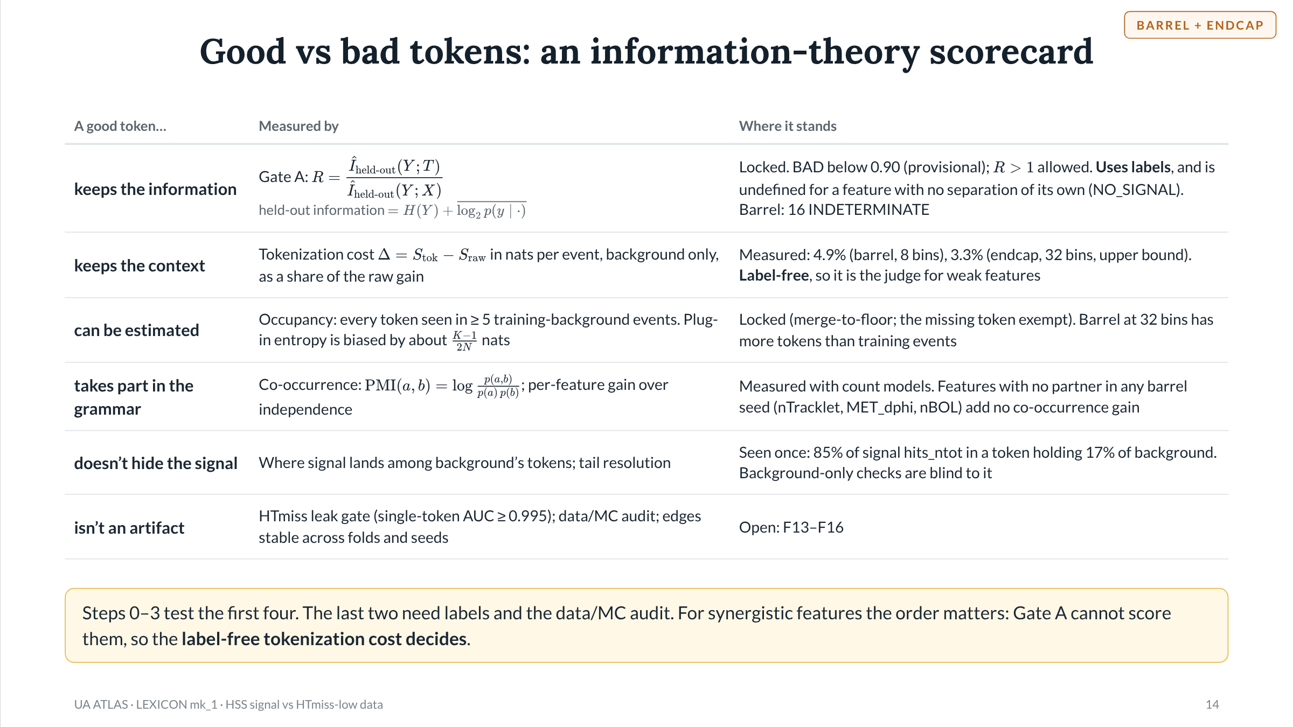
Notes:
Slide 14 of 49. Gate A as locked 12 Oct (lexicon_mk2/mk6 README): R = held-out info(tokens) / held-out info(raw-value model), on the base sweep's folds with balanced classes; held-out info = H(Y) + mean log2 p(y | .), model fitted on training folds, scored on the test fold. Token model: count model per token, add-1 toward the prior. Raw model: count model for missing values, spikes and discrete values plus a rank-window kNN for the continuous part. NO_SIGNAL when the raw model's held-out info has a lower bound <= 0. The 0.90 line is still provisional and only decides BAD. Tokenization cost = CutFormer surprise - raw-control surprise (nats/event, held-out background): barrel T0_b8 +0.90 +/- 0.24 (4.9% of raw gain, 3-seed mean), endcap T0_b32 +0.78 (3.3%, upper bound: epoch cap). Occupancy floor 5 training-background events (provisional). The (K-1)/(2N) term is the Miller-Madow correction for the plug-in entropy estimator. No-partner features from the order-2 ladder (progress §3.5). Open top bin: barrel T0_b8, fold 0, 999 signal / 218 background out of fold.

Slide 15
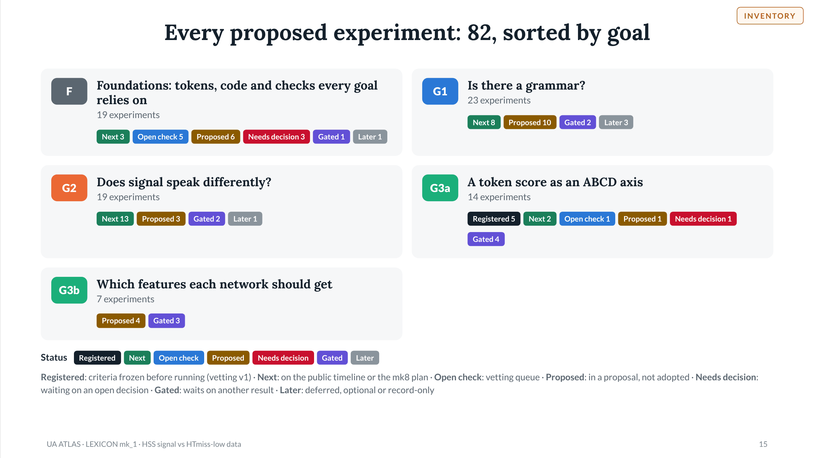
Notes:
Slide 15 of 49. Inventory of every proposed or planned LEXICON experiment as of 5 Nov 2026, built from: Prog = LEXICON_progress.md R15 (19 Oct); Vet = LEXICON_vetting.md v1, queue §D and variant inventory §E (19 Oct); mk8 = plans/LEXICON_mk8_plan.md (19 Oct); xNLL = plans/LEXICON_RouteA_variant_exactNLL_mk1.md (14 Oct); Routes = plans/LEXICON_routes_to_prediction.md; Page = public page projects/lexicon/project.json (30 Oct); Add4 = LEXICON_addendum4_proposal.md (2 Nov); mk2 = LEXICON_goal_set_and_model_labels_mk2.md (4 Nov); GAM = GAMBIT_lexicon_partition_crosscheck_mk1.md (4 Nov); IT = INFO_THEORY_lexicon_concepts_mk1.md (4 Nov); FS = feature_selection_beyond_separation.md (5 Nov); SBX = SIG/BG Explorer mk5_r1: drop_suggestions.txt and pool_*.txt (Sep-21 files). Goal 2 items marked Gated run after the data/MC token audit (F13), because signal is MC and background is data.

Slide 16
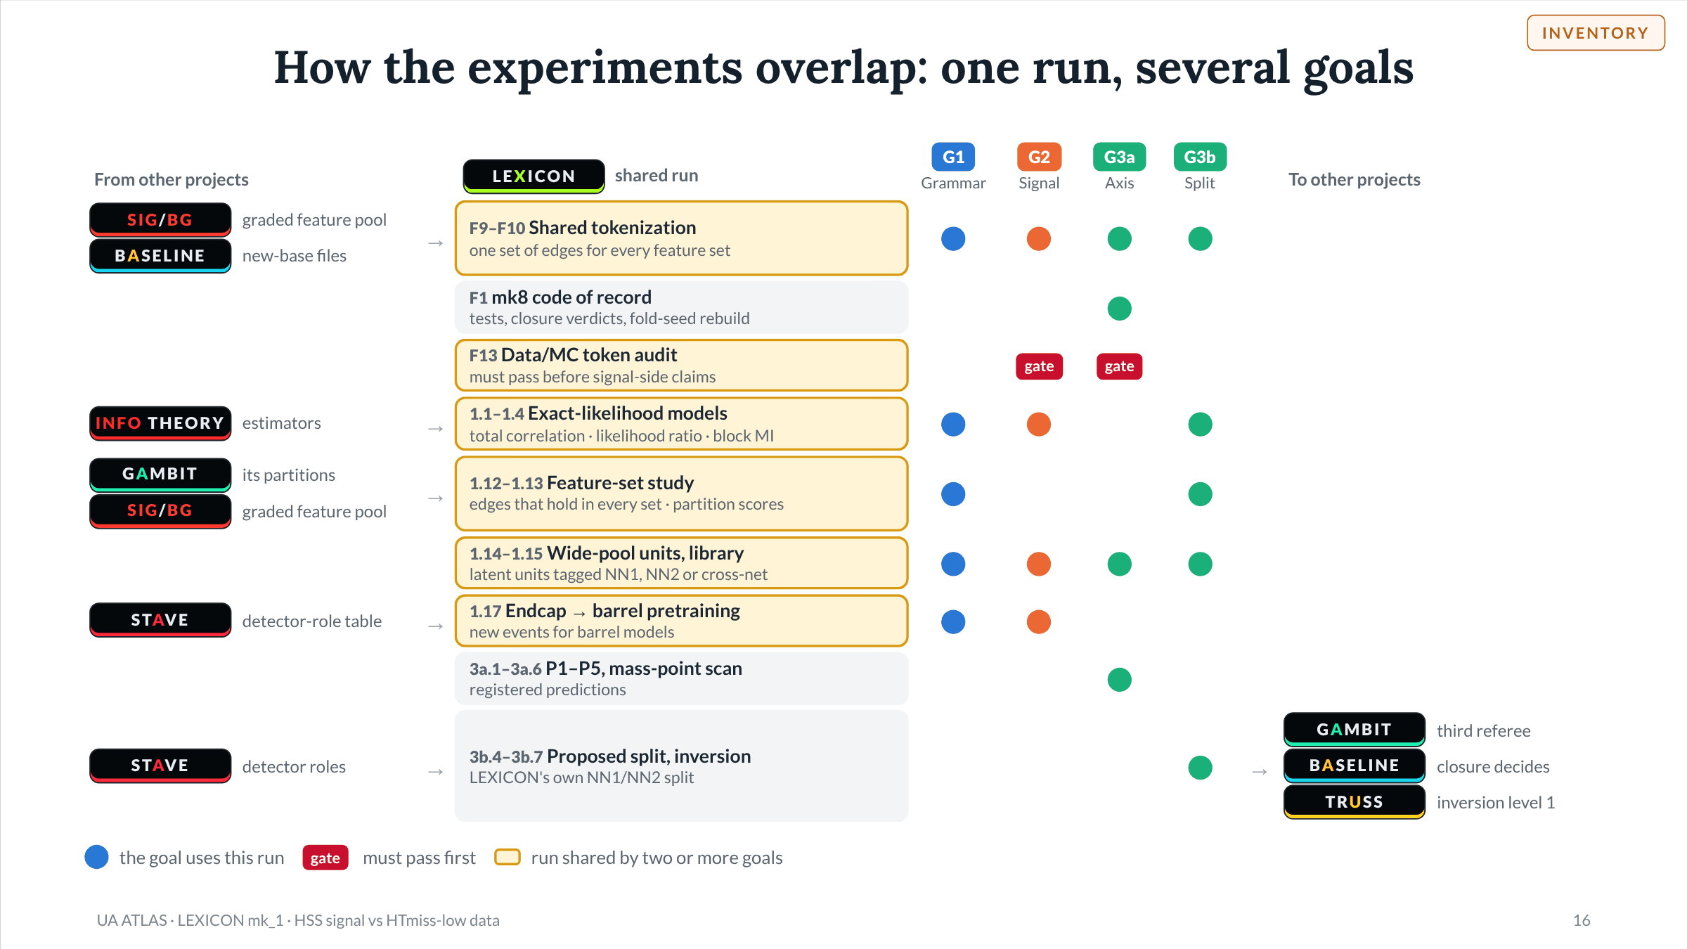
Notes:
Slide 16 of 49. Overlap map. Each row is one run whose output is reused; a mark means the goal uses it. Shared by several goals: shared tokenization (F9–F10, all four), exact-likelihood models (1.1–1.4: G1 total correlation, G2 likelihood ratio, G3b block mutual information), feature-set study (1.12–1.13: G1 and G3b), wide-pool library (1.14–1.15: all four), endcap-to-barrel pretraining (1.17: barrel G1 and G2 models). The data/MC token audit (F13) gates every G2 experiment and the signal side of P1. Other projects: SIG/BG Explorer supplies the graded pool; BASELINE the new-base files and, for split disagreements, the closure grader; GAMBIT its partitions as feature sets, and receives LEXICON's split as a third, non-game referee (3b.5); STAVE the detector-role table (1.17, 3b.6); INFO_THEORY the estimators (1.21); TRUSS receives level 1 of inversion (3b.7).

Slide 17
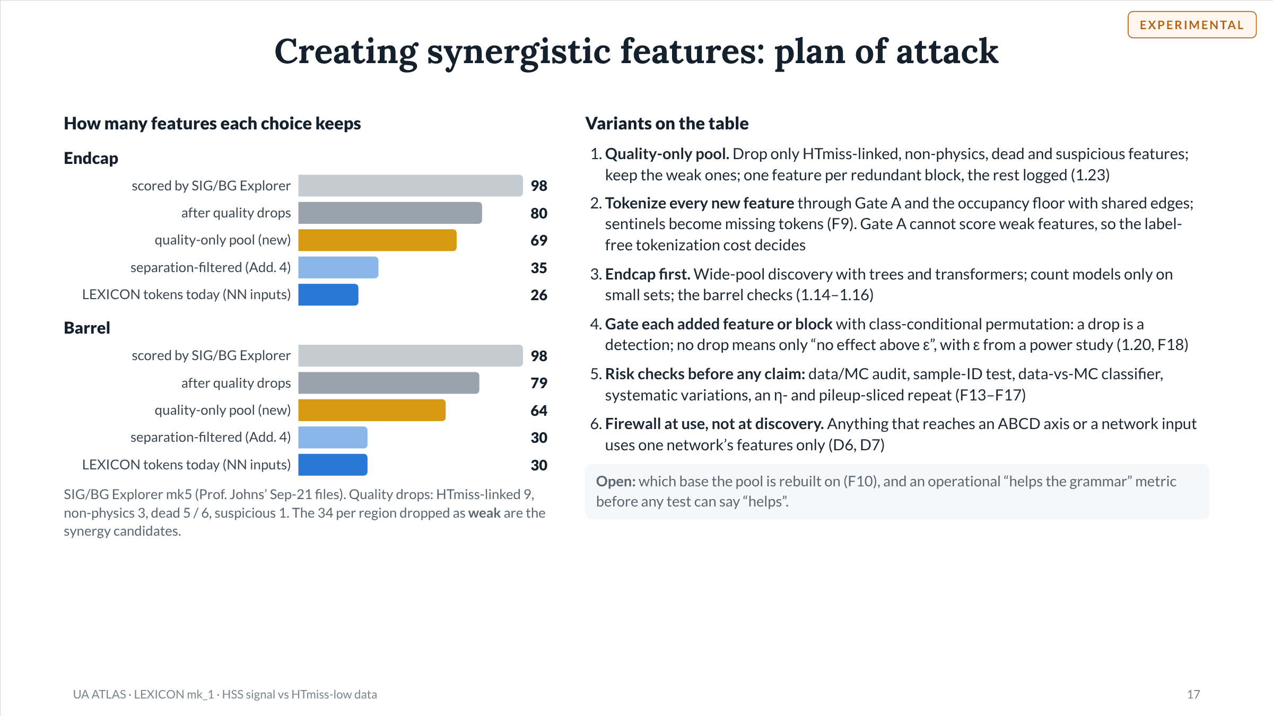
Notes:
Slide 17 of 49. Counts per region from SIG/BG Explorer results/mk5_r1 (round 1, Sep-21 files): 98 features scored; drop_suggestions.txt categories endcap htmiss-linked 9, non-physics 3, dead 5, suspicious 1, redundant 11, weak 34; barrel 9, 3, 6, 1, 15, 34. Quality-only pool = 98 minus quality drops minus redundant = 69 endcap, 64 barrel; it equals the separation-filtered candidate pool (pool_endcap.txt 35, pool_barrel.txt 30) plus the 34 weak features. LEXICON's current token sets are the registry mk4 NN inputs: endcap 16 + 10 = 26, barrel 20 + 10 = 30. Weak features already in the NN lists include msvtx_el3hcal and msvtx_trackSoftSumPt_NOSYS. Weak candidates include context-type variables such as msvtx_eta_NOSYS and msvtx_y. Counts must be rebuilt on whichever base the next rounds use (F10). All six variants are experimental; none is adopted.

Slide 18
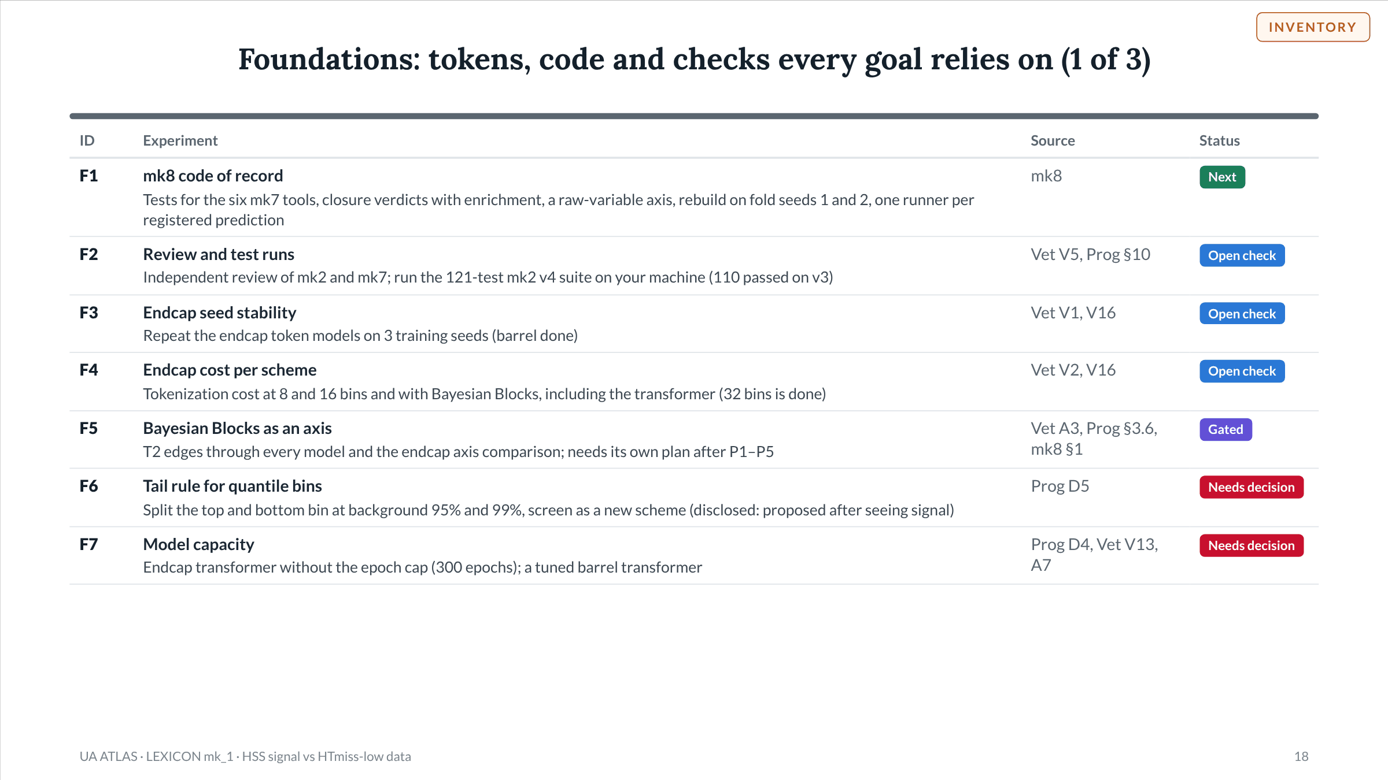
Notes:
Slide 18 of 49. Foundations: tokens, code and checks every goal relies on (1 of 3). Sources on this slide: .

Slide 19
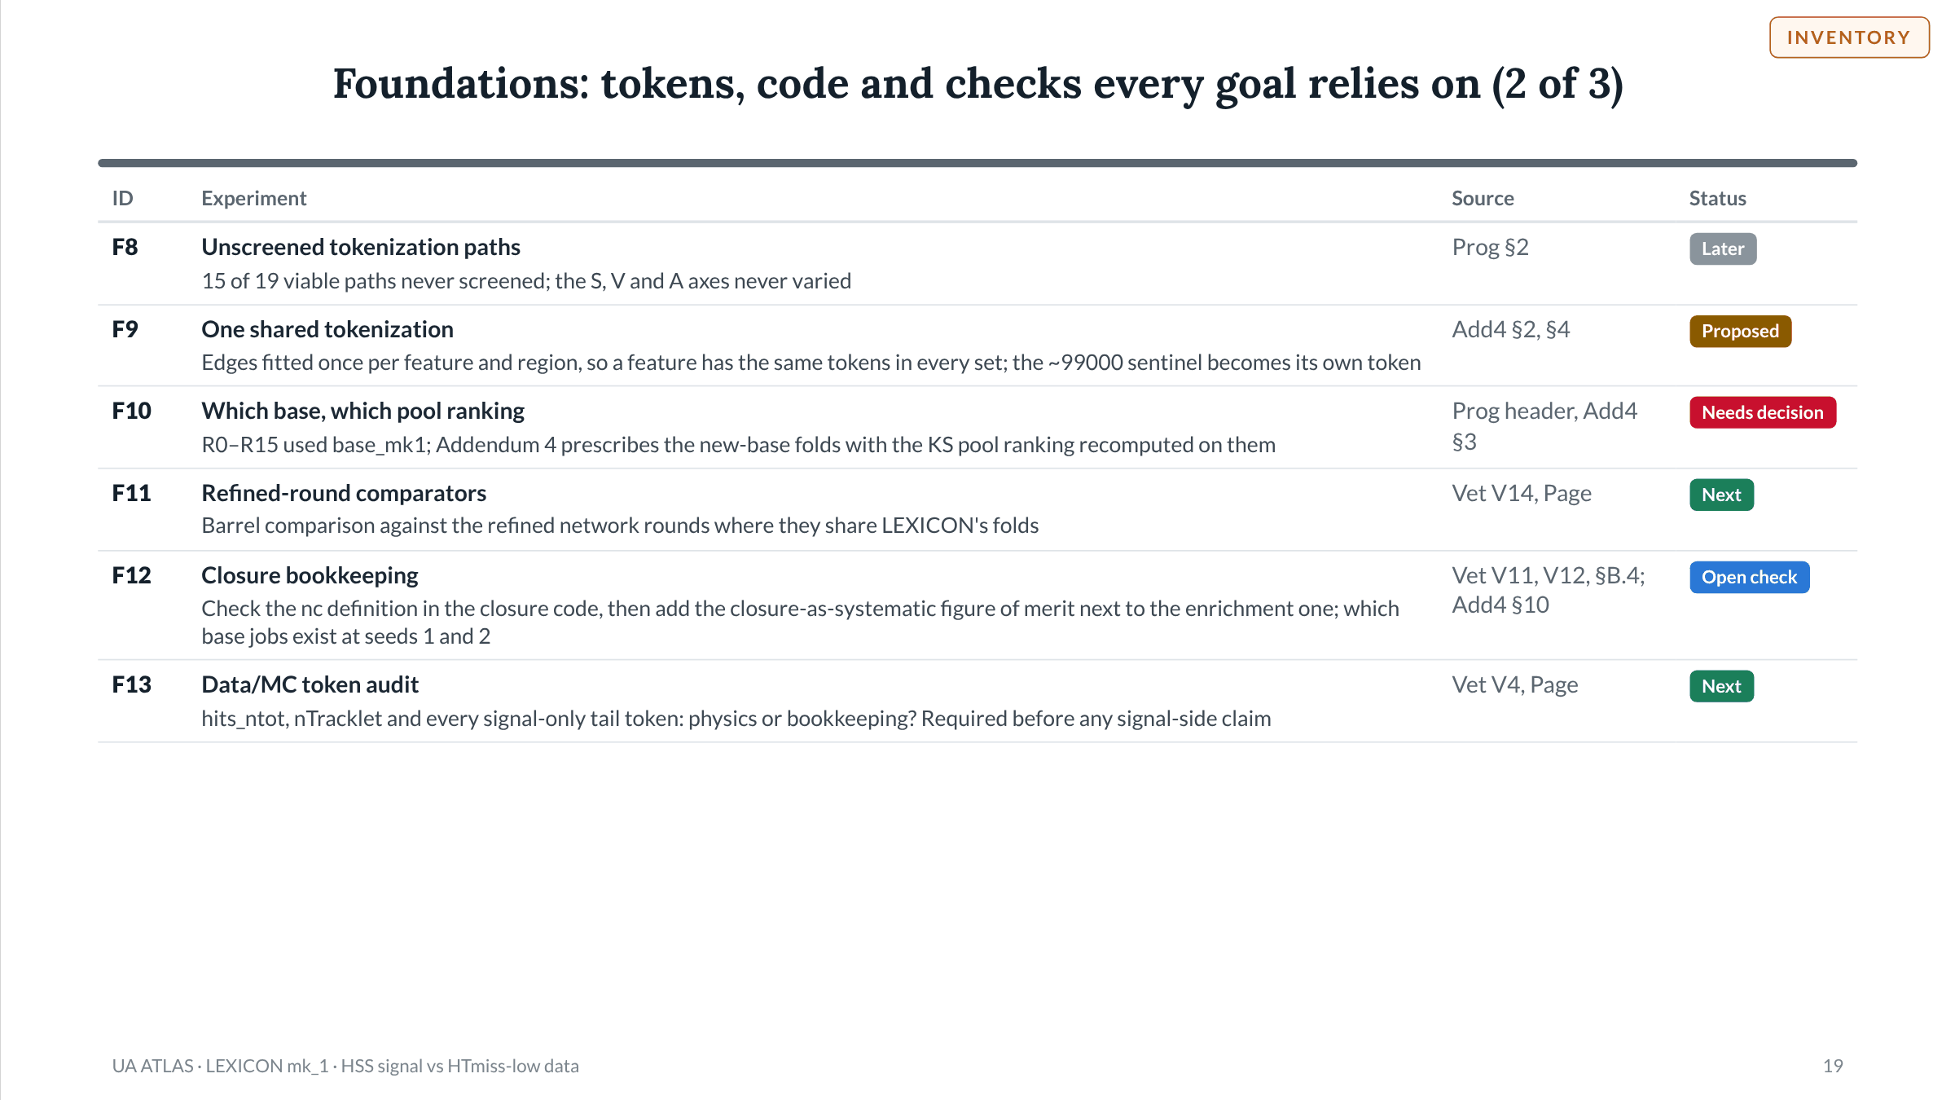
Notes:
Slide 19 of 49. Foundations: tokens, code and checks every goal relies on (2 of 3). Sources on this slide: .

Slide 20
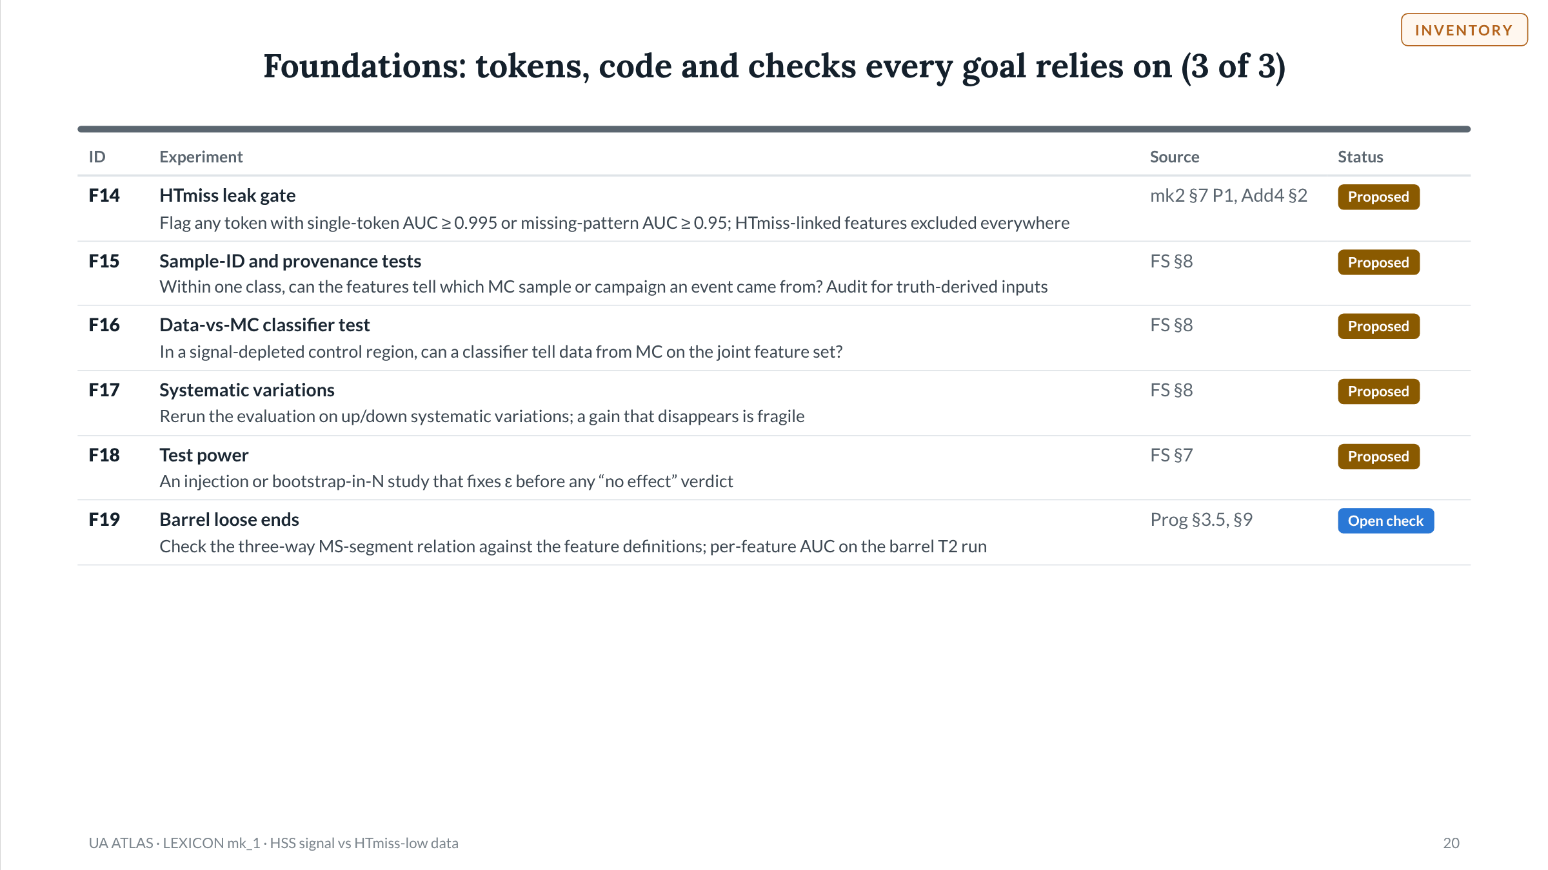
Notes:
Slide 20 of 49. Foundations: tokens, code and checks every goal relies on (3 of 3). Sources on this slide: .

Slide 21
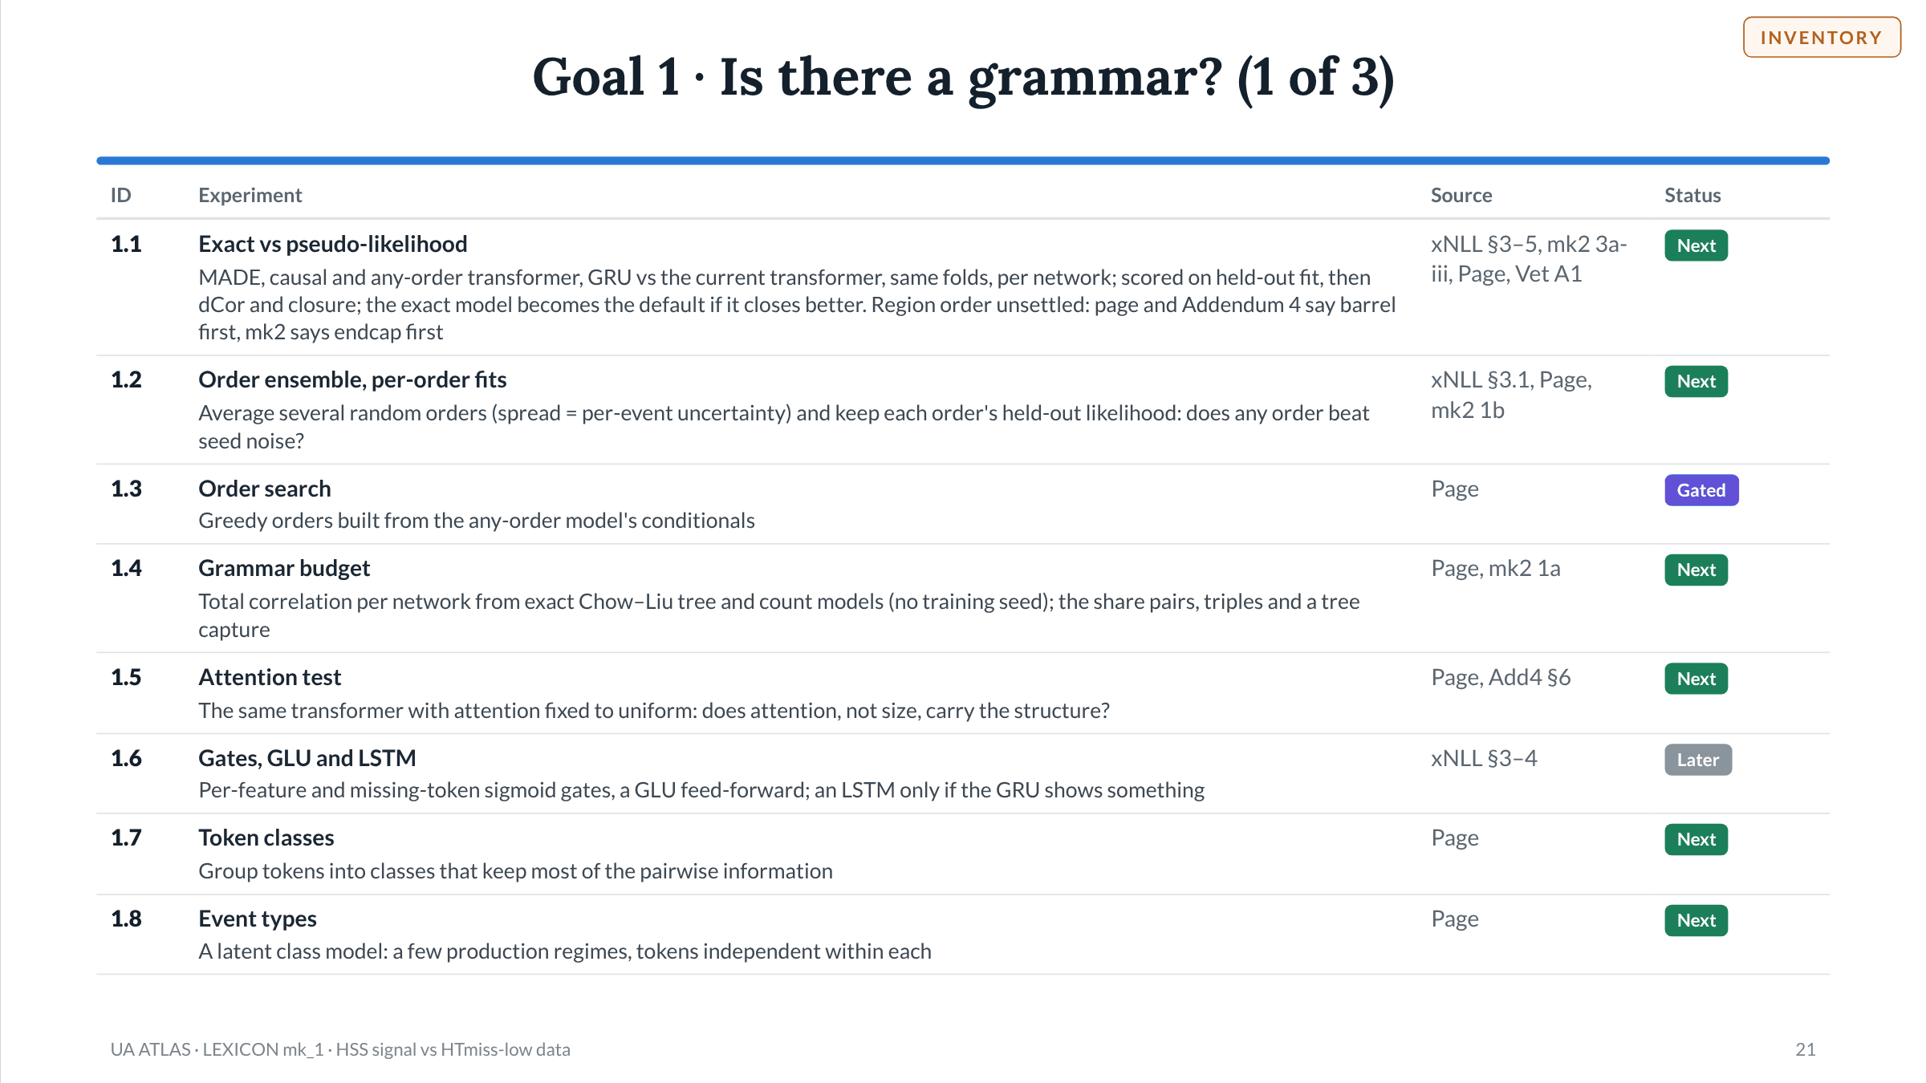
Notes:
Slide 21 of 49. Goal 1 · Is there a grammar? (1 of 3). Sources on this slide: .

Slide 22
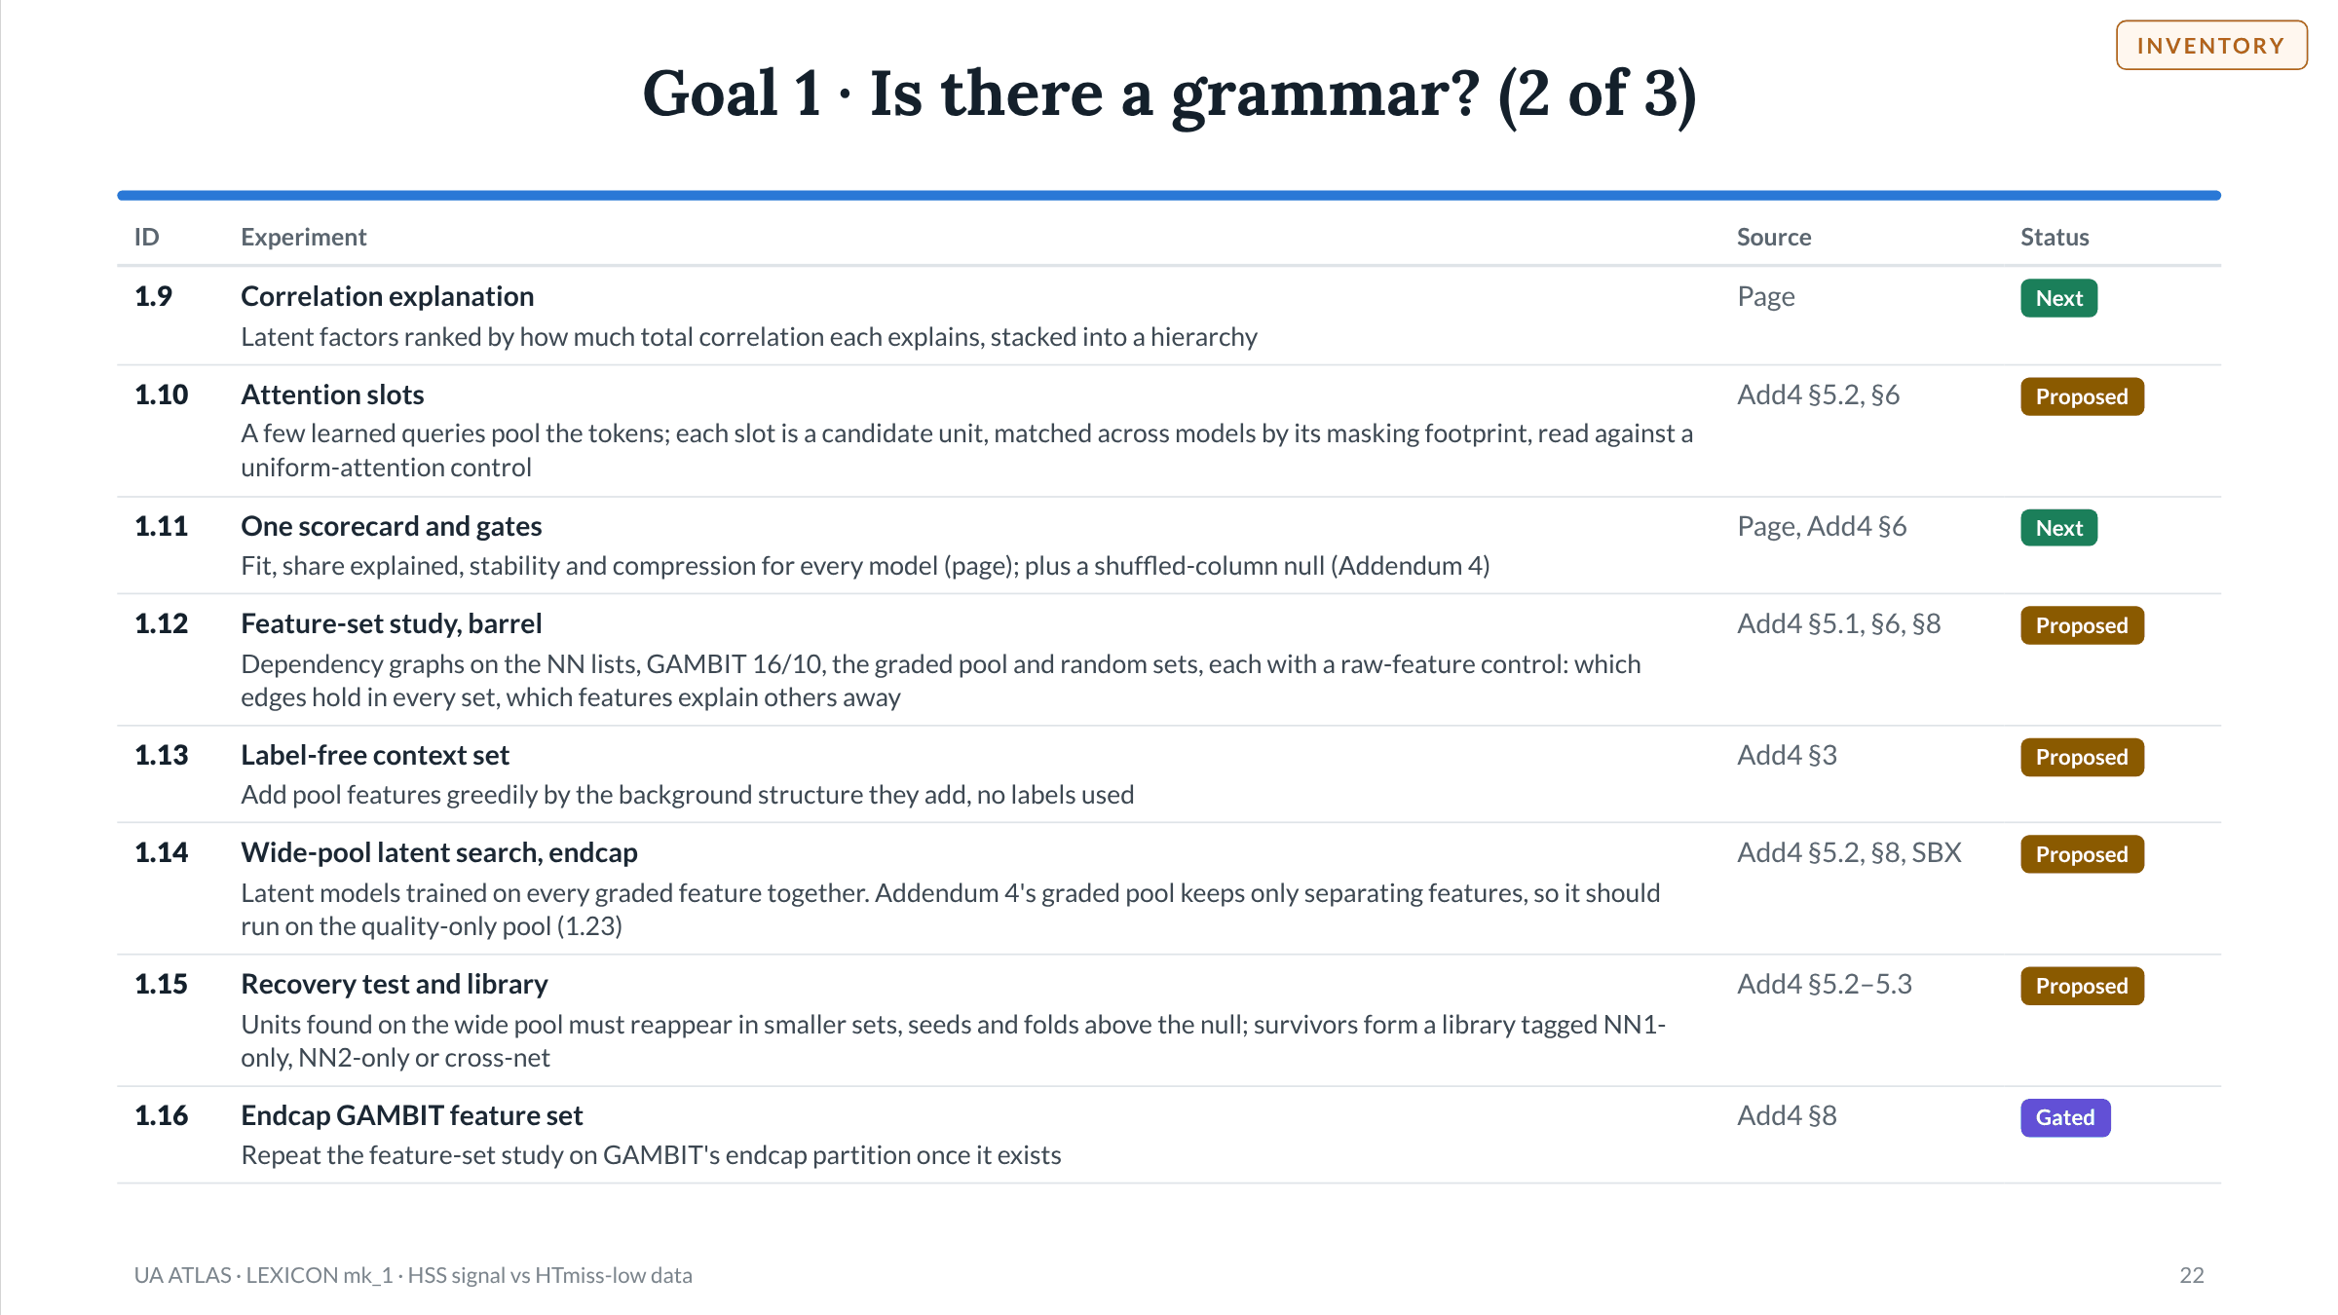
Notes:
Slide 22 of 49. Goal 1 · Is there a grammar? (2 of 3). Sources on this slide: .

Slide 23
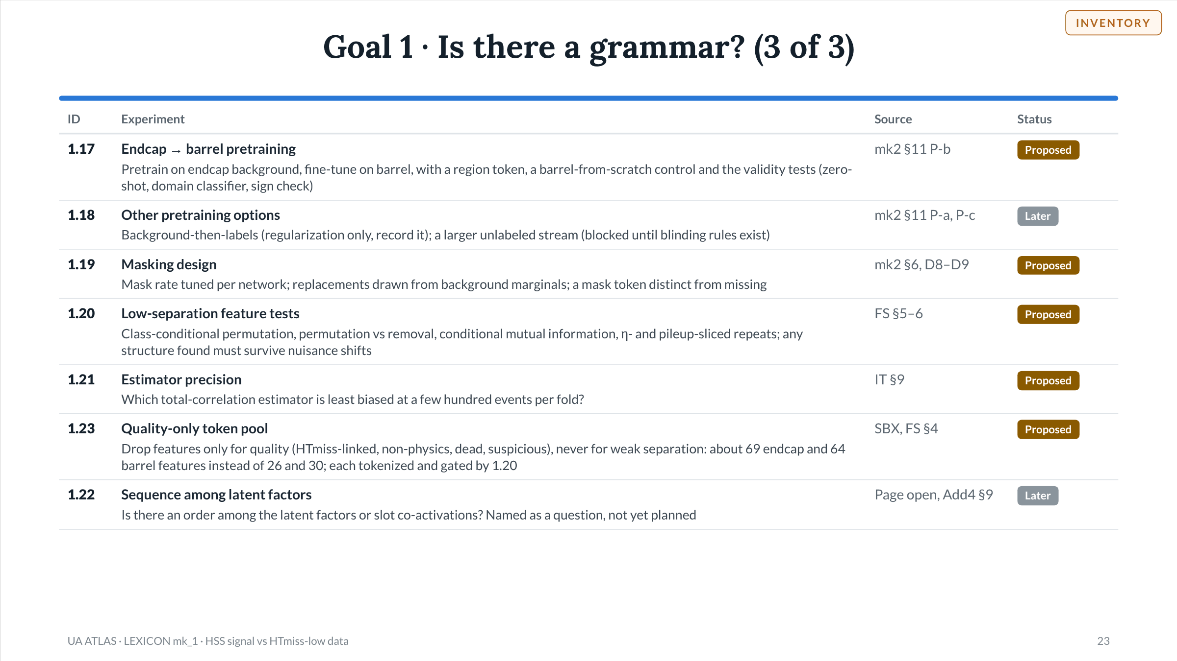
Notes:
Slide 23 of 49. Goal 1 · Is there a grammar? (3 of 3). Sources on this slide: .

Slide 24
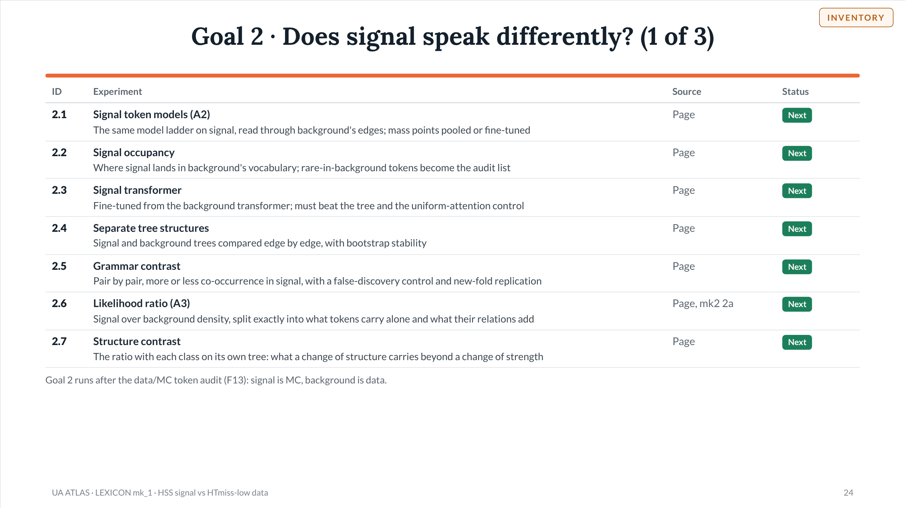
Notes:
Slide 24 of 49. Goal 2 · Does signal speak differently? (1 of 3). Sources on this slide: .

Slide 25
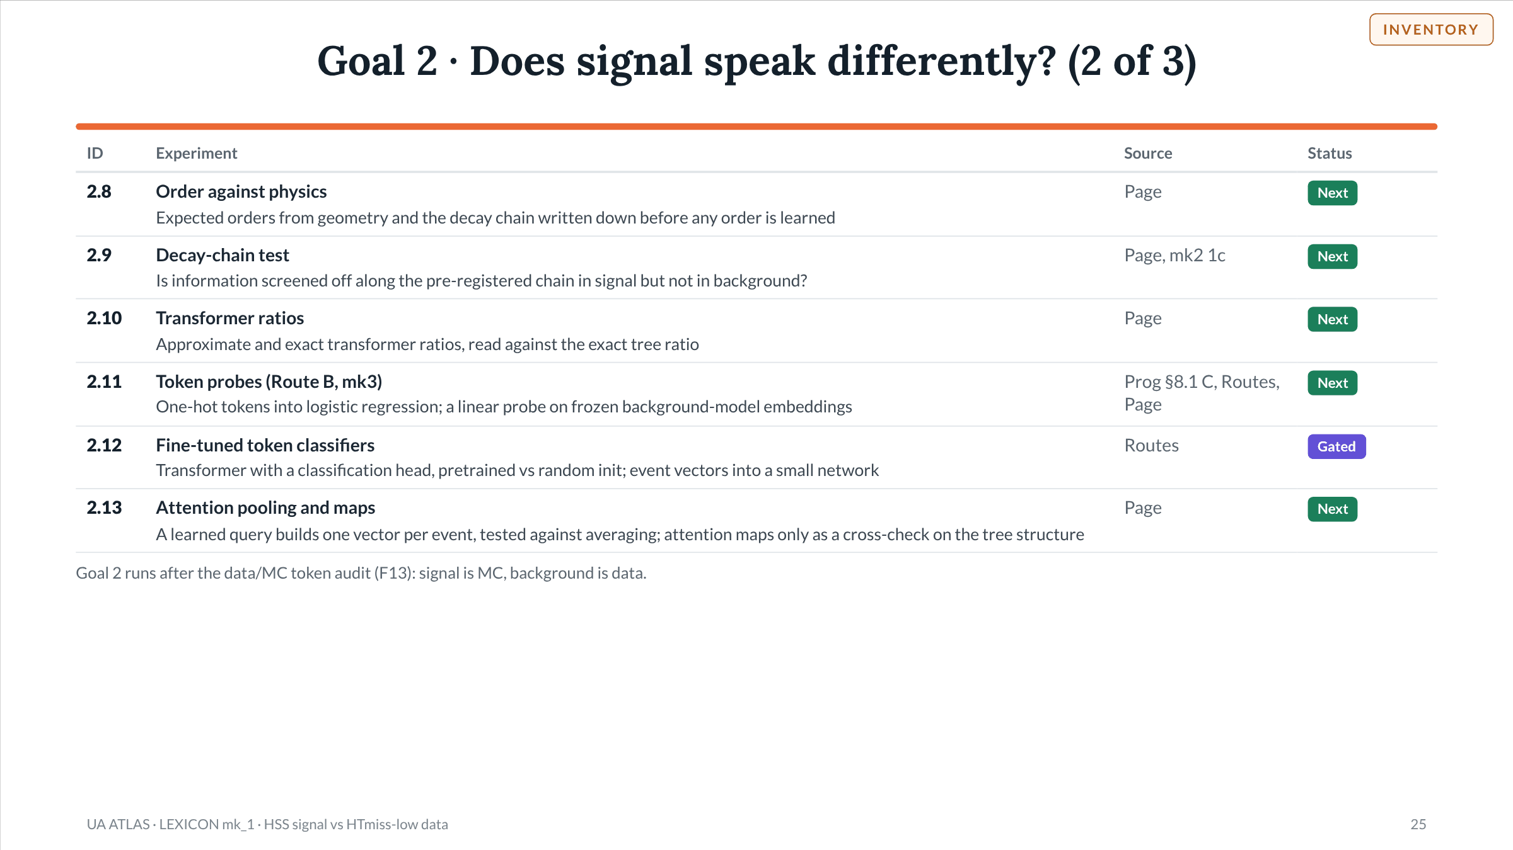
Notes:
Slide 25 of 49. Goal 2 · Does signal speak differently? (2 of 3). Sources on this slide: .

Slide 26
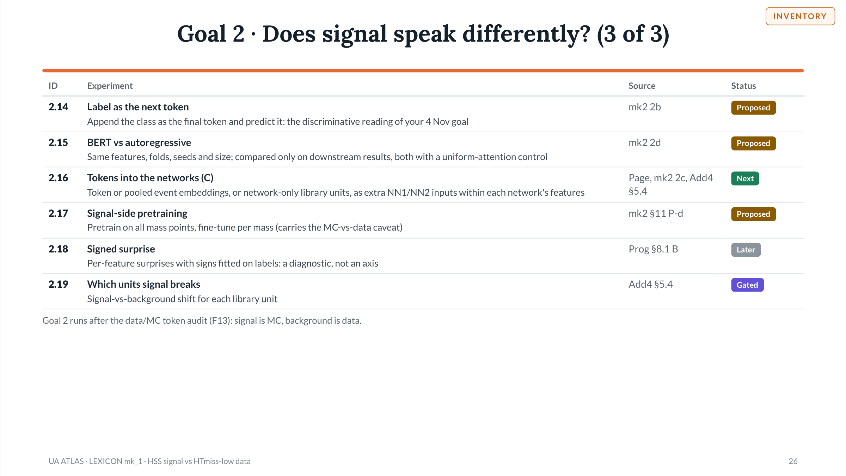
Notes:
Slide 26 of 49. Goal 2 · Does signal speak differently? (3 of 3). Sources on this slide: .

Slide 27
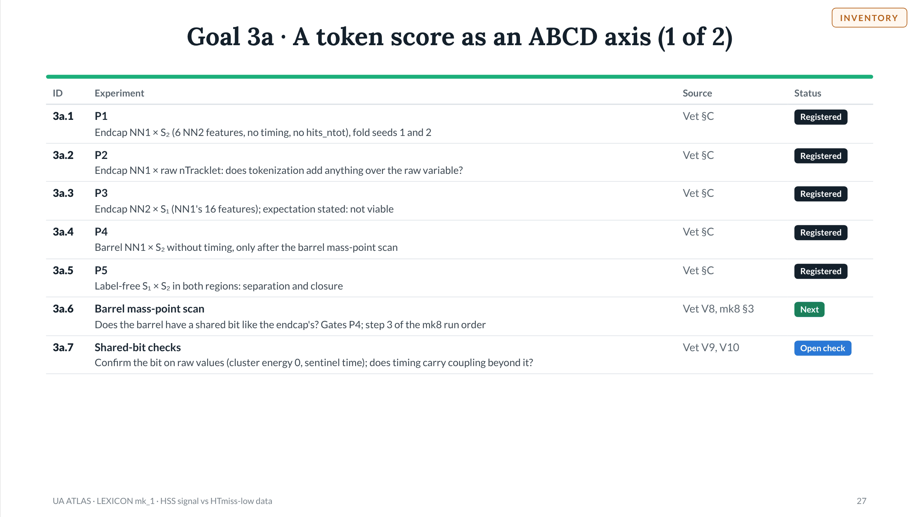
Notes:
Slide 27 of 49. Goal 3a · A token score as an ABCD axis (1 of 2). Sources on this slide: .

Slide 28
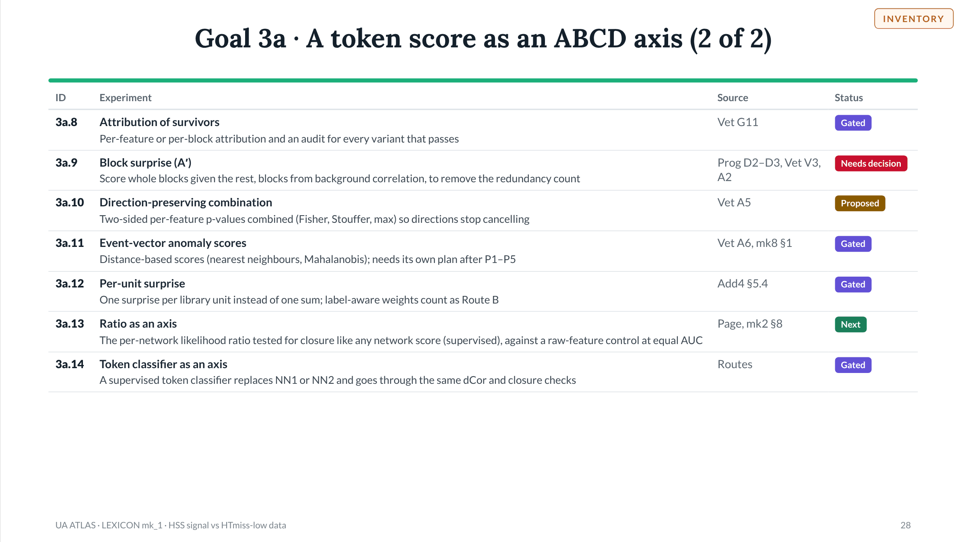
Notes:
Slide 28 of 49. Goal 3a · A token score as an ABCD axis (2 of 2). Sources on this slide: .

Slide 29
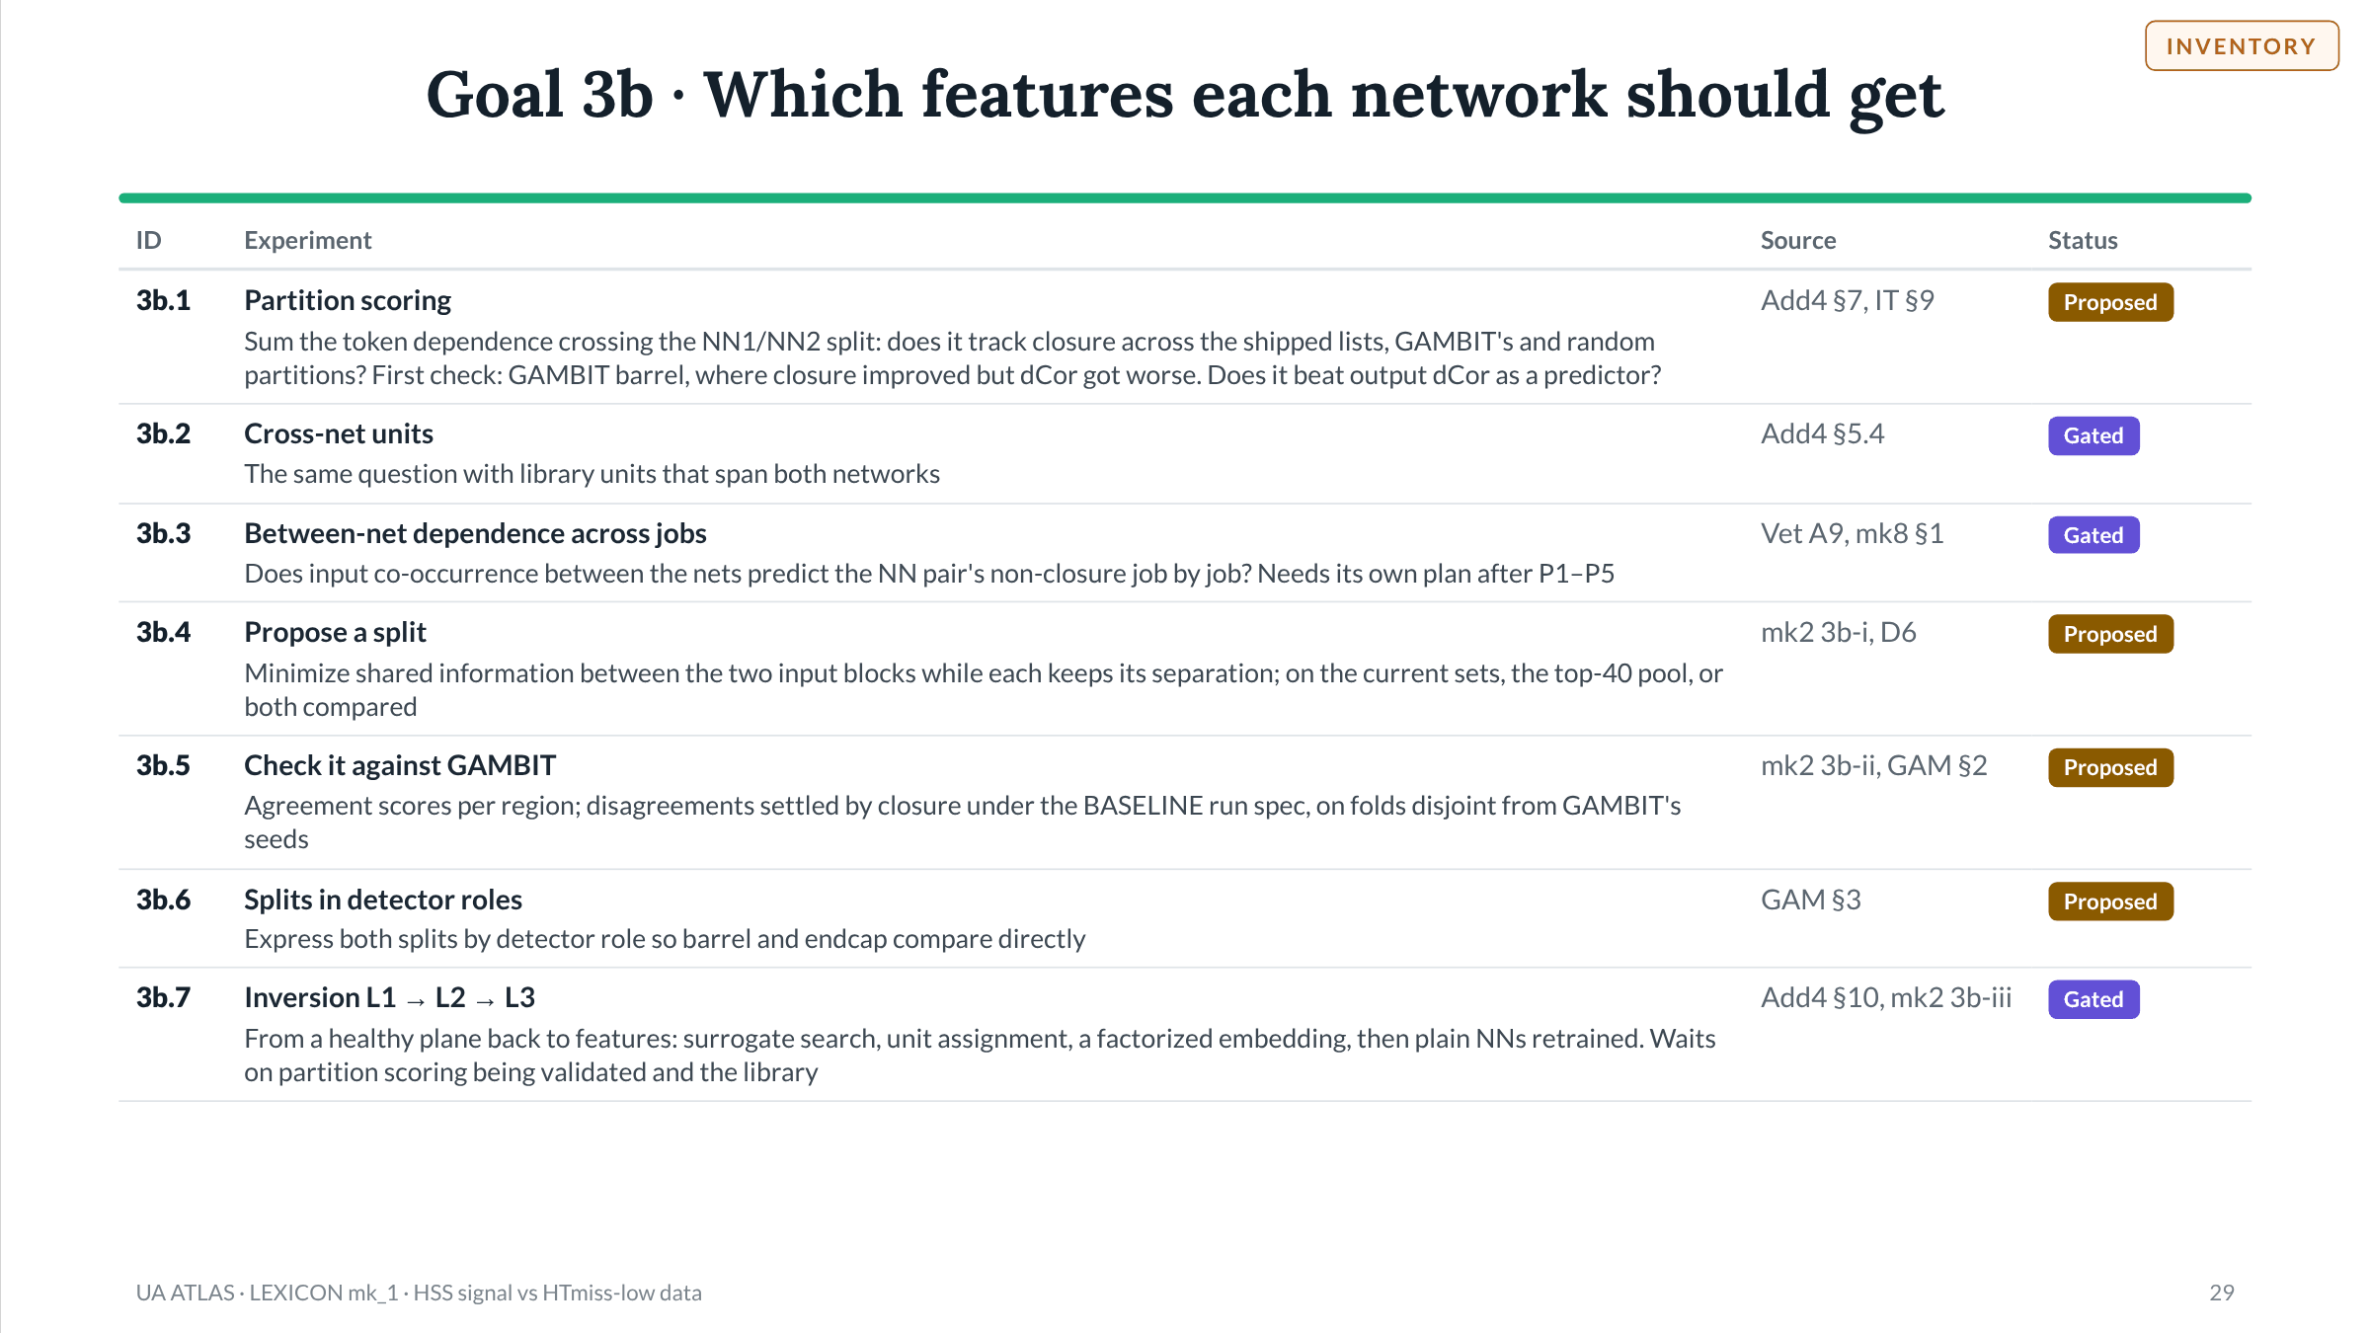
Notes:
Slide 29 of 49. Goal 3b · Which features each network should get. Sources on this slide: .

Slide 30
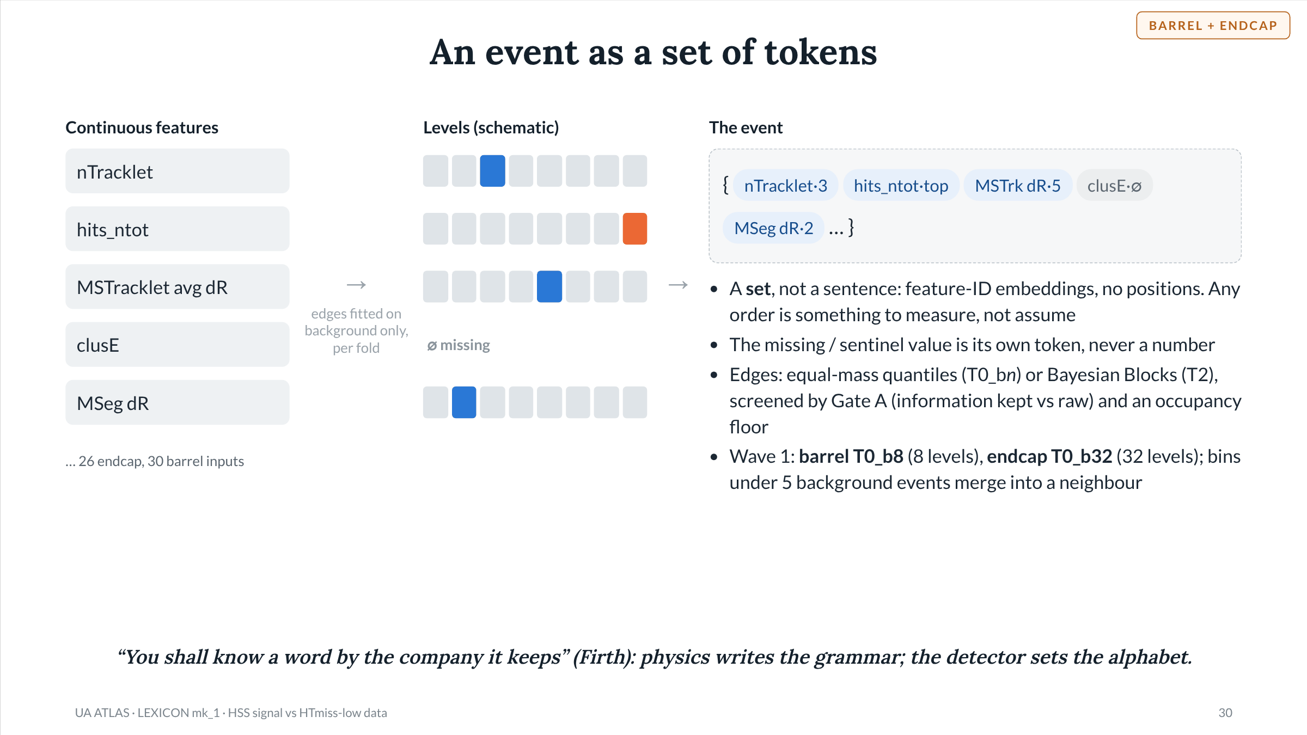
Notes:
Slide 30 of 49. Tokenization. Wave-1 paths: barrel S4 / T0_b8 / V1 / A1, endcap S4 / T0_b32 / V1 / A1. Path space 120 options, 25 on S4, 19 after T1 = T0; 8 screened; step 3 trained on the endcap wave-1 path and all 4 barrel schemes. Gate A = cross-fitted R (held-out information of tokens over that of a raw-value model). Occupancy: merge-to-floor at 5 training-background events, missing token exempt. The levels drawn here are a schematic, not data.

Slide 31
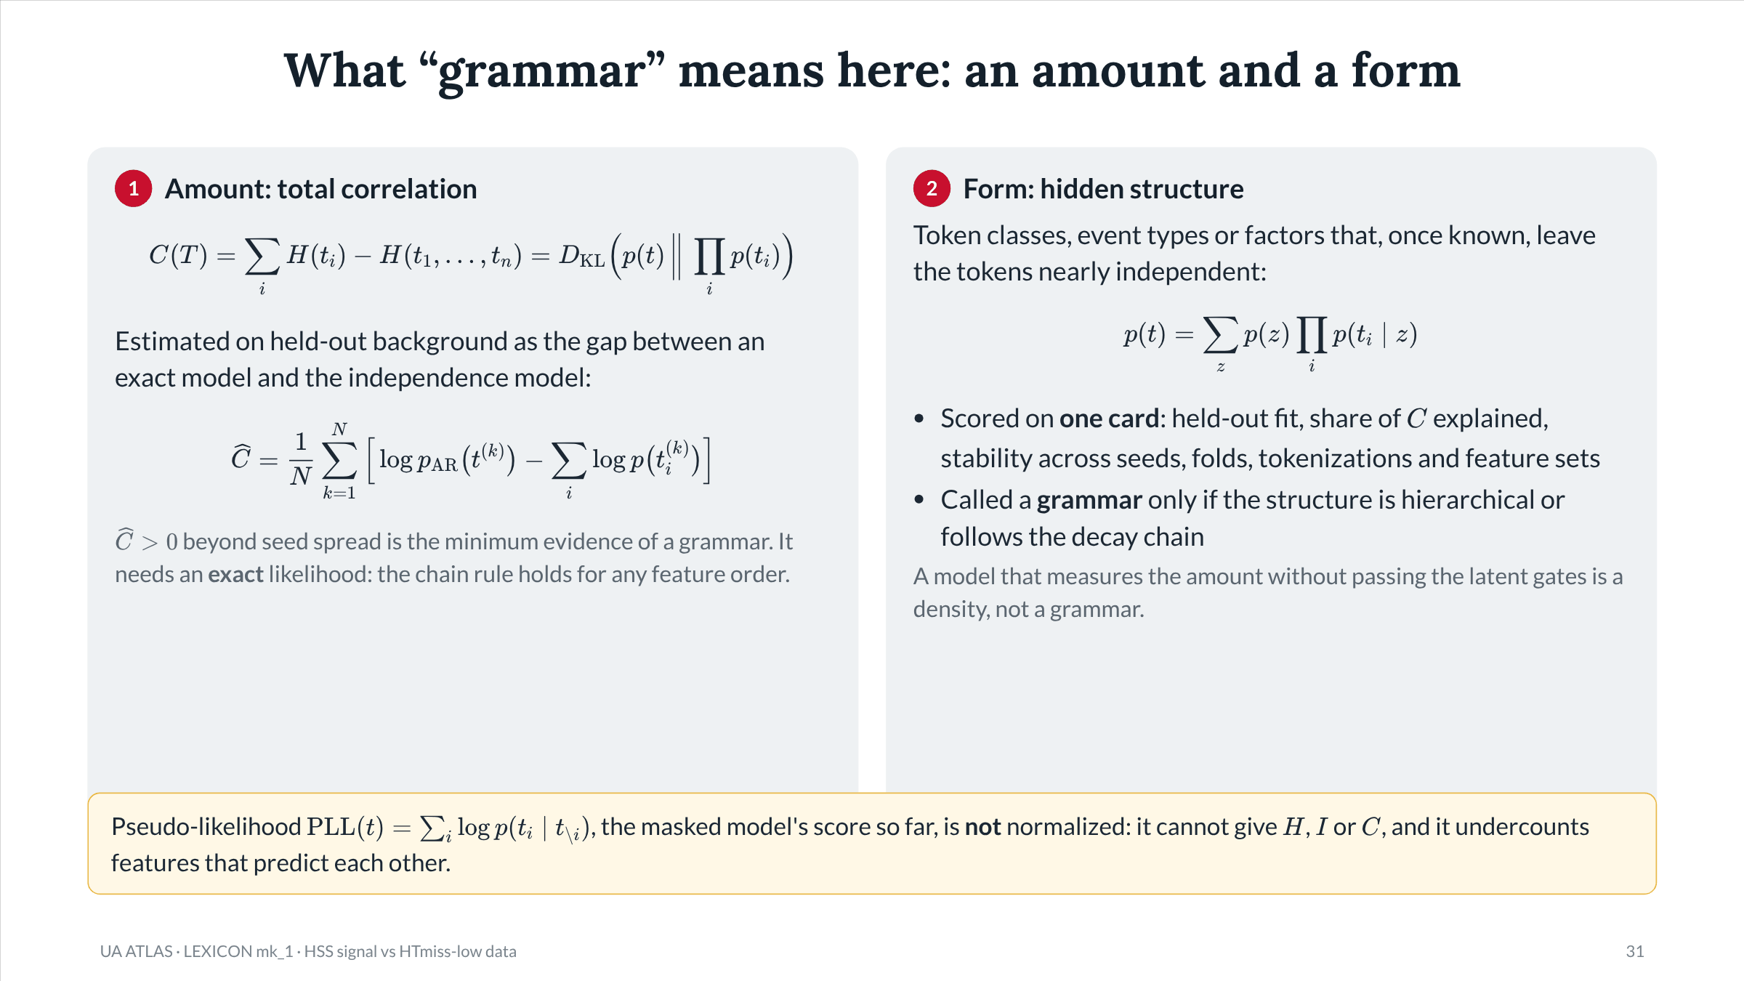
Notes:
Slide 31 of 49. Grammar has two parts. Amount: total correlation (Watanabe 1960), estimated as the held-out log-likelihood gap between an autoregressive (exact) model and the independence model. Form: latent models (token classes, event types, correlation explanation, Versteeg 2014/2015). The PLL warning matters because every CutFormer and count-model number in Part II is a pseudo-likelihood; only the independence values (product of marginals) are exact.

Slide 32
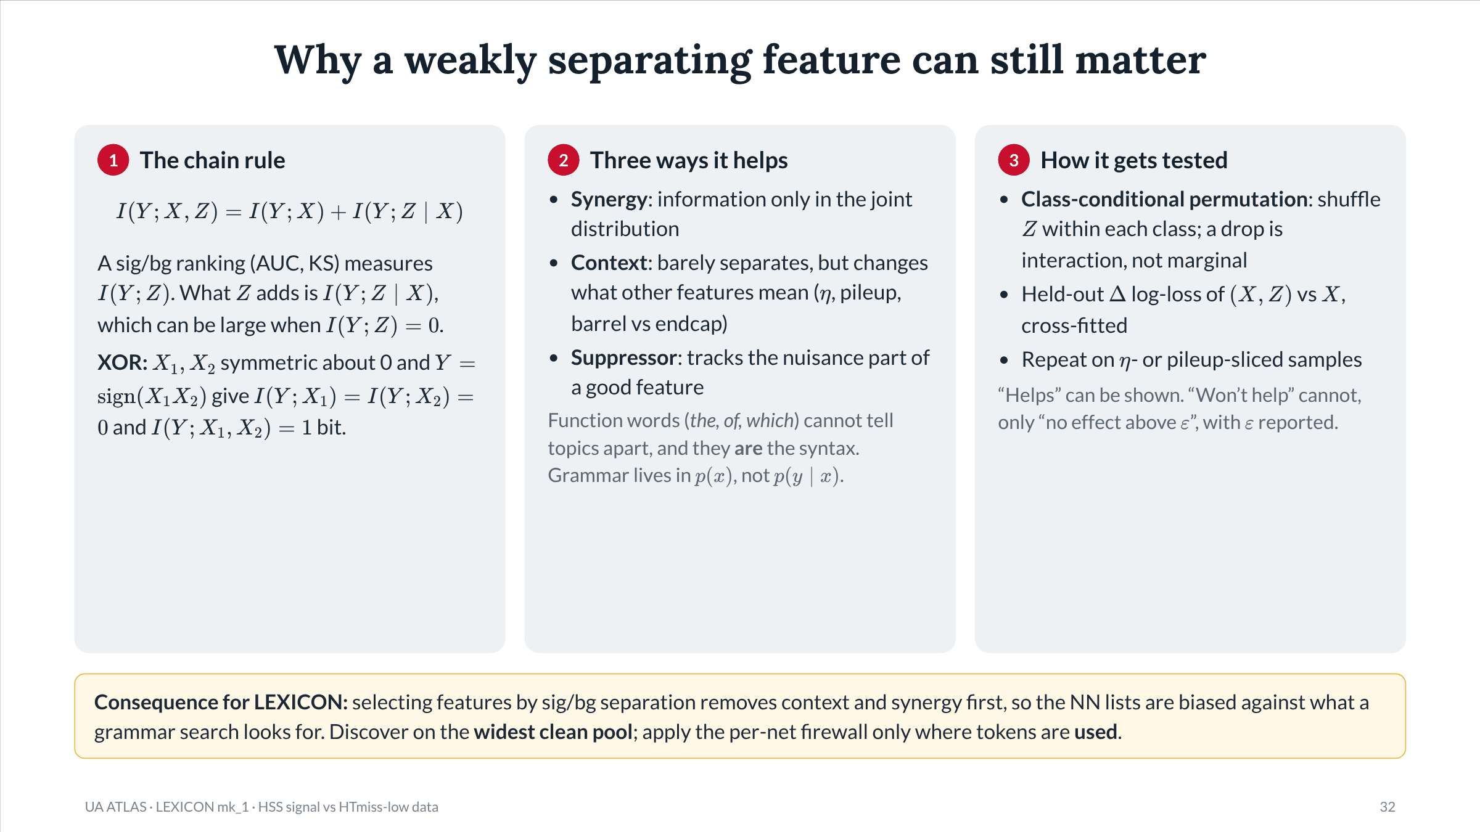
Notes:
Slide 32 of 49. From feature_selection_beyond_separation.md (5 Nov). Reference: Guyon and Elisseeff, JMLR 3 (2003) 1157, for the useless-alone, useful-together examples. Risks of adding low-separation features: detector grammar instead of physics grammar (needs invariance checks), MC-only joint mismodeling (classifier two-sample test in a control region), ABCD closure (keep the LEXICON feature set and the NN input set as separate decisions), capacity dilution.

Slide 33
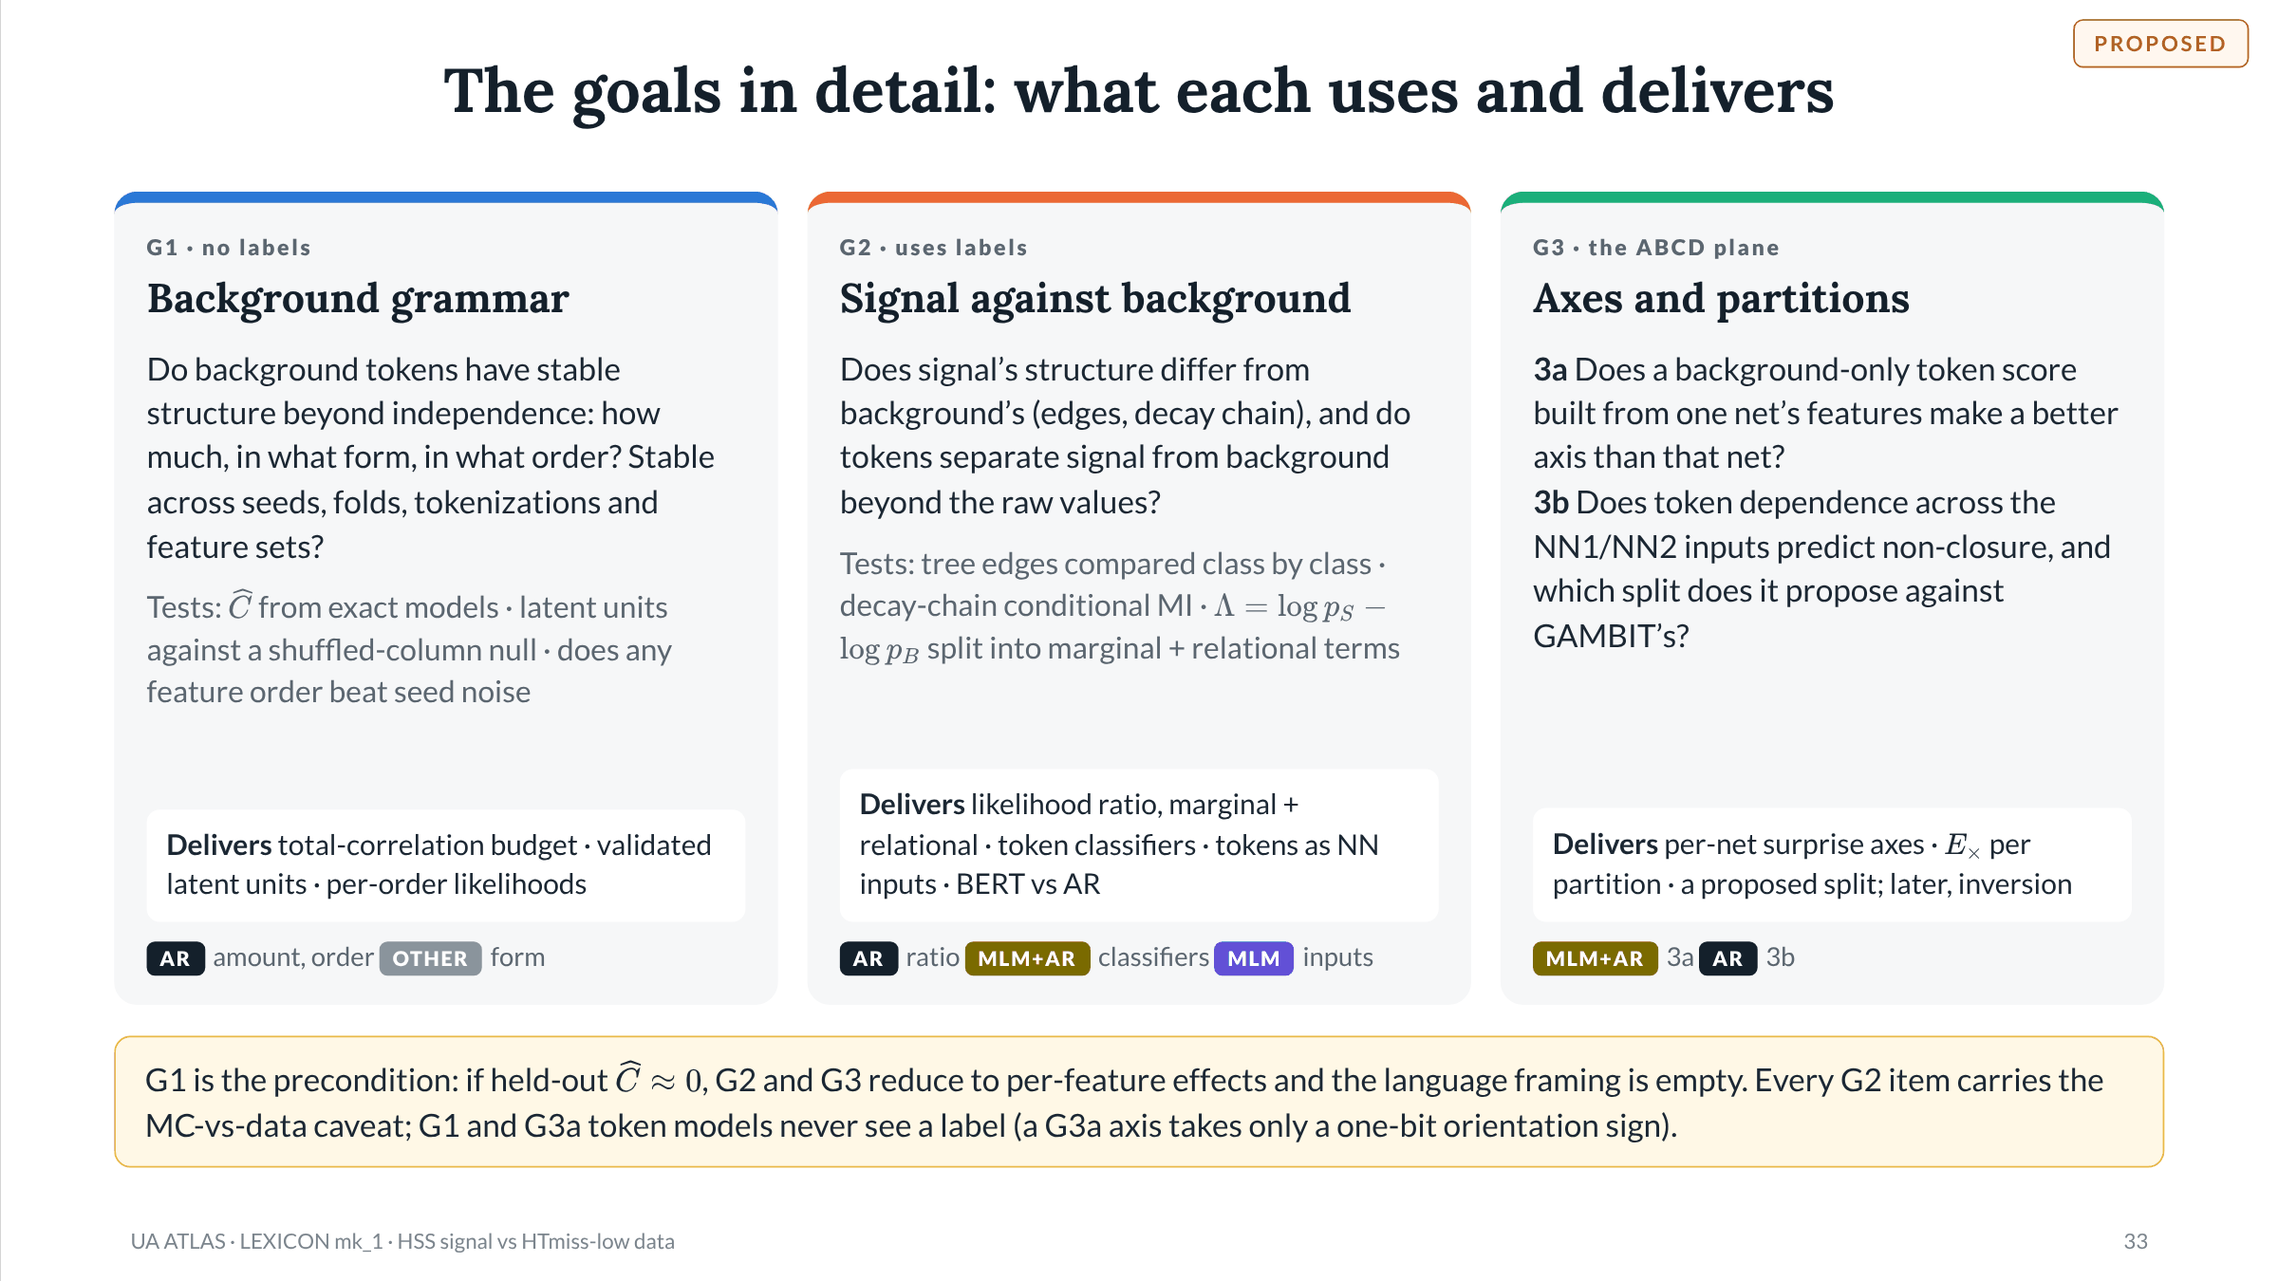
Notes:
Slide 33 of 49. Proposed spine for this deck, built from goal set mk2 (4 Nov). One change from mk2 as written: mk2 put signal-structure items 1c (decay-chain test) and 1e (Route A2) under Goal 1; here they sit in G2, so G1 is entirely label-free and every labeled item, with its sim-vs-data and HTmiss caveats, is in one goal. G3b holds Addendum 4's verdict 4 and Steve's 4 Nov goal 1 (identify what GAMBIT does). Steve's 4 Nov goal 2 (next-token prediction of sig/bg) is G2: generative reading = likelihood ratio, discriminative reading = label as the final token.

Slide 34
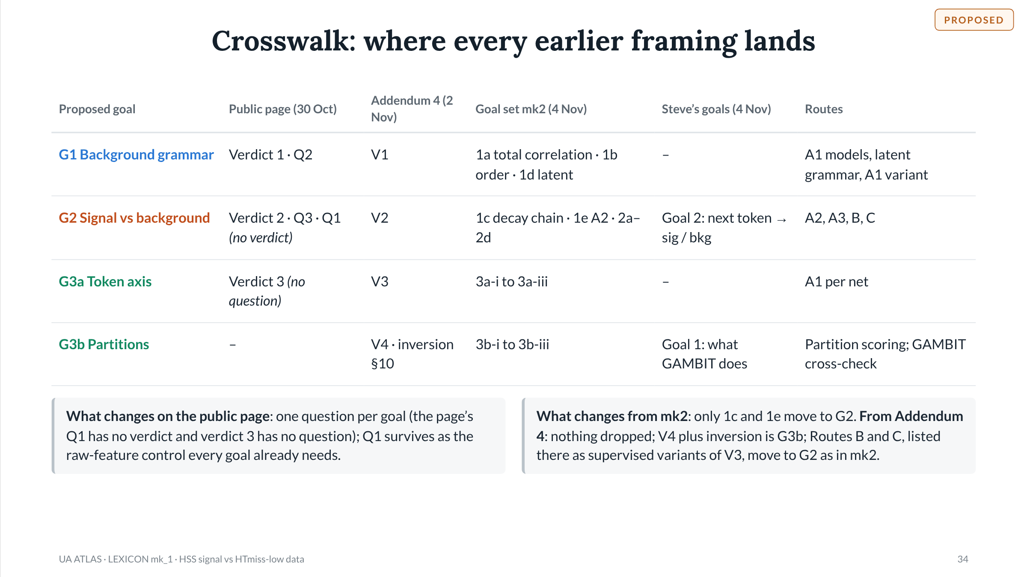
Notes:
Slide 34 of 49. Crosswalk. Q1 on the public page: does co-occurrence carry sig-vs-bg information beyond the raw values. Addendum 4 already noted Q1 has no verdict and V3 has no question. Decision asked of the group: adopt this spine (G1 / G2 / G3a / G3b) for the public page and the progress document, or keep mk2's grouping.

Slide 35
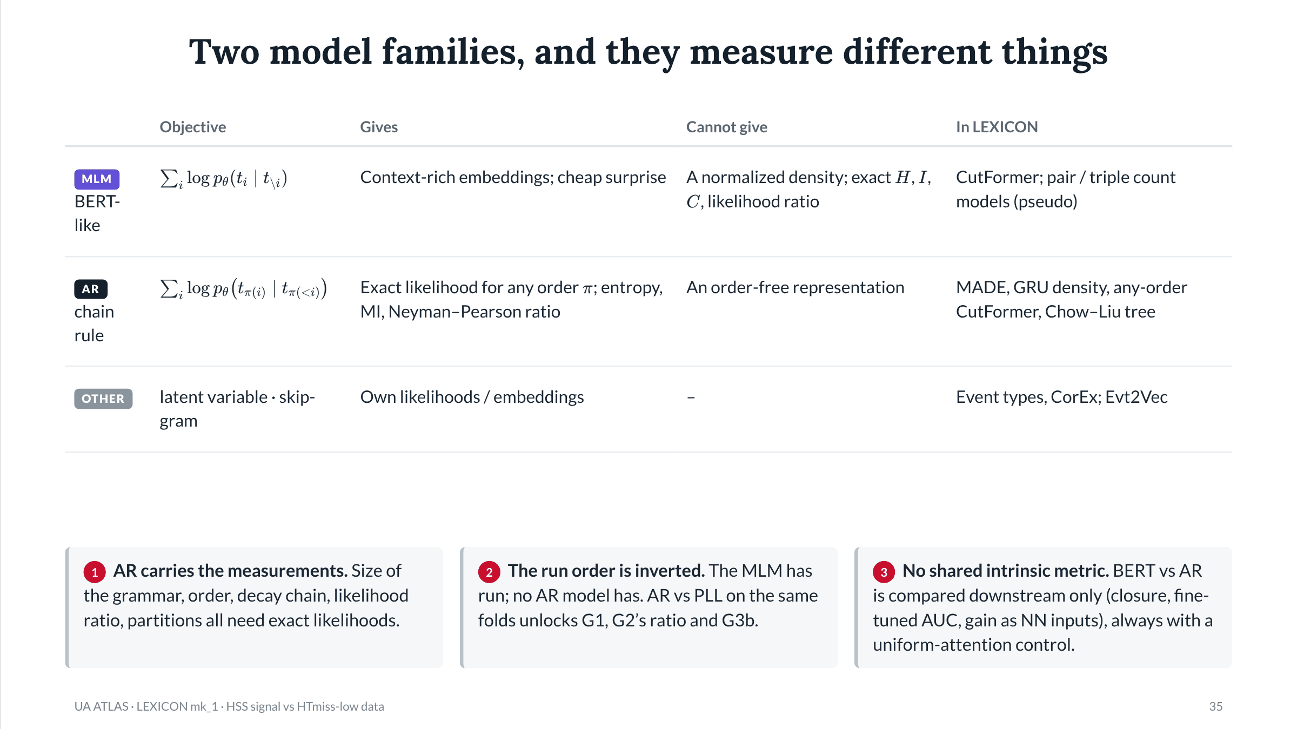
Notes:
Slide 35 of 49. From goal set mk2 §2 and §5; the masking point is mk2 §6. Masking is not augmentation: every (masked input, target) pair is a deterministic function of the same N events, so N_eff is unchanged; masking only raises targets per event. New information enters only from new events (pretraining endcap tokens into the barrel, option P-b) or a real symmetry.

Slide 36
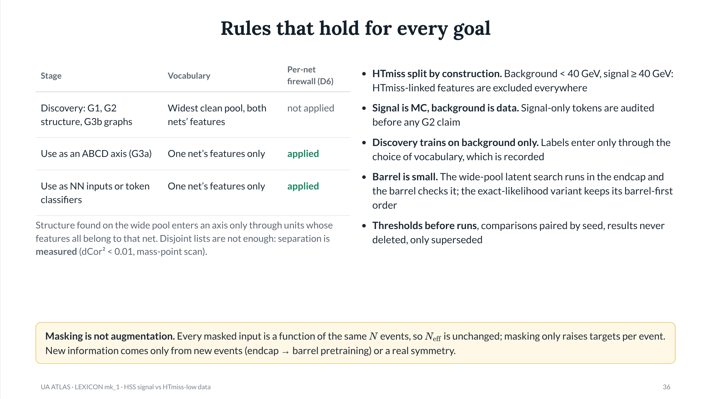
Notes:
Slide 36 of 49. Firewall rescoped in Addendum 4: discovery vs use. D6 (locked 19 Oct): an ABCD axis opposite net k is built only from the other net's features, every learned part fitted on that subset, with a measured separation check (G6). D7 (locked 19 Oct): a bit carried by both nets' inputs sits on one axis only. Preconditions P1-P6 from goal set mk2 §7.

Slide 37

Notes:
Slide 37 of 49. Section divider. All Part II results use base_mk1 Round_1, base seed 0, 5 folds. Only seed-0 base jobs share LEXICON's folds. Every number is quoted from LEXICON_progress.md R15.

Slide 38
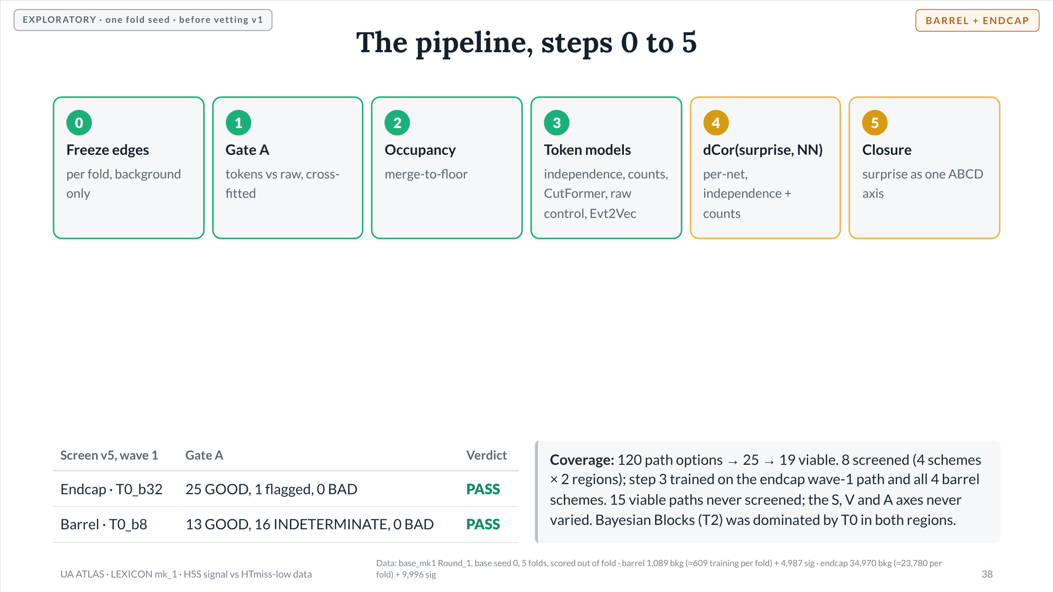
Notes:
Slide 38 of 49. Steps 0-3 done in both regions. Step 4-5: all-feature runs R8-R10 are the leaky baseline (D6); per-net runs R11-R14 with independence in both regions and count models (orders 2-3) in the endcap. CutFormer and GRU on per-net subsets not run. Routes B and C not built. Known merge cases: MS1Vtx_nTracklet (both regions), MSTracklet_barrel avg and rms dR. DATA: Data: base_mk1 Round_1, base seed 0, 5 folds, scored out of fold · barrel 1,089 bkg (≈609 training per fold) + 4,987 sig · endcap 34,970 bkg (≈23,780 per fold) + 9,996 sig

Slide 39
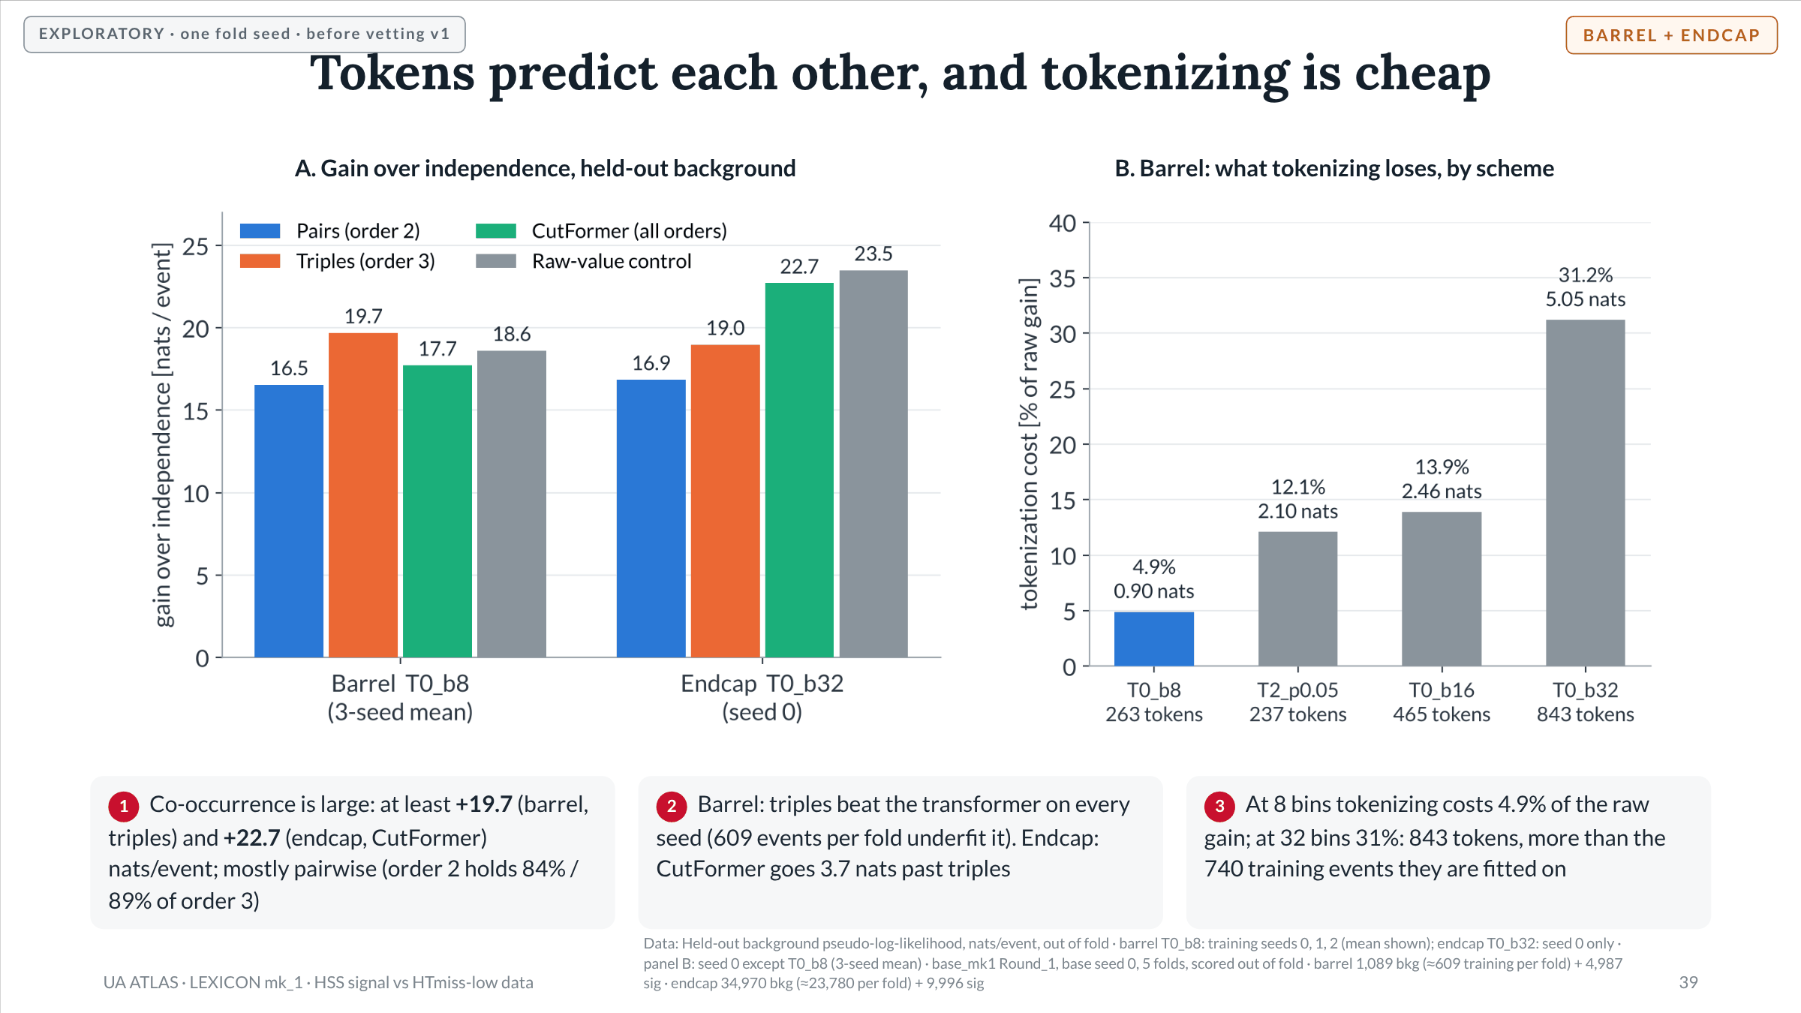
Notes:
Slide 39 of 49. Barrel T0_b8 seed means: independence 47.2 nats; co-occurrence gain +17.72 ± 0.28; raw gain +18.62 ± 0.45; tokenization cost +0.90 ± 0.24 (4.9% of raw gain). Order 2 gains 16.74 / 16.78 / 16.10 (mean 16.54); order 3 19.84 / 19.90 / 19.34 (mean 19.69). Endcap T0_b32 seed 0: independence 64.86, gain +22.71 [22.64, 22.78], raw gain +23.49, cost +0.78 (3.3%, upper bound: CutFormer stopped at the epoch cap), order 2 +16.85, order 3 +18.98. Training seed moves nats-per-event numbers by about twice the event-bootstrap half-width, so seed means are quoted. Barrel cost by scheme: T0_b16 2.46 nats (13.9%), T0_b32 5.05 (31.2%), T2 2.10 (12.1%). CutFormer and count-model numbers are pseudo-likelihoods (independence is exact); exact versions are a G1 item. Training events for barrel b32: the progress record quotes 740 in §3.3 and about 609 per fold in §3. DATA: Data: Held-out background pseudo-log-likelihood, nats/event, out of fold · barrel T0_b8: training seeds 0, 1, 2 (mean shown); endcap T0_b32: seed 0 only · panel B: seed 0 except T0_b8 (3-seed mean) · base_mk1 Round_1, base seed 0, 5 folds, scored out of fold · barrel 1,089 bkg (≈609 training per fold) + 4,987 sig · endcap 34,970 bkg (≈23,780 per fold) + 9,996 sig

Slide 40
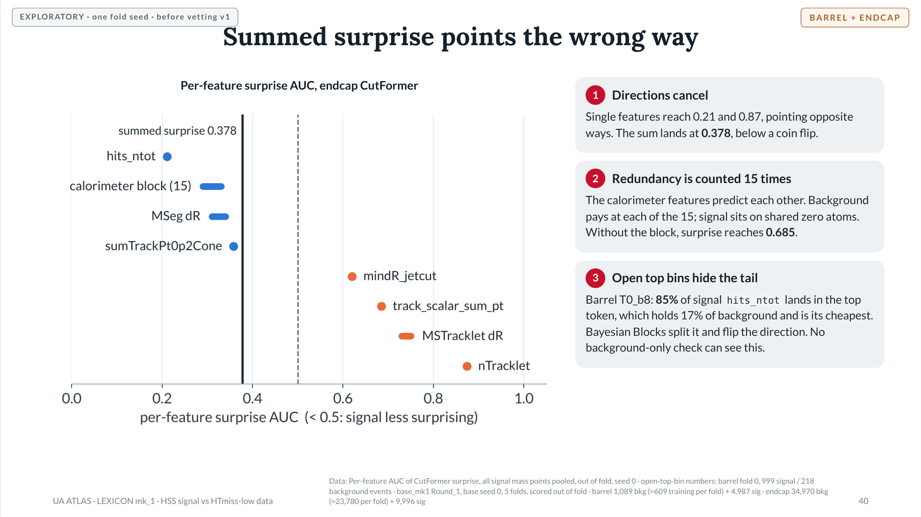
Notes:
Slide 40 of 49. Total surprise AUC 0.407 barrel, 0.378 endcap. Calorimeter block test: AUC of the rest of the event without the block 0.557 barrel, 0.685 endcap. Same inversion in count models (barrel T0 0.43-0.46, endcap 0.38), so it is not a transformer artifact. Known failure mode of likelihood-based anomaly scores (Nalisnick et al. ICLR 2019; Finke et al. JHEP 2021). hits_ntot is also first on the data/MC audit list: signal is MC and background is data. Proposed tail rule D5 (split the top/bottom quantile bin at background 95% and 99%) is awaiting a decision and must be disclosed as proposed after seeing signal. DATA: Data: Per-feature AUC of CutFormer surprise, all signal mass points pooled, out of fold, seed 0 · open-top-bin numbers: barrel fold 0, 999 signal / 218 background events · base_mk1 Round_1, base seed 0, 5 folds, scored out of fold · barrel 1,089 bkg (≈609 training per fold) + 4,987 sig · endcap 34,970 bkg (≈23,780 per fold) + 9,996 sig

Slide 41
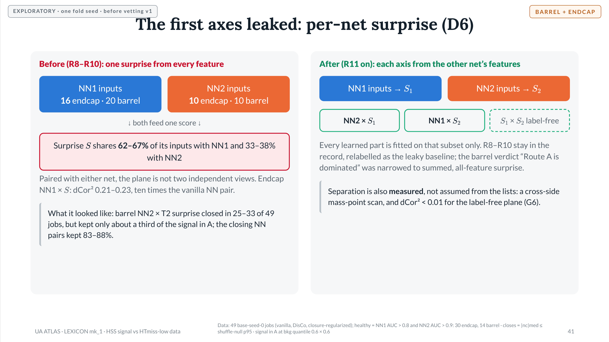
Notes:
Slide 41 of 49. R10 (17 Oct): endcap against all 49 jobs, nothing closes against the tight null (p95 about 0.03); NN2 x T0 CutFormer as close as the NN pair (r 2.83 vs 2.90), signal in A 0.71 vs 0.95. The leak runs both ways, which became D6. Registry mk4 feature counts: barrel 20/10, endcap 16/10. D6 locked 19 Oct with the measured-separation addendum (G6). DATA: Data: 49 base-seed-0 jobs (vanilla, DisCo, closure-regularized); healthy = NN1 AUC > 0.8 and NN2 AUC > 0.9: 30 endcap, 14 barrel · closes = |nc|med ≤ shuffle-null p95 · signal in A at bkg quantile 0.6 × 0.6

Slide 42
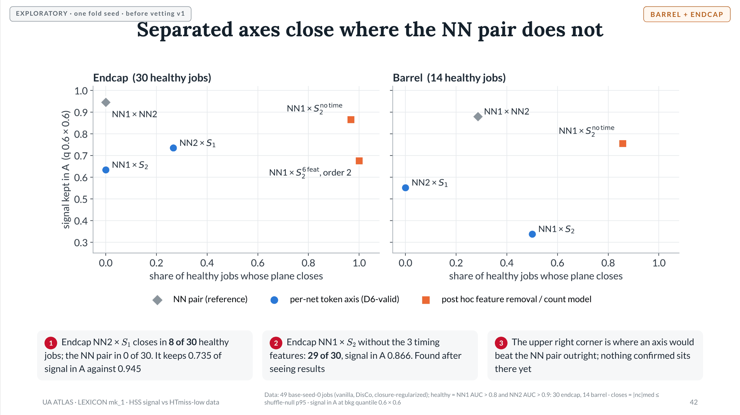
Notes:
Slide 42 of 49. R11-R13. Endcap: NN1 x NN2 0/30, r median 2.90, signal 0.945; NN2 x S1 8/30, r 2.04 (best 0.50), signal 0.735; NN1 x S2 0/30, r 14.09, signal 0.634 (S2 coupled to NN1, dCor2 0.13, explained next slide). NN1 x S2 no-time 29/30, r 0.72, signal 0.866; also without hits_ntot (6 features): 29/30, 0.876. Order-2 count model on the 6-feature S2 (no timing, no hits_ntot): 30/30 (49 of 49 jobs), signal 0.676. Barrel: NN1 x NN2 4/14, signal 0.88; NN1 x S2 7/14, 0.338; NN2 x S1 0/14, 0.552; NN1 x S2 no-time 12/14, r 0.78, 0.756. Open control: NN1 x raw nTracklet. nTracklet alone gives 23/30 with signal 0.847, so the best plane may be a raw-variable ABCD; that is registered prediction P2. DATA: Data: 49 base-seed-0 jobs (vanilla, DisCo, closure-regularized); healthy = NN1 AUC > 0.8 and NN2 AUC > 0.9: 30 endcap, 14 barrel · closes = |nc|med ≤ shuffle-null p95 · signal in A at bkg quantile 0.6 × 0.6

Slide 43
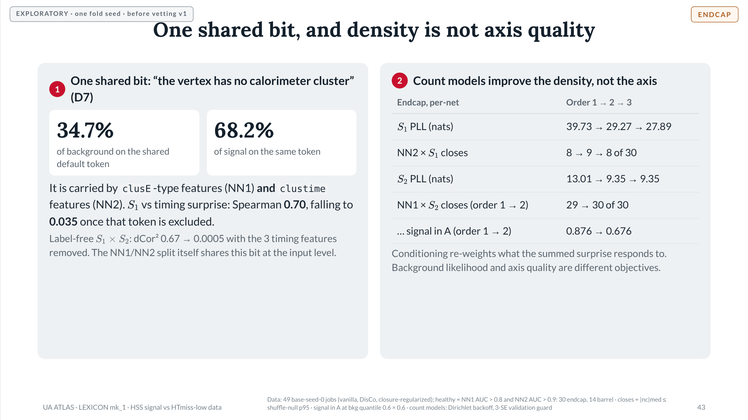
Notes:
Slide 43 of 49. R12 (label-free plane, timing bridge) and R14 (lexicon_masspoint_mk1): within a fold every event with the same token gets the same independence surprise, so a feature's most common surprise value is its most common token. Shared default token covers clusE, avg_clusE, rms_clusE, maxclusE (NN1) and avg/rms/maxclustime (NN2). dCor2(S1, one timing feature) 0.91. The order-2 best partner of each timing feature is another timing feature, which hid the shared bit. Other within-side mass points: nTracklet (55% bkg / 8% sig), MSTracklet dR (89% / 46%). R13: S2 here is the 6-feature version (no timing, no hits_ntot); its AUC falls 0.884 -> 0.717 with order 2. DATA: Data: 49 base-seed-0 jobs (vanilla, DisCo, closure-regularized); healthy = NN1 AUC > 0.8 and NN2 AUC > 0.9: 30 endcap, 14 barrel · closes = |nc|med ≤ shuffle-null p95 · signal in A at bkg quantile 0.6 × 0.6 · count models: Dirichlet backoff, 3-SE validation guard

Slide 44
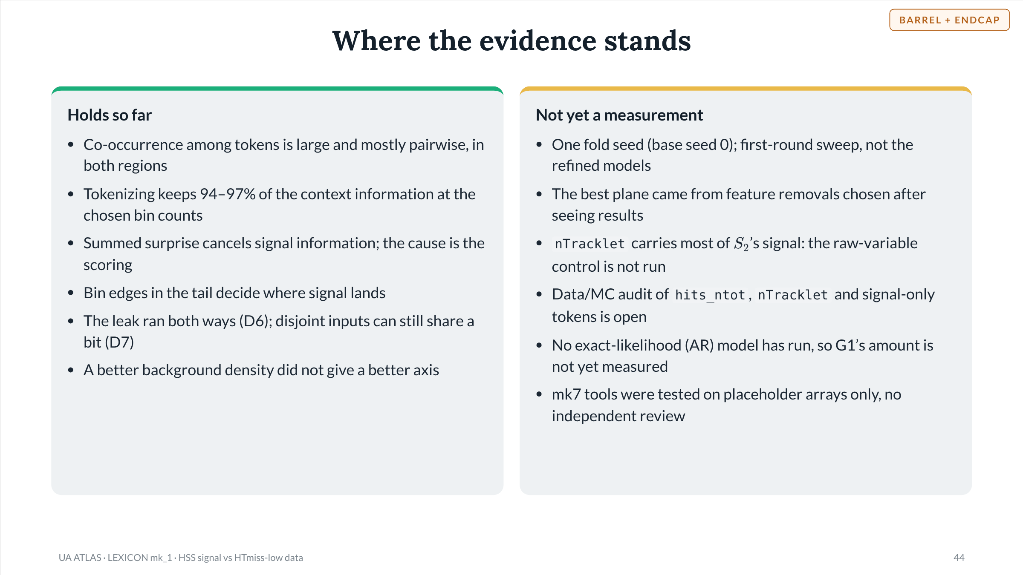
Notes:
Slide 44 of 49. Findings 1-22 of LEXICON_progress.md condensed. The 15 Oct review narrowed 'Route A answered the question and the answer was no' to summed surprise in the barrel. R11 marked the pre-registration-free expectation that per-net surprise would not change the verdict as unsupported.

Slide 45

Notes:
Slide 45 of 49. Section divider.

Slide 46
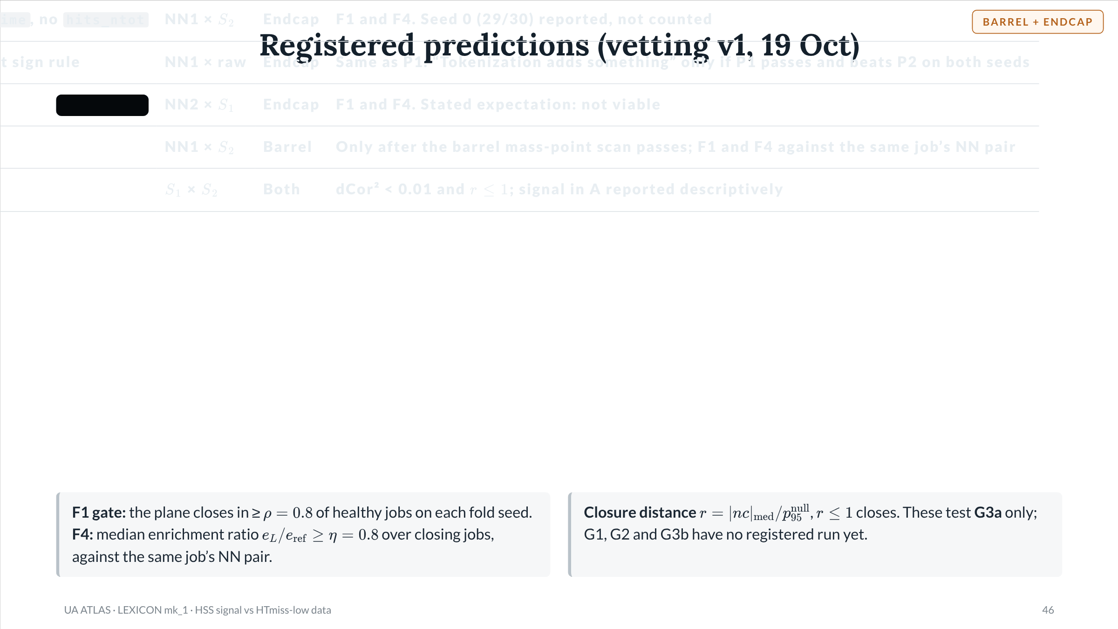
Notes:
Slide 46 of 49. LEXICON_vetting.md v1 frozen (tag vetting/v1); P1-P5 registered in commit 52c4a8d. Thresholds: rho = eta = 0.8, tau_sep = 0.01, tau_phi = 0.5, three fold seeds with the G7 rule. V4 (data/MC audit of hits_ntot, nTracklet, signal-only tail tokens) is required before P1's signal-side numbers count.

Slide 47
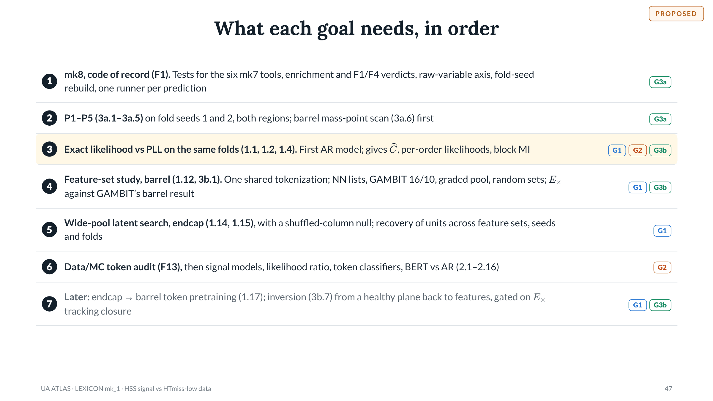
Notes:
Slide 47 of 49. Steps 1-2 from the mk8 plan (19 Oct). Step 3 is goal set mk2 decision D2 (promote 3a-iii). Steps 4-5 are Addendum 4 §8 (order of work). Step 6 needs preconditions P1/P2 (HTmiss split, MC vs data). Step 7: pretraining option P-b (about 24,850 endcap background events into the barrel, with a [REGION] token and the STAVE role table); inversion L1 -> L2 -> L3 (Addendum 4 §10), where L3's objective is essentially double-DisCo and the new part is the readout.

Slide 48
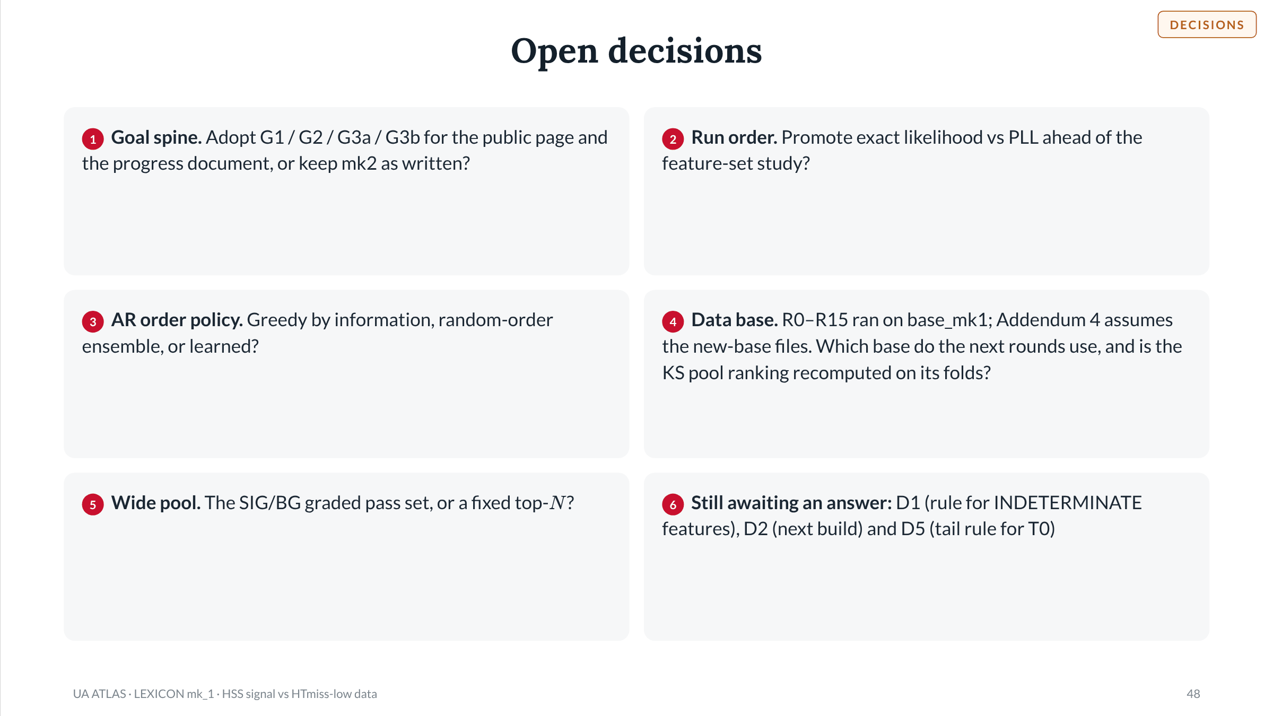
Notes:
Slide 48 of 49. Decision 1 is the one this deck exists for. Decision 4 is a consistency gap found while assembling the deck: the progress record and every Part II number use base_mk1 Round_1; Addendum 4 §3 says LEXICON trains on the new-base files and asks for the KS ranking to be recomputed on new-base training folds. Barrel background per fold differs (about 609 on base_mk1, the figure Addendum 4 also uses; about 456 quoted in goal set mk2 P4), and the endcap count behind pretraining option P-b (about 24,850) differs from base_mk1's 34,970.

Slide 49
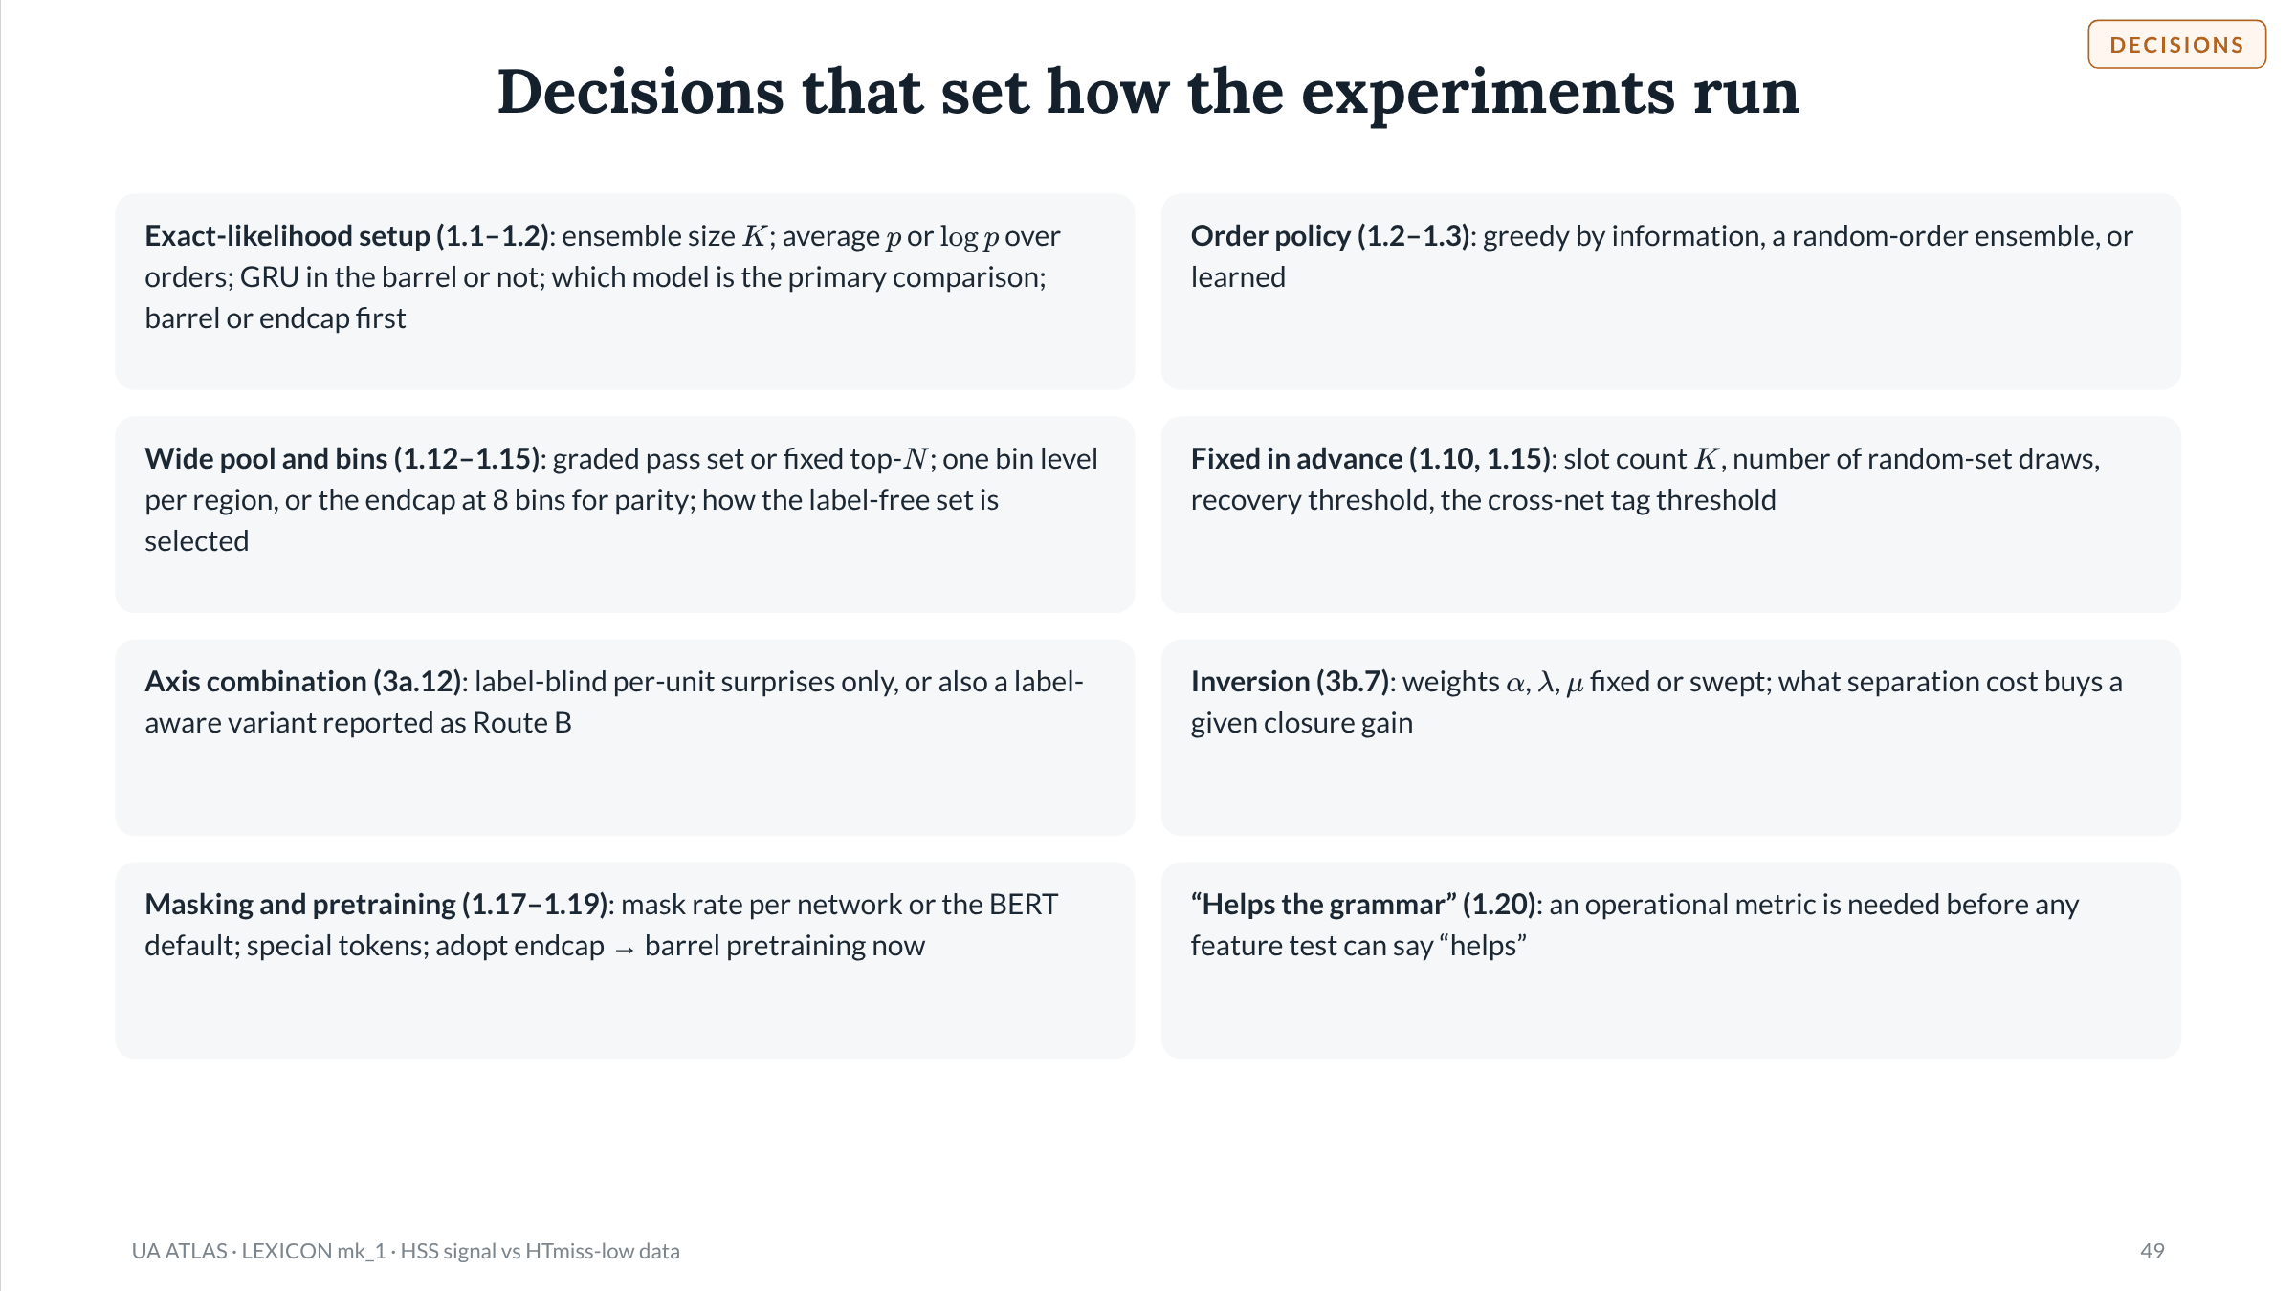
Notes:
Slide 49 of 49. Run-configuration decisions collected from: exact-likelihood plan §8 (renamed X1–X5 in vetting §E), goal set mk2 D4 and D7–D9, Addendum 4 §11 D1–D8, feature-selection notes §11. Each must be fixed before the experiments it names are run, so the results cannot steer it.

