Slide 1


Slide 2
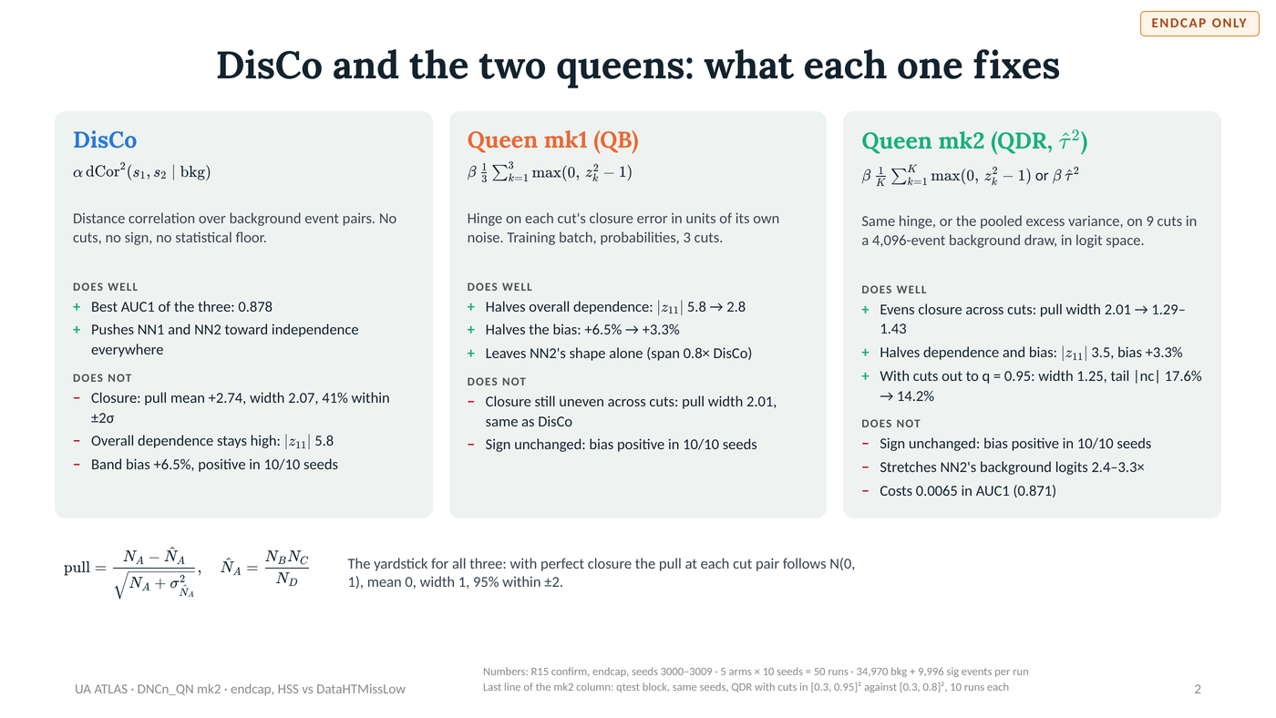

Slide 3
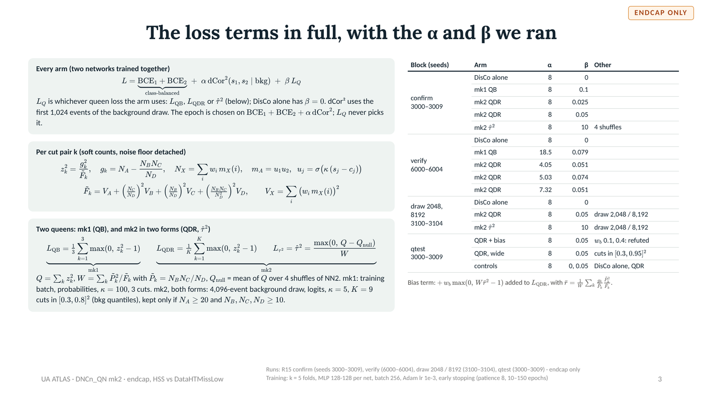

Slide 4
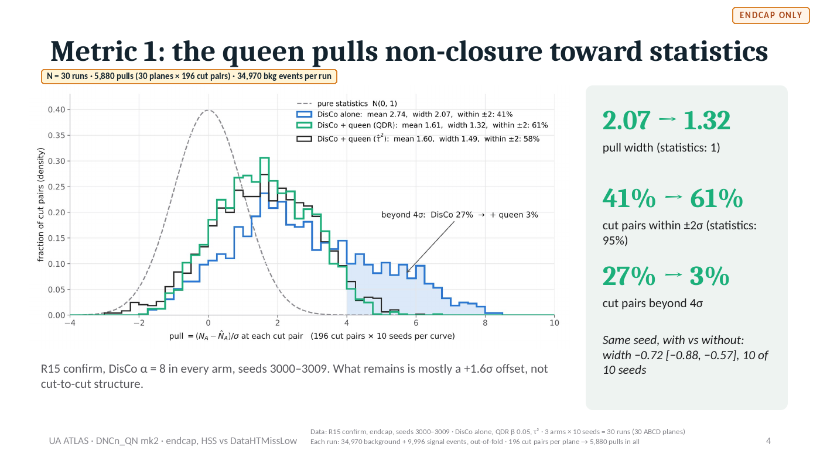
Notes:
Slide 4 of 20. Image of the 30 Oct deck; the editable source is QN2_disco_vs_queen.pptx on the other machine. DATA: Data: R15 confirm, endcap, seeds 3000–3009 · DisCo alone, QDR β 0.05, τ² · 3 arms × 10 seeds = 30 runs (30 ABCD planes) Each run: 34,970 background + 9,996 signal events, out-of-fold · 196 cut pairs per plane → 5,880 pulls in all

Slide 5
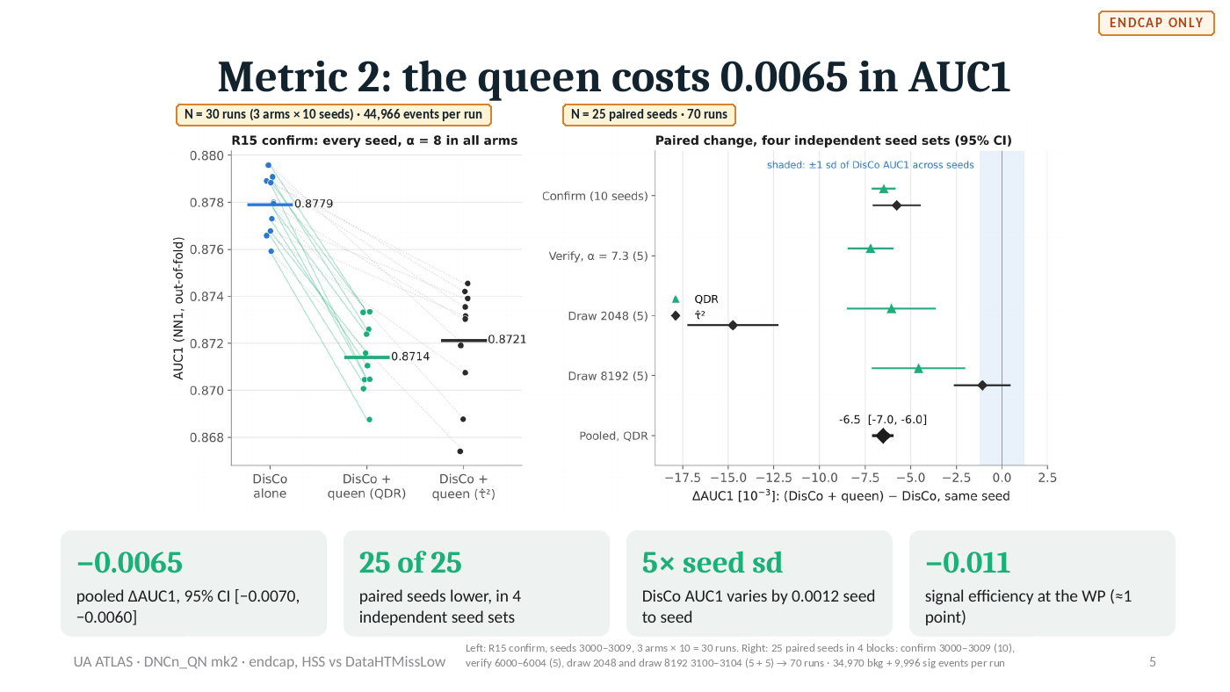
Notes:
Slide 5 of 20. Image of the 30 Oct deck; the editable source is QN2_disco_vs_queen.pptx on the other machine. DATA: Left: R15 confirm, seeds 3000–3009, 3 arms × 10 = 30 runs. Right: 25 paired seeds in 4 blocks: confirm 3000–3009 (10), verify 6000–6004 (5), draw 2048 and draw 8192 3100–3104 (5 + 5) → 70 runs · 34,970 bkg + 9,996 sig events per run

Slide 6
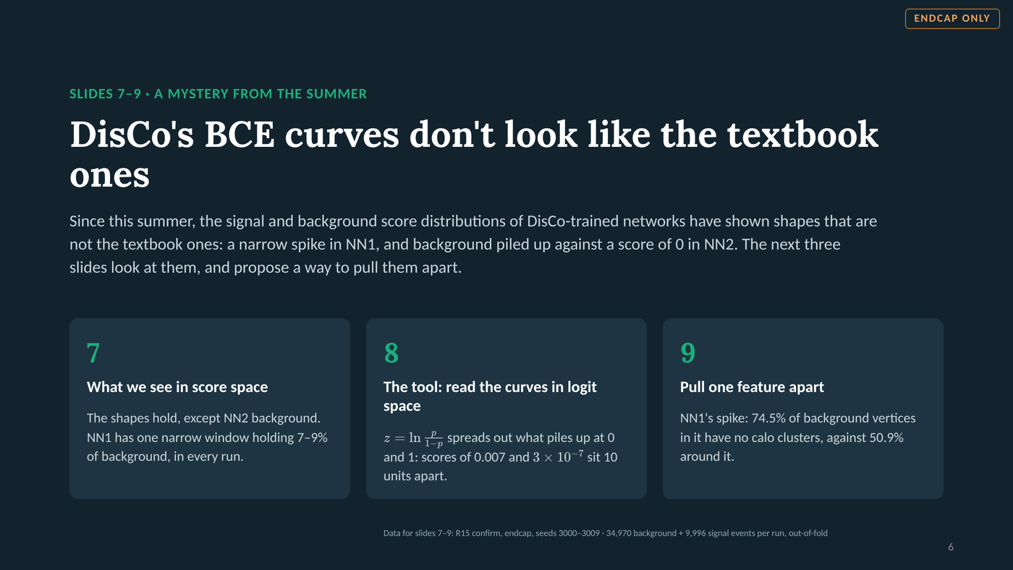
Notes:
Slide 6 of 20. Section divider (inserted 3 Nov 2026): slides 6-8 look at the non-textbook BCE curves (signal/background score distributions) seen with DisCo since the summer -- score space, logit space as the proposed tool, and NN1's spike traced to vertices with no calo clusters.

Slide 7
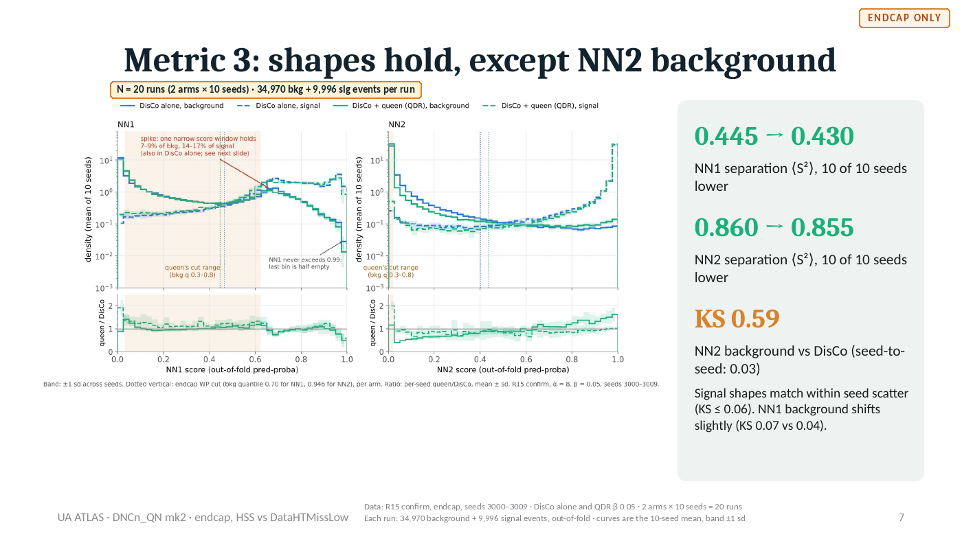
Notes:
Slide 7 of 20. Image of the 30 Oct deck; the editable source is QN2_disco_vs_queen.pptx on the other machine. DATA: Data: R15 confirm, endcap, seeds 3000–3009 · DisCo alone and QDR β 0.05 · 2 arms × 10 seeds = 20 runs Each run: 34,970 background + 9,996 signal events, out-of-fold · curves are the 10-seed mean, band ±1 sd

Slide 8
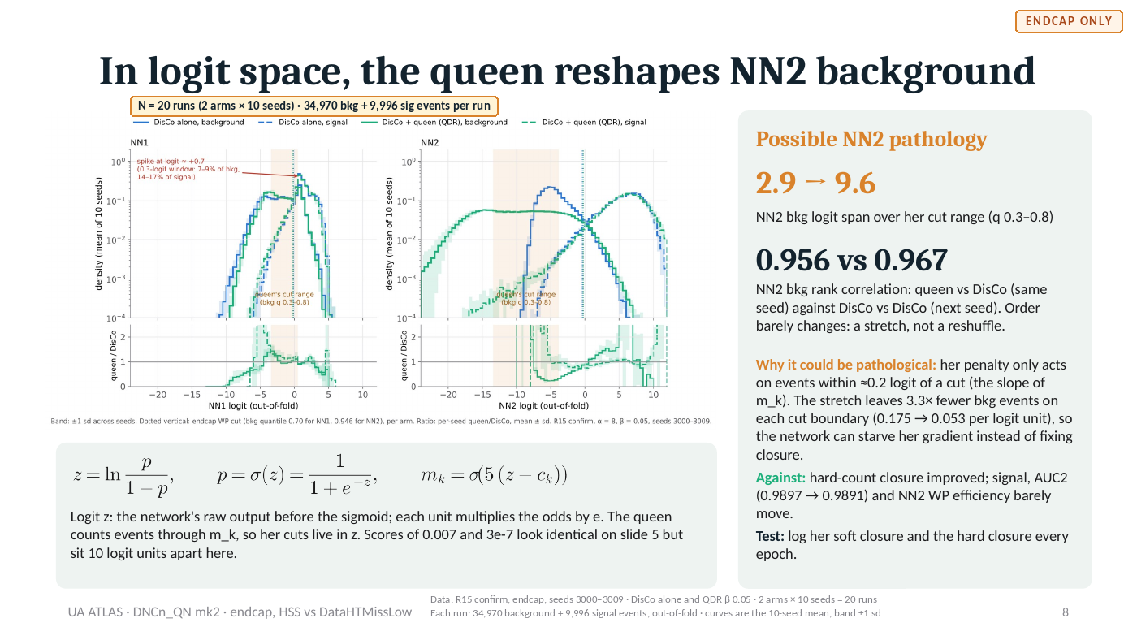
Notes:
Slide 8 of 20. Image of the 30 Oct deck; the editable source is QN2_disco_vs_queen.pptx on the other machine. DATA: Data: R15 confirm, endcap, seeds 3000–3009 · DisCo alone and QDR β 0.05 · 2 arms × 10 seeds = 20 runs Each run: 34,970 background + 9,996 signal events, out-of-fold · curves are the 10-seed mean, band ±1 sd

Slide 9
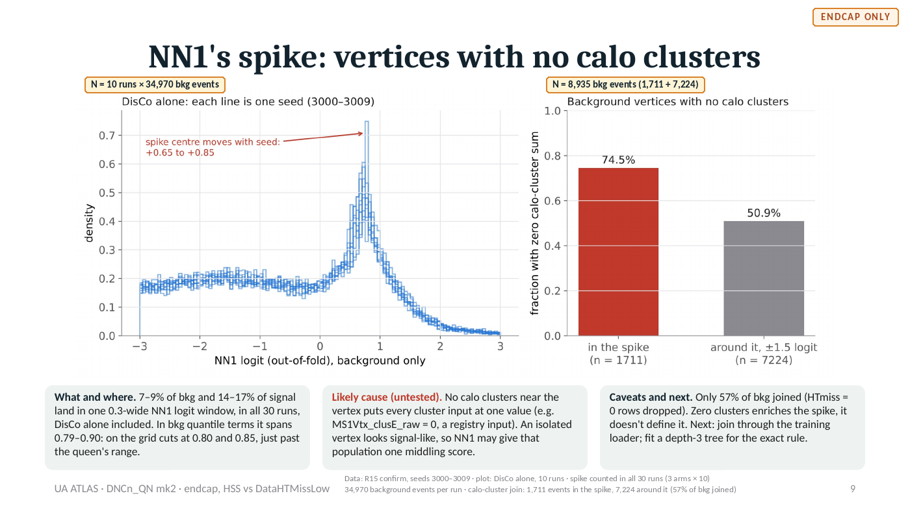
Notes:
Slide 9 of 20. Image of the 30 Oct deck; the editable source is QN2_disco_vs_queen.pptx on the other machine. DATA: Data: R15 confirm, seeds 3000–3009 · plot: DisCo alone, 10 runs · spike counted in all 30 runs (3 arms × 10) 34,970 background events per run · calo-cluster join: 1,711 events in the spike, 7,224 around it (57% of bkg joined)

Slide 10
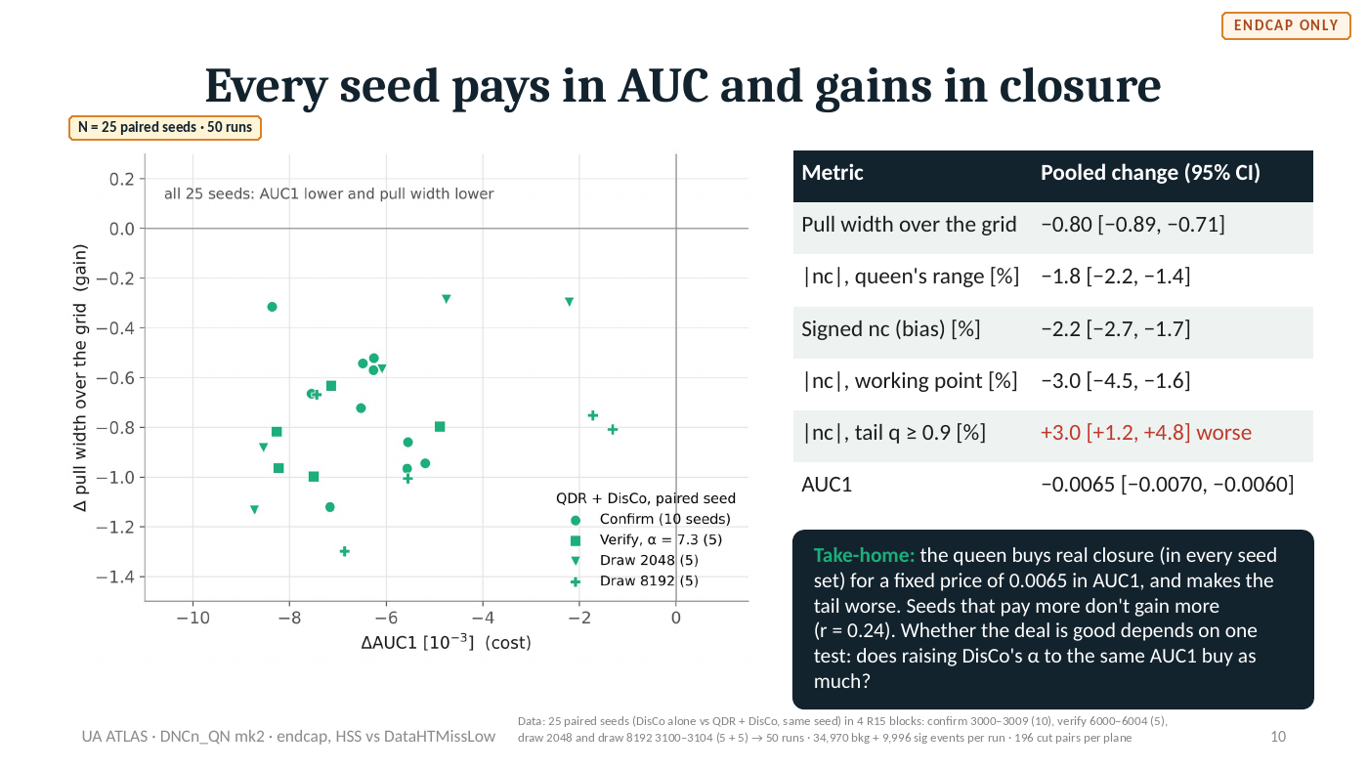
Notes:
Slide 10 of 20. Image of the 30 Oct deck; the editable source is QN2_disco_vs_queen.pptx on the other machine. DATA: Data: 25 paired seeds (DisCo alone vs QDR + DisCo, same seed) in 4 R15 blocks: confirm 3000–3009 (10), verify 6000–6004 (5), draw 2048 and draw 8192 3100–3104 (5 + 5) → 50 runs · 34,970 bkg + 9,996 sig events per run · 196 cut pairs per plane

Slide 11
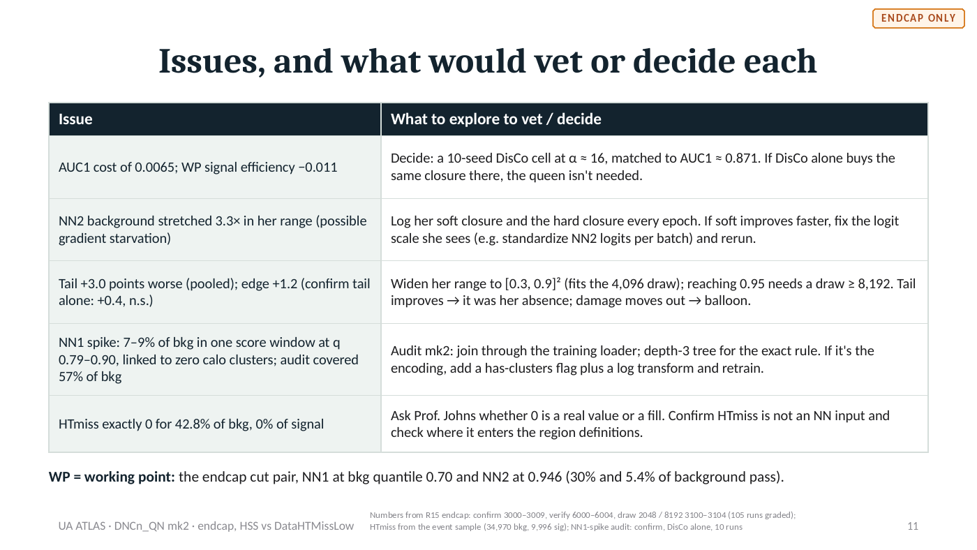
Notes:
Slide 11 of 20. Image of the 30 Oct deck; the editable source is QN2_disco_vs_queen.pptx on the other machine. DATA: Numbers from R15 endcap: confirm 3000–3009, verify 6000–6004, draw 2048 / 8192 3100–3104 (105 runs graded); HTmiss from the event sample (34,970 bkg, 9,996 sig); NN1-spike audit: confirm, DisCo alone, 10 runs

Slide 12
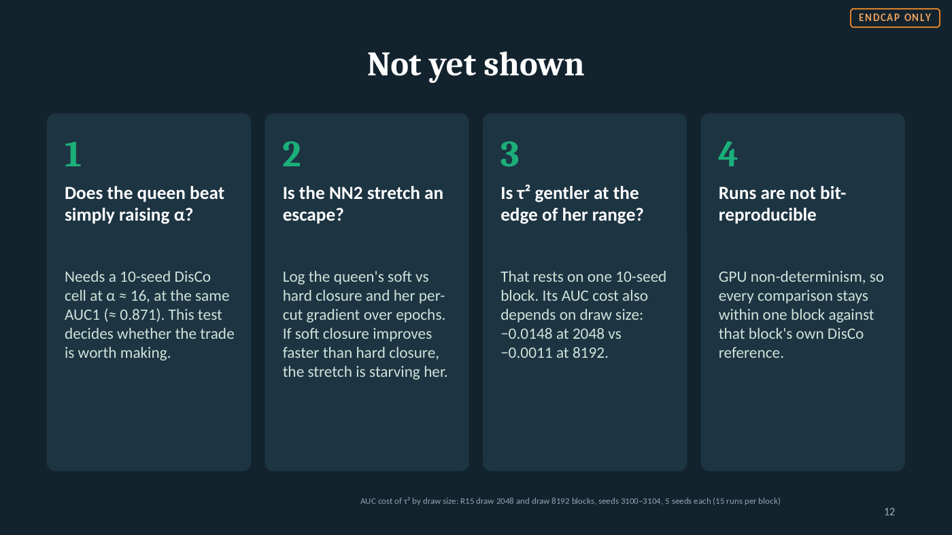
Notes:
Slide 12 of 20. Image of the 30 Oct deck; the editable source is QN2_disco_vs_queen.pptx on the other machine. DATA: AUC cost of τ² by draw size: R15 draw 2048 and draw 8192 blocks, seeds 3100–3104, 5 seeds each (15 runs per block)

Slide 13
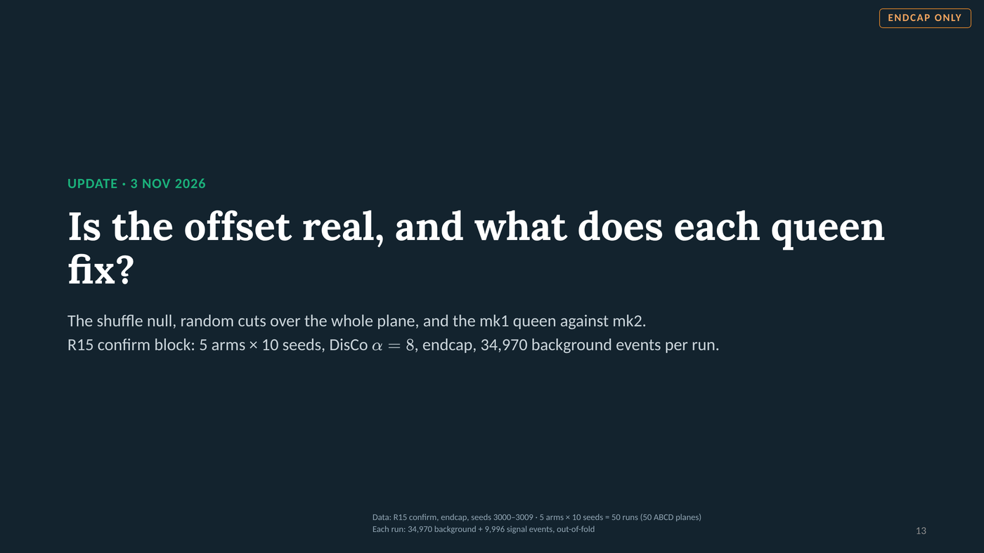
Notes:
Slide 13 of 20. Update, 3 Nov 2026. Section divider. Everything after this slide is new; slides 1-10 are the 30 Oct deck unchanged. DATA: Data: R15 confirm, endcap, seeds 3000–3009 · 5 arms × 10 seeds = 50 runs (50 ABCD planes) Each run: 34,970 background + 9,996 signal events, out-of-fold

Slide 14
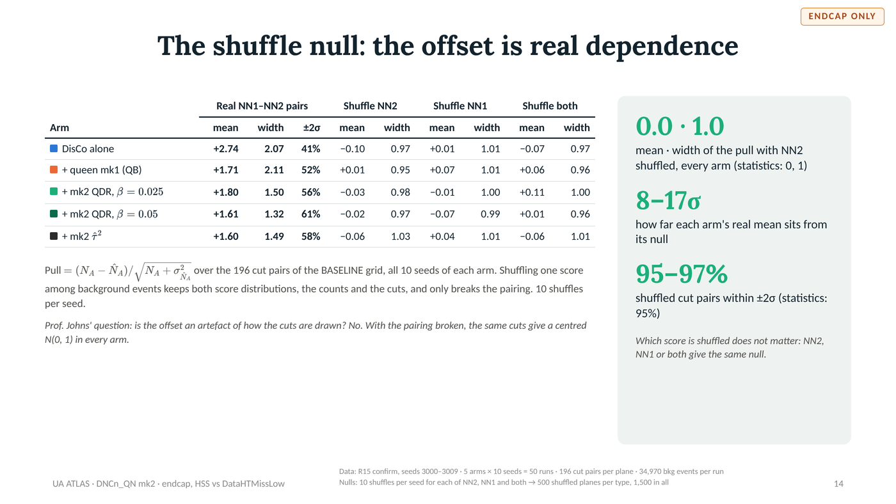
Notes:
Slide 14 of 20. Shuffle null. Real pairs vs one score shuffled among background events (10 shuffles per seed), BASELINE grid, 196 cut pairs, R15 confirm, 10 seeds per arm.
Real mean / width / within 2 sigma: DisCo +2.74 / 2.07 / 41%; QB +1.71 / 2.11 / 52%; QDR b0.025 +1.80 / 1.50 / 56%; QDR b0.05 +1.61 / 1.32 / 61%; tau2 +1.60 / 1.49 / 58%.
Shuffle NN2 mean / width: -0.10/0.97, +0.01/0.95, -0.03/0.98, -0.02/0.97, -0.06/1.03. Shuffle NN1: +0.01/1.01, +0.07/1.01, -0.01/1.00, -0.07/0.99, +0.04/1.01. Shuffle both: -0.07/0.97, +0.06/0.96, +0.11/1.00, +0.01/0.96, -0.06/1.01. Distance of the arm mean from its null: 17, 10, 10, 9, 8 sigma. DATA: Data: R15 confirm, seeds 3000–3009 · 5 arms × 10 seeds = 50 runs · 196 cut pairs per plane · 34,970 bkg events per run Nulls: 10 shuffles per seed for each of NN2, NN1 and both → 500 shuffled planes per type, 1,500 in all

Slide 15
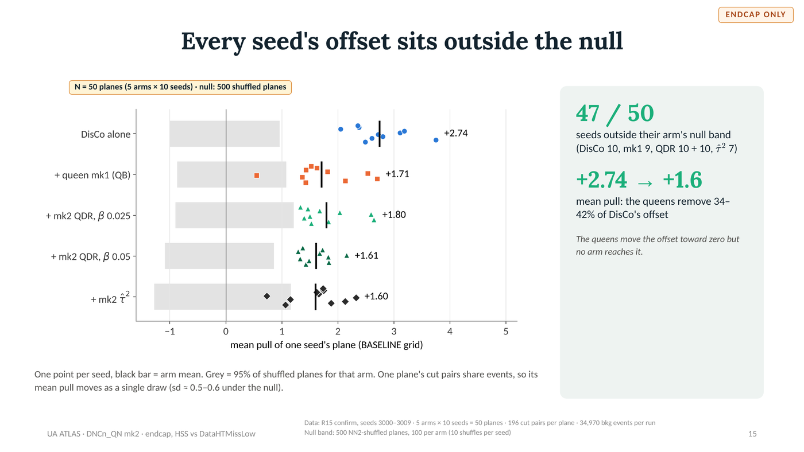
Notes:
Slide 15 of 20. Seed means against each arm's 95% band of shuffled-plane means. Outside: DisCo 10/10, QB 9/10, QDR b0.025 10/10, QDR b0.05 10/10, tau2 7/10 (47/50). Arm means +2.74, +1.71, +1.80, +1.61, +1.60. DATA: Data: R15 confirm, seeds 3000–3009 · 5 arms × 10 seeds = 50 planes · 196 cut pairs per plane · 34,970 bkg events per run Null band: 500 NN2-shuffled planes, 100 per arm (10 shuffles per seed)

Slide 16
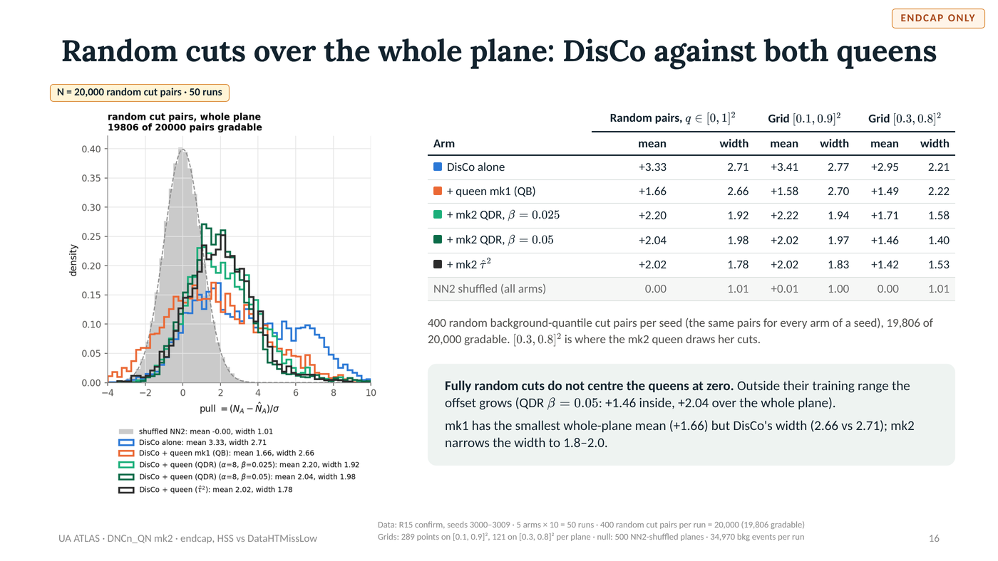
Notes:
Slide 16 of 20. Pull by cut range (mean / width). Random pairs over [0,1]^2 (400 per seed, 19,806 of 20,000 gradable): DisCo 3.33/2.71, QB 1.66/2.66, QDR b0.025 2.20/1.92, QDR b0.05 2.04/1.98, tau2 2.02/1.78, null 0.00/1.01. Grid [0.1,0.9]^2: 3.41/2.77, 1.58/2.70, 2.22/1.94, 2.02/1.97, 2.02/1.83, null 0.01/1.00. Grid [0.3,0.8]^2: 2.95/2.21, 1.49/2.22, 1.71/1.58, 1.46/1.40, 1.42/1.53, null 0.00/1.01. DATA: Data: R15 confirm, seeds 3000–3009 · 5 arms × 10 = 50 runs · 400 random cut pairs per run = 20,000 (19,806 gradable) Grids: 289 points on [0.1, 0.9]², 121 on [0.3, 0.8]² per plane · null: 500 NN2-shuffled planes · 34,970 bkg events per run

Slide 17
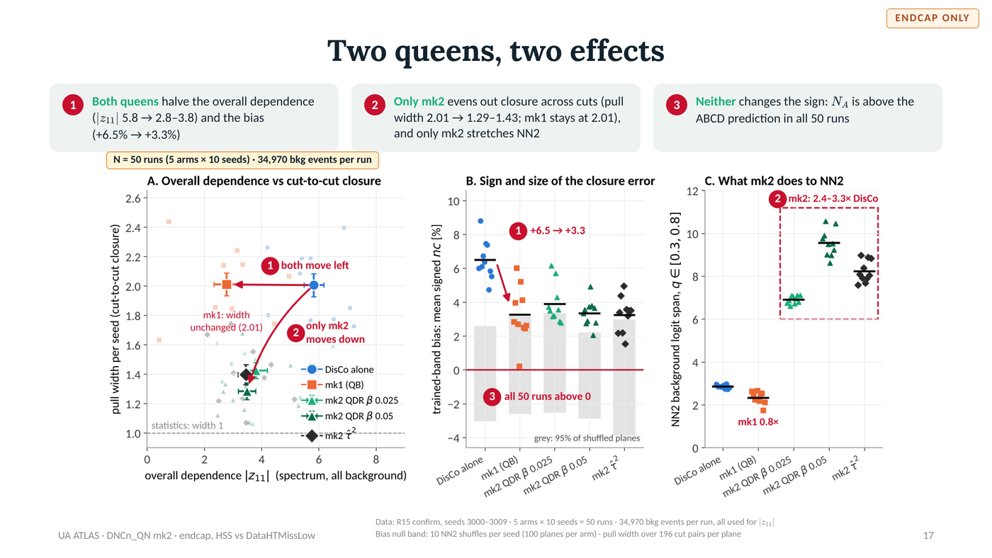
Notes:
Slide 17 of 20. Two queens, two effects. Claims 1-3 at the top; the same numbers in the figure mark where each is shown. Claim 1 (both queens halve |z11| and the bias): panel A, both arrows point left from DisCo; panel B, DisCo +6.5 -> mk1 +3.3. Claim 2 (only mk2 evens closure across cuts and stretches NN2): panel A, only the mk2 arms sit lower (per-seed width 2.01 -> 1.29-1.43, mk1 stays 2.01); panel C, mk2 NN2 span 2.4-3.3x DisCo, mk1 0.8x. Claim 3 (sign unchanged): panel B, every one of the 50 runs is above the zero line. Welch t, mk1 vs mk2 QDR b0.05: |z11| -1.3, width +7.6, bias -0.1. DATA: Data: R15 confirm, seeds 3000–3009 · 5 arms × 10 seeds = 50 runs · 34,970 bkg events per run, all used for |z11| Bias null band: 10 NN2 shuffles per seed (100 planes per arm) · pull width over 196 cut pairs per plane

Slide 18
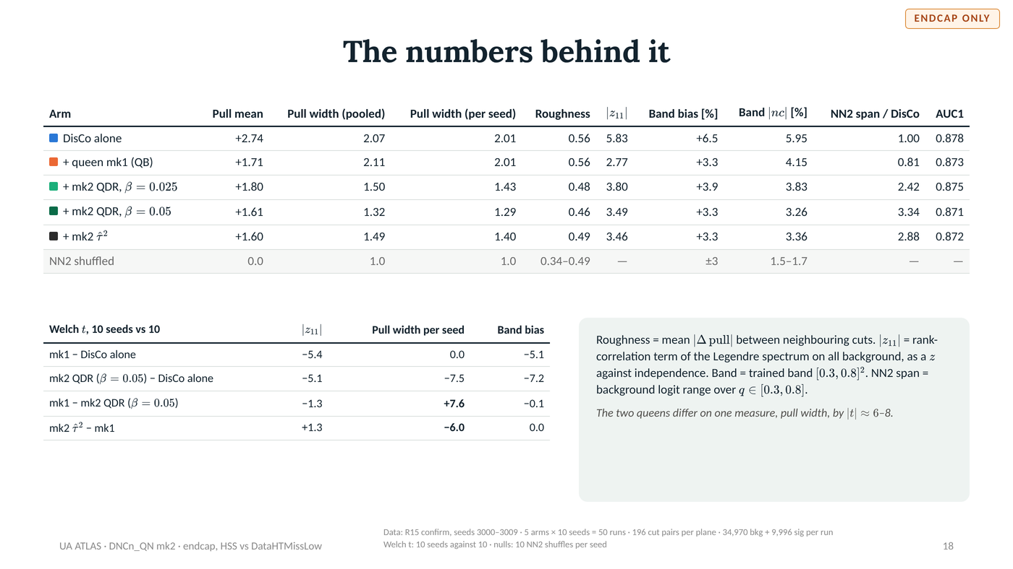
Notes:
Slide 18 of 20. Per arm: pull mean, pooled width, per-seed width, roughness, |z11|, band bias %, band |nc| %, NN2 span / DisCo, AUC1.
DisCo +2.74, 2.07, 2.01, 0.56, 5.83, +6.5, 5.95, 1.00, 0.878. QB +1.71, 2.11, 2.01, 0.56, 2.77, +3.3, 4.15, 0.81, 0.873. QDR b0.025 +1.80, 1.50, 1.43, 0.48, 3.80, +3.9, 3.83, 2.42, 0.875. QDR b0.05 +1.61, 1.32, 1.29, 0.46, 3.49, +3.3, 3.26, 3.34, 0.871. tau2 +1.60, 1.49, 1.40, 0.49, 3.46, +3.3, 3.36, 2.88, 0.872.
Welch t (|z11|, per-seed width, bias): mk1-DisCo -5.4, 0.0, -5.1; QDR b0.05-DisCo -5.1, -7.5, -7.2; mk1-QDR b0.05 -1.3, +7.6, -0.1; tau2-mk1 +1.3, -6.0, 0.0. DATA: Data: R15 confirm, seeds 3000–3009 · 5 arms × 10 seeds = 50 runs · 196 cut pairs per plane · 34,970 bkg + 9,996 sig per run Welch t: 10 seeds against 10 · nulls: 10 NN2 shuffles per seed

Slide 19
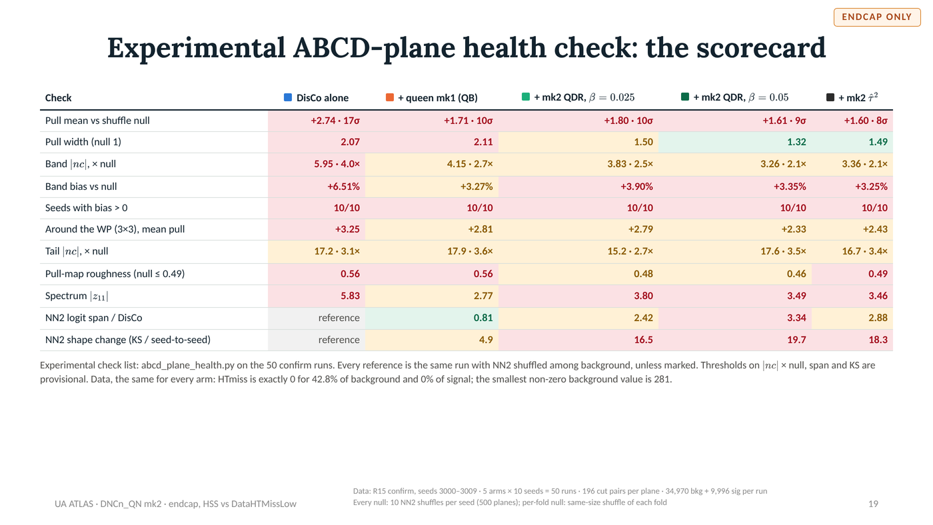
Notes:
Slide 19 of 20. EXPERIMENTAL check list, not validated limits. Scorecard from abcd_plane_health.py, 3 Nov 2026 run on the 50 confirm runs. Status OK / WARN / FLAG; provisional thresholds on |nc| x null, NN2 span and KS. DATA: Data: R15 confirm, seeds 3000–3009 · 5 arms × 10 seeds = 50 runs · 196 cut pairs per plane · 34,970 bkg + 9,996 sig per run Every null: 10 NN2 shuffles per seed (500 planes); per-fold null: same-size shuffle of each fold

Slide 20
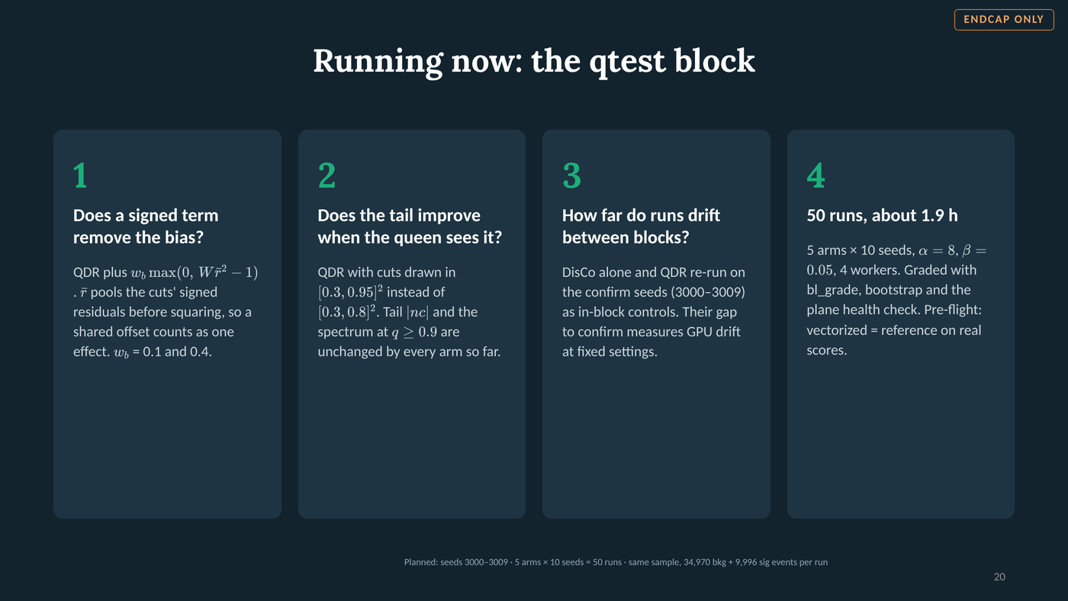
Notes:
Slide 20 of 20. qtest block (running): R | QDR | QDR + bias term w_b 0.1 | QDR + bias term w_b 0.4 | QDR with cuts in [0.3,0.95]^2. Seeds 3000-3009, alpha 8, beta 0.05, 50 runs, ~1.9 h at 4 workers. DATA: Planned: seeds 3000–3009 · 5 arms × 10 seeds = 50 runs · same sample, 34,970 bkg + 9,996 sig events per run

