Slide 1
What we know about Genesis call
Genesis RFA and FAQ - Register for Thu 26 webinar - Genesis Partnership Exchange
FY26 Phase 1 proposals due April 28
500-750k. July 1 start date. Six months performance period. Show results and opportunities to scale to apply for Phase 2 in December
Priority is to support DOE-funded universities. 15-50 awards
ATLAS/CMS collaboration encouraged where it makes sense
Phase 2 1st round LOIs April 28. May 19 proposals. Awards in FY27
2-5M/year three years. 1 or 2 HEP awards.
Cross-frontier
FY27 call for Phase 2 and possibly more Phase 1
Three HEP and NP tracks:
14a Foundation Models, AI ready data, new methods (TREASURE)
14b DUNE,
14c HEP applications on PB-scale datasets (data movement, data quality, analysis, simulation very broad)
DUNE is a relabelling of review recommendations

Slide 2
More Thoughts on Strategy
Collaborative proposals stronger, as usual.
First within US ATLAS, then with CMS and others.
Both Phase 1 and Phase 2 projects must point to transformative use of AI to double productivity.
Phase 1 have six-nine months to demonstrate the core of their idea.
Timeline favors existing projects with a functioning team
Phase 2 timescale few years, targeting HL-LHC, DUNE, EIC.
Long-term project like FCC out of scope
but future colliders applicability could strengthen the proposal

Slide 3
Goals for Today
Quickly present our ideas
Ask clarifying questions
Create connections
NOT A GOAL:
Discuss merit of proposed ideas
Ask detailed questions
Discuss collaboration composition, leadership, funding, etc

Slide 4
US ATLAS Expressions of Interest Spreadsheet
Please add your ideas, and keep the information updated
https://docs.google.com/spreadsheets/d/1zLZu2O5_jceYk5kTw20eu09koUimU2uE-fLq-9zvH6c/edit?usp=sharing

Slide 5
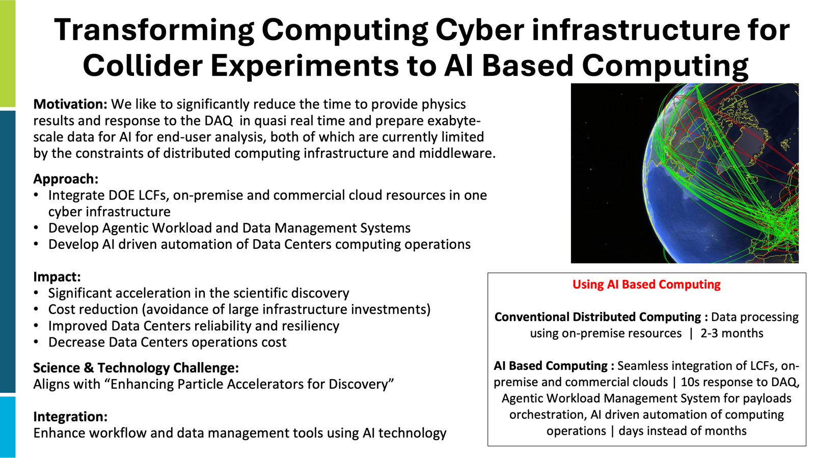
Alexei Klimentov aak@bnl.gov
Alexei with input from KD, JE, FHBM,TM,...

Slide 6
Project ARGUS: Agentic Runtime & Generalization for Universal Software-orchestration (Alex Undrus)
Agentic CI/CD for PB-Scale HEP Frameworks
Genesis FY26 Phase 1 | Topic 14/C (Expedited Discovery) and Focus Area 18 (AI-Assisted Software Engineering)
SCIENTIFIC VISION & AI ADVANTAGE
PHASE 1 SPRINT (6 MONTHS)
• Problem: Current HEP CI/CD (Athena/CMSSW) is static and brittle, requiring high manual effort to tune for CPU/GPU/FPGA environments. • AI Advantage: ARGUS replaces rigid workflow components with LLM-based Agents. These 'DevOps Agents' reason over build logs and environment traces to self-heal and optimize workflows. • Outcome: Enables 'Intent-Driven' science where the framework handles the mapping of physics kernels to PB-scale infrastructure.
• Primary Deliverable: A 'Self-Healing' Agentic Wrapper for software development workflow and/or grid job orchestration (PanDA/Kubernetes). • Technical Goal: Automate the 'Debug-Refactor-Redeploy' cycle. Agents detect failures, suggest code fixes for environment mismatches, and re-trigger pipelines. • KPI: 50% reduction in Human-in-the-Loop time for software release and deployment to production sites.
Alex Undrus, undrus@bnl.gov
THE AGENTIC CI/CD LOOP (AUTONOMOUS FRAMEWORK)
1. MONITOR Grid/Logs
2. REASON Agent Analysis
3. ACT Auto-Refactor
4. DEPLOY Cloud/Edge
Team: PanDA expert(s) and Alex (DevOps expert). Direct connection to Analysis Facilities & PanDA development.

Slide 7
Project AURA: Autonomous Unified Response Agents for Infrastructure Assurance
Cyberagents for Proactive Infrastructure Management
Genesis FY26 Phase 1 | Topic ?
SCIENTIFIC VISION & AI ADVANTAGE
PHASE 1 SPRINT (6-9 MONTHS)
• Problem: Current infrastructure monitoring is reactive - failures detected only AFTER they occur, causing wasted
• AI Advantage: AURA uses specialized agents that analyze sensors and configurations to identify subtle patterns indicating impending failures and performance degradation.
• Goal: Increase scientific productivity by preventing infrastructure, software and configuration issues before they impact research.
• Primary Deliverable: Three LLM-based Cyberagents for Hardware Health, Task Performance, and Configuration Analysis.
• Technical Goal: Detect infrastructure, software and hardware issues 24-48 hours before traditional monitoring. • KPI: 40% reduction in unplanned downtime, 24h early warning lead time, <15% false positive rate.
Shawn McKee, smckee@umich.edu
THE CYBERAGENT INFRASTRUCTURE ASSURANCE LOOP
1. INGEST Metrics/Logs/Task Sensors
2. ANALYZE
LLM Correlation & Pattern Recognition
3. RECOMMEND Action Suggestions & Tuning Options
4. VALIDATE Human-in-the-Loop Feedback & Approval
Team: U. Michigan, U. Chicago, BNL, AmSC/ModCon (AI resources). Connect to AGLT2, MWT2, BNL operations.

Slide 8
Project GUARDIAN: Generative AI-based Unified Response and Decision Intelligence for Advanced Networks,
AI Security Orchestrator for Scientific Infrastructure
Genesis FY26 Phase 1 | Topic 20 (Cybersecurity for AI-driven Science Workflows) | Focus Area 20A (AI for Adversarial Robustness)
SCIENTIFIC VISION & AI ADVANTAGE
PHASE 1 SPRINT (6-9 MONTHS)
• Problem: Scientific infrastructures typically have minimal focus and tooling for security, putting science at risk; implementing standard Security Operations Centers (SOCs) is recommended.
• However: SOC-analysts drown in alerts (>95% false positives) from rule-based systems, missing subtle multi-stage attacks and taking 30+ minutes to generate incident reports manually.
• AI Advantage: GUARDIAN uses LLMs to intelligently correlate events across network, threat intel and system telemetry, distinguishing legitimate workflows and transfers from malicious ones.
• Goal: Enabling rapid security mitigation with context aware input to prevent science workflow interruptions and resource compromises.
• Primary Deliverable: LLM-enhance Security Orchestrator that correlates security telemetry across heterogeneous sources(Zeek, MISP, net flows, metrics)
• Technical Goal: Identify a wide range of threats while reducing false positive rate by >50% and automating incident reports <10 minutes.
• KPI: >50% false positive reduction, <10 minute incident report generation, >80% analyst accept rate.
Shawn McKee, smckee@umich.edu
THE AI SECURITY ORCHESTRATION LOOP (AUTONOMOUS ANALYSIS)
1. GATHER Multi-source Telemetry
2. CORRELATE
LLM Pattern Recognition
3. CLASSIFY
Binary Classification Normal vs Malicious
4. REPORT
Automated Context Aware Incident Reports
Team: U. Michigan, LBNL/ESnet, U. Chicago. Direct connection to WLCG SOC implementations at AGLT2 and MWT2.

Slide 9
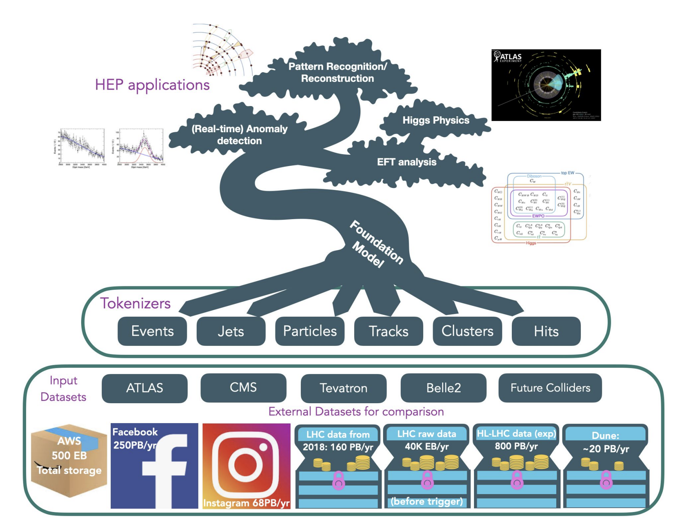
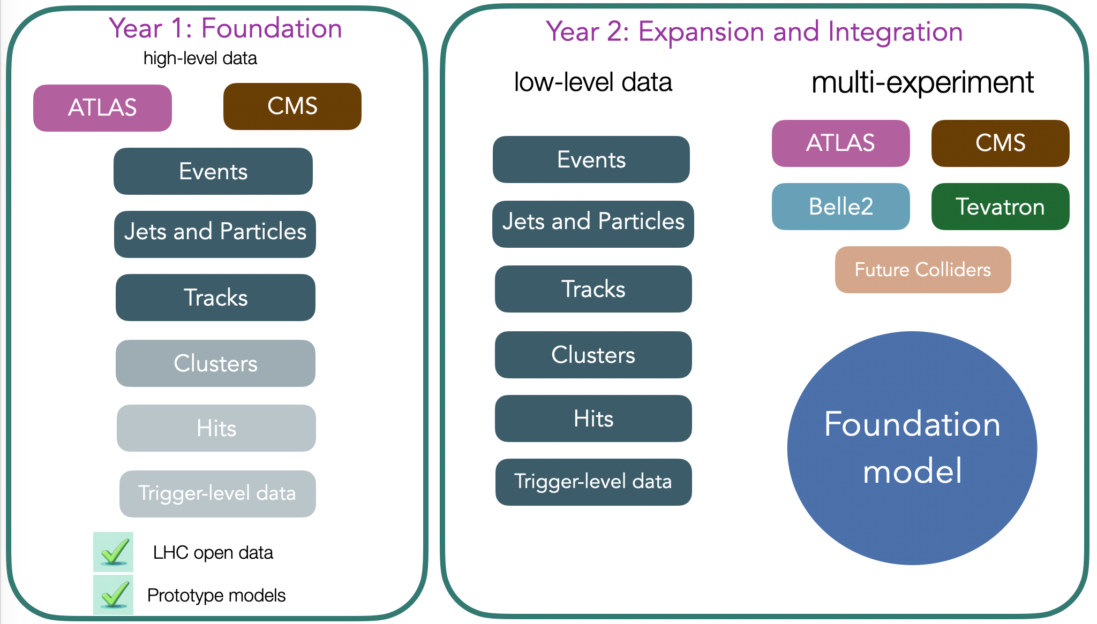

Foundation Model for HEP(Viviana)
Treasure is currently here
Logo by L. Brost

Slide 10
Foundation Model for HEP(Viviana)
We are imagining a Phase 2 Treasure that aims at building a Foundation Model for HEP with different end goals in mind:
Reconstruction, Classification, EFT analysis, Real time application, cross-experiment discovery etc.
In order for this to happen various elements have to come into play
It would be nice if as a community we could think of different aspects for different institutions to lead that could come together into a single Phase 2
Treasure ATLAS Pi: Viviana Cavaliere, Paolo Calafiura, Walter Hopkins, Michael Kagan. CMS: Kevin Pedro

Slide 11
Towards a Foundation Model for Calorimetry (1/2)
Amir Farbin
afarbin@uta.edu
Haleh Hadavand
hadavand@uta.edu
Blake Burghgrave
blake.burghgrave@uta.edu
UTA
Working Title: From Taus to Full Calorimetry: Graph Foundation Models for Reconstruction, Simulation, and Data-Driven Inference in ATLAS
Core idea
Build a detector-conditioned graph foundation model for calorimetry: one shared AI backbone that learns from low-level calorimeter response and produces reusable detector-aware embeddings.
Treat calorimeter information as a multi-scale, multi-graph problem, not a single flat input.
How the information is represented
Static detector graph: calorimeter cells as nodes, with edges from geometry/neighborhood, layer transitions, material boundaries, and detector conditions.
Dynamic event graph: active cells with energies, times, quality/noise, gains, and optional track/context information for each event.
Learned shower / cluster: latent nodes representing showers or clusters, with soft cell→shower assignments.
Object graph: higher-level nodes for τ, e/\gamma, jets, neutral hadrons, MET contributors, etc.
Privileged MC / truth graph: decay chain, particles at calorimeter entrance, calibration-hit decomposition, and truth↔reco associations used only during training.
AI / training strategy
Pretrain the backbone on generic calorimeter tasks:
masked cell reconstruction / denoising
calibration-hit prediction
shower association / clustering objectives
uncertainty estimation and detector-nuisance conditioning
Mix simulation and data:
MC gives privileged supervision (truth, calibration hits, latent energy composition)
data supports weak supervision, calibration, and robustness/domain adaptation
Fine-tune lightweight task heads instead of rebuilding a new model for every analysis.

Slide 12
Towards a Foundation Model for Calorimetry (2/2)
Amir Farbin
afarbin@uta.edu
Haleh Hadavand
hadavand@uta.edu
Blake Burghgrave
blake.burghgrave@uta.edu
UTA
Long-term vision
A single calorimeter foundation model for reconstruction, calibration, fast simulation, and inference.
Same backbone can eventually support:
clustering and energy calibration
e/gamma, tau, jets, …
particle flow / MET
anomaly detection
detector optimization and fast surrogate simulation
Goal is a shared framework where different teams can add new calorimeter tasks as modular heads/adapters on top of the same pretrained backbone.
Why start with taus?
Physics-rich but localized: taus contain narrow charged cores, π⁰→ γγ EM subshowers, and strong pile-up/noise sensitivity.
Exercises the full chain: cell-level response → shower structure → object ID → analysis-level fake-rate inference.
High-impact benchmark: τ reco/ID and jet→τ fake modeling are already important analysis bottlenecks with clear quantitative metrics.
Manageable first step: seeded τ regions are much smaller and simpler than full-event calorimeter reconstruction, but still stress the core AI ideas.
Strong connection to current ATLAS workflows: existing τ ID / GNTau / UFF-style fake modeling provide a natural validation path and early adoption route.
Phase-I: Demonstrate quantitative AI advantage on the τ benchmark first, then use the same framework as the foundation for broader calorimeter reconstruction, simulation, and inference.
Phase-II: Cells → Model Base Inference in Reconstruction → Embeddings → Heads Tuned for Tasks / Analysis
Questions
How would this fit with the broader Foundation Model Efforts like TREASURE?
Ideally the approach or even model is not ATLAS specific. Should we consider collaboration with CMS?
Can we form a Lab/University team around this idea?

Slide 13
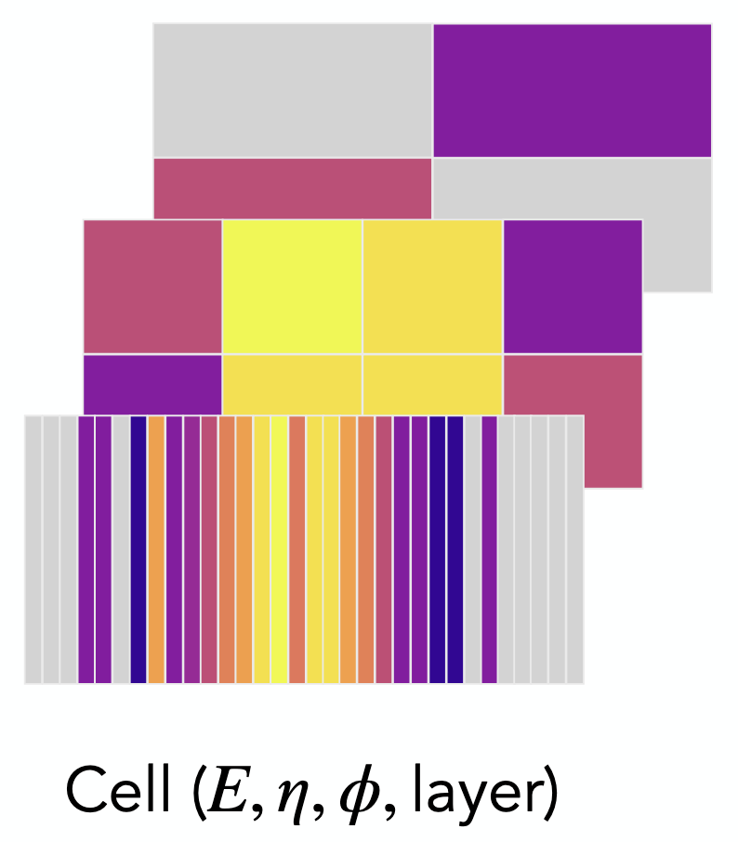
A Low-Level Calorimeter Foundation Model to Enhance Current and Future Collider Experiments
Electromagnetic calorimeters provide critical information for the reconstruction and selection of interesting events at high energy colliders, notably for the Higgs to diphoton discovery channel and looking towards di-Higgs observation. The upgraded ATLAS detector for the High Luminosity LHC will provide full-granularity, full-precision LAr calorimeter information off-detector at the 40 MHz bunch crossing rate, offering a new opportunity for low-level AI-enhanced analysis tools.
An ATLAS LAr calorimeter foundation model would leverage the vast amounts of raw LHC data to enhance performance at a variety of tasks crucial to the ATLAS physics program, such as optimized “5D” electron and photon reconstruction and calibration (energy, position, time). The design of such an FM with hardware-aware principles will further enable latency/power-sensitive downstream tasks such as improved e/y FPGA triggers for Higgs and BSM/LLP signals, and potentially ultra-fast and efficient generative calorimeter simulations.
6-month deliverable: demonstrate pre-trained backbone model on ATLAS Run 3 data to enhance performance at 3 downstream tasks: e/y reconstruction, HHyybb triggering, generative simulation
Phase-2 vision: integrate for ATLAS Run 4, FCC (ALLEGRO) design/optimization, potential connection to TREASURE?
Institutions: Columbia (Parsons parsons@nevis.columbia.edu), UTAustin (Andeen), UCBerkeley/LBL (Haichen), SLAC (Gonski)
Focus area options: 14A. "Foundation Models of Particle Interactions and Cosmic Physics”

Slide 14
Self-Supervised Learning towards Improved HEP Foundation Models
Considering potential Phase 1 submission in 14A specifically focused on exploring self-supervised learning schemes with a focus on HEP data, but still working out details and very open to collaborating
Description: We would propose to explore the use of self-supervised learning (SSL) techniques with a dedicated eye to HEP data. This could involve studies of different SSL methods, SSL for different data modalities (jets/events/calorimeter data/etc), or different applications (improved classification, improved generalization, improved data/MC, etc). A final proposal would obviously include only a small subset of these.
Existing work in this regime: https://arxiv.org/abs/2601.11719 (jBOT), https://arxiv.org/abs/2410.13947 (MACK)
Contact: Dylan Rankin (UPenn) [dsrankin@sas.upenn.edu]

Slide 15
Foundation Model Event Reconstruction in ATLAS and Future Colliders: A Unified Framework for 5D Calorimetry, Timing, and Tracking
Ariel Schwartzman (SLAC) [sch@slac.stanford.edu]
High-luminosity operation of the LHC will require a qualitatively new approach to event reconstruction capable of resolving the complex, overlapping particle interactions present in high pileup environments. In ATLAS Run 4, precise timing information from the High Granularity Timing Detector (HGTD), combined with calorimeter and tracking measurements, provides a unique opportunity to extend reconstruction into the time domain and enable a full “5D” description of events.
We propose a foundation model framework for ATLAS reconstruction that combines LAr calorimeter timing, HGTD, and tracking to improve jet energy resolution, vertex time, pileup mitigation, and particle flow object reconstruction at HL-LHC.
A key feature of this approach is that it provides a direct bridge to next-generation calorimetry concepts based on digital, single-photon readout, where the detector output is intrinsically discrete and can be naturally interpreted as a sequence of tokens. In this sense, ATLAS serves as a testbed for a broader paradigm in which detector design, data representation, and AI are co-optimized. This connection establishes continuity between Run 3/4 reconstruction challenges and the development of future 5D calorimeters for HL-LHC upgrades and future collider experiments.

Slide 16
Event-Level Reconstruction at HL-LHC: A Foundation Model Framework for Multi-Vertex Inference, Panoptic Tagging, and Timing
The High-Luminosity LHC (HL-LHC) will operate in a regime where each recorded event contains hundreds of overlapping proton-proton interactions. In this environment, the traditional paradigm of event reconstruction—based on identifying a single primary vertex, processing jets independently, and combining sub-detector information through sequential algorithms—reaches its fundamental limits. Multiple hard-scatter interactions may coexist within the same event, correlations across jets become essential for correct flavor assignment, and precise timing information introduces an additional dimension that cannot be treated independently. These challenges indicate that HL-LHC reconstruction is no longer an object-level problem, but an inherently event-level inference problem. Scaling the existing paradigm for event reconstruction to large models will not address these fundamental limitations. We propose a new class of foundation model event-level inference that enables multi-vertex reconstruction, panoptic jet tagging, and optimal timing integration.
This paradigm is motivated by several concrete limitations of current approaches. First, the assumption of a single primary vertex breaks down at high luminosity; recent studies show that multiple vertices may be relevant for a given physics process, requiring a shift toward multi-vertex inference rather than vertex selection. Second, jet tagging methods based on independent jet processing fail to capture correlations between nearby jets, particularly in dense environments with heavy flavor; this motivates a panoptic tagging (PanopTag) approach in which all jets in the event are classified simultaneously. Third, the integration of precision timing information—essential for resolving pileup and determining vertex time (t₀)—requires the coherent combination of calorimeter, tracking, and timing measurements within a unified framework.
A common feature of these challenges is that they cannot be solved by scaling existing object-based algorithms. In particular, improving single-jet tagging will not recover the information lost by ignoring inter-jet correlations, and selecting a single “best” vertex will fail in events with multiple relevant interactions. These are not incremental limitations, but indicators of a breakdown of the current reconstruction paradigm.
Ariel Schwartzman (SLAC)
sch@slac.stanford.edu

Slide 17
Improved datasets for ML research
Genesis FY26 Phase 1 | Topic 14/A (Foundation Models)
(This is in the context of a request from UMass to prepare a proposal for Genesis)
The idea is to leverage the work already happening within NGT, plus new efforts to create ML-friendly datasets from ACTS, to help produce a petabyte scale resource suitable for use with ML research (including foundational models). Since ACTS is is also used on ePIC, this effort would not be ATLAS-specific.
PI: Stephane Willocq willocq@umass.edu
Associated lab: LBL

Slide 18
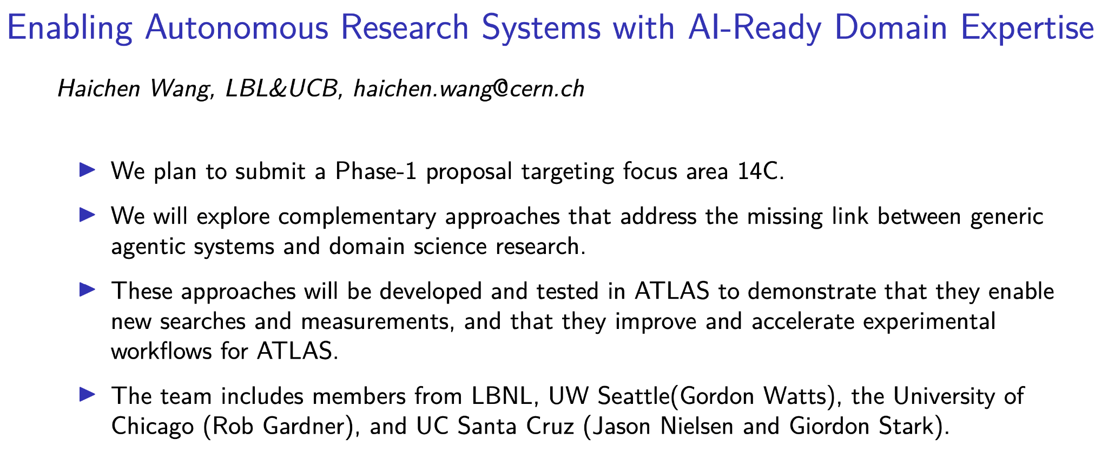

Slide 19
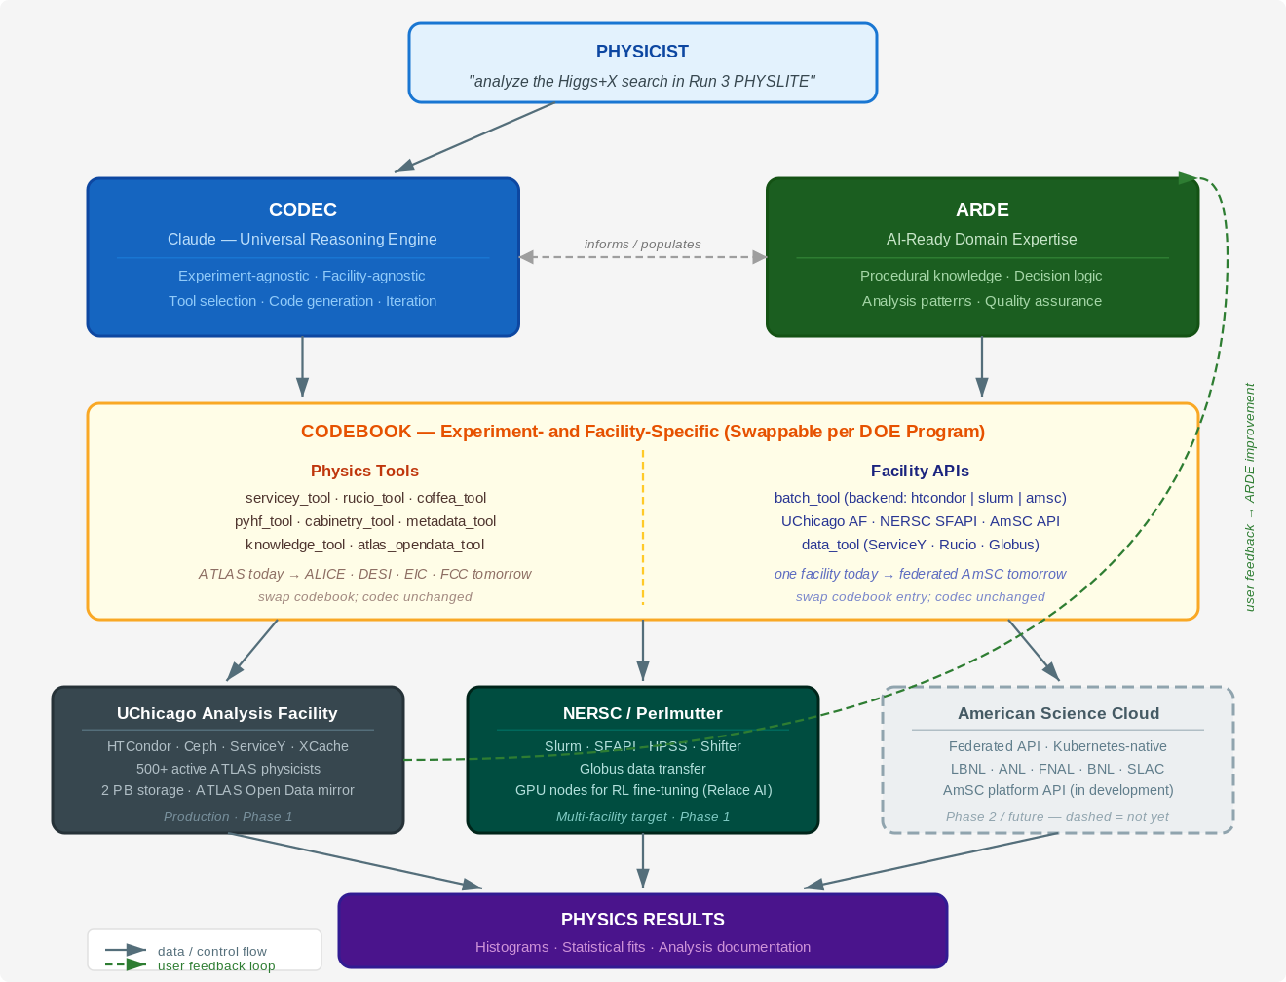
ELWOOD
Production-Scale Agentic Analysis Infrastructure · DOE Experimental Portfolio
DOE Genesis Phase 1 · Q2C Lighthouse
March 2026 · Rob Gardner & Giordon Stark Ilija Vukotic
Infrastructure at Production Scale
500+ active ATLAS physicists · petabyte-scale Ceph storage · HTCondor / ServiceY / Rucio NOT a laptop demo — a standing facility service with live user feedback
Codec / Codebook Architecture
Codec = universal reasoning engine — experiment-agnostic, facility-agnostic Codebook = swappable tool + knowledge layer · ATLAS today → EIC / FCC tomorrow
ARDE — AI-Ready Domain Expertise (LBNL-led, coordinated)
Procedural knowledge · decision logic · analysis patterns feeds into the Codebook · live user corpus → continuous improvement
Physics Use Cases
Fig. 1 — Codec (Claude) and ARDE are universal; Codebook is swappable per experiment and facility.
pMSSM Scan
Higgs+X H→γγ
★ Top+X ttbar
DESI BAO DR1
BSM landscape
agentic survey
100s signal
regions, Run 3
Chicago / Liantao
exotic top decays
Codebook portability:
survey cosmology
Rob Gardner (UChicago) · Giordon Stark (UCSC) · Coordinated with Haichen Wang (UCB/LBNL)

Slide 20
Agentic Analysis (Watts)
Agentic Analysis to start from an Analysis Specification and implement an analysis
Physicist interacts with the specification to drive the analysis forwards
Collaborative effort - physicist with the ideas, agents with the implementation
Use ATLAS data and infrastructure as well as OpenData
Do our best to use existing tools (e.g. claude code, codex, copilot), rather than rolling our own
Of course, where necessary
Work to expose experiment metadata to the agents to enable the analysis
Obvious collaboration possibilities with Haichen
Gordon Watts, gwatts@uw.edu, University of Washington

Slide 21
AI Agents for End-to-End Analysis
Simplifying and accelerating data analysis using AI agents
Gustaaf Brooijmans, gusbroo@nevis.columbia.edu, Columbia
Agentic AI, analysis

Slide 22
Detector Operation (1/2)
(Catrin Bernius: Catrin.Bernius@cern.ch / Peter Onyisi ponyisi@utexas.edu / Verena Martinez Outschoorn vimartin@umass.edu)
Various opportunities related to detector operation, inspired and presented at the ATLAS SCOPE workshop: https://indico.cern.ch/event/1649694
Data quality (possible collaborators: Louisiana Tech, UT Austin, UTA, LBL/UC Berkeley, Stony Brook)
Improve online references: predict plots based on luminosity, collision mode, etc. Discover when new features appear, request feedback on whether they are OK, quickly incorporate into predictions. Try to replace TWikis of outdated reference plots, vague whiteboard instructions.
Automated defect determination. Learn which histograms are truly relevant to marking data bad, use them to propose defects automatically. Learn as detector and DQ assessment evolve.
Summary Agent: collect logbook information, histograms, databases into a single dashboard
AI Ready Data on Demand (possible collaborators: UMass, UTA, SLAC, Oregon, …)
General idea: Define and design an architecture with a central interface/API layer and that:
Connects multiple data sources (DCS, DAQ, DQ, COOL/CREST, RunQuery, etc.)
Hides complexity from users
Supports many-to-many relationships (apps ↔ data sources) and with that provides ready-to-use data
A concrete example is the ATLAS MDT operation platform (AMOP) which aims to go beyond simple visualization by integrating DCS data, DAQ information, and data quality metrics into a centralized interface. The goal is to help detector experts diagnose problems more quickly and eventually use AI/ML models to detect anomalies such as high-voltage sparking or failing hardware.

Slide 23
Detector Operation (2/2)
(Catrin Bernius: Catrin.Bernius@cern.ch / Peter Onyisi ponyisi@utexas.edu / Verena Martinez Outschoorn vimartin@umass.edu)
Various opportunities related to detector operation, inspired and presented at the ATLAS SCOPE workshop: https://indico.cern.ch/event/1649694
Data quality (possible collaborators: Louisiana Tech, UT Austin, UTA, LBL/UC Berkeley, Stony Brook)
AI Ready Data on Demand (possible collaborators: UMass, …)
Real-time anomaly-detection on time-series for Operation Monitoring (possible collaborators: Argonne, SLAC, UTA, …)
Use anomaly detection in operational data to identify detector issues early and potentially predict failures. This could be done through combination of various sources of information (which are somewhat correlated): HLT farm monitoring: Detecting anomalies in data collection manager (DCM) rates, Level-1 and HLT trigger rate monitoring;
AI-Driven Operational Support System with RAG and Agentic Pipelines (possible collaborators: Argonne, UCI, …)
Design, implement and evaluate AI-based systems (LLMs and agents) to support shifters and experts in the day-to-day operation. Some options include:
Assist shifters and experts by answering questions from documentation in the experiment (twiki, jira, elog ELISA, DAQ message feed/shifter assistant) with a RAG-based chatbot to reduce the response time in case of issues.
Provide a quick summary of daily activities and happenings in the form of a daily summary from shift logs of the day (not just the 3 summaries by the shift leader but by a larger selection of elog entries, also by other systems. This can also assist the shift crew / experts to get an overview of the daily activities faster in case of issues.

Slide 24
Self-Driving Trigger Systems: Deploying Autonomous Real-Time Data Acquisition and Online Foundation Model Inference for DOE High-Energy Physics Facilities (Miller)
Plan to demonstrate autonomous trigger menu optimization and physics gains
Builds on existing work across L0/L1/HLT
“Go/No Go” demonstration of cross-experiment generalizability and impact
Builds on our existing collaboration to deliver a real-time DAQ system that can demonstrate intelligent feedback and control to the ATLAS/CMS trigger combined with a foundation model guiding a reinforcement learning agent or PID loop for optimization, and trigger level analysis.
The system would monitor both physics coverage and resource usage, and we’d aim to demonstrate the ability to transfer the model between different experiments (ie ATLAS and CMS) with minimal retraining.
David W. Miller, David.W.Miller@uchicago.edu, University of Chicago

Slide 25
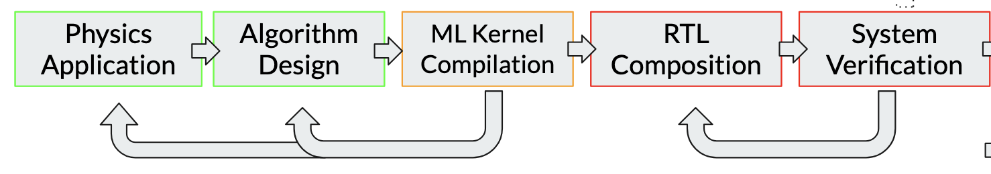
AI agentic workflows for firmware and hardware integration in LS3 and future operations
Leverage AI assisted toolkits for firmware and hardware integration in LS3 and future operations
Significant firmware development with frequent updates needed for the integration and commissioning of the Run 4 ATLAS and CMS detectors
Agents have been found to provide verifiably correct RTL, debugging, and algorithm-firmware codesign optimization (26XX.XXXXX)
Further development of the existing agentic-based firmware code generator at SLAC to enable postdocs and students to rapidly develop, debug, and deploy firmware for FPGAs
6-month deliverable: develop firmware for triggering on cosmic muon events inside the collision hall during LS3 integration/commissioning (many sub-detector frontend electronics operate in triggerless mode and no scintillators, making cosmic muon triggering particularly challenging)
Phase-2 vision: accelerate firmware development cycle for rapid trigger updates in HL-LHC and towards detector design/testing for FCC and beyond energy frontier
Institutions: SLAC (Catrin, Julia, Qibin, Rainer), UMass (Verena), Michigan (Junjie junjie@umich.edu), …
Focus area options: 9C. "AI-Driven Architecture Design", 14C. "Expedited Discovery from High Complexity and Petabyte-Scale Datasets”

Slide 26
Incorporating AI in ATLAS Data Quality Assessment
Genesis FY26 Phase 1 | Topic 14/C (Expedited Discovery)
Data Quality Monitoring in ATLAS currently depends on dozens of shifters examining hundreds of plots per run recorded. We will develop AI-based tools that incorporate high level processing of distributions across sub-detectors sand reconstructed physics objects with reinforcement learning to differentiate true data anomalies from expected variations.
Lee Sawyer, sawyer@latech.edu, Louisiana Tech
data quality, data monitoring, reinforcement learning

Slide 27
14-C: ML-Based Lossless Data Compression for Energy Frontier and Neutrino Experiments
AI-driven lossless data compression for particle physics—reducing storage costs for exabyte-scale datasets across the DOE large-experiment portfolio and enabling greater rates for near-real-time analysis streams at ATLAS (TLA) and CMS (L1 scouting).
Proposal Systematic evaluation and further development of ML-based guaranteed-lossless compression on HEP data formats across ATLAS, CMS, and DUNE prototype data. Characterize compression performance/throughput, understand optimal representation and optimization considerations, theoretical limit, and robustness on a variety of data formats from L1 Scouting outputs to raw data to analysis ntuples/Open Data. Aligns with TREASURE.
Team (ATLAS, CMS, DUNE, Information theory)
OSU: Boveia (PI, ATLAS TLA), Vallari (DUNE) + postdocs + students + OSU ECE/CSE collaborators (compression, HPC)
Fermilab: Ngadiuba (CMS L1 Scouting)
BNL: Cavaliere et al (ATLAS, TREASURE — discussed)
Manchester: Doglioni (HSF + EU AI, ATLAS TLA) + software engineer + compression students
Other collaborators in progress—open to more!
Resources OSU HPC (e.g. ~>10M GPU-hr) + potential additional resources available to BNL. Working compression codebase with a lossless encoder (arXiv:2511.11337 submitted to MLST) benchmarked against 13+ algorithms. Additional existing collaboration network e.g. collaboration with ROOT/NextGen on integration.
Phase II: develop production-ready implementations and benchmark for deployment in experiment data pipelines, real-time compression in the trigger, AI-accelerated analysis for TLA and scouting. Aligns with TREASURE foundation model Phase II.
Contact Antonio Boveia, boveia.1@osu.edu
lossless data compression, trigger-level analysis, data scouting, storage cost reduction, real-time analysis, online compression, cross-experiment methods, HL-LHC computing,compression benchmarking, information theory, AI-ready data formats, TREASURE

Slide 28
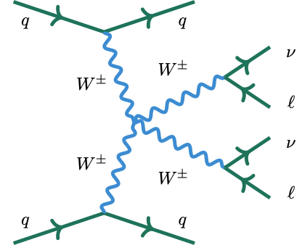
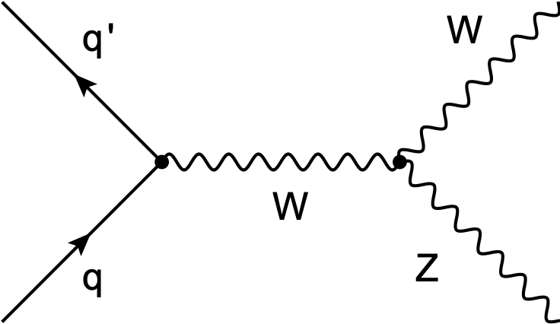
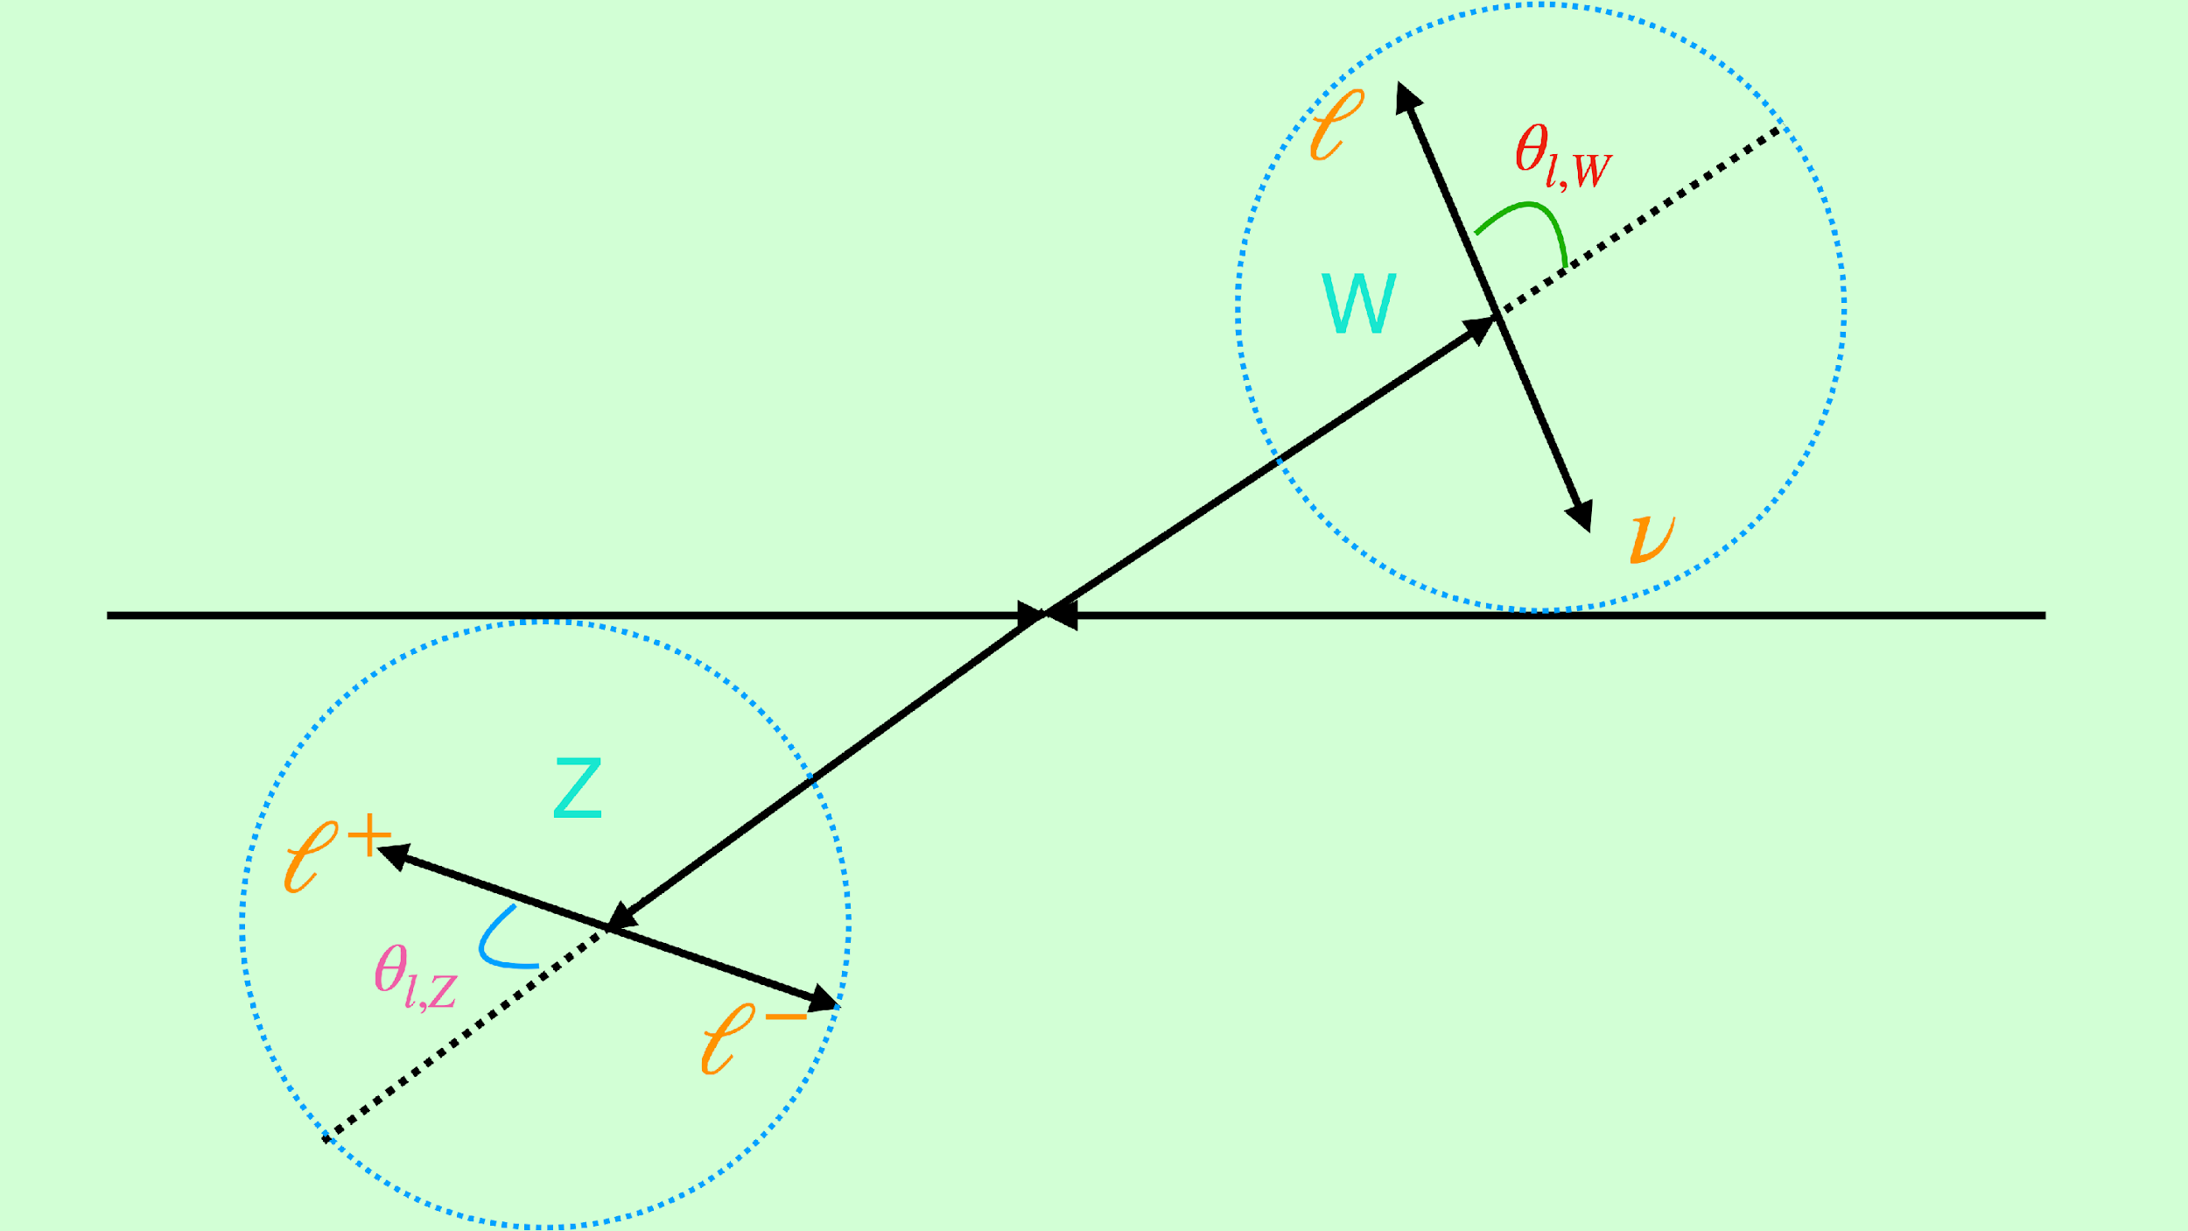
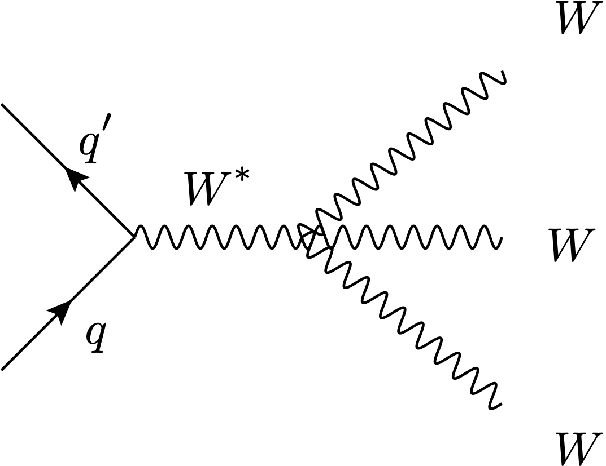
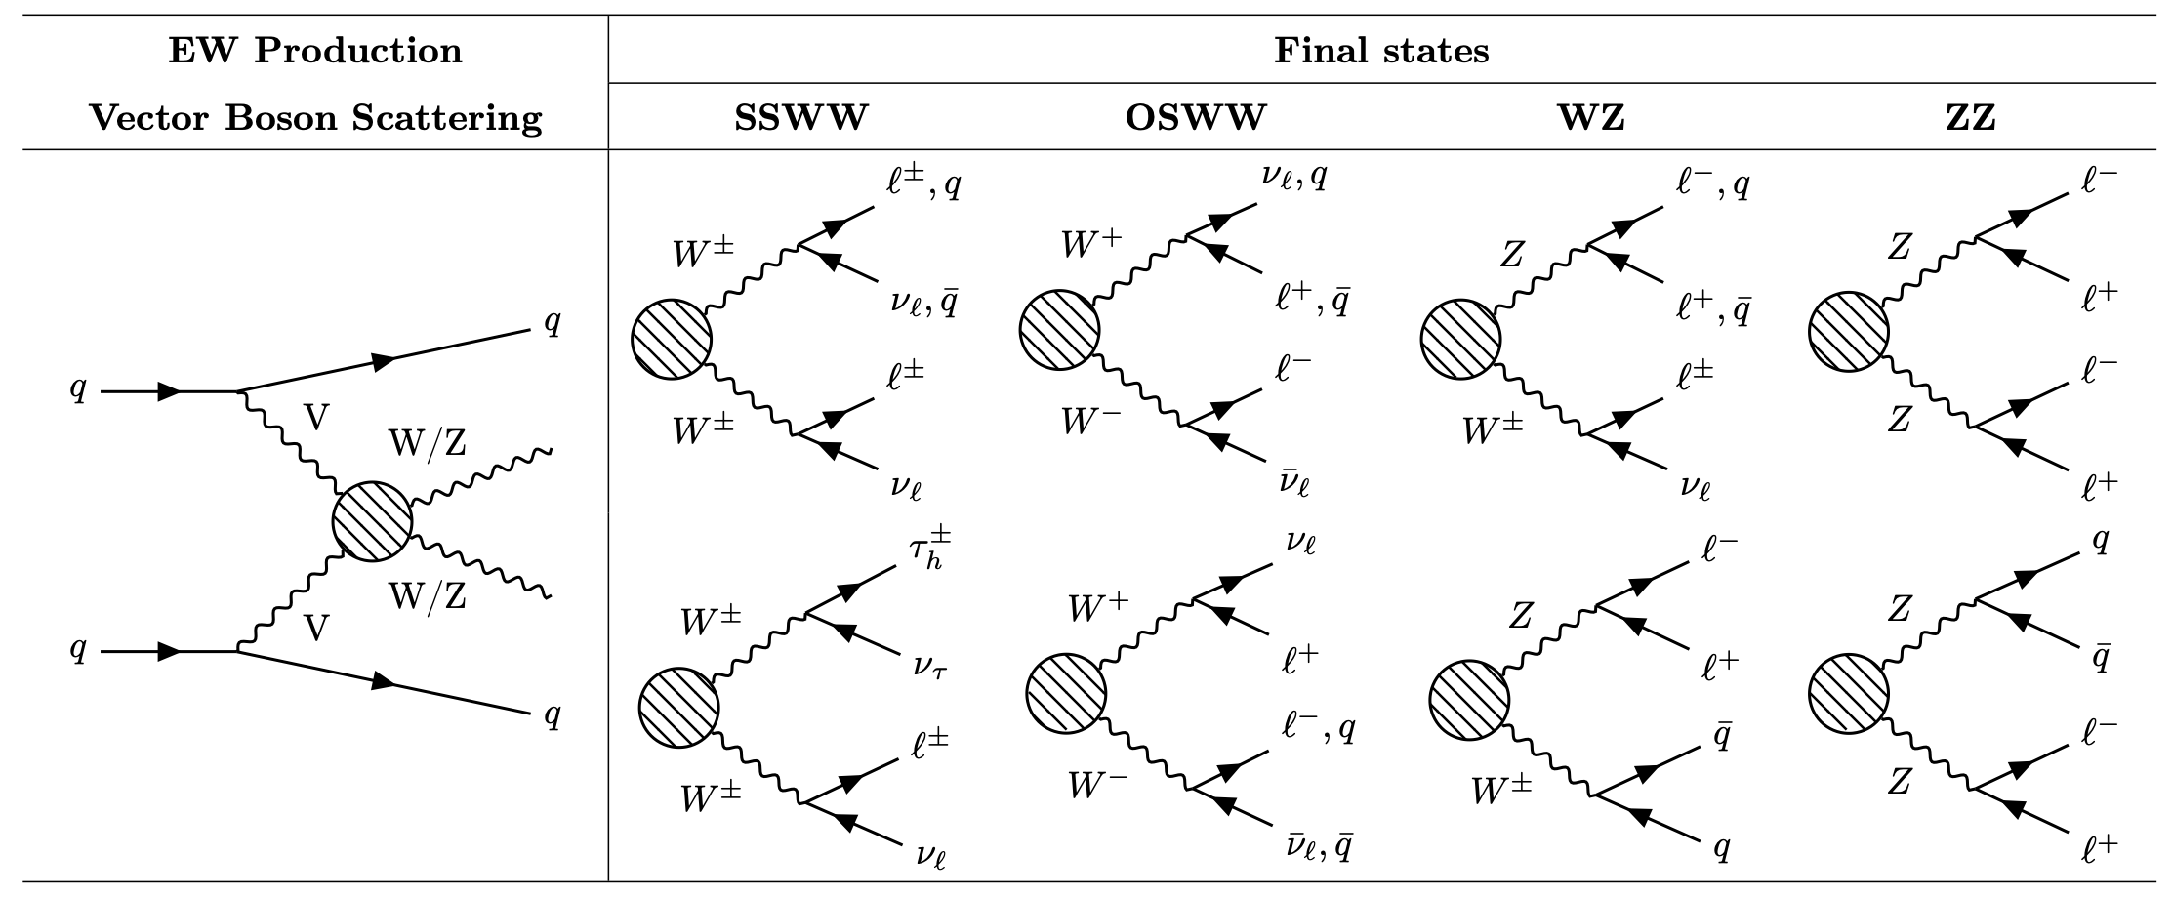

ASSET: AI-Steered SMEFT Event Tomography
We propose a novel, unified AI approach to the confluence of multi-boson production, spin-density matrix (QIS) determination, and SMEFT interpretation for data-driven discovery
Powerful AI methods such as neural simulation-based inference with agentic optimization can extract subtle kinematic features from complex event topologies and perform inference in high-dimensional spaces in an automated and efficient manner
University Collaborators: Saptaparna Bhattacharya (SMU), Aishik Ghosh (Georgia Tech), Mark Neubauer (UIUC), Philip Chang (UF), Elliot Lipeles (Penn)
saptaparnab@smu.edu, msn@illinois.edu
National lab partners: ANL (Tim Hobbs, Walter Hopkins) and BNL (Sally Dawson, Robert Szafron)
Multibosons
Spin density matrix
Standard Model Effective Field Theory

Slide 29
Autonomous Discovery of New Physics Through Anomaly Detection with Agentic Workflow
Grand Challenge Topical Area: Unifying Physics from Quarks to the Cosmos
[Goal] To develop an agentic AI framework to automate and enable a comprehensive, mode-agnostic scan for resonant new-physics signatures in particle collision experiments. The framework will systematically iterate over candidate invariant masses, retrain the anomaly-detection model for each probed mass, scan multiple anomaly-score thresholds, and evaluate the statistical significance of any localized enhancement in data.
[Final outcome] A data-driven, AI-enabled framework for discovering new resonant phenomena in collider experiments. It identifies the most likely signals in collision data, including the relevant physics channels, peak mass positions, and widths, after probing a range of sensitivity conditions for generic signals in anomaly-region scans.
Participants: ANL, UIC, U.Wisc.
Looking for a PI from University !
Contact: S.Chekanov (chekanov@anl.gov)

Slide 30
Projects being discussed
Paolo Agentic analysis: LBL, UW, connection with UC AF (conversation started)
Phase 1: UCB, UC, UCSC, LBNL, … Giordon/Ilija/Rob (initial concept) - agentic analysis framework
Alexei/Kaushik: Bamboo (Agentic PanDA): BNL, UTA, connection with Redwood? Talk with CMS on Friday
Alexei: New cyberinfrastructure (for HL-LHC/EIC) : BNL, UTA, … Google (Distributed computing evolution)
Kaushik: Automation of ATLAS computing facility operations; UTA, BNL, … Google (if we are allowed to have all 3)?
2,3, and 4 will be combined into a Phase 1. May not be good to combine with CMS yet and wait for Phase 2
Paolo: AI Ready Data on Demand (Analysis Facility-connected). Also connected to simulation on demand (e.g. OpenCosmos)
Verena: operations data must be made available as well

Slide 31
Projects being discussed 2
Viviana: Foundation Models for HENP
Thinking about TREASURE phase 2. Need to go cross-frontier. Will require buy in from labs.
Current preferred: Alternative: multiple Phase 1 which will converge into a Phase 2 in December
Gordon: Phase 1 would need to be narrowly focused to deliver in six months
Catrin/Peter Detector operations
Projects discussed during SCOPE workshop last week
Self-Driving Trigger Systems: Deploying Autonomous Real-Time Data Acquisition and Online Foundation Model Inference for DOE High-Energy Physics Facilities
Targeting 14A
Presented at ATLAS SCOPE workshop by David Miller (Chicago)
https://arxiv.org/abs/2104.06622 , https://arxiv.org/abs/2601.08910
ATLAS+CMS+Industry (NVIDIA)

Slide 32
Projects being discussed 3
Shawn: AURA: Autonomous Unified Response Agents for Infrastructure Assurance, This proposal addresses Topic 15/A: AI for Operational Resilience of Scientific Infrastructure by developing AURA - an autonomous cyberagent system that proactively identifies and mitigates infrastructure issues before they impact scientific workflows.
Shawn: GUARDIAN: Generative AI-based Unified Response and Decision Intelligence for Advanced Networks, This proposal addresses Topic 20/A: Cybersecurity for AI-driven Science Workflows by developing GUARDIAN - an AI/LLM Security Orchestrator that intelligently gathers, correlates, and acts upon security information from diverse scientific infrastructure sources.
Alex Undrus: Project ARGUS: Agentic Runtime & Generalization for Universal Software-orchestration. This proposal aligns Topic 14/C (Expedited Discovery) and Focus Area 18 (AI-Assisted Software Engineering). It resonates AURA, but applies to the software development and testing lifecycle (with AI—automate, optimize, and generalize software orchestration, enabling more efficient and reliable development workflows)

Slide 33
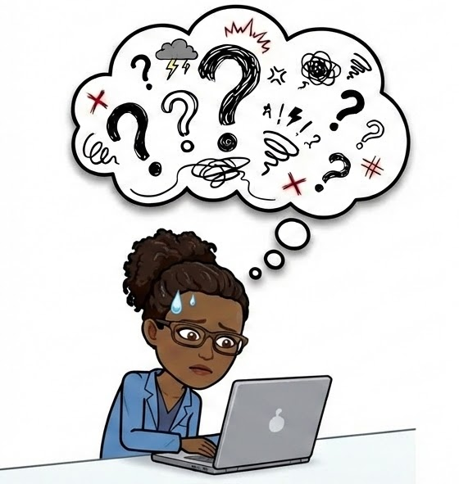
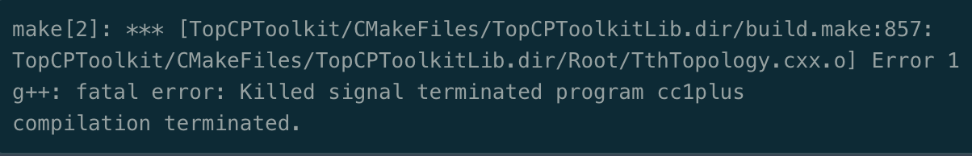
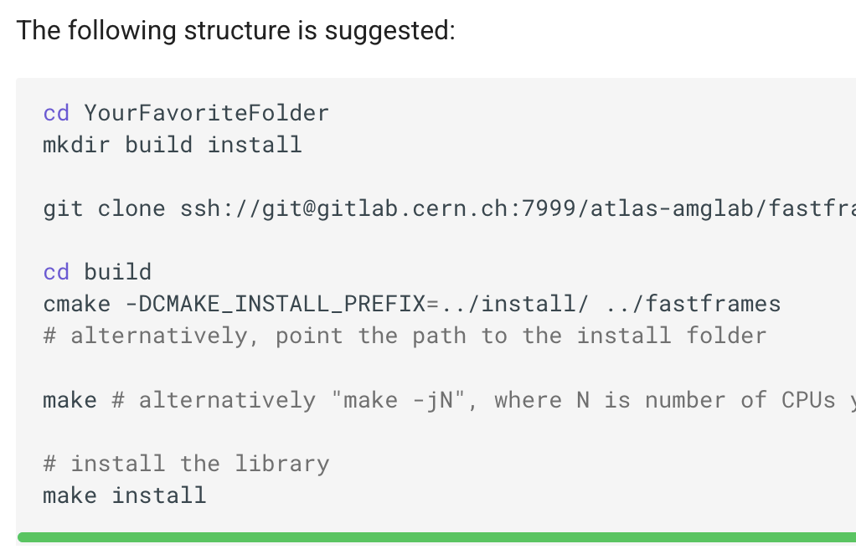
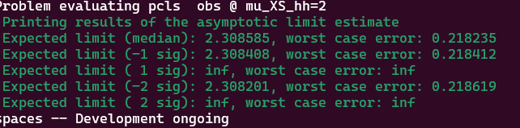
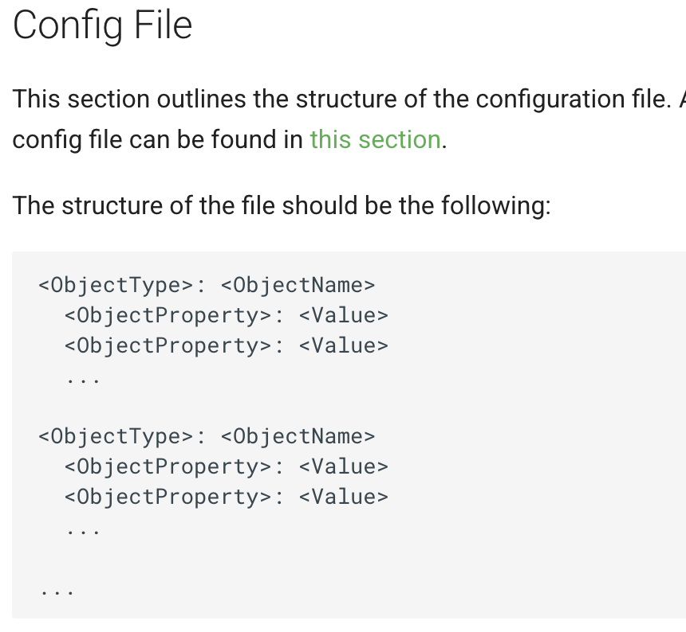
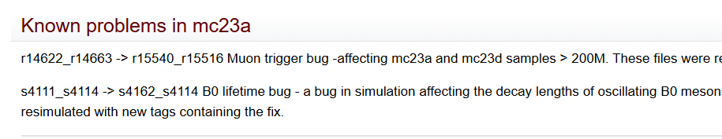
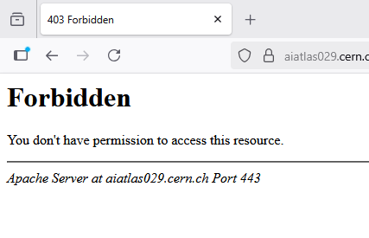
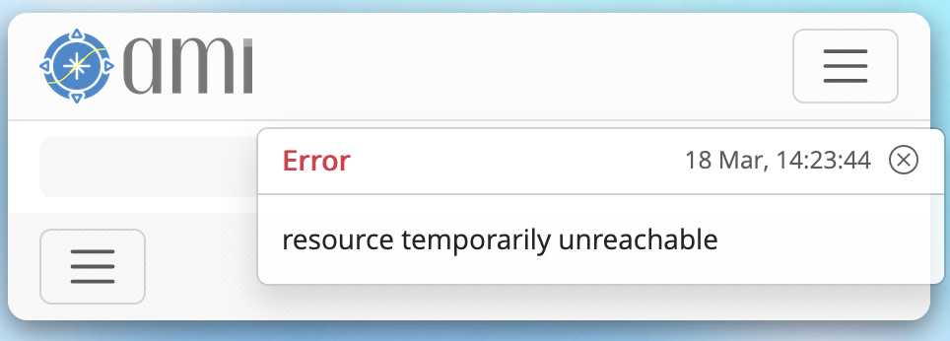
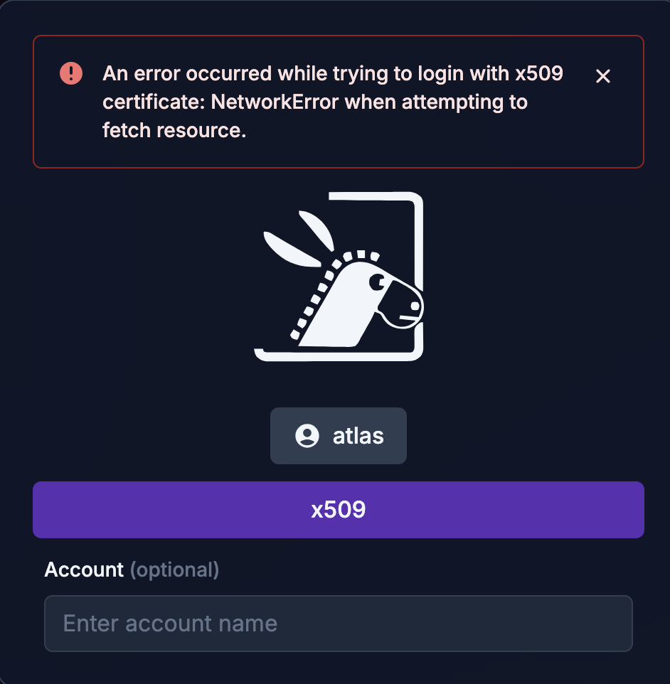
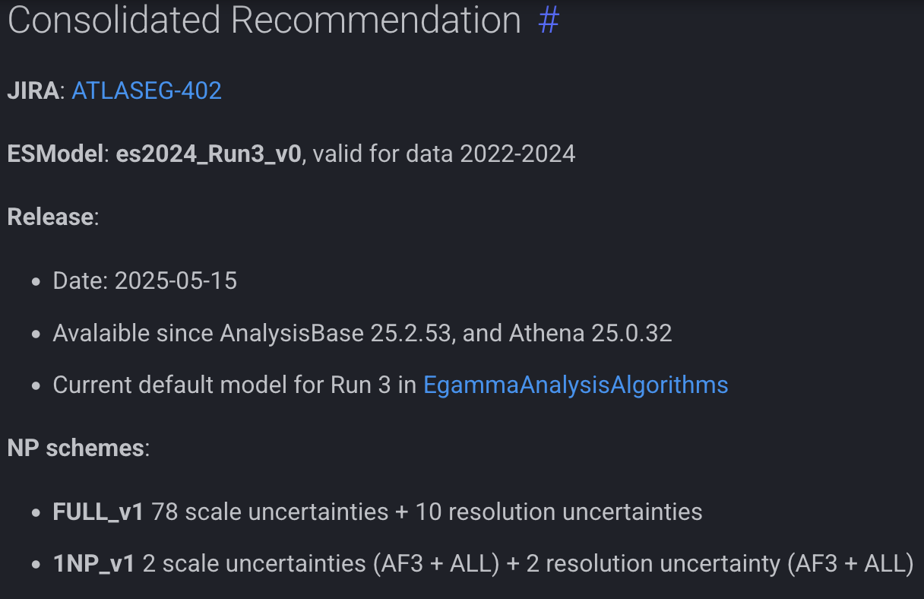
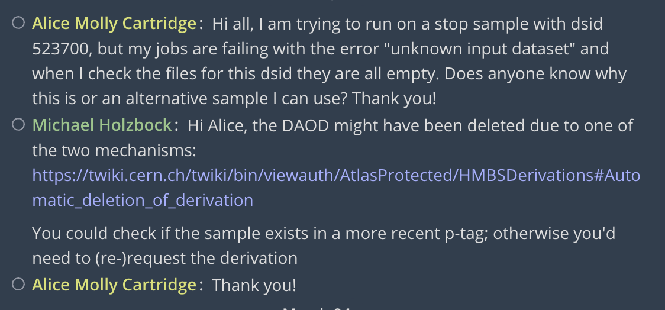
ATLAS Analysis – the current approach
ATLAS physics analysis has grown in complexity.
Terminals with rucio download commands and transfer progress bars
Jupyter notebooks with red error tracebacks
Using AMI’s web interface to find datasets but run into authentication errors
Reading TWiki pages to find out about CP recommendations
Lots of held jobs with condor (or slurm)
Asking on mattermost about samples or p-tags or problems with software
Using different tools and frameworks with all sorts of varying different ways of plaintext configuration
Accessing different analysis facilities to run code and transfer data and work with other people
A browser with 15+ tabs open
This is a lot to handle, and you’re not alone!

Slide 34
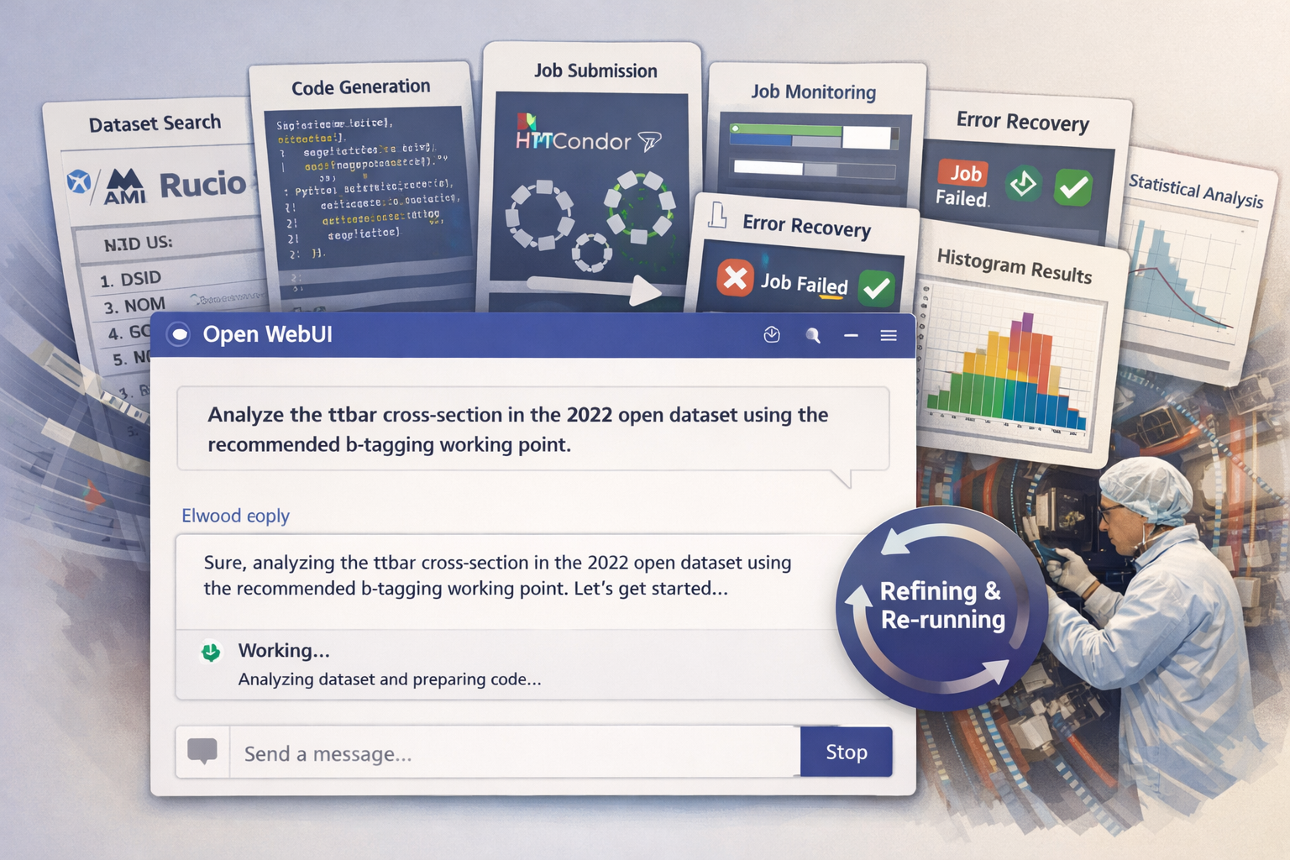
ATLAS Analysis – using Elwood
Image generated by Claude

Slide 35
Agentic Analysis (Giordon, Rob, Ilija)
What is Elwood? Elwood is an agentic analysis framework proposed. A physicist describes their analysis intent in natural language: "find the ttbar MC samples matching my p-tag, run the coffea selection, and fit the result with pyhf"; Elwood autonomously handles the full workflow: dataset discovery via Rucio and AMI, columnar data delivery through ServiceX, histogram production with coffea, and statistical inference with pyhf. The key architectural idea is that the AI model is a general-purpose reasoning engine while the experiment-specific knowledge such as which tools to call, which datasets to query, which recommendations to follow all live in a swappable, extensible configuration layer we call the codebook . This means the framework is not locked to ATLAS or an analysis facility: swap the codebook and it works for EIC and NERSC, or DUNE and American Science Cloud.
What is the quantifiable improvement? Every ATLAS analyst knows the overhead: debugging grid jobs, chasing down the right datasets, resubmitting jobs, navigating TWiki pages for CP recommendations. None of that is physics, it's infrastructure friction. Elwood targets that friction directly. The Phase 1 demonstrator measures productivity on the analysis facility benchmarking pipeline: how long does it take to go from an empty starting state to a first histogram with systematics, comparing an Elwood-assisted run against a manual baseline? We are also planning a workshop experiment where students use Elwood on ATLAS Open Data, measuring how many participants reach the fitting stage compared to prior tutorials.

