Slide 1
Customer Churn Analysis
N Jhansi mahalakshmi | Internship Project

Slide 2
Introduction
Customer churn refers to the percentage of customers who stop using a company’s service during a given period.
It is a critical metric for businesses to monitor customer retention and growth.
Customer churn analysis involves studying the rate and reasons why telecom customers discontinue their service over a period.
This analysis helps us understand patterns and factors causing customer loss, such as network issues, pricing, or service dissatisfaction. By uncovering these insights, the company can build targeted strategies to improve customer retention, enhance service quality, and boost long-term profitability.
In this presentation, we will explore key churn metrics, identify main drivers behind customer departures, and recommend data-driven actions to reduce churn and grow our customer base.

Slide 3
OBJECTIVE
Understand the churn rate: Measure how many customers discontinue telecom services during a specific period.
Identify key drivers: Discover the main factors that cause customers to leave, such as pricing, network issues, billing problems, or customer service.
Segment customers: Differentiate customer groups by demographics, service plans, usage patterns, and tenure to target retention efforts effectively.
Predict churn: Use data analytics and machine learning models to identify customers at high risk of leaving before they actually churn.
Recommend actions: Propose strategies to reduce churn by improving service quality, customizing offers, enhancing customer support, and optimizing pricing plans.
Maximize profitability: Focus especially on retaining high-value customers to minimize revenue loss and improve lifetime customer value.

Slide 4
Business understanding
Retaining existing customers is 5 times cheaper than acquiring new ones.
Customer churn directly impacts revenue and profitability.
Churn analysis helps to:
Identify customers who are at risk of leaving.
Understand the reasons behind customer departures.
Design effective retention strategies tailored to specific customer segments.
Prioritize high-value customers for focused engagement.
Optimize marketing and service efforts to reduce unnecessary costs.
Enhance customer satisfaction and brand loyalty.
Predict future revenue losses and take proactive action.
Boost long-term revenue and increase customer lifetime value through improved retention.

Slide 5
Dataset Overview
Source: [Telco Customer Churn dataset / CRM data]
Size: 7,043 customers, 21 attributes
Key Features:
Demographics: gender, SeniorCitizen, Partner, Dependents, HasFamily
Service Details: PhoneService, MultipleLines, InternetService, OnlineSecurity, OnlineBackup, DeviceProtection, TechSupport, StreamingTV, StreamingMovies, Contract, PaperlessBilling, PaymentMethod, ProtectionPlan, NumServicesUsed, IsMonthToMonth, HighRiskPayment
Account Info: customerID, tenure, MonthlyCharges, TotalCharges, Churn, TenureGroup, AvgRevenuePerMonth, IsNewCustomer
Target: Churn (Yes/No)
📌 Visual: Table with sample columns + pie chart of churn distribution.

Slide 6
DATA CLEANING
Handled Missing Values:
No missing values
No duplicate records
Verified data types (e.g., dates, categorical variables)
Dataset Growth:
Before: 20 columns
After: 29 columns
New Features Added:
Revenue: Total Charges, Average Revenue per Month, Tenure Group
Risk & Behavior : NumServicesUsed, IsMonthToMonth, HighRiskPayment,HasFamily,ProtectionPlan, IsNewCustomer

Slide 7
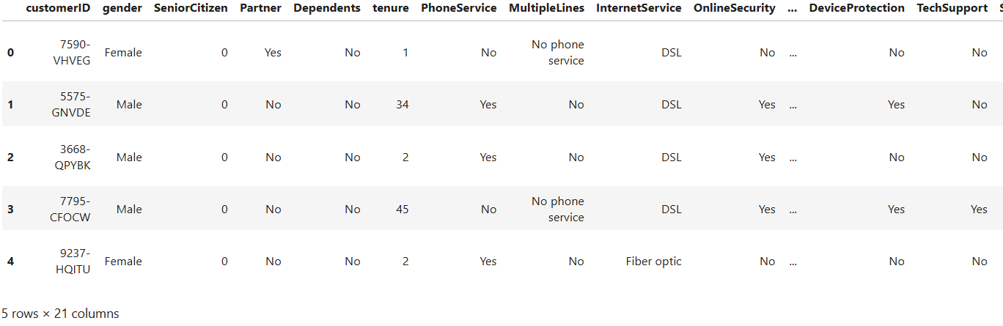
Sample columns
Sample columns

Slide 8
Feature Engineering
Feature Name | Business Meaning
Tenure Group | Customer lifecycle segmentation
Total Charges | Lifetime revenue
Average Revenue per Month | Normalized revenue
Number of Services Used | Adoption intensity
NumServicesUsed | Total subscribed services
IsMonthToMonth | Contract flexibility (risk indicator)
HighRiskPayment | Electronic check usage flag
HasFamily | Presence of partner/dependents
ProtectionPlan | Subscription to any protection services
IsNewCustomer | Customers with ≤3 months tenure

Slide 9
kpi
Metric | Description
Risk Score | Quantifies likelihood of churn using customer behavior and demographics.
Risk Category | Classifies customers into Low / Medium / High Risk based on Risk Score.
Churn Rate | Calculates % of customers leaving over a period to track retention performance.

Slide 10
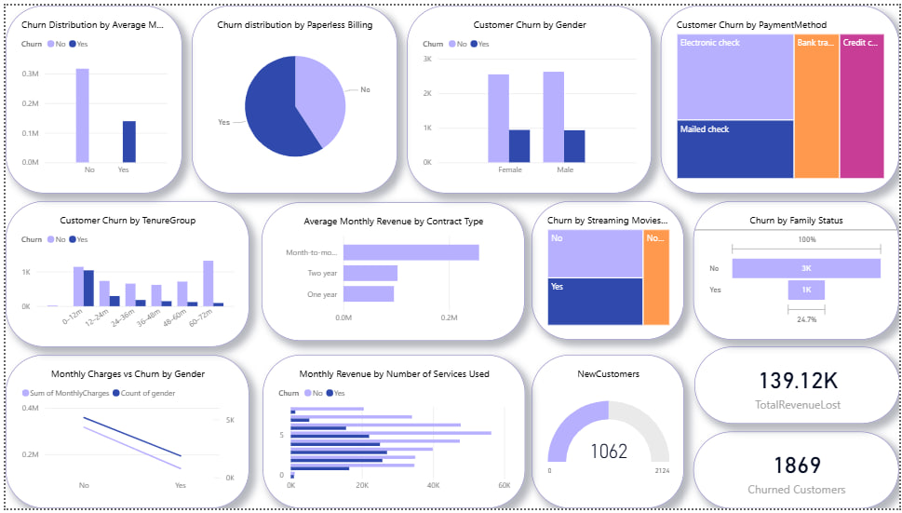
Eda graphs

Slide 11
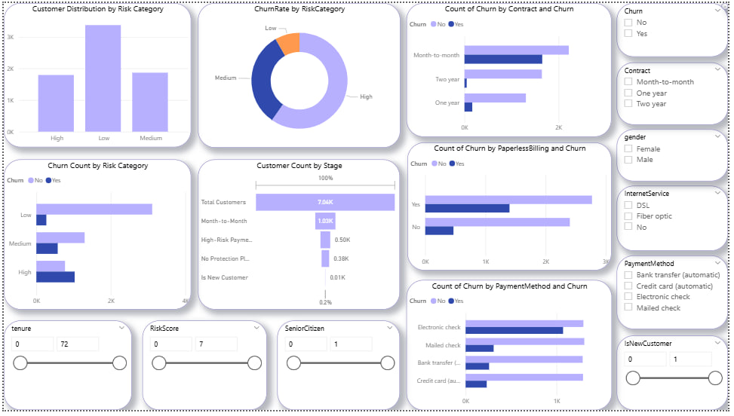

Slide 12
insights
Churn Trends
Customers with month-to-month contracts and higher monthly charges are more likely to churn.
Low tenure groups (0–12 months) and high-risk payment types are associated with higher churn.
Churn is fairly balanced across genders but slightly higher among new customers.
Revenue Impact
Total revenue lost due to churn is 139.12K, with 1869 customers churned, indicating a significant revenue risk.
Average monthly revenue is higher in month-to-month contracts, so losing these customers has a disproportionate revenue impact.

Slide 13
Risk and Protection
Customers without protection plans or high-risk payment methods are more prone to churn.
High-risk category has fewer customers but a higher churn rate than the low-risk segment.
Service and Usage Insights
Customers using fewer services are more likely to churn.
Streaming movies and multiple services usage seems to slightly reduce churn, implying service engagement lowers churn probability.
Demographic and Payment Method
Customers using electronic checks or no paperless billing have higher churn.
Family status impacts churn: customers with no family are more likely to leave

Slide 14
Top Churn Drivers
Short Tenure customers more likely to churn.
Month-to-Month contract customers have high churn rates.
High monthly charges correlated with churn.
Customers without tech support or online security churn more.

Slide 15
Key Insights
Month-to-Month contracts are high churn risk.
Senior citizens have higher churn probability.
High service charges increase likelihood of churn.
Value-added services (e.g., tech support) reduce churn risk.

Slide 16
Business recommendations
Retention Strategies
Offer loyalty programs or discounts for month-to-month and new customers.
Promote protection plans and bundled services to reduce churn among medium/high-risk segments.
Predictive Churn Model
Build a machine learning model incorporating tenure, risk score, payment method, services used, and contract type to predict churn probability.
Prioritize interventions based on high-risk customers with high revenue potential.
Customer Engagement Initiatives
Target low-service users with engagement campaigns (upsell streaming, device protection, tech support).
Implement automated alerts for accounts showing high-risk behaviors (payment delays, low engagement).
Revenue Forecasting
Combine churn probability with average monthly revenue to estimate future revenue at risk, enabling proactive retention campaigns.

Slide 17
Conclusion
Churn analysis highlights key drivers of customer attrition.
Predictive modeling enables proactive retention strategies.
Future work: Deploy churn prediction model in production environment.

Slide 18
Modeling Approach
Machine Learning models tested:
- Logistic Regression
- Random Forest Classifier
- XGBoost
Best model selected based on accuracy & ROC-AUC.

Slide 19
Evaluation Metrics
Accuracy, Precision, Recall, F1-score used for evaluation.
ROC-AUC curve compared for models.
Random Forest achieved highest performance (~82% accuracy).

Slide 20
Churn Rate Calculation
Churn Rate = (Customers Lost ÷ Total Customers) × 100
Example Result: ~26.5% churn rate in dataset.

Slide 21
Exploratory Data Analysis (EDA)
Analyzed churn distribution across gender, tenure, contract type, and payment methods.
Visualized churn trends using charts and plots.
Identified high-risk customer segments.

Slide 22
To do
Source of dataset
Feature engineering
Sample columns
Data cleaning
Kpi
Ml model+ accuracy metrics

Slide 23
Objective
Understand customer churn behavior.
Identify top churn drivers.
Build predictive models for churn forecasting.
Segment Customers.
Maximize profitability.
Provide actionable recommendations to reduce churn.

