Slide 1
CAREEBRIDGE / 医路桥
Turn symptom chaos
into safer care decisions.
What makes this submission credible
Red-flag aware triage decisions
Follow-up questions only when missing context changes urgency
Doctor-facing summary that can be copied, downloaded, or printed
Persistent revisit flow for follow-up
AI Triage & Visit Preparation Assistant for Underserved Patients
让患者在见到医生之前，就完成更清晰、更安全的就医准备。
Healthcare accessibility
Safety boundaries
Hackathon-ready

Slide 2
Problem
医疗资源不均，不只是“看病难”，更是“就医前判断难”
The biggest gap often happens before the patient reaches a doctor.
Patients do not know urgency
Symptoms are described poorly
Doctors lose time on reconstruction
A fever, chest discomfort, or worsening cough often starts with uncertainty, not action.
Patients and family members rarely arrive with structured, consultation-ready information.
Short consultation time gets spent rebuilding context instead of making the best clinical decision.
The care journey breaks before diagnosis
1
Symptoms start
2
Search / ask family
3
Choose where to go
4
Arrive at clinic
Unclear if it is serious
Advice is fragmented
Wrong department or delay
Doctor hears incomplete story
Medical friction often begins with uncertainty, delay, and fragmented patient communication.

Slide 3
Users
Who we serve
CareBridge helps the people around the first medical handoff.
Patients in rural and county settings
Family caregivers
Need a clearer answer to: should I go now, where should I go, and what should I say?
Need a way to record symptoms and support elderly or low-tech patients.
Primary / community doctors
Receiving clinicians
Need structured intake context before repeated basic questioning.
Need a clean summary that helps them start closer to clinical decision-making.

Slide 4
Solution
Introducing CareBridge
We do not replace doctors. We prepare patients better.
1. Symptom intake
2. Guided follow-up
3. Risk stratification
4. Visit summary
Patients start with natural language instead of medical jargon.
The system asks only for missing signals that could change urgency.
Four action levels turn uncertain symptoms into clear next steps.
A doctor-ready summary supports faster handoff.
Core value proposition
CareBridge helps patients enter the healthcare system earlier, safer, and better prepared.
Turn ambiguous symptoms into a clear action recommendation
Reduce wrong-department visits and avoidable delay
Improve the first doctor-patient handoff with structured context

Slide 5
Workflow
How it works
A narrow, realistic loop is easier to trust and easier to demo.
1
2
3
4
5
Intake
Clarify
Assess
Summarize
Track
Natural-language symptoms and patient context
Targeted follow-up questions for missing risk signals
Risk level, suggested action, and suggested department
Doctor-facing handoff summary
Follow-up logs and revisit workflow

Slide 6
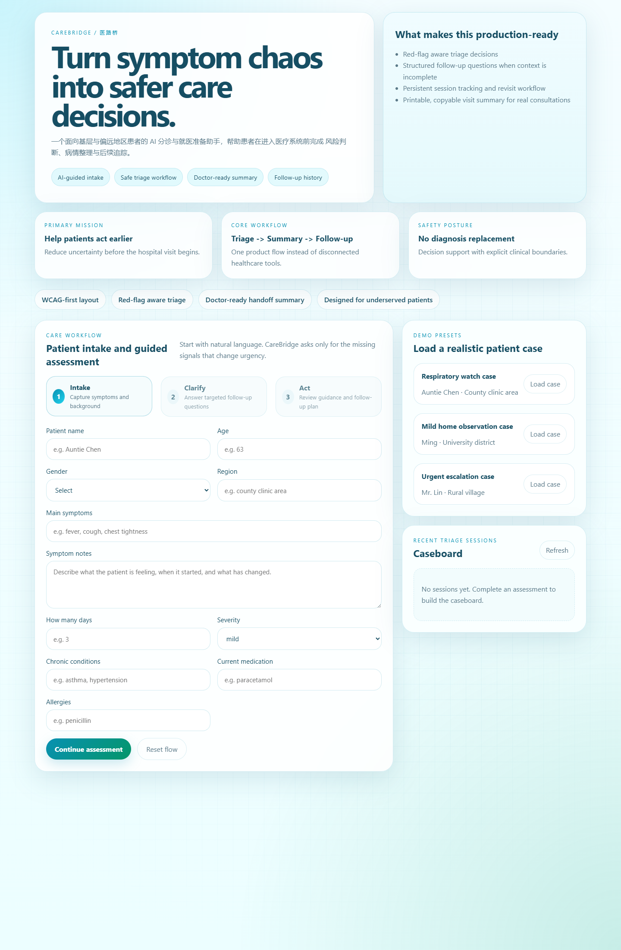
Product
Live product: intake + caseboard
A trust-first interface matters in healthcare.
Demo presets
Fast, reliable demo cases for recording and judging.
Caseboard
Recent sessions persist locally so a patient can be revisited later.
Accessibility-first UI
High-contrast light palette, visible focus states, and large tap targets.

Slide 7
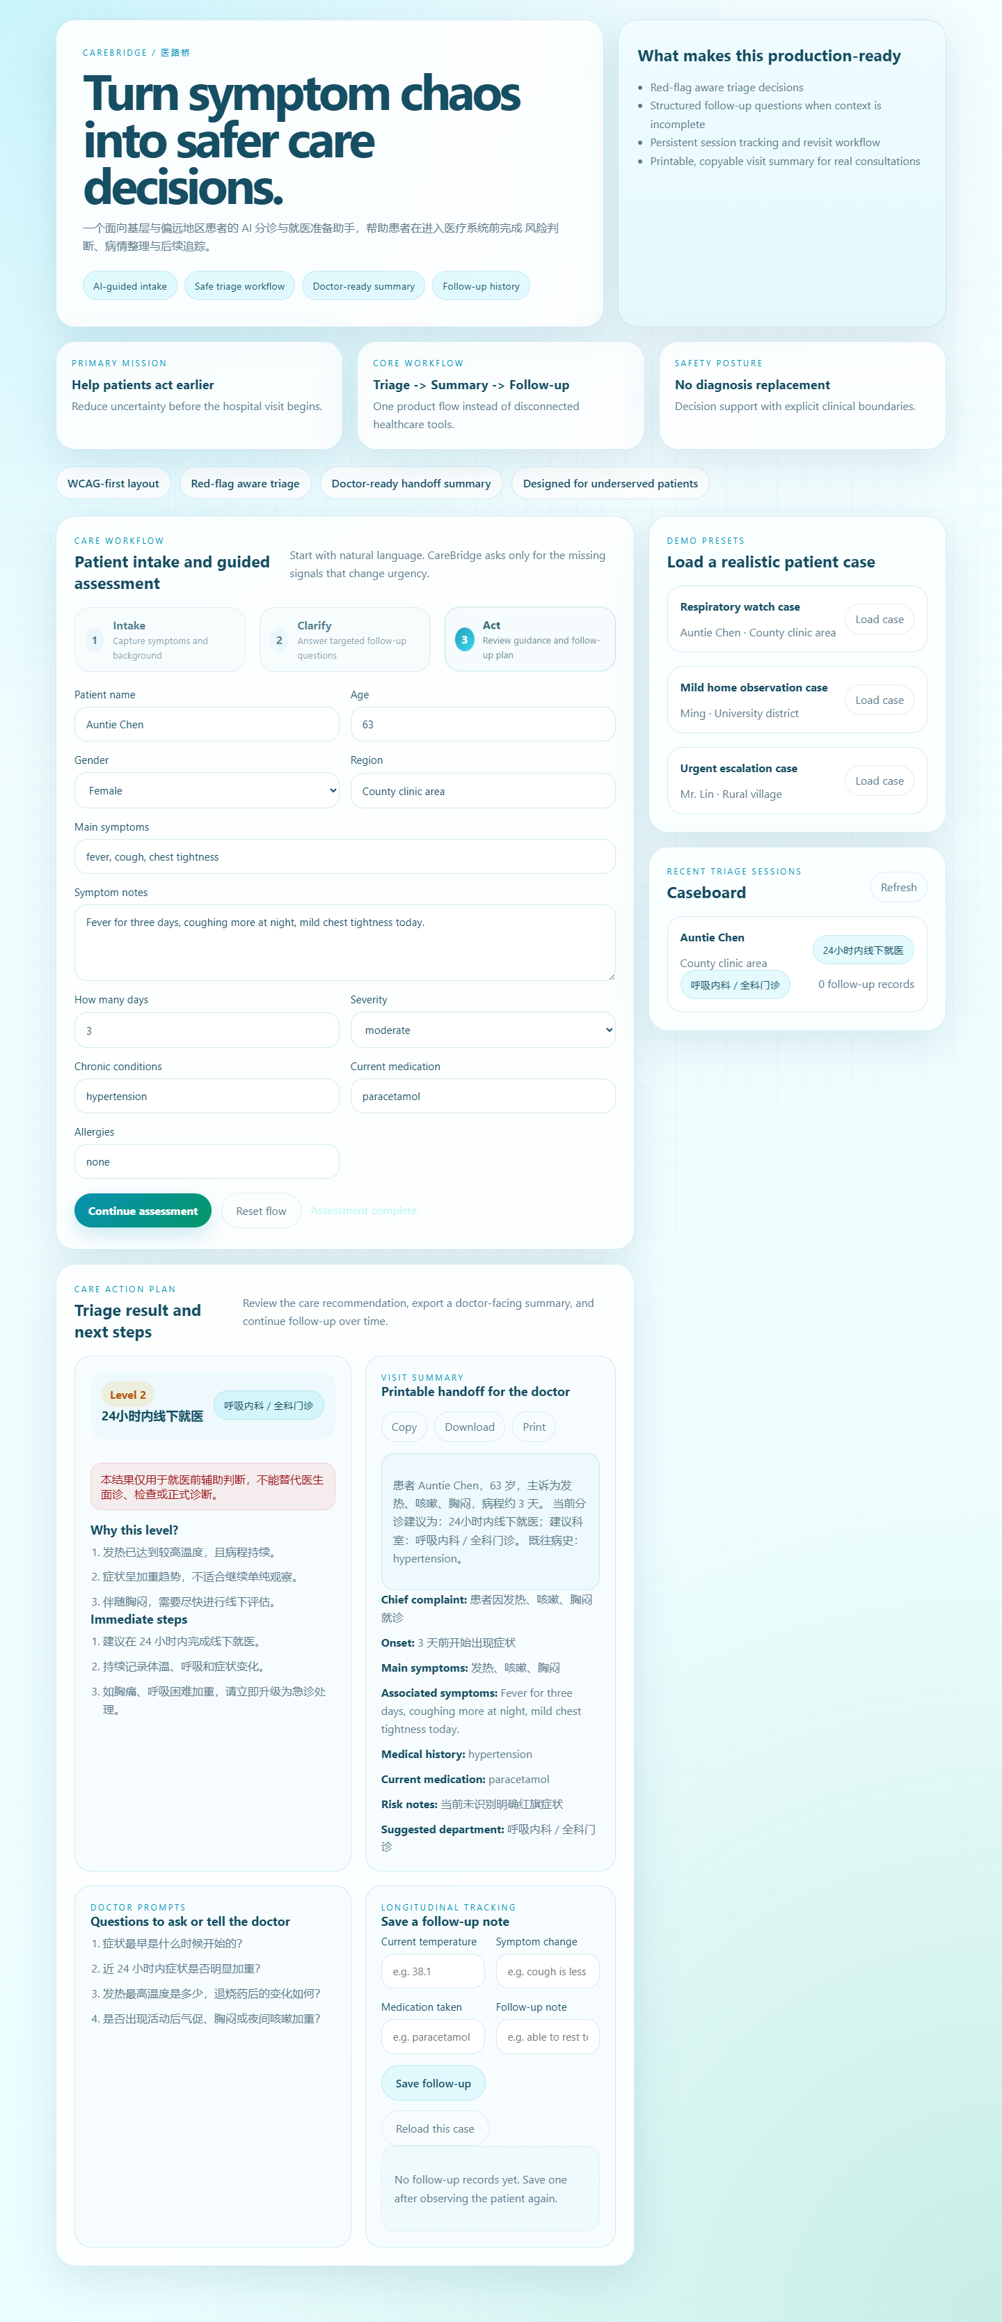

Product
Live product: guidance, summary, and follow-up
The product does not stop at advice.

Slide 8
Safety
Medical safety boundaries
A responsible healthcare product should be clear about what it does not do.
No final diagnosis
The product does not claim to identify a disease or replace clinical judgment.
No doctor replacement
All outputs are pre-visit guidance and structured communication support.
Conservative escalation
Red-flag symptoms push the product toward urgent in-person care.
Local privacy by design
The MVP stores session history locally and only saves the minimum needed context.
Rules + explanation
Risk stratification is bounded by explicit logic instead of free-form chatbot output.

Slide 9
Architecture
Technical design
Built as a narrow, testable local MVP instead of a speculative platform.
Frontend
Backend
Persistence
Vanilla HTML/CSS/JS delivers the intake flow, caseboard, export actions, and follow-up experience.
Node.js + Express handles triage assessment, follow-up recording, and session retrieval APIs.
Local JSON storage keeps the MVP simple, inspectable, and hackathon-friendly.
Decision pipeline
Patient intake
Missing-signal detection
Red-flag rules
Risk/action output
Visit summary
Follow-up persistence

Slide 10
Execution
Built and verified
A hackathon project feels more credible when the core flow is testable.
10 automated tests
1 E2E browser flow
3 product screenshots
GitHub-ready repo
Unit + API tests pass across triage logic and session workflows.
Playwright validates the main patient journey end-to-end.
The repo includes visual proof for README, PPT, and submission assets.
Code, docs, assets, scripts, and tests are packaged for submission.
Why this matters for judges
Submission package
This is a working local product, not only a concept.
The user flow is coherent enough to demo in under five minutes.
The team thought about safety and responsibility, not only features.
GitHub repository with source code and tests
Product design doc and pitch outline
Screenshots, video script, and submission checklist

Slide 11
Impact
Why this matters
The contribution is social, operational, and communication-oriented.
For patients
For families
For clinicians
They get a clearer answer to whether care is urgent, where to go, and what to tell a doctor.
They can record context for elderly or overwhelmed patients and track what changed later.
They receive a more structured first handoff instead of fragmented storytelling.
CareBridge improves the entry point into healthcare. That makes it practical for a hackathon and meaningful in the real world.

Slide 12
CareBridge / 医路桥
Helping patients reach care
earlier, safer, and better prepared.
Not a diagnosis engine.
A better first step into the healthcare system.
Healthcare accessibility
Responsible AI
Hackathon-ready MVP

