Slide 1

Shri Vishnu Engineering College for Women::Bhimavaram (Autonomous) Department of Computer Science and Engineering
Project title
Human Activity Recognition
IV B.Tech II Sem Project powerpoint presentation
In
Computer Science and Engineering
By
1. K. Lovely Srenika – 19B01A0583
2. M. Alekhya – 19B01A0594
3. V. Harshita Sai – 19B01A05A2
4. N. Lasya – 19B01A05B9
5. N. Tulasi – 19B01A05C2
Under the guidance of
Dr. T. Gayathri
(Assistant Professor)
REVIEW NO: 4
Date: 13-02-2023
Department of Computer Science and Engineering Slide No: 1

Slide 2
Shri Vishnu Engineering College for Women::Bhimavaram (Autonomous) Department of Computer Science and Engineering
Domain Knowledge :
Machine Learning
Python Modules
CNN Algorithm
LSTM
Department of Computer Science and Engineering Slide No: 2

Slide 3
Shri Vishnu Engineering College for Women::Bhimavaram (Autonomous) Department of Computer Science and Engineering
Abstract :
Recognizing a person's activities has been a critical Time series classification problem that includes predicting Human movements based on sensor data. The conventional approach using Machine learning algorithms requires in-depth domain knowledge for signal processing to the correct construction of features from raw data.
The Convolutional Neural Networks(CNNs) with the ability of automatic feature extraction, autoencoders(AEs) used for dimensionality reduction and Long short-term memory(LSTM) which are good at temporal modeling complement each other. In this work, we would like to leverage the complementarity of CNNs, AEs and LSTMs by integrating them into a unified architecture.
Department of Computer Science and Engineering Slide No: 3

Slide 4
Shri Vishnu Engineering College for Women::Bhimavaram (Autonomous) Department of Computer Science and Engineering
Introduction :
Efficient, Accurate, and Faster Human activity recognition(HAR) can have a wide range of applications. For Instance, in healthcare, particularly in the case of elderly people, HAR when used with other technologies such as the Internet of Things (IoT), can be leveraged to initiate a quick response to any contingency as the Human activity is being observed, thereby reducing loss of lives.
Various HAR frameworks have been proposed based on audio/video data frameworks, wearable sensor based and smartphone sensor based which cites different pros and cons according to the ease with which the information is gathered or by measuring the utility of the sensors in use. For example, wearable and audio/video based sensors can be uncomfortable to the users and requires complex signal processing.
Department of Computer Science and Engineering Slide No: 4

Slide 5
Shri Vishnu Engineering College for Women::Bhimavaram (Autonomous) Department of Computer Science and Engineering
On the contrary, portability and intraoperative properties of the smartphone have been leveraged to build smartphone based physical HAR systems. Data can be collected continuously while carrying out any physical activity through a smartphone. Furthermore, the range of built-in smartphone sensors makes mobile health-related data monitoring more elegant and accurate.
Smartphone-based HAR systems that use traditional machine learning algorithms or deep learning techniques are becoming increasingly popular. Because it extracts the relevant characteristics that are responsible for discriminating diverse activity patterns, feature engineering is a dominant phase in classical ML approaches.
Extensive data preparation techniques are necessary to deliver sensory data in a suitable format, and handmade characteristics are derived from the collected sensory data based on expert domain knowledge Finally, to recognise distinct human physical activities, the handmade feature vector is passed to traditional classifiers.
Department of Computer Science and Engineering Slide No: 5

Slide 6
Shri Vishnu Engineering College for Women::Bhimavaram (Autonomous) Department of Computer Science and Engineering
Problem Statement :
In this project, we would like to propose and build advanced methodologies and compare them with the previous methods. To build a robust system, we would like to consider datasets where data is collected from various sensors, images, accelerometers, and gyroscopes.
We will study various deep neural network architectures based on convolutional neural networks, recurrent neural networks to solve this problem and propose a novel architecture that can better perform the task.
The primary public dataset that will be used in this project is the experiment that was conducted in a group of 30 volunteers within the 19-48 year age group. Each person wore a smartphone on their waist and performed six different activities (walking, walking_downstairs, walking_upstairs, standing, sitting, laying).
With a built-in accelerometer and gyroscope in the smartphone, recorded 3-axis linear acceleration and 3-axis angular velocity at a constant frequency of 50Hz. The experiment was recorded on video for manual labeling of the data.
Department of Computer Science and Engineering Slide No: 6

Slide 7
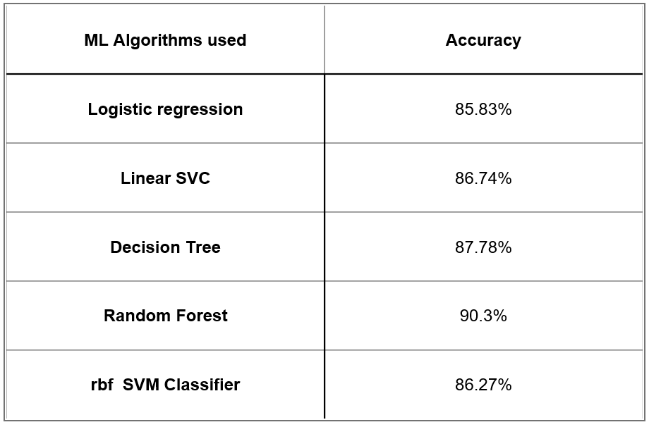
Shri Vishnu Engineering College for Women::Bhimavaram (Autonomous) Department of Computer Science and Engineering
Existing System:
Machine learning methods with handcrafted features are the dominant methods used in previous works.
We tested various ML methods and found the Average validation accuracies.
Deep learning Methods such as CNN, LSTM and other combinations resulted in the test accuracy of around 90% with a validation accuracy of around 95% in the previous research works.
Department of Computer Science and Engineering Slide No: 7

Slide 8
Shri Vishnu Engineering College for Women::Bhimavaram (Autonomous) Department of Computer Science and Engineering
Existing System:
ML approaches can provide good accuracy on par to DL methods but in HAR domain particularly there should be an extensive manual feature extraction
DL approach such as CNN can be used to improve performance
As CNNs are good at automatic feature extraction
Now AEs are impeccable at dimensionality reduction
So, As seen in previous works combining them gave better results
Now LSTMs are important to preserve sequential data
As expected we can see combining LSTM is also given still better results
Department of Computer Science and Engineering Slide No: 8

Slide 9
Shri Vishnu Engineering College for Women::Bhimavaram (Autonomous) Department of Computer Science and Engineering
Proposed System:
The proposed model consists of three different modules, the first module is a convolutional AE, containing a convolutional layer, a pooling layer and a deconvolutional layer.
The output of the convolution AE passes through the flattened layer and is converted to the LSTM input format. The LSTM output goes through a fully connected layer to get a high level representation.
Finally, the softmax (using the softmax function) layer is used as the final step in detecting human physical activity.
A flattened layer is added after the deconvolutional layer of the convolution AE, and the feature data of the LSTM layer is formatted. This is because the data format of the convolution layer is different from the input data format of the LSTM layer.
The time-sharing wrapper provided by Python's Keras library takes a slice as an argument and applies a convolution to the signal while maintaining the temporal integrity of the LSTM slice.
Since the time division layer operates in 3D data format, it is necessary to convert the input signal from 128 time frames using the exact number of signals. A total of 128 timeframes are divided into 4 slices of 32 timeframes each.
Department of Computer Science and Engineering Slide No: 9

Slide 10
Shri Vishnu Engineering College for Women::Bhimavaram (Autonomous) Department of Computer Science and Engineering
Modules:
The model proposed consists of three modules:
The first being the convolutional AE consisting of a convolutional layer, a pooling layer and a deconvolutional layer.
The output of this layer is passed through a flattened layer which serves as a desired input for the LSTM layer.
The LSTM output goes through a fully connected layer to get a high level representation.
Department of Computer Science and Engineering Slide No: 10

Slide 11
Shri Vishnu Engineering College for Women::Bhimavaram (Autonomous) Department of Computer Science and Engineering
Modules: Convolutional AE
Convolutional AE is a variation of AE where a Convolutional layer replaces a fully connected layer. Convolutional AE has the advantages of both an AE with unsupervised pre-training capabilities and a convolutional layer. The difference between an AE and a Convolutional AE is that instead of having a fully connected layer in the decoder, Convolutional AE contains deconvolutional layers in the decoder and convolutional layers in the encoder.
The proposed Convolutional AE comprises a convolution, pooling and deconvolution layers . Encoder includes a convolutional layer and a Maxpool layer whereas Decoder comprises a deconvolutional layer. The results from the convolutional layer are encoded with a Maxpool layer that allows high-layer representations that doesn’t alter with small changes in the inputs which reduces the overall computational cost.
Department of Computer Science and Engineering Slide No: 11

Slide 12
Shri Vishnu Engineering College for Women::Bhimavaram (Autonomous) Department of Computer Science and Engineering
Modules: LSTM
Temporal features play an important role in modelling human movements. In recent years, LSTMs have performed impressively in HAR and various other domains. The temporal features are extracted from time sensory signals by the LSTM architecture because of its long-term dependencies and temporal characteristics.
In our proposed architecture as explained earlier, convolutional AE is followed by a LSTM model. The results of the convolutional AE are passed as inputs to the LSTM to deduce the latent temporal interactions across the timeframes.
Department of Computer Science and Engineering Slide No: 12

Slide 13
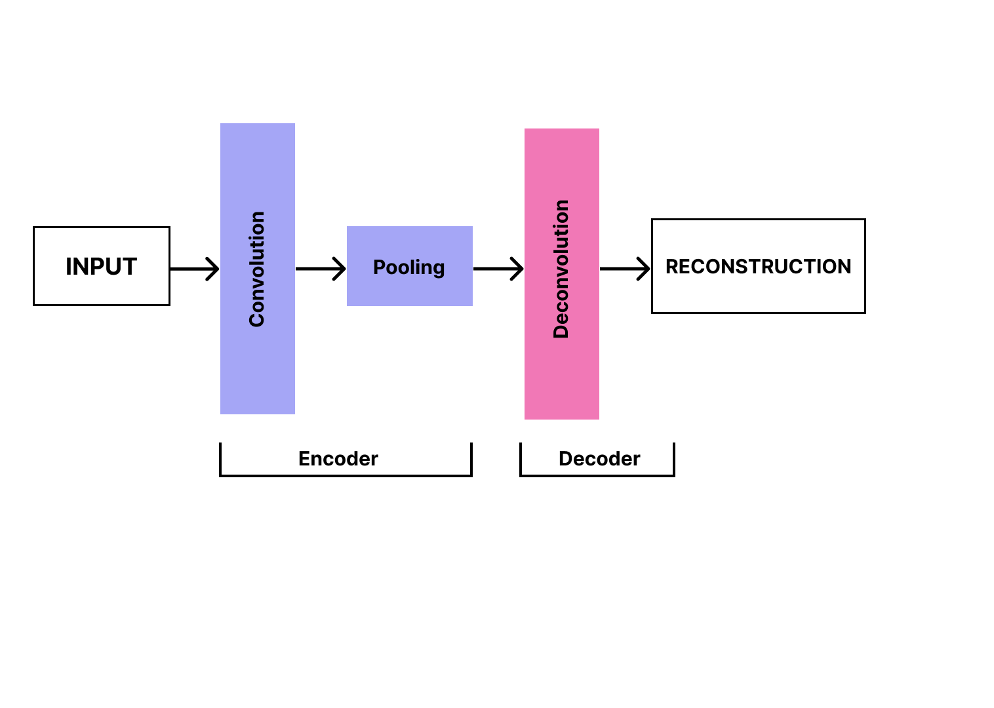
Shri Vishnu Engineering College for Women::Bhimavaram (Autonomous) Department of Computer Science and Engineering
System Design :
Department of Computer Science and Engineering Slide No: 13

Slide 14
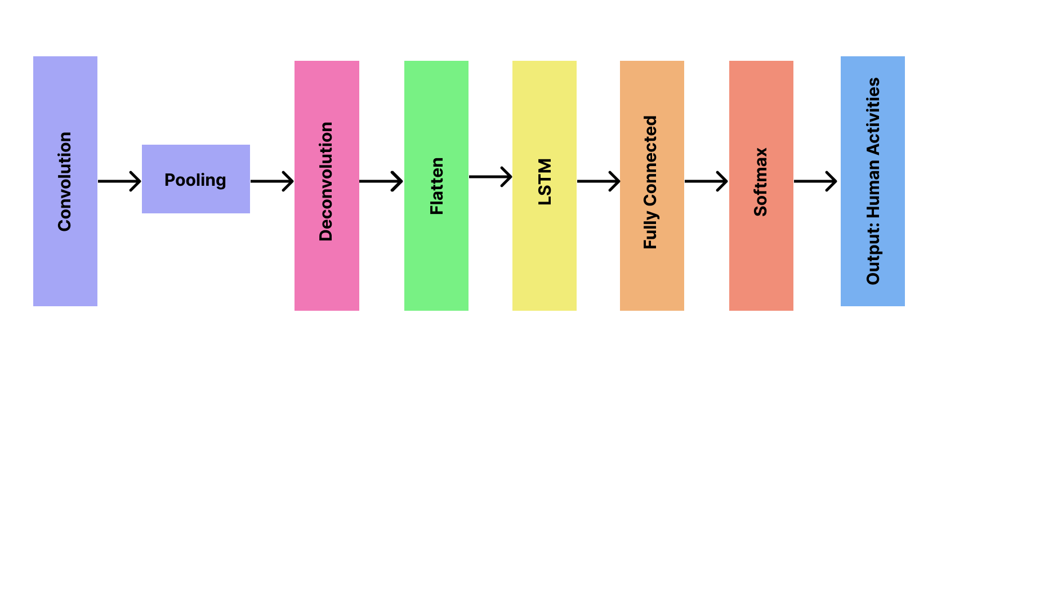
Shri Vishnu Engineering College for Women::Bhimavaram (Autonomous) Department of Computer Science and Engineering
System Design :
Department of Computer Science and Engineering Slide No: 14

Slide 15
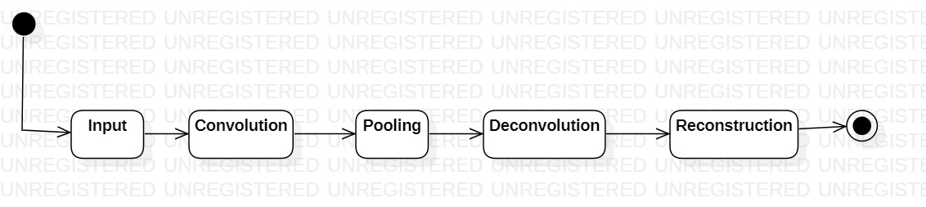
Shri Vishnu Engineering College for Women::Bhimavaram (Autonomous) Department of Computer Science and Engineering
UML Diagrams:
State Chart Diagram:
Department of Computer Science and Engineering Slide No: 15

Slide 16
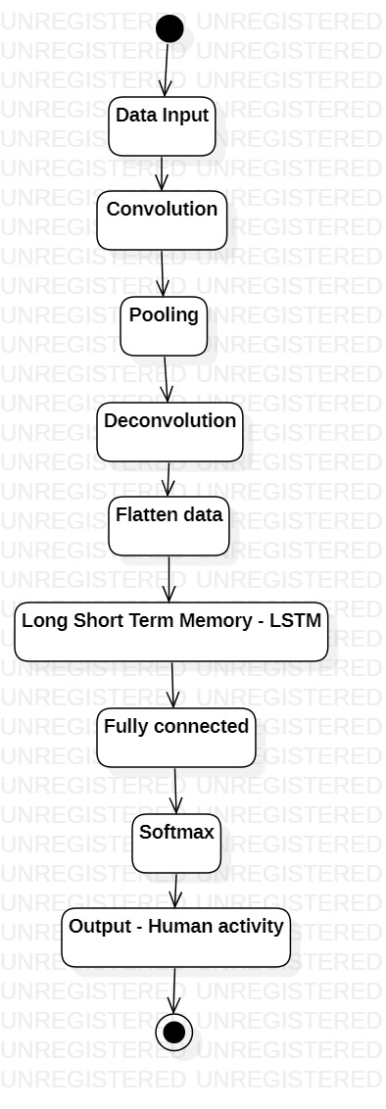
Shri Vishnu Engineering College for Women::Bhimavaram (Autonomous) Department of Computer Science and Engineering
UML Diagrams:
Activity Diagram:
Department of Computer Science and Engineering Slide No: 16

Slide 17
Shri Vishnu Engineering College for Women::Bhimavaram (Autonomous) Department of Computer Science and Engineering
Implementation:
model = Sequential()
model.add(
tf.keras.layers.TimeDistributed(
tf.keras.layers.Conv1D(
filters=64, kernel_size=3,strides=2,
activation="relu",
input_shape=(n_length, n_features)
)
)
)
model.add(
tf.keras.layers.TimeDistributed(
tf.keras.layers.MaxPool1D(pool_size=2, strides=2)
)
)
model.add(
tf.keras.layers.TimeDistributed(
tf.keras.layers.Conv1DTranspose(
filters=64, kernel_size=3,strides=2,
activation="relu"
)
)
)
model.add(
tf.keras.layers.TimeDistributed(
tf.keras.layers.Flatten()
)
)
model.add(Dropout(0.5))
model.add(LSTM(64))
model.add(Dense(64, activation='relu'))
model.add(Dense(64, activation='relu'))
model.add(Dense(n_classes, activation='softmax')
Department of Computer Science and Engineering Slide No: 17

Slide 18
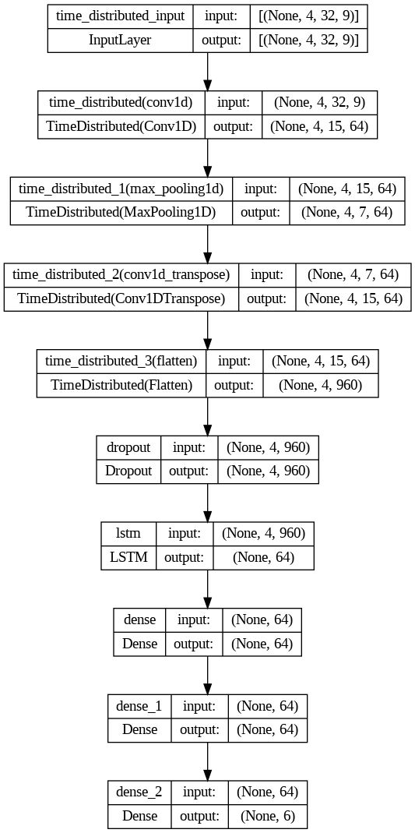
Shri Vishnu Engineering College for Women::Bhimavaram (Autonomous) Department of Computer Science and Engineering
Department of Computer Science and Engineering Slide No: 18

Slide 19
Shri Vishnu Engineering College for Women::Bhimavaram (Autonomous) Department of Computer Science and Engineering
Results and Discussions:
With 5-fold cross validation we are achieving an average accuracy of more than 98% with almost no loss.
With LOSO cross validation, We are getting an overall accuracy around 93%(93.42%) with a loss of around 0.4.
The optimiser we used is an Adam optimiser and the loss function suitable in this case is categorical cross-entropy.
Department of Computer Science and Engineering Slide No: 19

Slide 20
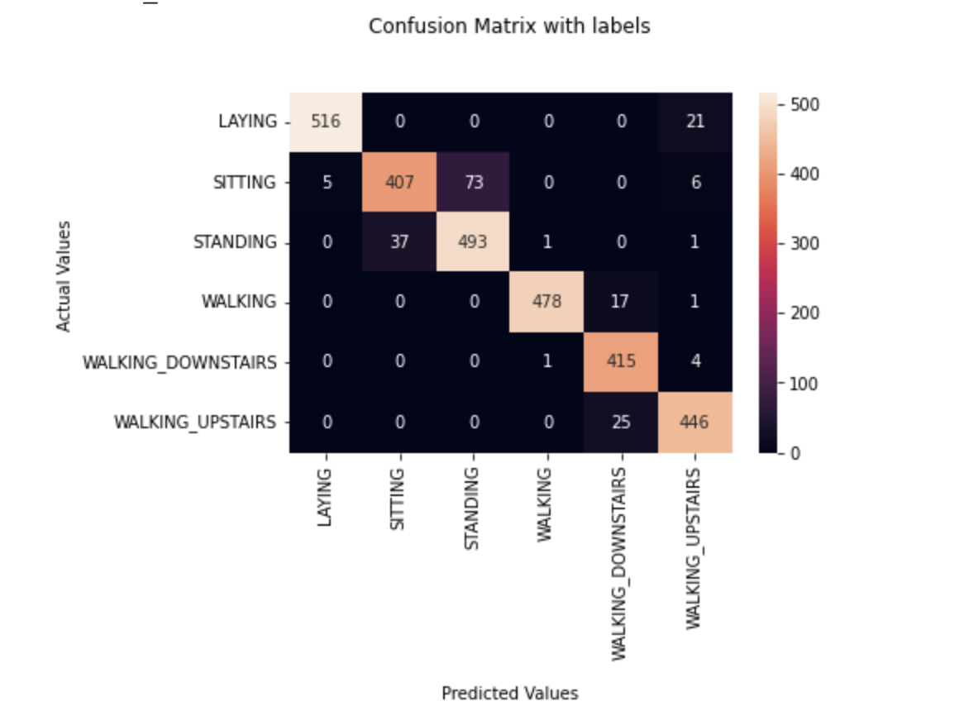
Shri Vishnu Engineering College for Women::Bhimavaram (Autonomous) Department of Computer Science and Engineering
Department of Computer Science and Engineering Slide No: 20

Slide 21
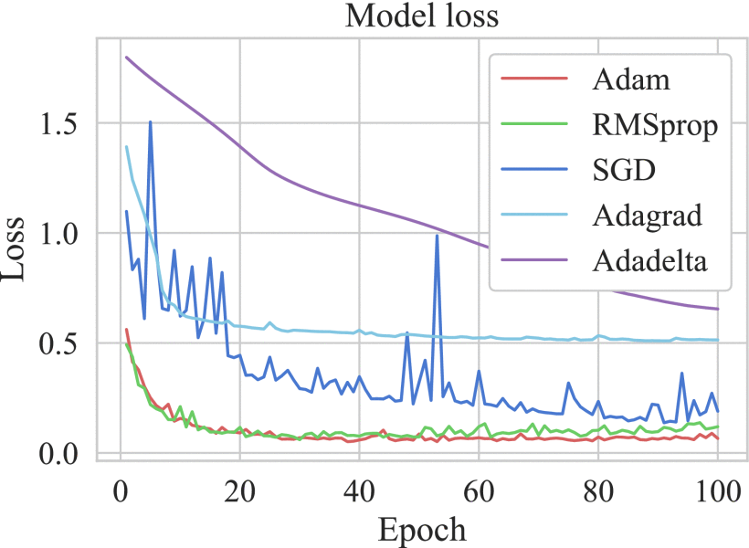
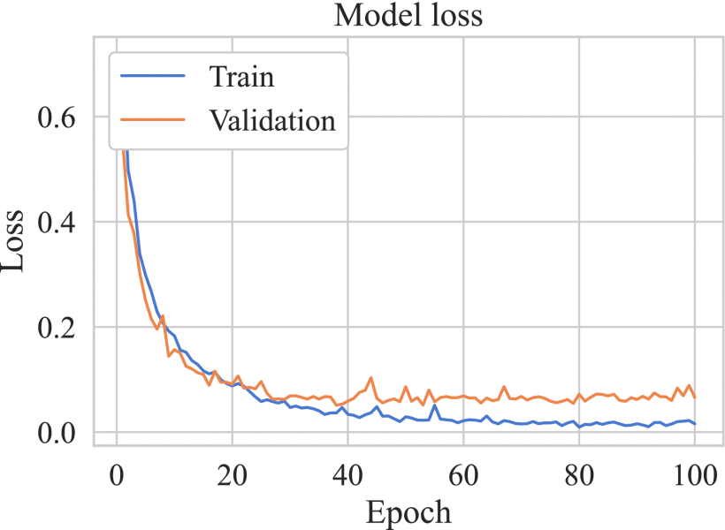
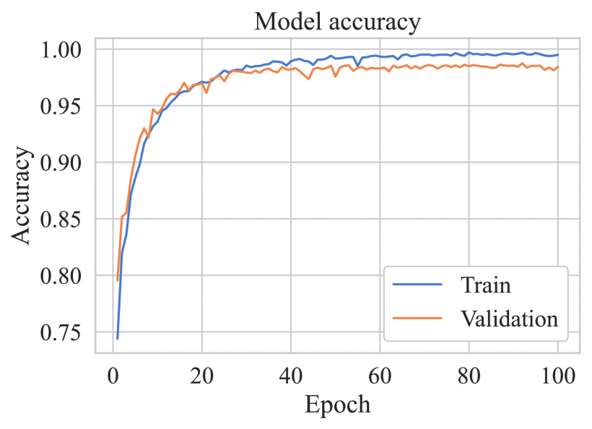
Shri Vishnu Engineering College for Women::Bhimavaram (Autonomous) Department of Computer Science and Engineering
Department of Computer Science and Engineering Slide No: 21

Slide 22
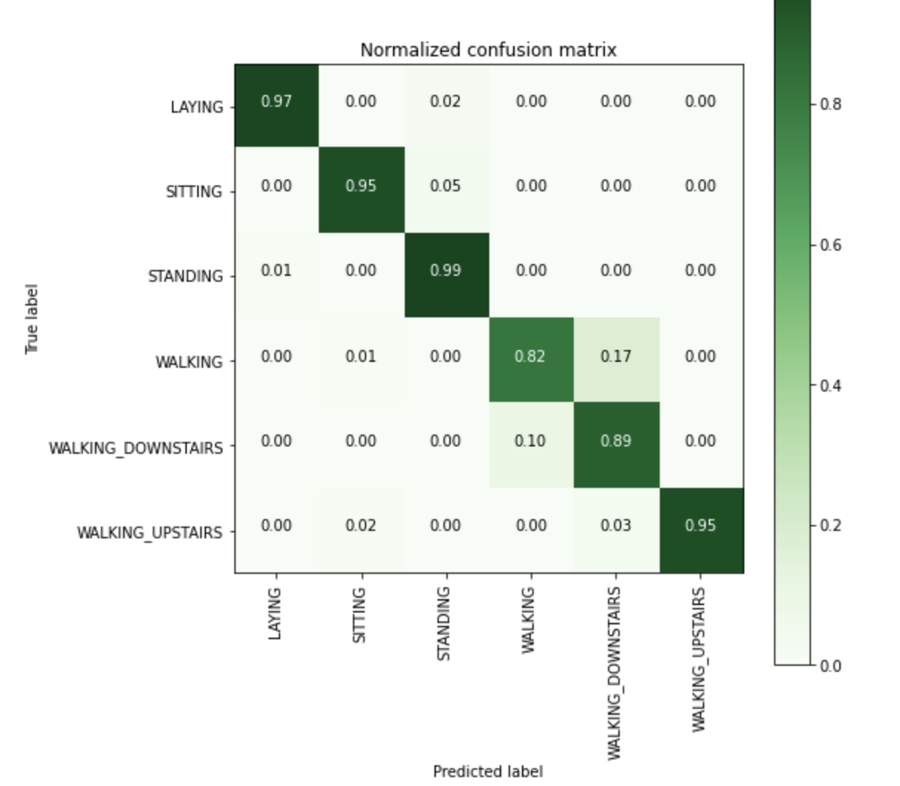
Shri Vishnu Engineering College for Women::Bhimavaram (Autonomous) Department of Computer Science and Engineering
Department of Computer Science and Engineering Slide No: 22

Slide 23
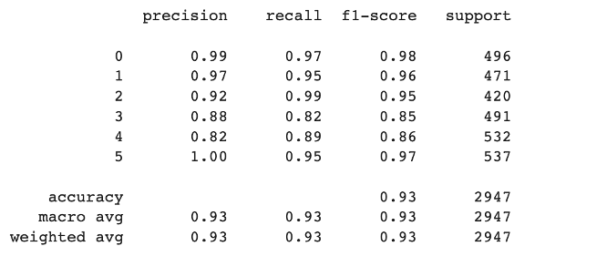
Shri Vishnu Engineering College for Women::Bhimavaram (Autonomous) Department of Computer Science and Engineering
Department of Computer Science and Engineering Slide No: 23

Slide 24
Shri Vishnu Engineering College for Women::Bhimavaram (Autonomous) Department of Computer Science and Engineering
Conclusion :
In conclusion, we proposed a unified architecture.
This architectures combines the abilities of CNN, AE and LSTM.
CNN with its automatic feature extraction and AE with its ability of efficient dimensionality reduction and LSTM with the ability to preserve sequence information.
Currently we have primarily got the performance results of the proposed architecture on UCI-HAR dataset.
Further, we want to study the performance of the model in other datasets for this research work to be presented.
Department of Computer Science and Engineering Slide No: 24

Slide 25
Shri Vishnu Engineering College for Women::Bhimavaram (Autonomous) Department of Computer Science and Engineering
Requirement Analysis:
Software Requirements :
IDE : Google Colab
Language : Python
Libraries : Tensorflow, Keras, Pandas, Numpy
Hardware Requirements:
Processor : Tesla P 100
RAM : 12GB
Space on Hard Disk : 500GB
Department of Computer Science and Engineering Slide No: 25

Slide 26

Shri Vishnu Engineering College for Women::Bhimavaram (Autonomous) Department of Computer Science and Engineering
Department of Computer Science and Engineering Slide No: 26

