Slide 1
Analysis of direct marketing campaigns data of a Portuguese banking institution using Tableau
BY:
N.S.P.Priyanka

Slide 2
TABLE OF CONTENTS
CHAPTERS
ABSTRACT
CHAPTER 1: INTRODUCTION
INTRODUCTION
PROBLEM DEFINITION
SCOPE
PURPOSE
PROBLEM AND EXISTING TECHNOLOGY
PROPOSED SYSTEM
CHAPTER 2: REQIUREMENTS & ANALYSIS
PLATFORM REQUIREMENTS
MODULE DESCRIPTION
CHAPTER 3: DESIGN & IMPLEMENTATION
ALGORITHMS
PSEUDO CODE
CHAPTER 4: SCREENSHOTS
CHAPTER 5: CONCLUSION
CHAPTER 6: REFERENCES

Slide 3
1. INTRODUCTION
1.1 INTRODUCTION
Data visualization is the process of translating large data sets and metrics into charts, graphs and other visuals. The resulting visual representation of data makes it easier to identify and share real time trends, outliers, and new insights about the information represented in the data.
Data visualization allows business users to gain insight into their vast amounts of data. It benefits them to recognize new patterns and errors in the data. Making sense of these patterns helps the users
pay attention to areas that indicate red flags or progress.The basic uses of the Data Visualization technique are as follows:
In the data mining process, it acts as a primary step in the pre-processing portion.
It supports the data cleaning process by finding incorrect data and corrupted or missing values. 3)It is a powerful technique to explore the data with presentable and interpretable results.
It also helps to construct and select variables, which means we have to determine which variable to include and discard in the analysis.
In the process of Data Reduction, it also plays a crucial role while combining the categories.
PROBLEM DEFINITION
The main objective of the project is to visualize and make analysis of the given data. The data is related with direct marketing campaigns of a Portuguese banking institution. The marketing campaigns were based on phone calls. Often, more than one contact to the same client was required, in order to access if the product (bank term deposit) would be ('yes') or not ('no') subscribed. There are four datasets:
bank-additional-full.csv with all examples (41188) and 20 inputs, ordered by date (from May 2008 to November 2010), very close to the data analyzed in [Moro et al., 2014]
bank-additional.csv with 10% of the examples (4119), randomly selected from 1), and 20 inputs. 3.bank-full.csv with all examples and 17 inputs, ordered by date (older version of this dataset with less inputs). 4.bank.csv with 10% of the examples and 17 inputs, randomly selected from 3 (older version of this dataset with less inputs). The smallest datasets are provided to test more computationally demanding machine learning algorithms (e.g., SVM). The classification goal is to predict if the client will subscribe (yes/no) a term deposit (variable y).
bank client data:
- age (numeric)
- job : type of job (categorical: 'admin.','blue- collar','entrepreneur','housemaid','management','retired','self- employed','services','student','technician','unemployed','unknown')
- marital : marital status (categorical: 'divorced','married','single','unknown'; note: 'divorced' means divorced or widowed)
- education (categorical: 'basic.4y','basic.6y','basic.9y','high.school','illiterate','professional.course', 'university.degree', 'unknown')
- default: has credit in default? (categorical: 'no','yes','unknown')

Slide 4
6 - housing: has housing loan? (categorical: 'no','yes','unknown') 7 - loan: has personal loan? (categorical: 'no','yes','unknown')
related with the last contact of the current campaign:
- contact: contact communication type (categorical: 'cellular','telephone')
- month: last contact month of year (categorical: 'jan', 'feb', 'mar', ..., 'nov', 'dec')
- day_of_week: last contact day of the week (categorical: 'mon','tue','wed','thu','fri')
- duration: last contact duration, in seconds (numeric). Important note: this attribute highly affects the output target (e.g., if duration=0 then y='no'). Yet, the duration is not known before a call is performed. Also, after the end of the call y is obviously known. Thus, this input should only be included for benchmark purposes and should be discarded if the intention is to have a realistic predictive model.
other attributes:
- campaign: number of contacts performed during this campaign and for this client (numeric, includes last contact)
- pdays: number of days that passed by after the client was last contacted from a previous campaign (numeric; 999 means client was not previously contacted)
- previous: number of contacts performed before this campaign and for this client (numeric) 15 - poutcome: outcome of the previous marketing campaign (categorical: 'failure','nonexistent','success')
social and economic context attributes
16 - emp.var.rate: employment variation rate - quarterly indicator (numeric) 17 - cons.price.idx: consumer price index - monthly indicator (numeric)
18 - cons.conf.idx: consumer confidence index - monthly indicator (numeric) 19 - euribor3m: euribor 3 month rate - daily indicator (numeric)
- nr.employed: number of employees - quarterly indicator (numeric)
Output variable (desired target):
- y - has the client subscribed a term deposit? (binary: 'yes','no')
SCOPE
This project helps us understand direct marketing techniques of a Portuguese banking institution. This will help us understand the trends and make analysis on the data by visualizing it. Data visualization gives us a clear idea of what the information means by giving it visual context through maps or graphs. This makes the data more natural for the human mind to comprehend and therefore makes it easier to identify trends, patterns, and outliers within large data sets.
PURPOSE
The main objective of this project is to visualize the given bank dataset in Tableau and Python.

Slide 5
Process for visualizing data is:
Defining Problem Statement
Model Building
Presentation & demonstration
Analysis & Conclusion
1.5 PROBLEM AND EXISTING TECHNOLOGY
The main task of our project is to visualize and make analysis of the given data.The data is related with direct marketing campaigns of a Portuguese banking institution. The marketing campaigns were based on phone calls. Often, more than one contact to the same client was required, in order to access if the product (bank term deposit) would be ('yes') or not ('no') subscribed.
A data visualization tool is a form of software that’s designed to visualize data. Each tool's capabilities vary but, at their most basic, they allow you to input a dataset and visually manipulate it. Most, but not all, come with built-in templates you can use to generate basic visualizations.
Some of the existing technology for data visualization are:
Microsoft Excel (and Power BI)
Google Charts
Tableau
Zoho Analytics
Python (Jupyter Notebook, Google Colab)
1.6 PROPOSED SYSTEM
In this Project we are going to use Tableau and Python (Jupyter notebook) for visualizing data. Tableau:
Tableau is a visual analytics engine that makes it easier to create interactive visual analytics in the form of dashboards. These dashboards make it easier for non-technical analysts and end users to convert data into understandable, interactive graphics. Tableau facilitates the use of data from public sources in conjunction with your proprietary data, enabling new and useful insight. For example, blending census data with your proprietary data can yield new insights into activity by providing normalized results for population.
Python (Jupyter Notebook):
Data visualization in python is perhaps one of the most utilized features for data science with python in today’s day and age. The libraries in python come with lots of different features that enable users to make highly customized, elegant, and interactive plots. Useful packages for visualizations in python are Matplotlib, Seaborn, Bokeh, Altair, plotly, ggplot etc.

Slide 6
2. REQUIREMENTS & ANALYSIS
2.1 PLATFORM REQUIREMENTS
Tableau Desktop
Jupyter Notebook
Dataset
2.2 MODULE DESCRIPTION
Defining Problem Statement
The main objective of the project is to visualize and make analysis of the given data. The data is related with direct marketing campaigns of a Portuguese banking institution. The marketing campaigns were based on phone calls. Often, more than one contact to the same client was required, in order to access if the product (bank term deposit) would be ('yes') or not ('no') subscribed.
Model Building
In this Project we are going to use Tableau and Python (Jupyter notebook) for visualizing data.
Tableau Steps:
Step 1: Connect to your data.
Step 2: Drag and drop to take a first look. Step 3: Focus your results.
Step 4: Explore your data geographically. Step 5: Drill down into the details.
Step 6: Build a dashboard to show your insights. Step 7: Build a story to present.
Step 8: Share your findings.
Python Steps:
Step 1: Importing data.
Step 2: Basic visualization using Matplotlib.
Step 3: More advanced visualizations, still using Matplotlib.
Step 4: Building quick visualizations for data analysis using Seaborn. Step 5: Building interactive charts.
Analysis and Presentation
The data can be presented from the graphs which are developed from Tableau and Python and can be used for analysis.

Slide 7
3. DESIGN & IMPLEMENTATION
ALGORITHMS
Python:
Matplotlib: Python based plotting library offers matplotlib with a complete 2D support along with limited 3D graphic support. It is useful in producing publication quality figures in interactive environment across platforms. It can also be used for animations as well.
Seaborn: Seaborn is a library for creating informative and attractive statistical graphics in python. This library is based on matplotlib. Seaborn offers various features such as built in themes, color palettes, functions and tools to visualize univariate, bivariate, linear regression, matrices of data, statistical time series etc which lets us to build complex visualizations.
PSEUDO CODE:
MATPLOTLIB:
import numpy as np
import matplotlib.pyplot as plt plt.bar(df1['age'], df1['job'],width = 0.4) plt.show()
SEABORN:
import pandas as pd import seaborn as sb
dataplot = sb.heatmap(df4.corr(), cmap="YlGnBu", annot=True) mp.show()

Slide 8
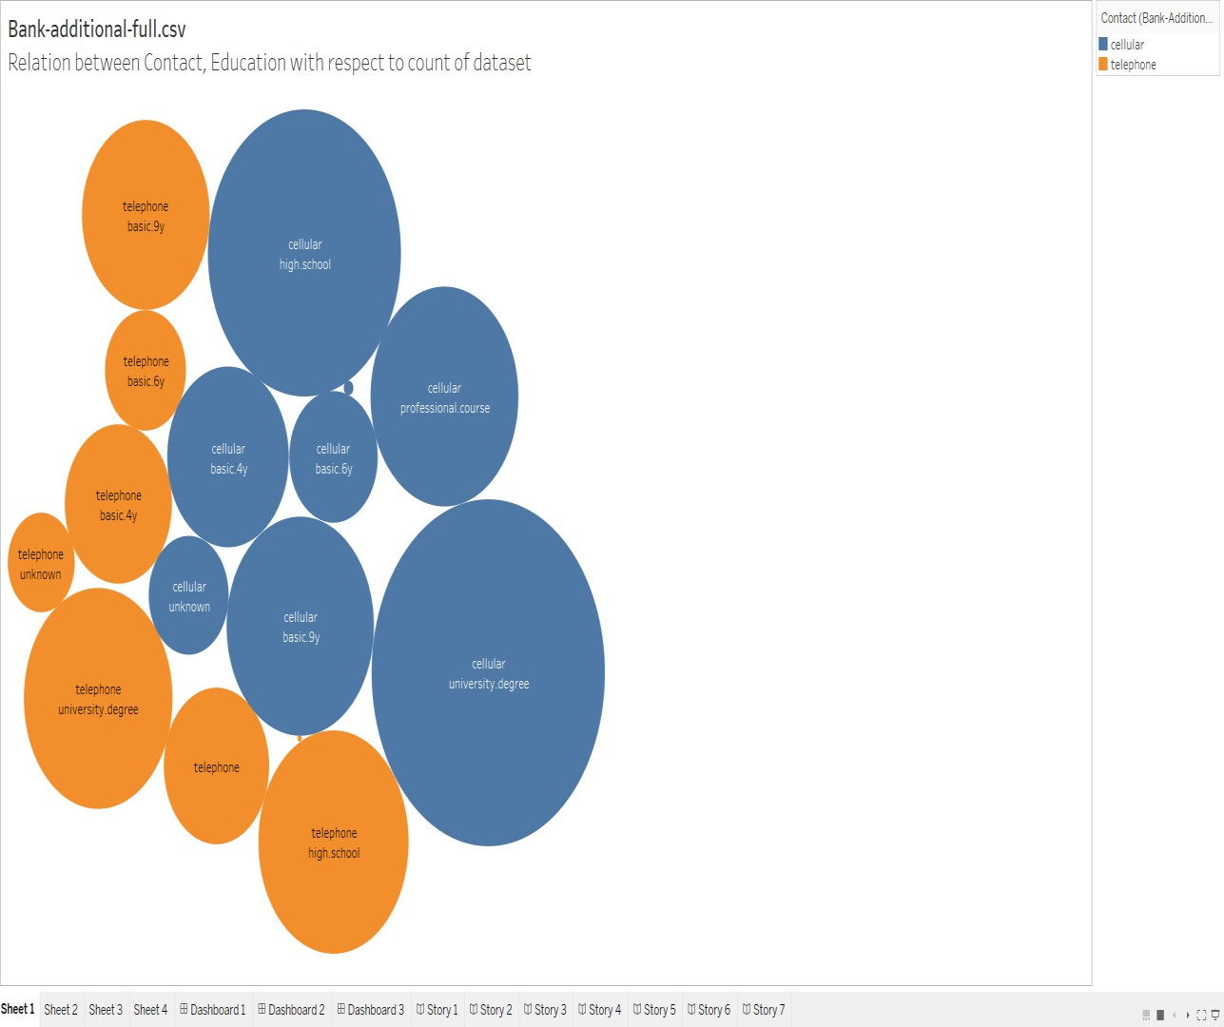
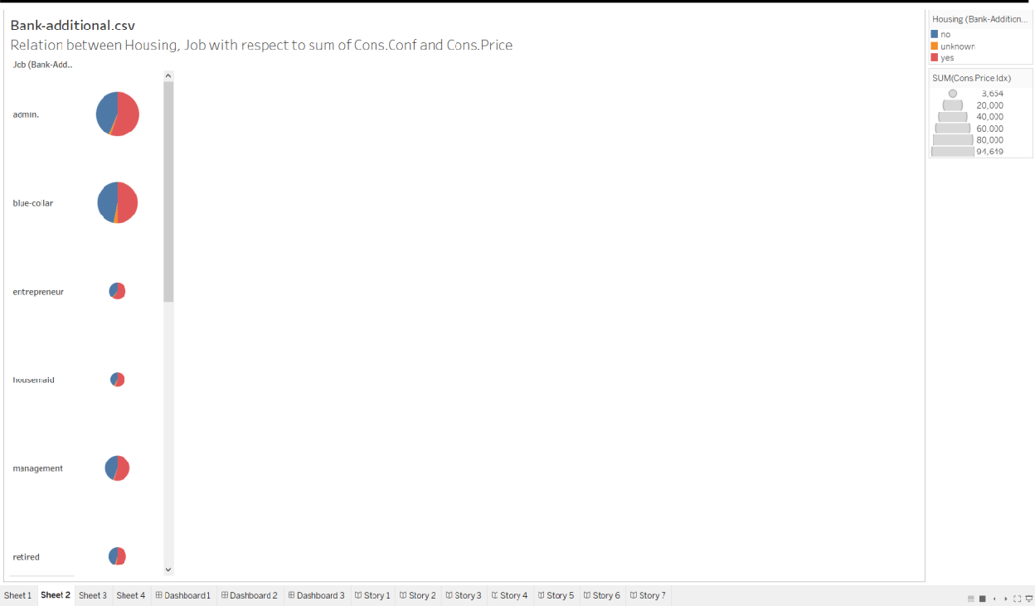
4. SCREENSHOTS
TABLEAU: SHEETS:

Slide 9
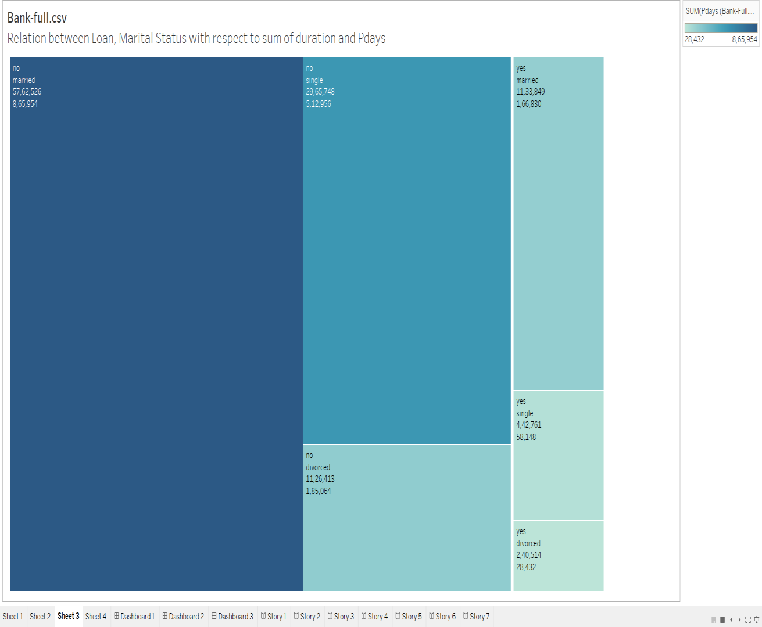
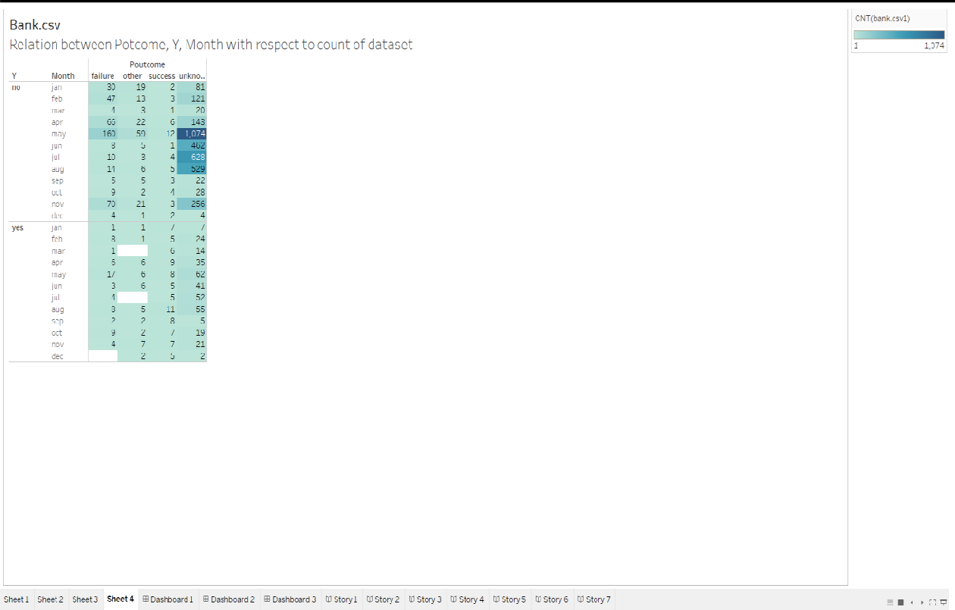

Slide 10
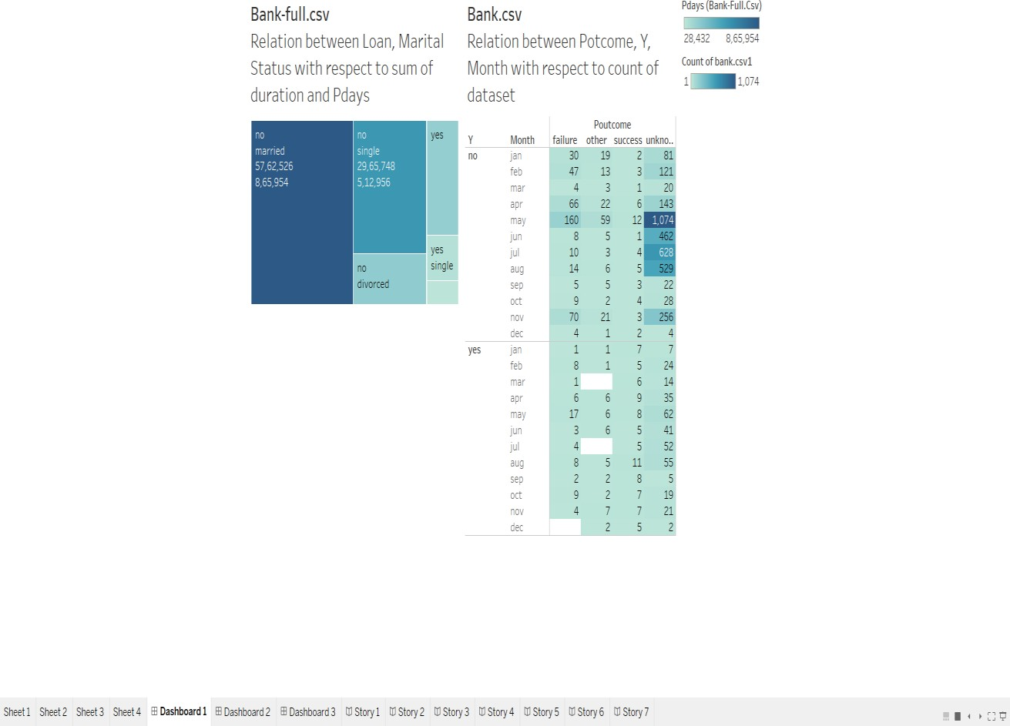
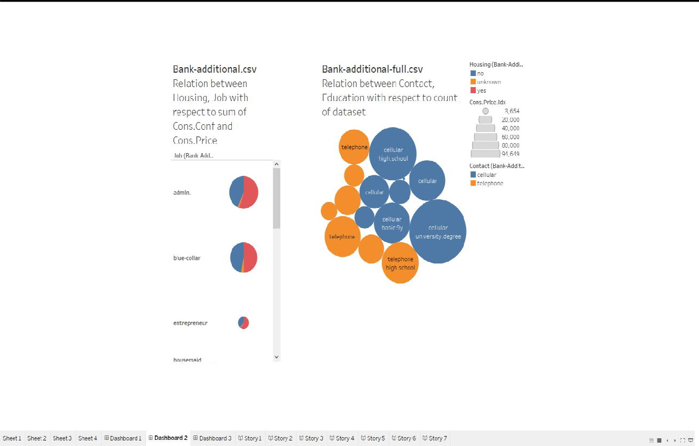
DASHBOARDS:

Slide 11
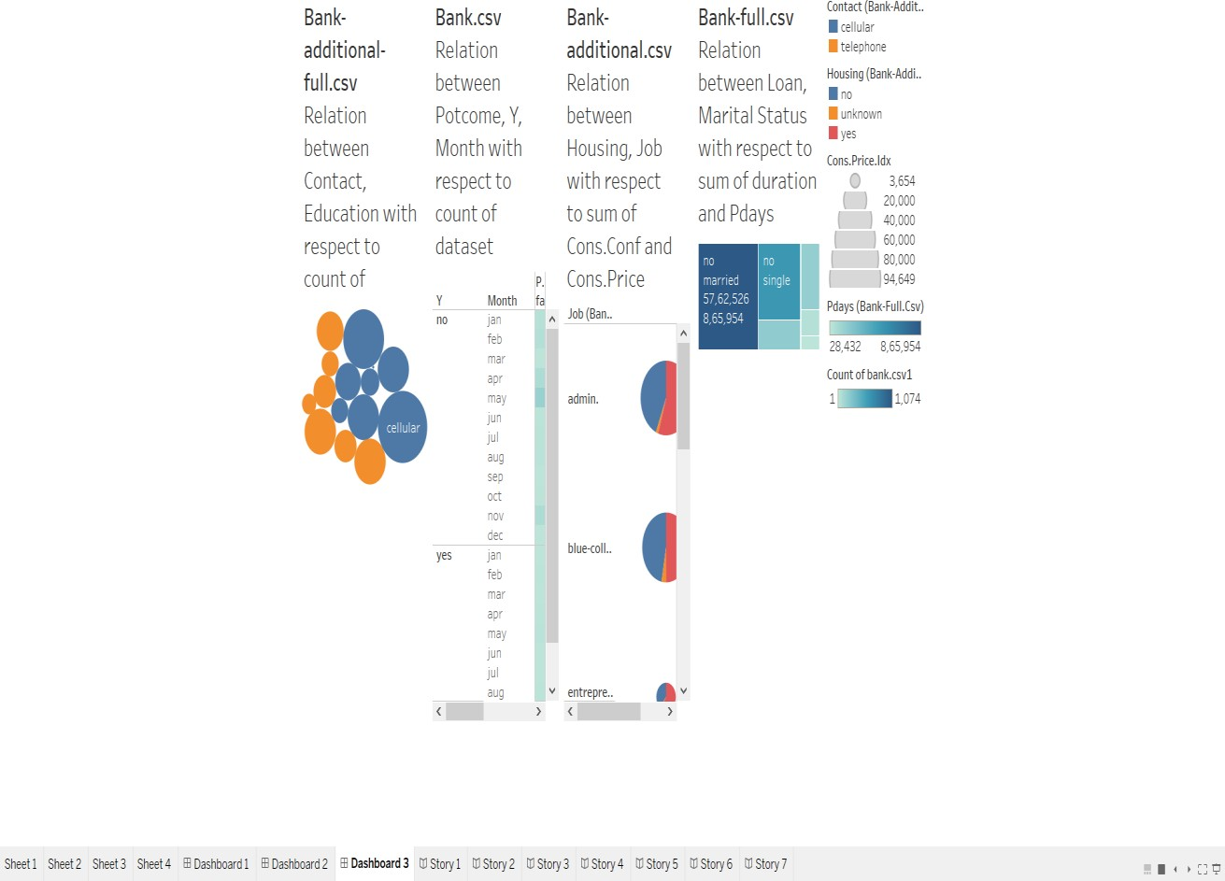
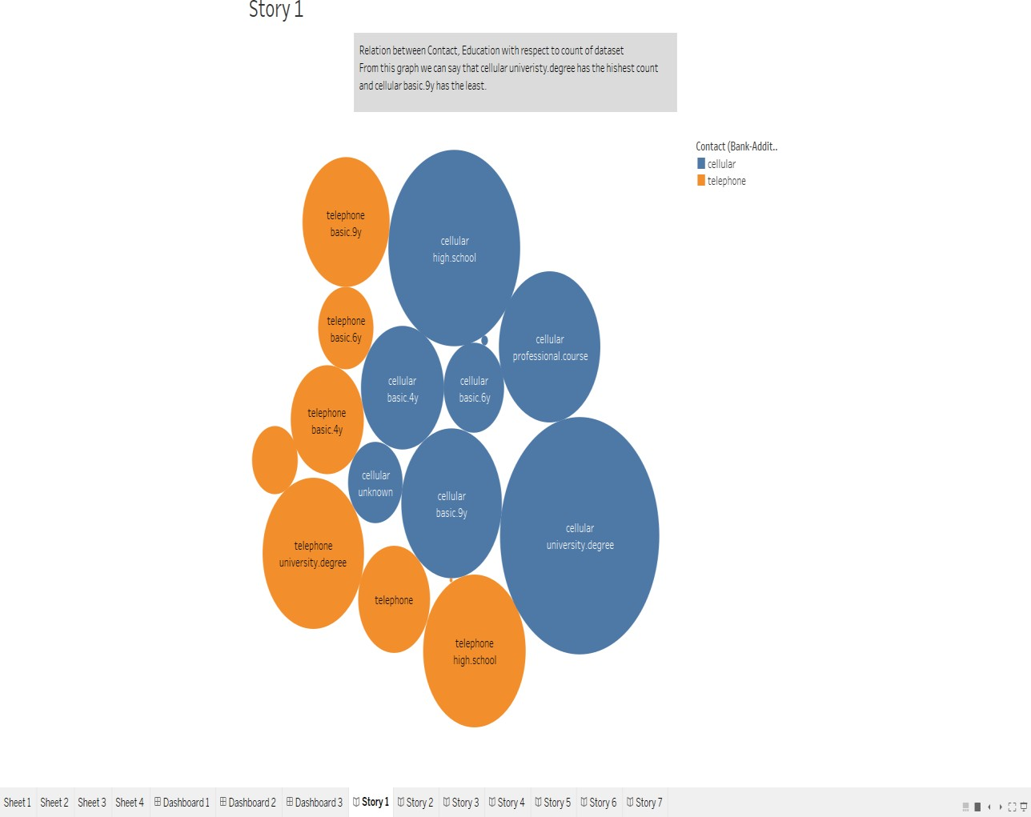
STORIES:

Slide 12
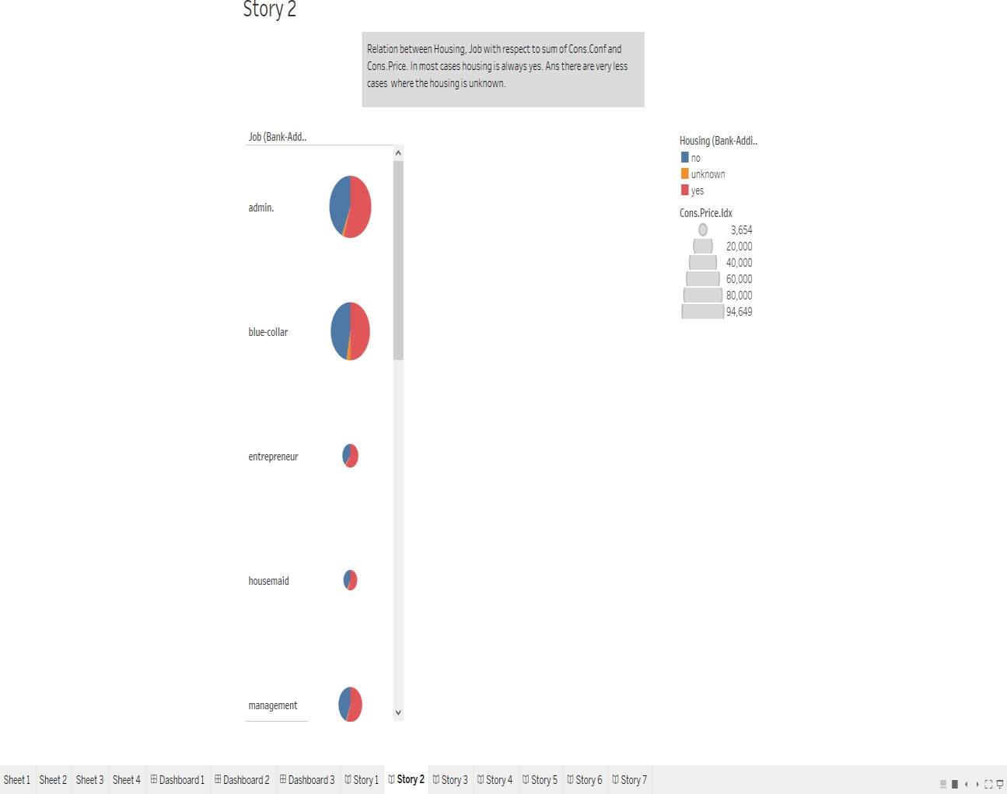
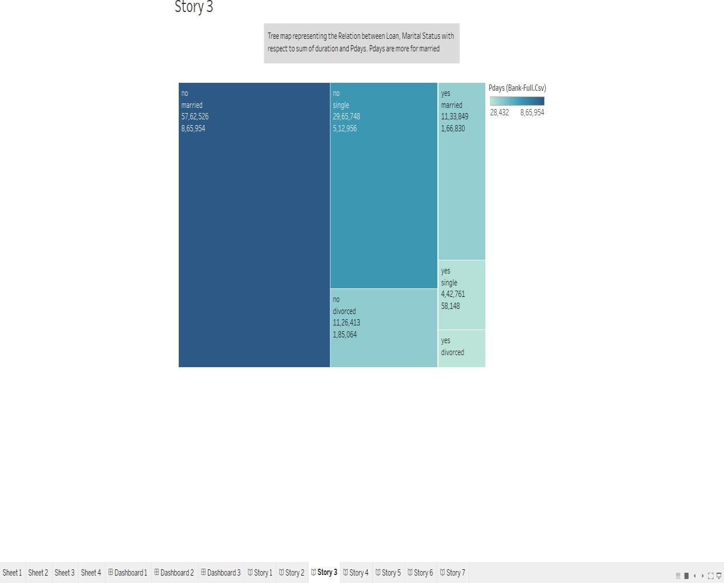

Slide 13
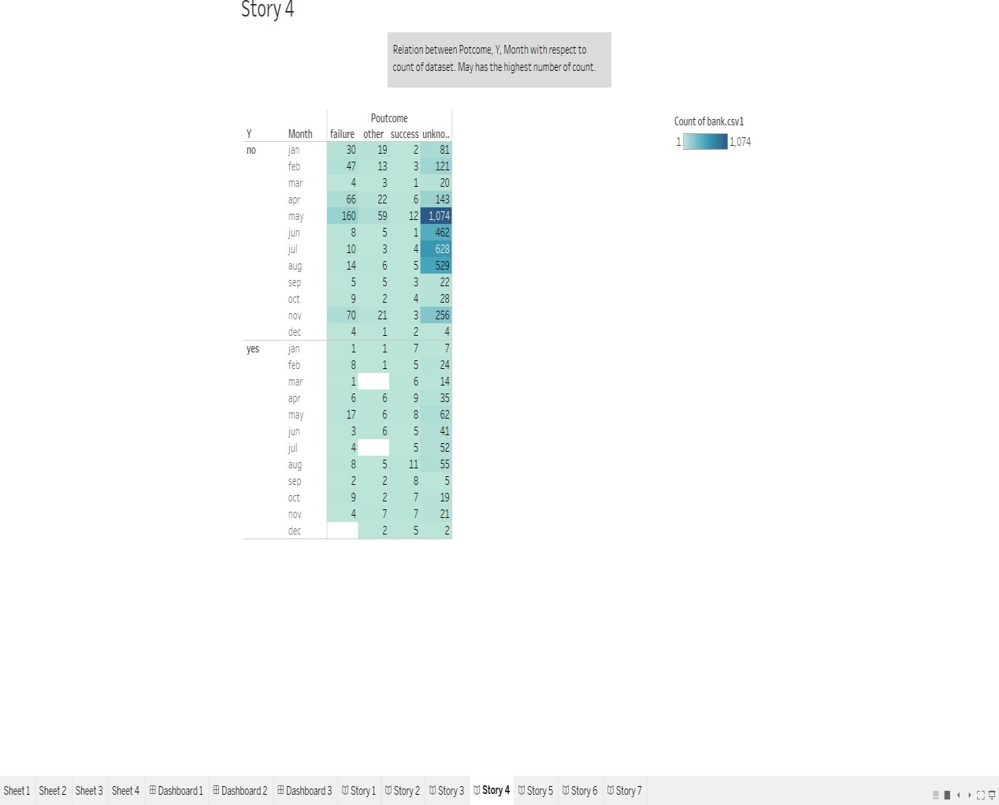
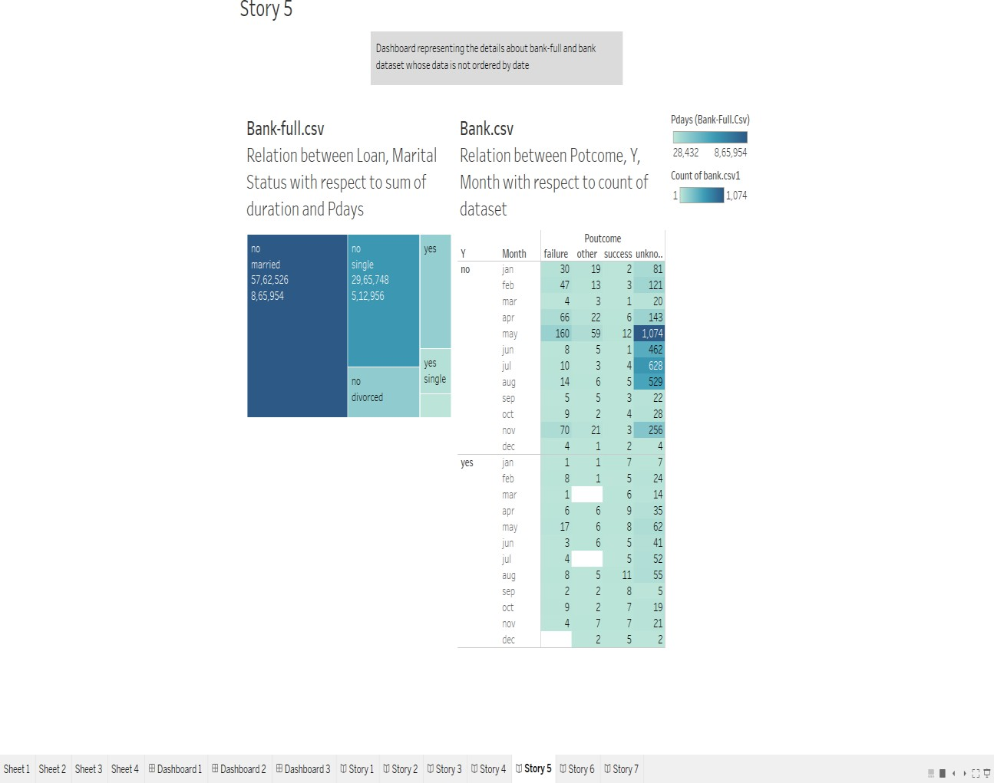

Slide 14
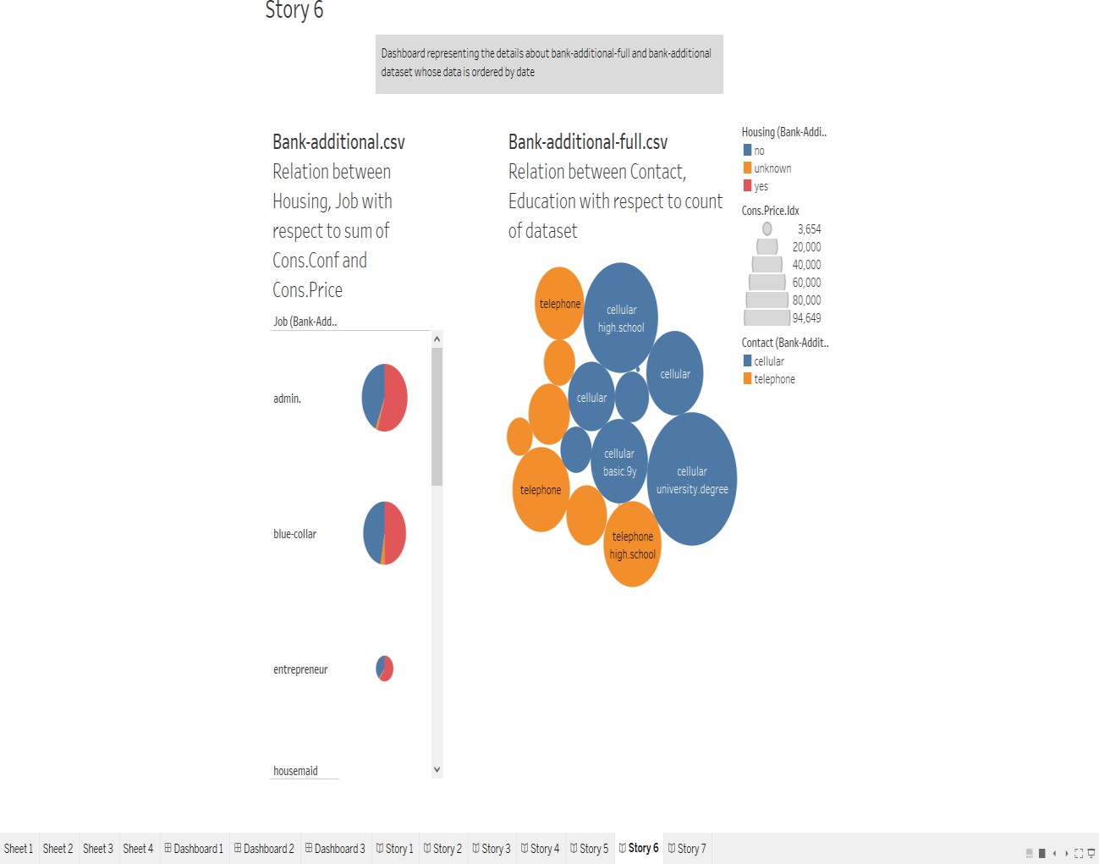
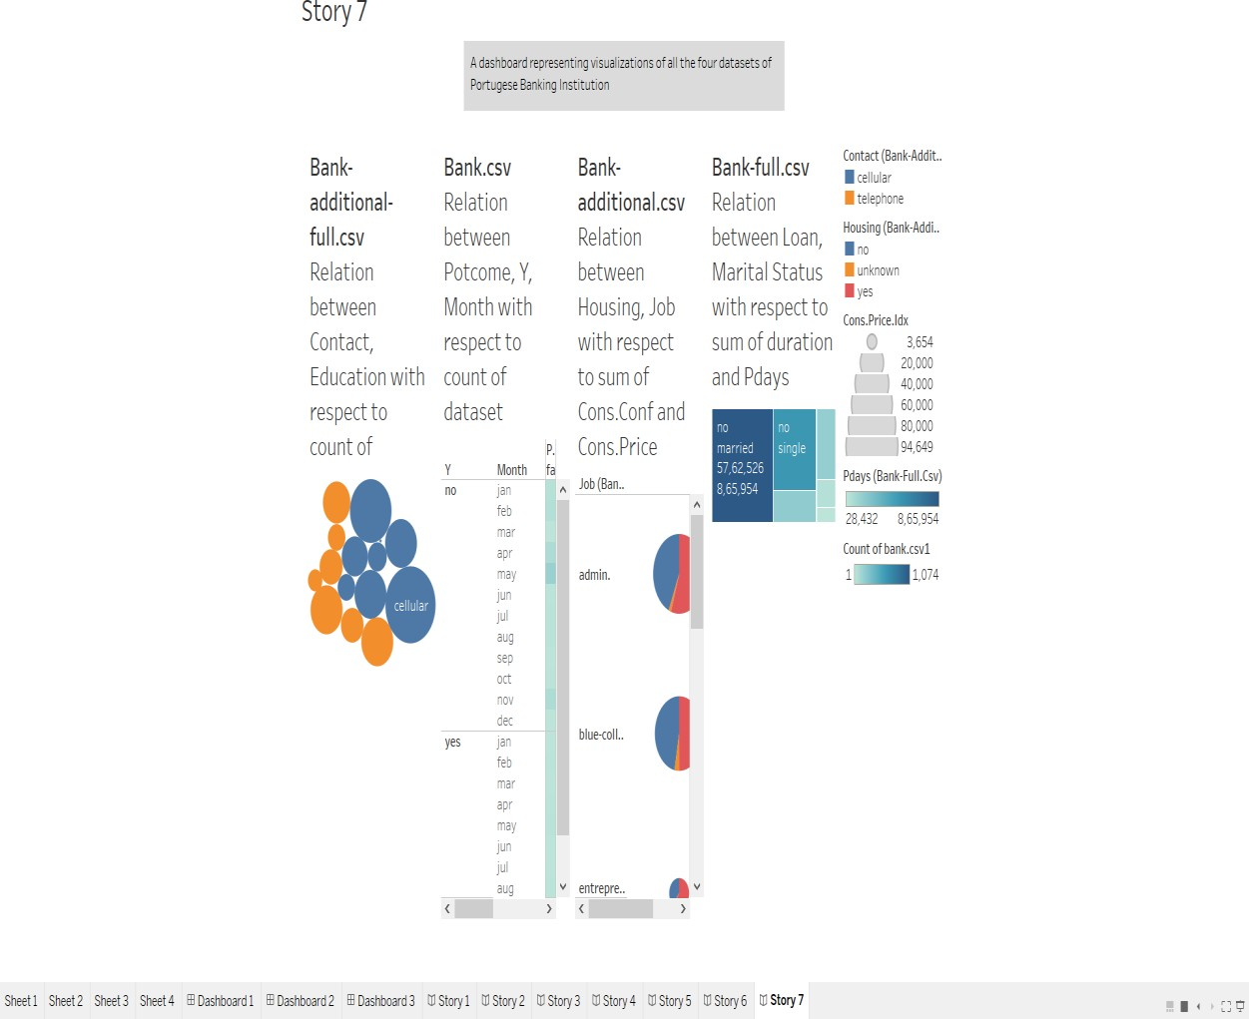

Slide 15
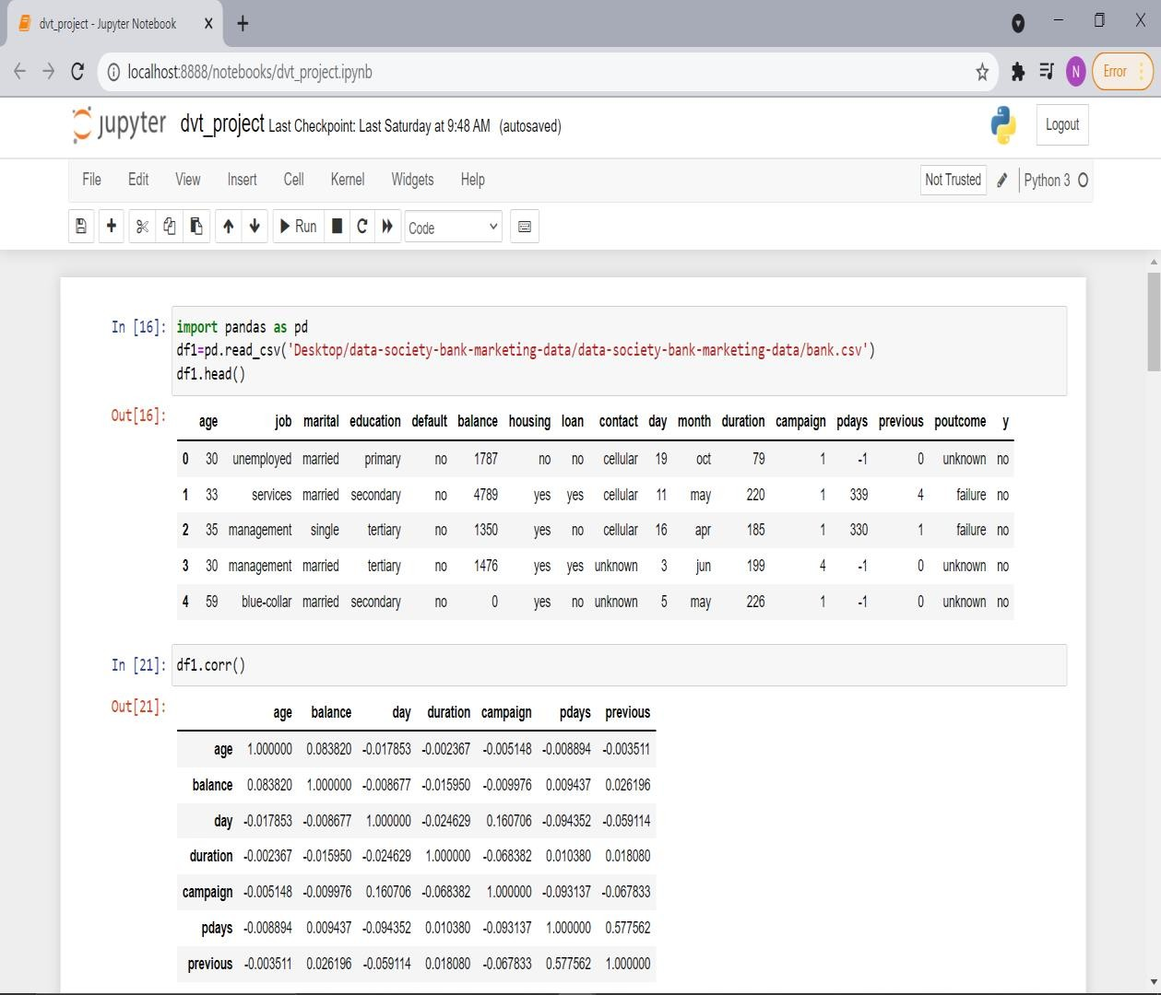
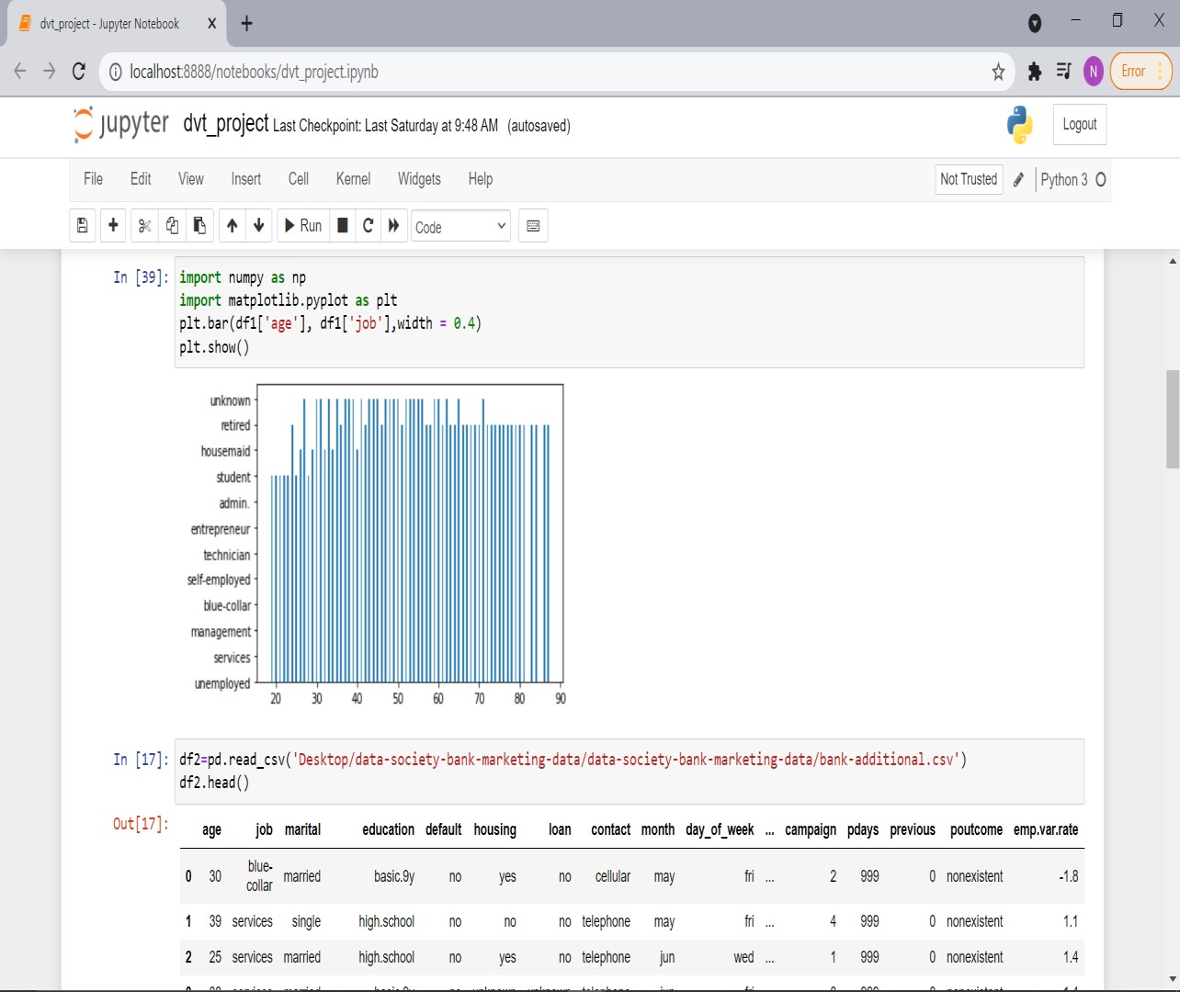
PYTHON:

Slide 16
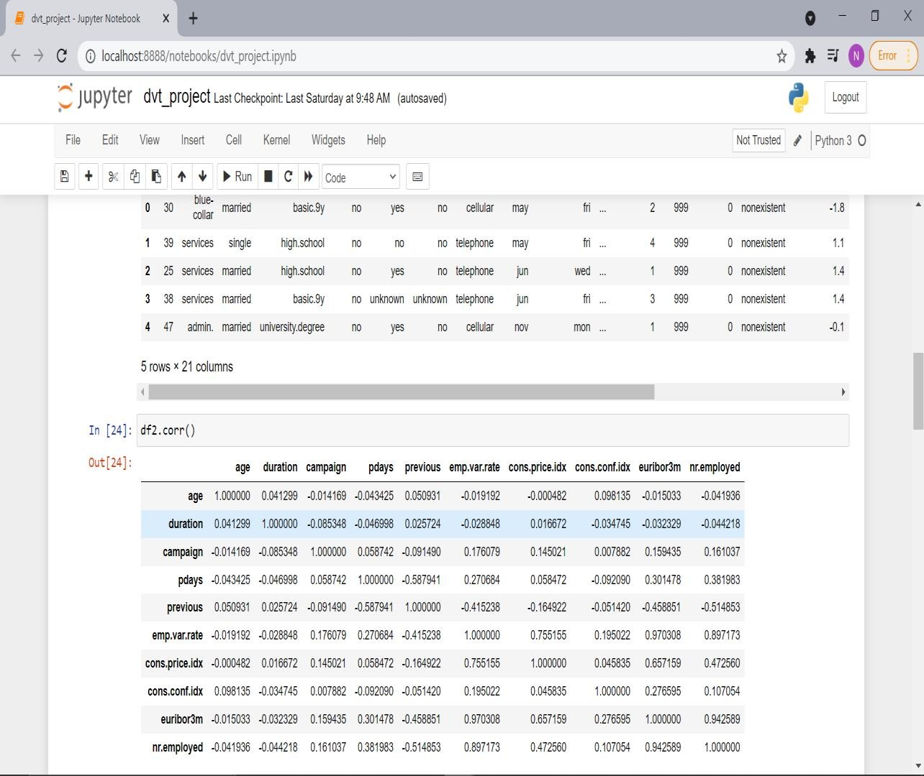
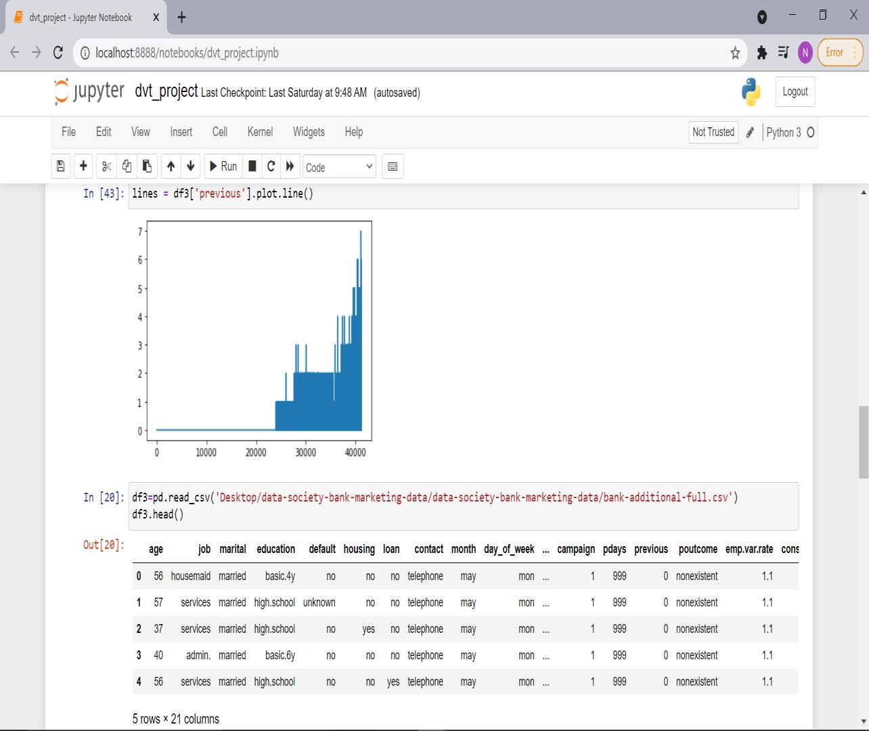

Slide 17
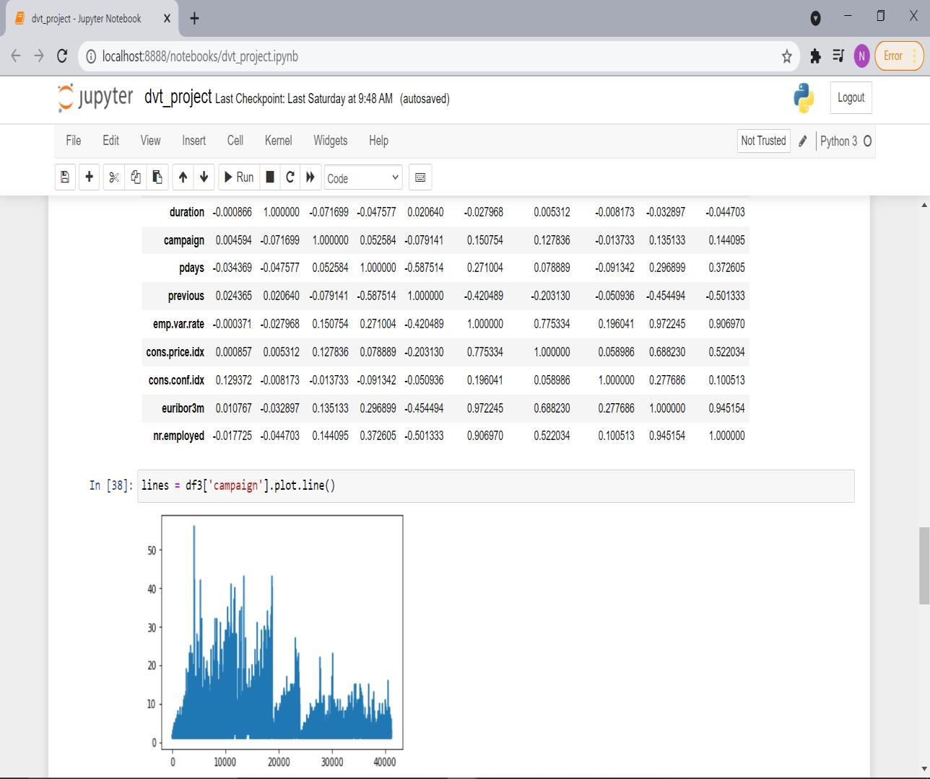
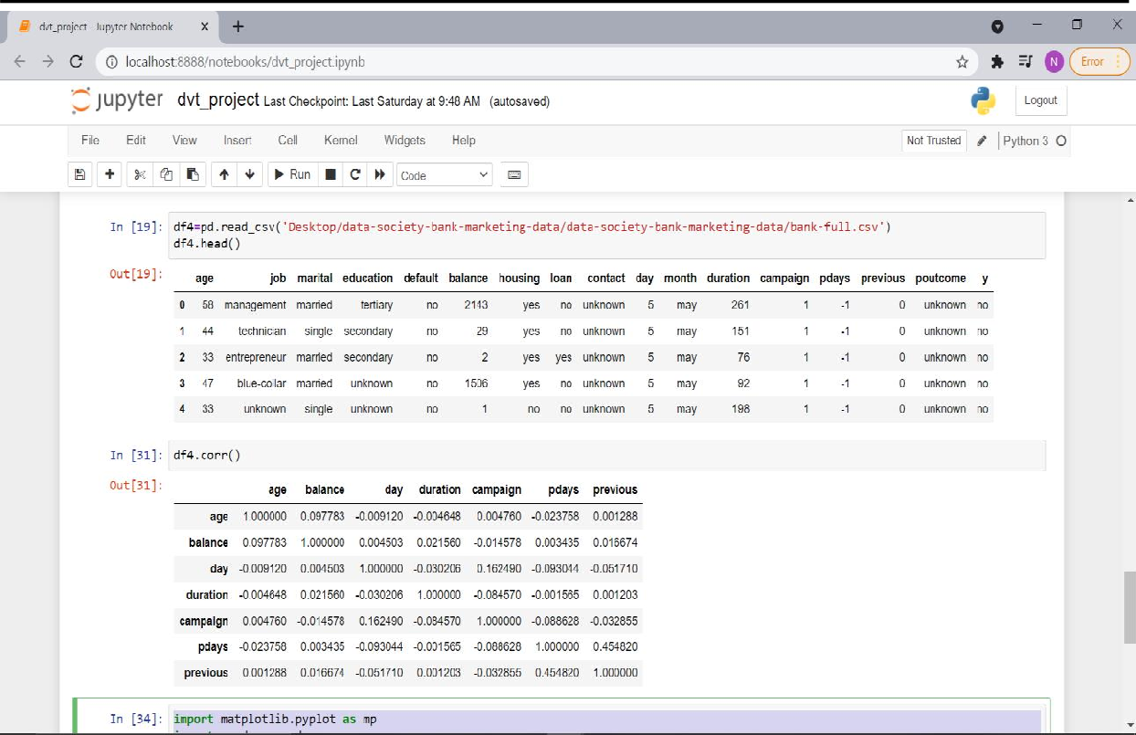

Slide 18
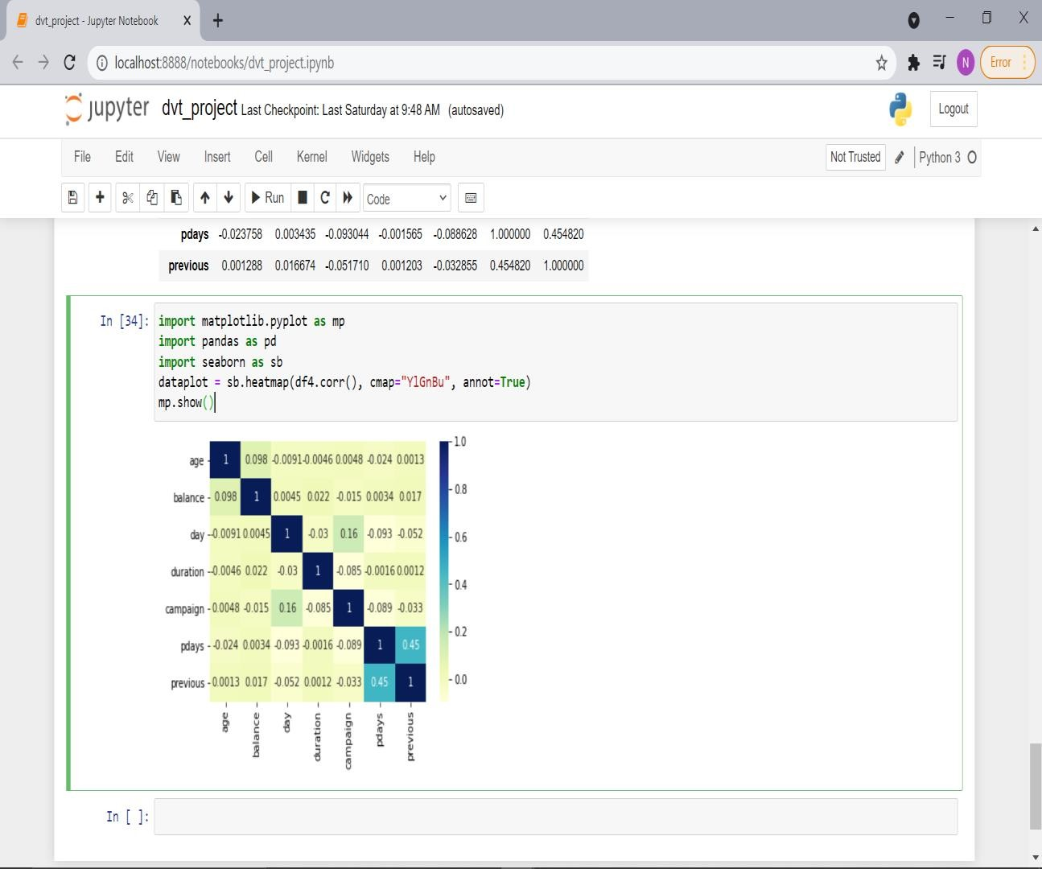

Slide 19
5. CONCLUSION
The first sheet shows Relation between Contact, Education with respect to count of dataset
From this graph we can say that cellular univeristy.degree has the hishest count and cellular basic.9y has the least.
The second sheet shows Relation between Housing, Job with respect to sum of Cons.Conf and Cons.Price. In most cases housing is always yes. Ans there are very less cases where the housing is unknown.
The third map is Tree map representing the Relation between Loan, Marital Status with respect to sum of duration and Pdays. Pdays are more for married people.
The fourth sheet shows the Relation between Potcome, Y, Month with respect to count of dataset. May has the highest number of count.
Dashboard shows visualizations of all the four datasets of Portugese Banking Institution.
We have visualized Portugese banking Institution data of their direct marketing campaigns. And we have made analysis of that data using those graphs.

