Slide 1


Movie/TV Show Recommendation System
Enhance your entertainment experience with personalized movie and TV show recommendations based on your preferences and history. Learn how the system works and its benefits.

Slide 2



Collaborative Filtering Algorithm
What is it?
How it works
Implementation
A process of filtering and analyzing information based on patterns of user behavior and preferences that helps generate personalized recommendations.
The algorithm compares your viewing history and preferences with other users' data and recommends content that has been enjoyed by viewers with similar interests as yours.
The algorithm is implemented in the system's database with statistical modeling and machine learning techniques that help provide true-to-interest content recommendations.

Slide 3
Machine Learning Techniques
Content-based filtering
Clustering
Considers user interests and previous search histories to recommend movies and TV shows in a similar genre or plot.
Segments users into groups based on their viewing behavior, similar viewing habits among users in a particular group can suggest preferred content within that group.
Decision tree
Neural networks
Visualizes a model that represents decisions and their possible consequences that lead to a recommendation based on the user’s overall viewing history.
Analyses data with a system of interconnected processing nodes that infer user preferences and suggest content recommendations based on those inferences.

Slide 4
Analyzing User Behavior
1
2
3
Collecting data
Exploration
Model building
The system collects data such as viewing history, preferences, ratings and feedback, that are analyzed to determine user interest and match the recommendation to their preferences.
Data analysis uncovers connections between user behavior and viewing preferences. The system explores new ways to represent data specific to user groups to generate better recommendations.
Models are built to understand separate user preferences and enable recommendations that fit the viewing pattern of each group.

Slide 5

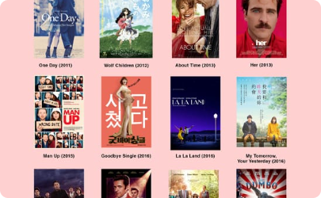
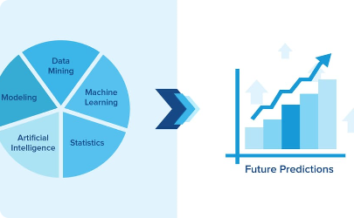
User Preferences and History
Analyzing TV show preferences
Combining with data analysis
Integrating feedback in the recommendations
The system looks not only at the type of shows you have watched, but also the genres, actors, directors, and themes that make up your viewing history.
The system uses machine learning and data analysis to make personalized recommendations based on your viewing history. It presents you with content that is similar to the content you like, creating a minor variation that is close to your interests.
The system considers the feedback and preferences shared by the user as well to generate informed decision recommendations based on the analyzed data.

Slide 6
Benefits and Advantages of Personalized Recommendations
1
Efficient
Saves time and effort by automatically providing deep insight content recommendations based on user history.
2
Tailored
Provides tailored recommendations that enhance the overall viewing experience by matching the user's interests and preferences.
3
Diversity
The system recommends content tailored to the preferences of each individual or group, providing a diverse range of options.
4
Financial benefits
Enables viewers to identify popular content, eliminating the need to waste time and money on movies and TV shows that don’t match the viewer's taste.

Slide 7
Conclusion and Future Prospects
Conclusion
Future
The Movie/TV Show Recommendation System is a web-based application that suggests tailored recommendations based on user behavior and preferences, enhancing users' entertainment experiences.
As technological advances continue, the system can be improved by incorporating more data sources and analysis methods, which will lead to an even more personalized and enhanced viewing experience.

