Slide 1
BDM
CIA-4
Submitted by
Santhosh-22121024
Siddharth-22121027
Submitted to
Prof. Alwin Joseph

Slide 2

Education Institute
This a education institution represents the stakeholders of a college system, including students, faculty, courses, departments, classrooms, staff, alumni, library, fees, and attendance. The college system works together to provide high-quality education to students and prepare them for successful careers. Students enroll in courses offered by faculty members, and the courses are organized into departments. Classrooms are managed by staff, and the college has a library containing relevant materials. Fees are collected to cover expenses, and attendance is tracked. Alumni are former students who have graduated from the institution. The college system works together to provide high-quality education to students and prepare them for successful careers.

Slide 3


OBJECTIVES
This MySQL database is designed to support the educational institution's management system, which includes various stakeholders such as students, faculty members, courses, departments, classrooms, staff, alumni, library, fees, and attendance. The college system aims to provide high-quality education to students and prepare them for successful careers. Students enroll in courses offered by faculty members, and these courses are organized into departments. Classrooms are managed by staff members, and the college has a well-equipped library containing relevant materials. Fees are collected to cover expenses, and attendance is tracked to ensure student progress. Alumni are former students who have graduated from the institution and can serve as a valuable resource for current students. The institution's success is attributed to the collaboration between these stakeholders and their dedication to achieving the college's goals. This database will aid in managing the vast amount of data required for effective decision-making, improving the college system's overall performance.

Slide 4
STUDENT TABLE
STUDENT ADDRESS TABLE

Slide 5
FACULTY TABLE
FACULTY ADDRESS TABLE

Slide 6
ALUMNI TABLE
ALUMNI ADDRESS TABLE

Slide 7
STAFF TABLE
STAFF ADDRESS TABLE

Slide 8
COLLEGE TABLE
COURSE TABLE
DEPARTMENT TABLE

Slide 9
FEE TABLE
LIBRARY TABLE

Slide 10
PHONE TABLE
EMAIL TABLE

Slide 11
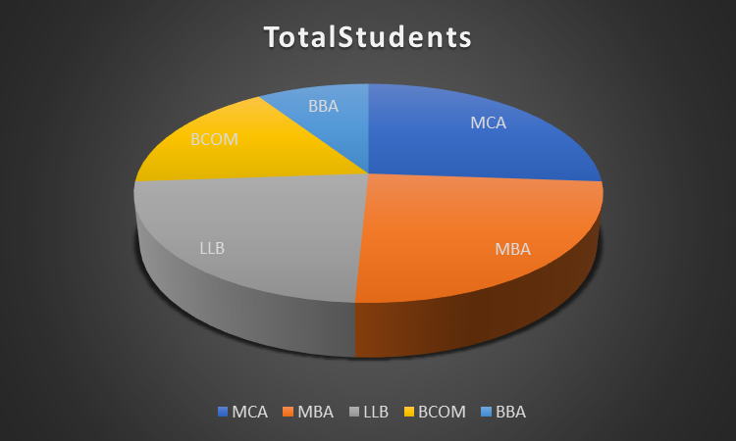
PROBLEM STATEMENT:
Retrieve the total number of students enrolled in each course.
QUERY:
SELECT CourseName, COUNT(*) as TotalStudents FROM Student JOIN Course ON student.courseID = course.CourseID GROUP BY CourseName;

Slide 12
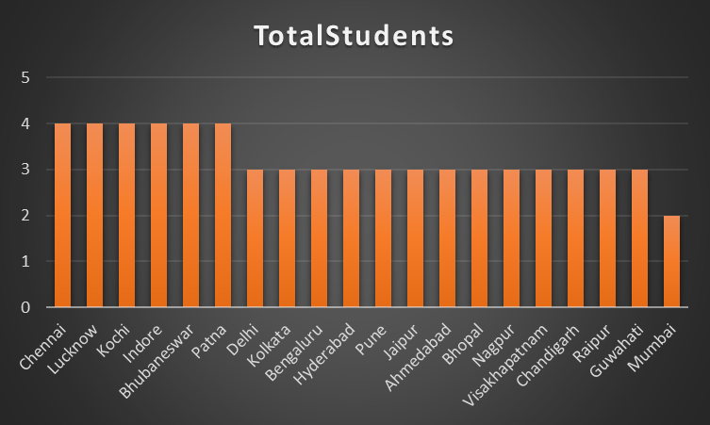
The institute wants to analyze the geographic distribution of its students and identify the cities from which the highest number of students come from. Write a query to retrieve the list of cities along with the count of students from each city.
QUERY:
SELECT city, COUNT(*) as TotalStudents FROM Student_Address GROUP BY city;

Slide 13
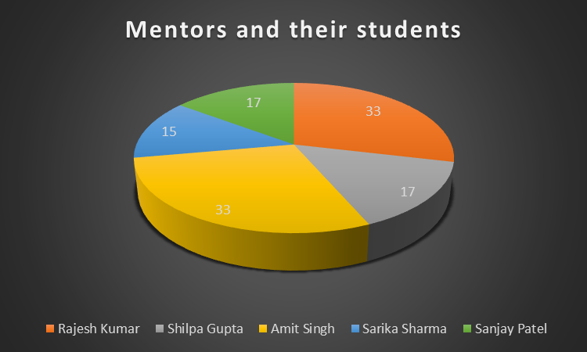
Retrieve the list of staff members and the number of students they have mentored.
QUERY:
SELECT Staff.StaffName, COUNT(Student.student_id) as MentoredStudents FROM Staff LEFT JOIN Department ON Staff.DepartmentID = Department.DepartmentID LEFT JOIN Course ON Department.DepartmentID = Course.DepartmentID LEFT JOIN Student ON Course.CourseID = Student.courseID GROUP BY Staff.StaffName;

Slide 14
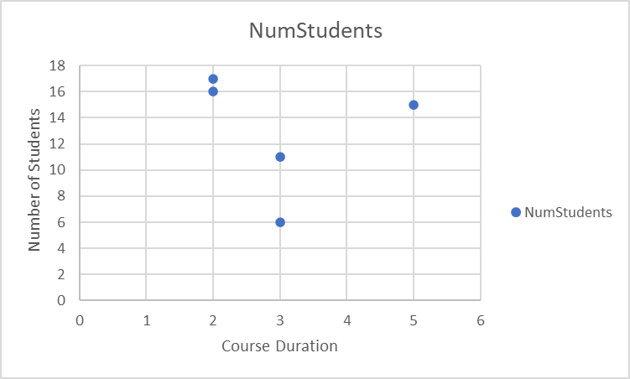
Retrieve the CourseName, CourseDuration and the number of students enrolled.
QUERY:
SELECT CourseName, CourseDuration, COUNT(*) AS NumStudents FROM Student JOIN Course ON Student.CourseID = Course.CourseID GROUP BY CourseName, CourseDuration;

Slide 15
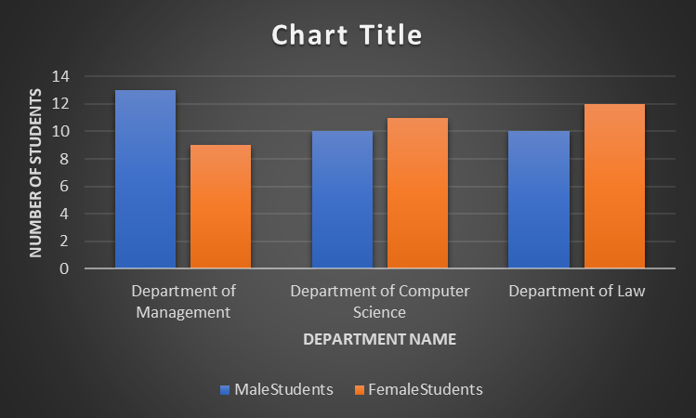
Show the number of students from each department by gender.
QUERY:
SELECT DepartmentName, (SELECT COUNT() FROM Student WHERE Department.DepartmentID = Student.departmentID AND student_gender = 'male') AS MaleStudents, (SELECT COUNT() FROM Student WHERE Department.DepartmentID = Student.departmentID AND student_gender = 'female') AS FemaleStudents FROM Department;

Slide 16
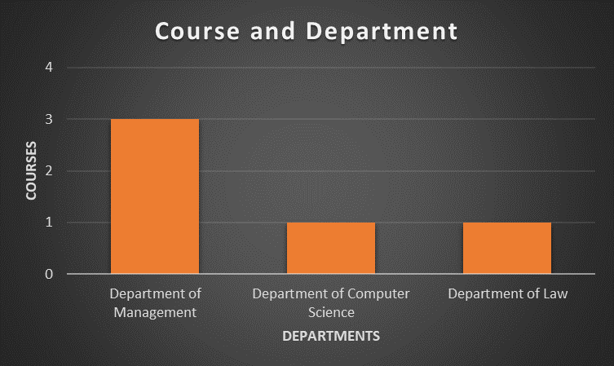
Show the number of courses offered by each department:
QUERY:
SELECT DepartmentName, COUNT(*) AS CourseCount FROM Course JOIN Department ON Course.DepartmentID = Department.DepartmentID GROUP BY DepartmentName;

Slide 17
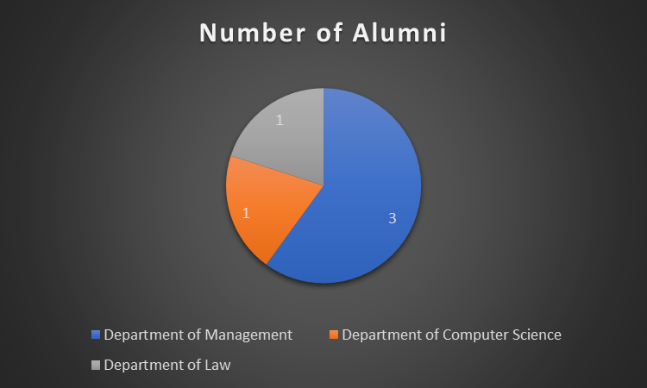
Retrive the list of number of alumni by department
QUERY:
SELECT DepartmentName, COUNT(*) as NumAlumni FROM Alumni INNER JOIN Department ON Alumni.DepartmentID = Department.DepartmentID GROUP BY DepartmentName;

Slide 18
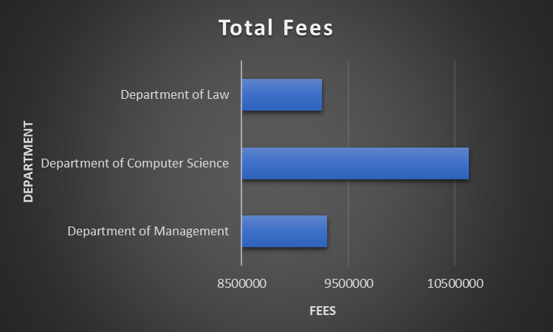
Show the Total fees earned by each department.
QUERY:
SELECT d.DepartmentName, SUM(f.Amount) AS TotalFees FROM Department d JOIN Student s ON s.DepartmentID = d.DepartmentID JOIN Fees f ON f.student_id = s.student_id GROUP BY d.DepartmentName;

Slide 19
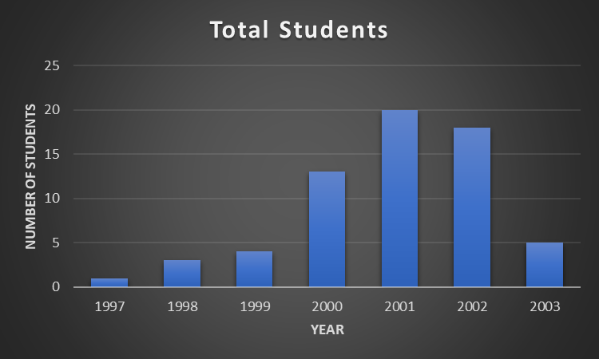
Retrieve the count of students born in each year for generating a graph showing the distribution of students' birth year.
QUERY:
SELECT YEAR(student_date_of_birth) AS Year, COUNT(*) AS StudentCount FROM Student GROUP BY YEAR ORDER BY YEAR;

Slide 20
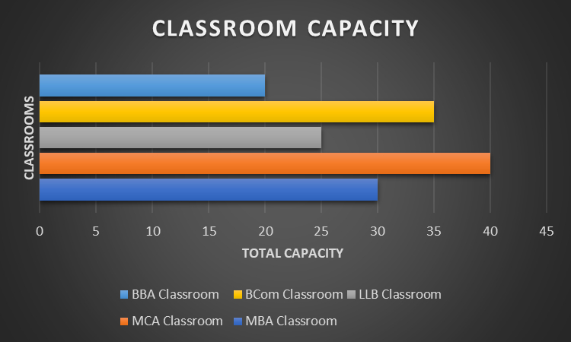
To retrieve the classroom names and their respective capacities
QUERY:
SELECT ClassroomName, ClassroomCapacity FROM Classroom

Slide 21
THANK YOU

