Slide 1
SHESHAN N
Final Project
3/21/2024 Annual Review

Slide 2
PROJECT TITLE
Plant Disease Detection from leaf images using CNN
3/21/2024 Annual Review

Slide 3


AGENDA
AGENDA
Problem Statement
Project Overview
Who are the end users?
Solutions and value of propositions
WOW factor in the solution
Modelling
Results
3/21/2024 Annual Review

Slide 4

PROBLEM STATEMENT
The problem statement involves developing a machine learning model for classifying plant images into three categories: Healthy, Powdery, and Rust. This task is crucial in agriculture for early detection of plant diseases, allowing farmers to take necessary measures to prevent widespread damage.
The dataset likely consists of images of plants affected by various diseases, as well as images of healthy plants for comparison. The task involves training a classification model to accurately identify and classify these images into their respective categories.
3/21/2024 Annual Review

Slide 5

PROJECT OVERVIEW
The project aims to develop a Convolutional Neural Network (CNN) using TensorFlow/Keras to classify plant images into three categories: Healthy, Powdery, and Rust. The dataset comprises images of varying sizes, representing both healthy plants and plants affected by powdery or rust diseases. These images undergo preprocessing and augmentation to improve the model's performance.
3/21/2024 Annual Review

Slide 6

WHO ARE THE END USERS?
End users of this project could include:
Agricultural researchers
Farmers
Agricultural extension workers
Plant disease consultants
3/21/2024 Annual Review

Slide 7

YOUR SOLUTION AND ITS VALUE PROPOSITION
Automated Plant Disease Diagnosis: The model provides an automated solution for identifying plant diseases, enabling early detection and intervention.
Improved Yield: Early disease detection helps in timely treatment, leading to improved crop yield and reduced economic losses for farmers.
Efficient Resource Allocation: Agricultural practitioners can efficiently allocate resources such as pesticides and fertilizers by targeting specific areas affected by plant diseases.
Educational Tool: The model can serve as an educational tool for farmers and agricultural students, helping them understand various plant diseases and their symptoms.
3/21/2024 Annual Review

Slide 8

THE WOW IN YOUR SOLUTION
High Accuracy: The model achieves a high accuracy rate, indicating its reliability in identifying plant diseases.
Data Augmentation: By implementing data augmentation techniques, the model learns robust features from the augmented images, improving its generalization capability.
Scalability: The solution can be scaled to handle larger datasets and extended to classify additional plant diseases, catering to evolving agricultural needs.
Real-time Application: With optimization, the model can be deployed in real-time applications such as mobile apps or IoT devices, providing instant plant disease diagnosis on the field.
3/21/2024 Annual Review
8

Slide 9
MODELLING
Data Preprocessing:Resizing images to a consistent size ensures compatibility with the model, while normalization stabilizes training by scaling pixel values to a standard range.
Split Data:Proper splitting into training, validation, and test sets ensures unbiased evaluation and enables effective tuning of model hyperparameters.
Build Model Architecture:Convolutional layers extract hierarchical features, while dense layers at the end perform classification based on these features.
Train Model:Training iteratively adjusts model parameters using optimization algorithms, with batch size influencing stability and convergence speed.
Evaluate Model:Evaluation on a separate test set provides an unbiased estimate of model performance, essential for understanding generalization ability.
Fine-Tuning (Optional):Hyperparameter tuning and regularization techniques optimize model performance, preventing overfitting and improving robustness.
Save or Deploy Model:Saving the model enables reusability without retraining, while deployment integrates it into applications or systems for making predictions on new data.
3/21/2024 Annual Review
9

Slide 10
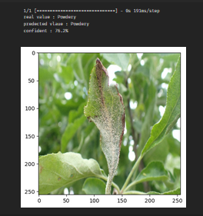
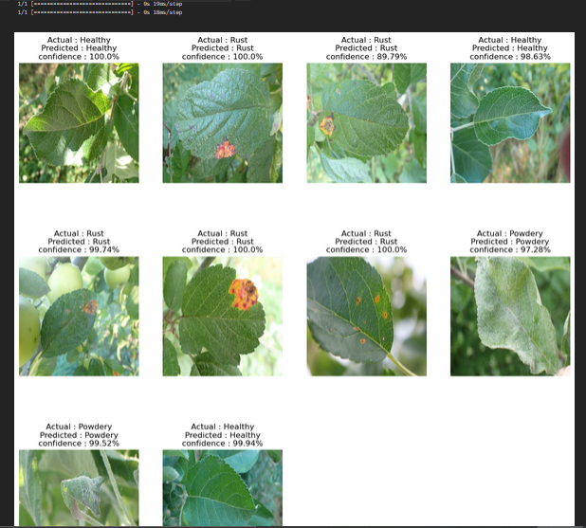
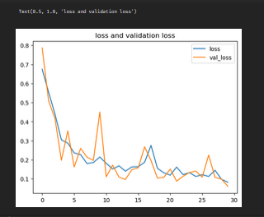
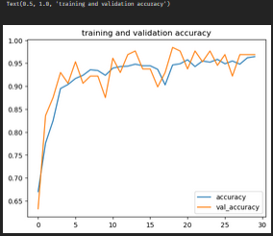
RESULTS
Demo Link
3/21/2024 Annual Review
10

