Slide 2
Contents
Background
Coding Language
Case study

Slide 3
Background
Traditional methods
Engineering method, dedicated building energy simulation tools.
Bottleneck
Time problem, requirement of remarkable technical expertise and detailed building physics information, the growing scale of building operational data
Data-driven methods
The adoption of sensors and systems(BASs) in buildings provide the foundation and development motivation for the data-driven approach.
Notes:
Traditionally, the energy consumption model is based on engineering method and on dedicated building energy simulation tools.
But when building-related problems become more and more complicated, the traditional forward method encounters some bottlenecks. It is often time-consuming, and requires remarkable technical expertise and detailed building physical information provided by the user or designer. Moreover, it is difficult for forward method to deal with the building operational data of growing scale.

Slide 4
Data Analytics Framework
Real value
prediction
Data Analytics
Raw Data
Data preprocessing
Variable selection
Optimization, Statistical learning
Machine learning, Data mining
Categorical value
prediction
Data cleaning
Data transformation
Data reduction
Domain knowledge
Statistical methods
Data Interpretation
Verification
Discovery
Hypothesis
testing
Prediction
Description
Regression
Classification
Clustering
Correlation mining
Association rules
Notes:
Here I’m going to give you an overview of a general framework of Data Analytics.
Firstly, there is raw data. The building-related data is usually structured data stored in excel files.
Then in the Data preprocessing section, three tasks need to be finished. That is, the Data cleaning, data transformation and data reduction.
And then, we can use domain knowledge together with statistical methods to do the variable selection.
After selecting the proper variables, lots of data analytics methods can be used for verification, prediction and description work.
With the data analytics result, we can do things like real value prediction, categorical value prediction and data interpretation.

Slide 5
Coding Languages
Python is an interpreted high-level programming language for general-purpose programming. Created by Guido van Rossum and first released in 1991, Python has a design philosophy that emphasizes code readability, notably using significant whitespace. It provides constructs that enable clear programming on both small and large scales.
R is a language and environment for statistical computing and graphics. It is a GNU project which is similar to the S language and environment which was developed at Bell Laboratories (formerly AT&T, now Lucent Technologies) by John Chambers and colleagues. R can be considered as a different implementation of S. There are some important differences, but much code written for S runs unaltered under R.
Matlab is a multi-paradigm numerical computing environment. A proprietary programming language developed by MathWorks, MATLAB allows matrix manipulations, plotting of functions and data, implementation of algorithms, a creation of user interfaces, and interfacing with programs written in other languages, including C, C++, C#, Java, Fortran, and Python.

Slide 6
Pros & Cons
Language/Tool | Advantages | Disadvantages
Python | End To End development to execution (some brokers packages allows execution, IB) Open source packages( Pandas, Numpy, scipy) Best for general programming and application development can be a “glue” language to connect R, C++, and others (python) Fastest general speed especially in iterative loops | Some packages are not compatible with others or contain overlap More code required for same operations vs R or Matlab
R | End To End development to execution (some brokers packages allows execution, IB) Rapid development speed (60% fewer lines vs python, ~500% less than C) A large number of Open Source Packages Largest Community | Slow vs Python especially in iterative loops and non vectorized functions Worse plotting than python and difficult to implement interactive charts Limited capabilities in creating stand-alone applications
Matlab | Fastest mathematical and computational platform especially vectorized operations/ linear matrix algebra Commercial level packages for all fields of mathematics and trading Very short scripts considering the high integration of all packages Best visualization of plots and interactive charts Well tested and supported due to it being a commercial product Best debugger | Can not execute — must be translated into another language Expensive ~1000 per license and 50+ per additional individual package Can not integrate well with other languages Can not develop stand-alone applications at all

Slide 7
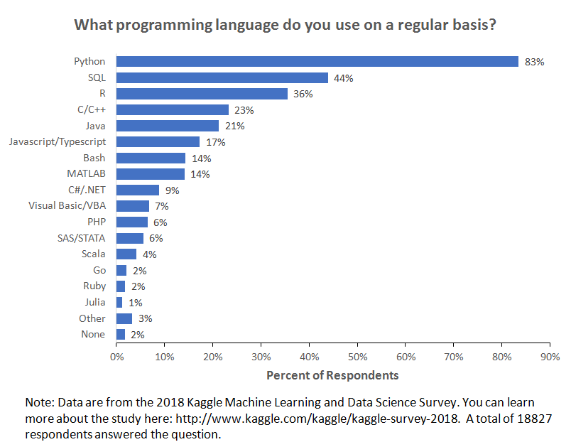
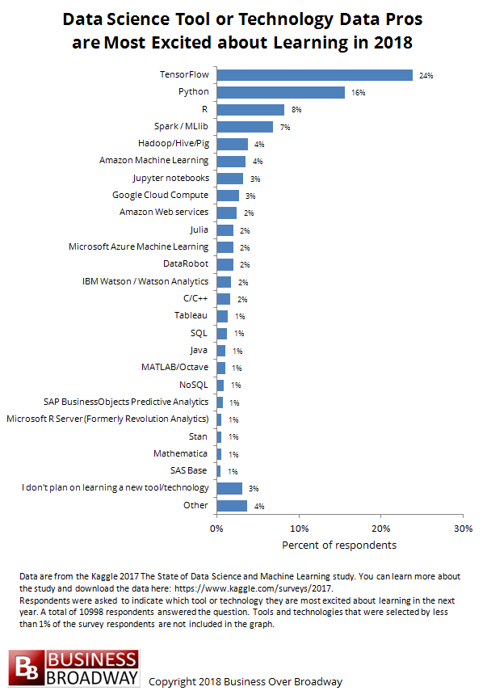
Coding Languages
https://www.kaggle.com/surveys/2017
https://www.kaggle.com/kaggle/kaggle-survey-2018

Slide 8
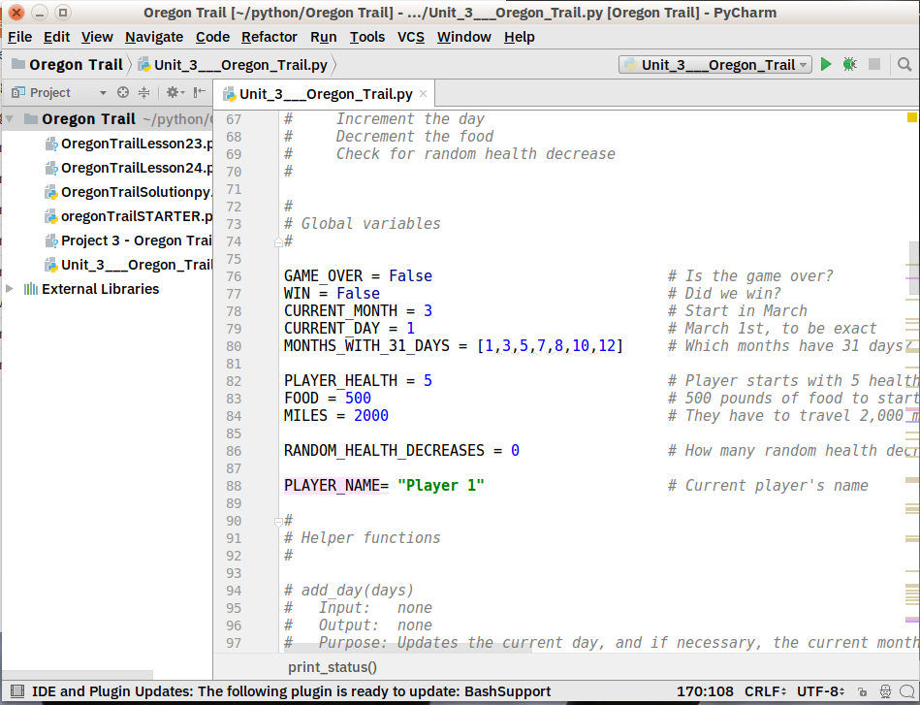
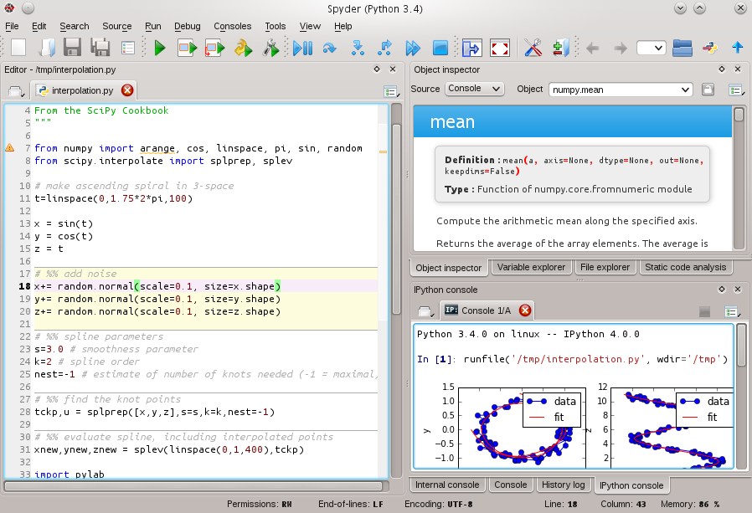
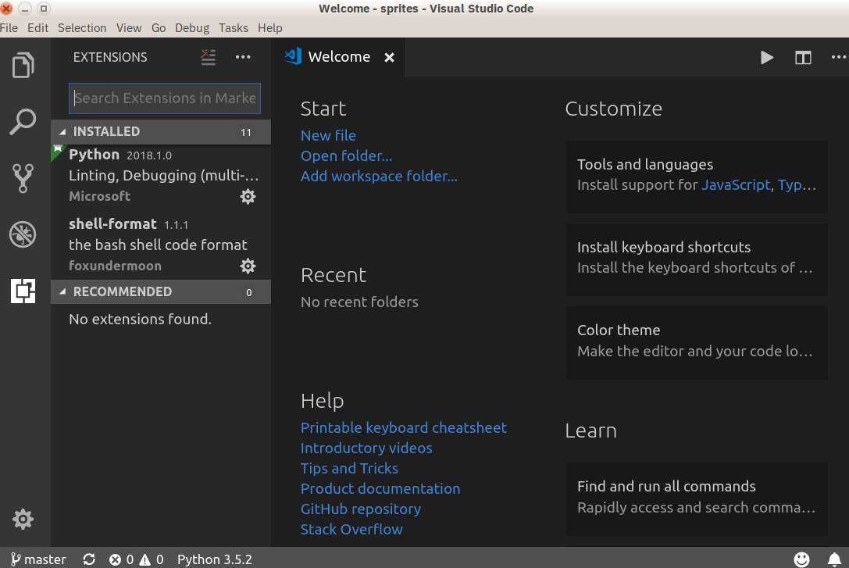
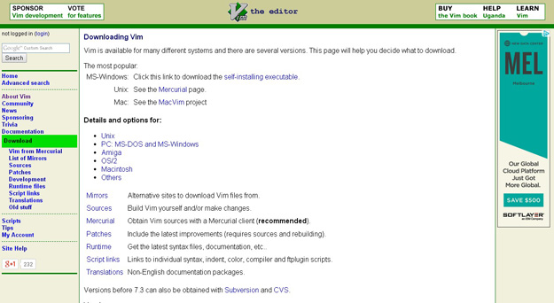
IDE for Python
An IDE (or Integrated Development Environment) is a program dedicated to software development. As the name implies, IDEs integrate several tools specifically designed for software development. These tools usually include:
An editor designed to handle code (with, for example, syntax highlighting and auto-completion)
Build, execution, and debugging tools
Some form of source control
Visual Studio Code
PyCharm
Spyder(Anaconda)
Vim
https://realpython.com/python-ides-code-editors-guide/
https://jaxenter.com/top-5-ides-code-editors-python-146136.html
Find more
Notes:
Most IDEs support many different programming languages and contain many more features. They can, therefore, be large and take time to download and install. You may also need advanced knowledge to use them properly.
In contrast, a dedicated code editor can be as simple as a text editor with syntax highlighting and code formatting capabilities. Most good code editors can execute code and control a debugger. The very best ones interact with source control systems as well. Compared to an IDE, a good dedicated code editor is usually smaller and quicker, but often less feature rich.

Slide 9
Python Brief Introduction
标识符
1.第一个字符必须是字母表中字母或下划线_
2.标识符的其他部分由字母、数字和下划线组成
3.标识符对大小写敏感
赋值
将等号右边的值赋给左边
同时赋多个值
行与缩进
缩进的空格数是可变的，但是同一个代码块的语句必须包含相同的缩进空格数
数字类型与字符串
示范：创建几个标识符

Slide 10
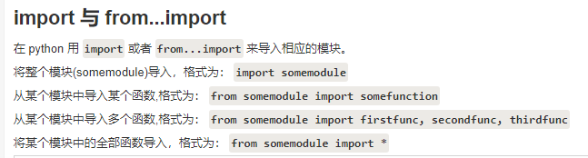
Python Brief Introduction
常用的语句
Print输出
Import/from…import/import X as

Slide 11
Frequently-used Library
Pandas
Numpy
Matplotlib

Slide 12
Case study

