Slide 1
KEYLOGGER
CYBER SECURITY PROJECT
Presented By:
Sruthika N - Jeppiaar Institute of Technology - B .Tech Information Technology

Slide 2

OUTLINE
Problem Statement
Proposed System/Solution
System Development Approach (Technology Used)
Algorithm & Deployment
Result (Output Image)
Conclusion
Future Scope
References

Slide 3
Problem Statement
In many IT infrastructure organizations now-a-days, data security and data recovery are the most
important factors which is basically deployed in Computer Forensics. Computer forensics consists of
the art of examining digital media to preserve, recover and analyze the data in an effective manner.
There are many cases where data recovery is required essentially. So by using keylogger application
users can retrieve data in the time of disaster and damaging of working file due to loss of power etc.
Keyloggers are specially effective in monitoring ongoing crimes. This is a surveillance application
used to track the users which log keystrokes, uses log files to retrieve information, capture a record
of all typed keys. The collected information is saved on the system as a hidden file or emailed to the
Admin or the forensic analyst.

Slide 4
Proposed Solution
The main objective of this document is to illustrate the requirements of the project Keylogger. Now-
a-days IT business infrastructures are mostly in need of the cyber security factor that is Computer
Forensics. Keyloggers can effectively assist a computer forensics analyst in the examination of
digital media.
Keystroke loggers are available in software and hardware form, and are used to capture and compile
a record of all typed keys. The information gathered from a keystroke logger can be saved on the
system as a hidden file Generic keystroke
loggers typically record the keystrokes associated with the keyboard typing. Advanced keystroke
loggers have many additional features. Our project keylogger has the following features;
• Monitors Keystrokes
• Logs keystrokes including special keys
Keyloggers have the advantage of collecting information before it is encrypted; thus making a
forensic analyst’s job easier. Most keyloggers show no signs of any intrusion within the system
allowing for them to gain typed information without anyone having knowledge of its actions except
the user who use it. Keyloggers incorporate a wide array of cyber security issues and provide a
practical approach to understand topics such as attacker goals, varieties of malware and their
implementation, the role of malware in infecting and how stealth is archived in an infected system.

Slide 5
System Approach
Programming Environment:
1. Python 3.8.0
2. PyCharm
Program Files Used:
Keylogger.py
The Code will be operating in windows, Linux environment. The hardware configuration include
Hard Disk: 40 GB, Monitor: 15” Color monitor, Keyboard: 122 keys. The basic input devices
required are keyboard, mouse and output devices are monitor, mobile devices etc.

Slide 6
Algorithm & Deployment
The core of the proposed system is built around sophisticated algorithms capable of detecting anomalous keystroke logging activities.
These algorithms use a combination of signature-based detection for known keyloggers and anomaly-based detection for new or unknown variants.
Machine learning techniques further refine detection capabilities by learning from past detection patterns.
Deployment of the system can be done through a cloud-based service or a local installation, depending on the user's needs and infrastructure capabilities.

Slide 7

Result

Slide 8
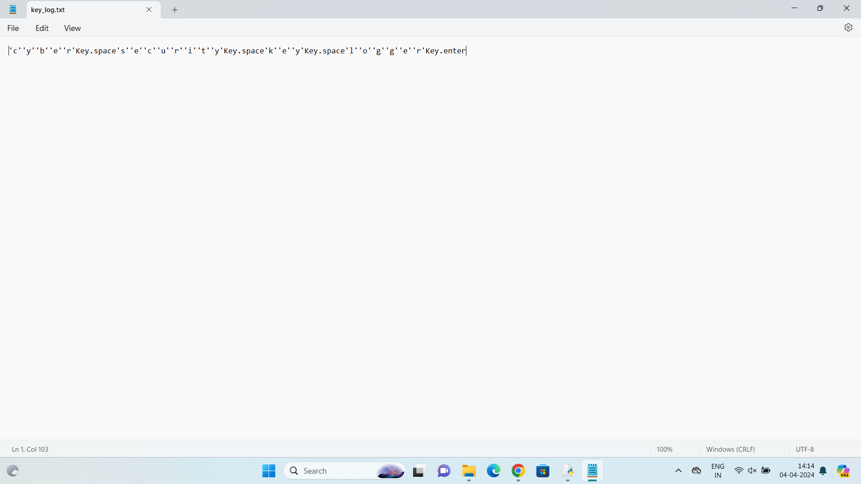

Slide 9
Conclusion
A Keylogger is a form of software which is used to track or log the all the keys that a user
strikes on their keyboard, usually in secret so that the user of the system doesn’t know that
their actions are being monitored. It is otherwise known as keyboard capturer. Key logger record keystrokes
Legitimate use : monitor employee activity
legal uses : steal password , user name and other personal / corporate data . Reports show that there is an increased tendency to use rootkit technologies in keylogging software, to help the keylogger evade manual detection and detection by antivirus solutions.
Only dedicated protection can detect that a keylogger is being used for spy purposes.
Be conscious what installed in the computer.
Use caution when snuffing the internet.
Keep your computer software update.

Slide 10
Future scope
Future developments of the system will focus on enhancing machine learning algorithms for better predictive accuracy, expanding detection capabilities to cover emerging threats, and improving system integration with existing IT infrastructures.
Additionally, research into new deployment models, such as mobile or IoT devices, will ensure comprehensive protection across all user platforms.

Slide 11
References
https://medium.com/
https://www.slideshare.net/
https://en.m.wikipedia.org/wiki/
https://security.stackexchange.com/
https://www.ionos.com/digitalguide/
https://github.com/techtrainer20/TNSDC/blob/main/links.txt

Slide 12
THANK YOU

