Slide 1

AUTOMATIC SELF-PARKING CHAIR USING ARDUINO
Presented By
N.TEJAS
C.SASHIDHAR

Slide 2

CONTENTS
Introduction
Objective of the project
Existing system
Implementation
Block diagram
Components
Advantages
Applications
Results
Future scope
References

Slide 3
INTRODUCTION
As in the modern world everything is going automatic. We want to make what was once difficult to perform an easy task for the average individual.
We are inventing self-powered office chair that park themselves back into their original position by click on a wireless switch.
The chair, which was inspired by the slightly more useful self-parking car technology.

Slide 4
OBJECTIVE
The main objective of the project is to reduce human efforts and less man power in arranging chairs.
A unique solution to the problem of tidying up rows of chairs after office meetings.

Slide 5
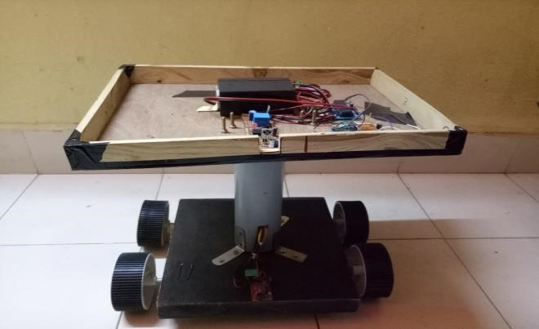
EXISTING SYSTEM
The chair is expected to do the following tasks in a complete automatic parking process:
1.Once the length of a parking space larger than the length of the chair plus a buffering distance is detected, the chair will stop automatically.
2.Otherwise it performs a smooth and efficient parking.

Slide 6
BLOCK DIAGRAM
Micro
Controller
8051
IR Sensor
L293D
Motor drivers
IC
Motor
1
Motor2
RF Module

Slide 7
DISADVANTAGE
The drawback in this system is if any obstacle comes between the chair and parking position IR sensor will detect the obstacle and the chair will stop until the obstacle is moves away.
As soon as the obstacle moves the chair will go to its parking position

Slide 8
IMPLEMENTATION
We have deployed a microcontroller used to sense the movement of chair and check whether there is a capacity for Chair to park, then decide to move or not.
In our proposed system if any obstacle comes between the chair and parking position it rotates and moves in another direction towards the target location.
As soon as chair finds its parking path it will moves towards its respected parking position.

Slide 9
BLOCK DIAGRAM
Sensors
Ultrasonic
Metal Detector
Arduino Uno
(AT mega
328P)
Motor
1
L293D
Motor drivers
IC
IR
Motor2
RF Module
RF
Receiver
Wireless switch

Slide 10
WORKING
When we press the switch which is present in the RF module, the command signal is sent to the main or controller system.
At the controller side the RF receiver circuit starts the programming implementation and the chair starts moving forward.
IR sensors detects the obstacle. After its found, motors will rotate and change the direction of chair. Ultrasonic sensor calculates the distance between obstacle and system.
Metal detection sensor is fitted at below of the table, if metal is found by it, then chair will stops automatically.
LCD is connected to the controller for monitoring the distance at every time.

Slide 11
COMPONENTS USED
HARDWARE : SOFTWARE:
1. Arduino Uno 1. Arduino IDE
2. RF Module
3. L293D Motor Driver IC
4. IR Sensor
5. Ultrasonic Sensor
6. Metal Detector
7. LCD Display

Slide 12
ADVANTAGES
This technology reduces the human effort to arrange the chairs after a long day works or lengthy.
It reduces the works of peon who has so many other works like to arrange the files clean the rooms which can be done simultaneously.
It is less time consuming as these self-parking chairs arrange themselves automatically just on a single click on a wireless button.
This technology helps to maintain the order and discipline in the institute as there is no stress on arrangement of the chairs.

Slide 13
APPLICATIONS
In Schools, Colleges and Offices like
Seminar Halls.
Board rooms.
Laboratories.

Slide 14
RESULTS
Whenever we want to arrange chairs just on the switch. After the switch is turned on, the chair starts moving to park in desired location.
Using this system we can reduce the human effort. It is a self parking system because of this there is no manual operation required. Due to this we can easily arrange the chairs in their respective places just by giving the interrupt to the chair.

Slide 15
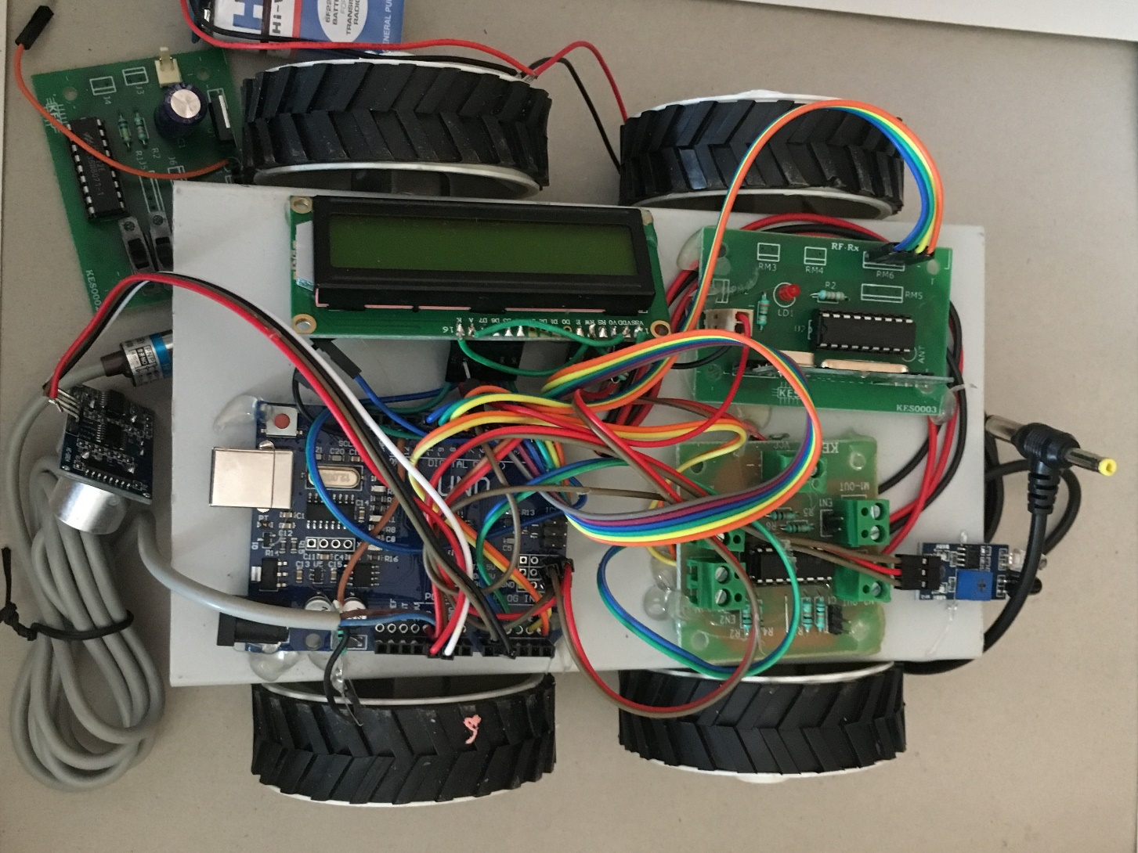
EXPERIMENTAL RESULT

Slide 16
FUTURE SCOPE
In corporate companies like board room after completion of meeting the employees moves away without arranging the chairs thus, this system automatically arrange the shuffled chairs to their respective position.
It may used in schools and colleges like in the practical labs the students moves away without arranging the shuffled chairs hence, by giving the interrupt to the system it arrange the chairs in their original destination.
In conference halls the people goes away after completion of conference without arranging the displaced chairs. This system helps in arranging the displaced chairs in their located position.

Slide 17
REFERENCES
Self-parking chairs at conference tables show Nissan's auto push by Nancy Owano Self-parking (2016, February 15) retrieved 23 February 2018 from https://techxplore.com/news/2016-02-selfparking-chairs-conferencetables-nissan.html
Nissan’s self-parking office chair is here to make your Monday better https://www.theverge.com/2016/2/15/10996234/Nissans-self-parking-chair-car/
Real time car parking system using image processing From http://ieeexplore.ieee.org/document/5941663/
The Microcontroller and Embedded systems using Assembly and C by Muhammad Ali Mazidi , Janice Gillispie Mazidi, Rollin D. McKinley.

Slide 18


