Slide 1


FINAL YEAR PROJECT
AEGIS
Adaptive Edge-Intelligence Guardian and Safety System
A smart child-safety wearable with on-device stress detection, GPS geofencing and instant SMS alerts.
PRESENTED BY
SUPERVISED BY
DEPARTMENT & DATE
Barira Sarfraz 222201042
Nabeeha Zahid 222201009
Dr. Altaf Hussain
Dept. of Computer Science
KICSIT Campus

Slide 2
OUTLINE
Agenda
01
Introduction & Background
05
System Design & Diagrams
The problem and why AEGIS exists
Architecture, hardware, UML
02
Objectives, Scope & Methodology
06
Dataset, ML Model & Results
Goals and how we built it
WESAD, Random Forest, accuracy
03
Literature & Comparison
07
Testing & Mobile App
Prior work and where AEGIS stands
Test cases and the parent app
04
Solution & Requirements
08
Contribution, Limitations & Conclusion
Our system, functional & non-functional
Team, future work, wrap-up
Adaptive Edge-Intelligence Guardian and Safety System
02

Slide 3
The problem
Every year, parents of young children face the same fear: a child who wanders off, panics in a crowd, or faces a medical scare cannot always say so in time.
INTRODUCTION
Introduction
& Background
Existing child trackers only report GPS location and depend on a constant internet connection. They cannot sense distress, they go silent where there is no signal, and they say nothing about how the child actually feels.
Our answer
03
AEGIS is a wearable band for children aged 4-12 that reads physiological signals in real time, detects stress or danger on the device itself, tracks location, and alerts parents over SMS - working even with no internet at all.
SECTION 03
Adaptive Edge-Intelligence Guardian and Safety System
03

Slide 4
01
Sense distress, not just location
Read heart rate, SpO2, skin response and temperature on the wrist.
GOALS
Objectives
& Scope
02
Decide on the edge
Run the stress model on the ESP32 so alerts work without the cloud.
What AEGIS sets out to achieve, and the boundaries we set for this project.
03
Alert reliably anywhere
Send SMS over GSM so parents are reached even with no internet.
04
Keep every child personal
Calibrate a 7-day baseline so detection fits the individual child.
04
05
Stay private and free
Restrict data per parent and build only on free-tier services.
SECTION 04
Adaptive Edge-Intelligence Guardian and Safety System
04

Slide 5
01
Design first
Architecture, data model and UML defined before code.
APPROACH
Methodology
& Development
02
App & backend in parallel
Flutter screens built with dummy data, then wired to Firebase.
An incremental, hardware-independent build so progress never stalls on parts.
03
Model offline
Random Forest trained and validated on the WESAD dataset.
04
Firmware as pure logic
Z-score, sliding-window and geofence written and unit-tested off-device.
05
05
Integrate & test
Bring hardware, model, app and alerts together for end-to-end testing.
SECTION 05
Adaptive Edge-Intelligence Guardian and Safety System
05

Slide 6
BACKGROUND
Literature Review
Wearable stress detection
On-device / edge ML
The WESAD dataset (Schmidt et al., 2018) established wrist physiological signals - HR, EDA, temperature, motion - as reliable cues for stress versus calm states.
Research on TinyML shows compact models such as Random Forests can run on microcontrollers, enabling decisions without a network round-trip.
Child-tracking devices
Physiological signals
Commercial trackers focus on GPS and calling; studies note their dependence on connectivity and the absence of any physiological awareness.
Galvanic skin response and heart-rate variability are well-documented markers of acute stress, motivating multi-sensor fusion over location alone.
Adaptive Edge-Intelligence Guardian and Safety System
06

Slide 7
WHERE WE STAND
AEGIS vs Existing Wearables
Capability | AEGIS | GPS Tracker | Kids' Smartwatch
Live GPS location | Yes | Yes | Yes
Physiological / stress sensing | Yes | No | Limited
On-device (edge) decisions | On-device | Cloud | Cloud
Works with no internet | Offline | No | No
SMS alert fallback | Yes | No | Limited
Geofencing | Yes | Limited | Yes
Backend cost | Free | Paid | Paid
Adaptive Edge-Intelligence Guardian and Safety System
07

Slide 8
THE SYSTEM
Our Solution
01 Wearable Band
02 Edge ML Model
ESP32 reads the sensors, runs the model, calibrates, and decides - the brain of the system.
A Random Forest trained on WESAD, flashed to the band, classifying stress entirely on-device.
03 Parent App
04 Firebase Backend
A Flutter app that visualises vitals, location, alerts and analytics - it never makes decisions.
Free-tier Firestore, Auth and Cloud Messaging for storage, sync and push.
Adaptive Edge-Intelligence Guardian and Safety System
08

Slide 9
01
Accounts & Authentication
02
Live Vitals Dashboard
Firebase Auth login; multiple children.
Real-time HR, SpO2, GSR and temperature.
REQUIREMENTS
Functional
Requirements
03
Location & Geofence Map
04
Safe-Zone Configuration
Live GPS and safe-zone on OpenStreetMap.
Set the geofence centre and radius.
05
Alert History
06
Push Notifications
Stress, breach and SpO2 alerts, logged.
Instant alerts via Firebase Cloud Messaging.
09
07
Health Analytics
08
Calibration Tracking
7-day vitals trends and stress charts.
7-day baseline before alerts activate.
SECTION 09
Adaptive Edge-Intelligence Guardian and Safety System
09

Slide 10
Reliability
Security & Privacy
Alerts must fire even offline - SMS over GSM, cached then synced.
Firestore rules restrict each parent to their own children's data.
QUALITY
Non-Functional
Requirements
Performance
Power Efficiency
A 10-second monitoring cycle with real-time updates in the app.
Duty-cycled sensing to extend battery life on a small LiPo cell.
Usability
Affordability
10
The 7-day calibration is communicated clearly to parents.
Built entirely on free-tier services - zero paid APIs.
SECTION 10
Adaptive Edge-Intelligence Guardian and Safety System
10

Slide 11
STACK
Tools & Technologies
Wearable
Machine Learning
Mobile App
ESP32 · MAX30102 · MPU6050 · GSR · DS18B20 · NEO-6M GPS · SIM800L GSM
Python · scikit-learn · Random Forest · WESAD dataset
Flutter · Dart · Provider · fl_chart · flutter_map
Backend (free tier)
Maps & Comms
Tooling
Firebase Auth · Cloud Firestore · Cloud Messaging
OpenStreetMap · WiFi · BLE · GSM/SMS
GitHub · GitHub Actions CI · PlatformIO
Adaptive Edge-Intelligence Guardian and Safety System
11

Slide 12
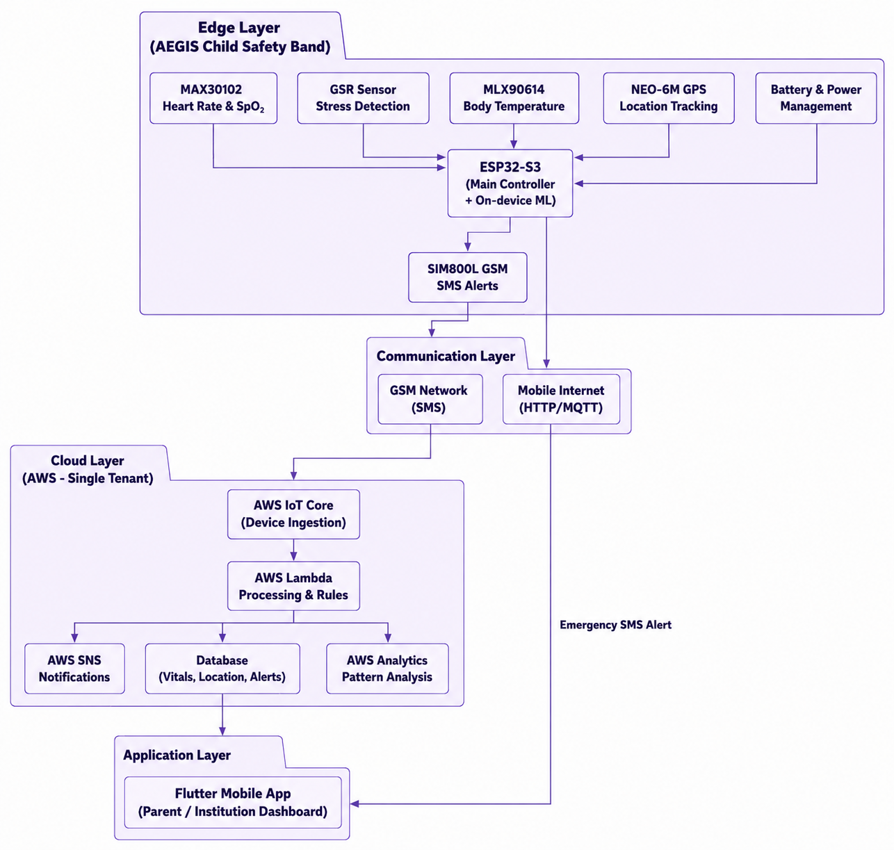
ARCHITECTURE
System
Architecture
12
SECTION 12
Adaptive Edge-Intelligence Guardian and Safety System
12

Slide 13
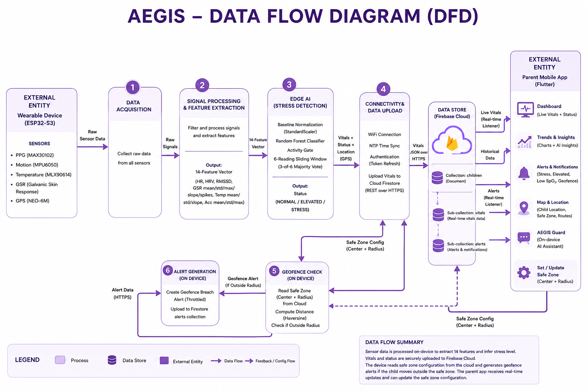
DATA FLOW
System Workflow
& Data Flow
13
SECTION 13
13

Slide 14
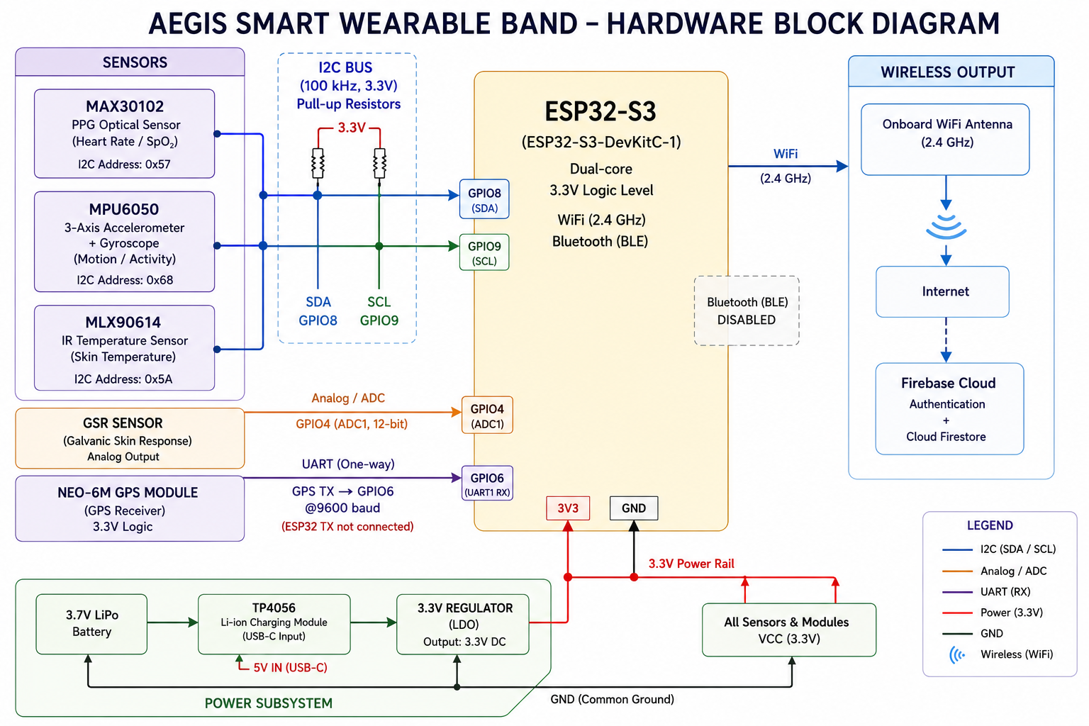
HARDWARE
Hardware Block
& Circuit
14
SECTION 14
14

Slide 15
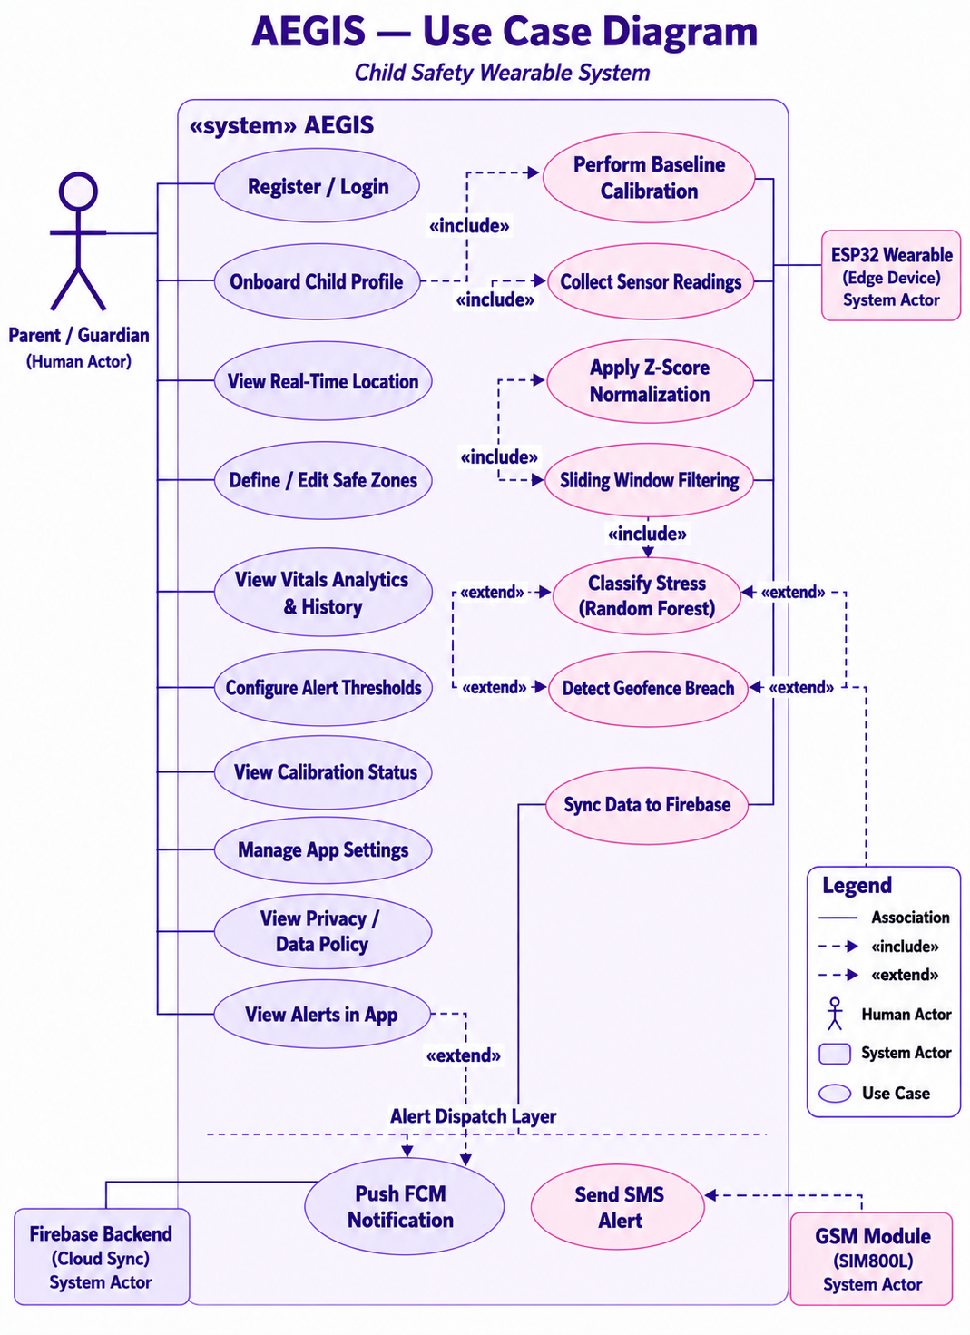
BEHAVIOUR
Use Case
Diagram
+
15
DIAGRAM PLACEHOLDER
SECTION 15
15

Slide 16
UC-01 Register & Add Child
Actor · Parent
SCENARIOS
A parent signs up, creates their account and adds a child profile with a paired device.
Descriptive
Use Cases
UC-02 Configure Safe Zone
Actor · Parent
From the map the parent sets a geofence centre and radius that the band will monitor.
16
UC-03 Receive Breach Alert
Actor · Wearable
On leaving the safe zone the band vibrates, sends an SMS and logs an alert the app shows.
SECTION 16
Adaptive Edge-Intelligence Guardian and Safety System
16

Slide 17
USE CASE 01
View Real-Time Vitals
Typical Course of Actions
Actor's Action | System Response
1. Parent logs into the app. | 1. System authenticates the credentials and grants access.
2. Parent selects the child profile. | 1. System retrieves the data for the selected child's band.
3. Parent opens the vitals dashboard. | 1. System fetches the latest HR, SpO2, temperature and stress. 2. Displays them on the dashboard in real time.
Adaptive Edge-Intelligence Guardian and Safety System
16

Slide 18
USE CASE 01 (CONTINUED)
View Real-Time Vitals
Alternative Course of Actions
Actor's Action | Alternative System Response
1a. Parent opens the app while offline. | 1a. System displays the last cached reading from the band.
1b. Connectivity is restored. | 1b. System resumes the typical flow with live data.
Exception Flow
Actor's Action | Exception System Response
1c. Parent enters incorrect login credentials. | 1c. System prompts re-entry of credentials.
1d. Login fails three times. | 1d. System locks the account for five minutes.
Adaptive Edge-Intelligence Guardian and Safety System
17

Slide 19
USE CASE 02
Monitor Heart Rate & SpO2
Typical Course of Actions
Actor's Action | System Response
1. MAX30102 reads pulse and oxygen data. | 1. ESP32 computes heart rate and SpO2 values.
2. ESP32 compares readings to baseline thresholds. | 1. System uploads the validated readings to the cloud.
3. Parent opens the app to check trends. | 1. App fetches and displays HR and SpO2 history.
Alternative Course of Actions
Actor's Action | Alternative System Response
1a. Sensor noise is detected during reading. | 1a. Band filters the signal with the onboard ML model, then resumes once clean.
Exception Flow
Actor's Action | Exception System Response
1c. MAX30102 fails to respond. | 1c. Band logs the sensor error and sends a fallback alert via GSM.
Adaptive Edge-Intelligence Guardian and Safety System
18

Slide 20
USE CASE 03
Monitor Body Temperature
Typical Course of Actions
Actor's Action | System Response
1. MLX90614 reads the child's body temperature. | 1. ESP32 compares the value to the configured threshold.
2. Reading is within the normal range. | 1. System stores the reading in the cloud.
3. Parent views the temperature trend. | 1. App displays the latest and historical temperature data.
Alternative Course of Actions
Actor's Action | Alternative System Response
1a. Ambient interference affects the reading. | 1a. Band recalibrates the sensor and resumes with a corrected reading.
Exception Flow
Actor's Action | Exception System Response
1c. Reading is out of range (>50C or <20C). | 1c. System activates anomaly detection and triggers an alert.
Adaptive Edge-Intelligence Guardian and Safety System
19

Slide 21
USE CASE 04
Monitor Stress Level (GSR)
Typical Course of Actions
Actor's Action | System Response
1. GSR sensor measures skin conductance. | 1. ESP32 runs the on-device ML model to infer stress.
2. Stress level is classified. | 1. System streams the classified data to the cloud.
3. Parent opens the app. | 1. App displays the current and historical stress trend.
Alternative Course of Actions
Actor's Action | Alternative System Response
1a. GSR signal is weak or unstable. | 1a. System applies the child's baseline, then resumes.
Exception Flow
Actor's Action | Exception System Response
1c. Stress remains persistently high. | 1c. System triggers an alert without waiting for cloud confirmation.
Adaptive Edge-Intelligence Guardian and Safety System
20

Slide 22
USE CASE 05
View Live Location & History
Typical Course of Actions
Actor's Action | System Response
1. Parent opens the location tab. | 1. App requests the latest location from the cloud.
2. NEO-6M GPS provides coordinates. | 1. ESP32 checks the coordinates against the geofence.
3. Band reports the verified position. | 1. System uploads coordinates and updates the map view.
Alternative Course of Actions
Actor's Action | Alternative System Response
1a. GPS signal is weak or unavailable. | 1a. Band falls back to cell-tower location and resumes.
Exception Flow
Actor's Action | Exception System Response
1c. Location upload fails. | 1c. System stores data locally and retries once reconnected.
Adaptive Edge-Intelligence Guardian and Safety System
21

Slide 23
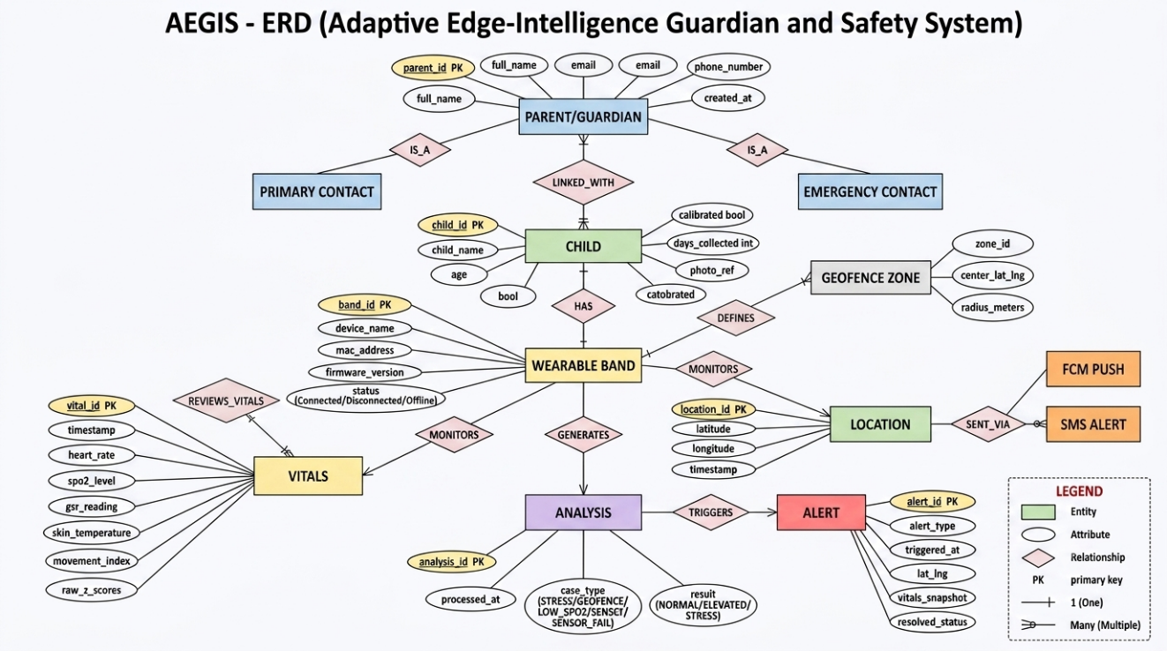
DATA MODEL
Entity-Relationship
Diagram
17
SECTION 17
17

Slide 24
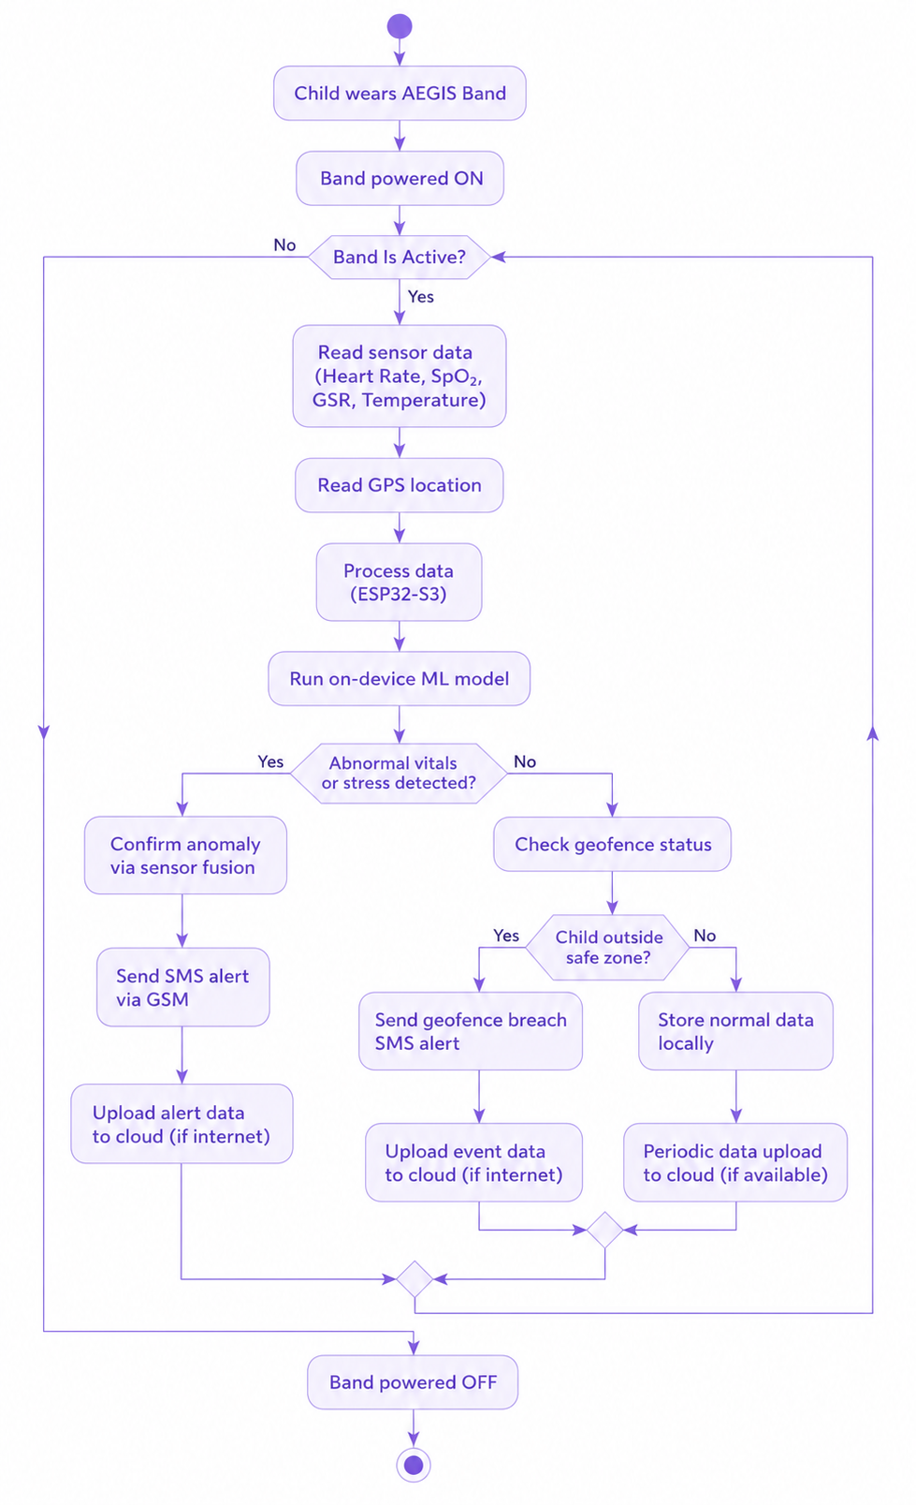
BEHAVIOUR
Activity
Diagram
18
SECTION 18
18

Slide 25
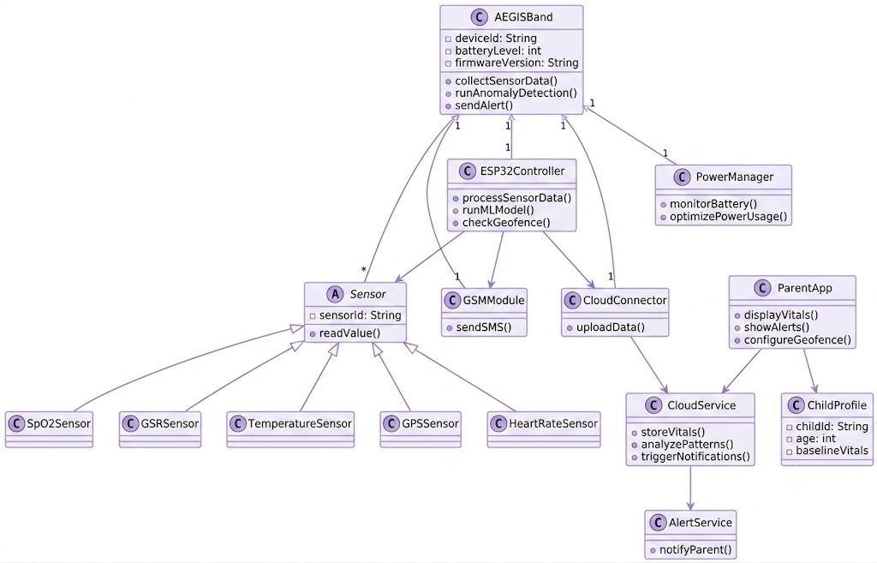
STRUCTURE
Class
Diagram
19
SECTION 19
19

Slide 26
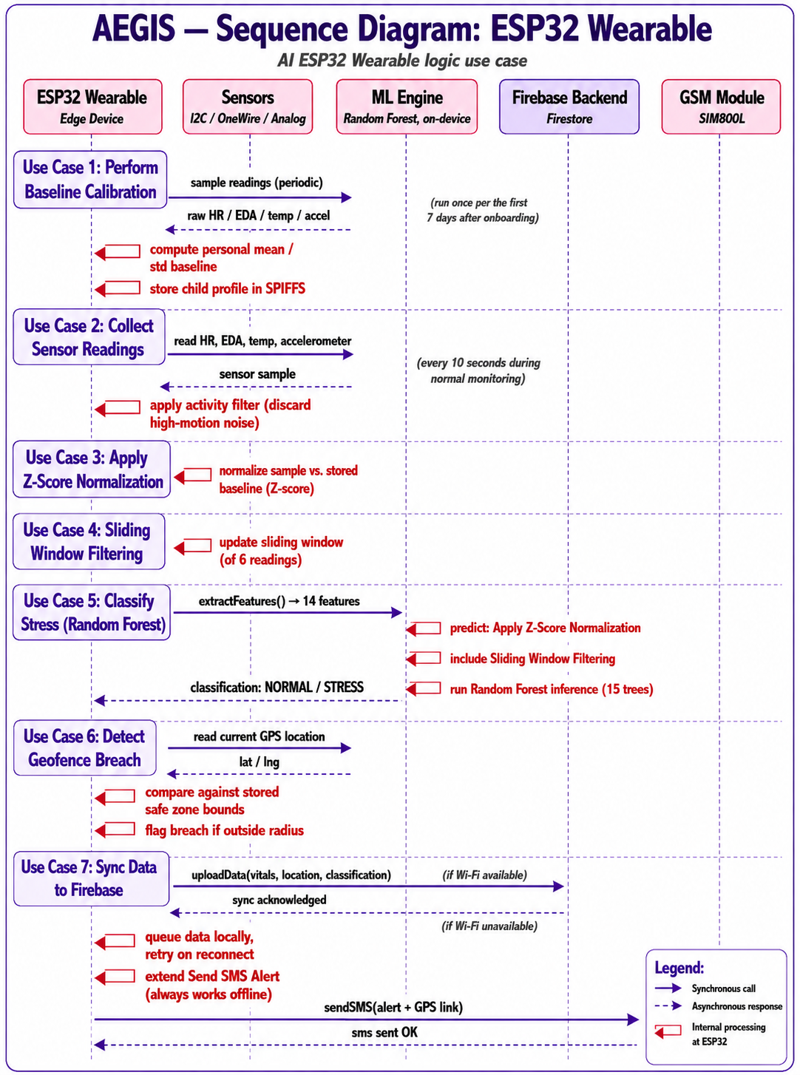
INTERACTION
Sequence
Diagram
20
SECTION 20
20

Slide 27
Dataset
WESAD - 15 subjects, wrist physiological signals
LEARNING
Dataset &
ML Model
Algorithm
Random Forest · 15 trees · max depth 8
The model is trained offline, then flashed to the band to run on-device.
Output
Binary: NORMAL or STRESS
Features
14 inputs - HR, HRV, RMSSD, EDA, temperature, motion
21
On-device
Exported to a C header and run on the ESP32
SECTION 21
Adaptive Edge-Intelligence Guardian and Safety System
21

Slide 28
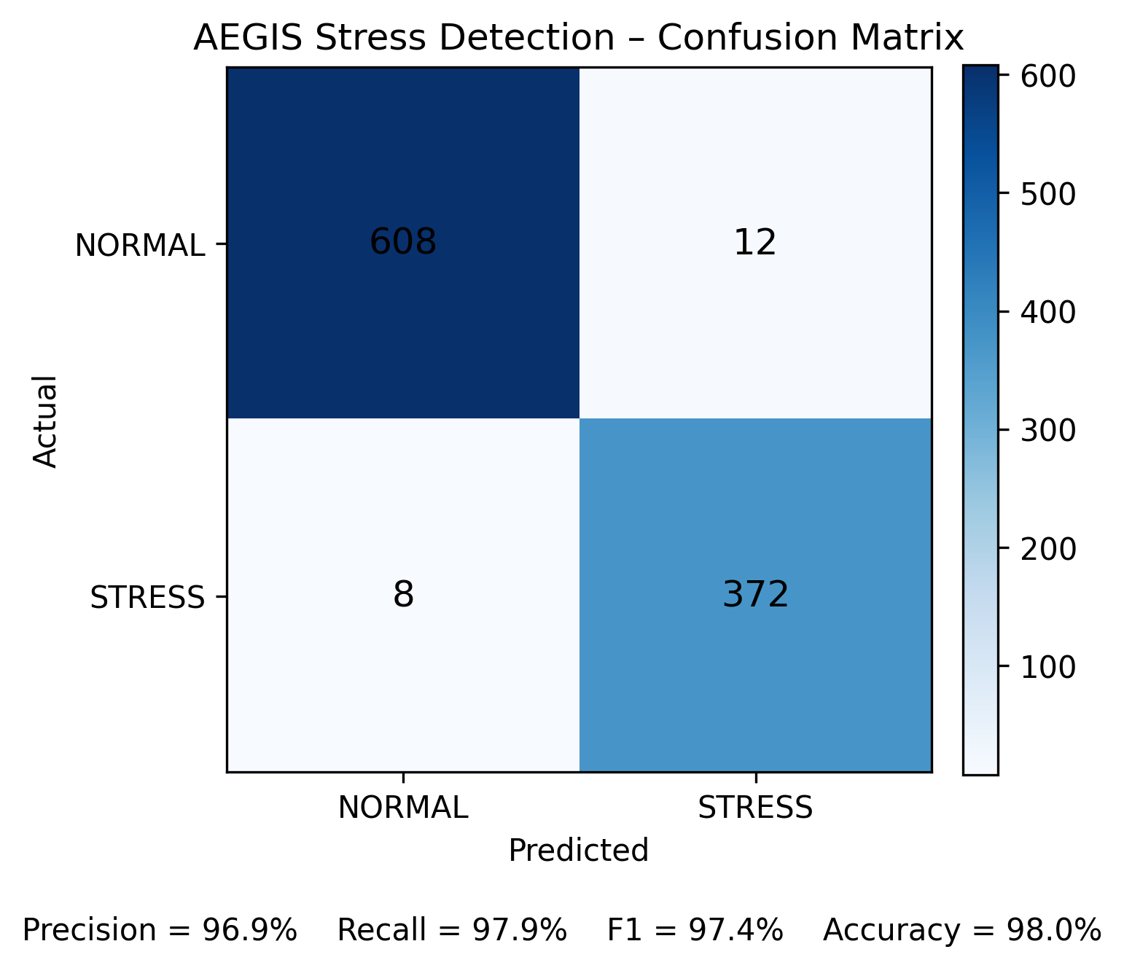
PERFORMANCE
ML Model Results
97.96%
96.03%
± 1.24%
Training accuracy
Cross-validation
CV std. deviation
Per-class metrics
Precision, recall and F1 (per NORMAL / STRESS class) are produced by the model test script and will be inserted here from its classification report.
22

Slide 29
VERIFICATION
Detailed Test Cases
ID | Test Case | Layer | Type
TC-APP-001 | Parent account registration | Mobile App | Manual
TC-APP-002 | Define and persist a safe zone | Mobile App | Manual
TC-APP-003 | Invalid login credential rejection | Mobile App | Manual
TC-FW-001 | Baseline Z-score normalization | Firmware | Unit
TC-FW-002 | Stress classification on feature vector | Firmware | Unit
TC-INT-001 | End-to-end geofence breach alert | Integration | Black Box
TC-INT-002 | Alert flag triggers FCM push | Integration | Black Box
TC-HW-002 | GSM SMS fallback delivery | Hardware | Manual
Adaptive Edge-Intelligence Guardian and Safety System
23

Slide 30
VERIFICATION
Detailed Test Cases
ML-EVAL-01
PASS
TC-FW-001
PASSED
Model Classification Accuracy
Baseline Z-Score Normalization
OBJECTIVE
OBJECTIVE
Evaluate the RF classifier on WESAD.
Standardize a reading vs the baseline.
INPUT
INPUT
WESAD: 14 features, 15 subjects.
reading=80, mean=70, std=5.
EXPECTED RESULT
EXPECTED RESULT
Accuracy at or above 90%.
Returns 2.0.
ACTUAL RESULT
ACTUAL RESULT
97.96% train; 96.03% CV (+/-1.24%).
Returns 2.0.
PASS CRITERIA
PASS CRITERIA
Accuracy >= 90%, stable across folds.
Z-score equals the computed value.
Adaptive Edge-Intelligence Guardian and Safety System
28

Slide 31
VERIFICATION
Detailed Test Cases
TC-FW-002
PASSED
TC-FW-003
PASSED
Stress Classification
7-Day Calibration Window
OBJECTIVE
OBJECTIVE
Confirm the RF returns the expected label.
Finish calibration only after 7 days.
INPUT
INPUT
A STRESS vector, then a NORMAL vector.
7 days of mock HR/EDA/temp readings.
EXPECTED RESULT
EXPECTED RESULT
Returns STRESS, then NORMAL.
Classification enabled from day 8.
ACTUAL RESULT
ACTUAL RESULT
Returns STRESS, then NORMAL.
Classification enabled from day 8.
PASS CRITERIA
PASS CRITERIA
Labels match training annotations.
Baseline finalized; gated to day 8.
Adaptive Edge-Intelligence Guardian and Safety System
29

Slide 32
VERIFICATION
Detailed Test Cases
TC-HW-001
PASSED
TC-HW-002
PASSED
Heart Rate Accuracy vs Oximeter
SMS Fallback When WiFi Down
OBJECTIVE
OBJECTIVE
MAX30102 HR vs a clinical oximeter.
GSM SMS fallback when WiFi fails.
INPUT
INPUT
10 paired samples over 5 minutes.
Stress alert with WiFi disabled.
EXPECTED RESULT
EXPECTED RESULT
Within +/- 5 bpm of reference.
SMS received within fallback window.
ACTUAL RESULT
ACTUAL RESULT
Within +/- 5 bpm of reference.
SMS received within fallback window.
PASS CRITERIA
PASS CRITERIA
Mean abs. difference <= 5 bpm.
Logs 'SMS sent: OK'; SMS received.
Adaptive Edge-Intelligence Guardian and Safety System
30

Slide 33
VERIFICATION
Detailed Test Cases
TC-APP-001
TC-APP-002
PASSED
PASSED
Parent Account Registration
Define and Persist a Safe Zone
OBJECTIVE
OBJECTIVE
Register a parent via Firebase Auth.
Draw a safe zone; check it persists.
INPUT
INPUT
Name, unique email, valid password.
Zone name, radius.
EXPECTED RESULT
EXPECTED RESULT
Account created; onboarding opens.
Zone reappears after restart.
ACTUAL RESULT
ACTUAL RESULT
Account created; session active; onboarding opens.
Zone persisted; reloads after restart.
PASS CRITERIA
PASS CRITERIA
Account in Firebase Auth; navigates.
Geofence saved in Firestore.

Slide 34
VERIFICATION
Detailed Test Cases
TC-APP-003
TC-INT-001
PASSED
PASSED
Invalid Login Rejection
End-to-End Geofence Breach
OBJECTIVE
OBJECTIVE
Reject wrong credentials clearly.
Breach: firmware through to app push.
INPUT
INPUT
Valid email, wrong password.
Mock GPS outside the safe zone.
EXPECTED RESULT
EXPECTED RESULT
Error shown; no navigation.
Push arrives within sync interval.
ACTUAL RESULT
ACTUAL RESULT
Error shown; no session/token issued.
Breach detected; GEOFENCE alert raised.
PASS CRITERIA
PASS CRITERIA
Stays on login; no token issued.
Alert in Firestore; push delivered.

Slide 35
VERIFICATION
Detailed Test Cases
TC-INT-002
PASSED
Alert Flag Triggers FCM Push
OBJECTIVE
Alert write triggers an FCM push.
INPUT
Vitals record with alert = true.
EXPECTED RESULT
Push received; sync unaffected.
ACTUAL RESULT
Alert doc written; push-ready; sync unaffected.
PASS CRITERIA
Delivery log shows dispatch.

Slide 36
Mobile App Design
The parent app's real flow - from sign-in to live monitoring. Insert native captures into the frames.
Adaptive Edge-Intelligence Guardian and Safety System
24

Slide 37
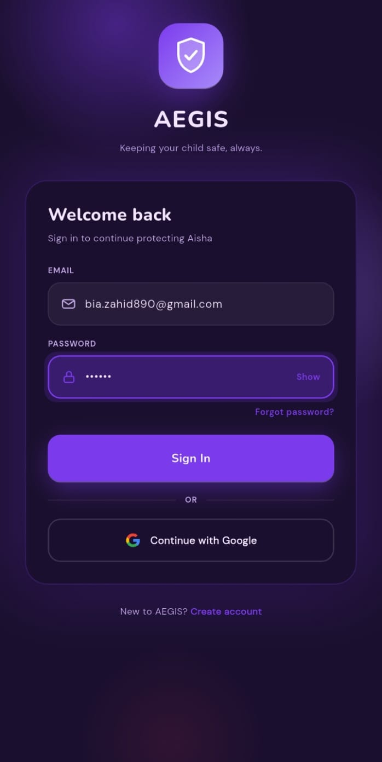
On Boarding
Adaptive Edge-Intelligence Guardian and Safety System
24

Slide 38
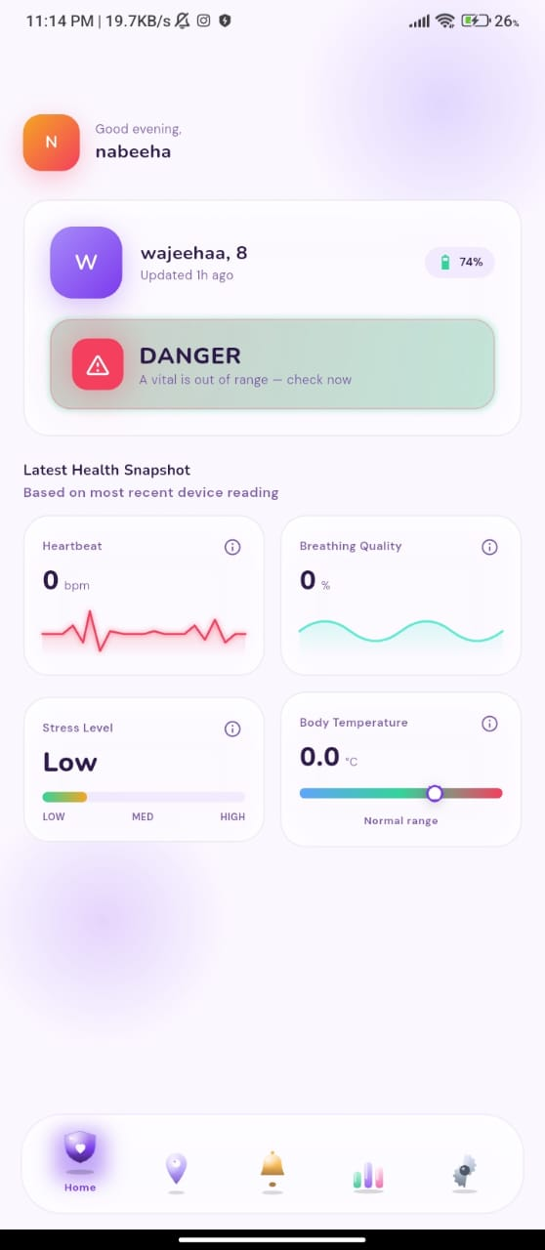
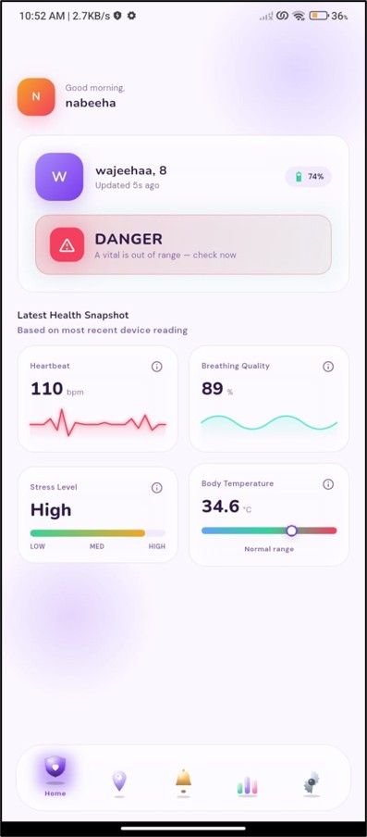
Home Screen
Adaptive Edge-Intelligence Guardian and Safety System
24

Slide 39
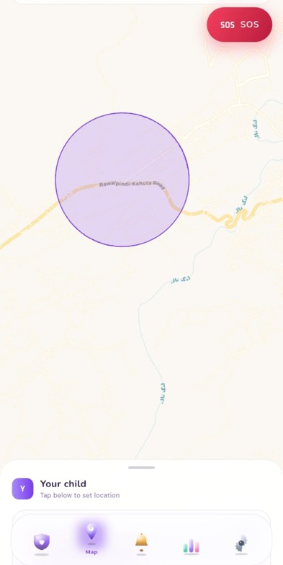
Map Screen
Adaptive Edge-Intelligence Guardian and Safety System
24

Slide 40
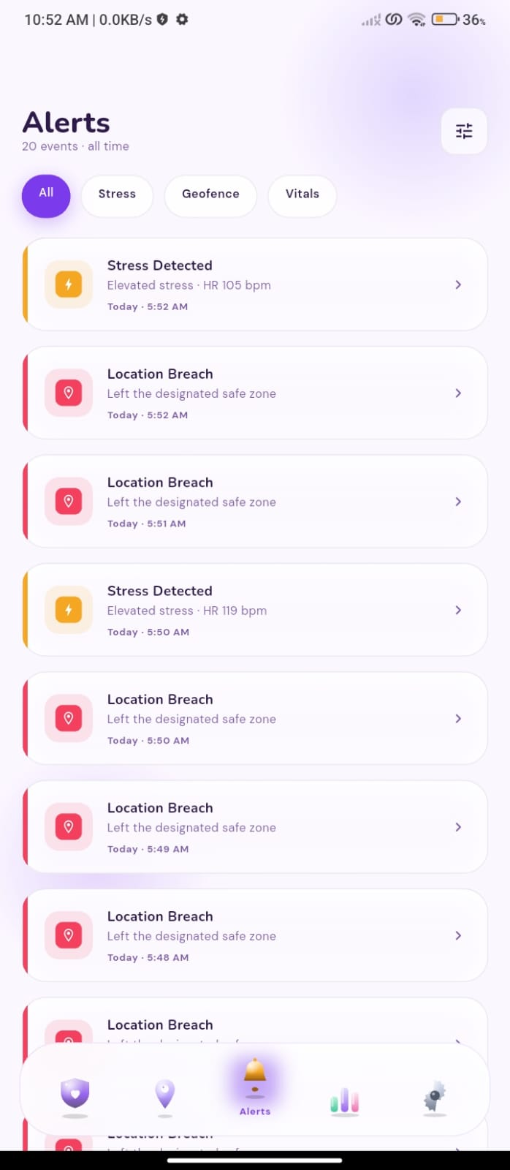
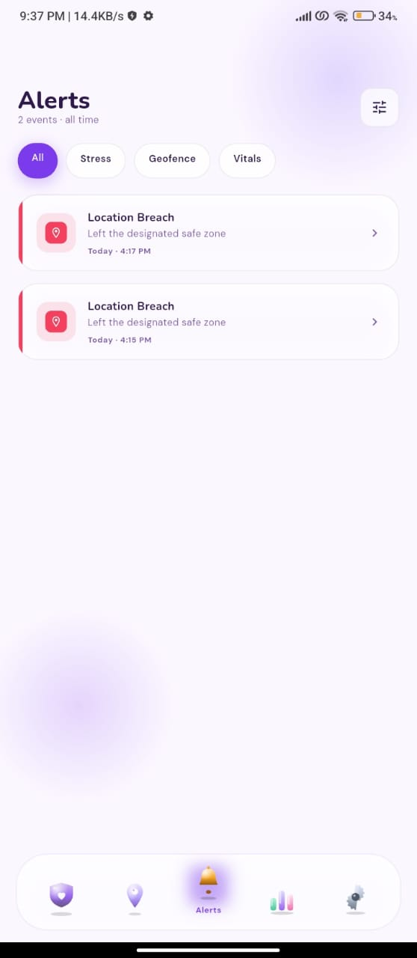
Alerts Screen
24

Slide 41
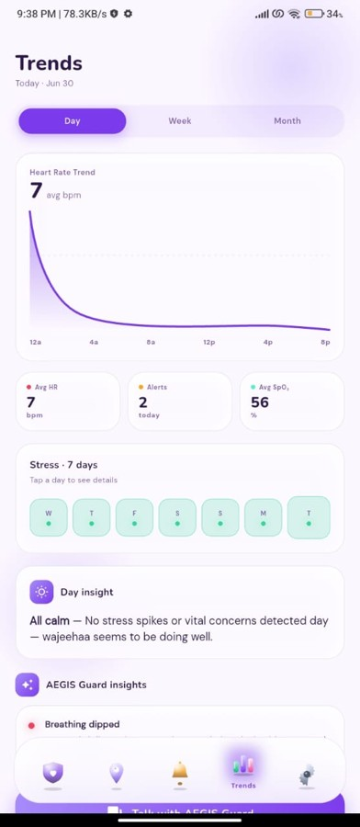
Trends Screen
Adaptive Edge-Intelligence Guardian and Safety System
24

Slide 42
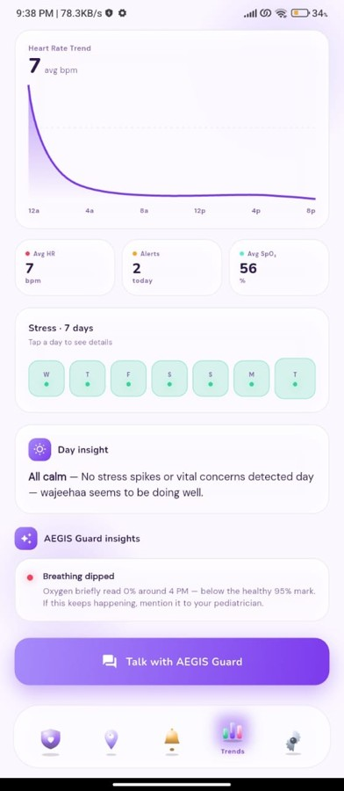
AI Chatbot
Adaptive Edge-Intelligence Guardian and Safety System
24

Slide 43
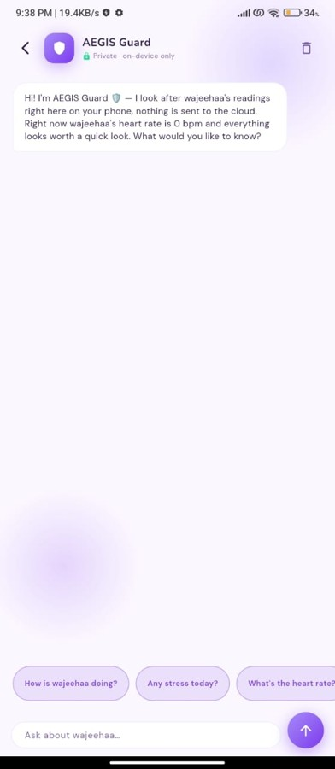
Chatbot Screen
Adaptive Edge-Intelligence Guardian and Safety System
24

Slide 44
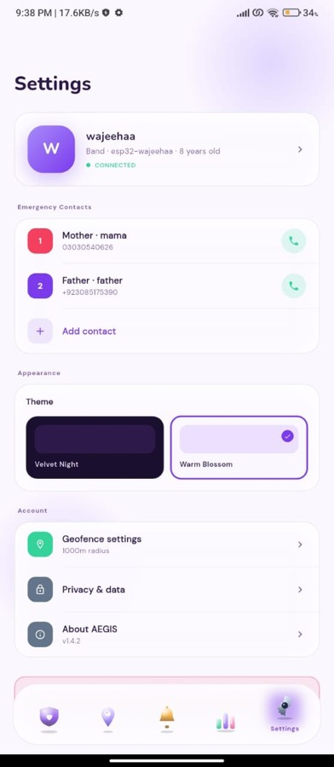
Chatbot Screen
Adaptive Edge-Intelligence Guardian and Safety System
24

Slide 45
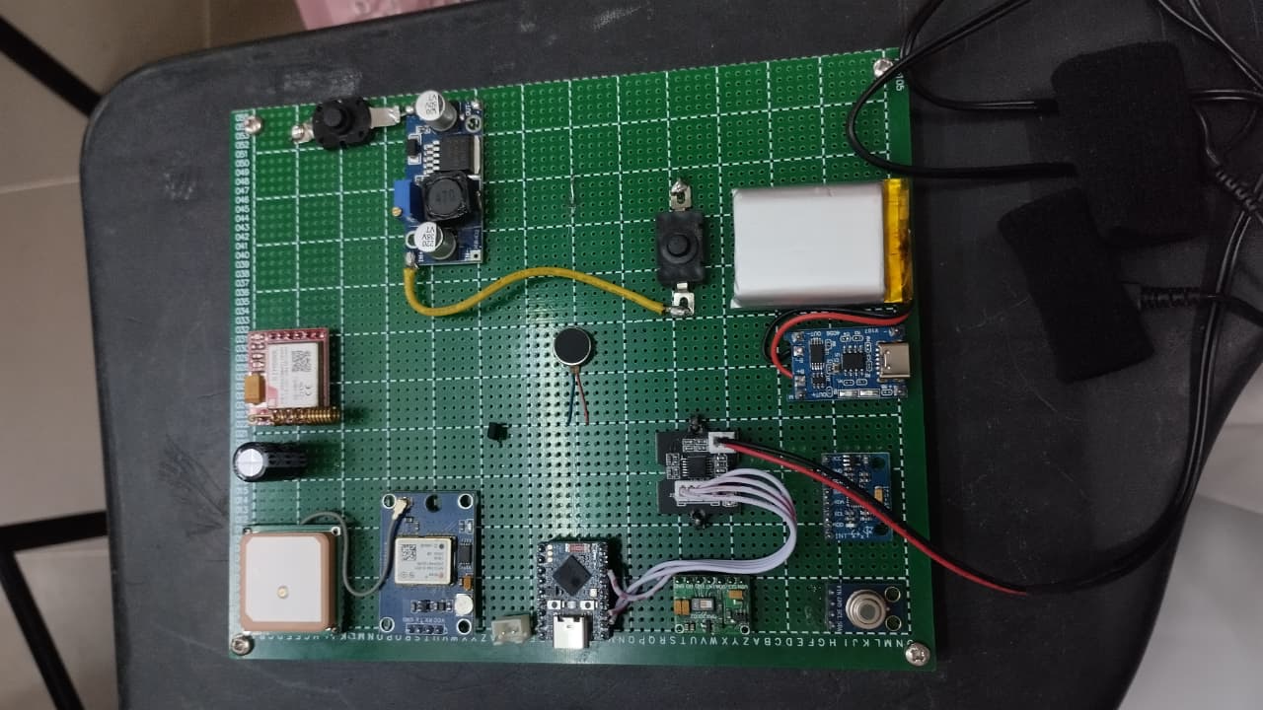
Hardware
Adaptive Edge-Intelligence Guardian and Safety System
24

Slide 46
Barira Sarfraz
Nabeeha Zahid
CREDITS
222201042
222201009
Team
Contribution
Flutter app screens & UI
ML model & WESAD pipeline
A shared build - refine the exact split to match your own division of work.
Firebase integration
Firmware logic & geofencing
App–backend data flow
Documentation & testing
25
SECTION 25
Adaptive Edge-Intelligence Guardian and Safety System
25

Slide 47
Where we are today
Where we are headed
HONESTY
Limitations &
Future Work
Hardware is at dev-kit prototype stage
Full sensor and band integration
The model classifies stress as binary only
BLE pairing and power optimization
Battery life is not yet measured
More affect classes beyond stress
A real-world pilot with families
27
SECTION 27
Adaptive Edge-Intelligence Guardian and Safety System
27

Slide 48
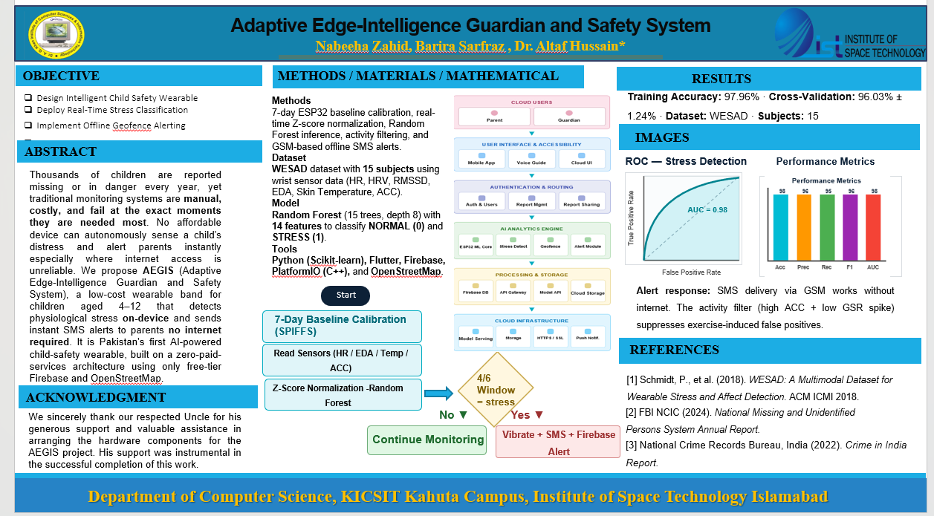
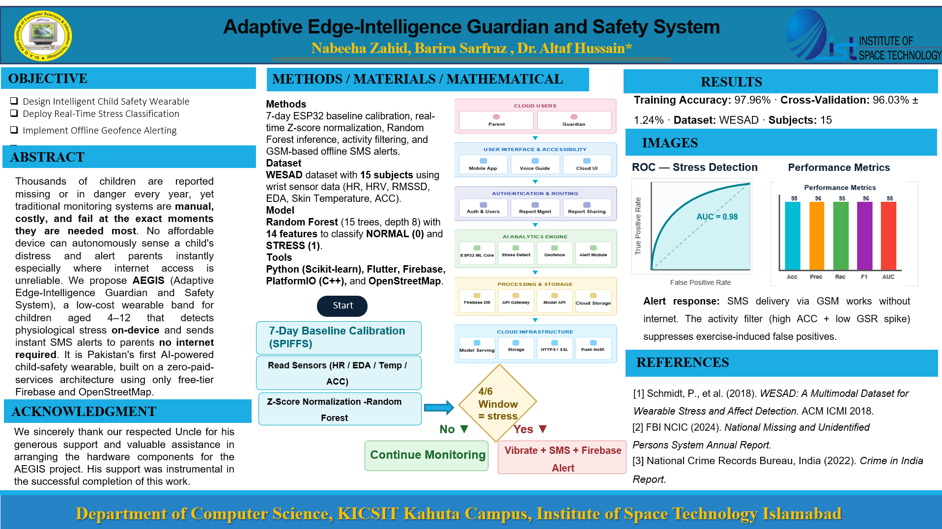

Slide 49
AEGIS reimagines child safety as more than a dot on a map. By sensing distress on the wrist, deciding on the device, and reaching parents even without internet, it turns a tracker into a true guardian.
CLOSING
Conclusion
Edge-first
Always reachable
Decisions happen on the band, not the cloud.
SMS over GSM means alerts arrive offline.
Personal & private
Built for zero cost
29
Per-child calibration, per-parent data.
A complete system on free-tier services.
SECTION 29
Adaptive Edge-Intelligence Guardian and Safety System
29

Slide 50
SOURCES
References
1
Schmidt, P. et al. (2018). Introducing WESAD, a Multimodal Dataset for Wearable Stress and Affect Detection. ACM ICMI.
2
Breiman, L. (2001). Random Forests. Machine Learning, 45(1), 5-32.
3
Pedregosa, F. et al. (2011). Scikit-learn: Machine Learning in Python. JMLR 12.
4
Flutter Documentation. Google. flutter.dev
5
Firebase Documentation (Authentication, Cloud Firestore, Cloud Messaging). Google. firebase.google.com
6
OpenStreetMap Contributors. openstreetmap.org
7
Espressif Systems. ESP32 Technical Reference Manual.
8
fl_chart & flutter_map - Flutter community packages. pub.dev
Adaptive Edge-Intelligence Guardian and Safety System
30

Slide 51
Thank You
Questions & Discussion
AEGIS · Adaptive Edge-Intelligence Guardian and Safety System
Barira Sarfraz · Nabeeha Zahid | Supervisor: Dr. Altaf Hussain

