Slide 1
Creating a Gravitational N-Body Simulation
Uzair Nawaz
Institute for Computing in Research
August 4, 2022

Slide 2
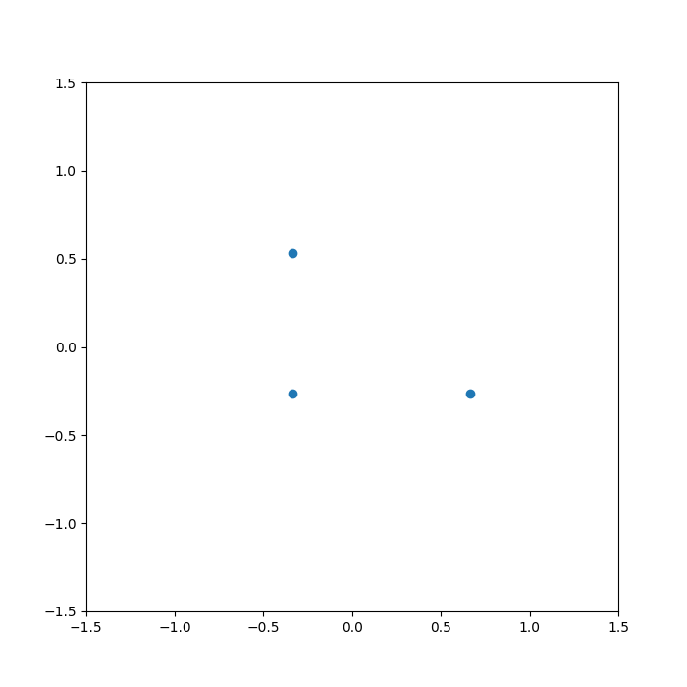
What is the N-Body Problem?
Predicting motion of particles affected by gravity
General solution for 3+ particles is mathematically impossible
Deterministic
Chaotic

Slide 3
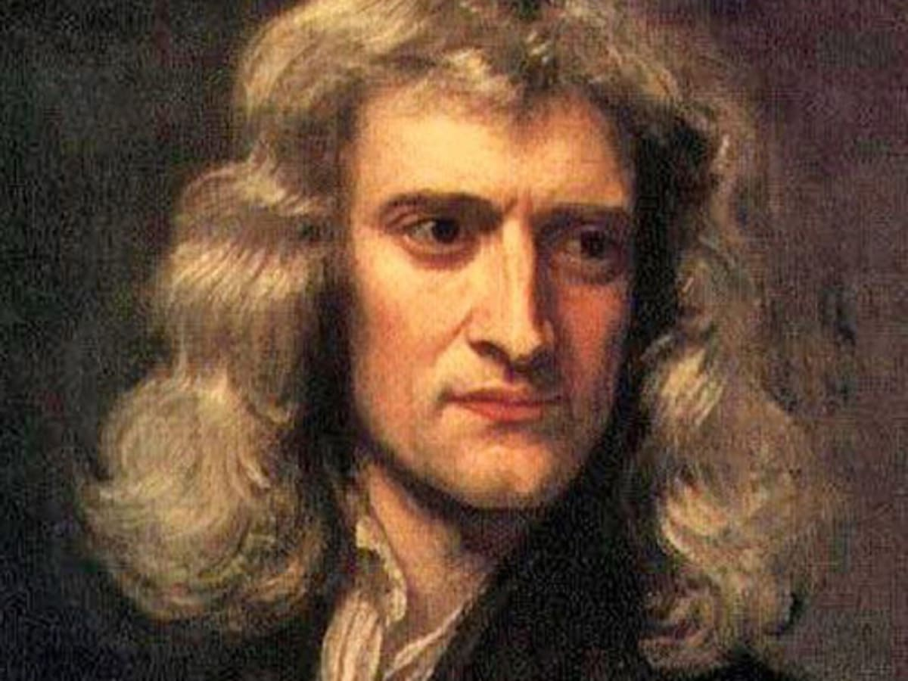
Let’s Talk About Gravity

Slide 4
Approximating Gravitational Motion
Let time_step = 1
While simulation is running:
  For each Particle p:
    p.acceleration = 0
    For each Particle q:
      Increase p.acceleration by grav_acceleration(p, q)
  update_particle_positions(time_step)

Slide 5
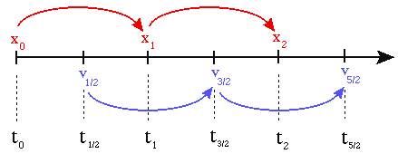
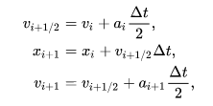
Leapfrog Integration
How do we turn our acceleration into actual movement?
My initial thought:
Better way:

Slide 6
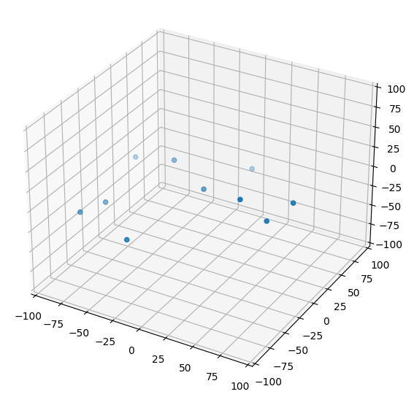
The Simulation Works!

Slide 7
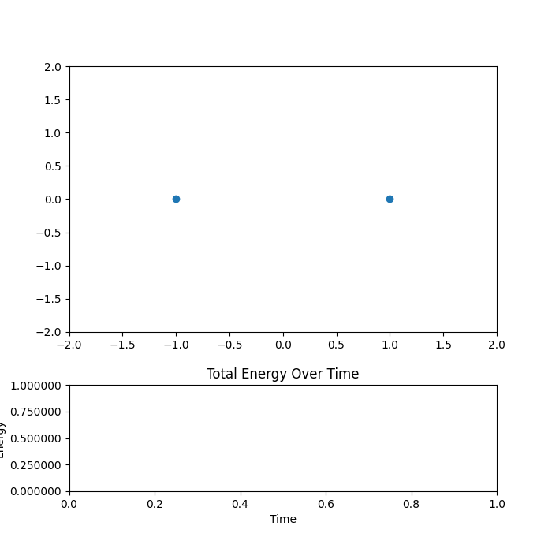
Or does it?

Slide 8
Current Issue
When particles get too close, they speed off
Why?
Moderately Far

Slide 9
Current Issue
When particles get too close, they speed off
Why?
Very Close

Slide 10
Current Issue
When particles get too close, they speed off
Why?
Very Far

Slide 11
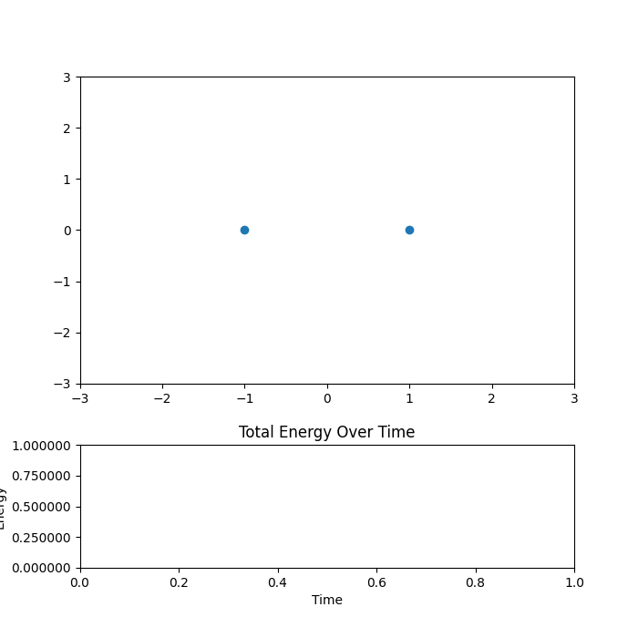
Force Softening
Artificially increasing the distance to reduce extreme forces

Slide 12

Elastic Collisions
Ideal collisions – no energy lost to friction, heat, etc
Conservation of kinetic energy

Slide 13
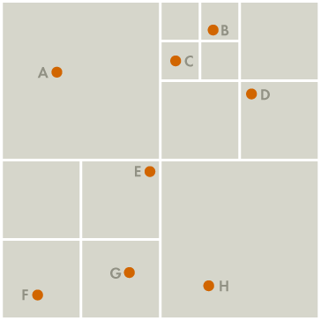
Barnes-Hut Tree
Three dimensional octree
Each node can contain either 1 or 0 particles
Used to group particles together
Clusters of particles that are far away are approximated as a single mass

Slide 14
Barnes-Hut Tree
Three dimensional octree
Each node can contain either 1 or 0 particles
Used to group particles together
Clusters of particles that are far away are approximated as a single mass

Slide 15
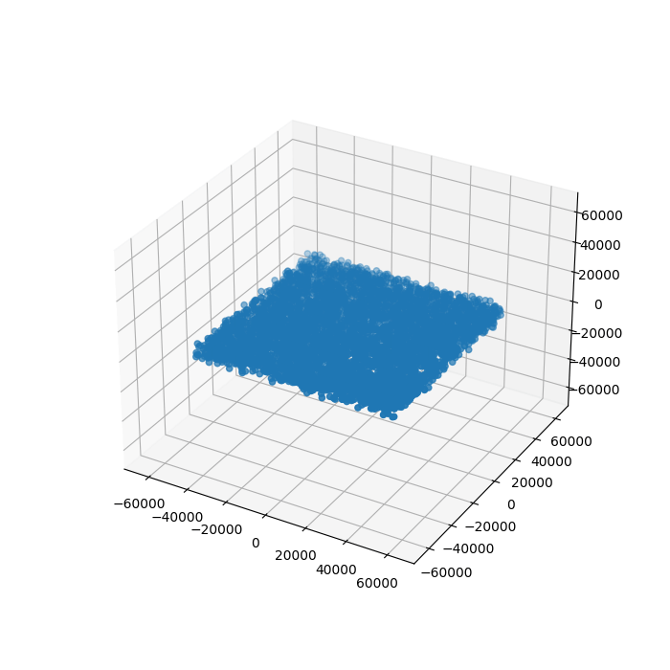
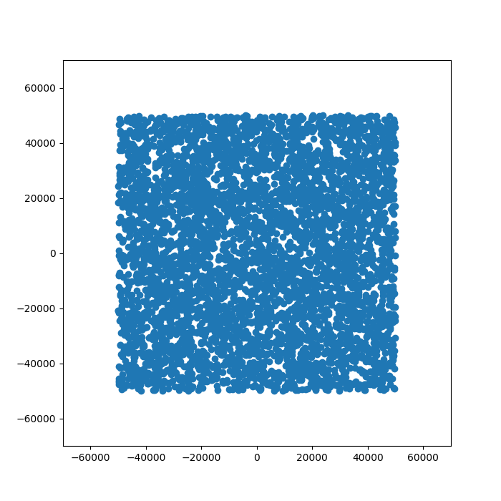
More Particles!

Slide 16
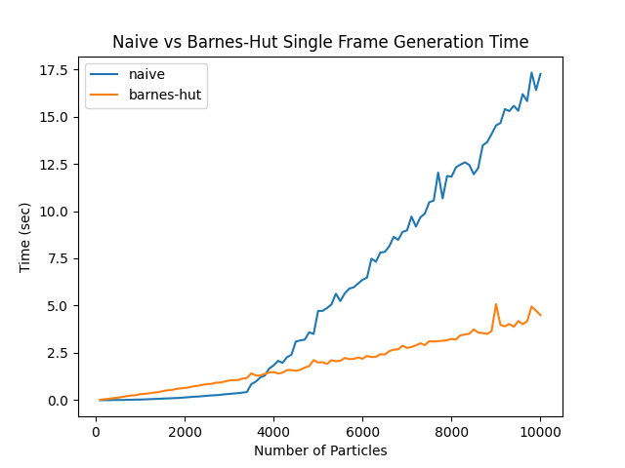
Naive vs Barnes Hut Efficiency

Slide 17
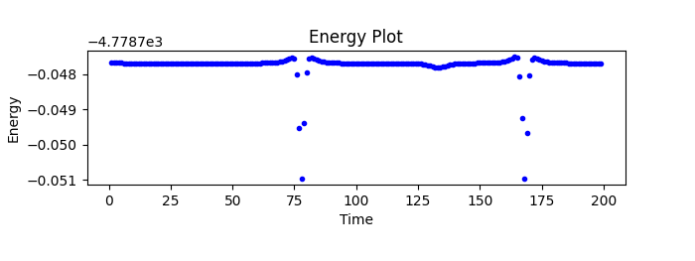
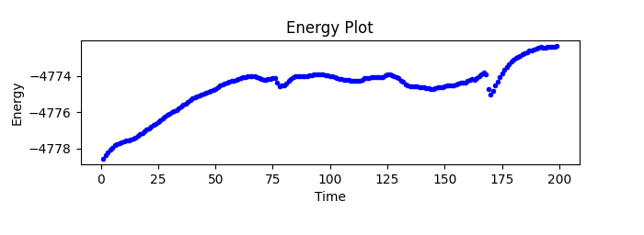
Naive vs Barnes Hut Energy Conservation
Naive
Barnes-Hut

Slide 18
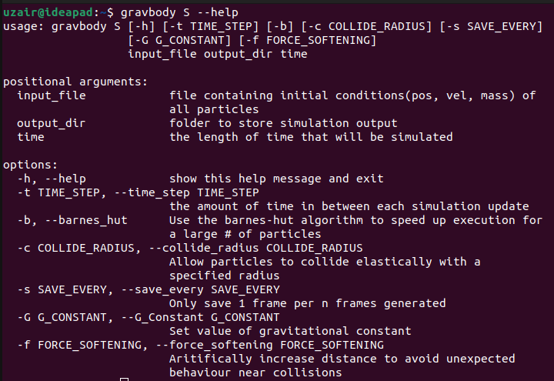
Command Line Interface - Simulation

Slide 19
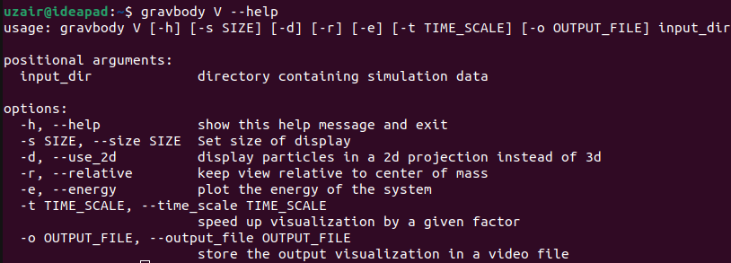
Command Line Interface - Visualization

Slide 20
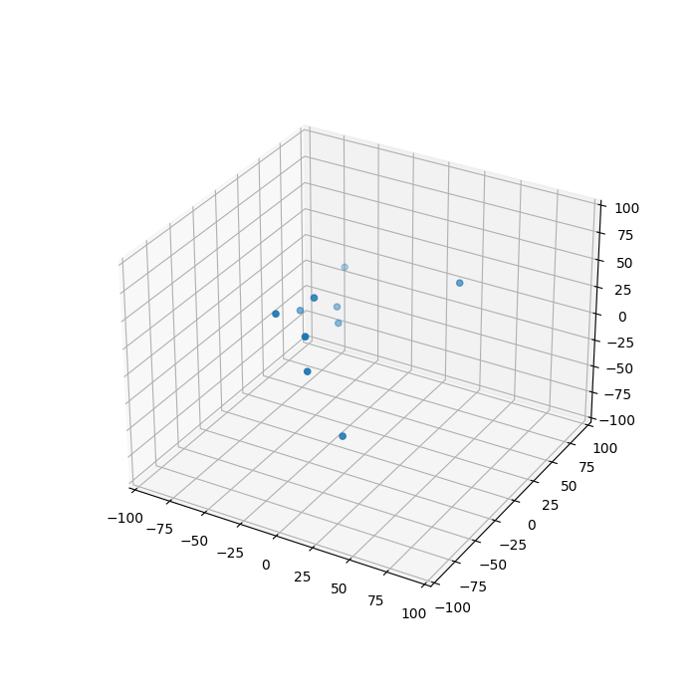
Command Line Interface – Sample Use
$ gravbody S SAMPLES/rand10.txt animations/test 10
$ gravbody V animations/test

Slide 21
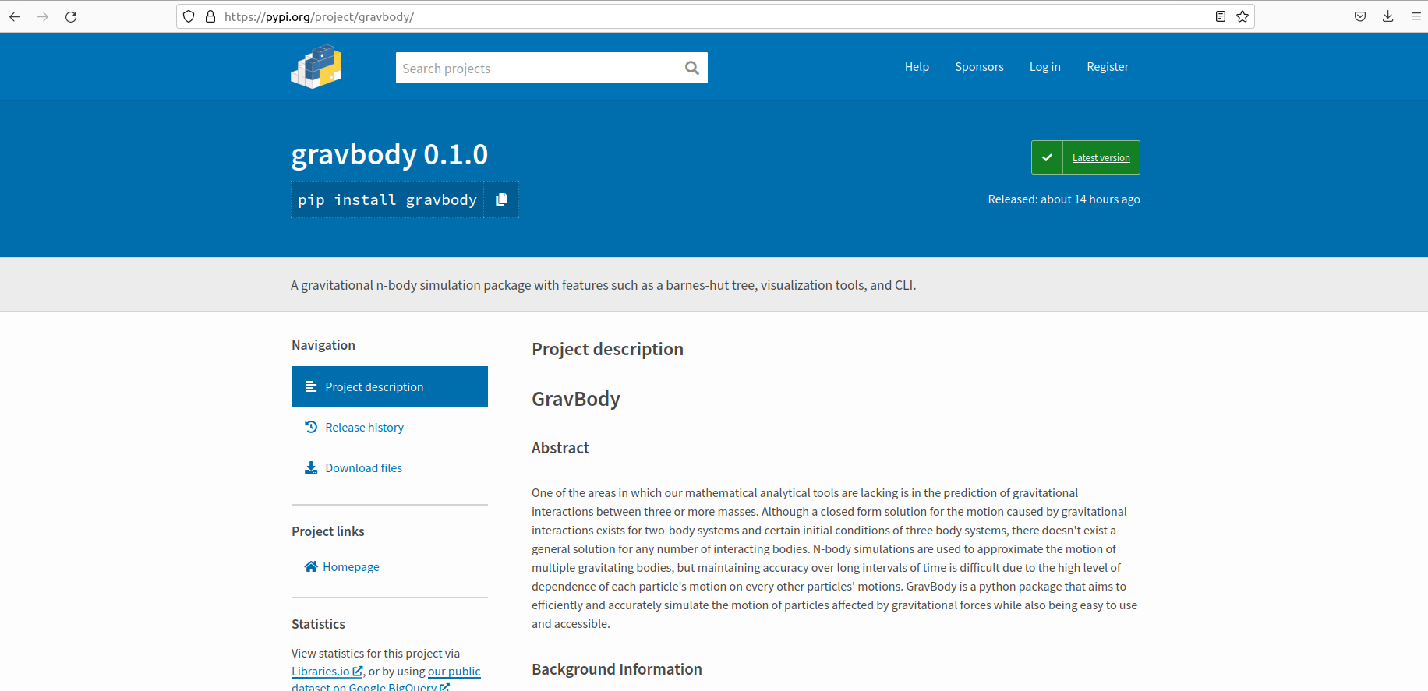
Packaging
Can be installed and used by anyone, anywhere

Slide 22
Future Goals / Potential Extensions
Variable time-step
Parallelization
GPU usage
Rewriting in a compiled language

Slide 23
Features List
Naive O(n^2) approach
Barnes-Hut approach O(n log n) which handles larger scales better
Optional elastic collisions between particles
Optional force softening
2D/3D visualization tool that also contains an energy plot to evaluate accuracy
Command Line Interface

Slide 24
Acknowledgments
Special thanks to my mentor, Mitchell Burdorf for giving my project a direction and providing good feedback!
Thanks to the ICR and Optiver for providing a space for us and allowing us to have this amazing opportunity!

Slide 25
Sources
Barnes, J., & Hut, P. (1986, December). A Hierarchical O(n log n) Force-Calculation Algorithm. Nature, 324(6096), 446-449. doi:10.1038/324446a0
Burdorf, M. (2021). Analyzing Cosmological Evolution through n-body Simulation of Dark and Luminous Matter using ChaNGa.
McMillan, S. (n.d.). The Leapfrog Integrator. Retrieved August 2, 2022, from http://www.physics.drexel.edu/~steve/Courses/Comp_Phys/Integrators/leapfrog/
Mocz, P. (2020, September 13). Create your own N-body simulation (with python). Retrieved August 1, 2022, from https://medium.com/swlh/create-your-own-n-body-simulation-with-python-f417234885e9.
Ventimiglia, T., & Wayne, K. (n.d.). Retrieved August 1, 2022, from http://arborjs.org/docs/barnes-hut

