Slide 1
LOAN PREDICTION
NIDA KHAN

Slide 2
BACKGROUND AND MOTIVATION
A recent development of machine learning techniques and data mining has led to an interest of implementing these techniques in various fields .The banking sector is no exclusion and the increasing requirements towards financial institutions to have robust risk management has led to an interest of developing current methods of risk estimation. Potentially, the implementation of machine learning techniques could lead to better quantification of the financial risks that banks are exposed to.

Slide 3
PROBLEM STATEMENT
The objective of this thesis is to investigate which method from a chosen set of machine learning techniques performs the best default prediction.

Slide 4
DATASET
NO.OF ROWS | 614
NO. OF COLUMNS | 13
NO.OF CATEGORICAL VARIABLES | 8
NO.OF CONTINOUS VARIABLES | 4
CONTINOUS VARIABLES :
Income
Coapplicant_Income
Loan Amount
Tenure
CATEGORICAL VARIABLES :
Gender
Marital Status
No. Dependents
Education Status
Self Employed
Credit History
Property Area

Slide 5
CHALLENGES I FACED
“KEEP CHALLENGING YOURSELF TO THINK BETTER ,DO BETTER AND BE BETTER”
I faced the challenges while detecting and replacing outliers in the dataset.
Visualization was the second one I faced throughout the project

Slide 6
1.EDA
2.PREPROCESSING
3.FEATURE SELECTION
4.MODEL SELECTION
5.EVALUATION METRICS
WORKFLOW

Slide 7
TOOLS AND PACKAGES
Python Jupyter Notebook
Numpy
Pandas
Matplotlib
Scikit-Learn
Seaborn

Slide 8
DATA PREPROCESSING
First for all in our data having ‘Loan ID’ column so we have to replace that column into indexing. Because that variable is not having any predictive power.
Our data is having null values , so for replacing that null values I used ‘Mean’ for numerical variable And ‘Mode’ for categorical variable by Using fillna method.
Balance variable & Total Income in our data are having outliers .we fixed them by using Quantile method.
After that we created a derived variables like :
‘Total Income = Income + Co Applicant Income’
‘EMI = (loan Amount*Interest*(1+Interest)**Tenure)/(1+Interest)**Tenure-1)’
‘Balance = Total Income – EMI’
Then to avoid the multicollinearity we deleted ‘Income’ variable.

Slide 9
VISUALIZATION

Slide 10
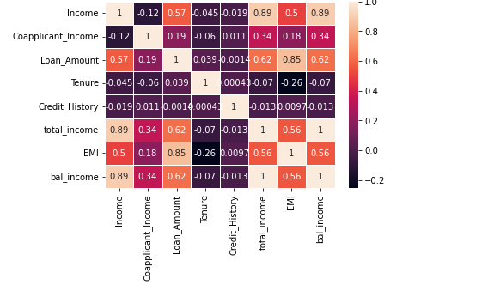
CORELLOGRAM
Correlogram gives the information about co-relation between the independent Variables.
‘Income’ Variable 89% co-related with ‘Balance’ Variable.
By using correlogram we can see that Income variables are having multicollinearity, so we have to delete one of the variable which is having multicollinearity.
Total Income – Income (89%)
Loan Amount – Balance (62%)

Slide 11
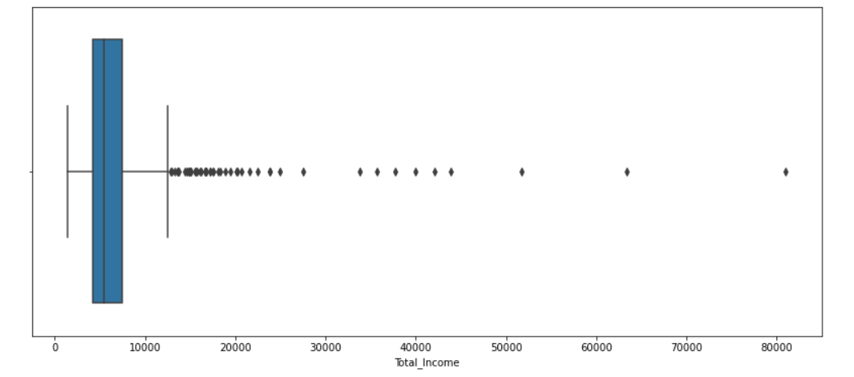
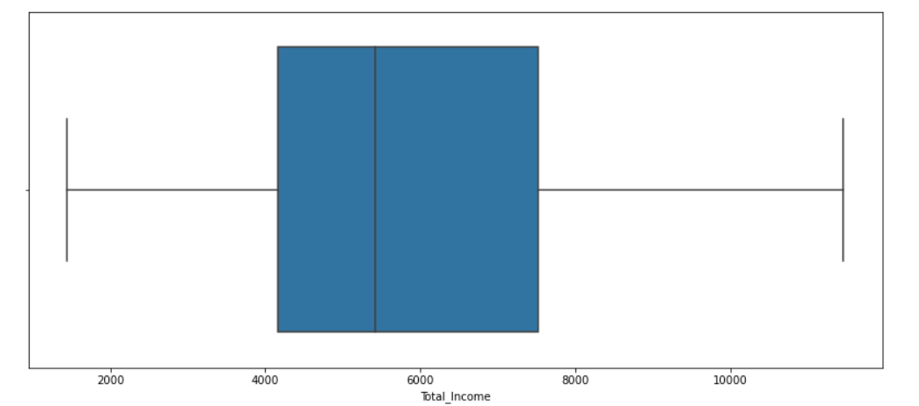
Univariate Analysis:
1) ‘Total Income’ variable is having outliers only above the max range. We can clearly see that Using box plot
After fixing outlier’s from ‘Total Income’ Variable with quartile method.

Slide 12
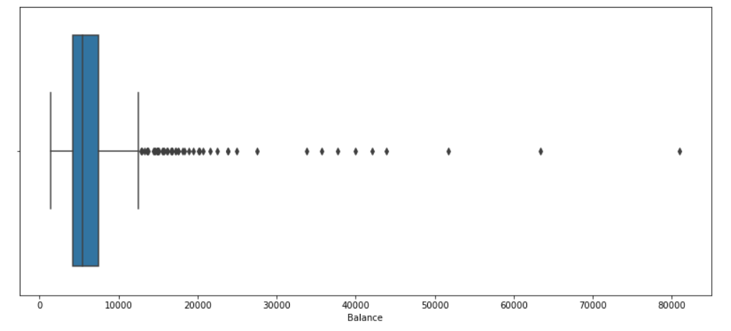
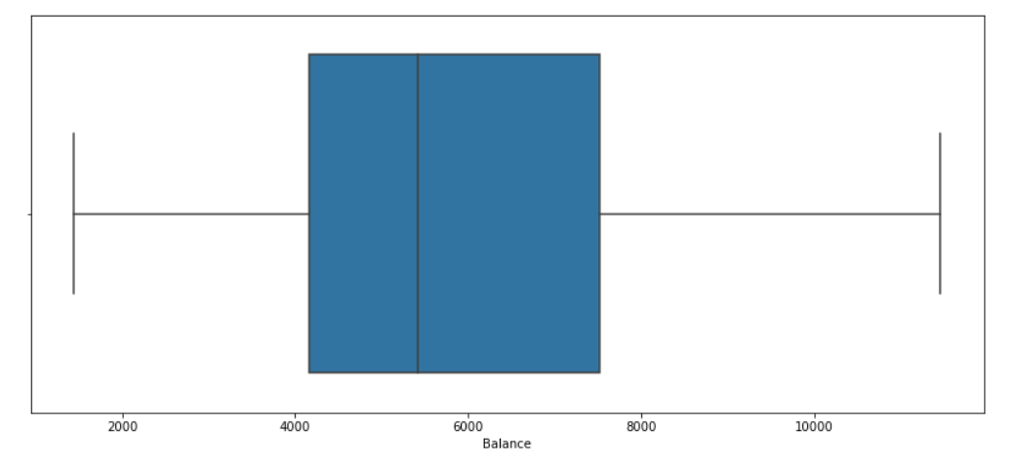
2) In our dataset ‘balance Variable’ is having outliers above the max range. Need to fix them .
After fixing outlier’s from ‘Balance’ Variable with quartile method.

Slide 13
2) In our dataset ‘balance Variable’ is having outliers above the max range. Need to fix them .
After fixing outlier’s from ‘Balance’ Variable with quartile method.

Slide 14
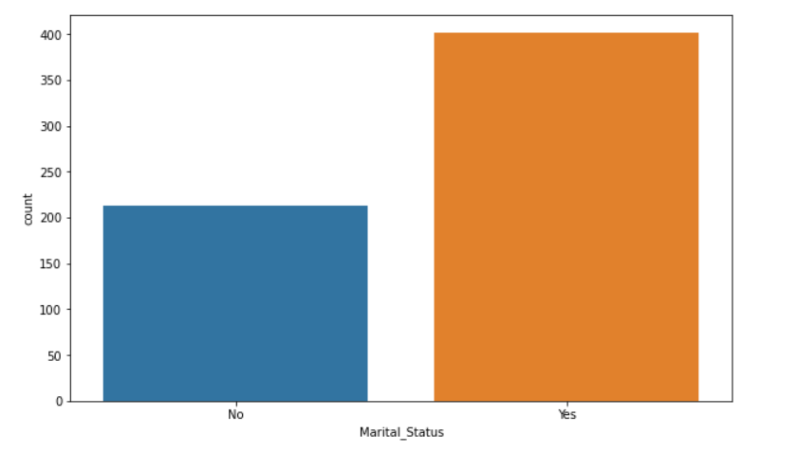
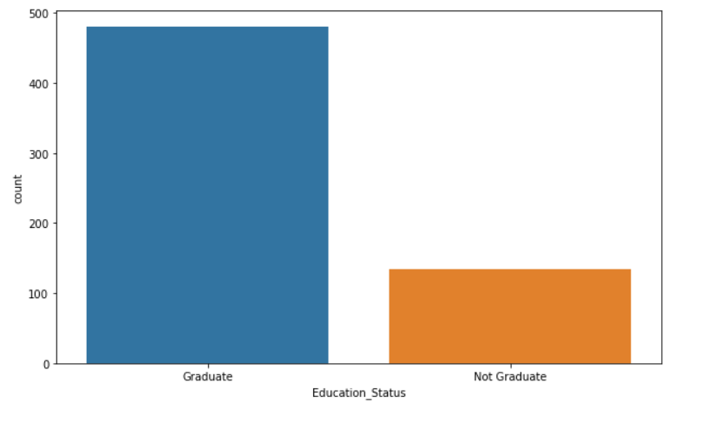
5) In our data people graduated people are 78.17% and not graduated are 21.81% with respect to Loan Status
6) Married people are 64.82% & unmarried peoples are 35.18% in our dataset with respect to Loan Status.

Slide 15
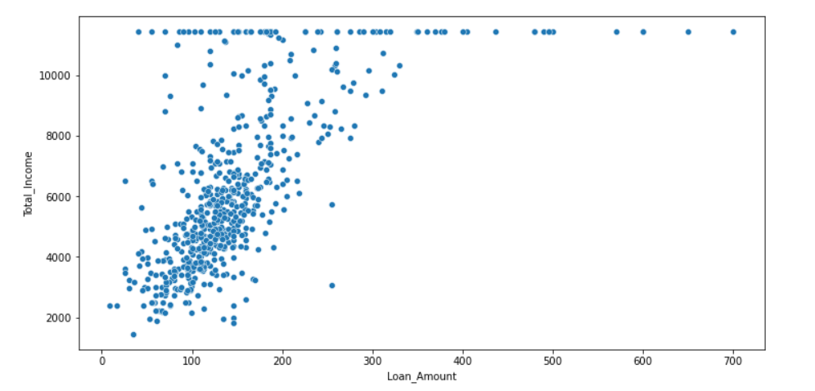
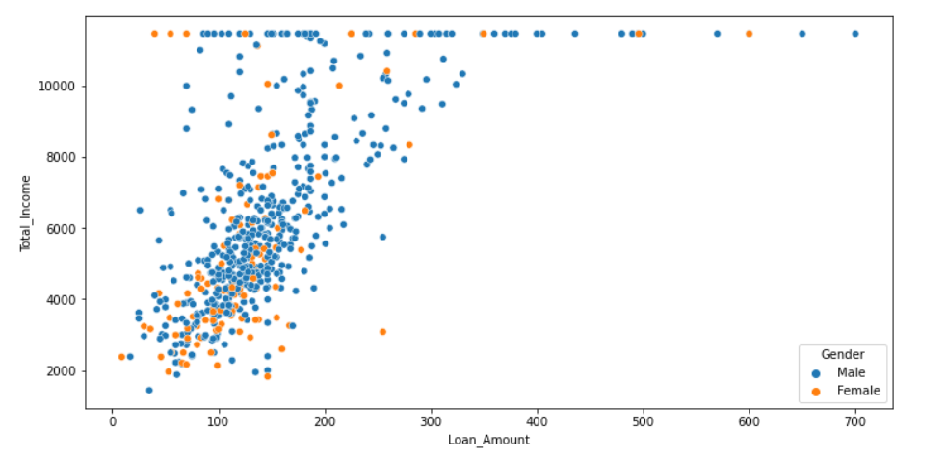
Bivariate Analysis:
1) using scatter plot we can see that as ‘Total Income’ increases ‘Loan Amount’ also increases.
2) using scatter plot we can see that as ‘Total Income’ increases ‘Loan Amount’ also increases with respect to Gender of applicant.

Slide 16
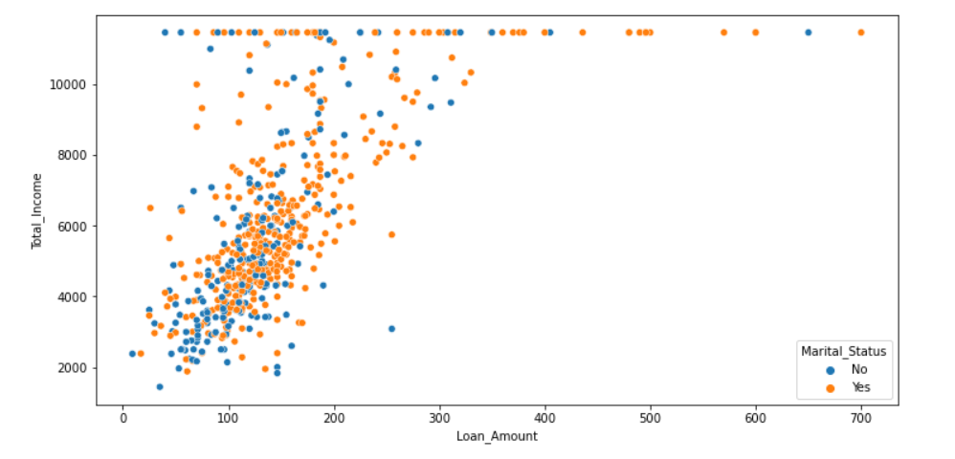
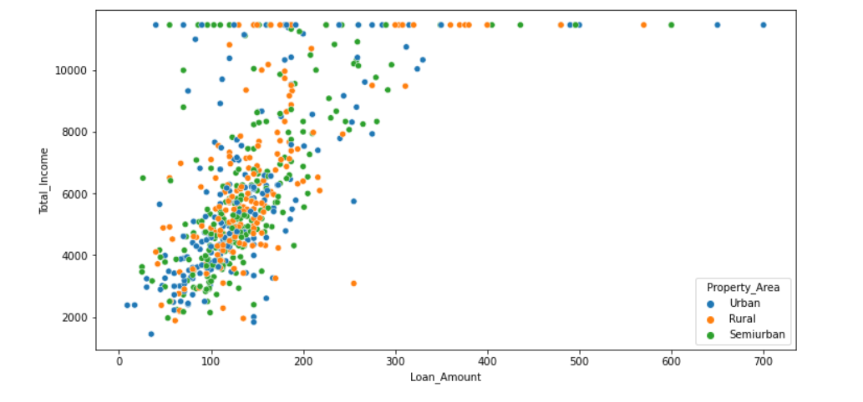
3) ‘Total Income’ increases ‘Loan Amount’ also increases with respect to Marital Status Using scatterplot.
4)Relation between ‘Total Income’ and ‘Loan Amount’ with respect to different-different property area’s.

Slide 17
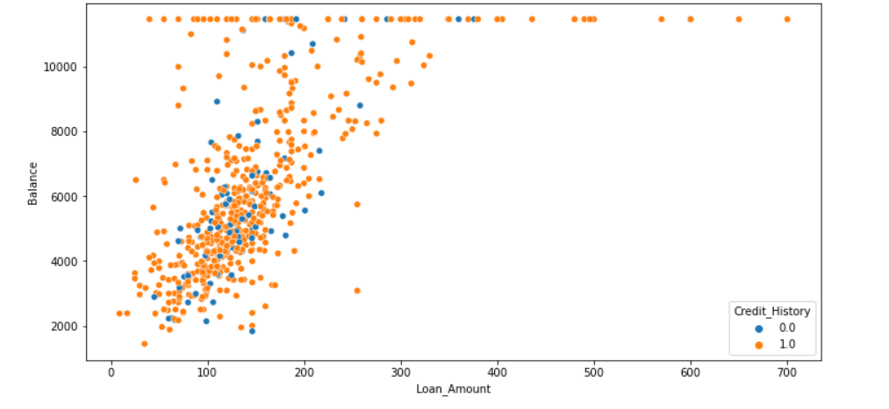
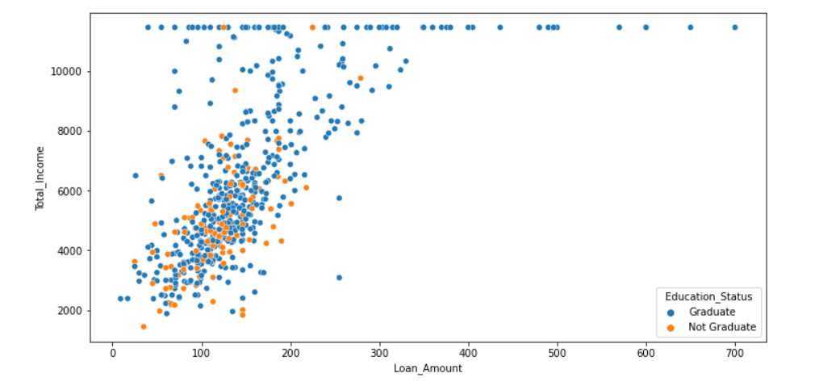
5) Relation between ‘Balance’ and ‘Loan Amount’ is having positive co-relation means ‘balance’ increases ‘Loan Amount’ also increases with respect to credit history.
6) Relation between ‘Balance’ and ‘Loan Amount’ is having positive co-relation means ‘balance’ increases ‘Loan Amount’ also increases with respect to ‘Education Status’.

Slide 18
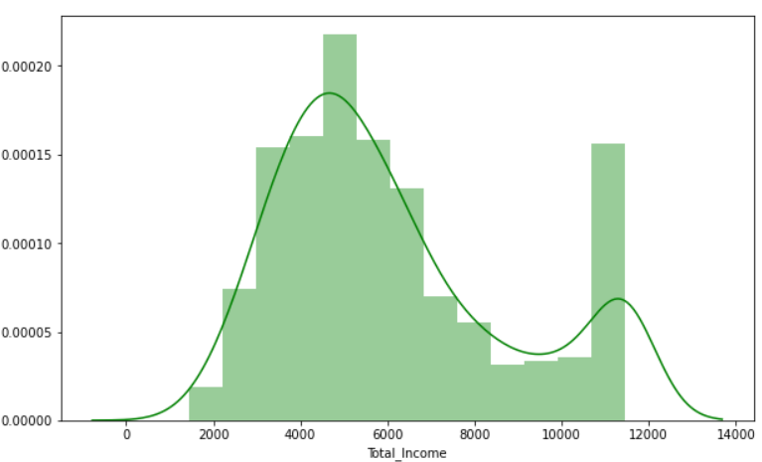
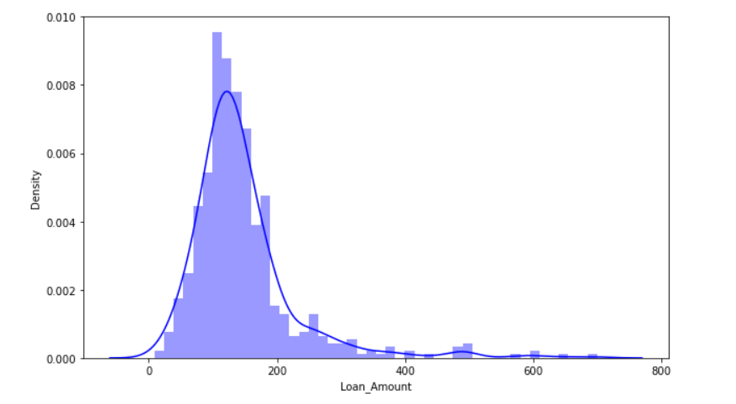
DISTRIBUTION PLOTS
1) Income Variable is slightly positively skewed.
2)Loan amount Variable is positively skewed.

Slide 19
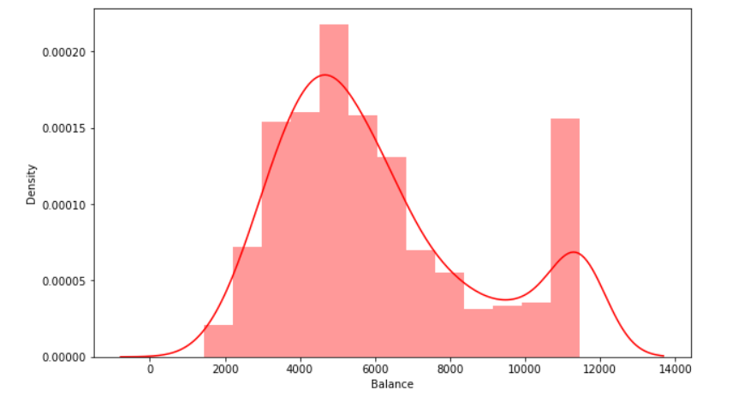
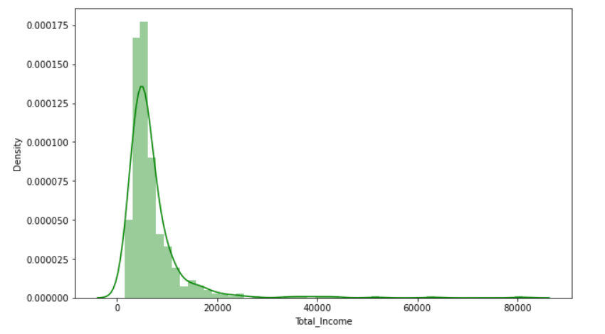
3)Balance variable is also positively skewed.
3) Total Income variable is also positively skewed.

Slide 20
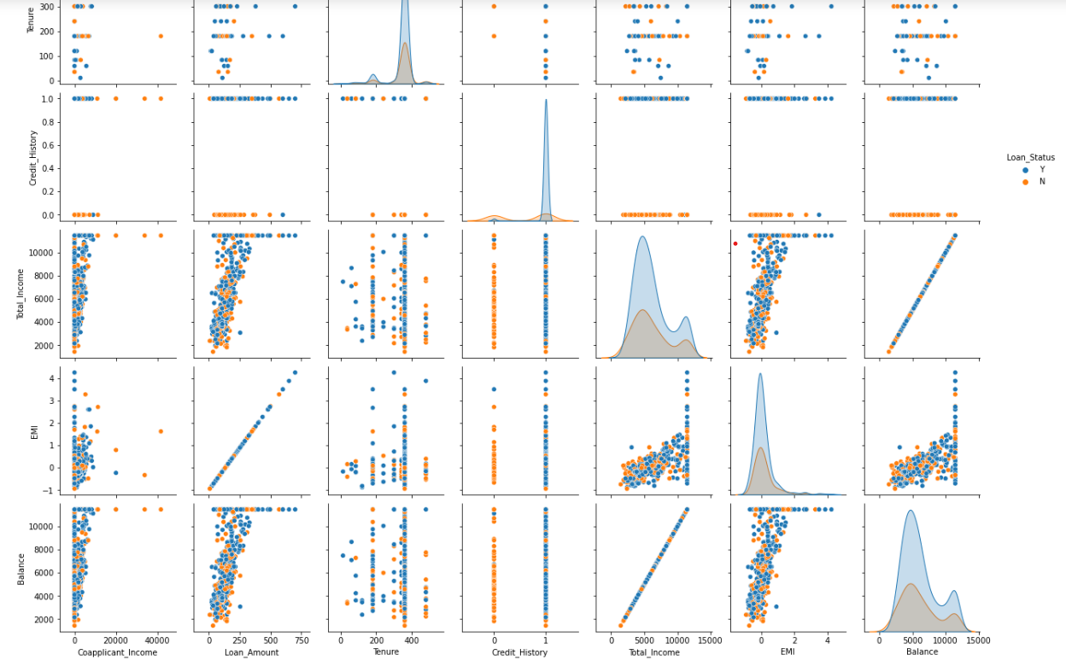
Using pair plot we can plot the multiple variable .
This plot shows that as Total Income increases Loan Amount also increases with respect to Loan Status.
As Balance increases EMI also increases with respect to Loan Status.

Slide 21
ALGORITHMS TO BE USED
Logistic Regression
Decision Tree
Random Forest
KNN

Slide 22
Evaluation
Metrics

Slide 23
1 | LOGISTIC REGRESSION MODEL |  | precision | recall | f1 score | support
 |  | 0 | 0.88 | 0.33 | 0.48 | 21
 |  | 1 | 0.74 | 0.98 | 0.84 | 41
 |  | accuracy |  |  | 0.76 | 62
 |  | macro avg | 0.81 | 0.65 | 0.66 | 62
 |  | weighted avg | 0.79 | 0.76 | 0.72 | 62
2 | DECISION TREE MODEL |  | precision | recall | f1 score | support
 |  | 0 | 0.59 | 0.56 | 0.57 | 61
 |  | 1 | 0.79 | 0.81 | 0.80 | 124
 |  | accuracy |  |  | 0.72 | 185
 |  | macro avg | 0.69 | 0.68 | 0.68 | 185
 |  | weighted avg | 0.72 | 0.72 | 0.72 | 185

Slide 24
3 | DECISION TREE CLASSIFIER MODEL Maximum Depth = 2 Pruned Tree |  | precision | recall | f1 score | support
 |  | 0 | 0.86 | 0.41 | 0.56 | 61
 |  | 1 | 0.77 | 0.97 | 0.86 | 124
 |  | accuracy |  |  | 0.78 | 185
 |  | macro avg | 0.82 | 0.69 | 0.71 | 185
 |  | weighted avg | 0.80 | 0.78 | 0.76 | 185
4 | DECISION TREE CLASSIFIER MODEL Maximum Leaf Nodes = 3 Pruned Tree |  | precision | recall | f1 score | support
 |  | 0 | 0.86 | 0.41 | 0.56 | 61
 |  | 1 | 0.77 | 0.97 | 0.86 | 124
 |  | accuracy |  |  | 0.78 | 185
 |  | macro avg | 0.82 | 0.69 | 0.71 | 185
 |  | weighted avg | 0.80 | 0.78 | 0.76 | 185

Slide 25
5 | DECISION TREE CLASSIFIER MODEL Criterion = Entropy |  | precision | recall | f1 score | support
 |  | 0 | 0.59 | 0.52 | 0.56 | 61
 |  | 1 | 0.78 | 0.82 | 0.80 | 124
 |  | accuracy |  |  | 0.72 | 185
 |  | macro avg | 0.69 | 0.67 | 0.68 | 185
 |  | weighted avg | 0.72 | 0.72 | 0.72 | 185
6 | RANDOM FOREST CLASSIFIER MODEL |  | precision | recall | f1 score | support
 |  | 0 | 0.71 | 0.47 | 0.57 | 61
 |  | 1 | 0.76 | 0.90 | 0.83 | 121
 |  | accuracy |  |  | 0.75 | 185
 |  | macro avg | 0.74 | 0.68 | 0.70 | 185
 |  | weighted avg | 0.75 | 0.75 | 0.74 | 185

Slide 26
7 | KNN MODEL |  | precision | recall | f1 score | support
 |  | 0 | 0.57 | 0.43 | 0.49 | 65
 |  | 1 | 0.73 | 0.82 | 0.77 | 120
 |  | accuracy |  |  | 0.69 | 185
 |  | macro avg | 0.65 | 0.63 | 0.63 | 185
 |  | weighted avg | 0.67 | 0.69 | 0.67 | 185

Slide 27
COMPARISON BETWEEN MODEL
SR.NO | NAME OF MODEL | ACCURACY%
1 | LOGISTIC REGRESSION MODEL | 0.76
2 | DECISION TREE MODEL | 0.72
3 | DECISION TREE CLASSIFIER MODEL Maximum Depth = 2 Pruned Tree | 0.78
4 | DECISION TREE CLASSIFIER MODEL Maximum Leaf Nodes = 3 Pruned Tree | 0.78
5 | DECISION TREE CLASSIFIER MODEL Criterion = Entropy | 0.72
6 | RANDOM FOREST CLASSIFIER MODEL | 0.75
7 | KNN MODEL | 0.69

Slide 28
CONCLUSION AND FUTURE SCOPE
The main purpose of the project is to classify and analyze the nature of the loan applicants. From a proper analysis of data set and constraints of the banking sector, different graphs were generated and visualized. From the graphs, many conclusions have been made and information were inferred such as short-term loan was preferred by majority of the loan applicants and the clients majorly apply for loan. This project work can be extended to higher level in future. Predictive model for loans that uses machine learning algorithms, where the results from each graph of the paper can be taken as individual criteria for the machine learning algorithm.

Slide 29
REFERENCE
www.pandas.com
www.numpy.com
www.geeksforgeeks.com
www.stackoverflow.com
www.python.org

