Slide 1
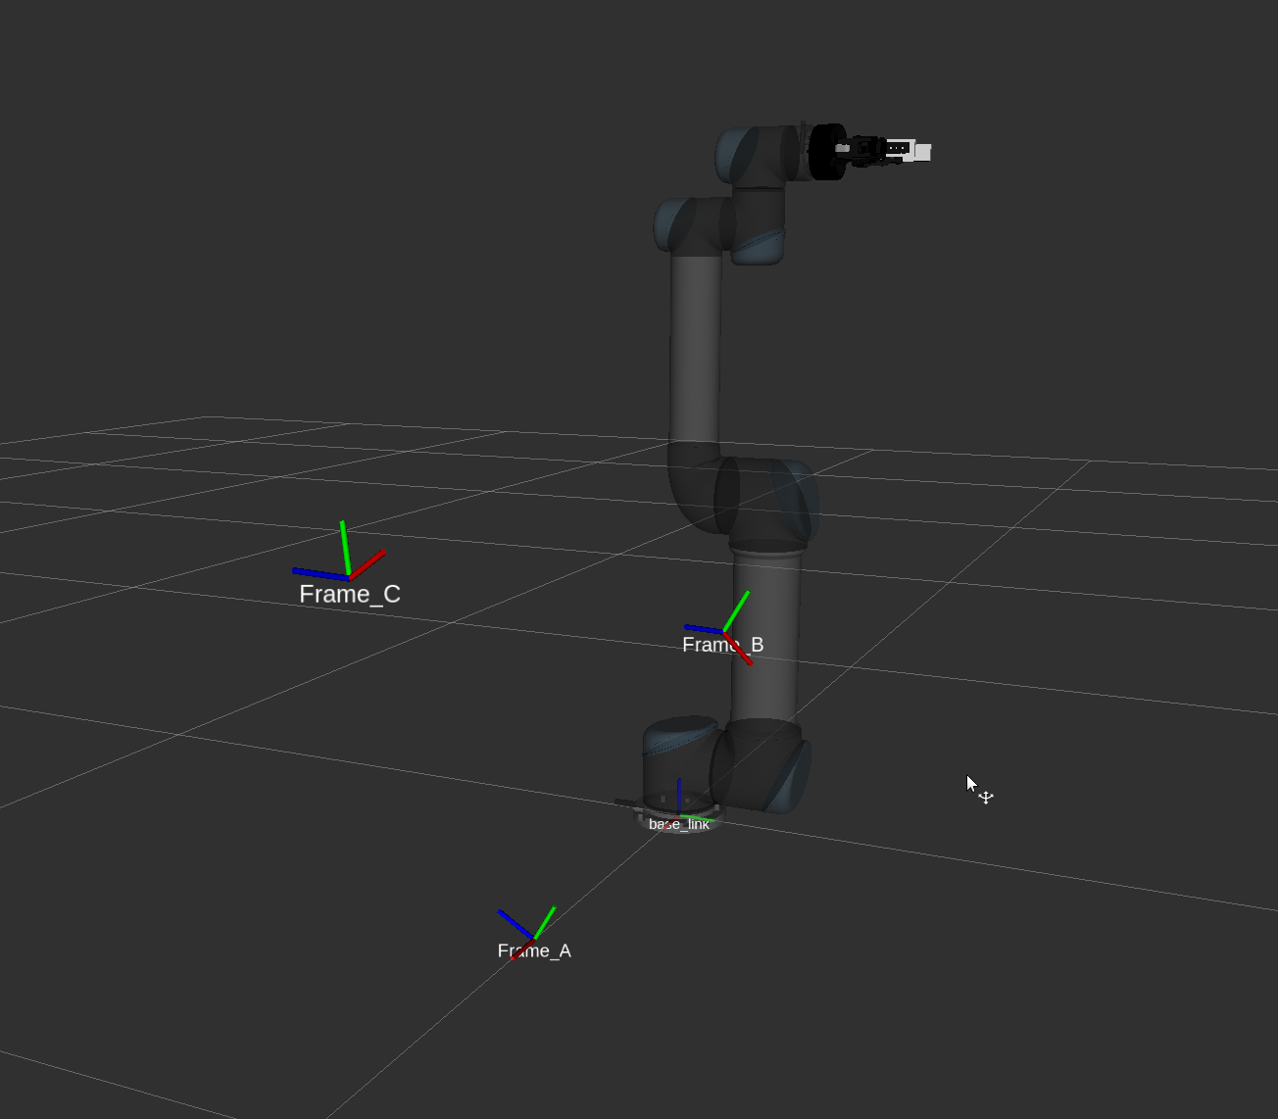
gbc
g0a
gac
gab

Slide 2
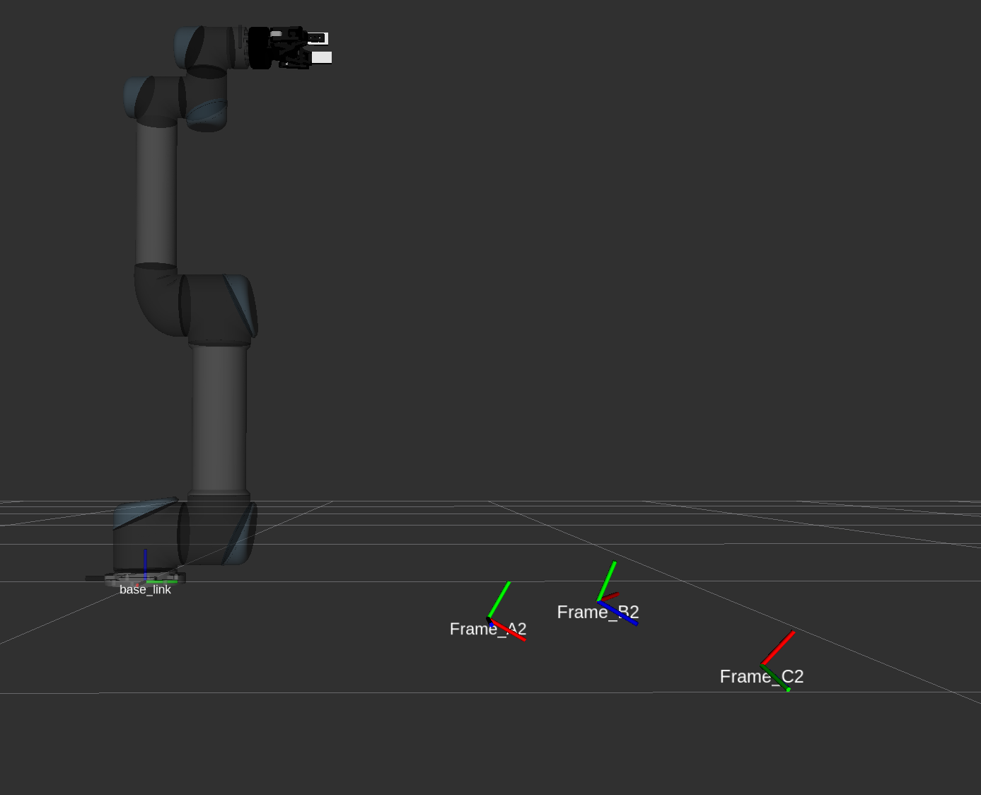
gab2
gbc2
g0a2
gac2

