Slide 1
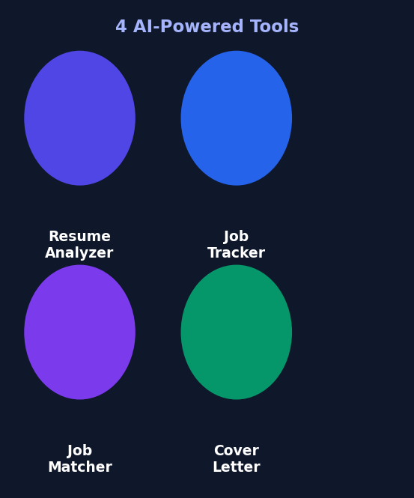
AI Job Analyzer
Your AI-powered career co-pilot
Resume Analysis · Job Tracking · Job Matching · Cover Letter Generation
Next.js 14
FastAPI
Claude AI
Tailwind CSS
SQLite
Vercel · Render

Slide 2
The Problem
Job hunting is painful — and the odds are stacked against you
ATS Rejection
Zero Visibility
Up to 75% of resumes are rejected by automated tracking systems before a human ever reads them.
Applicants have no idea how well they fit a role. Applying blind wastes months of effort.
Cover Letter Fatigue
Tracking Chaos
Writing a tailored cover letter for every application takes 30–60 minutes per job.
Managing dozens of applications in spreadsheets is error-prone and demoralizing.

Slide 3
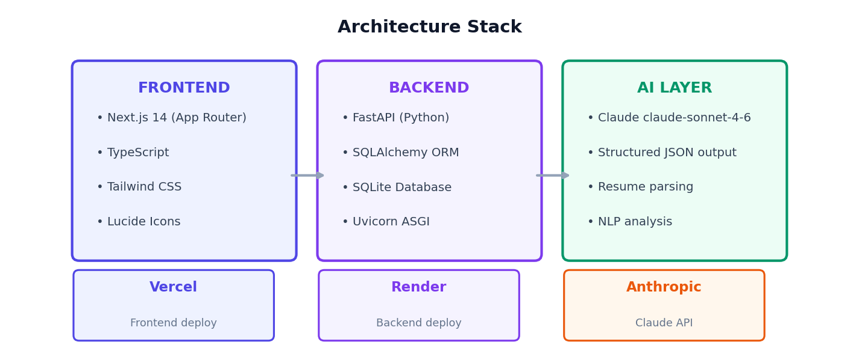
Tech Stack
Modern, production-ready tooling — deployed on free tiers

Slide 4
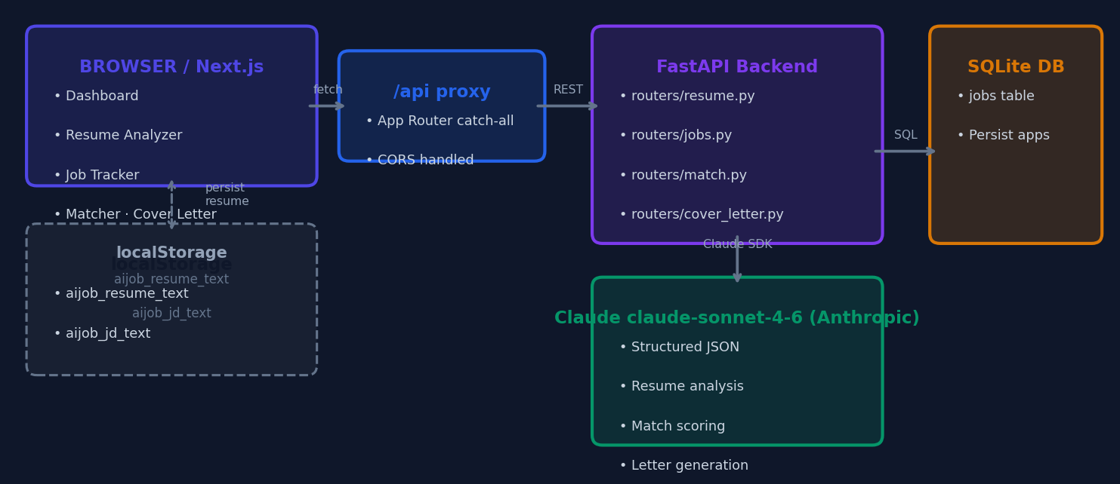
System Architecture
How the pieces connect end-to-end

Slide 5
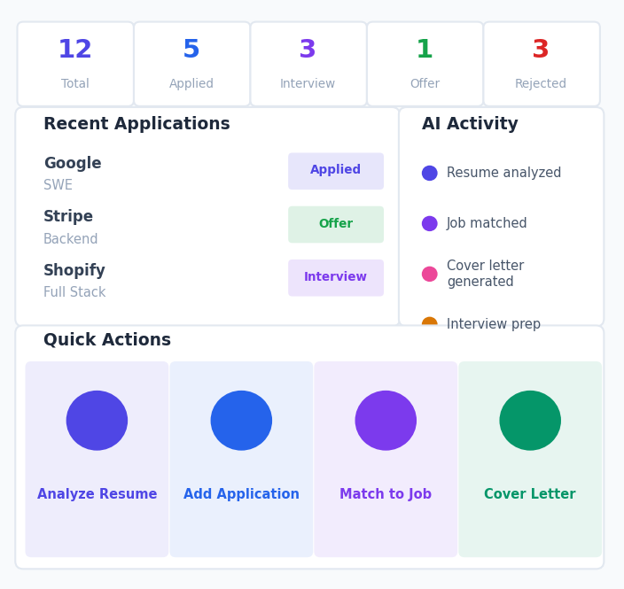
Feature 1 · Dashboard
A command center for the entire job search
Stats Cards
Total, Applied, Interviewing, Offers, Rejected — live counts from the API
Recent Applications
Latest 5 entries with status badges, link to full tracker
AI Activity Log
Timestamped history of every Claude action, persisted in localStorage
Quick Actions
One-click shortcuts to all four AI tools
Pro Tip Card
Contextual advice surfaced on the dashboard

Slide 6
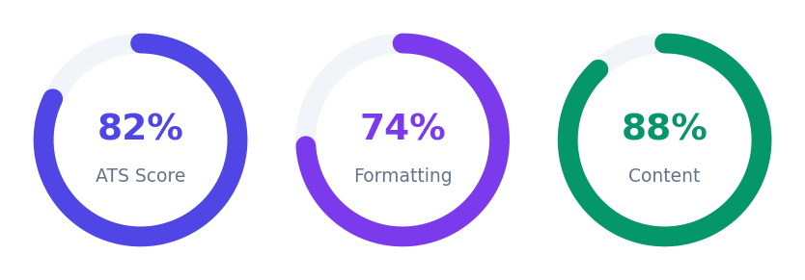
Feature 2 · Resume Analyzer
Upload once → get a full ATS audit powered by Claude
How It Works
1
Parse PDF / DOCX / TXT
2
Extract experience & education
3
Identify technical + soft skills
4
Evaluate ATS compatibility
Strengths
Weaknesses
5
Calculate 3 scores
Clear contact info, strong technical skills, quantified achievements
Missing summary, sparse keywords, formatting inconsistencies
6
Generate prioritized recommendations
Recommendations
Missing Keywords
High: Add professional summary · Medium: Quantify more bullets
Docker · Kubernetes · CI/CD · Agile · REST APIs

Slide 7
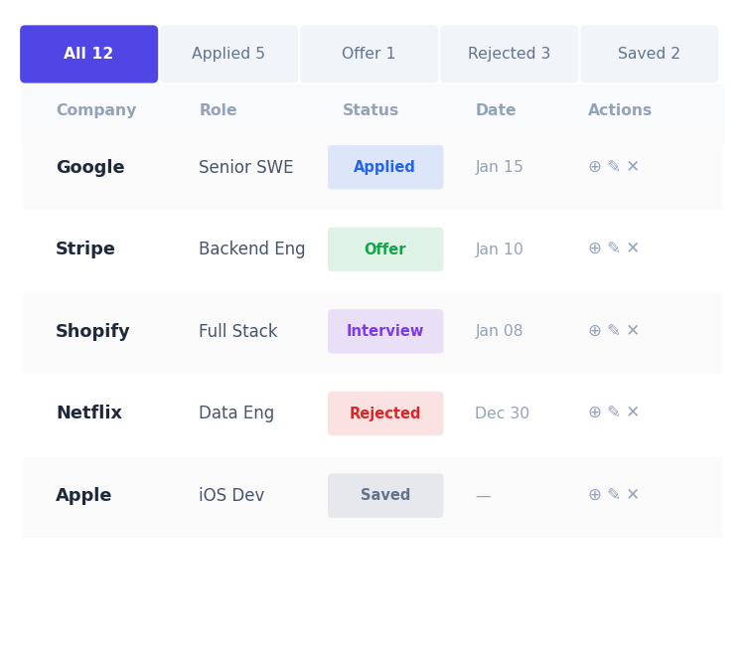
Feature 3 · Job Tracker
Full CRUD application — track every application in one place
Add / Edit / Delete
Full modal form: company, role, status, location, URL, salary, notes, dates
Status Filter Tabs
All · Applied · Interviewing · Offer · Rejected · Saved with live counts
Inline Status Update
Click the status badge in the table row to change it instantly
Bulk Operations
Select multiple rows → delete in one action
Demo Data Loader
Seed realistic sample applications with one click
Deep Links to AI
Launch Job Matcher or Cover Letter Generator from any row

Slide 8
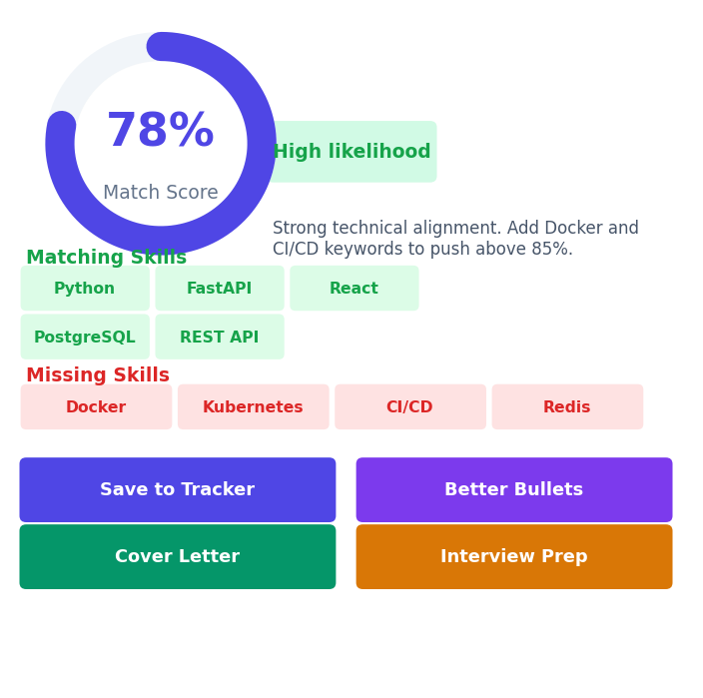
Feature 4 · Job Matcher
Paste resume + job description → Claude scores the fit and tells you exactly what to fix
Match Score & Likelihood
0–100% score with Low / Medium / High likelihood badge
Matching vs Missing Skills
Color-coded skill tags — green matched, red missing
Experience Gaps
Side-by-side matching experience and gap analysis
Tailoring Suggestions
Section-by-section resume advice tied to the JD
Better Bullets (AI)
Rewrites your resume bullets to match the JD keywords
Interview Prep (AI)
Behavioral/technical/situational Q&A accordion

Slide 9
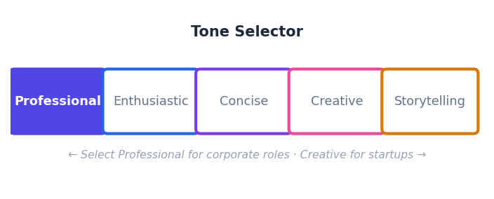
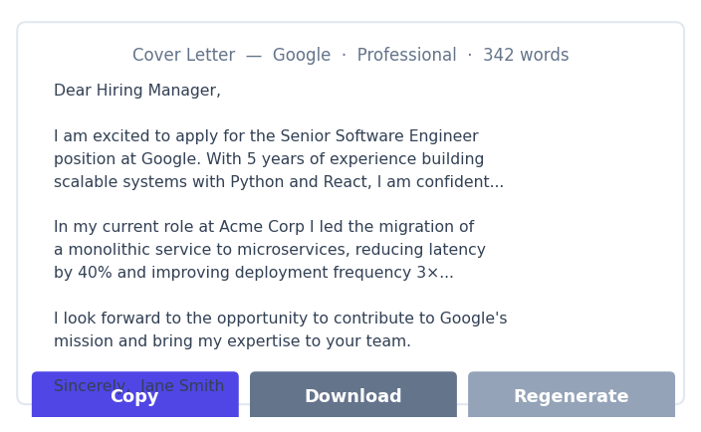
Feature 5 · Cover Letter Generator
AI-written, perfectly tailored — copy, download, or save to your application
5 Tone Options
Professional · Enthusiastic · Concise · Creative · Storytelling
Context Pre-fill
Resume and JD auto-loaded from localStorage — no re-typing
Job Selector
Pick any saved application from the tracker to pre-fill details
Copy / Download
Clipboard copy or .txt download with one click
Regenerate
Instant re-generation with a different tone via shortcut buttons
Save to Application
Appends letter snippet to the job's notes in the tracker

Slide 10
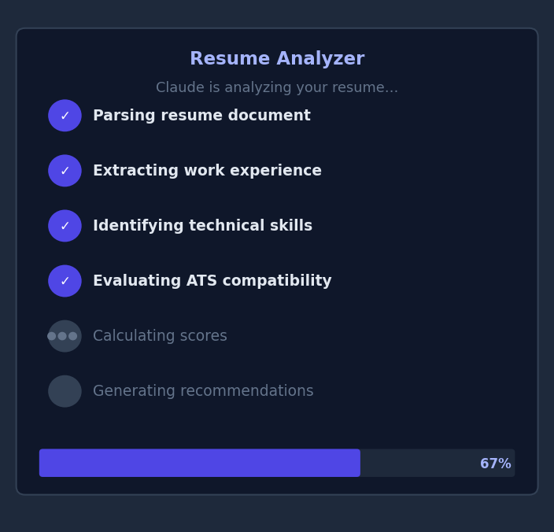
AI Agent UX Pattern
Every Claude call surfaces its work — not just a spinner
Transparent Processing
Users see exactly what Claude is doing at each step — parsing, scoring, generating.
Reusable Component
AgentActivity accepts a steps[] array, isRunning, and isDone flags — used across all 4 AI flows.
Trust Through Visibility
Showing step-by-step progress builds confidence that the AI is working, not stalled.
Animated Completion
Each step gets a checkmark as it completes. The panel stays visible after finishing so results feel earned.

Slide 11
Key Engineering Decisions
The non-obvious choices that make it work smoothly
localStorage for Context Passing
Structured JSON from Claude
Resume text and JD are cached in the browser so navigating from Analyzer → Matcher → Cover Letter is seamless — no re-uploading or re-pasting required.
All Claude responses are requested as typed JSON schemas so the frontend can render individual sections (scores, skill tags, recommendations) instead of raw text.
Single claude_service.py
Next.js API Proxy (catch-all route)
All Anthropic API calls live in one service file, making it easy to swap models, tune prompts, or add caching in a single place.
A catch-all App Router route proxies /api/* to the FastAPI backend, eliminating CORS issues in production and keeping env vars server-side only.
SQLite → PostgreSQL in one line
Composable AI Flows
SQLAlchemy abstracts the database; swapping to Postgres for production requires changing only the connection string.
The Job Matcher chains 4 distinct Claude calls (match → bullets → interview Q&A → cover letter navigation) from a single result page without overwhelming the user.

Slide 12
Live Demo Walk-through
6 steps that showcase the full user journey
1. Dashboard
2. Resume Analyzer
Open the app — see empty state with stat cards and quick action shortcuts.
Upload a PDF → watch agent steps animate → get ATS score, skills, recommendations.
3. Job Matcher
4. Save to Tracker
Resume pre-filled → paste any JD → analyze → generate bullets & interview Q&A.
Hit 'Save to Tracker' → fill company/role → job saved with AI match score in notes.
5. Job Tracker
6. Cover Letter
See the new entry → change status inline → use filter tabs to slice the list.
Click Cover Letter icon on the row → context pre-filled → choose Creative → generate → copy.

Slide 13
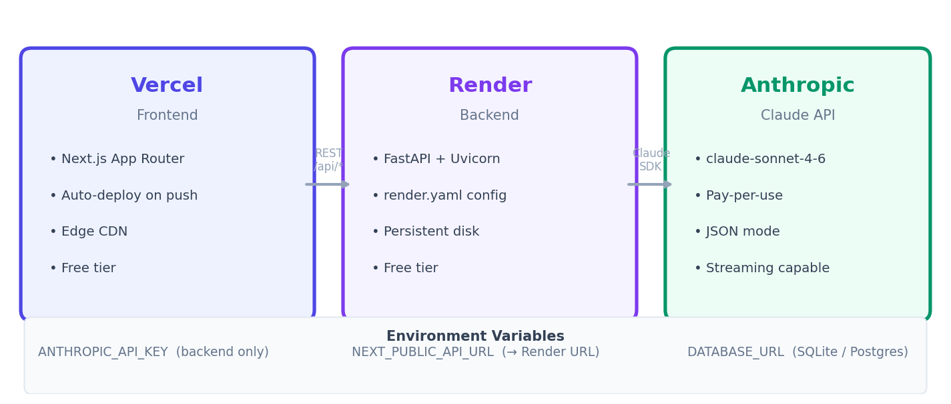
Deployment
Production-ready, zero-cost hosting on free tiers

Slide 14
Thank You
AI Job Analyzer
Built with Next.js 14 · FastAPI · Claude claude-sonnet-4-6 · Tailwind CSS
Resume Analyzer — ATS scores, skill extraction, prioritized recommendations
Job Tracker — Full CRUD, inline status updates, bulk operations
Job Matcher — Fit score, gap analysis, AI bullets, interview prep
Cover Letter Gen — 5 tones, pre-filled context, copy / download / save
Questions?

