Slide 1

Pokemon as Seen by Stats
Up to gen 6
By : M. Fatahillah Aqsa

Slide 2
Table of Contents
Pokemon Added per Generations
What about typings?
Effects of Typings on Stats
The Stats for Battle Enthusiast
Stats Distribution
The “Strongest” Pokemon
“Speed Defines the Winner”

Slide 3
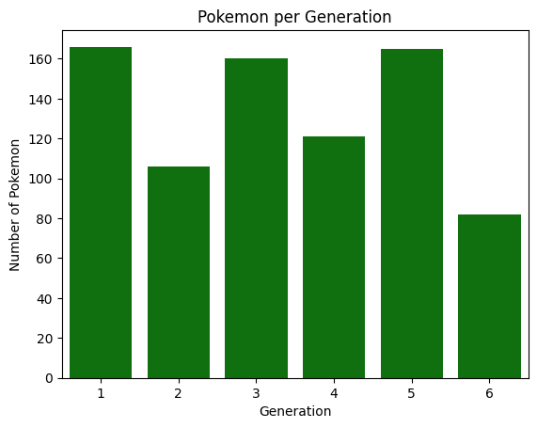
Pokemon Added per Generations
Each generations add new Pokemon onto the already packed roster of the Pokemon World. Here’s the amount of new Pokemon added with every new installments of the game.
It is to be noted that each game includes some Pokemon from the previous generation. So that the amount of Pokemon in the game is relatively the same initially

Slide 4
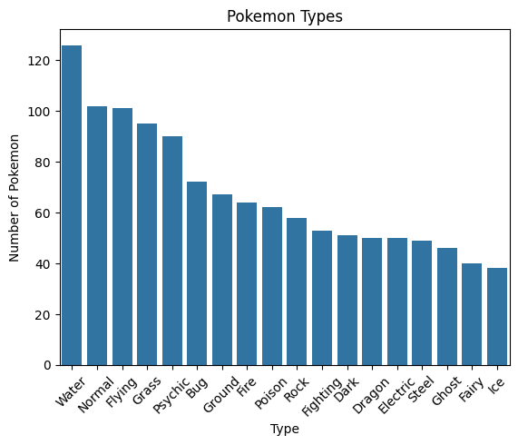
What about typings?
As we all know, our little Pokemon friends each have their own elements or typings. There are a total of 18 types of element in the Pokemon World which contributes to the complexity of Pokemon Battles.
As we can see, water-types dominates the distribution of Pokemon typings. This is due to the vast watery area of the Game which demands a lot of Pokemon to be placed there. On the contrary, Ice-types have the least amount of Pokemon. This can be explained by Pokemon Games having very little amount of snowy or winter-themed places.

Slide 5
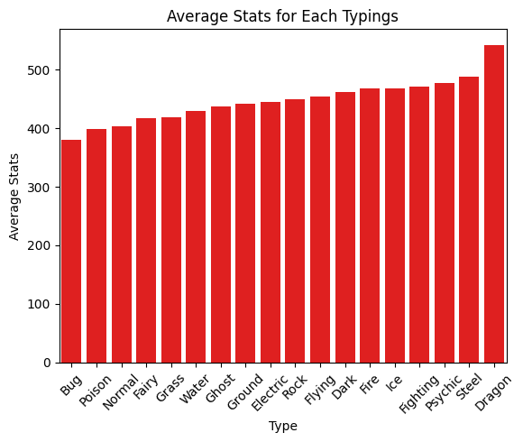
Effects of Typings on Stats
Bug Pokemons are considered to be weak overall because of its early availability, which they make up for with their ability to evolve much sooner. However this does not mean that all bug Pokemon are weak. In fact, some bug Pokemon like Heracross and Beedrill have access to Mega Evolution
On the contrary, because of their rarity and how much later they’re available, dragon Pokemons have increased average stats. Some dragon Pokemon even earned the title of “Pseudo-legendary” because their total stats resembles that of Legendary Pokemon

Slide 6
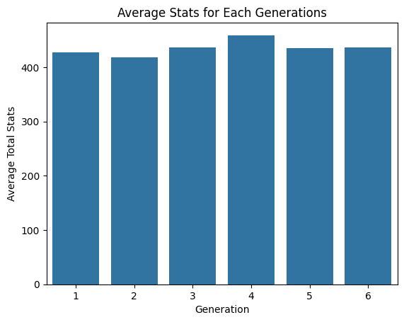
The Stats for Battle Enthusiast
Pokemon Stats is often the deciding factor in term of its ability to do Battles. Each generations offer relatively the same average stats, with Gen 4 having a slight increase.
Some players, especially professionals, prioritize the Movesets of Pokemon rather than the Stats

Slide 7
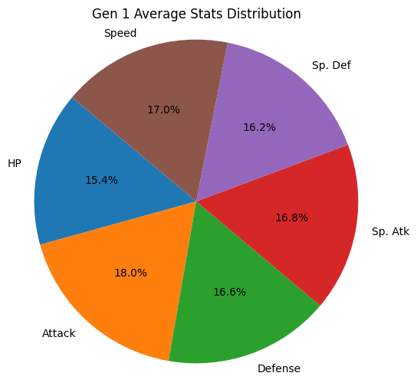
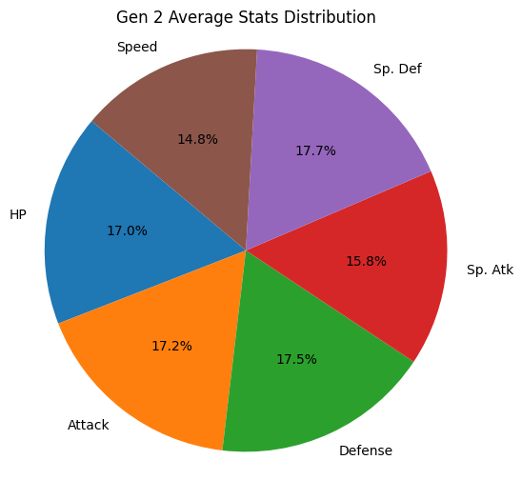
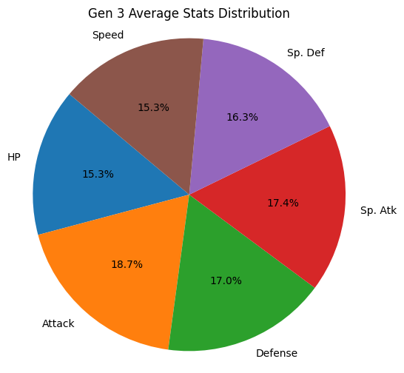
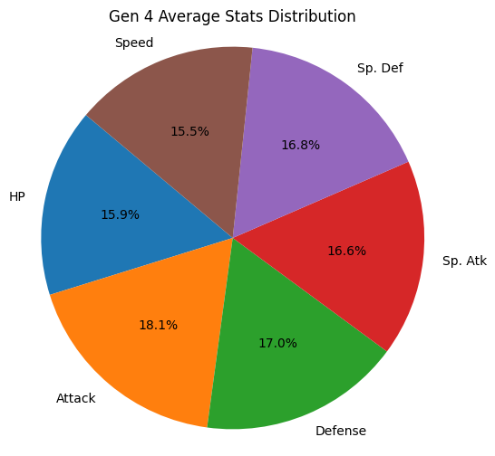
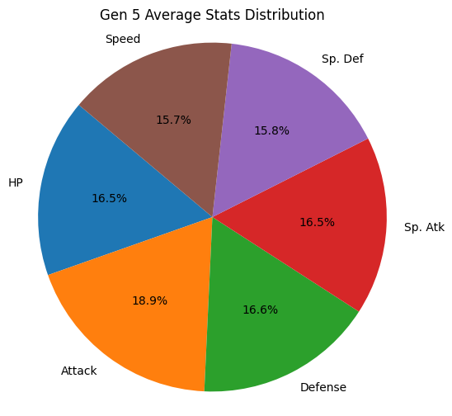
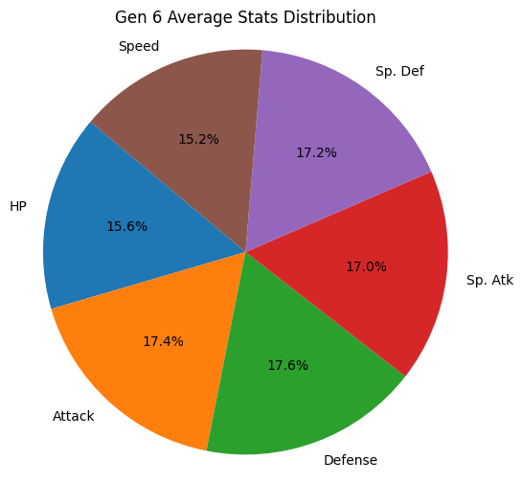
Stats Distribution
Heavily affected by movesets, each generations offer a different approach to the game. Whether you want to sweep the enemy team with high attack move or you want to stall the battle with high defense, each Pokemon across generations is ready to do the job

Slide 8
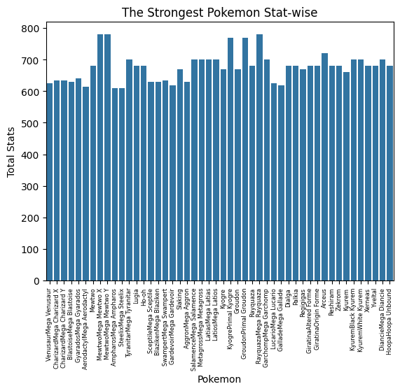
The “Strongest” Pokemon
Those who regarded as the “Strongest Pokemon” often have the stats to back their strength. These are the Pokemons that have over 600 in Total Stats.
These Pokemons are mostly “Legendaries” or those that have access to “Mega Evolutions”.

Slide 9
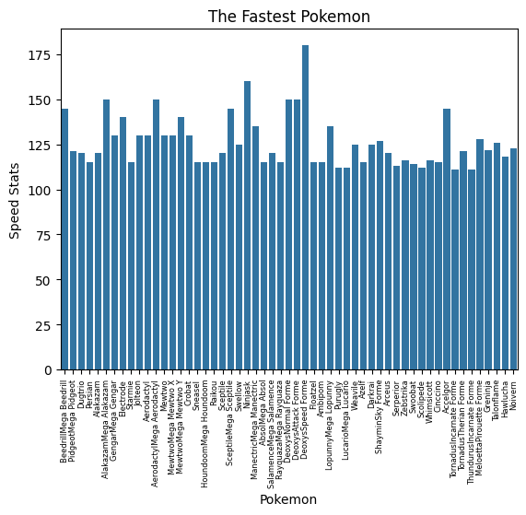
“Speed Defines the Winner”
Speed, which determines who gets to move first in a Pokemon Battle, is regarded as one of the most important stats in the game. Therefore some Pokemon have this swift advantage in winning battles.
Even though they’re not Legendaries nor have Mega evolutions, some Pokemons can keep up with their “Strong” peers.

Slide 10
Thank you for your attention!
This is a small project made with the guidance from Dibimbing.id, thank you Dibimbing.id for this opportunity

