Slide 1
Pokemon as seen by Stats
Up to gen 6

Slide 2
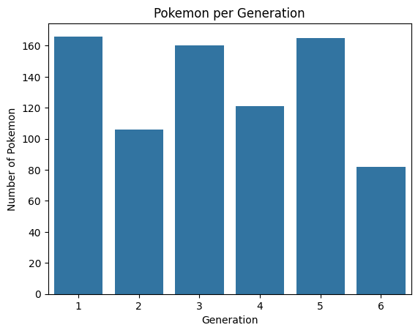
Pokemon Added per Generations
Each generations add new Pokemon onto the already packed roster of the Pokemon World. Here’s the amount of new Pokemon added with every new installments of the game.
It is to be noted that each game includes some Pokemon from the previous generation. So that the amount of Pokemon in the game is relatively the same initially

Slide 3
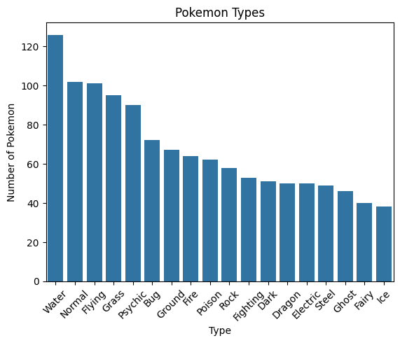
What about typings?
As we all know, our little Pokemon friends each have their own elements or typings. There are a total of 18 types of element in the Pokemon World which contributes to the complexity of Pokemon Battles.
As we can see, water-types dominates the distribution of Pokemon typings. This is due to the vast watery area of the Game which demands a lot of Pokemon to be placed there. On the contrary, Ice-types have the least amount of Pokemon. This can be explained by Pokemon Games having very little amount of snowy or winter-themed places.

Slide 4
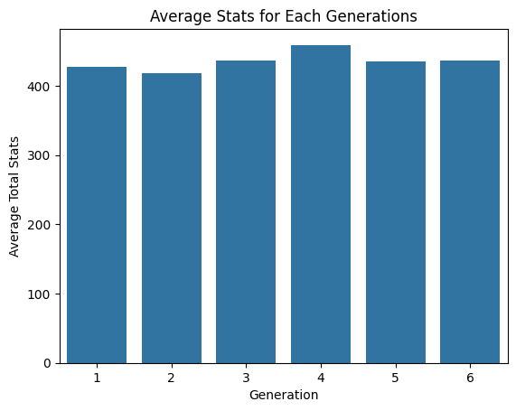
The Stats for the Battle Enthusiast
Pokemon Stats is often the deciding factor in term of its ability to do Battles. Each generations offer relatively the same average stats, with Gen 4 having a slight increase.
Some players, especially professionals, prioritize the Movesets of Pokemon rather than the Stats

Slide 5
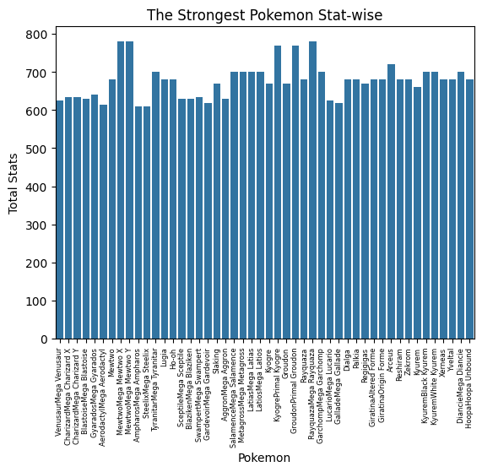
The “Strongest” Pokemon
Those who regarded as the “Strongest Pokemon” often have the stats to back their strength. These are the Pokemons that have over 600 in Total Stats.
These Pokemons are mostly “Legendaries” or those that have access to “Mega Evolutions”.

Slide 6
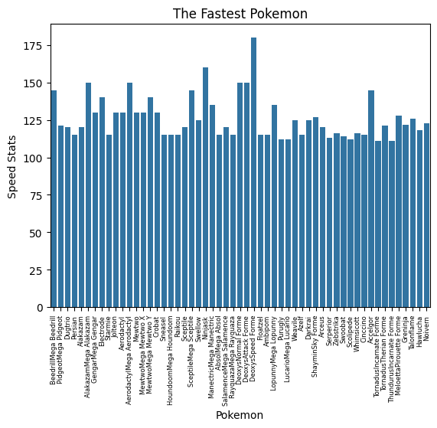
“Speed Defines the Winner”
Speed, which determines who gets to move first in a Pokemon Battle, is regarded as one of the most important stats in the game. Therefore some Pokemon have this swift advantage in winning battles.
Even though they’re not Legendaries nor have Mega evolutions, some Pokemons can keep up with their “Strong” peers.

Slide 7
Thank you for your attention!
This is a small project made with the guidance from Dibimbing.id, thank you Dibimbing.id for this opportunity

