Slide 1
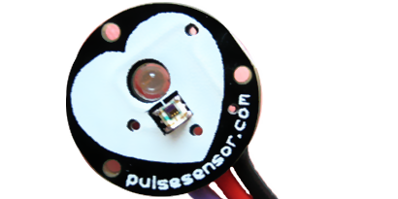
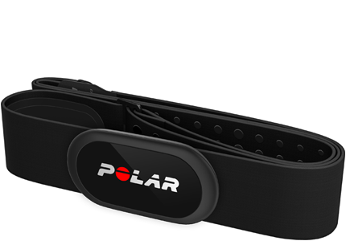
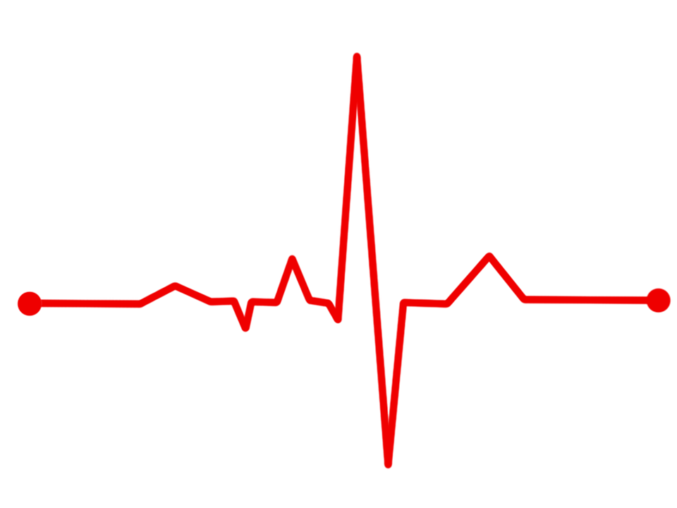
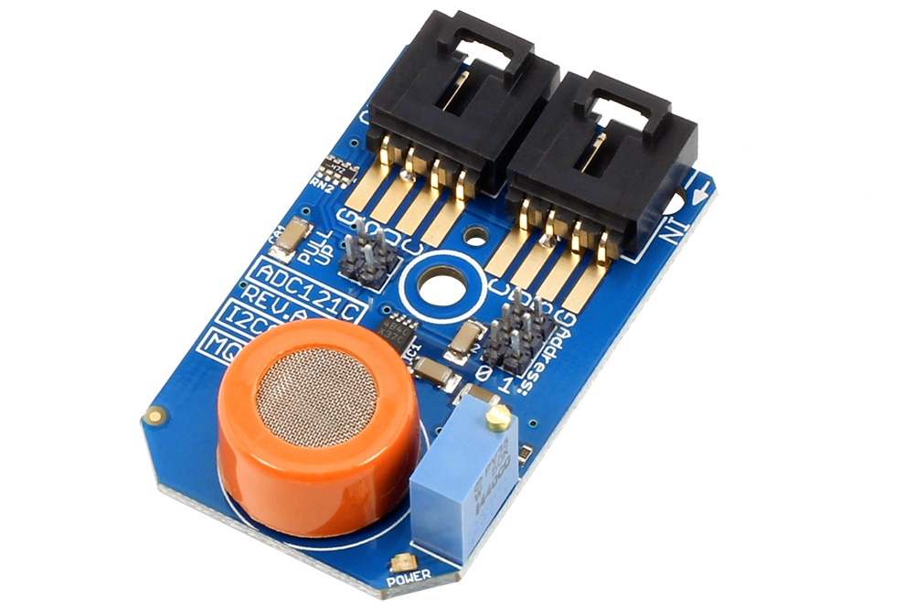
Mkm Breathalyzer
BY :
MOHITA PRABHAKAR
KARANDEEP SINGH
MAHESHWERIE SAMAROO

Slide 2
introduction
The primary focus of our project is to address the issue of DUI (Driving under the Influence). Our target audience is the general public. The main reason for the development of our product, is due to the fact that many lives are being lost as a result of DUI (Driving under the Influence). With our product, we intend to combat this issue and reduce the statistics. We intend to reduce the number of deaths and prevent occurrences of DUI (Driving under the Influence). It is stated that the target audience is the general public. What this means is that, anyone can use this product. This product can be taken along with someone who decides to go to the Bar or to the Club or to any event that involves alcohol consumption. The project involves the integration of the mobile application which was built along with the hardware component. Basically the user will be required to blow into the alcohol sensor as well as use the provided pulse sensor. The sensors will capture the readings which will then be pushed to a database. The mobile application will then pull the data from the database and display the readings via the application. Once the user is above the legal limit, he/she has the option to either call an Emergency Contact or request an UBER cab. The desired outcome of the overall project would be to assist in reducing DUI (Driving Under the Influence) occurrences.

Slide 3
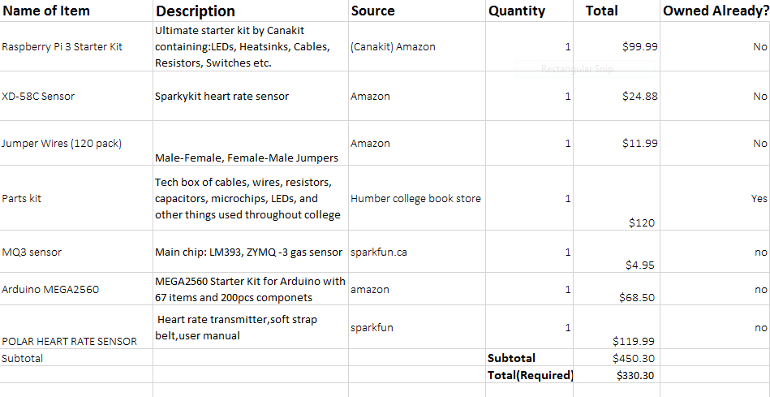
Budget
Individually ,we had different budget .This is the combined budget for our project

Slide 4
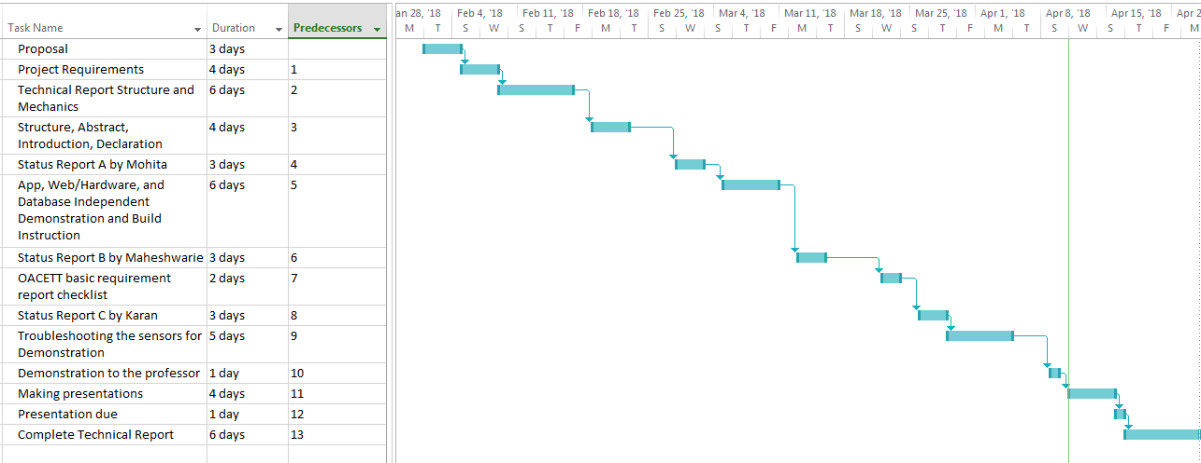
Schedule change due to strike

Slide 5
Knowledge from the previous courses
TECH 153:- We became familiar to Raspberry pi
Tech 152:- Wireless Protocols like 802.11
Tech 101:- Familiar to work with electronic circuits
CENG216:-Made familiar to Gantt Chart , choose the project type
CENG 212 :-Programming techniques with Java, learnt JAVA programming
CENG 256:- Web Access of database from Internet Scripting
CENG 319:-Became familiar to Mobile application ,Firebase database

Slide 6
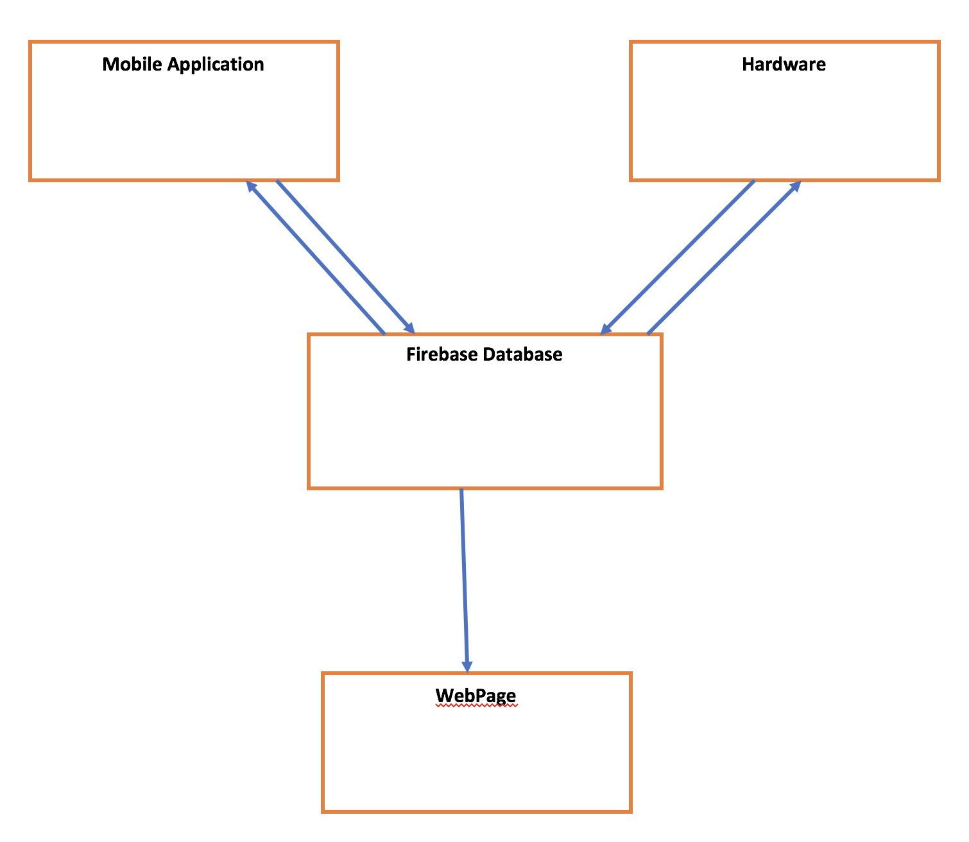
ownload a google-services.json
How is data transferred from Hardware to database and the application?
How it works?
Have the sensors connected onto
a raspberry pi and get the
readings from the sensors using
python script.
It shows us the results
by pulling it from the firebase
by using data snapshot
functionality
Install Google Repository
Add Firebase to the application
Download google-services.json file
Installing pip
Installing Pyrebase
Connecting python to the
database using firebase auth. The
output of the sensors get pushed to
the database

Slide 7
Demo...

Slide 8
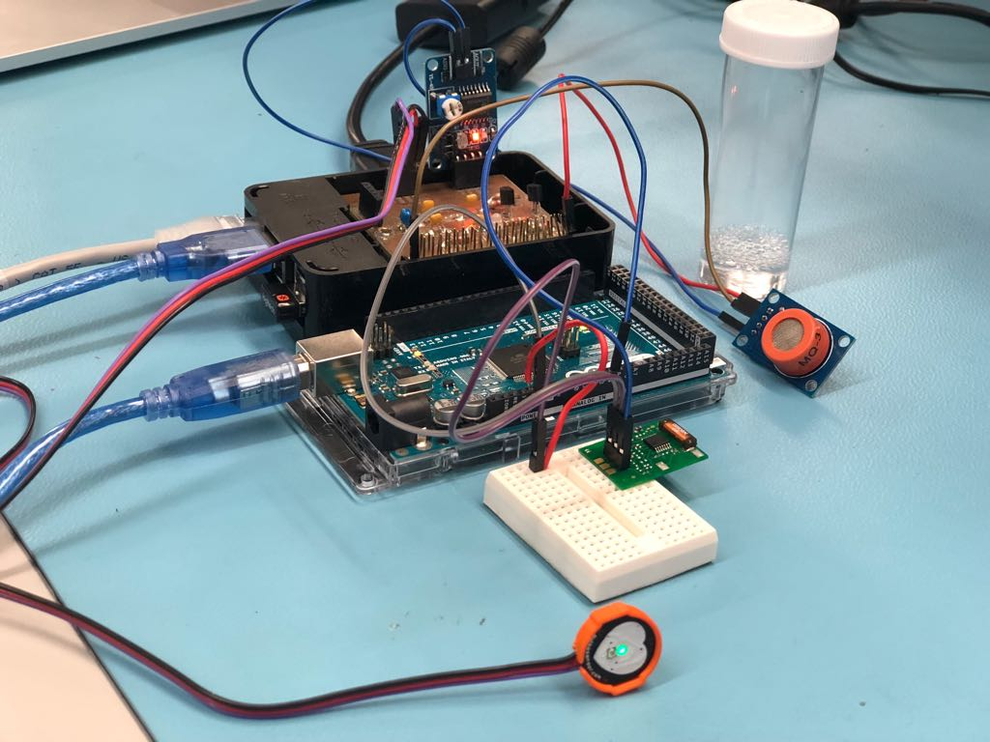

Slide 9
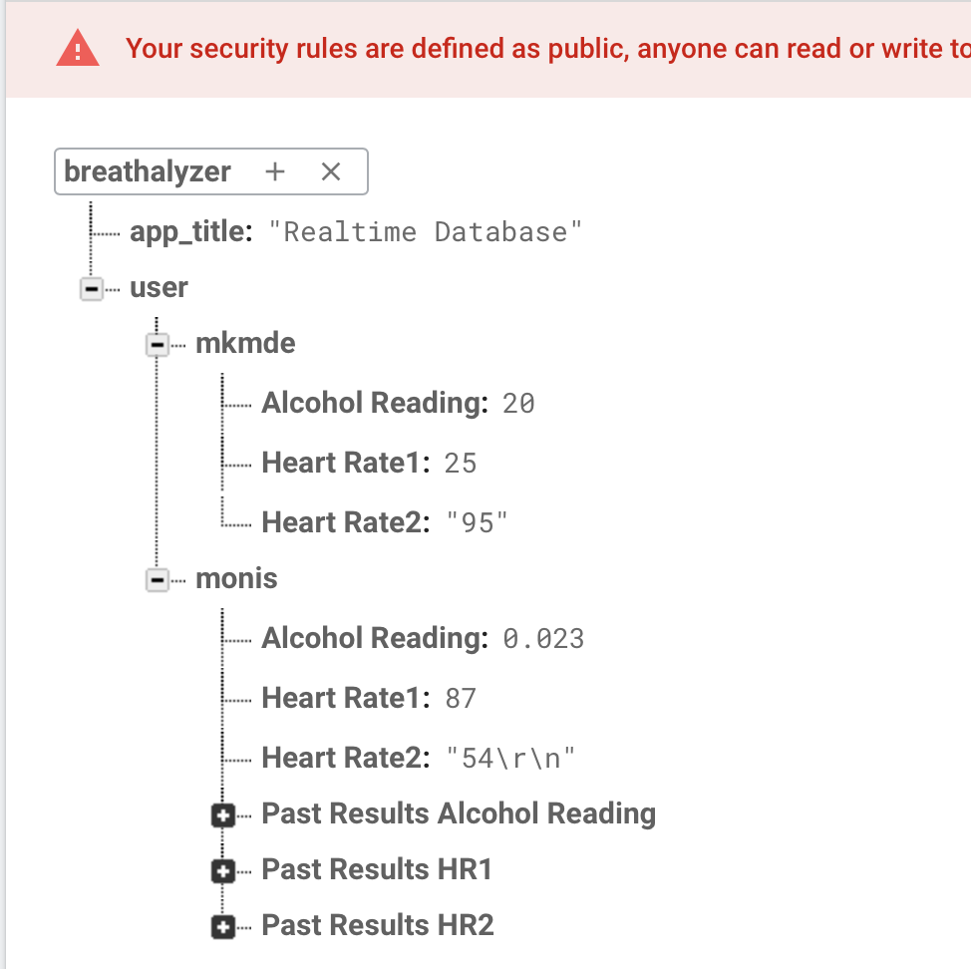
Firebase Database with Live Update

Slide 10
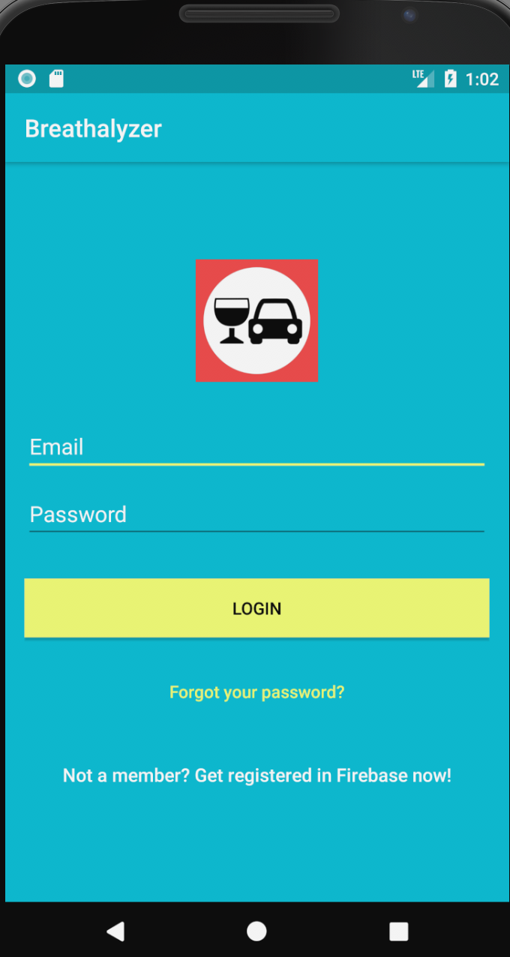
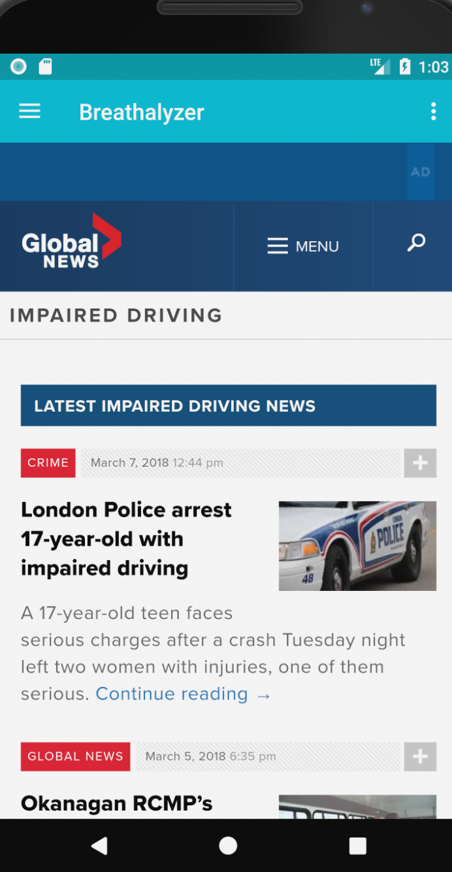
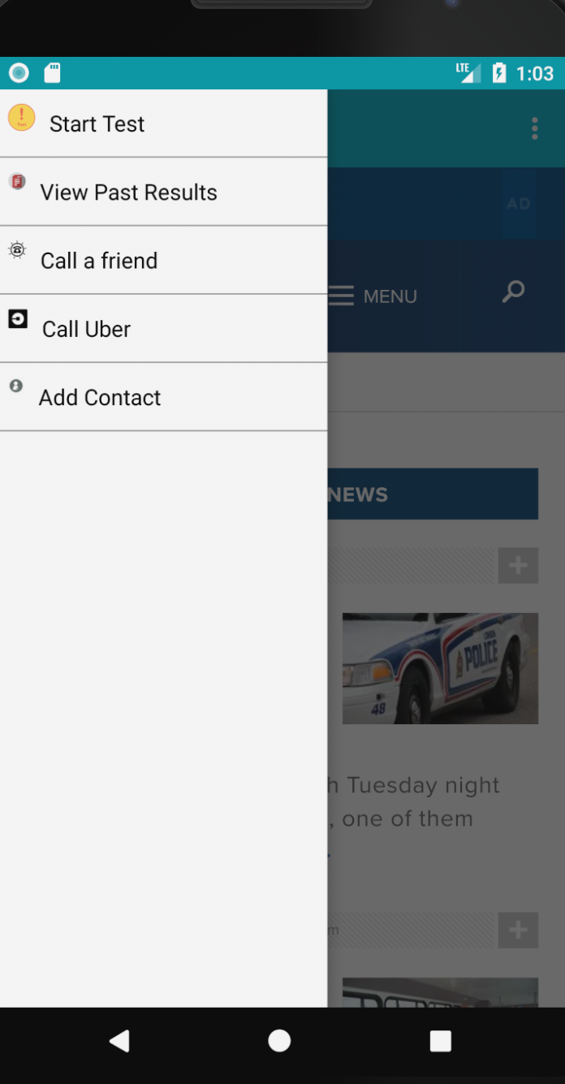
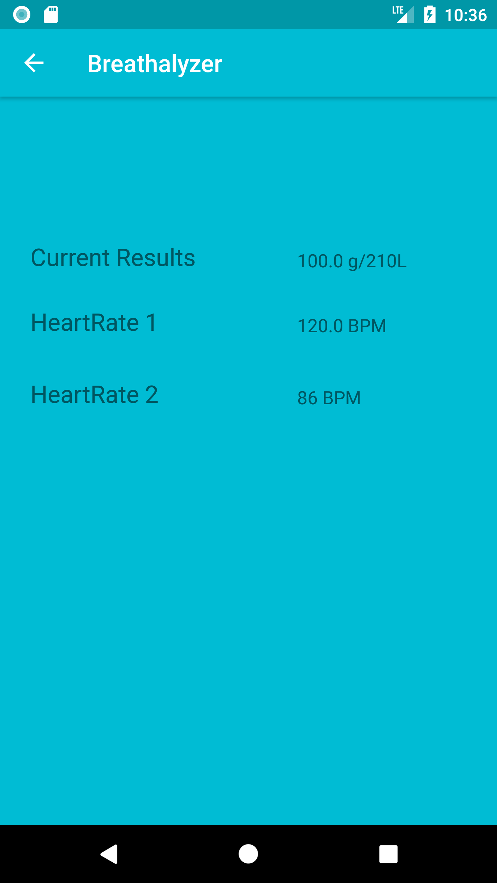
Mobile Application

Slide 11
Conclusions/Recommendations
Although it is an expensive project , We will try making it cost effective
Since we are using UBER in our Application ,
we can make a profit per ride and make some commission per ride.

Slide 12
Thank you

