Slide 1
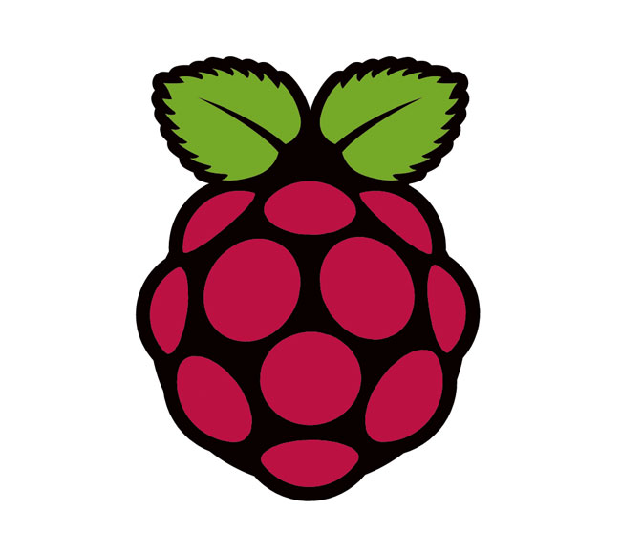

Finale
Contents
I. Aim of the Project
II. Background Information
III. Procedure
IV. Results
V. Conclusion

Slide 2
Aim of the Project
Simply put, the aim of my project was to create a program that would allow for the control of an RGB led using only hand gestures.
I was to write a program for a “host” PC connected to the Leap Motion motion controller that would allow for gesture input to a remote Raspberry Pi.
I was then to create a program for the Raspberry Pi that would accept these inputs and control an RGB led.
My project was to include the ability to turn the led on, turn the led off, change the color of the led and dim the led.
A self-imposed restriction on my project was to make it as simple, approachable and user-friendly as possible.

Slide 3
Background Information:
General
The first and possibly most important thing to understand about this project is that the Raspberry Pi does not directly support the use of the Leap Motion. I discovered this early enough to be able to formulate a new plan.
I decided that the best way of mitigating this possibly project-breaking issue was to separate the Raspberry Pi and Leap Motion controller; to have a communication protocol active between a PC (connected to the Leap) and the Pi.
In this way, I was able to effectively control the Pi's GPIO functions through the use of the Leap Motion.

Slide 4
Background Information: Leap Motion
The Leap Motion controller is a device that tracks the motions and gestures of a user's hands and uses this information to control myriad functions of a PC.
The controller was released in July 2013 and came with it a suite of programming tools.
The SDK provided to developers can be programmed using various languages including C, Python and Java.
I decided to write my Opus in Java given my aptitude with the language and the wide availability of free, open-source IDE's.

Slide 5
Background Information: Raspberry Pi
The Raspberry Pi's pinout has 17 General Purpose Input/Output(GPIO) pins.
GPIO pins are a processors way of interfacing with peripherals and allow for the transmission and acceptance of external signals.
By default, control over these pins is only granted to superusers and requires the manual modification of the “gpio” file on the Pi.
There is however an amazing suite of utilities called wiringPi that allows for much easier control over the Pi's GPIO capabilities.
WiringPi is written in C, so I needed to brush off the C cobwebs and write my GPIO controlling programs for the Pi.

Slide 6
Procedure
The first step in accomplishing my goal was to devise a plan of attack that would make all the moving parts fit.
At one point, I had imagined a suite of small programs on the Pi, each controlling a separate function I wished to perform on the leds.
It quickly became clear that this was a bulky, unwieldy approach, so I opted for one big program that would allow for the control of each function.
I wrote this program in stages, first working on getting the led to turn on and off using keyboard inputs.
I then began working in the ability to change the color of the led.

Slide 7
Procedure
Finally, I utilized pulse width modulation to control the brightness of the led.
I then needed to concoct a method of controlling all these functions using simple inputs, as it was my final goal of controlling the program not with a keyboard but the Leap Motion controller.
I settled on a number system. Each color was coded to a number 1-7. Any number above 7 (up to 100) would be considered a brightness level.
This allowed for minimal code and simple controls.

Slide 8
Procedure
I then began working on the PC end of things.
I broke out Eclipse and got a simple sample application provided in the Leap SDK up and running.
The sample program tracked and output information on every frame/gesture captured by the Leap Motion.
I started by stripping out all the code I knew was unnecessary for my purposes.
I then configured the program to perform specific actions whenever a gesture was recognized.

Slide 9
Procedure
It then came time to decide how I would remotely connect to the Pi in my Java program.
I landed on the SSH protocol and after many failed attempts at implementing it in my program, I discovered JSCh.
JSCh is a set of tools written in Java that allow for simple integration of the SSH protocol in java programs.
After importing the libraries into my project, I began working with a sample program provided by JSCh that allowed for shell access and control.

Slide 10
Procedure
After integrating the SSH protocol into my Java program, I began the long process of debugging my code.
Finally, without going into too much detail, I was able to connect to the Rpi and send commands using the Leap Motion controller.
The last step was making sure the project would function correctly on school grounds.
I was unable to connect to the Rpi wirelessly, but with a few tweaks I was able to successfully demonstrate my project using a LAN cable.

Slide 11
Results
This project was challenging and at times very frustrating. This however made the final experience of seeing my project function properly all the more satisfying.
I was ultimately able to implement all the functions I had originally intended: the ability to turn the led on and off, 7 distinct colors the user can switch between using swipes, and the ability to dim the led. And all of this in a discrete, easy to use package.
Given the restrictions placed on my project, self-imposed or otherwise, I'd say it was a – if not resounding – success.

Slide 12
Conclusions
It goes without saying that the Raspberry Pi and the Leap Motion controller are devices of immense power and potential.
The Pi has established itself as a staple in the computing world, a device experts and hobbyists alike need to have in their toolkit.
The Leap Motion, while a new and relatively untested product, has incredible potential for projects large and small. It just takes some effort and imagination.
While my project was not earth-shattering, it is a good indication of the Leap's capabilities. If the Leap can control a led, why not a robotic hand utilized in a surgery, or a space-faring rover exploring the outer reaches of our galaxy.

Slide 13
Conclusions:
What I Learned
The most important lesson I learned working on this project was how to work with pre-made code.
Previously, I'd only ever written my own code. I had control over what everything did and, more importantly, I knew exactly how everything worked.
Utilizing an SDK means you have to work within the confines of what others have previously coded.
I technically used two SDKs, one for the Leap Motion, and another for JSCh. I also used the wiringPi module. Each of these packages had their own methods and restrictions.
If I was to successfully complete my project, I needed to learn to work with/for people I'd never met, nor would I meet in person.

Slide 14
Conclusions:
What I Learned
Another important skill I developed was the use of the Linux command line.
I had previously worked in small measure with the Windows command line, but never to the extent of the command line in Linux.
I also brushed up on my C and Java coding skills, both of which proved invaluable to my project's success.

