Slide 1
Being Black and Getting Your Foot In The Door
By Kadeen Douglas, Dr. Cruz Caridad Bueno, Jabari Dash
Sponsored by the SUNY New Paltz Black Studies Department

Slide 2
Who Are We?
Fellows of MLT Career Prep classes ‘16 and ’17
Students of color who have interned for Fortune 500 companies such as Target Corporation and JPMorgan Chase & Co.
Professionals who would like to share our experiences and knowledge to assist students in securing competitive internships and employment opportunities

Slide 3
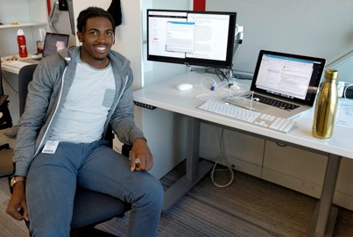
Jabari Dash
Software Engineer
MLT Career Prep ‘16 Fellow
Graduating Senior at SUNY New Paltz
Bachelor of Science in Computer Science, May 2018
Post Grad, will be a Software Engineer in Silicon Valley or Minneapolis

Slide 4
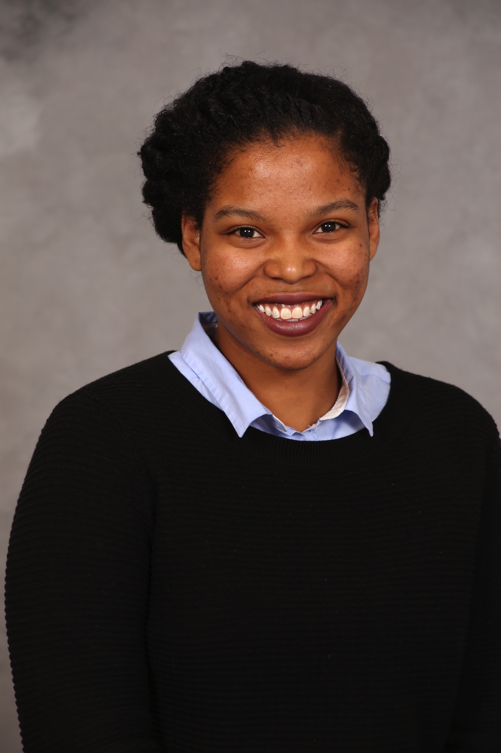
Kadeen Douglas
Financial Analyst
MLT Career Prep ‘17 Fellow
Graduating Senior at SUNY New Paltz
Bachelor of Science in Mathematics, May 2018
Post Grad, will be a Financial Analyst at JPMorgan in New York City

Slide 5
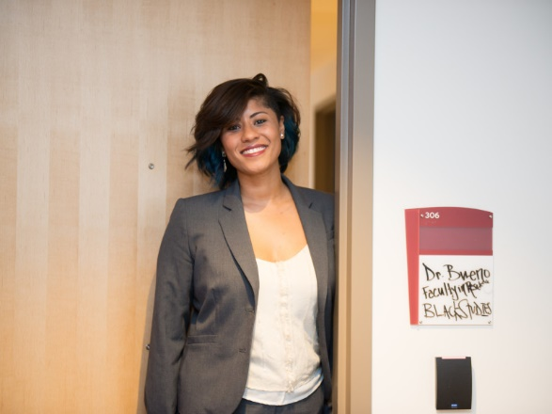
Dr. Cruz Caridad Bueno
Economist
Advisor for Being Black and Getting Your Foot in the Door
Ph.D. in Economics from the University of Massachusetts-Amherst
Assistant Professor of Black Studies at SUNY New Paltz

Slide 6
Why Are We Having This Meeting?
To inspire more students who look like us to join programs like MLT Career Prep Program
To help students in our community to organize their professional profiles
‘To whom much is given, much is required.’

Slide 7
What Is The MLT Career Prep Program?

Slide 8
What Is The MLT Career Prep Program?
A fast-track career acceleration program that empowers students to maximize their college and internship experiences, and conquer their post-grad job search

Slide 9
Who Is MLT Career Prep Program For?
Students of underrepresented descent (more formally defined later)
College Sophomores (or Juniors who are doing a fifth year)
Students looking for internships (typically at large companies and corporations) in fields including (but not limited to):
Accounting
Finance
Investment Banking
Software Engineering

Slide 10
How Does It Work?
Complete the application process and be accepted
Attend 4 in-person conferences over a span of 18 months (about 350 participants)
Schedule and attend interviews for internships and full time employment
Work in 1-on-1 and group sessions with an assigned career coach each month
Complete monthly assignments that help improve your professional development

Slide 11
Our Experiences As MLT Career Prep Fellows

Slide 12
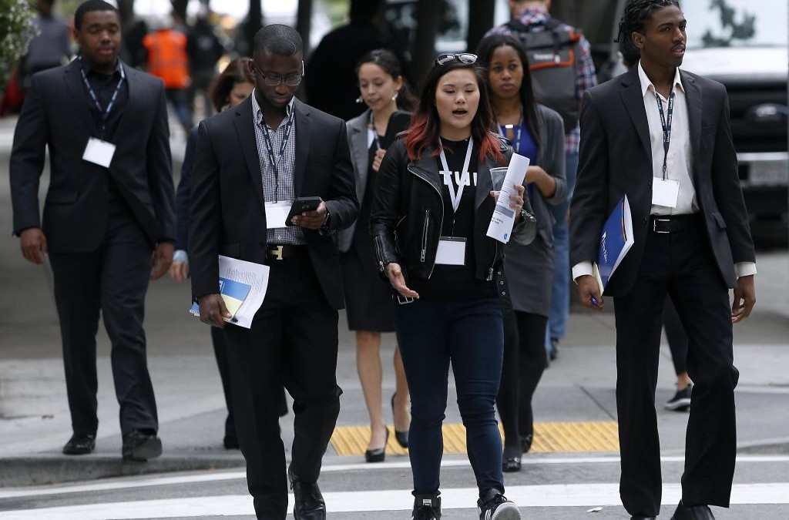
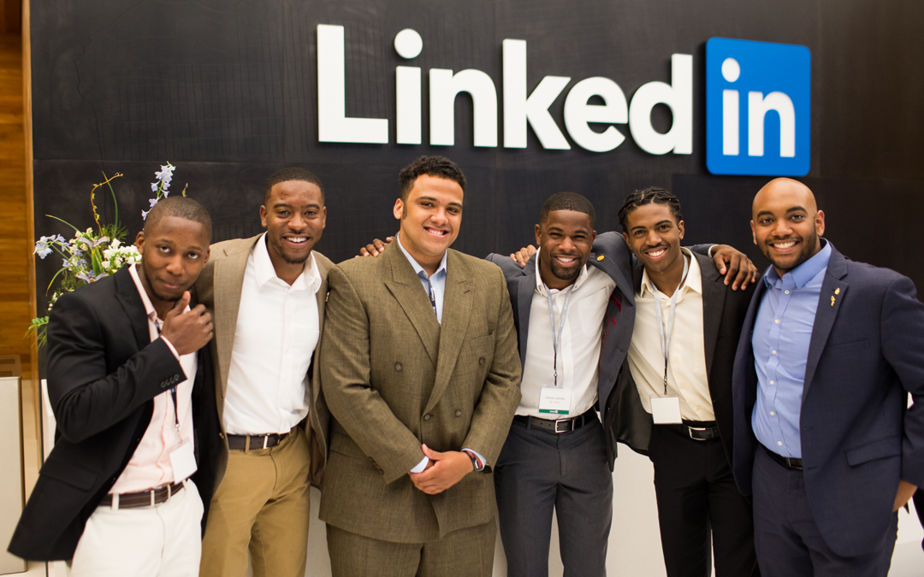
Jabari’s Experience with MLT Career Prep

Slide 13
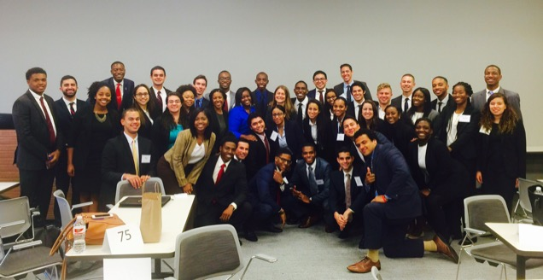
Jabari’s Cohort

Slide 14
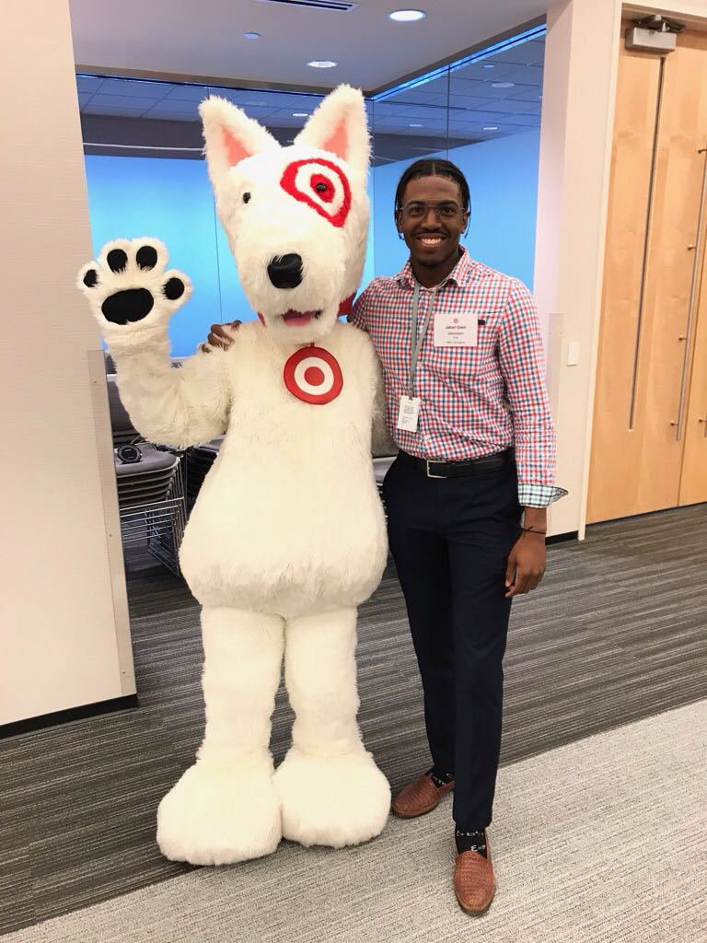
Two Summer Internships At Target HQ

Slide 15
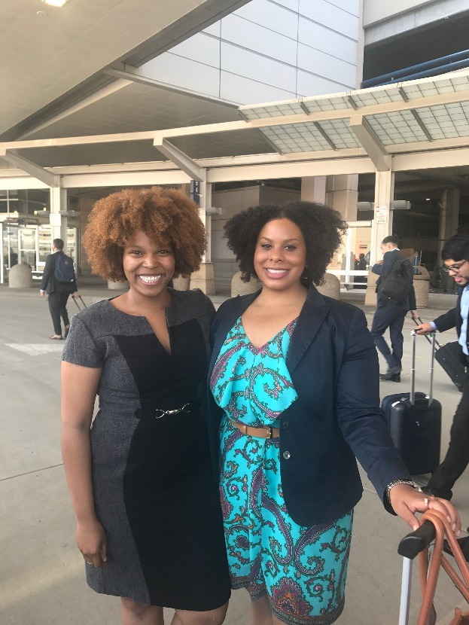
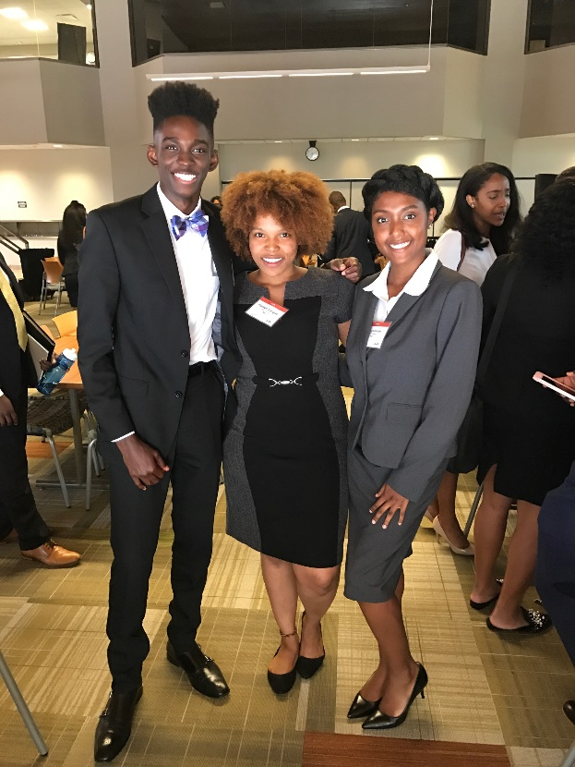
Kadeen’s Experience With MLT Career Prep

Slide 16
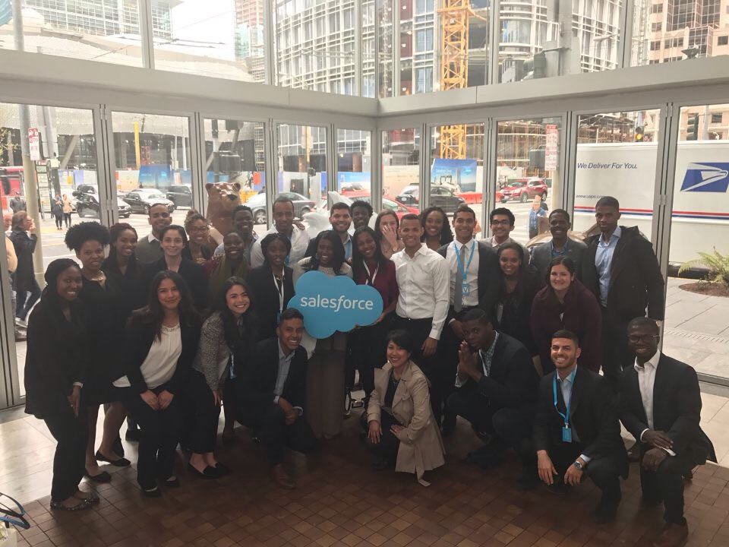
Kadeen’s Cohort

Slide 17
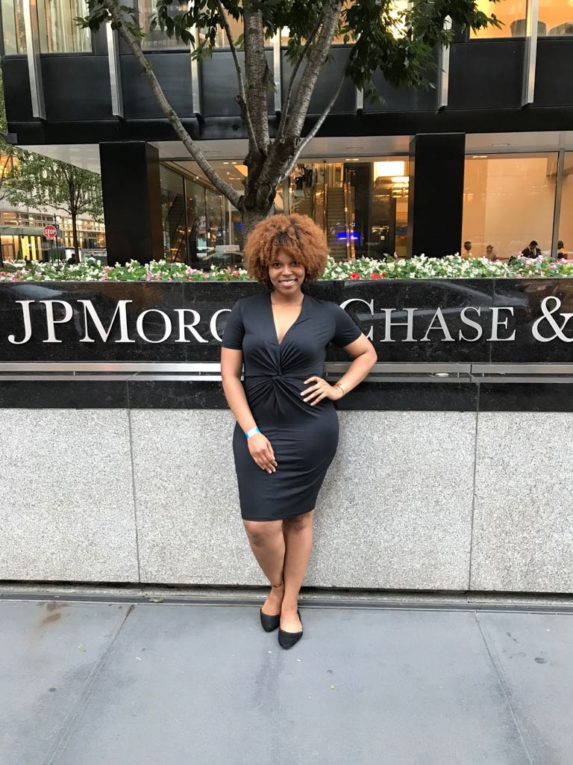
A Summer Internship At JPMorgan Chase

Slide 18
Applying To MLT Career Prep Program

Slide 19
Eligibility
U.S. Citizen or US permanent resident (including DACA participant)
Applicants must be Black / African American, Hispanic / Latino(a), or Native American
Applications must be college sophomores (graduation in Fall 2019, Spring 2020, Summer 2020)
Minimum GPA 2.8
Other requirements and FAQ can be found here

Slide 20
Application Requirements
Demographic info
SAT and / or ACT score(s)
Extracurricular activities
Honors / and awards
Career and industry interests

Slide 21
Application Requirements
Short answer essays
Career Goals (200 word limit)
Analytical Skills (200 word limit)
Video response
1 – 2 minute video response to the prompt “What unique qualities or capabilities will you bring to Career Prep and how will they benefit the CP class?”

Slide 22
Application Requirements
Recommendations
1 -2 recommendation (at least 1 required, second is optional but HIGHLY recommended) forms completed by current or previous supervisors, college professors, student club advisors, or community leaders
Resume (no longer than 1 page)
Unofficial Transcript (with all classes and grades)
Digital interview (you will receive this after submitting the application)

Slide 23
Application Deadlines
Early Decision - December 30, 2017
*Note* We are aiming to submit all applications before this deadline to maximize your chances of being accepted
Round 1 Deadline – January 30, 2017
Round 2 Deadline – March , 2018

Slide 24
MLT Not For You?

Slide 25
You Can Still Learn About...
Resume writing
Cover letter writing
Elevator pitches
Digital footprint
Personal brand
Overall recruitment process

Slide 26
You Can Also Check Out Similar Programs
Code 2040 (for STEM students)
Prep for Prep
T Howard Foundation
SEO
MLT MBA Prep (for grad students)
MLT Ascend (for freshman)

Slide 27
Next Steps

Slide 28
Future Meetings
October 26th Resume Writing Workshop
Deadline: By October 19th submit drafts of resume and short essay responses
November 9th Keys to Success Panel
December 7th Wrap Up Session

Slide 29
Resources
MLT Career Prep Application
How to Write a Resume
Sample Resumes
Answering Short Answer Questions
MLT Career Prep FAQ
Career Prep Non-admitted Applicants

Slide 30
Questions Thank You!

