Slide 1

PLACEMENT PRESENTATION

Slide 2
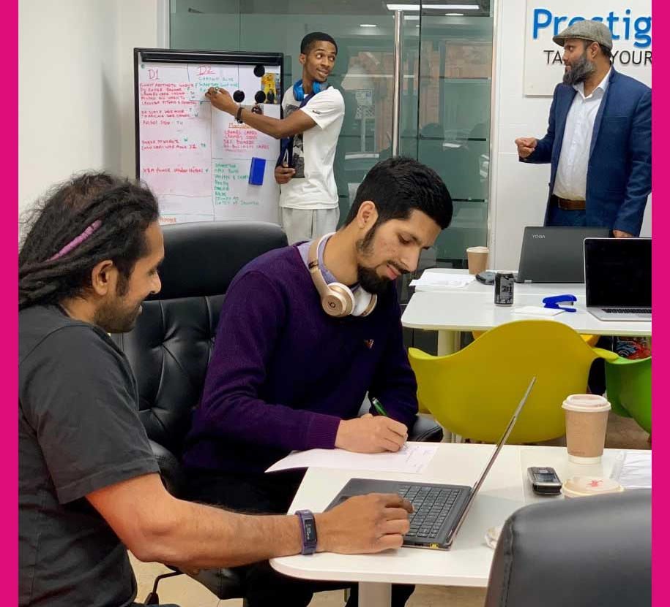
Prestige designz

Slide 3

My role

Slide 4

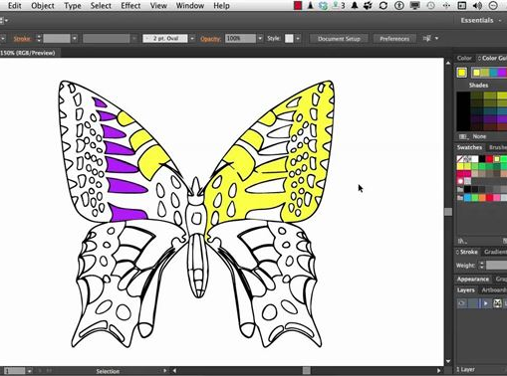
Activities

Slide 5


Mistakes made

Slide 6

Skills I gained

Slide 7

Skills I need to improve on

Slide 8
Conclusion

