Slide 1

PLACEMENT PRESENTATION

Slide 2
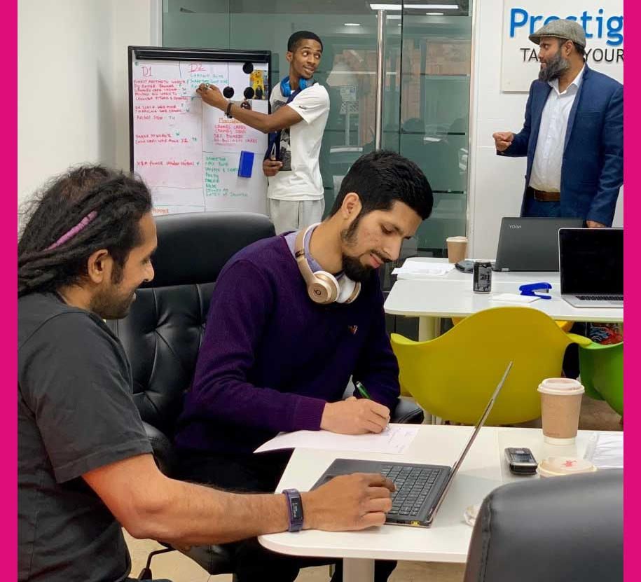
Prestige designz

Slide 3

My role

Slide 4

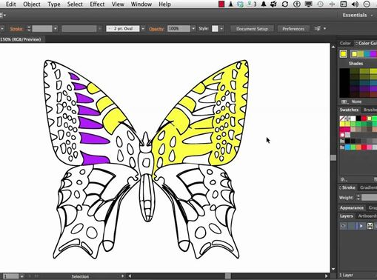
Projects

Slide 5


Skills

Slide 6

Mistakes made

Slide 7
Skills I need to improve on

Slide 8
Conclusion

