Slide 1
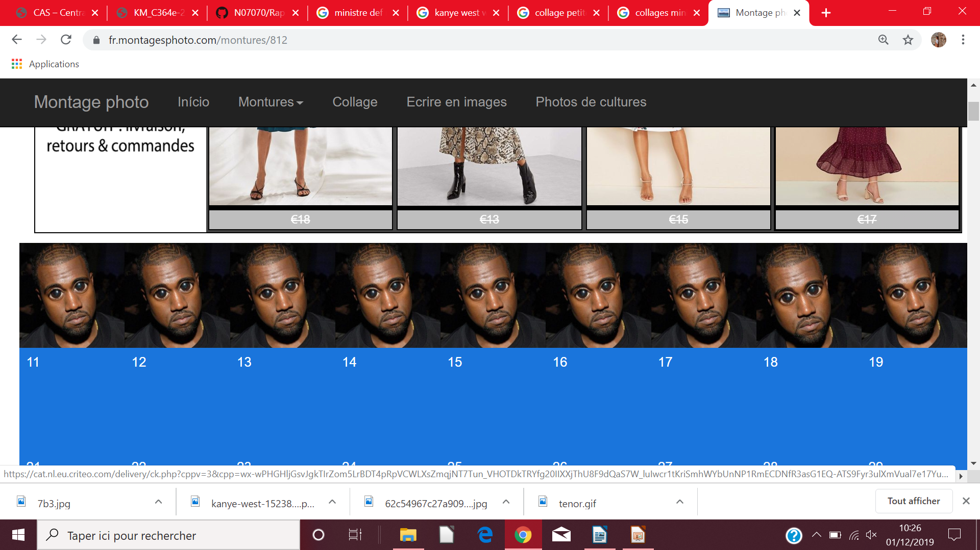

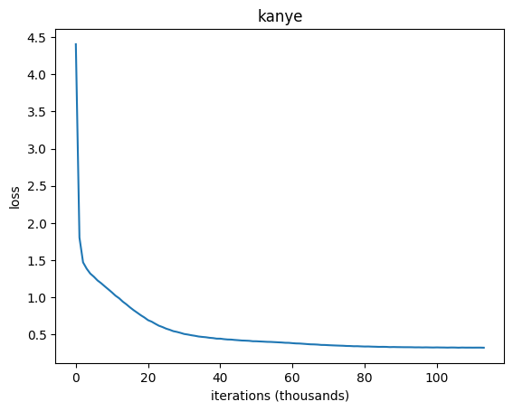
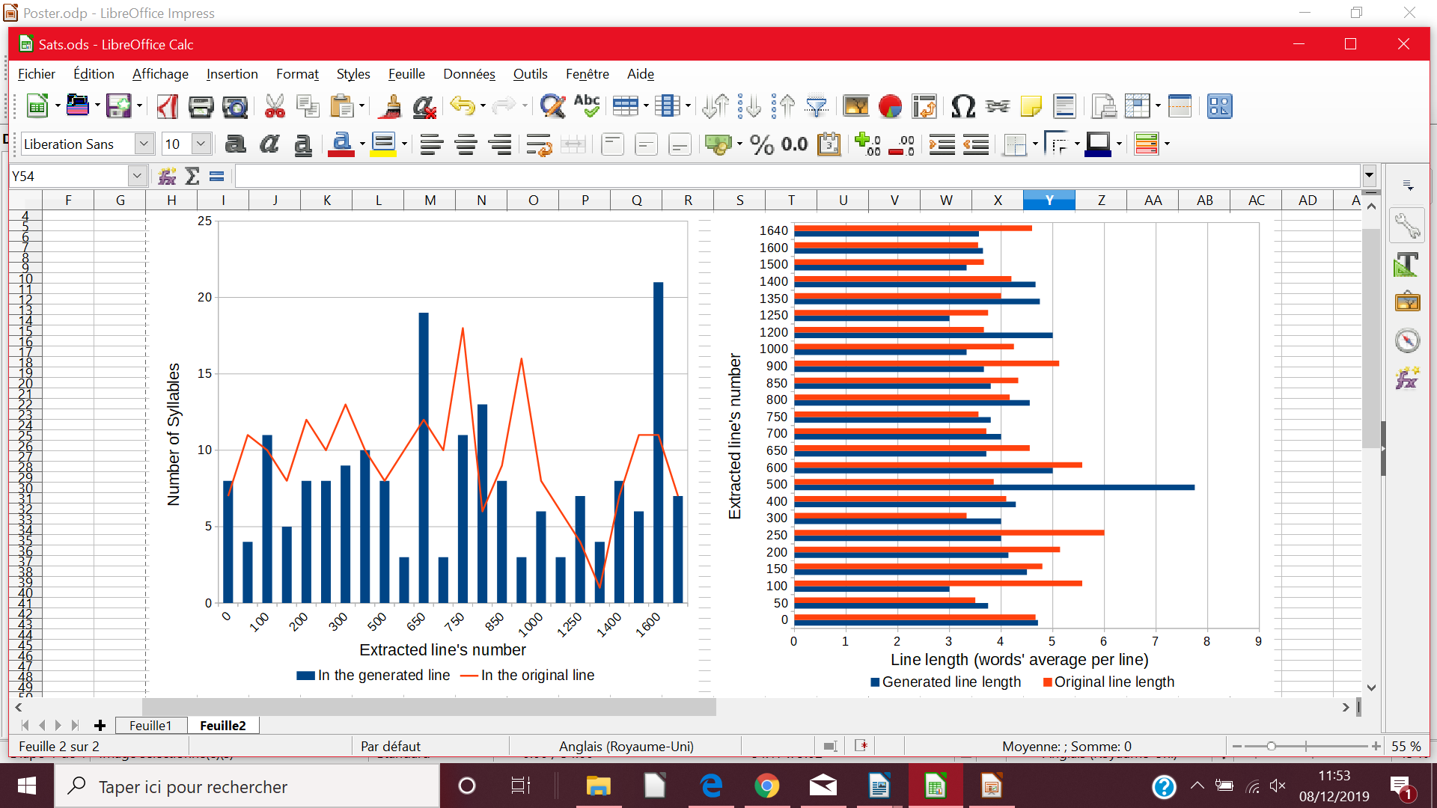
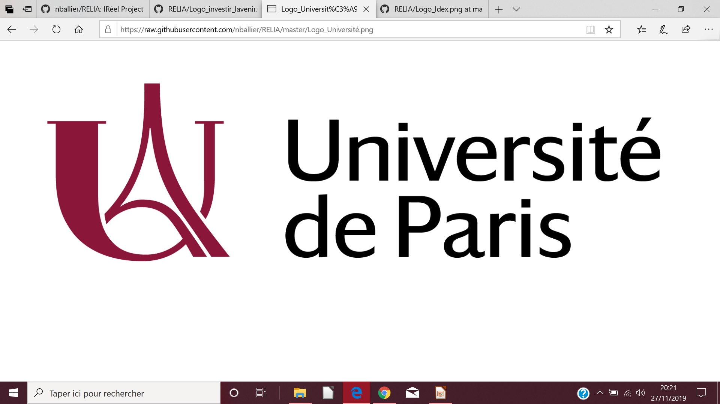

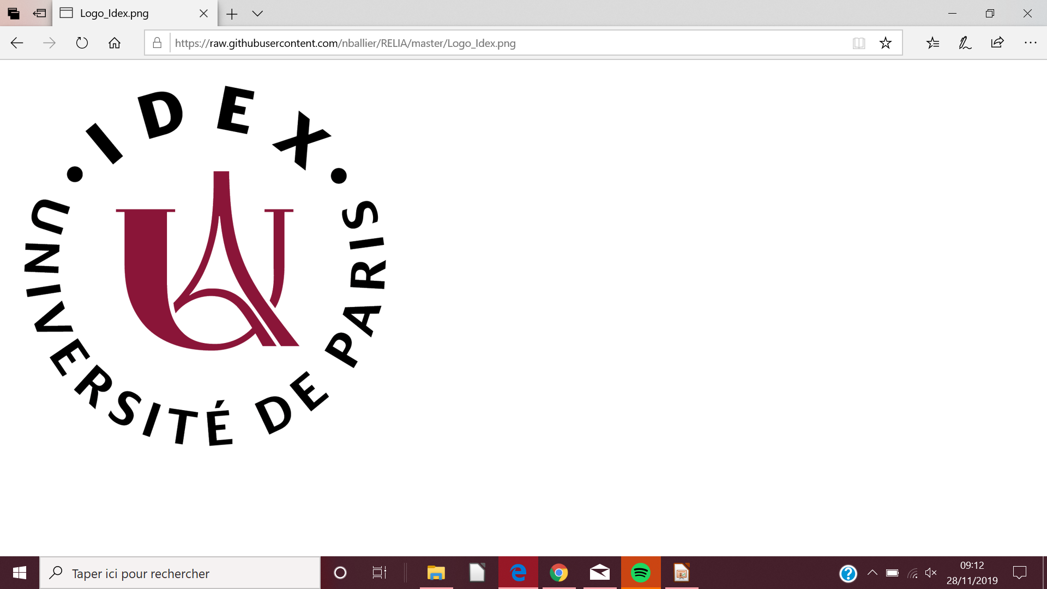
Rap and text generation : how a rap text can be generated considering the metrical and lexical questions
Nelson Perdriau, UFR Informatique
Eitanite Partouche, UFR Etudes Anglophones
Nelson Perdriau, UFR Informatique
Eitanite Partouche, UFR Etudes Anglophones
Nelson Perdriau, UFR Informatique
Eitanite Partouche, UFR Etudes Anglophones
nelson.perdriau@etu.univ-paris-diderot.fr
eitanite.partouche@etu.univ-paris-diderot.fr
Research Question
Methods
How we can use a LSTM to generate a rap text or to create a “rap machine”, including the generation of rhymes, rhythm and a various vocabulary, considering metrical analysis for the pronunciation of words. CMU Pronouncing Dictionary appears to be essential [6], as it make it possible for us to capture the global pronunciation of a group of words. One of the goals of this research is to have a nicely generated pronunciation of the text at the same time. We will (Malmi, et. al, 2016) consider the length of verses in a rap text generated and all the kind of rhymes that we can ﬁnd in it. Then, our main goal is to produce a more precise model for rap lyrics generation by ghostwriting Kanye West’s lyrics (P. Potash, et. Al, 2015), another of our goals being to produce a coherent new rap text, being as coherent as the Kanye West’s ones.
We write a model in Python, using the TensorFlow library and a RNN. In it, we add the CMU Pronouncing Dictionary, allowing us to read the generated text produced with the good accents, considering the word’s syllable(s) and the metric of the sentence. The initial set of lyrics are from Rap Genius, where we download the lyrics thanks to a scraper [7], hoping to produce ghostwritten texts, as if Kanye West had produced a new song. In this way, we calculate the similarity between the verses generated and K. West’s verses, in order to see if our generated lyrics is the “freshest” plus a calculation of the syllables density and the line length enabling us to see if the produced line resemble to the artist’s one, or is even better than what has produced K. West. Then, we trained the model on a computre about 130. 000 iterations. Here are some examples below.
V.1 – Iteration 1000
V.2 – Iteration 55.000
V.3 – Iteration 110.000
Cause I greaves in night
I been if ain't kidsiin than in't griends, what I like Im
And by ins, Mes fiends
And a contromity tapissed tryna take
(aospe) Whose shalling in throuictifing
This just right nigga get todd in the aintion it
You mean I way you can't timatin of I feel it wanna gards belied
Pleep]
Her new, thissle new killin', get reak, what I guestin, are my take for it for you
What n
night blackak can devile us, morace Roc-Croby Will just my ocident?
I'm a Polo dick right now, I gree at her Ill
Every to the leaves
I know Im three
I speak to the most head that brother""
(Yeezy taught me. I had give him) on hot!)
How you turned girls junior, homie
He lost his soul
To eat bill of the lights
But my sight is better tonight
And my girl you laugh with that
Good did they lanes that he does 2 & Phatry taste bottles
Plus all the way this daughter, passacades (All of the lights)
Now throw ya hands up hustlers, busters, boosters, hoes
[Verse 4: Kanye West]
Strap kicked at me Bustack
Loyee oyee or suits of the leaves
Yeah I used to lose helped
[Verse 3: Desiigner]
I got a plan, I spit this jeople for Beans of y'all
Lookin' at my own money, while y'all niggas packs
You know the shit reasong, ah school bust you can't connect
When you gon' end up up
Data n°1 : rate of similiraty between the
generated rap text and the original artist
Data n°2 : syllables density per line
Data n°3 : metrical length
Results and Discussion
References
Important quantity of nonsensical words in the generated text (V.1: "kidsiin", "throuictifing", "griends"): the CMU P. Dic. is not really helpful for their pronunciation because not listed. Shortened, mixed (ex : "nigga", "tryna"; really usual in K. W. texts) or misspelled (ex : "ocident") words also unrecognized. Because of these problems, we may think that the lines in the generated text contain less syllables than the original one. Nevertheless, the syllables average in the generated lines ≈ 8 syl. /line while the one of the original text ≈ 9.3 syl. /line : still very close. The rate of similarity with the lines by K. W. is really low, considering the loss of the generated lines. However, the final iterations goes against our bias : still nonsensical words as "loyee oyee" (interjections style, common in in K. W. texts), "reasong" or shortened words as "niggas", "lookin' ". But we can imagine the first line been rapped. More regularity in the lines length than for the previous iterations; shorter generated lines (in general) than the K. W’s. Lines but the length remains close from the K. W. lines’ length ( average for both of them ≈ 4,1 - 4,3 words). After hundred of thousands iterations, the rate of similarity is close from 0, meaning that between the verses’ corpus from K. W. and our corpus of verses’, there are fewer and fewer losses. It could be interesting to integrate in this kind of program a dictionary that recognizes not the word as a whole but first every syllables of every word, even if it has no sense or contains mistakes in its spelling.
[1] I. Sutskever, J. Martens, and G. Hinton, “Generating Text with Recurrent Neural Networks,” p. 8.
[2] J. Raiman, “Nano size Theano LSTM module,” https://github.com/JonathanRaiman/theano_lstm, Mar. 2015.
[3] G. Surma, “Text Predictor - Generating Rap Lyrics,” https://towardsdatascience.com/text-predictor-generating-rap-lyrics-with-recurrent-neural-networks-lstms-c3a1acbbda79, Toronto, Oct. 2018.
[4] P. Potash, A. Romanov, and A. Rumshisky, “GhostWriter: Using an LSTM for Automatic Rap Lyric Generation,” in Proceedings of the 2015 Conference on Empirical Methods in Natural Language Processing, (Lisbon, Portugal), pp. 1919–1924, Association for Computational Linguistics, 2015.
[5] R. Nikolaev, “Generating Drake Rap Lyrics using Language Models and LSTMs,” https://towardsdatascience.com/generating-drake-rap-lyrics-using-language-models-and-lstms-8725d71b1b12, Toronto, Apr. 2018.
[6] H. Hirjee and D. Brown, “Using Automated Rhyme Detection to Characterize Rhyming Style in Rap Music,” Empirical Musicology Review, vol. 5, no. 4, pp. 121–145, 2010.
[7] E. Malmi, P. Takala, H. Toivonen, T. Raiko, and A. Gionis, “DopeLearning: A Computational Approach to Rap Lyrics Generation,” Proceedings of the 22nd ACM SIGKDD International Conference on Knowledge Discovery and Data Mining - KDD ’16, pp. 195–204, 2016.
[8] F. Paupier, “How to build and deploy a lyrics generation model — framework agnostic,” https://towardsdatascience.com/how-to-build-and-deploy-a-lyrics-generation-model-framework-agnostic-589f3026fd53, Toronto, Sept. 2018.
This project was supported by
IdEx Université de Paris
ANR-18-IDEX-000101

