Slide 1



Pitch Perfector
Product Functionality
Vocal pitch correction
Programmable shifting
Core Demographic
Nervous karaoke singers
Bad X-Factor contestants
Unique Selling Points
Handheld operation
Cost
Portability
A real-time pitch shifting microphone
@PerfectorPitch
pitch-perfector

Slide 2
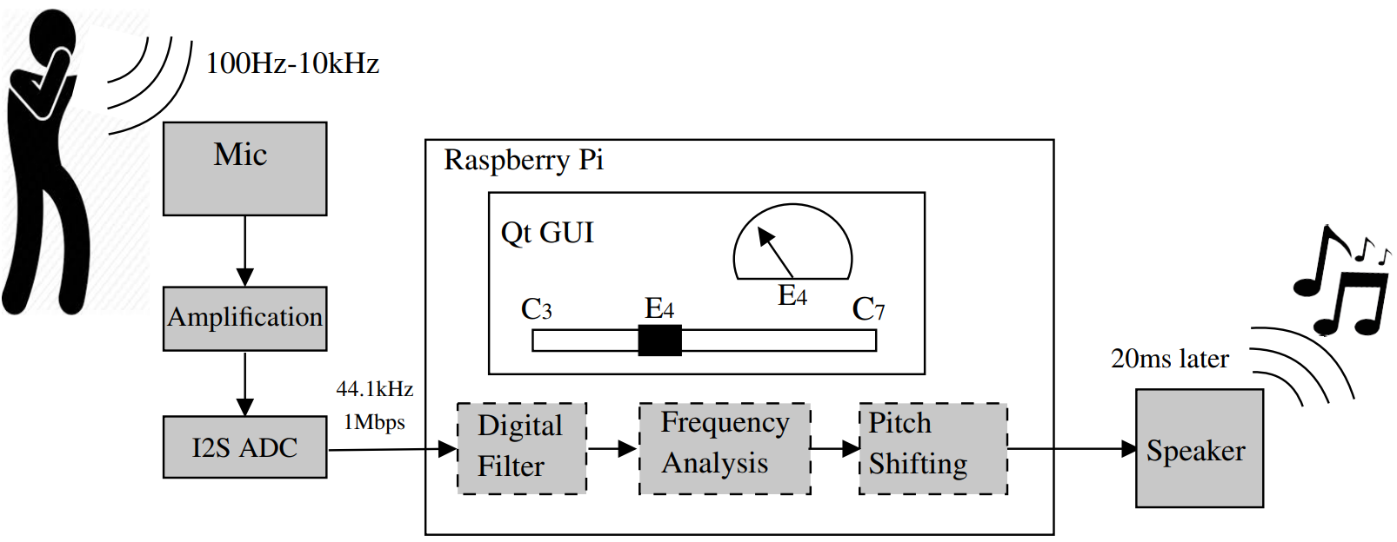
System Design
Real-time pitch shifting microphone
Notes:
ANDREW
So how will this device work?
Here you can see the system design for the handheld pitch-shifting microphone
The singer sings into the device and this audio is picked up by the ECM and is amplified and converted into I2S
This I2S data-stream is then input to the Raspberry Pi through the I2S configured pin
Following this, the data-stream is piped through an IIR filter to reduce the band to only the vocal range
An FFT is applied to analyse the frequency spectrum and determine the dominant frequency of the signal
And in order to change the pitch of the vocals, phase vocoding will be used based on the results of this analysis
This is then output to a speaker for playback
A GUI allows the user to change the note which is being shifted to
This input could be done in a number of ways including using a pre-programmed karaoke song with pre-determined pitch requirements or, as you can see here, a slider interface where the desired note can be selected
It also provides feedback to let the singer know how far away from the desired note the vocals are
I’ll now pass you over to Hanoz who will outline some of the values associated with this process
____________________________________________________________________________________
HANOZ
Mention - frequency of vocals (100-5kz), frequency of microphone output (up to 20kHz), hard real-time deadline (200ms - taken from vocal experiments), aiming for 20ms (un-noticable delay for vocals - equivelant to being 5m away from the speakers)
Any latency that could be added by the processing (10ms buffers plus calculation times)

