Slide 1


Investment Strategies Simulation Multi-Agent System
Sérgio da Gama (up201906690)
Tomás Fidalgo (up)
Julián Herrero (up)

Slide 2




Project Description
In this project we simulate multiple investment strategies inside an approximately real stock market scenario.
This is accomplished by using historical data from the United States stock market and having various agents performing different investment strategies in that same context.
The simulation happens on a daily basis, throughout the period of real data selected.
There are four agents involved in the simulation:
Market
Trader
Broker
Exchange

Slide 3
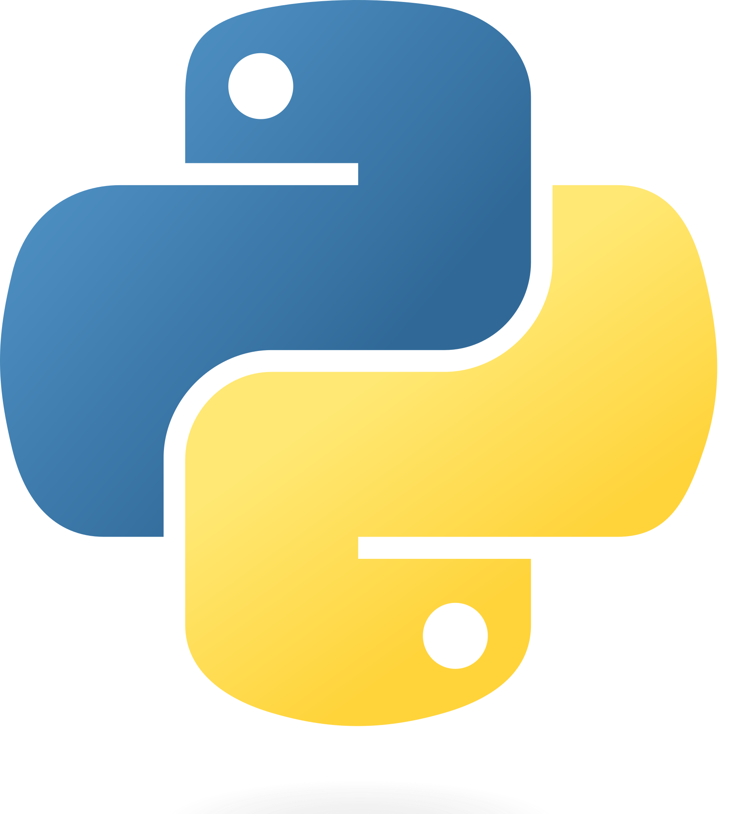


Collecting Data
To simulate the market with real data, we had to first collect the data, which usually is paid
We found this endpoint, /v2/aggs/grouped/locale/us/market/stocks/{date} , from Polygon.io, which returns the daily open, high, low, and close for the entire US stocks/equities markets, for a given date (around 10k stocks).
Polygon.io is a paid market data API, thus it had a rate limit of 5 request per minute, for the free version.
Hence, we created a python script to make 5 requests per minute, to collect the data from 2021-12-27 to 2023-02-20, which totalizes around 250 working days and taking aprox. 1 hour to execute.
Python
Polygon.io
data (250MB)

Slide 4
Communication flow
The simulation starts with the Trader Agents subscribing to the Market Agent.
After that, the Market sends to the subscribers the daily stocks information
Market
Trader
Broker
Exchange

