Slide 1
Can an internal “debate” add-on make a small language model reason better?
Progress meeting · MSc thesis Ekdant · Hochschule Heilbronn
Harshil Gorasiya · November 2026
Notes:
Purpose of the meeting: report where the L2 experiments stand, answer the four comments from your email, and agree on the next step.

Slide 2
The answer so far: L2 does not reason better
+3.3*
−0.4
0 of 4
points on PubMedQA from training the yes/no decision on the evidence — without any add-on
balanced-accuracy change from L2: its +2.07 accuracy gain was a shift towards “yes”
reasoning predictions of the working hypothesis were met
What worked: the data fix and the evaluation method. What did not: the L2 layer itself.
* = paired bootstrap 95 % CI excludes 0. All numbers: mean of seeds 17, 23, 31.
Notes:
Main message first. The +3.3 comes from the evidence data (T61) against the old baseline, 58.0 to 61.3 percent. The -0.4 is balanced accuracy over yes and no questions for v5 versus its baseline (66.1 to 65.7). The four reasoning predictions are P1, P2, P3 and P5 on the hypothesis slide.

Slide 3
Your four comments — short answers
1
“Only a single model — what about a larger LM?”
2
“The ‘yes’ boost looks like a calibration problem — why?”
Correct: only SmolLM2-135M so far. At this size only PubMedQA is informative. Proposal: repeat the decisive comparison on SmolLM2-360M, then 1.7B if there is a signal.
Agreed: the +2.07 is exactly a threshold shift towards “yes”; balanced accuracy does not improve. Cause: the yes/no word was never trained and the data is 92.8 % “yes”.
→ slide 20
→ slides 17–19
3
“What is the working hypothesis behind L2?”
4
“Related work is missing.”
That considering, cross-checking and reconciling several hypotheses — as self-consistency and debate do in text — works inside one forward pass on hidden states. Five testable predictions; none met.
Added: multi-path reasoning, latent reasoning, multi-stream networks, energy-based refinement, calibration, counterfactual data. The contribution is a combination, not a new ingredient.
→ slides 11–12
→ slides 13, 25
Notes:
Overview of the four points from your email, in your order. Each has a full slide later; the written answers are section 13 of the report.

Slide 4
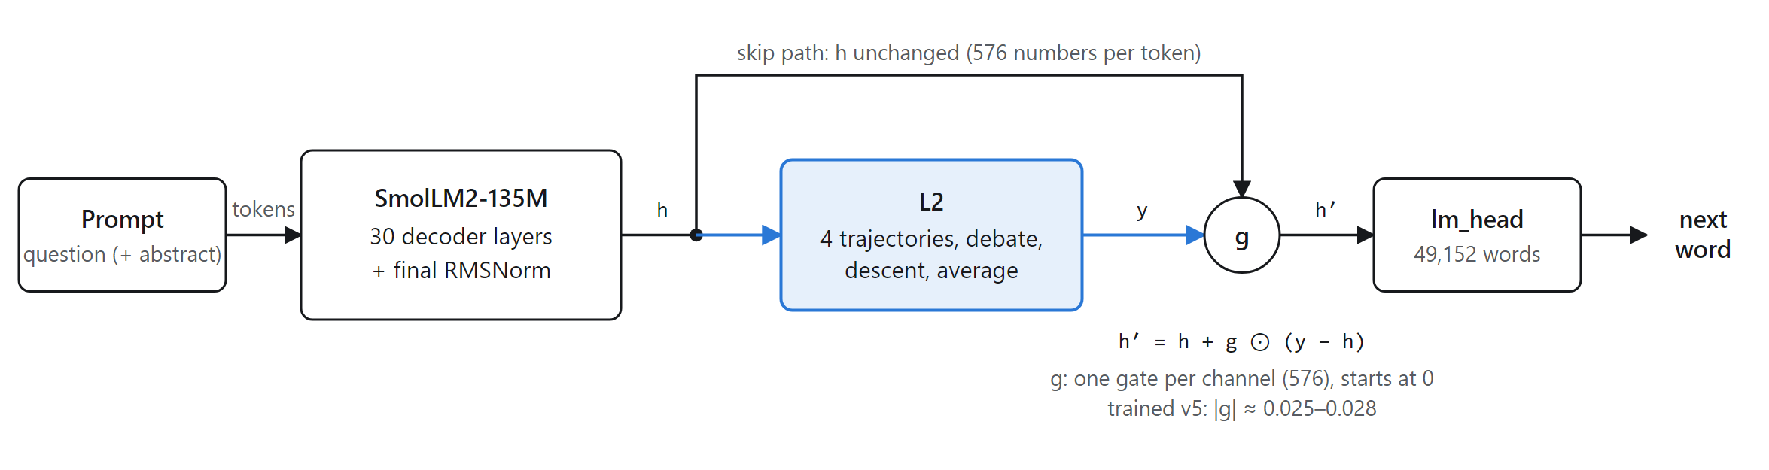
Setup: SmolLM2-135M with L2 before the output
134.5 M
19.6 M
0 → 0.027
pretrained backbone, all weights fine-tuned
L2 parameters (+14.6 %); architecture-matched, not parameter-matched
gate size: L2 starts as a no-op and ends changing ≈ 3 % of the state
Notes:
h' = h + g (y - h). Because g starts at 0, both arms start exactly as SmolLM2, so every difference is learned. Training: PubMedQA stage 1 (1 epoch), MedQuAD stage 2 (3 epochs), identical data and order for both arms, three seeds.

Slide 5
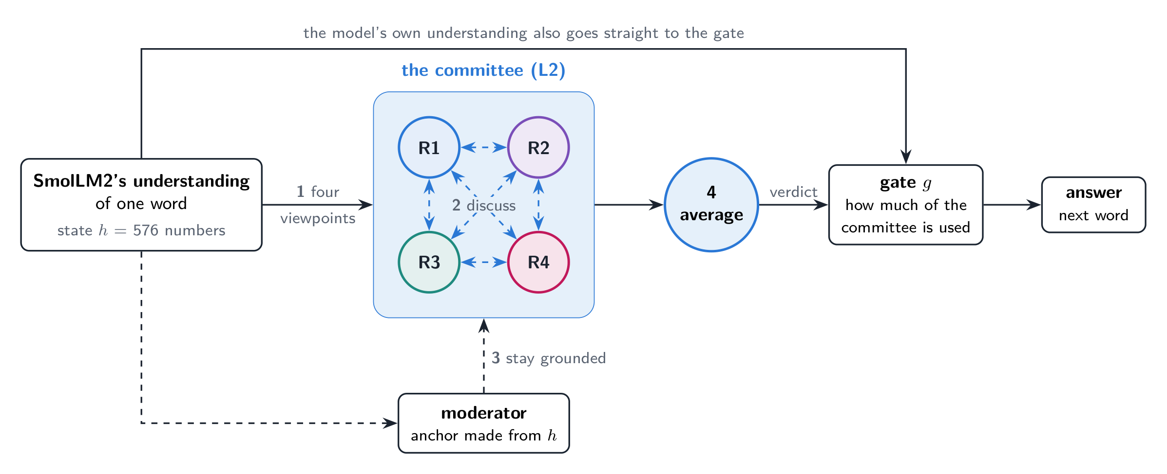
L2 in plain words: a committee of four
One important limit: L2 works one word at a time and only sees SmolLM2's final state of that word — it never reads the abstract itself.
Notes:
Without L2, SmolLM2 forms one understanding of each word, a list of 576 numbers, and answers from it straight away. L2 is a committee of four reviewers between that understanding and the answer: four viewpoints, four rounds of discussion, a moderator anchor that keeps them close to what the text said, the average as verdict, and a gate that decides how much of the verdict is used. All with numbers, in one pass, no extra text.

Slide 6
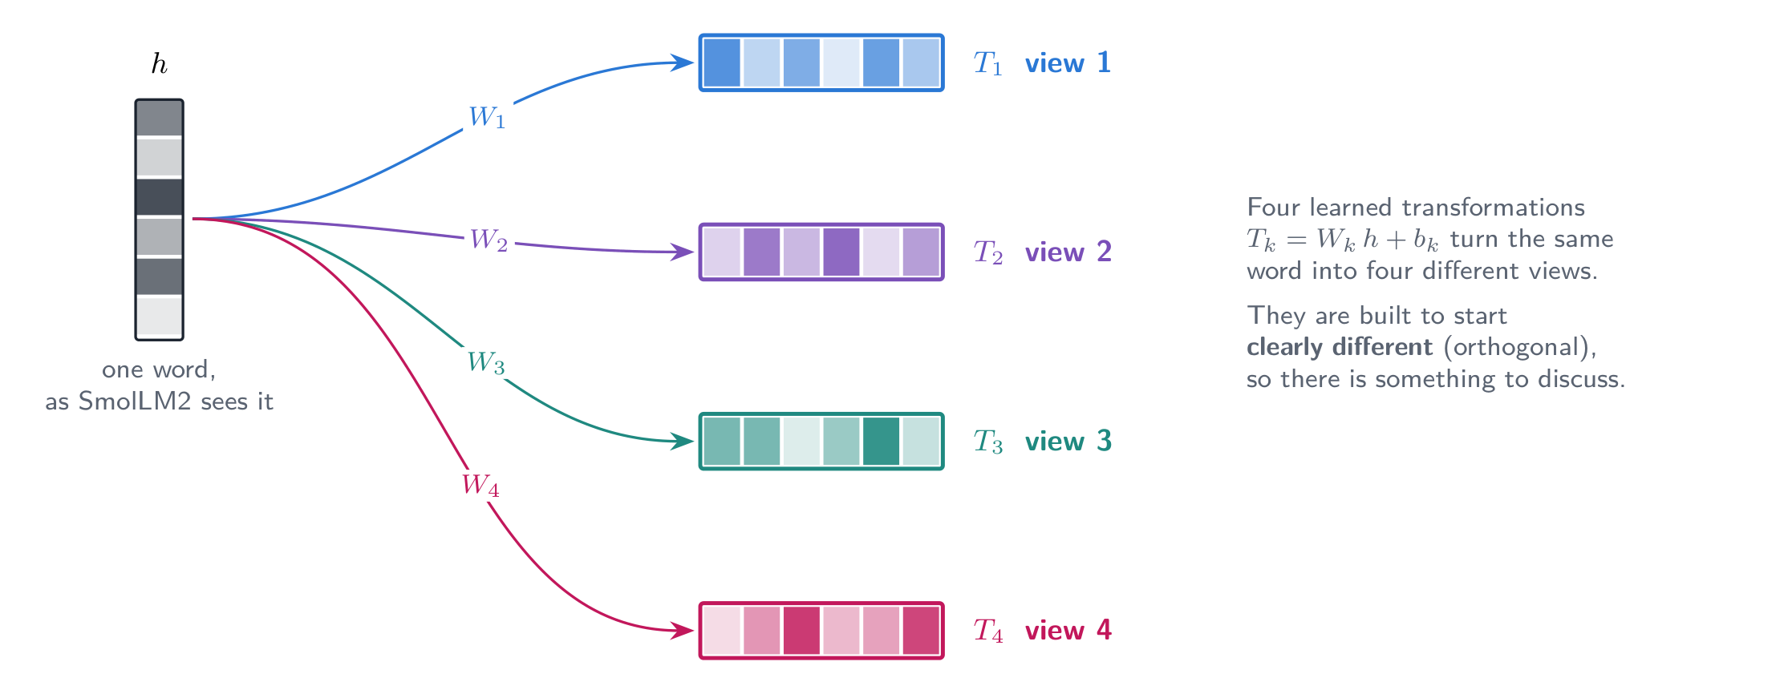
Step 1 · four viewpoints
What happens
The word's state h is turned into 4 versions by 4 learned transformations
Like 4 reviewers who each focus on something different
Built to start clearly different — identical reviewers would have nothing to discuss
Notes:
Formula: T_k = W_k h + b_k. The four matrices start mutually orthogonal with gains spread from 0.8 to 1.25. 1.33 million parameters.

Slide 7
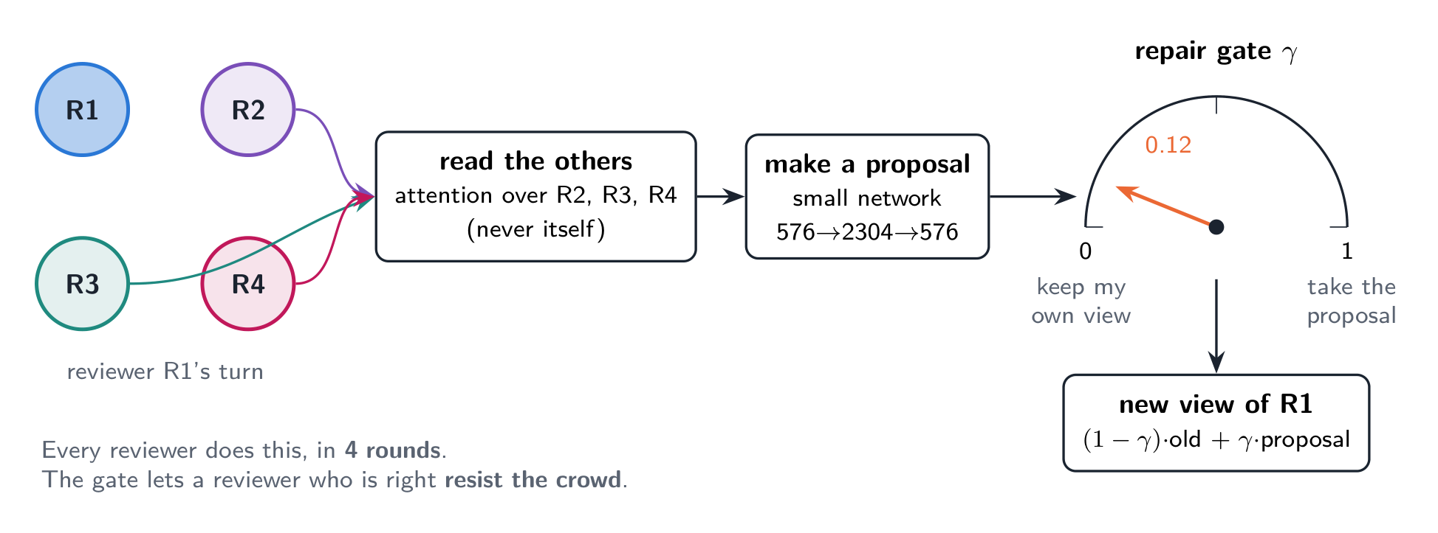
Step 2 · four rounds of discussion
In every round, each reviewer
reads what the other 3 think (never itself)
makes a proposal for its new view
decides with a dial (repair gate) how much to accept: 0 = keep own view, 1 = take the proposal
The dial starts cautious (0.12), so a reviewer who is right can resist the crowd
Notes:
Each round has its own weights, 4.32 million parameters per round. The reading is attention across the four trajectories of the same word, never across words.

Slide 8
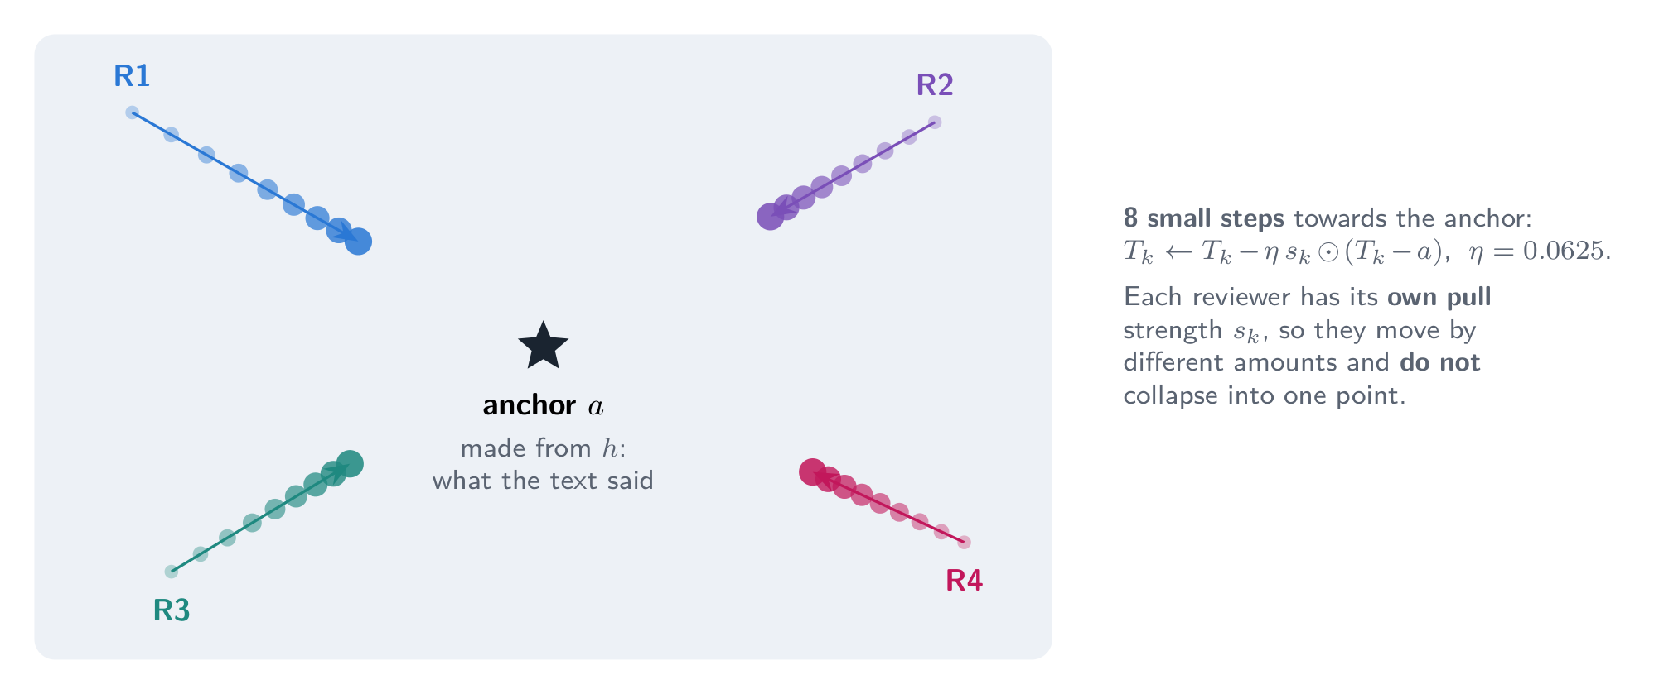
Step 3 · staying grounded
The moderator
A discussion can drift away from the facts
An anchor is computed from the original state h: “what the text said”
8 small steps pull every reviewer towards it
Each has its own pull strength, so they stay apart
Notes:
Formula: T_k <- T_k - eta * s_k * (T_k - a), eta = 0.0625, a = W_a h. The anchor must come from outside the committee: pulling the reviewers towards their own average provably changes nothing.

Slide 9
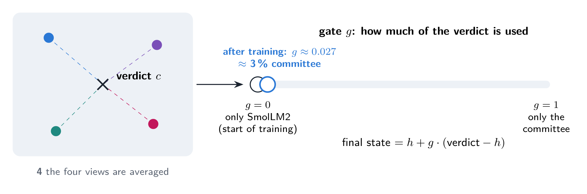
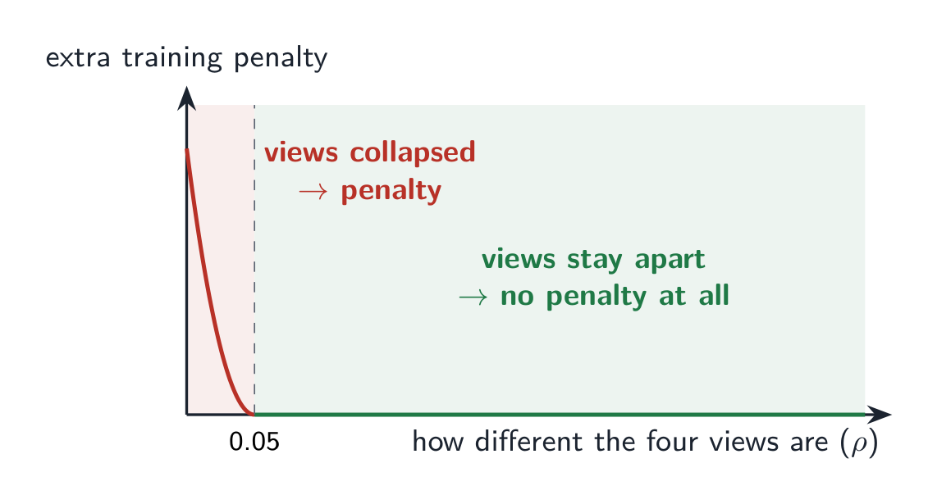
Step 4 · the verdict and the gate
Verdict and gate
The 4 views are averaged into one verdict
The gate g decides how much of the verdict is used
g starts at 0: the model starts as exactly SmolLM2
After training g ≈ 0.027: the committee changes ≈ 3 % of the state
Safety rule during training: if the four views became identical the committee would be pointless, so training adds a penalty only when they come too close.
Notes:
Final state = h + g (verdict - h). The gate is 576 numbers, one per channel. Spread floor: penalty lambda * max(0, 0.05 - rho)^2, rho = spread of the four views relative to the size of h.

Slide 10
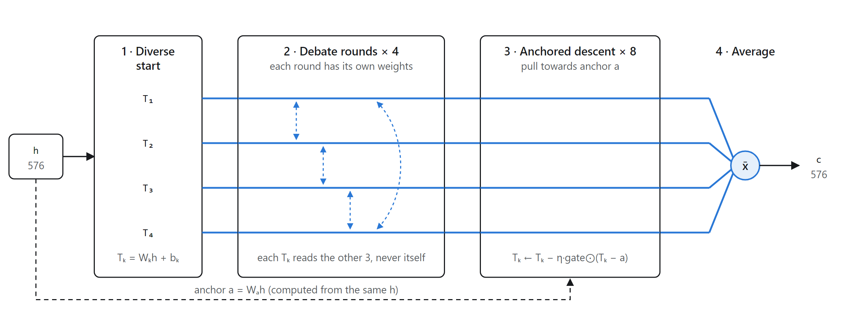
The same four steps, as wired in the code
Key property: L2 works per token on SmolLM2's final state only. It never reads the abstract itself — it can reshape what SmolLM2 already computed, not gather new evidence.
Notes:
Diverse start: 4 orthogonal projections. Debate: each trajectory attends to the other three, an MLP proposes an update, a repair gate decides how much to accept. Anchored descent: 8 steps towards an anchor computed from h. Average: plain mean. A spread-floor loss keeps the four apart. Later versions v3 and v4 let L2 read the text and sit inside the network; none was better.

Slide 11
Your question 3: the working hypothesis
1
Diversity
H
4 different views of the same state
Self-consistency and debate improve reasoning by producing several candidates, cross-checking and reconciling them — in text, at K× the cost.
We hypothesised that the same benefit can be obtained inside one forward pass, on hidden states: the consensus of K interacting hypotheses should depend more on the evidence and less on priors.
2
Error correction
hypotheses read and revise each other
3
Grounding
descent towards an evidence-based anchor
4
Aggregation
averaging reduces the variance
5
Honesty signal
agreement should predict correctness
Notes:
This answers your third question. Each numbered part matches one component of L2: diverse start, debate rounds, anchored descent, averaging, and the agreement signal. The hypothesis was written as falsifiable predictions, next slide.

Slide 12
Predictions of the hypothesis vs. what we measured
If H is true … | Test | Measured (L2 minus no L2)
P1 accuracy rises on yes- and no-questions | test 1: accuracy by true answer | yes +10.99*, no −11.83* | NOT MET
P2 the answer depends more on the abstract | test 2 (never trained on) | +0.17 old data; −1.07* evidence data | NOT MET
P3 the answer follows flipped evidence | test 3: 164 flipped conclusions | +3.25, +1.22, +1.02 — never starred | NOT MET
P4 L2 does the work at test time | switch L2 off | model leans on L2 but is no better | PARTLY
P5 agreement predicts correctness | AUROC vs own probability | 0.81 vs 0.906 (next word) | NOT MET
Rule fixed before the runs: L2 “reasons better” only if tests 2 and 3 both show a starred gain. A compute-matched study (Rauba et al. 2026) had already reported no reliable gain for latent refinement, so a negative result was planned for.
Notes:
P1 numbers are v5 versus baseline on the old data. P2 and P3 list old data, evidence data and pair loss where three numbers are given. P5 comes from v3c (T54): L2 confidence AUROC 0.81 against 0.906 for the model's own next-word probability; on PubMedQA 0.52-0.53 against 0.60-0.62.

Slide 13
Your question 4: related work
Multi-path reasoning in text
Reasoning in latent space
Several streams in one network
Chain-of-thought, self-consistency, multi-agent debate, Mixture-of-Agents. A critique: debate rarely beats self-consistency at equal cost.
Coconut (continuous thoughts), Tiny Recursive Models.
Multi-Stream Transformers (closest ancestor), Talking-Heads Attention, Dual-Stream Transformer (29 M).
L2 moves this pattern into hidden states
Rauba et al. 2026: no reliable gain — matches our result
L2: full-width streams that cross-read
Energy-based refinement
Calibration and label bias
Counterfactual data
Energy Transformer: output by descending an energy. Agreement losses collapse diversity.
Neural networks are miscalibrated (Guo 2017); LMs over-predict frequent answers (Zhao 2021).
Minimally edited examples with flipped labels (Kaushik 2020); PairCFR pair loss (2024).
→ anchored descent and the spread floor
→ explains the “yes” preference
→ basis of T61 and T63
Notes:
This answers your fourth question; the full section with references is section 3 of the report. Claimed contribution: the combination of multi-hypothesis debate, anchored gated descent and the collapse floor in one module after a pretrained backbone, not any single ingredient.

Slide 14
How we test reasoning, not only accuracy
1
Where the gain comes from
2
Uses the abstract
3
Follows flipped evidence
Accuracy split by the true answer and the share of each answer.
% right with the abstract minus % right without it. Never trained on.
The conclusion as only context, as written and with one negation flipped (164 questions).
Reasoning: gains on yes and no questions
Reasoning: a starred increase
Reasoning: more “right on both”
Plus: PubMedQA (1,000), MedMCQA (4,183), MedQA (1,273) by option likelihood; perplexity and generated text; L2 switched off at test time. Every L2 model is compared with the same model without L2 on the same data, three seeds, paired bootstrap 95 % CI.
Notes:
From T61 on, flipped conclusions are part of the training data on other questions, so test 3 measures training success there; test 2 stays unseen.

Slide 15
Accuracy: the data helped, L2 did not
+2.07*
old data: a shift towards “yes” (next slides)
−0.10
evidence data: L2 adds nothing
+4.27*
pair loss: baseline damaged; unchanged with L2 switched off
+3.30*
evidence data vs old baseline, without any add-on
Notes:
First three numbers: L2 minus SmolLM2 alone on the same data. Last: evbase minus the old baseline. MedMCQA and MedQA never move by more than 0.5 points; they stay near chance for a 135M model.

Slide 16
Reasoning tests: no effect of L2
The evidence data lifts test 3 from 27 % to ≈ 80 % for both arms (it is trained from T61 on). The pair loss makes SmolLM2 alone stop using the abstract (0.6).
Notes:
L2 minus no L2, test 2: +0.17, -1.07*, +4.43* (the last against a damaged baseline). Test 3: +3.25, +1.22, +1.02, never starred.

Slide 17
Your question 2: the “yes” boost is calibration
The whole gain is a threshold shift
0.552 × (+10.99) + 0.338 × (−11.83)
= +6.07 − 4.00 = +2.07 points
66.1 → 65.7
balanced accuracy (yes/no weighted equally)
+1.90*
same gain without the abstract — not from evidence
+2.77*
“yes” shift when L2 is dropped 30 % of training (v5drop), gain only +0.97*
Notes:
This answers your second question. The benchmark has 552 yes, 338 no and 110 maybe questions; maybe is never answered correctly by any model. Moving the yes/no boundary towards yes trades no-accuracy for yes-accuracy, and because yes is 1.63 times more frequent, accuracy rises without any better use of the evidence.

Slide 18
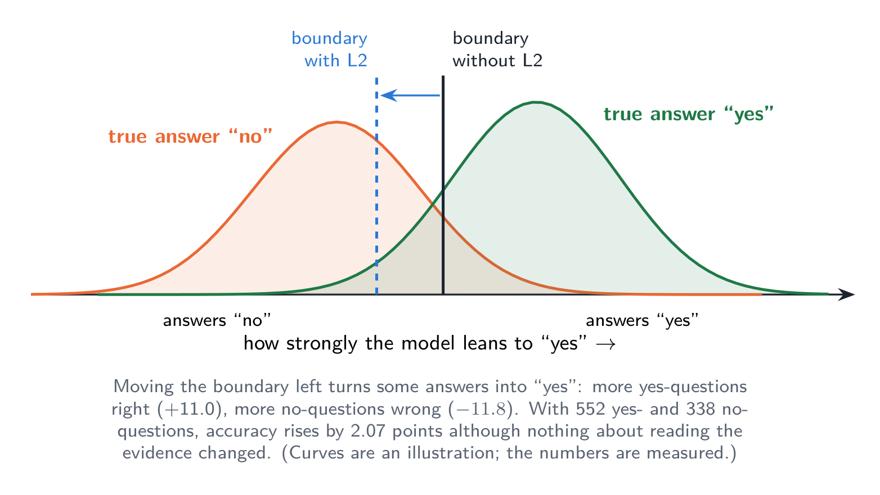
Why accuracy rose without better reasoning
Measured (v5 vs baseline)
Boundary moved towards “yes”: 60.8 % yes answers instead of 49.7 %
Yes-questions right: +10.99*
No-questions wrong: 11.83* more
552 yes vs 338 no questions → net +2.07, with no better use of the evidence
Notes:
The curves are an illustration of the mechanism; all numbers are measured on the 1,000 PubMedQA questions over three seeds.

Slide 19
Why the “yes” preference occurred
1
The decision was never trained
Proposed check (no training)
The target was the conclusion text, not the yes/no word the benchmark scores. Nothing anchors the threshold.
Fit one yes/no log-odds offset per model on half of the 1,000 questions, score the other half, swap (contextual calibration).
If v5's advantage disappears once both models are calibrated, the +2.07 was purely calibration.
From now on: report balanced accuracy next to accuracy.
2
The training text is affirmative
92.8 % of labels are “yes”; fitting that text raises the probability of “yes” (majority-label bias).
3
L2's position invites a prior shift
Right before the output layer, a global shift of the output distribution is the cheapest way for L2 to lower the loss.
4
Training the decision removes it
With balanced evidence data, ev5 and evbase say “yes” equally often (39.7 vs 40.8 %) and L2's gain vanishes.
Notes:
Points 1 to 3 are our explanation, to discuss. Point 4 is measured. The evidence-trained models are miscalibrated the other way (about 40 percent yes against a true 55.2), because training was 50/50 and the benchmark is not.

Slide 20
Your question 1: only one backbone so far
All L2 results use SmolLM2-135M. At this size MedMCQA and MedQA stay near chance, so only PubMedQA can show an effect — a negative result here does not rule out every scale.
Backbone (same family) | Hidden size | L2 parameters | Share
SmolLM2-135M (used) | 576 | 19.6 M | 14.6 %
SmolLM2-360M | 960 | 54.4 M | ≈ 15 %
SmolLM2-1.7B | 2,048 | 247.5 M | ≈ 15 %
1
Repeat only the decisive comparison on SmolLM2-360M: evidence data, with vs. without L2, three seeds, all tests + calibration check
2
Go to SmolLM2-1.7B only if 360M shows a signal
L2 size = 59 d² + 35 d for hidden size d
3
7 B and larger need LoRA, which collapsed to one answer in T60 — a separate study
Notes:
This answers your first question. Same family keeps tokenizer and recipe fixed, so only scale changes. Arguments both ways: a larger model encodes more evidence for L2 to work with and is off chance on the exam sets; but if L2 only learns a prior shift, a better-calibrated model may need it even less.

Slide 21
Text and L2-off: small numbers, no new ability
L2 minus alone, same data | Old data | Evidence
MedQuAD perplexity | −0.16 %* | −0.15 %*
Explanation perplexity | −1.78 %* | −1.46 %*
Generated explanation ROUGE-L | +0.05 | +0.01
Explanation names the right answer | −0.67 | −0.83
L2 predicts reference text slightly better, but writes no better text.
ev5 leans on L2 yet is no better than the model trained without it; pair5 barely uses L2.
Notes:
SmolLM2 hands part of its own work to L2 instead of L2 adding something new. pair5's lead over pairbase sits in SmolLM2's own weights: training next to L2 protected the backbone from the pair loss, but L2 does not compute the answer.

Slide 22
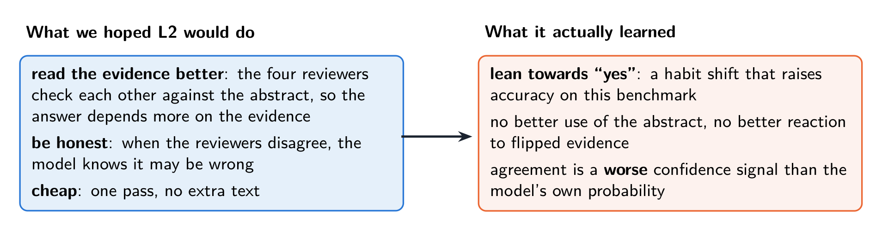
What we hoped L2 would do, and what it learned
Most likely reason: L2 sits at the very end and only sees the summary SmolLM2 already made. It cannot find new evidence; the easiest thing to learn was to lean towards the answer that is 92.8 % of the training data.
Notes:
This summarises the whole project in one picture: the hope was evidence use and an honesty signal at low cost; what L2 learned was a habit shift towards yes.

Slide 23
Verdict and what the thesis can claim
L2: not useful, not worth keeping
What the thesis can claim
Reasoning never shown; the pre-registered rule was never met
Its only accuracy gain was a calibration shift
Perplexity −<2 %, generated text no better
+19.6 M parameters; the model leans on it without gaining
Data finding: training the decision on balanced and flipped evidence gives +3.3* PubMedQA and 27 % → 80 % on flipped evidence
Evaluation method: by-answer split, abstract test, flip test and L2-off test expose a preference as such
A careful negative result for L2, with calibration analysis
Notes:
The negative result is against an architecture-matched baseline: the L2 arm has more parameters and more compute per token, which favours L2 and therefore strengthens the negative conclusion.

Slide 24
Decisions for today
Thesis framing
1
Report L2 as a careful negative result, with the data finding, the test method and the calibration analysis as the contributions?
Next step
2
A: larger backbone (360M) B: calibration check C: start writing D: new design — 4 candidate answers, L2 picks the best
Final model
3
Evidence-data recipe without L2 (evbase): same score as ev5, 19.6 M fewer parameters.
Notes:
The full written answers to your four comments are section 13 of the report; the report PDF has all numbers, the related work and the references.

Slide 25
References for the related work
Wei et al. 2022 — Chain-of-Thought Prompting. NeurIPS
Wang et al. 2023 — Self-Consistency. ICLR
Du et al. 2023 — Multiagent Debate. arXiv:2305.14325
Liang et al. 2023 — Divergent Thinking via Debate. arXiv:2305.19118
Wang et al. 2025 — Mixture-of-Agents. ICLR
Smit et al. 2024 — Should We Be Going MAD? ICML
Hao et al. 2024 — Coconut: Reasoning in a Continuous Latent Space. arXiv:2412.06769
Jolicoeur-Martineau 2025 — Tiny Recursive Models. arXiv:2510.04871
Rauba, Fanconi, van der Schaar 2026 — Tiny Autoregressive Recursive Models. arXiv:2603.08082
Burtsev & Rumshisky 2021 — Multi-Stream Transformers. arXiv:2107.10342
Shazeer et al. 2020 — Talking-Heads Attention. arXiv:2003.02436
Kerce & Fox 2026 — Dual-Stream Transformer. arXiv:2603.07461
Hoover et al. 2023 — Energy Transformer. NeurIPS
Guo et al. 2017 — On Calibration of Modern Neural Networks. ICML
Zhao et al. 2021 — Calibrate Before Use. ICML
Kaushik et al. 2020 — Counterfactually-Augmented Data. ICLR
Qiu et al. 2024 — PairCFR. ACL
Allal et al. 2025 — SmolLM2. arXiv:2502.02737
Notes:
Full bibliographic entries, including the medical benchmarks, are in the reference list of the report.

