Slide 1
MapReduce: simplified data processing on large clusters
Dean, Jeffrey, and Sanjay Ghemawat
Communications of the ACM 51, no. 1 (2008): 107-113
Pig latin: a not-so-foreign language for data processing
Olston, Christopher, Benjamin Reed, Utkarsh Srivastava, Ravi Kumar, and Andrew Tomkins
In Proceedings of the 2008 ACM SIGMOD international conference on Management of data, pp. 1099-1110. ACM, 2008.
Presentation 2
John Berlin
October 6, 2016
Old Dominion University
Introduction to Information Retrieval
CS734/834

Slide 2

In The Beginning There Was Big Data
What Is It?
  Crawled Documents
  Log Files
  Databases
How Big Is Big Data?
  More Data Than A Single Computer Can Handle
  > 1TB
How Do We Process It?
  100 Computers with 1/100 Of The Data?
  Distribute It All Over The Network?
  How Are We Going To Coordinate Our Machines?
  Do Our Programmers Need To Learn A New
  Language/Tool For This?
“Data: My programming may be inadequate to the task.
Counselor Troi: We're all more than the sum of our parts, Data. You'll have to be more than the sum of your programming.”
In Theory, TNG
https://twitter.com/wtrsld/status/424272437929205760

Slide 3
MapReduce: Simplified Data Processing on Large Clusters

Slide 4
Dean & Ghemawat’s Contribution
Created A Framework That Abstracted Away The Complexity From
  Parallelization Of The Computation
  Distribution Of The Data
“Devised” A Programming Model To Harness The Framework
  Write Smaller Code Modules → Quick Big Data Processing

Slide 5
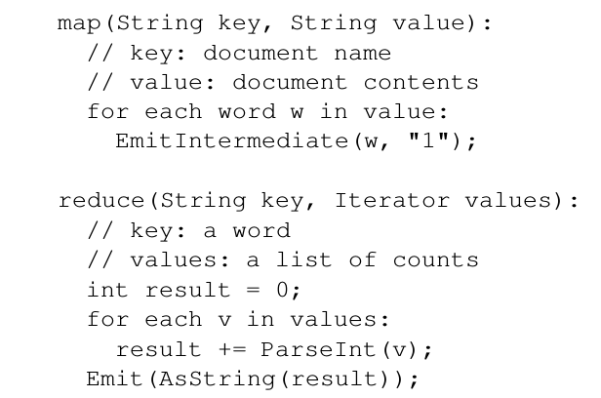
The MapReduce Programming Model
Computation By Two Functions
  Map: (K₁,V₁) → List(K₂,V₂)
  Reduce: (K_{2,}List(V₂)) → List(K₃,V₃)
Functions Bound By A Contract
  Take A Single Input Format
  Produce Single Output Format
Need Only These Two Functions
To Start Map And Reducing
Word Count Pseudo Code section 2.1, p2

Slide 6
MapReduce Is Really Functional Programming λ
Pure Functions
  Contract Ensures This
  Input Is Not Modified
  Produces Same Output
  Given The Same Input
Higher Order Functions
  Output Of One Function
  Is The Input Of The Next
  Composable: Reduce(Map(Reduce(Map(K₁,V₁))))
  Reduce(Map(Map(K₁,V₁)))
Map Only Transforms
  Given Input Produces Zero Or More K,V Pairs
Reduce Only Accumulates
  Combines A List Of V For a Given K

Slide 7
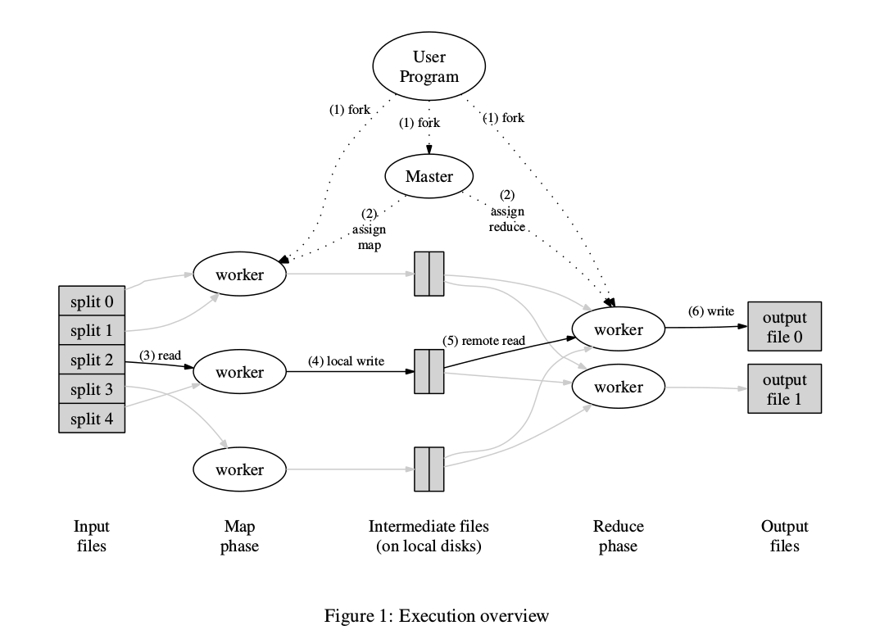
MapReduce Framework
Input Split Into M Splits
  Split Size Typically 16-64MB
Map Function Distributed
  Splits M = Number Of Mappers
Reduce Function Distributed
  Distribution Based On User Configured Number R
  Feed Data Based On Partitioning
  Partition Function Typically: Hash(key) Mod R
Figure page 3

Slide 8
Behind The Scenes Framework Execution
Data Lives On The Worker Machines
  Split Up On Start Of A MR Job
Map Tasks
  Master Schedules Map Tasks
  On End Are Rescheduled If Machine Still
  Has Unprocessed Data
  On Failure Master Starts Another On Same Machine
  Or Machine Close To The Data i.e Same Local Network Switch
Reduce Tasks
  Constantly Work As Input Is Sorted And Uniquely Keyed
  Reads Data From Mapper File System Via Network
  Writes To Final Output Destination

Slide 9
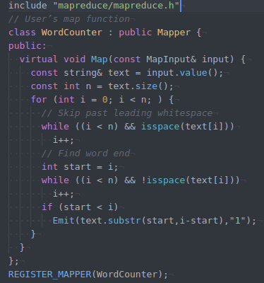
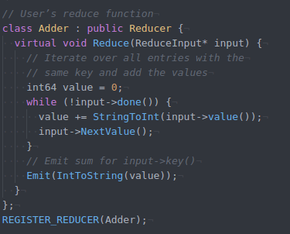
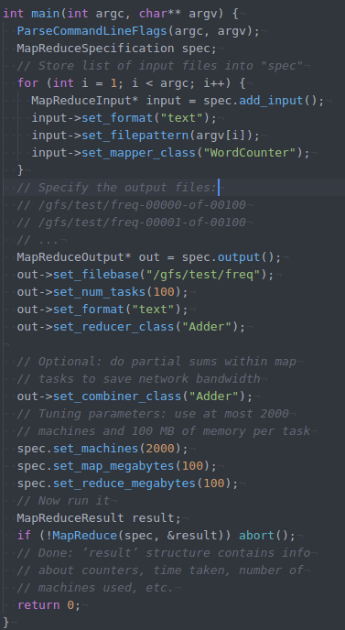
What Does A MapReduce Program Look Like
Work Frequency Appendix A Page 13

Slide 10
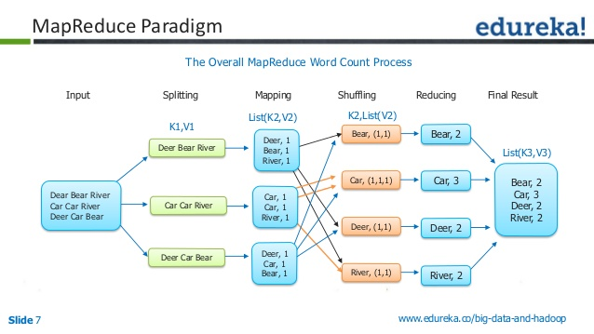
In Action
http://image.slidesharecdn.com/hadoopmr-150613152227-lva1-app6891/95/xml-parsing-with-map-reduce-7-638.jpg?cb=1434209024

Slide 11

Google Has Solved Our Problems Again
MapReduce Requires Little Knowledge Of:
  Parallel Programming
  Distributed Systems
MapReduces Framework
  Scales Well On Large Clusters
  Easily Adoptable To Many Real World Problem
BUT Not Open Source
The Google Viewpoint On It
  We Designed It, Built It For Ourselves (In C++, For GFS)
  We Told You How To Do It
  Now Build it Yourself.
http://www.pakpassion.net/ppforum/attachment.php?attachmentid=55146&d=1425986571

Slide 12
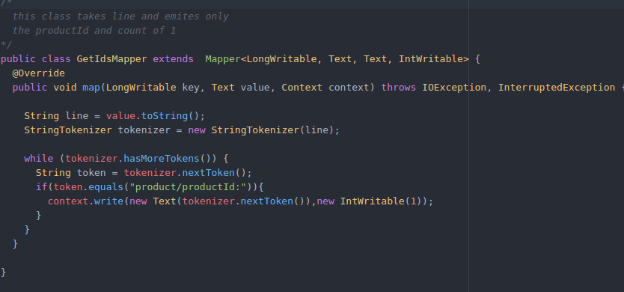
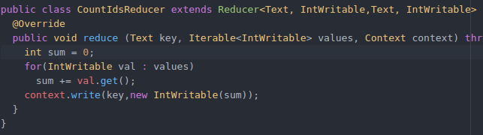
Some Background For The Next Paper: Hadoop
Communities Java Implementation Of Googles MapReduce
  Good Guy Apache
Full Implementation
  Hadoop File System
  Programming Model
  Executor
Code I Wrote For CS495 →
Spring 2014

Slide 13
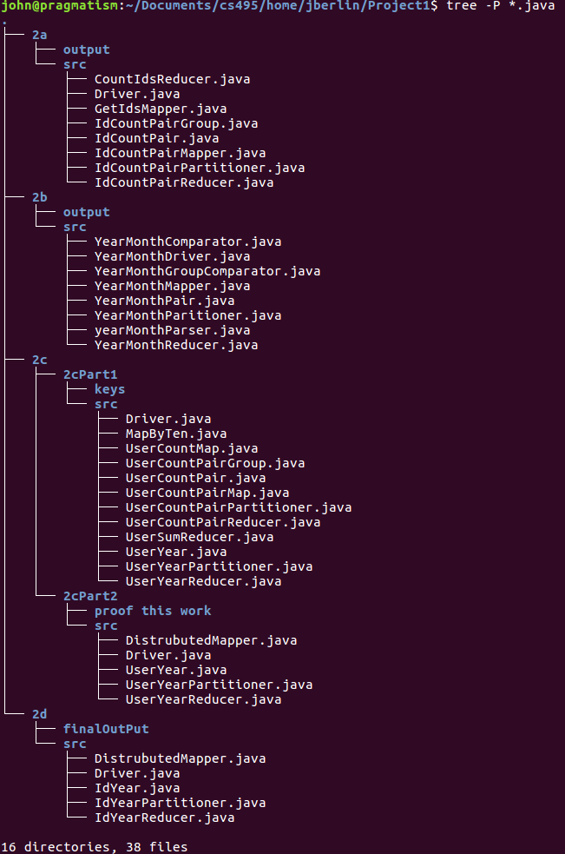
But Not Everyone Wants To Use Java
Making Hadoop Do The Dew Can Get Tricky
Must Make Your Types
  Only Primitive Types Supported i.e IntWritable
  Gotta Write Your Own Complex Key Value Types
No Easy Way To Do
  Map/Reduce Chaining
  Secondary Sorting
Projects Are Large →

Slide 14
Pig Latin: A Not-So-Foreign Language for Data Processing

Slide 15
Olston, Reed, Srrivastavas, Kumar, Tomkins Contribution
Created A Data Processing Environment Back By Hadoop
Made Processing Big Data SQL Like
Easier Nonstandard Operations On The Data

Slide 16

Motivation Behind Pig
Addresses The Short Comings Of Hadoop
Joins, Multi-Stage Processing Was A Pain
Conditional Selection
Custom Code Everywhere
Developers Understand SQL Like Expression Of The Computation Better Than Java
https://www.dynadot.com/community/image?image_id=1169

Slide 17
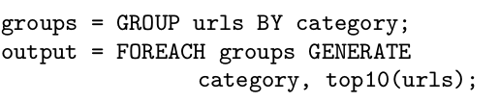
Pig A Dataflow Language
Nested Data Model
  term_info: (termId, termString), position: (termId,documentId,pos)
  Much Like Databases
  Captures The Flow Of The Data
UDFs: User Defined Functions
  Express The Computation Not Implement It
Example Two p3

Slide 18

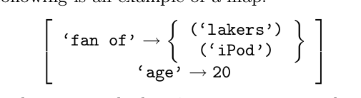
Pig’s Data Model
Atom: Simple Atomic Value Such As A String, “John”
Tuple: Sequence Of Fields Of Any Datatype, (“John”,”Berlin”)
Bag: Collection Of Tuples
Map: Collection Of Data Items
Section 3.1, p 4

Slide 19



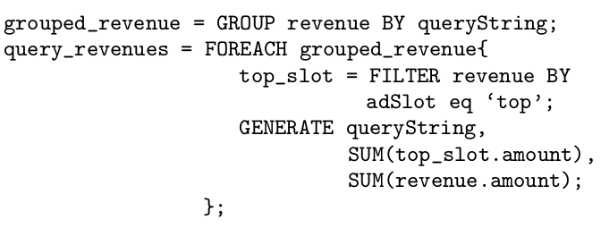
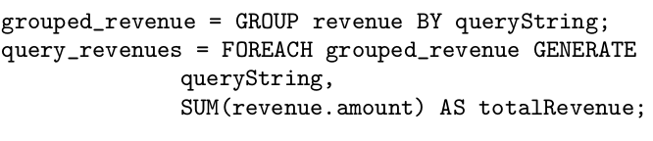

Pig Latin: Igspay Omputationcay Anguagelay
Examples Of How Pig Latin Is Used To Do
Map Reduce Operations.
Section 3.3-3.7, p5-7

Slide 20
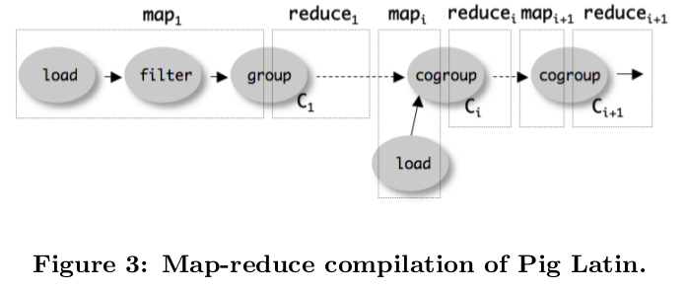
How Does This Work With Hadoop/MapReduce
Pig Latin Script → Logical Plan
  Data Model and Operations Have Their Own
  Each Step Is Checked For Validity
  Assignment Constructs Plan From Input
Logical Plan → MapReduce Compilation

Slide 21
Conclusion
MapReduce Provided The Framework For
  Efficient Big Data Processing
  Programming Model To Do It
  Framework For Distributing The Computation
Pig
  Abstracted Away The Complexity Of The Computation
  Made It Easier To Write MapReduce Jobs

