Slide 1
Presentation 2
MapReduce: simplified data processing on large clusters Dean, Jeffrey, and Sanjay Ghemawat Communications of the ACM 51, no. 1 (2008): 107-113 Pig latin: a not-so-foreign language for data processing Olston, Christopher, Benjamin Reed, Utkarsh Srivastava, Ravi Kumar, and Andrew Tomkins In Proceedings of the 2008 ACM SIGMOD international conference on Management of data, pp. 1099-1110. ACM, 2008.
John Berlin
October 6, 2016
Old Dominion University
Introduction to Information Retrieval
CS734/834

Slide 2

In The Beginning There Was Big Data
What Is It?
Crawled Documents
Log Files
Databases
How Big Is Big Data?
More Data Than A Single Computer Can Handle
> 1TB
How Do We Process It?
100 Computers with 1/100 Of The Data?
Distribute It All Over The Network?
How Are We Going To Coordinate Our Machines?
Do Our Programmers Need To Learn A New
Language/Tool For This?
“Data: My programming may be inadequate to the task.
Counselor Troi: We're all more than the sum of our parts, Data. You'll have to be more than the sum of your programming.”
In Theory, TNG
https://twitter.com/wtrsld/status/424272437929205760

Slide 3
MapReduce: Simplified Data Processing on Large Clusters

Slide 4
Dean & Ghemawat’s Contribution
Created A Framework That Abstracted Away The Complexity From
Parallelization Of The Computation
Distribution Of The Data
“Devised” A Programming Model To Harness The Framework
Write Smaller Code Modules → Quick Big Data Processing

Slide 5
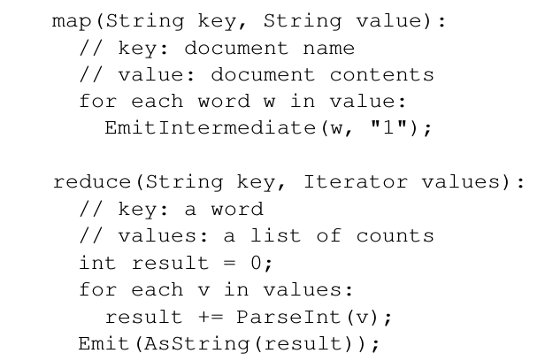
The MapReduce Programming Model
Computation By Two Functions
Map: (K₁,V₁) → List(K₂,V₂)
Reduce: (K_{2,}List(V₂)) → List(V₃)
Functions Bound By A Contract
Take A Single Input Format
Produce Single Output Format
Need Only These Two Functions
To Start Map And Reducing
Word Count Example section 2.1, p2

Slide 6
MapReduce Is Really Functional Programming λ
Pure Functions
Contract Ensures This
Input Is Not Modified
Produces Same Output
Given The Same Input
Higher Order Functions
Output Of One Function
Is The Input Of The Next
Composable: Reduce(Map(Reduce(Map(K₁,V₁))))
Reduce(Map(Map(K₁,V₁)))
Map Only Transforms
Given Input Produces Zero Or More K,V Pairs
Reduce Only Accumulates
Combines A List Of V For a Given K

Slide 7
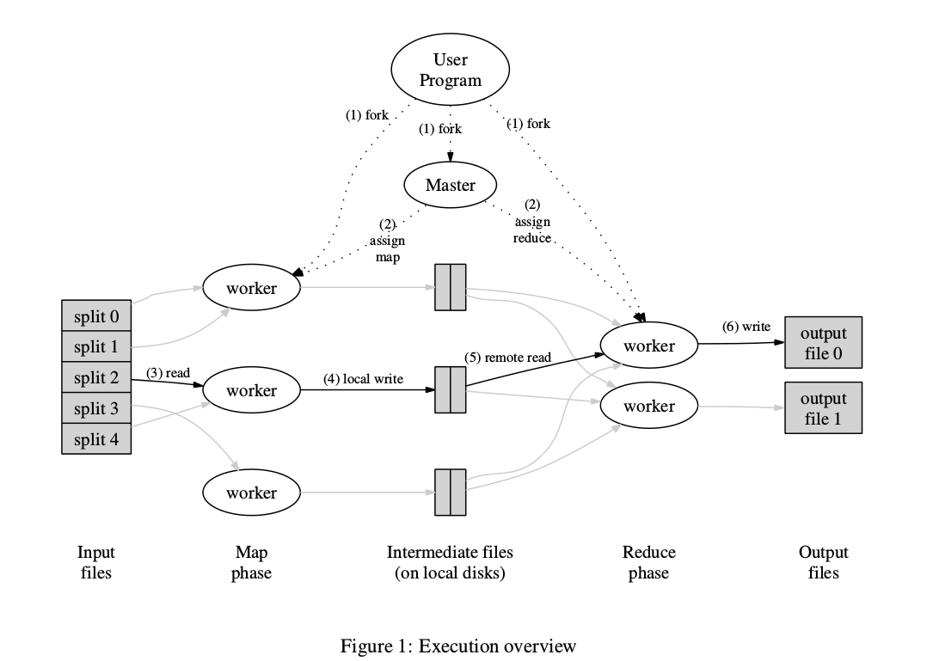
MapReduce Framework
Input Split Into M Splits
Split Size Typically 16-64MB
Map Function Distributed
Splits M = Number Of Mappers
Reduce Function Distributed
Distribution Based On User Configured Number R
Feed Data Based On Partitioning
Partition Function Typically: Hash(key) Mod R
Figure page 3

Slide 8
Behind The Scenes Framework Execution
Data Lives On The Worker Machines
Split Up On Start Of A MR Job
Map Tasks
Master Schedules Map Tasks
On End Are Rescheduled If Machine Still
Has Unprocessed Data
On Failure Master Starts Another On Same Machine
Or Machine Close To The Data i.e Same Local Network Switch
Reduce Tasks
Constantly Work As Input Is Sorted And Uniquely Keyed
Reads Data From Mapper File System Via Network
Writes To Final Output Destination

