Slide 1
Search Engines
Information Retrieval in Practice
Annotations by Michael L. Nelson
All slides ©Addison Wesley, 2008

Slide 2
Indexes
Indexes are data structures designed to make search faster
Text search has unique requirements, which leads to unique data structures
Most common data structure is inverted index
general name for a class of structures
“inverted” because documents are associated with words, rather than words with documents
similar to a concordance
https://en.wikipedia.org/wiki/Concordance_(publishing)

Slide 3
Indexes and Ranking
Indexes are designed to support search
faster response time, supports updates
Text search engines use a particular form of search: ranking
documents are retrieved in sorted order according to a score computing using the document representation, the query, and a ranking algorithm
What is a reasonable abstract model for ranking?
enables discussion of indexes without details of retrieval model

Slide 4
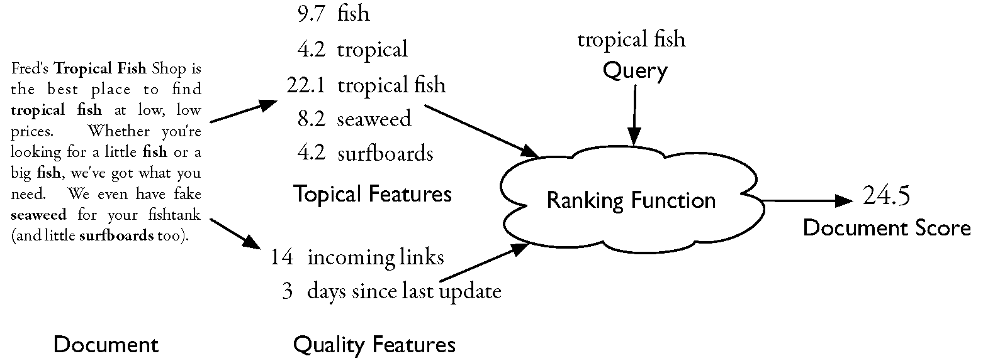
Abstract Model of Ranking

Slide 5
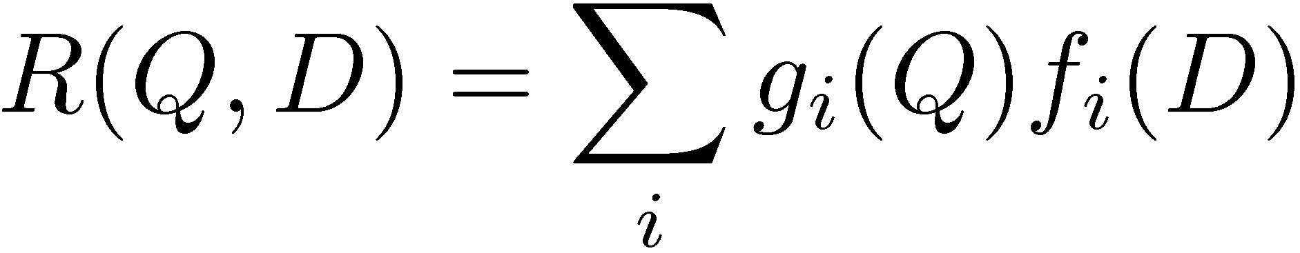
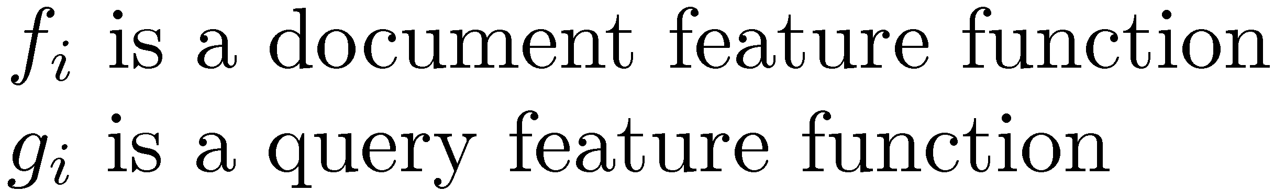
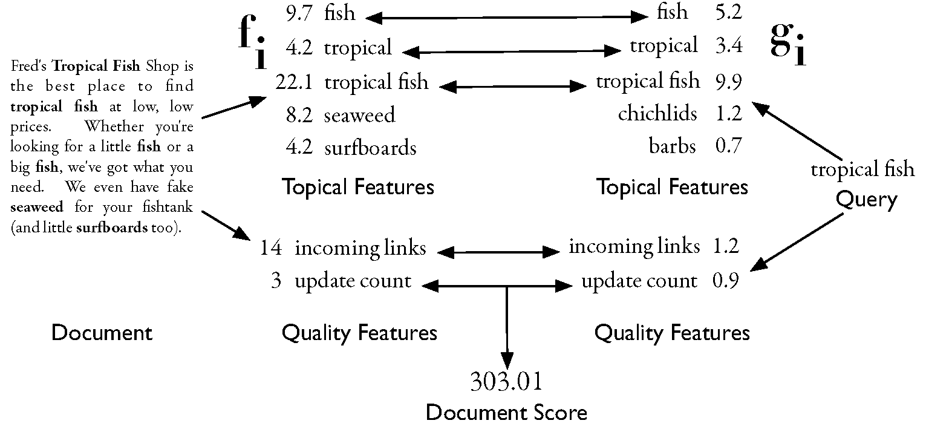
More Concrete Model

Slide 6
Inverted Index
Each index term is associated with an inverted list
Contains lists of documents, or lists of word occurrences in documents, and other information
Each entry is called a posting
The part of the posting that refers to a specific document or location is called a pointer
Each document in the collection is given a unique number
Lists are usually document-ordered (sorted by document number)

Slide 7
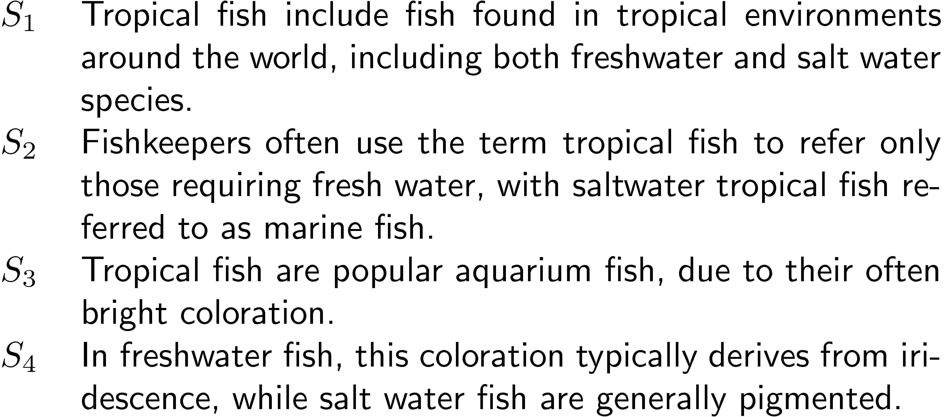
Example “Collection”

Slide 8
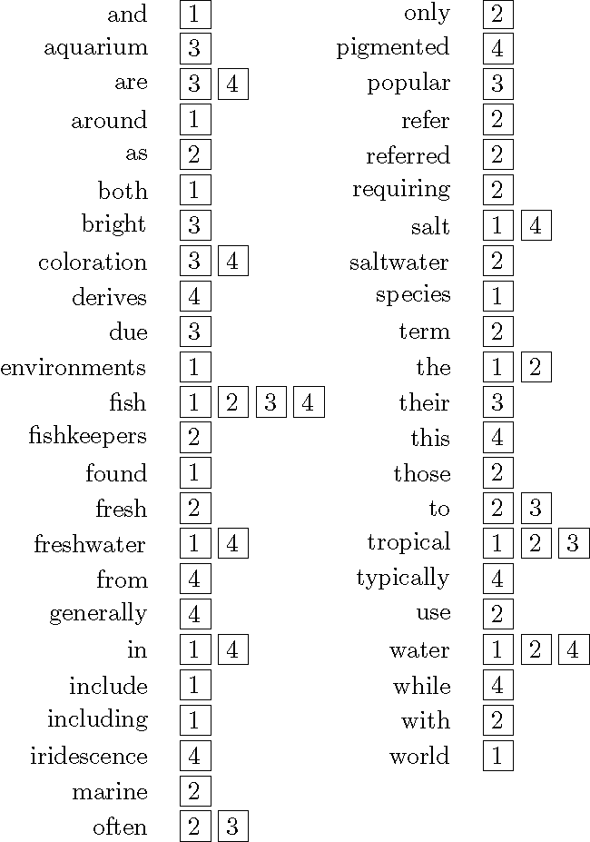
Simple Inverted Index

Slide 9
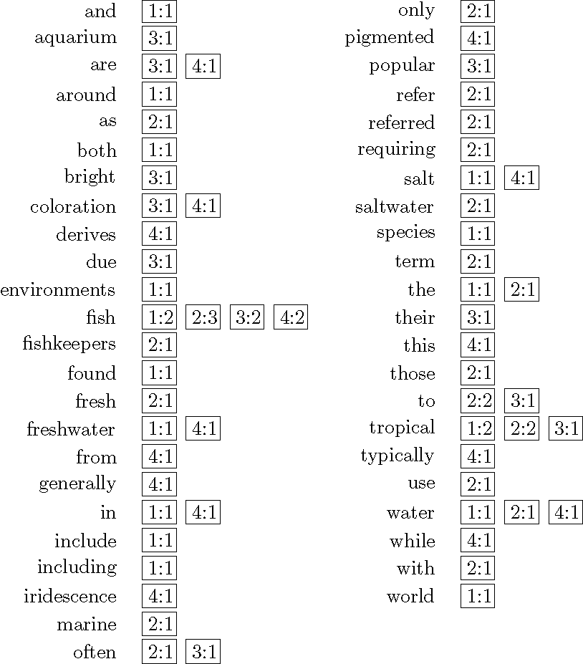
Inverted Index
with counts
supports better ranking algorithms

Slide 10
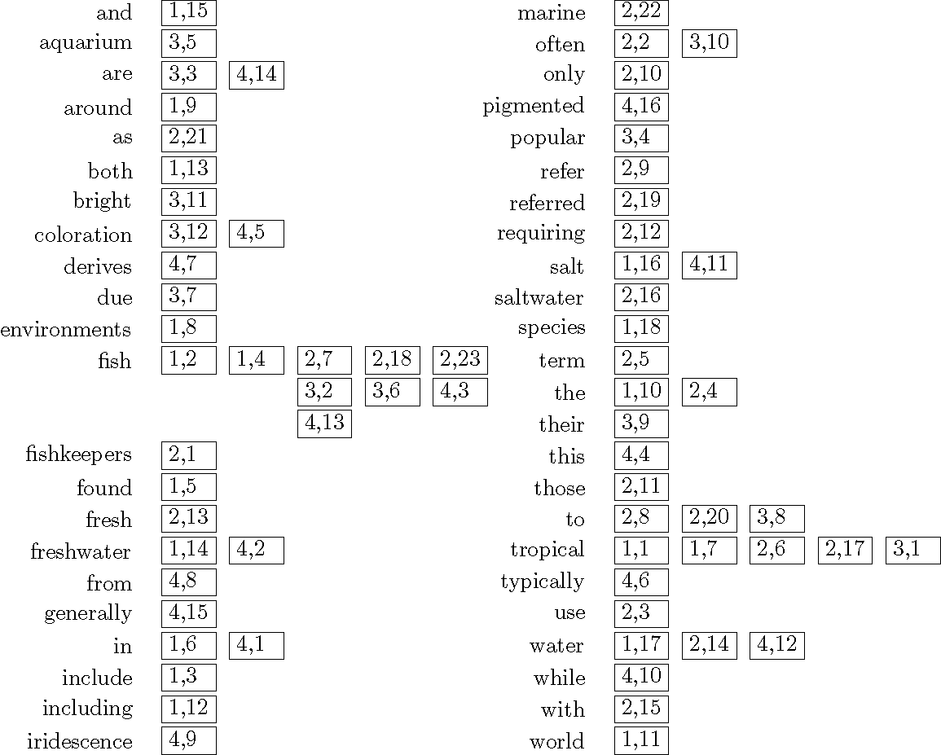
Inverted Index
with positions
supports
proximity matches

Slide 11
Proximity Matches
Matching phrases or words within a window
e.g., "tropical fish", or “find tropical within 5 words of fish”
Word positions in inverted lists make these types of query features efficient
e.g.,
a better example would include where both
"tropical" and "fish" occur, but are not adjacent

Slide 12
Fields and Extents
Document structure is useful in search
field restrictions
e.g., date, from:, etc.
some fields more important
e.g., title
Options:
separate inverted lists for each field type
add information about fields to postings
use extent lists

Slide 13
Extent Lists
An extent is a contiguous region of a document
represent extents using word positions
inverted list records all extents for a given field type
e.g.,
extent list

Slide 14
Other Issues
Precomputed scores in inverted list
e.g., list for “fish” [(1:3.6), (3:2.2)], where 3.6 is total feature value for document 1
improves speed but reduces flexibility
Score-ordered lists
query processing engine can focus only on the top part of each inverted list, where the highest-scoring documents are recorded
very efficient for single-word queries
note: proximity information is lost
in a score-ordered list

Slide 15
Compression
Inverted lists are very large
e.g., 25-50% of collection for TREC collections using Indri search engine
Much higher if n-grams are indexed
Compression of indexes saves disk and/or memory space
Typically have to decompress lists to use them
Best compression techniques have good compression ratios and are easy to decompress
Lossless compression – no information lost

Slide 16
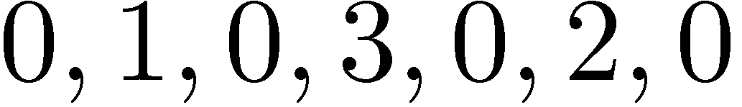
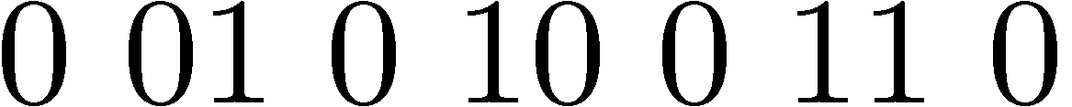
Compression
Basic idea: Common data elements use short codes while uncommon data elements use longer codes
Example: coding numbers
number sequence:
possible encoding:
encode 0 using a single 0:
only 10 bits, but...
14 bits

Slide 17
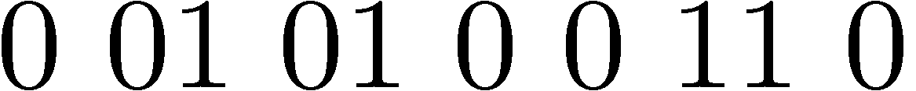
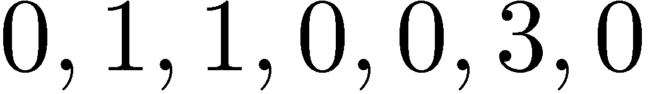
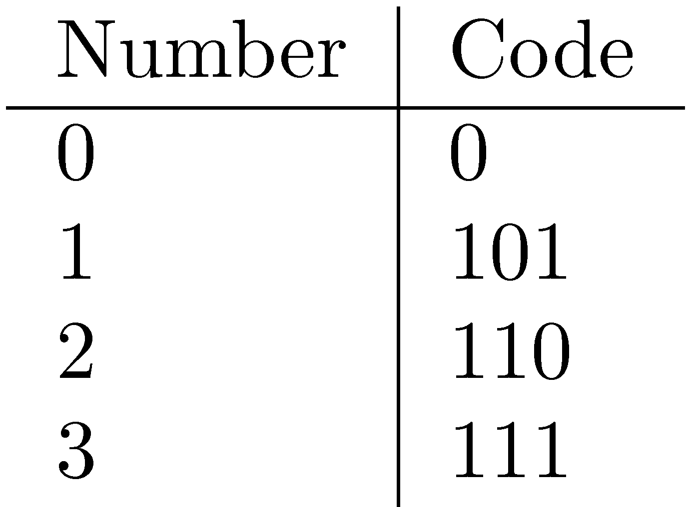
Compression Example
Ambiguous encoding – not clear how to decode
another decoding:
which represents:
use unambiguous code:
which gives:
13 bits

Slide 18
Delta Encoding
Word count data is good candidate for compression
many small numbers and few larger numbers
encode small numbers with small codes
Document numbers are less predictable
but differences between numbers in an ordered list are smaller and more predictable
Delta encoding:
encoding differences between document numbers (d-gaps)

Slide 19
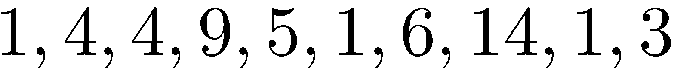
Delta Encoding
Inverted list (without counts)
Differences between adjacent numbers
Differences for a high-frequency word are easier to compress, e.g.,
Differences for a low-frequency word are large, e.g.,
d-gaps

Slide 20
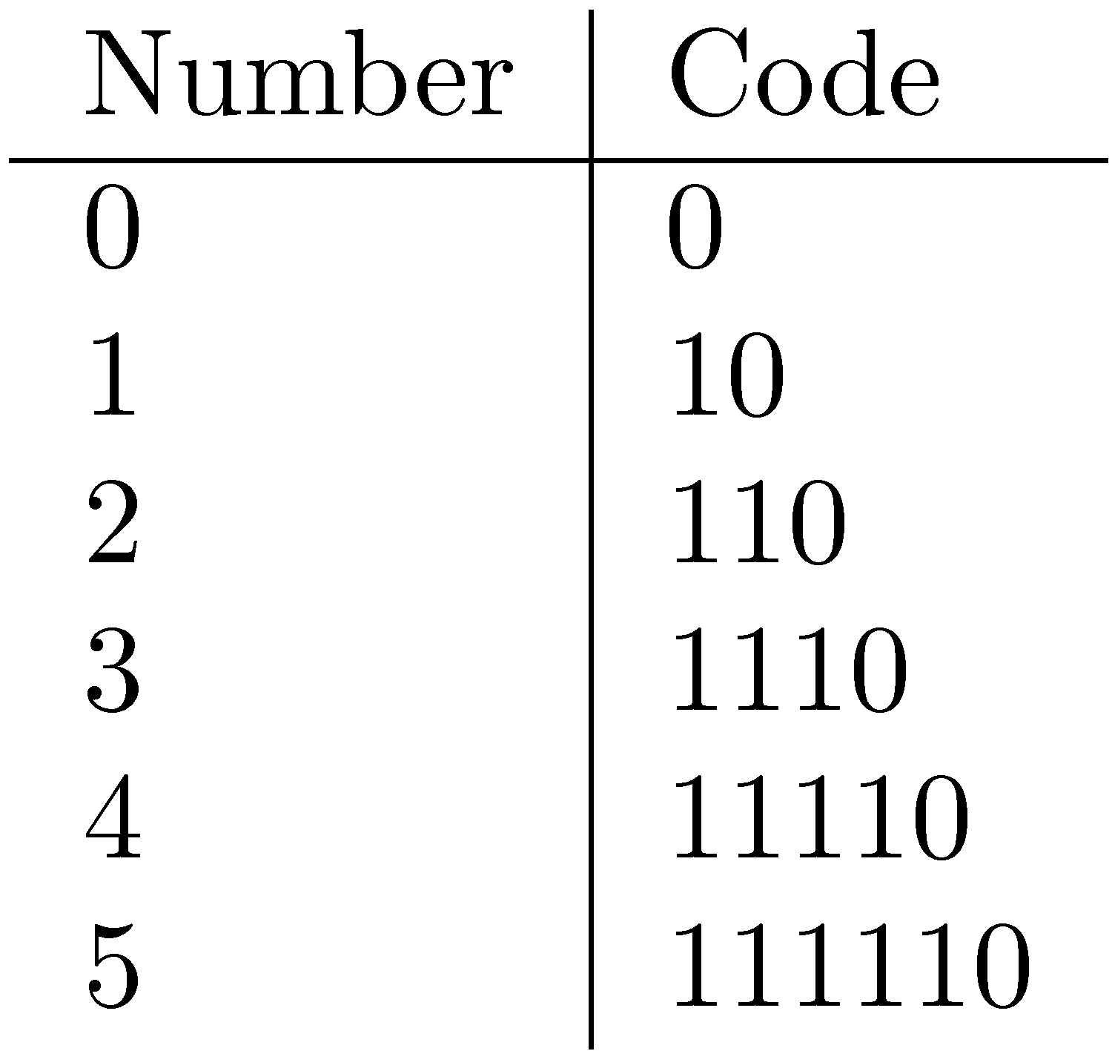
Bit-Aligned Codes
Breaks between encoded numbers can occur after any bit position
Unary code
Encode k by k 1s followed by 0
0 at end makes code unambiguous

Slide 21
Unary and Binary Codes
Unary is very efficient for small numbers such as 0 and 1, but quickly becomes very expensive
1023 can be represented in 10 binary bits, but requires 1024 bits in unary
Binary is more efficient for large numbers, but it may be ambiguous

Slide 22
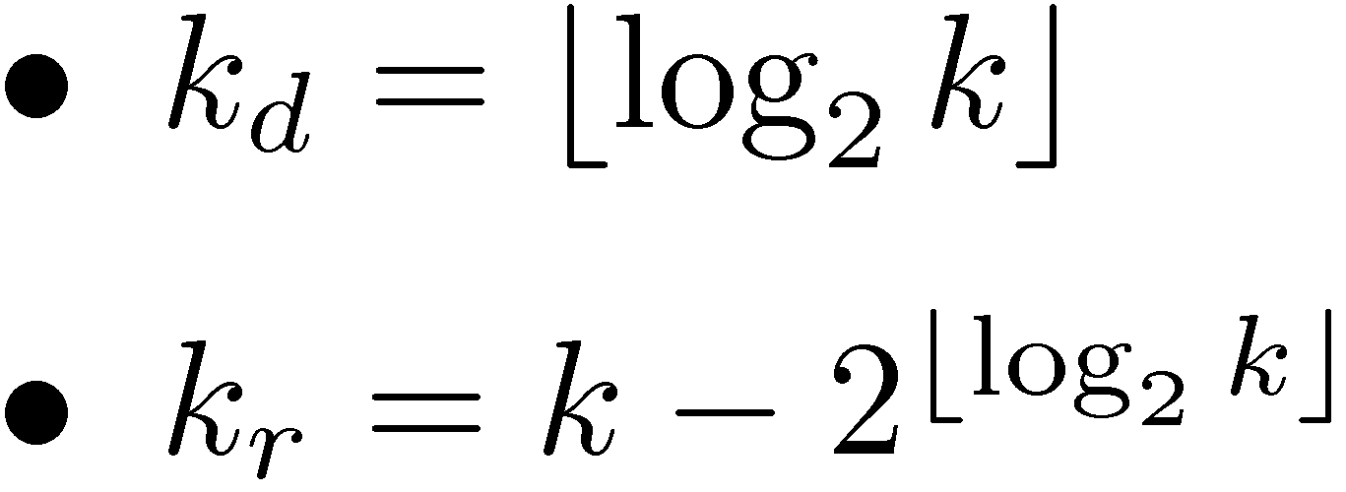
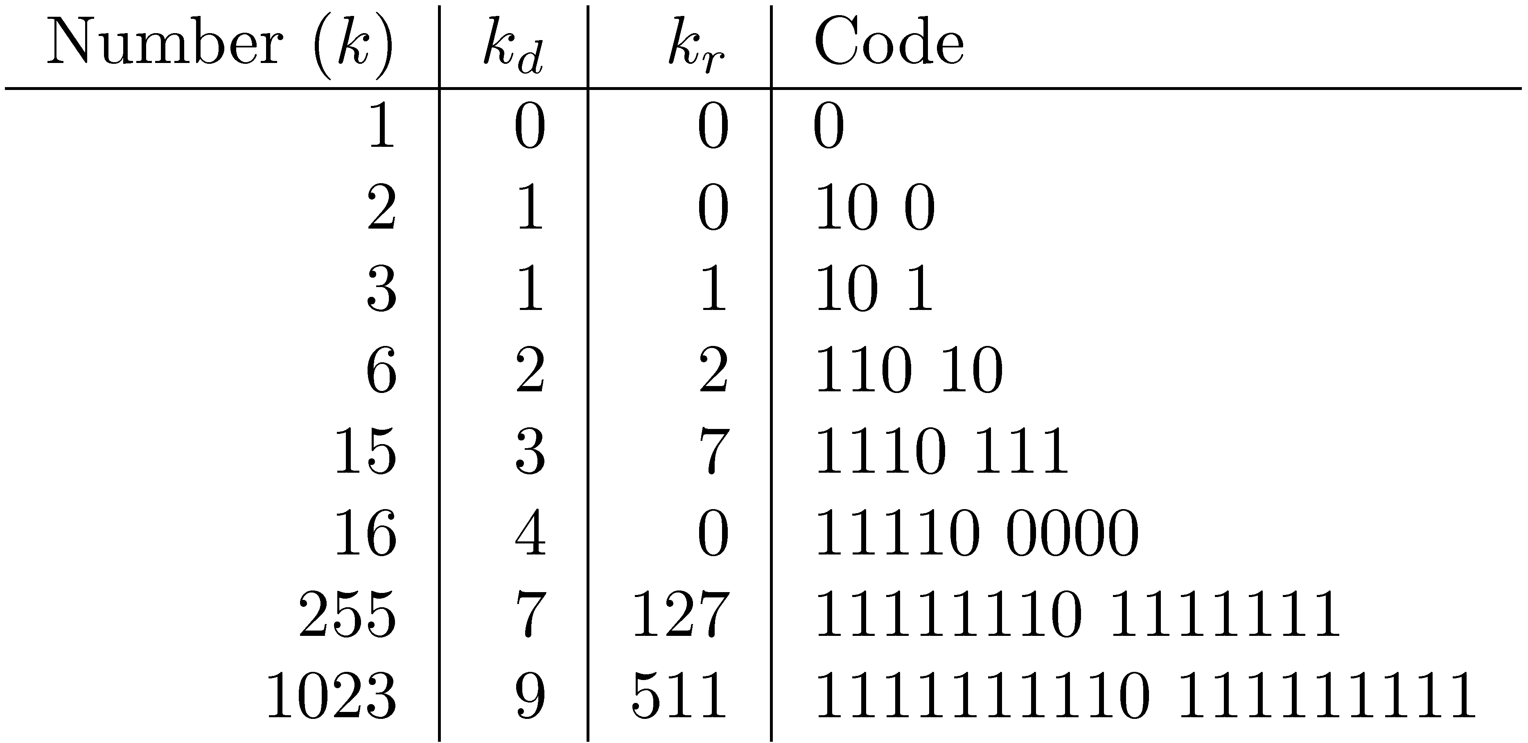
Elias-γ Code
To encode a number k, compute
k_{d} is number of binary digits, encoded in unary
<# of binary digits needed (in unary)> 0 <binary w/ leftmost 1 truncated>

Slide 23
Elias-δ Code
Elias-γ code uses no more bits than unary, many fewer for k > 2
1023 takes 19 bits instead of 1024 bits using unary
In general, takes 2⌊log₂k⌋+1 bits
To improve coding of large numbers, use Elias-δ code
Instead of encoding k_{d} in unary, we encode k_{d} + 1 using Elias-γ
Takes approximately 2 log₂ log₂ k + log₂ k bits

Slide 24
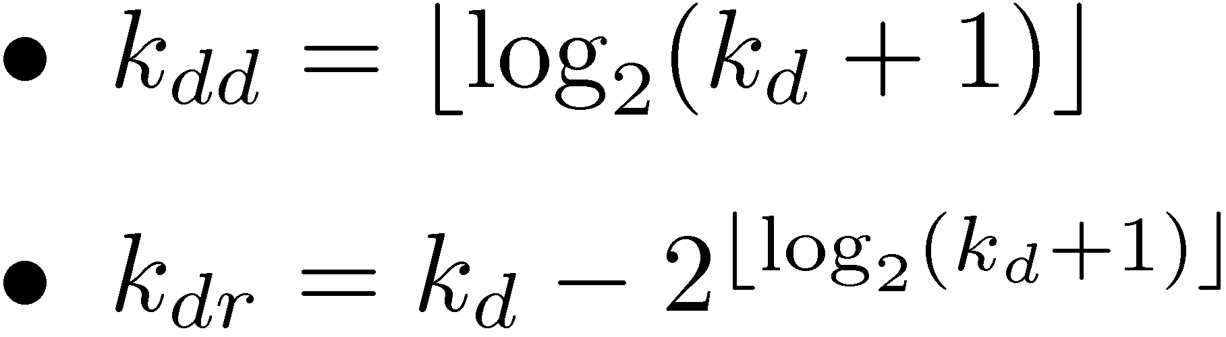
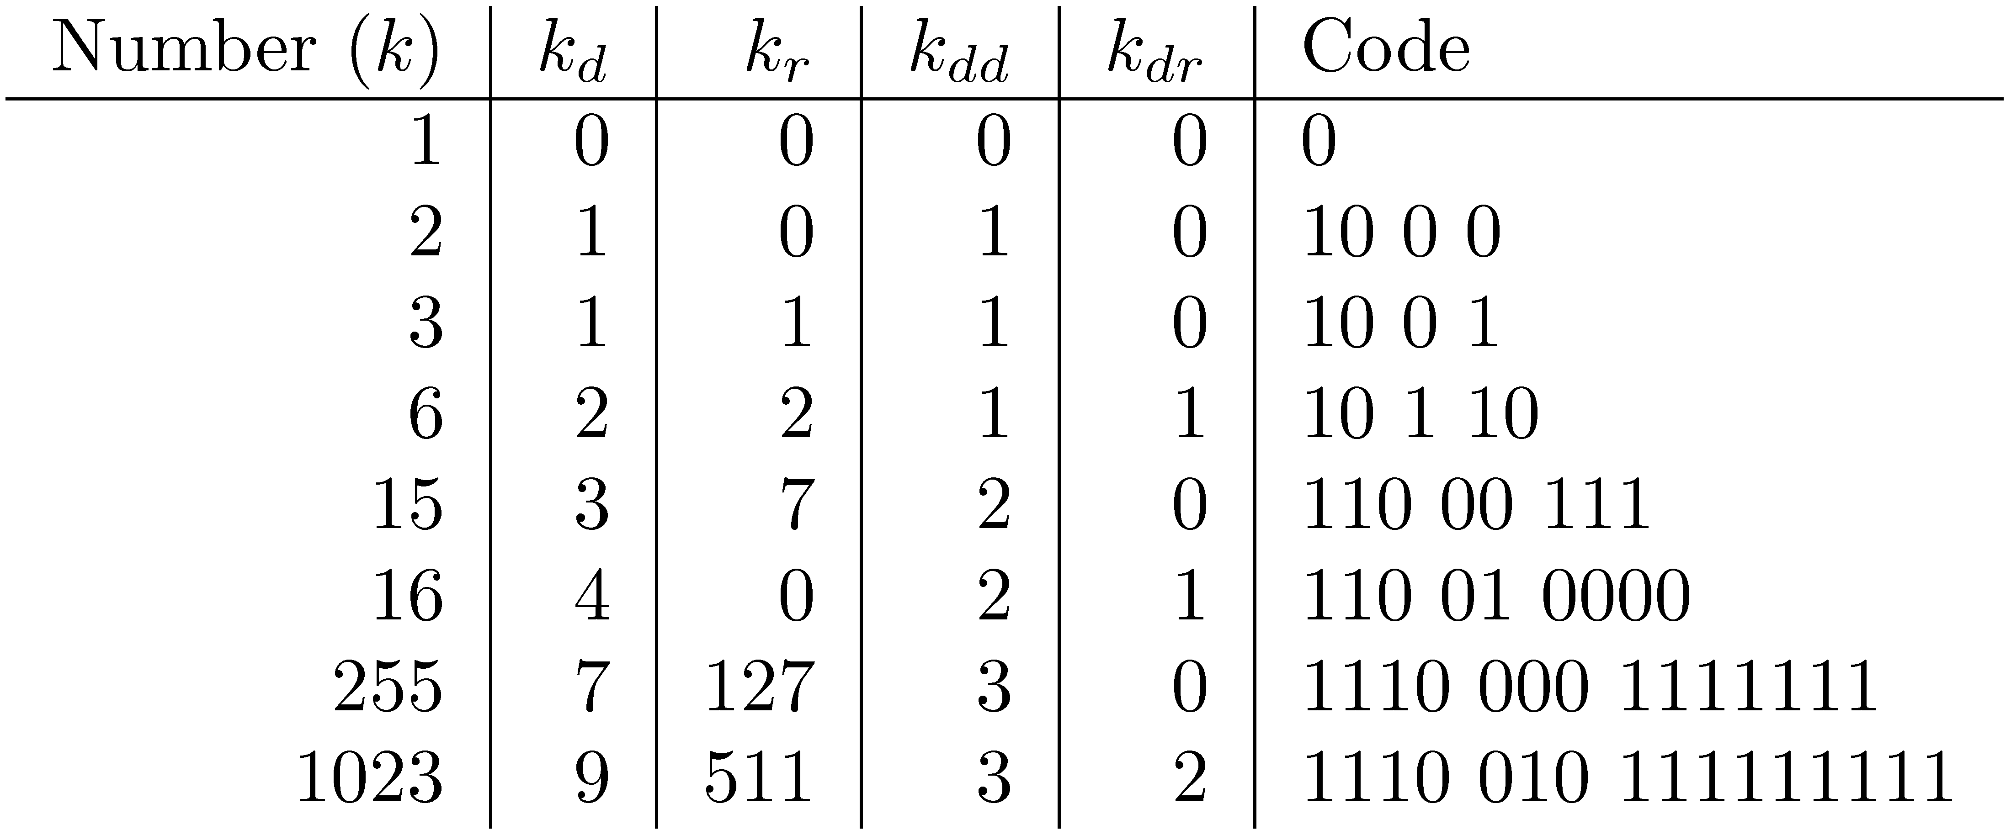
Elias-δ Code
Split k_{d} into:
encode k_{dd} in unary, k_{dr} in binary, and k_{r} in binary
(k_{d} +1)
= 1 bit 0-sep 10₂-1=1bit for-next-seg 10₂ = 2
= 1 bit 0-sep 11₂-1=2bits for-next-seg 110₂ = 6
= 11₁ bits 0-sep 101₂-1=4bits for-next-seg 10000₂ = 16

Slide 26
Byte-Aligned Codes
Variable-length bit encodings can be a problem on processors that process bytes
v-byte is a popular byte-aligned code
Similar to Unicode UTF-8
Shortest v-byte code is 1 byte
Numbers are 1 to 4 bytes, with high bit 1 in the last byte, 0 otherwise

Slide 27
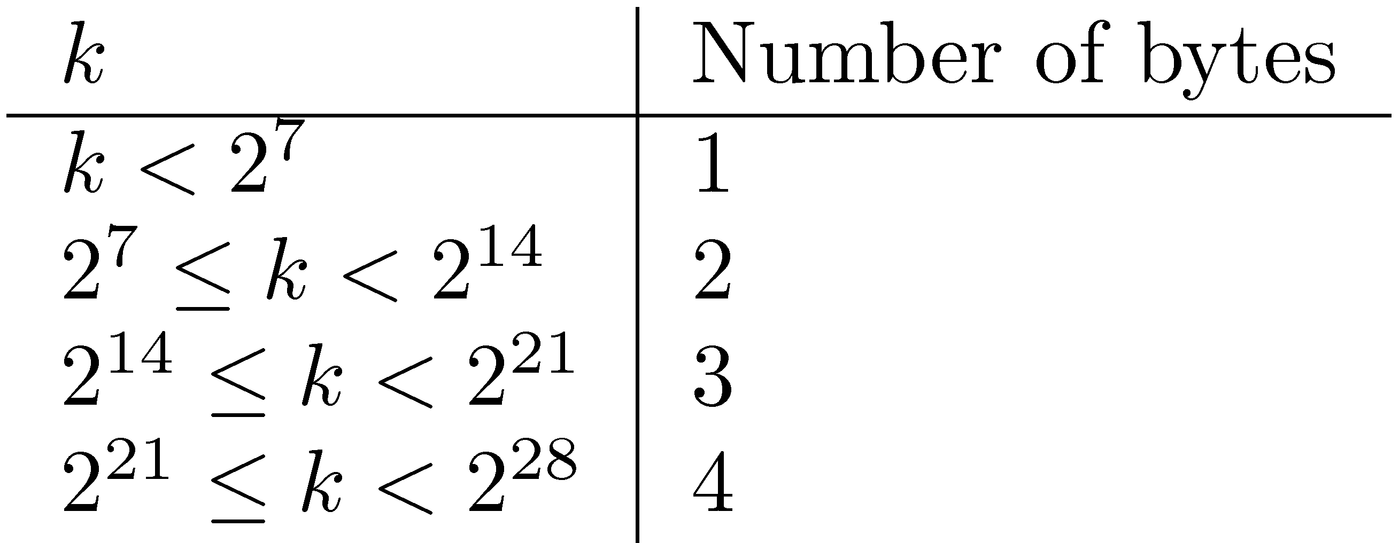
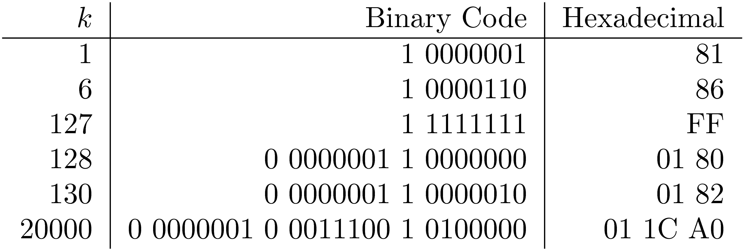
V-Byte Encoding
"1" in high-bit = "here comes the last byte"

Slide 28
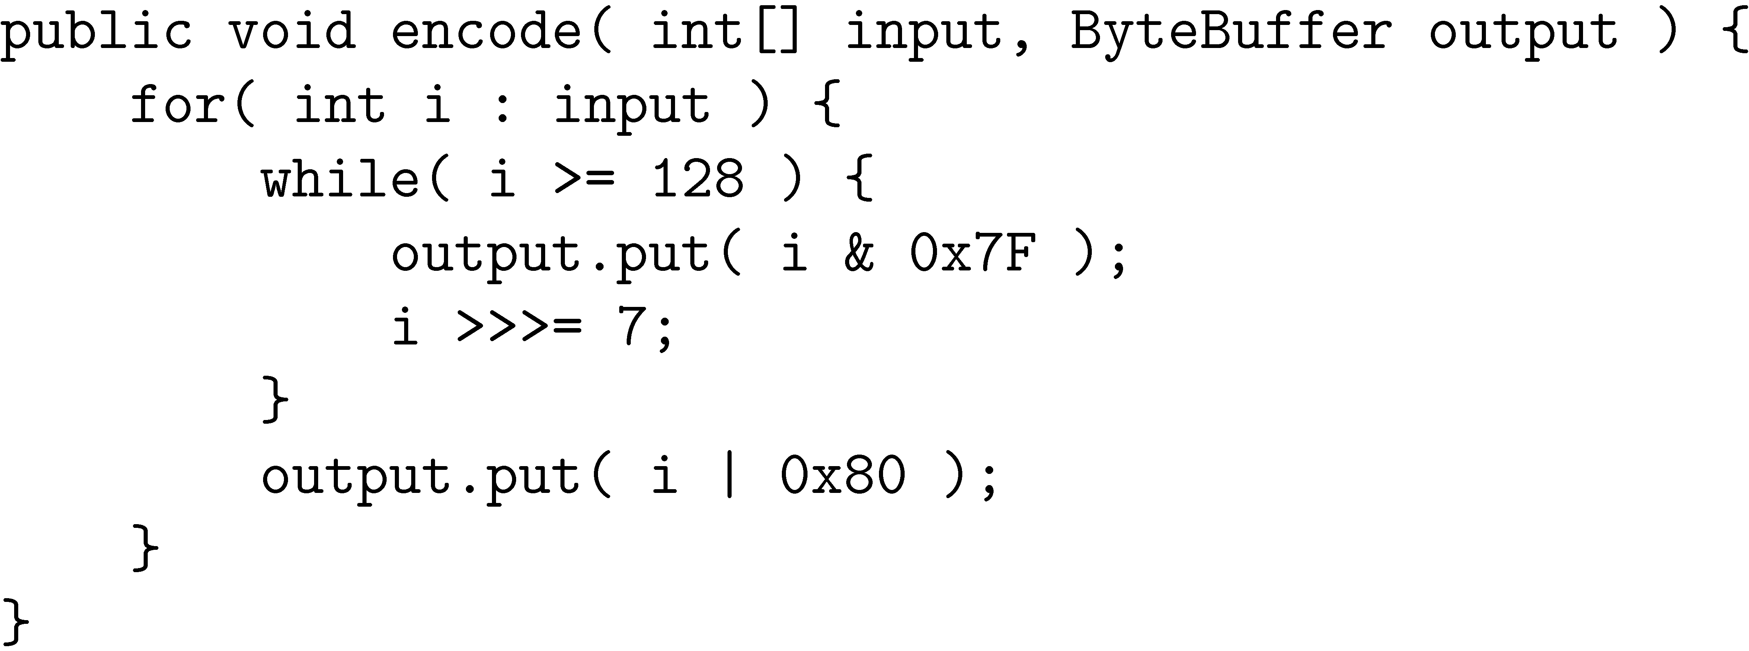
V-Byte Encoder

Slide 29
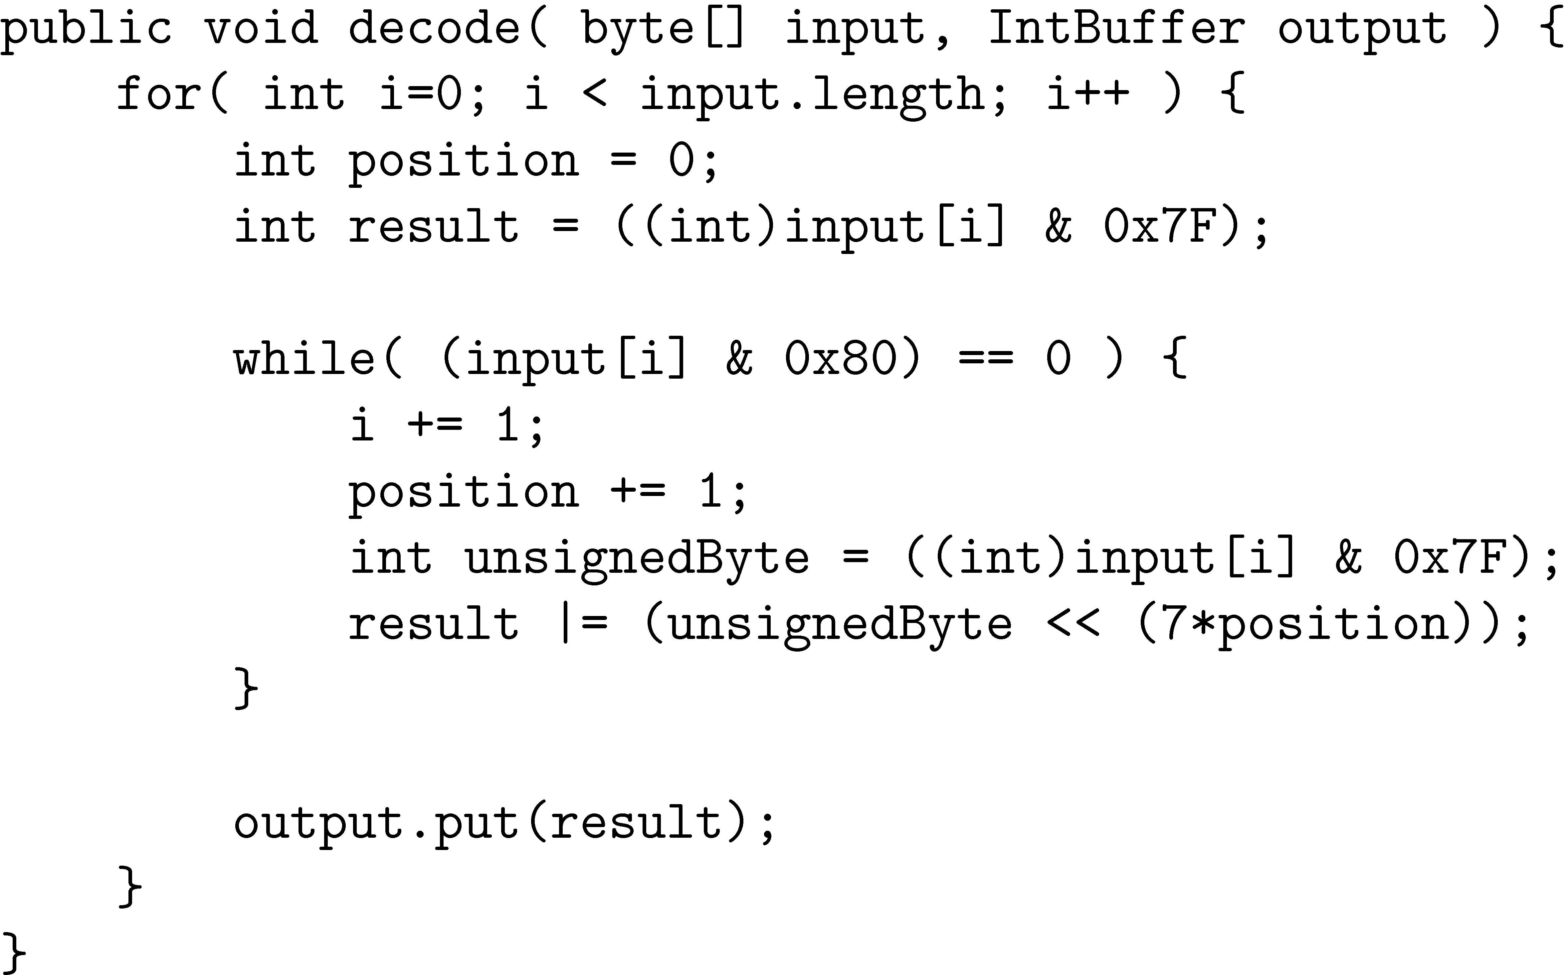
V-Byte Decoder

Slide 30
Compression Example
format = (document,count,[positions])
Consider inverted list with counts & positions:
Delta encode document numbers and positions (but not counts):
Compress using v-byte:
tropical =
83
2 bytes
needed
for 180
total space = 13 bytes
ASCII = 24 bytes

Slide 31
Skipping
Search involves comparison of inverted lists of different lengths
Can be very inefficient
“Skipping” ahead to check document numbers is much better
Compression makes this difficult
Variable size, only d-gaps stored
Skip pointers are additional data structure to support skipping

Slide 32
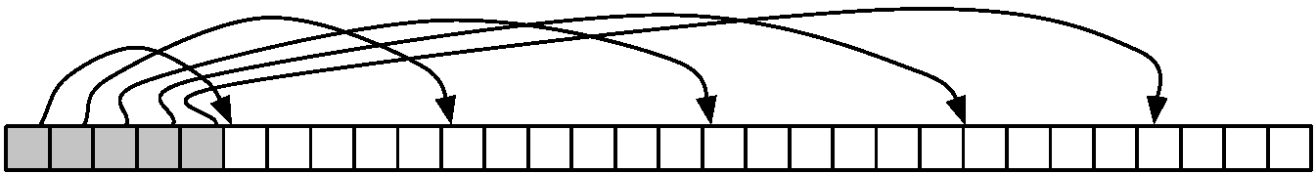
Skip Pointers
A skip pointer (d, p) contains a document number d and a byte (or bit) position p
Means there is an inverted list posting that starts at position p, and the posting before it was for document d
Inverted list
skip pointers

Slide 33
Skip Pointers
Example
Inverted list
D-gaps
Skip pointers
0
1
2
…
17
34
45
52
…
0
1
2
…
12
format = (document #, d-gap offset)
(34,6) = "goto pos 6 d-gap (0 indexed,
so 7th d-gap) and add that d-gap to 34 for the next doc"
2+34 = doc 36
looking for doc 80: 52 < 80 < 89,
so start at d-gap 12:
52+5 =57 (miss)
57+23=80 (hit)
looking for doc 85: 52 < 80 < 89,
so start at d-gap 12:
52+5 =57 (miss)
52+23=80 (miss)
80+9 =89 (miss); 89 > 85 = doc 85 isn't here

Slide 34
Auxiliary Structures
Inverted lists usually stored together in a single file for efficiency
Inverted file
Vocabulary or lexicon
Contains a lookup table from index terms to the byte offset of the inverted list in the inverted file
Either hash table in memory or B-tree for larger vocabularies
Term statistics stored at start of inverted lists
Collection statistics stored in separate file
in-memory index to the index;
where does "cat" end and "dog" start?

Slide 35
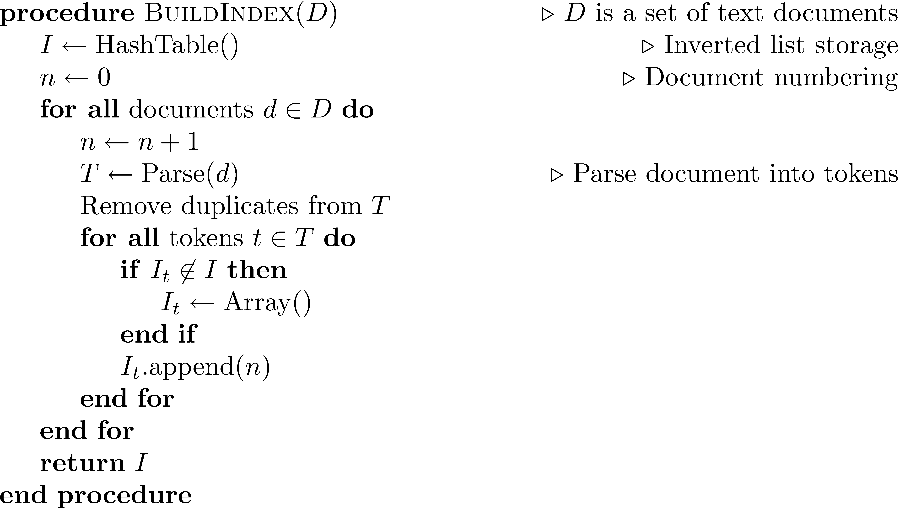
Index Construction
Simple in-memory indexer

Slide 36
Merging
Merging addresses limited memory problem
Build the inverted list structure until memory runs out
Then write the partial index to disk, start making a new one
At the end of this process, the disk is filled with many partial indexes, which are merged
Partial lists must be designed so they can be merged in small pieces
e.g., storing in alphabetical order

Slide 37
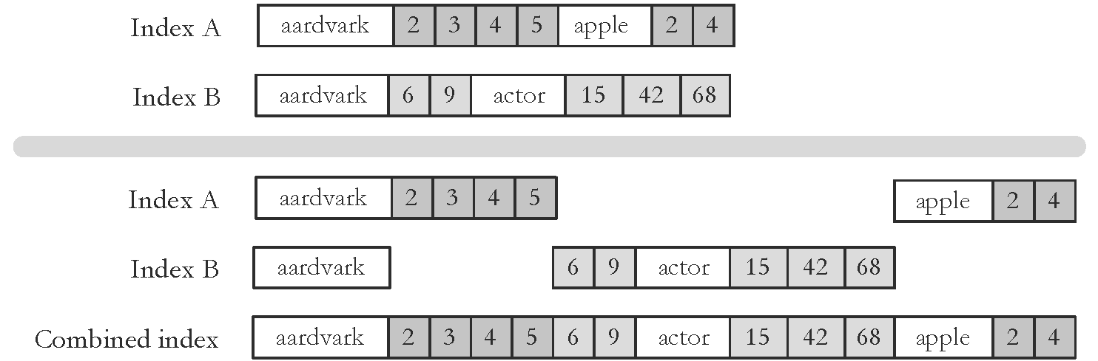
Merging
merging will make sure Index B doc numbers don't collide with those from Index A

Slide 38
Distributed Indexing
Distributed processing driven by need to index and analyze huge amounts of data (i.e., the Web)
Large numbers of inexpensive servers used rather than larger, more expensive machines
MapReduce is a distributed programming tool designed for indexing and analysis tasks

Slide 39
Example
Given a large text file that contains data about credit card transactions
Each line of the file contains a credit card number and an amount of money
Determine the number of unique credit card numbers
Could use hash table – memory problems
counting is simple with sorted file
Similar with distributed approach
sorting and placement are crucial

Slide 40
MapReduce
Distributed programming framework that focuses on data placement and distribution
Mapper
Generally, transforms a list of items into another list of items of the same length
Reducer
Transforms a list of items into a single item
Definitions not so strict in terms of number of outputs
Many mapper and reducer tasks on a cluster of machines

Slide 41
MapReduce
Basic process
Map stage which transforms data records into pairs, each with a key and a value
Shuffle uses a hash function so that all pairs with the same key end up next to each other and on the same machine
Reduce stage processes records in batches, where all pairs with the same key are processed at the same time
Idempotence of Mapper and Reducer provides fault tolerance
multiple operations on same input gives same output

Slide 42
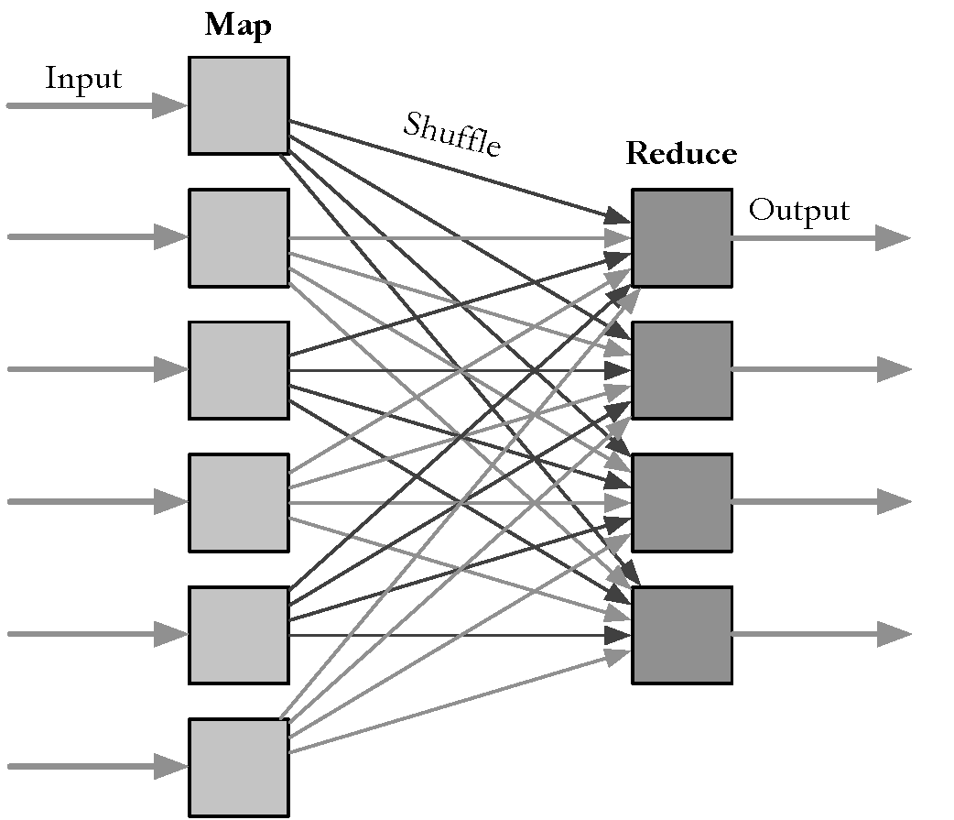
MapReduce
docs
0-9
docs
10-19
words
a-d
docs
20-29
words
e-l
docs
30-39
words
m-s
docs
40-49
words
t-z
docs
50-59

Slide 43
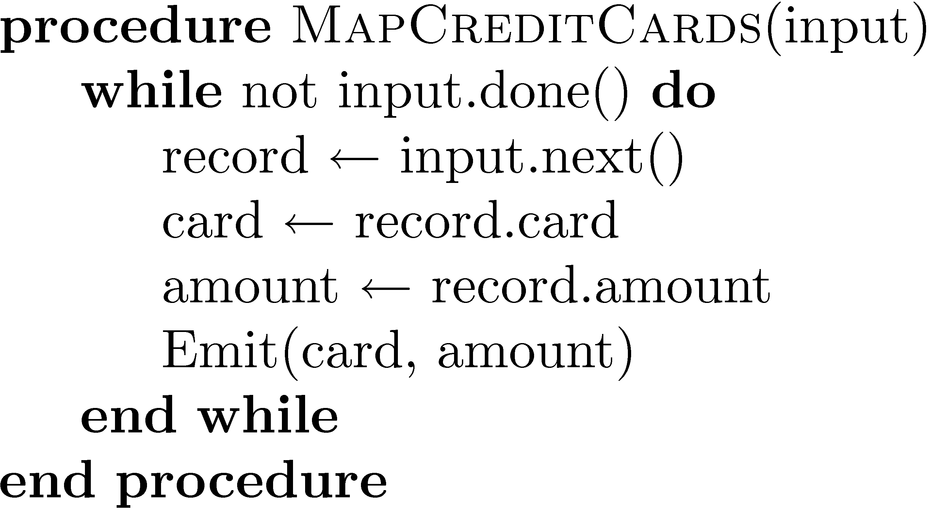
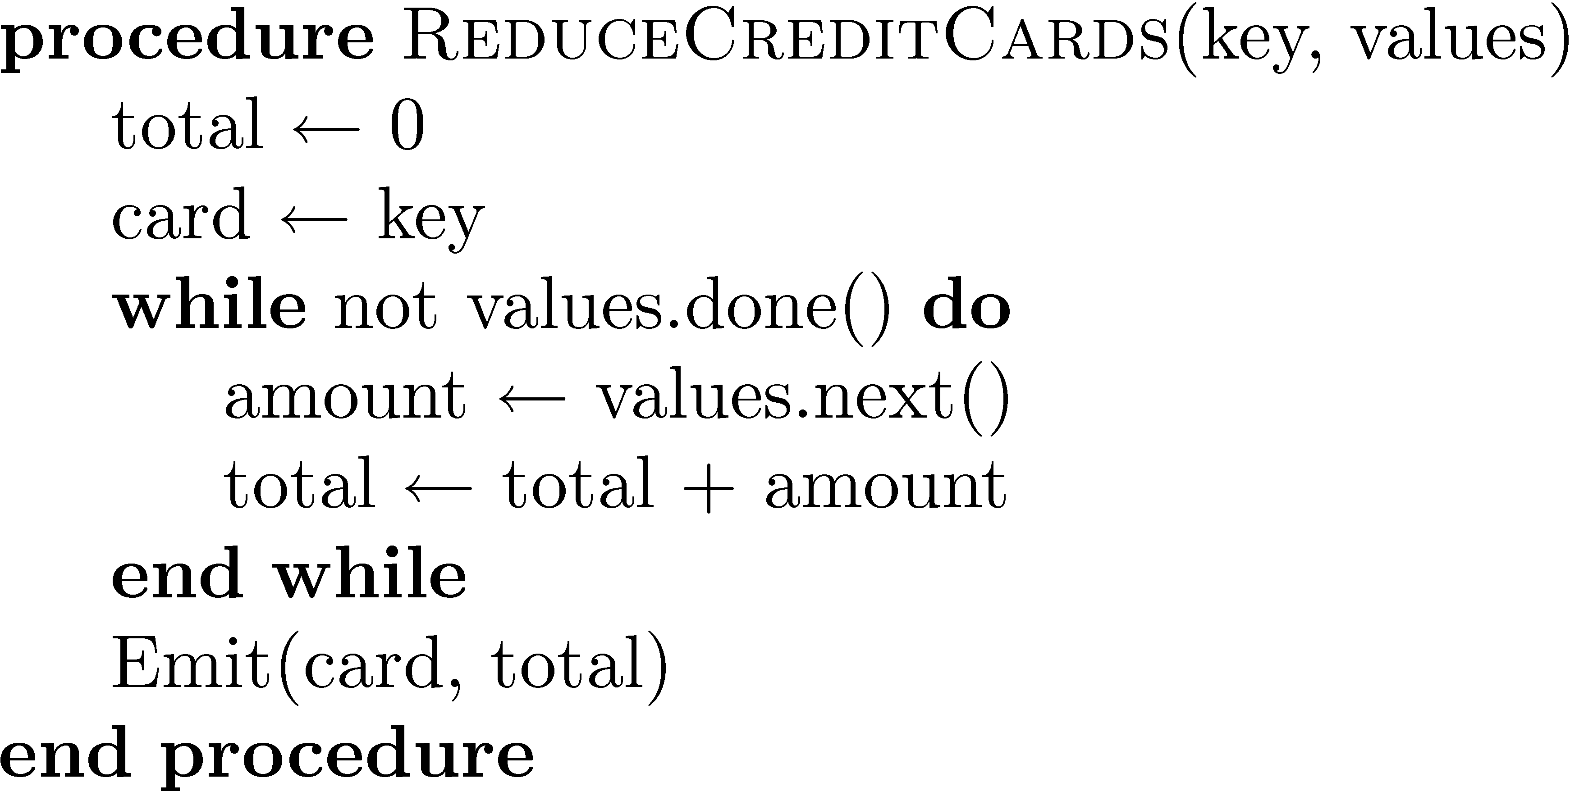
Example

Slide 44
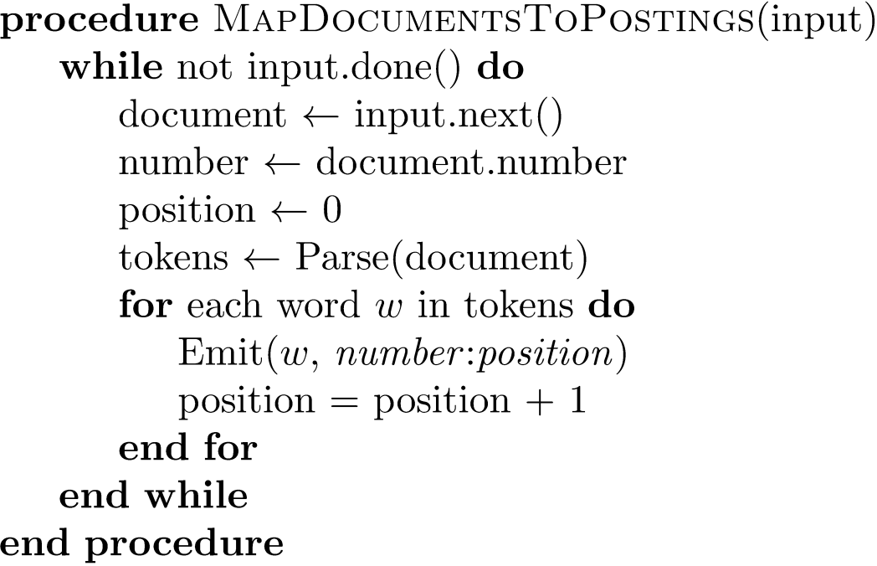
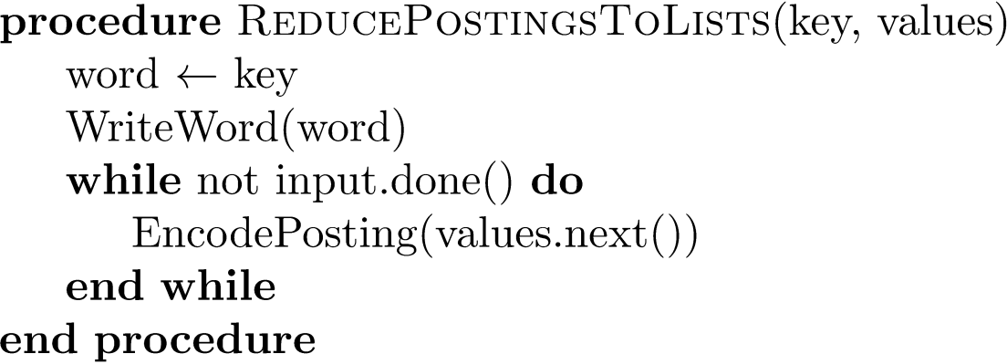
Indexing Example

Slide 45
Result Merging
Index merging is a good strategy for handling updates when they come in large batches
For small updates this is very inefficient
instead, create separate index for new documents, merge results from both searches
could be in-memory, fast to update and search
Deletions handled using delete list
Modifications done by putting old version on delete list, adding new version to new documents index
cf. URI redaction in the IA's Wayback Machine

Slide 46
Query Processing
Document-at-a-time
Calculates complete scores for documents by processing all term lists, one document at a time
Term-at-a-time
Accumulates scores for documents by processing term lists one at a time
Both approaches have optimization techniques that significantly reduce time required to generate scores

Slide 47
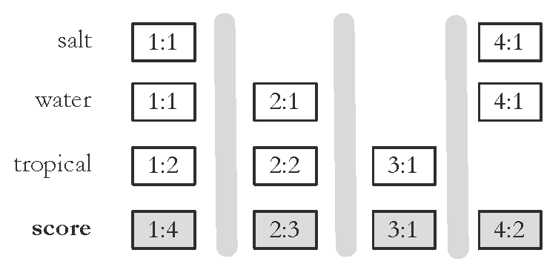
Document-At-A-Time
Q = "salt water tropical"

Slide 48
Pseudocode Function Descriptions
getCurrentDocument()
Returns the document number of the current posting of the inverted list.
skipForwardToDocument(d)
Moves forward in the inverted list until getCurrentDocument() <= d. This function may read to the end of the list.
movePastDocument(d)
Moves forward in the inverted list until getCurrentDocument() < d.
moveToNextDocument()
Moves to the next document in the list. Equivalent to movePastDocument(getCurrentDocument()).
getNextAccumulator(d)
returns the first document number d' >= d that has already has an accumulator.
removeAccumulatorsBetween(a, b)
Removes all accumulators for documents numbers between a and b. A_{d} will be removed iff a < d < b.

Slide 49
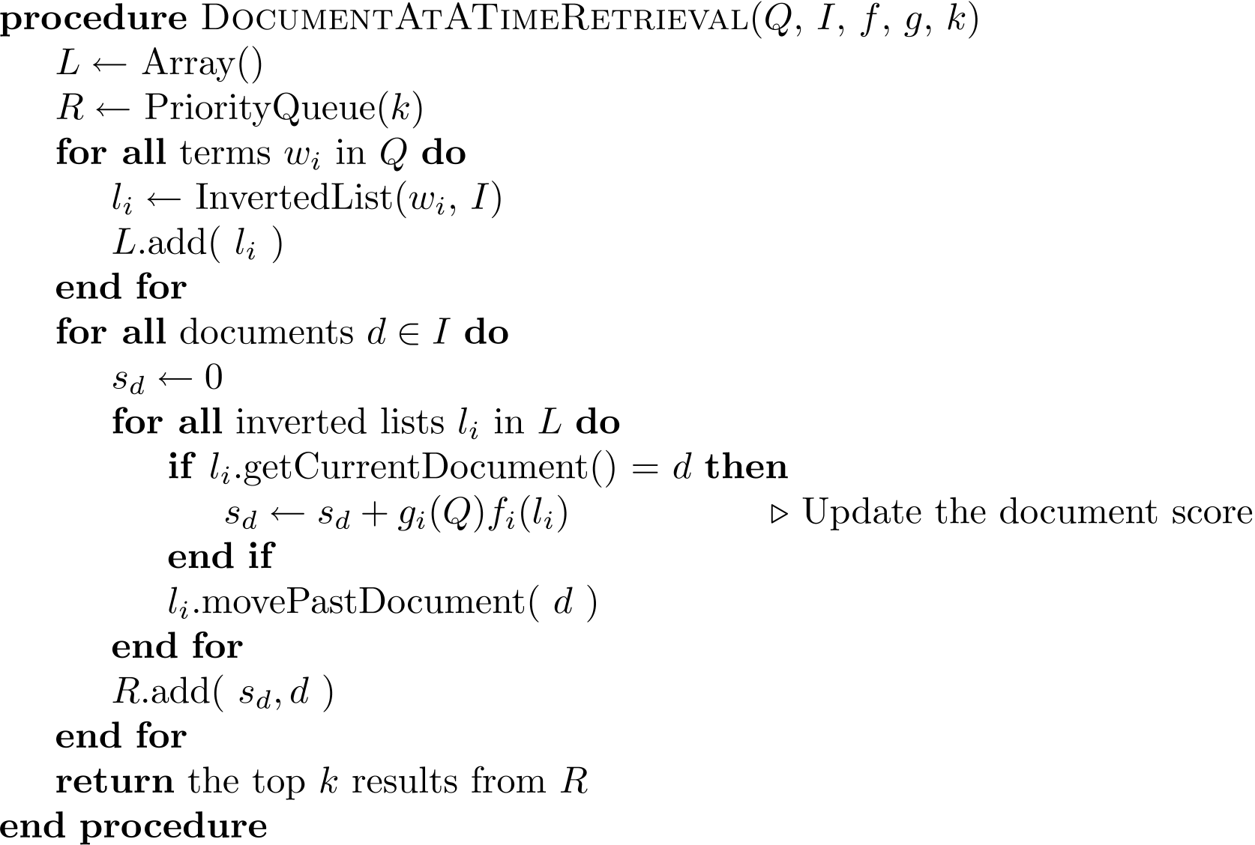
Document-At-A-Time

Slide 50
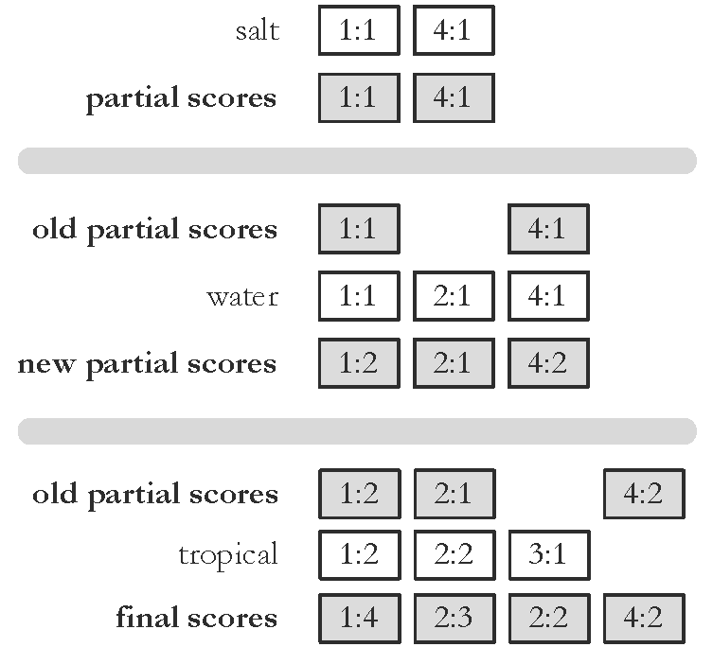
Term-At-A-Time
Q = "salt water tropical"
3:1
advantage = efficient disk access to inverted lists
disadvantage = keeping track of partial scores

Slide 51
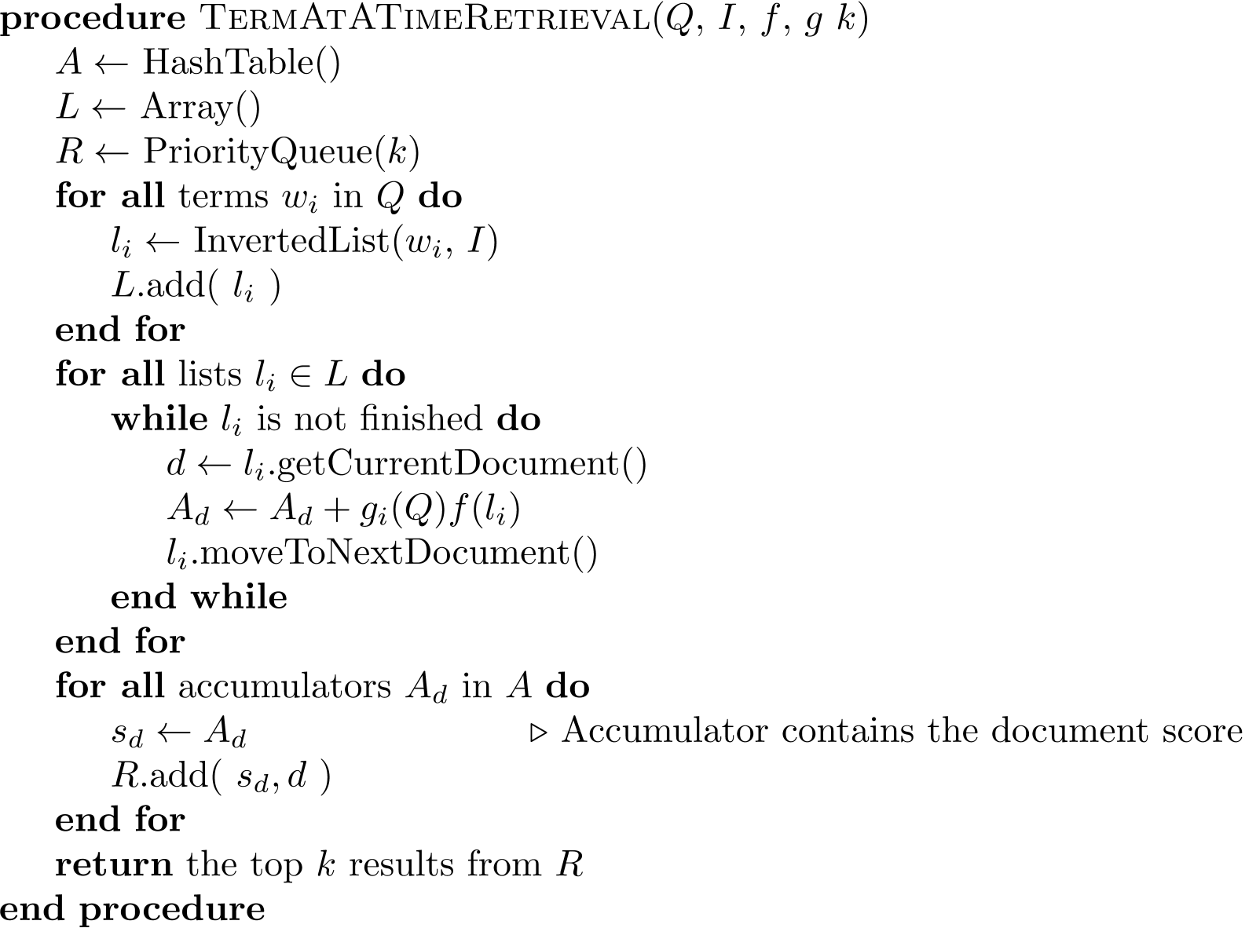
Term-At-A-Time

Slide 52
Optimization Techniques
Term-at-a-time uses more memory for accumulators, but accesses disk more efficiently
Two classes of optimization
Read less data from inverted lists
e.g., skip lists
better for simple feature functions
Calculate scores for fewer documents
e.g., conjunctive processing
better for complex feature functions
i.e., Boolean "AND"

Slide 53
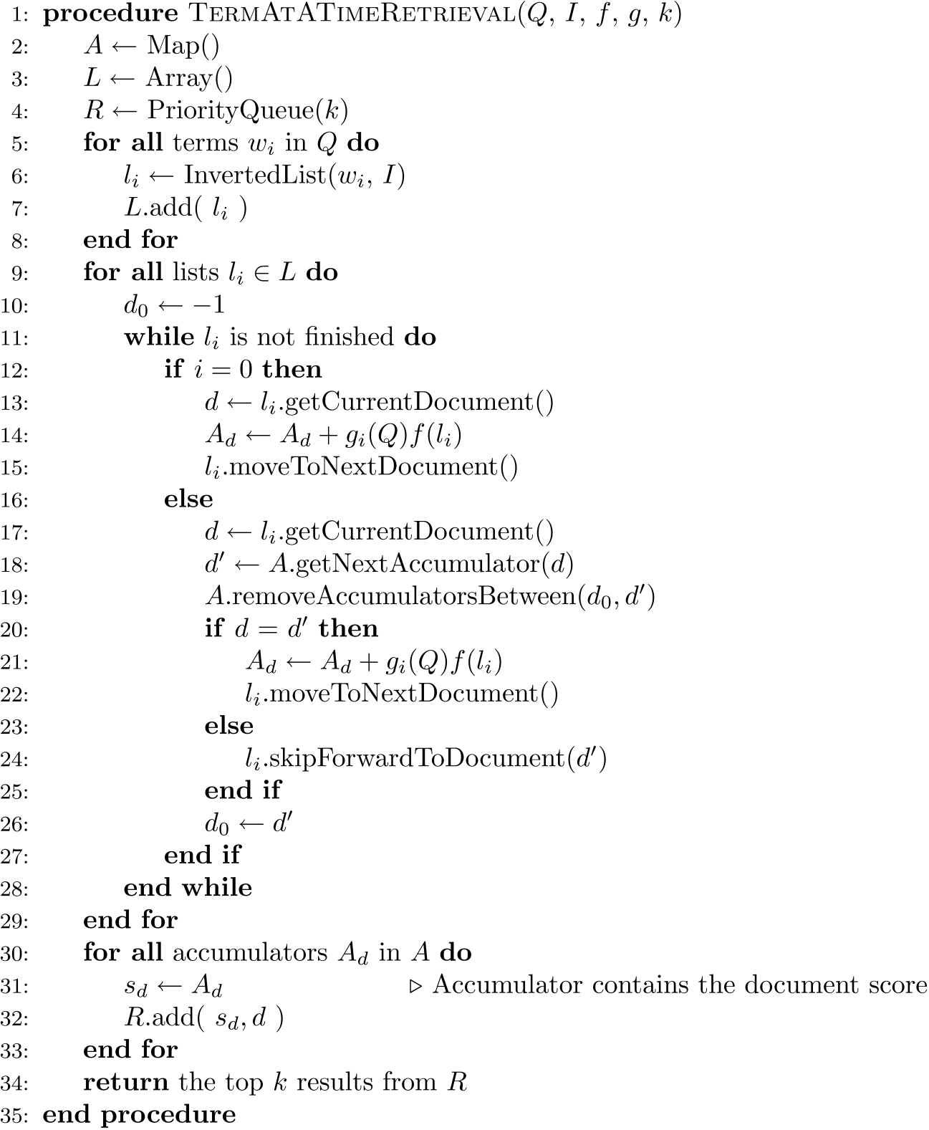
Conjunctive
Term-at-a-Time

Slide 54
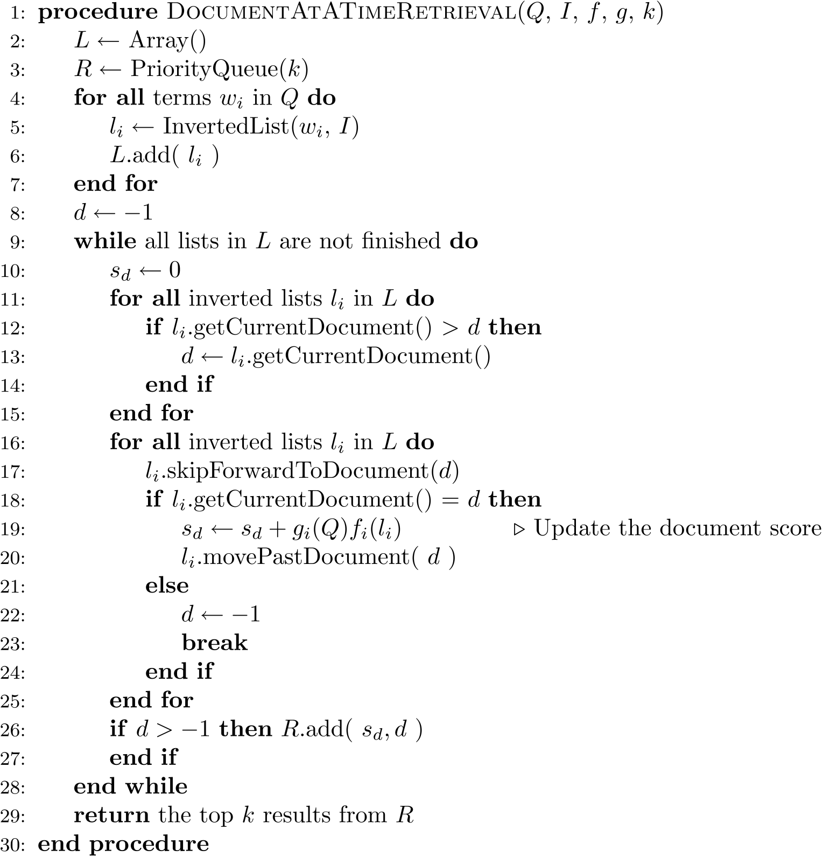
Conjunctive
Document-at-a-Time

Slide 55
Threshold Methods
Threshold methods use number of top-ranked documents needed (k) to optimize query processing
for most applications, k is small
For any query, there is a minimum score that each document needs to reach before it can be shown to the user
score of the kth-highest scoring document
gives threshold τ
optimization methods estimate τ′ to ignore documents
e.g., k=10 for SERPs
http://xkcd.com/1334/

Slide 56
Threshold Methods
For document-at-a-time processing, use score of lowest-ranked document so far for τ′
for term-at-a-time, have to use kth-largest score in the accumulator table
MaxScore method compares the maximum score that remaining documents could have to τ′
safe optimization in that ranking will be the same without optimization

Slide 57
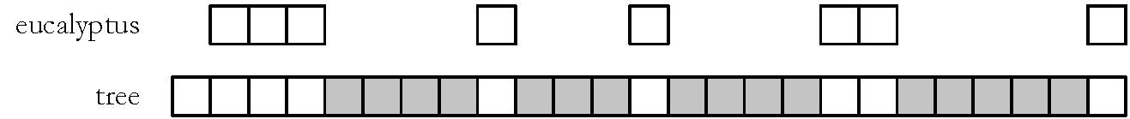
MaxScore Example
Indexer computes μ_{tree}
maximum score for any document containing just “tree”
Assume k =3, τ′ is lowest score after first three docs
Likely that τ ′ > μ_{tree}
τ ′ is the score of a document that contains both query terms
Can safely skip over all gray postings
Imagine all boxes are initially white.
We start processing left to right.
After 4th doc, we have 3 "good candidates",
so any docs with just "tree" probably won't
make the cut.
Gray those docs out and process only the
remaining white docs to look for best 3 docs.

Slide 58
Other Approaches
Early termination of query processing
ignore high-frequency word lists in term-at-a-time
ignore documents at end of lists in doc-at-a-time
unsafe optimization
List ordering
order inverted lists by quality metric (e.g., PageRank) or by partial score
makes unsafe (and fast) optimizations more likely to produce good documents
e.g.:
freq(tree) >> freq(eucalyptus)
also, consider only the first k query terms for large queries (e.g. 100+ terms)
recall “fake” DJ Shadow
page from last lecture…

Slide 59
Structured Queries
Query language can support specification of complex features
similar to SQL for database systems
query translator converts the user’s input into the structured query representation
Galago query language is the example used here
e.g., Galago query:
#od:1 = proximity of 1
("tropical fish" OR "aquarium fish”) OR "fish”

Slide 60
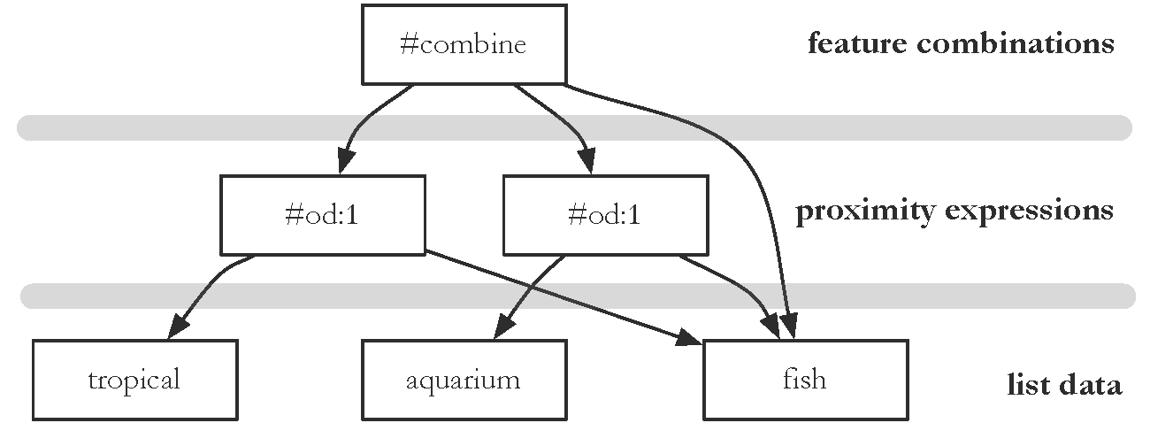
Evaluation Tree for Structured Query

Slide 61
Distributed Evaluation
Basic process
All queries sent to a director machine
Director then sends messages to many index servers
Each index server does some portion of the query processing
Director organizes the results and returns them to the user
Two main approaches
Document distribution
by far the most popular
Term distribution

Slide 62
Distributed Evaluation
Document distribution
each index server acts as a search engine for a small fraction of the total collection
director sends a copy of the query to each of the index servers, each of which returns the top-k results
results are merged into a single ranked list by the director
Collection statistics should be shared for effective ranking
IS1's best result might be not as good as IS2's worst result…

Slide 63
Distributed Evaluation
Term distribution
Single index is built for the whole cluster of machines
Each inverted list in that index is then assigned to one index server (e.g., IS1={alpha,bravo,charlie}, IS2={delta,echo,foxtro},…)
in most cases the data to process a query is not stored on a single machine
One of the index servers is chosen to process the query
usually the one holding the longest inverted list
Other index servers send information to that server
Final results sent to director

Slide 64
Caching
Query distributions similar to Zipf
About ½ each day are unique, but some are very popular
Caching can significantly improve effectiveness
Cache popular query results
Cache common inverted lists
Inverted list caching can help with unique queries
Cache must be refreshed to prevent stale data

