Slide 1

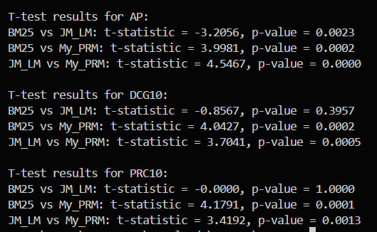
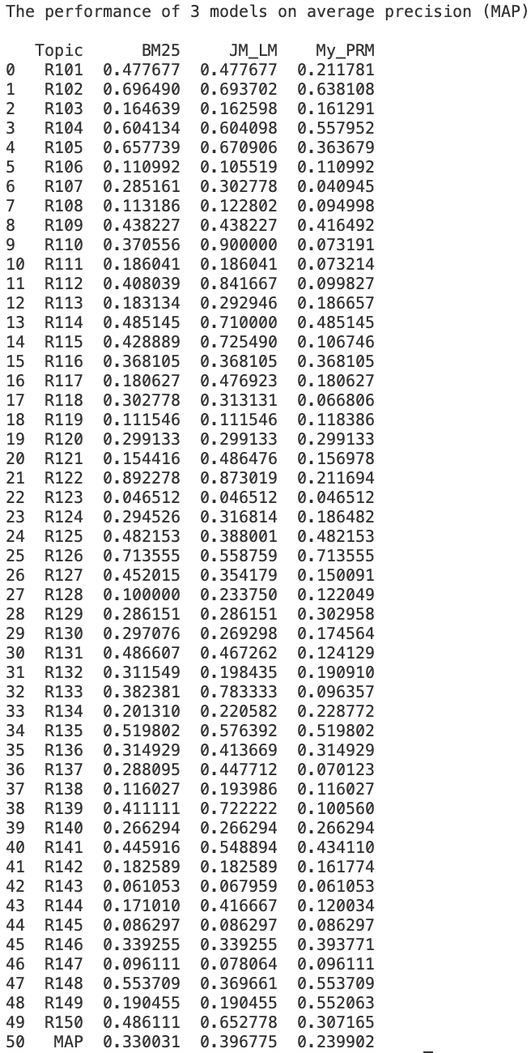
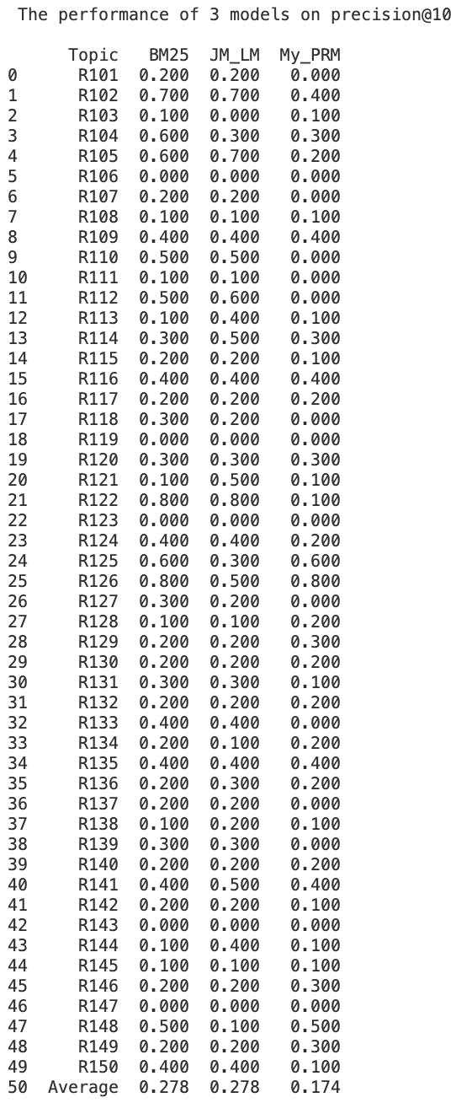
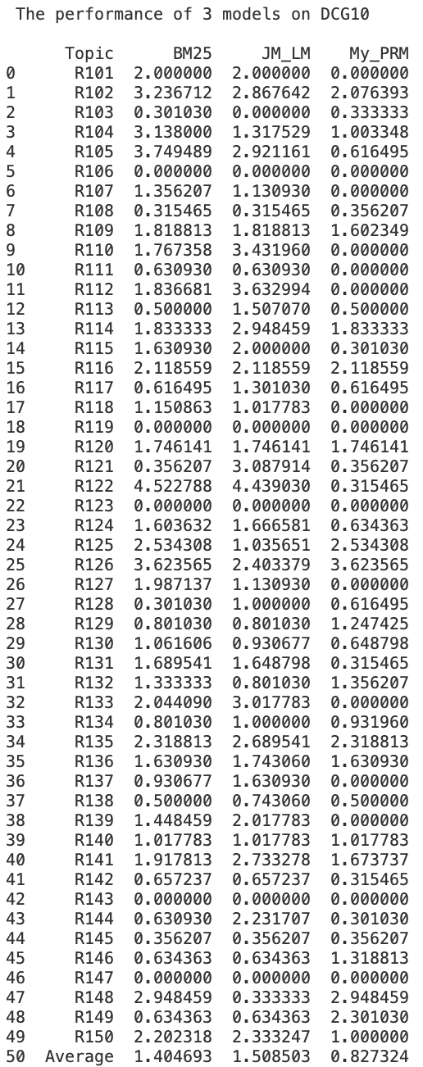
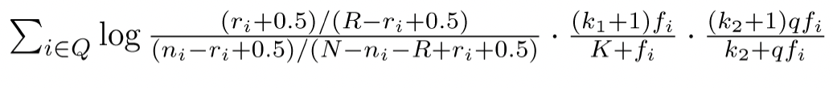
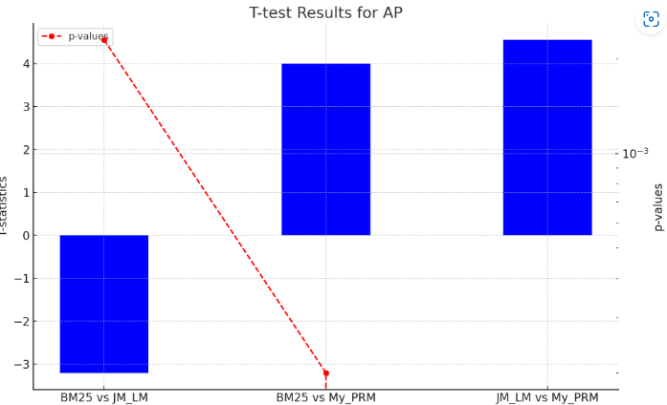
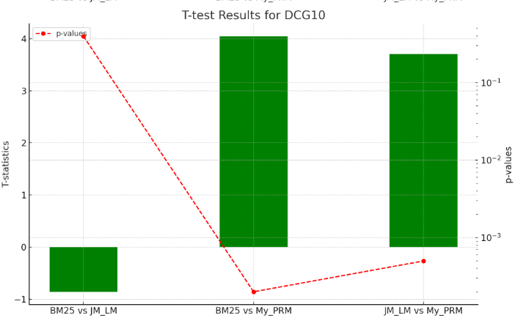
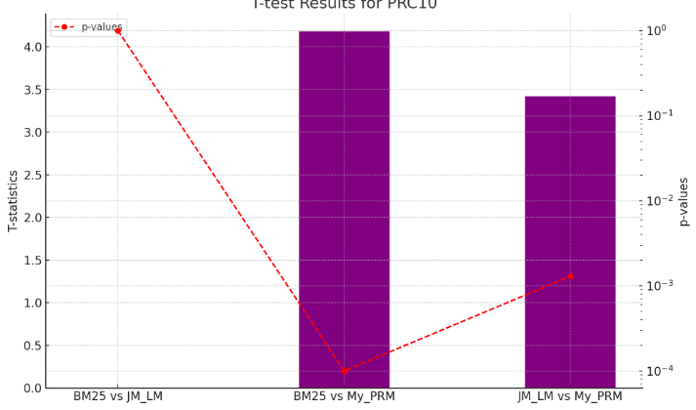

Enhancing Information Retrieval: Comparative Analysis of BM25, Jelinek-Mercer, and Pseudo- Relevance Models
Priya Gunda, Meetkumar Bhanderi, Tahura Naseer
Queensland University of Technology
Introduction to the system:
3. Pseudo relevance model:
My_PRM is designed to apply pseudo-relevance feedback to iteratively improve the retrieval performance. The model is using BM25 scoring function for modelling. The PRM provides initial ranking to the documents and select top-k documents, then refines term weights, and re-rank documents based on refined queries. This process can improve recall and precision because of iterative process of selecting relevant terms.
Results and Evaluation:
Key Findings::
In this project, we developed an information retrieval (IR) system to rank documents for 50 queries using three distinct models: BM25, Jelinek-Mercer Language Model (JM_LM), and a custom Pseudo-Relevance Model (My_PRM). We implemented each model, conducted evaluations using standard IR metrics (Model Average Precision, Precision@10, DCG@10), and performed statistical tests to compare their effectiveness. Then we have given some key finding and some recommendation based on the performance of the models.
The Pseudo-Relevance Model (My_PRM) consistently outperforms the BM25 and JM_LM across all evaluation metrics. This indicates that My_PRM offers superior retrieval effectiveness.
T Statistics shows My_PRM has provided higher scores in extracting relevant terms.
The low p-values denotes that My_PRM has provided strong statistical proofs against null hypothesis across all the models.
Approach and the Models:
BM25-based IR model:
The BM25-based IR model (BM25) is designed to rank documents within each data collection based on their relevance to the corresponding query string. This model uses BM25 scoring function, which considers various factors such as word frequency in the collection, document length, word frequency in the query to calculate a ranking score for each document.
The above equation is scoring function used to calculate the rank for each document. Here R is the number of relevance documents for a query and ri is the number of relevant documents containing term/word “i”. Since no relevance information is provided, we shall assume values of R, ri to be 0.
Parameters:
k1, k2 and K are parameters whose values are set empirically.
k1 = 1.2, k2 = 500, b = 0.75.
K = k_1*((1 - b) + b*(dl/avdl))
2. The Jelinek-Mercer based Language Model :
The Jelinek-Mercer based Language Model (JM_LM) is designed to rank documents within each data collection based on their relevance to the corresponding query string. This model
calculates the probability of generating the query terms from each document using Jelinek-Mercer smoothing, which balances the term probabilities between individual documents and the entire collection.
The JM_LM scoring function is used to calculate the rank for each document based on the probability of query terms appearing in the document..
The parameter λ is set to 0.4, which determines the balance between the document-specific term probability and the collection-wide term probability.
Recommendation::
Contribution::
Based on the evaluation results, My_PRM is recommended as the preferred model for information retrieval tasks, given its ability to provide better retrieval outcomes..
This poster is possible because of the work of
Priya Gunda, Tahura Naseer, MeetKumar Bhanderi

