Slide 1
Graph Connectivity
Miriyala Jeevan Kumar(18111041)
Nuka Siva Kumar (18111069)
Parallel Graph Connectivity in Log Diameter Rounds Andoni,Stein,Song,Wang,Zhong 2018

Slide 2
What is graph connectivity ?
11
11
12
12
7
7
14
3
14
3
15
15
0
2
0
2
1
1
9
16
9
16
5
5
8
8
4
4
13
13
6
10
6
10
Parallel machines
(14,12) (7,11) (9,16)..
[14,0] [12,0] [9,1] ..
Input Edges
output [vertex,color]
(16,13) (9,4) (2,4)..
[14,0] [7,1] ..

Slide 3
Previous Work
Best Known solutions : log(n) rounds
Using Leader Contraction Frame Work

Slide 4
An algorithmic framework
Input G = (V,E)
Initialize i ← 1 , G₁ = (V₁ , E₁) ← G
In i-th iteration, if Eᵢ = ɸ , stop the procedure
Randomly choose some vertices from Vᵢ as the leaders for Gᵢ
For each non-leader vertex v ∈ Vᵢ , if ∃ a leader u which is a neighbour of v in Gᵢ , then contract v to u.
(If there are multiple choices of u , choose an arbitrary one)
Let Gᵢ₊₁ = (Vᵢ₊₁ , Eᵢ₊₁) be the contracted graph and i ← i + 1
At the end of procedure for each v ∈ V if v is finally contracted to u then assign v the color of u.

Slide 5
Example
Iteration 1
11
12
7
14
3
15
0
2
1
9
16
5
8
4
13
6
10

Slide 6
Example
Iteration 1
11
12
7
14
3
15
0
2
1
9
16
5
8
4
13
6
10

Slide 7
Example
Iteration 2
12
11
0
7
15
5
8
16
4
6
10

Slide 8
Example
Iteration 2
12
11
0
7
15
5
8
16
4
6
10

Slide 9
Example
Iteration 3
11
12
15
0
6

Slide 10
Example
Iteration 3
12
11
0
15
6
Iteration 4(stop the procedure)
6
0
11

Slide 11
Number of rounds ?
# of vertices is Gᵢ₊₁ = # of leaders in Gᵢ + # of non leader which have no leader neighbour.
How to choose leaders ?
Choose each vertex with probability 0.5
𝛉(logn) rounds

Slide 12
Implementation
11
12
7
14
3
15
0
2
1
9
16
5
8
4
13
6
10

Slide 13
Step-1 (Reading Edges MPI_Parrallel_IO):-
0 | 1 | 2 | 3 | 4
5 | 6 | 7 | 8 | 9
10 | 11 | 12 | 13 | 14 | 15 | 16
14 --- 1
2 --- 15
6 --- 8
4 --- 9
5 --- 3
1 --- 3
9 --- 15
9 --- 16
7 --- 9
14 --- 12
7 --- 11
1 --- 12
9 --- 11
14 --- 5
2 --- 4
6 --- 10
8 --- 3
4 --- 13
15 --- 16
5 --- 6
13 --- 16
12 --- 3
11 --- 15
8 --- 10
2 --- 7

Slide 14
Step-2 ( Select Leaders and MPI_Allgatherv() ):-
0 | 1 | 2 | 3 | 4
5 | 6 | 7 | 8 | 9
10 | 11 | 12 | 13 | 14 | 15 | 16
14 --- 12
7 --- 11
1 --- 12
9 --- 11
14 --- 5
2 --- 4
6 --- 10
8 --- 3
4 --- 13
15 --- 16
5 --- 6
13 --- 16
12 --- 3
11 --- 15
8 --- 10
2 --- 7
14 --- 1
2 --- 15
6 --- 8
4 --- 9
5 --- 3
1 --- 3
9 --- 15
9 --- 16
7 --- 9
0 | 0 | 0 | 0 | 0
0 | 0 | 7 | 0 | 0
0 | 11 | 12 | 0 | 0 | 15 | 16
0 | 0 | 0 | 0 | 0
0 | 0 | 7 | 0 | 0
0 | 11 | 12 | 0 | 0 | 15 | 16

Slide 15
Step-3 ( Select Possible contracted Edges )
0 | 1 | 2 | 3 | 4
5 | 6 | 7 | 8 | 9
10 | 11 | 12 | 13 | 14 | 15 | 16
14 --- 12
7 --- 11
1 --- 12
9 --- 11
14 --- 5
2 --- 4
6 --- 10
8 --- 3
4 --- 13
15 --- 16
5 --- 6
13 --- 16
12 --- 3
11 --- 15
8 --- 10
2 --- 7
14 --- 1
2 --- 15
6 --- 8
4 --- 9
5 --- 3
1 --- 3
9 --- 15
9 --- 16
7 --- 9
0 | 0 | 0 | 0 | 0
0 | 0 | 7 | 0 | 0
0 | 11 | 12 | 0 | 0 | 15 | 16
0 | 0 | 0 | 0 | 0
0 | 0 | 7 | 0 | 0
0 | 11 | 12 | 0 | 0 | 15 | 16

Slide 16
Example
Iteration 1
11
12
7
14
3
15
0
2
1
9
16
5
8
4
13
6
10

Slide 17
Step-4 ( Do MPI_Alltoall(), MPI_Alltoallv() , Contract )
0 | 1 | 2 | 3 | 4
5 | 6 | 7 | 8 | 9
10 | 11 | 12 | 13 | 14 | 15 | 16
14 --- 12
7 --- 11
1 --- 12
9 --- 11
14 --- 5
2 --- 4
6 --- 10
8 --- 3
4 --- 13
15 --- 16
5 --- 6
13 --- 16
12 --- 3
11 --- 15
8 --- 10
2 --- 7
14 --- 1
2 --- 15
6 --- 8
4 --- 9
5 --- 3
1 --- 3
9 --- 15
9 --- 16
7 --- 9
-1 | 12 | 15 | 12 | -1
-1 | -1 | -1 | -1 | 7
-1 | -1 | -1 | 16 | 12 | -1 | -1

Slide 18
Step-5 ( Do MPI_Allgatherv() Contracted Info... )
0 | 1 | 2 | 3 | 4
5 | 6 | 7 | 8 | 9
10 | 11 | 12 | 13 | 14 | 15 | 16
14 --- 12
7 --- 11
1 --- 12
9 --- 11
14 --- 5
2 --- 4
6 --- 10
8 --- 3
4 --- 13
15 --- 16
5 --- 6
13 --- 16
12 --- 3
11 --- 15
8 --- 10
2 --- 7
14 --- 1
2 --- 15
6 --- 8
4 --- 9
5 --- 3
1 --- 3
9 --- 15
9 --- 16
7 --- 9
-1 | 12 | 15 | 12 | -1
-1 | -1 | -1 | -1 | 7
-1 | -1 | -1 | 16 | 12 | -1 | -1
-1 | 12 | 15 | 12 | -1
-1 | -1 | -1 | -1 | 7
-1 | -1 | -1 | 16 | 12 | -1 | -1

Slide 19
Step-6 ( Relink Edges... End of 1 Iteration)
0 | 1 | 2 | 3 | 4
5 | 6 | 7 | 8 | 9
10 | 11 | 12 | 13 | 14 | 15 | 16
14 --- 12
7 --- 11
1 --- 12
7 --- 11
12 --- 5
15 --- 4
6 --- 10
8 --- 12
4 --- 16
15 --- 16
5 --- 6
13 --- 16
12 --- 3
11 --- 15
8 --- 10
15 --- 7
12 --- 12
2 --- 15
6 --- 8
4 --- 7
5 --- 12
12 --- 12
7 --- 15
7 --- 16
7 --- 9
-1 | 12 | 15 | 12 | -1
-1 | -1 | -1 | -1 | 7
-1 | -1 | -1 | 16 | 12 | -1 | -1

Slide 20
Step-7 (MPI_Allreduce() next_round ??)
0 | 1 | 2 | 3 | 4
5 | 6 | 7 | 8 | 9
10 | 11 | 12 | 13 | 14 | 15 | 16
14 --- 12
7 --- 11
1 --- 12
7 --- 11
12 --- 5
15 --- 4
6 --- 10
8 --- 12
4 --- 16
15 --- 16
5 --- 6
13 --- 16
12 --- 3
11 --- 15
8 --- 10
15 --- 7
12 --- 12
2 --- 15
6 --- 8
4 --- 7
5 --- 12
12 --- 12
7 --- 15
7 --- 16
7 --- 9
6
6
5
17

Slide 21
Example
Iteration 2
12
11
0
7
15
5
8
16
4
6
10

Slide 22
Step-2 ( Select Leaders and MPI_Allgatherv() ):-
0 | 1 | 2 | 3 | 4
5 | 6 | 7 | 8 | 9
10 | 11 | 12 | 13 | 14 | 15 | 16
7 --- 11
7 --- 11
12 --- 5
15 --- 4
6 --- 10
8 --- 12
4 --- 16
15 --- 16
5 --- 6
11 --- 15
8 --- 10
15 --- 7
6 --- 8
4 --- 7
5 --- 12
7 --- 15
7 --- 16
0 | 0 | 0 | 0 | 0
0 | 6 | 0 | 0 | 0
0 | 11 | 12 | 0 | 0 | 15 | 0
0 | 0 | 0 | 0 | 0
0 | 6 | 0 | 0 | 0
0 | 11 | 12 | 0 | 0 | 15 | 0

Slide 23
Step-3 ( Select Possible contracted Edges )
0 | 1 | 2 | 3 | 4
5 | 6 | 7 | 8 | 9
10 | 11 | 12 | 13 | 14 | 15 | 16
7 --- 11
7 --- 11
12 --- 5
15 --- 4
6 --- 10
8 --- 12
4 --- 16
15 --- 16
5 --- 6
11 --- 15
8 --- 10
15 --- 7
6 --- 8
4 --- 7
5 --- 12
7 --- 15
7 --- 16
0 | 0 | 0 | 0 | 0
0 | 6 | 0 | 0 | 0
0 | 11 | 12 | 0 | 0 | 15 | 0
0 | 0 | 0 | 0 | 0
0 | 6 | 0 | 0 | 0
0 | 11 | 12 | 0 | 0 | 15 | 0

Slide 24
Example
Iteration 2
12
11
0
7
15
5
8
16
4
6
10

Slide 25
Step-4 ( Do MPI_Alltoall(), MPI_Alltoallv() , Contract )
0 | 1 | 2 | 3 | 4
5 | 6 | 7 | 8 | 9
10 | 11 | 12 | 13 | 14 | 15 | 16
7 --- 11
7 --- 11
12 --- 5
15 --- 4
6 --- 10
8 --- 12
4 --- 16
15 --- 16
5 --- 6
11 --- 15
8 --- 10
15 --- 7
6 --- 8
4 --- 7
5 --- 12
7 --- 15
7 --- 16
-1 | 12 | 15 | 12 | -1
-1 | -1 | -1 | -1 | 7
-1 | -1 | -1 | 16 | 12 | -1 | -1

Slide 26
Step-5 ( Do MPI_Allgatherv() Contracted Info... )
0 | 1 | 2 | 3 | 4
5 | 6 | 7 | 8 | 9
10 | 11 | 12 | 13 | 14 | 15 | 16
7 --- 11
7 --- 11
12 --- 5
15 --- 4
6 --- 10
8 --- 12
4 --- 16
15 --- 16
5 --- 6
11 --- 15
8 --- 10
15 --- 7
6 --- 8
4 --- 7
5 --- 12
7 --- 15
7 --- 16
-1 | 12 | 15 | 12 | 15
12 | -1 | 11 | 12 | 7
6 | -1 | -1 | 16 | 12 | -1 | 15
-1 | 12 | 15 | 12 | 15
12 | -1 | 11 | 12 | 7
6 | -1 | -1 | 16 | 12 | -1 | 15

Slide 27
Step-6 ( Relink Edges... End of 2nd Iteration)
0 | 1 | 2 | 3 | 4
5 | 6 | 7 | 8 | 9
10 | 11 | 12 | 13 | 14 | 15 | 16
7 --- 11
7 --- 11
12 --- 5
15 --- 4
6 --- 10
12 --- 12
15 --- 15
15 --- 16
12 --- 6
11 --- 15
8 --- 6
15 --- 11
6 --- 8
15 --- 11
12 --- 12
11 --- 15
11 --- 15
-1 | 12 | 15 | 12 | 15
12 | -1 | 11 | 12 | 7
6 | -1 | -1 | 16 | 12 | -1 | 15

Slide 28
Step-7 (MPI_Allreduce() next_round ??)
0 | 1 | 2 | 3 | 4
5 | 6 | 7 | 8 | 9
10 | 11 | 12 | 13 | 14 | 15 | 16
7 --- 11
7 --- 11
12 --- 5
15 --- 4
6 --- 10
12 --- 12
15 --- 15
15 --- 16
12 --- 6
11 --- 15
8 --- 6
15 --- 11
6 --- 8
15 --- 11
12 --- 12
11 --- 15
11 --- 15
0
4
4
8

Slide 29
Example
Iteration 3
11
12
15
0
6

Slide 30
Step-2 ( Select Leaders and MPI_Allgatherv() ):-
0 | 1 | 2 | 3 | 4
5 | 6 | 7 | 8 | 9
10 | 11 | 12 | 13 | 14 | 15 | 16
12 --- 6
11 --- 15
8 --- 6
15 --- 11
6 --- 8
15 --- 11
11 --- 15
11 --- 15
0 | 0 | 0 | 0 | 0
0 | 6 | 0 | 0 | 0
0 | 11 | 0 | 0 | 0 | 0 | 0
0 | 0 | 0 | 0 | 0
0 | 6 | 0 | 0 | 0
0 | 11 | 0 | 0 | 0 | 0 | 0

Slide 31
Step-3 ( Select Possible contracted Edges )
0 | 1 | 2 | 3 | 4
5 | 6 | 7 | 8 | 9
10 | 11 | 12 | 13 | 14 | 15 | 16
12 --- 6
11 --- 15
8 --- 6
15 --- 11
6 --- 8
15 --- 11
11 --- 15
11 --- 15
0 | 0 | 0 | 0 | 0
0 | 6 | 0 | 0 | 0
0 | 11 | 0 | 0 | 0 | 0 | 0
0 | 0 | 0 | 0 | 0
0 | 6 | 0 | 0 | 0
0 | 11 | 0 | 0 | 0 | 0 | 0

Slide 32
Example
Iteration 3
12
11
0
15
6

Slide 33
Step-4 ( Do MPI_Alltoall(), MPI_Alltoallv() , Contract )
0 | 1 | 2 | 3 | 4
5 | 6 | 7 | 8 | 9
10 | 11 | 12 | 13 | 14 | 15 | 16
12 --- 6
11 --- 15
8 --- 6
15 --- 11
6 --- 8
15 --- 11
11 --- 15
11 --- 15
-1 | 12 | 15 | 12 | 15
12 | -1 | 11 | 12 | 7
6 | -1 | 6 | 16 | 12 | 11 | 15

Slide 34
Step-5 ( Do MPI_Allgatherv() Contracted Info... )
0 | 1 | 2 | 3 | 4
5 | 6 | 7 | 8 | 9
10 | 11 | 12 | 13 | 14 | 15 | 16
12 --- 6
11 --- 15
8 --- 6
15 --- 11
6 --- 8
15 --- 11
11 --- 15
11 --- 15
-1 | 12 | 15 | 12 | 15
12 | -1 | 11 | 12 | 7
6 | -1 | 6 | 16 | 12 | 11 | 15
-1 | 12 | 15 | 12 | 15
12 | -1 | 11 | 12 | 7
6 | -1 | 6 | 16 | 12 | 11 | 15

Slide 35
Step-6 ( Relink Edges... End of 2nd Iteration)
0 | 1 | 2 | 3 | 4
5 | 6 | 7 | 8 | 9
10 | 11 | 12 | 13 | 14 | 15 | 16
12 --- 6
11 --- 15
8 --- 6
15 --- 11
6 --- 8
15 --- 11
11 --- 15
11 --- 15
-1 | 12 | 15 | 12 | 15
12 | -1 | 11 | 12 | 7
6 | -1 | 6 | 16 | 12 | 11 | 15

Slide 36
Step-7 (MPI_Allreduce() next_round ??)
0 | 1 | 2 | 3 | 4
5 | 6 | 7 | 8 | 9
10 | 11 | 12 | 13 | 14 | 15 | 16
12 --- 6
11 --- 15
8 --- 6
15 --- 11
6 --- 8
15 --- 11
11 --- 15
11 --- 15
0
0
0
STOP
0

Slide 37
Example
Iteration 4(stop the procedure)
6
0
11
-1 | 6 | 6 | 6 | 11
6 | -1 | 11 | 6 | 11
6 | -1 | 6 | 11 | 6 | 11 | 11
0 | 1 | 2 | 3 | 4
5 | 6 | 7 | 8 | 9
10 | 11 | 12 | 13 | 14 | 15 | 16

Slide 38
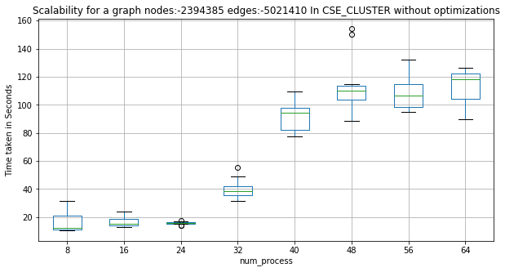
Experimental Results
Graph :
Wiki-Talk
Nodes : 2394385
Edges : 5021410

Slide 39
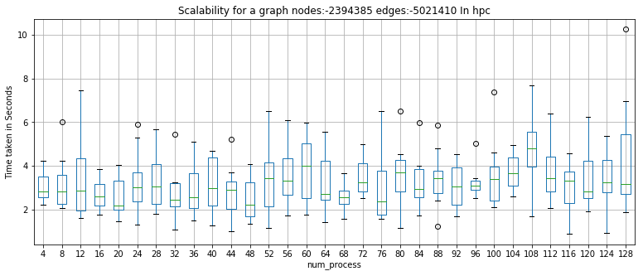
Experimental Results
Scalability ??

Slide 40
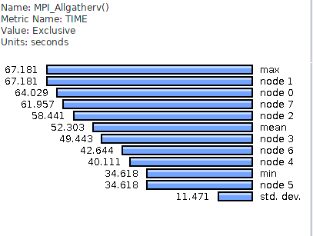
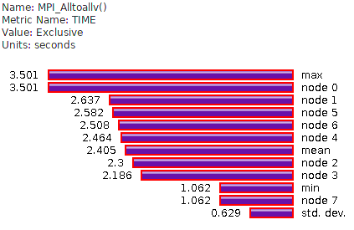
Profiling

Slide 41
Optimizations
OPtimization - I :
Remove unnecessary MPI_Barrier
Optimization - II :
MPI_Alltoallv() MPI_Isend(),MPI_Irecv()
MPI_Allgatherv() MPI_IN_PLACE
Optimization - III :
Reduce Unnecessary Memory allocations, Deallocations.

Slide 42
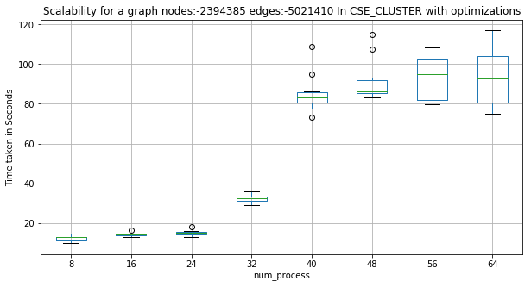
Results

Slide 43
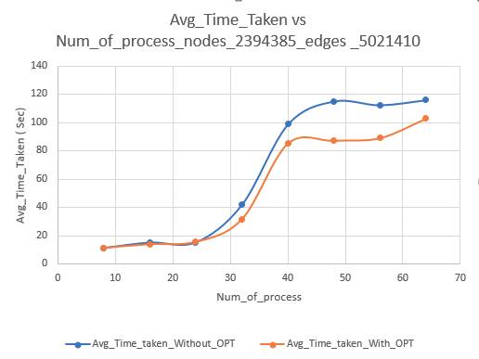
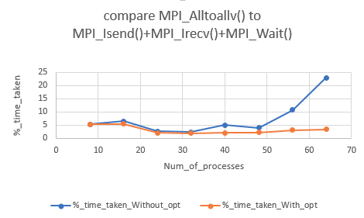
Results

Slide 44
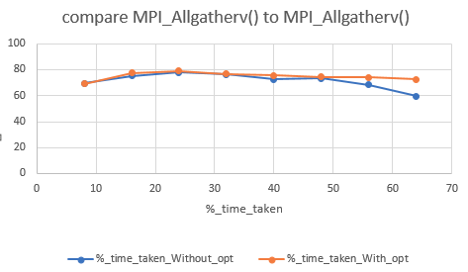
Results

Slide 45
References
Z. S. Z. W. P. Z. Alexandr Andoni, Clifford Stein, “Parallel Graph Connectivity in Log Diameter Rounds,” 2018
http://www.cs.uoregon.edu/research/tau/home.php, “tau.”
mpitutorial.com, “MPI collective communication.”
https://arxiv.org/abs/1805.03055
https://www.youtube.com/watch?v=8_OWKux3iW4
https://www.youtube.com/watch?v=YYPLqN8buqA&t=2552s

