Slide 1
Commands

Slide 2
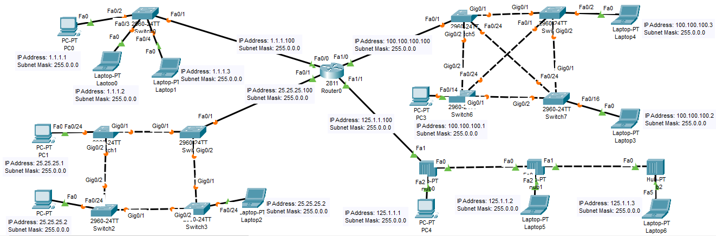

Slide 3
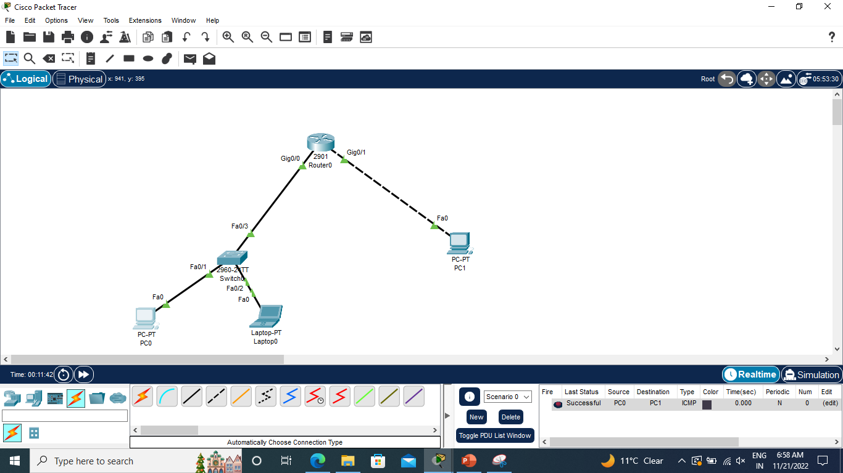
10.0.0.3
20.0.0.2
20.0.0.1
10.0.0.1
10.0.0.2

Slide 4
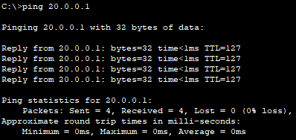
ping
ping from PC0 to PC1

Slide 5
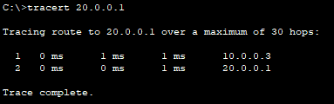
trace
tracert command based on previous ping command
On pc, there is tracert command and on router, there is trace command

Slide 6
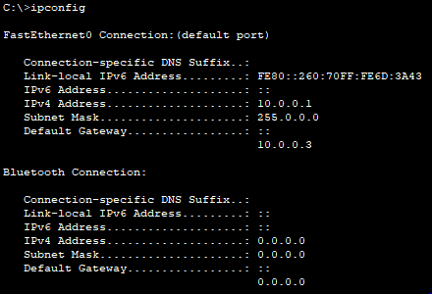
ipconfig
ipconfig on PC0

Slide 7
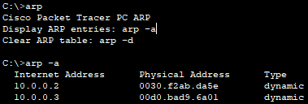
arp
The Address Resolution Protocol (ARP) is a communication protocol used for discovering the link layer address, such as a MAC address, associated with a given internet layer address, typically an IPv4 address.
arp –a on PC0

Slide 8
netstat
Displays active TCP connections, ports on which the computer is listening, Ethernet statistics, the IP routing table, IPv4 statistics (for the IP, ICMP, TCP, and UDP protocols), and IPv6 statistics (for the IPv6, ICMPv6, TCP over IPv6, and UDP over IPv6 protocols).
Syntax
netstat [-a] [-e] [-n] [-o] [-p Protocol] [-r] [-s] [Interval]

Slide 9
Parameters
-a : Displays all active TCP connections and the TCP and UDP ports on which the computer is listening.
-e : Displays Ethernet statistics, such as the number of bytes and packets sent and received. This parameter can be combined with -s.
-n : Displays active TCP connections, however, addresses and port numbers are expressed numerically and no attempt is made to determine names.

Slide 10
-o : Displays active TCP connections and includes the process ID (PID) for each connection. You can find the application based on the PID on the Processes tab in Windows Task Manager. This parameter can be combined with -a, -n, and -p.
-p Protocol : Shows connections for the protocol specified by Protocol. In this case, the Protocol can be tcp, udp, tcpv6, or udpv6. If this parameter is used with -s to display statistics by protocol, Protocol can be tcp, udp, icmp, ip, tcpv6, udpv6, icmpv6, or ipv6.
-s : Displays statistics by protocol. By default, statistics are shown for the TCP, UDP, ICMP, and IP protocols. If the IPv6 protocol for Windows XP is installed, statistics are shown for the TCP over IPv6, UDP over IPv6, ICMPv6, and IPv6 protocols. The -p parameter can be used to specify a set of protocols.
-r : Displays the contents of the IP routing table. This is equivalent to the route print command.

Slide 11
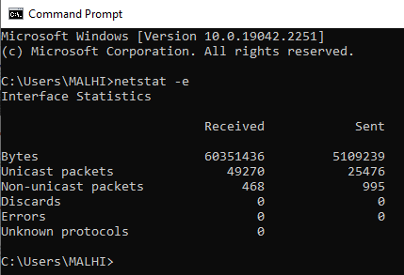
Parameter Description
netstat –e Displays Ethernet statistics, such as the number of bytes and packets sent and received.

Slide 12
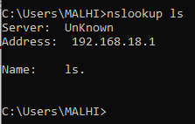
nslookup
Displays information that you can use to diagnose Domain Name System (DNS) infrastructure. Before using this tool, you should be familiar with how DNS works.
Parameter Description
nslookup ls Lists information for a DNS domain.

Slide 13
References
https://learn.microsoft.com/en-us/windows-server/administration/windows-commands/netstat

