Slide 1
Analyzing the San Francisco Bay Area Real Estate Market:
Group 5:
Aditya Mane
Christina Fox
Praneetha Kuna
Pavan Lokireddy
Naresh Kumar
Shashi Preetham
Sai Kumar
Venkat Ram Reddy
Notes:
SAI

Slide 2
Introduction:
The San Francisco Bay Area's real estate market has witnessed astounding price surges over the years, making it a compelling focus for data analytics.
Amidst the recent challenges posed by the pandemic and economic shifts, our newly collected data could unveil intriguing trends in this dynamic landscape.
Notes:
SAI

Slide 3
Initial Steps:
1) Data Collection - Scraping Redfin URLs
2.) DATA CLEANING
3.)PREPROCESSING
Notes:
SAI

Slide 4

DATA COLLECTION: SCRAPING REDFIN URL’S
For each URL, we concatenated it with "https://www.redfin.com" to create the complete Redfin URL for that city.
This compilation of URLs represents the foundation from which we will be extracting valuable real estate data.
Loading Scraped Data into Data Frame, it consists of several columns:
'AddressLine': The address of the property.
'StateCode': The state code (California in our case).
'City': The city in California where the property is located.
'Zipcode': The property's ZIP code.
'PropertyPrice': The price of the property.
'BedRooms': The number of bedrooms in the property.
'BathRooms': Number of bathrooms.
'Property_Sqft': Property size in square feet.
'School_rating': Nearby school ratings.
'Garage': Information on the presence of a garage.
'YearBuilt': Year the property was constructed.
‘TimeOnRedfin': Time the property has been listed on Redfin.
'PropertyType': Type of property (e.g., single-family, condo).
'PropertyStyle': Property style (e.g., colonial, modern).
'PropertyCommunity': Information about the property’s community.
Notes:
Pavan. We made sure that we get sufficient variables to cover the analysis. Columns like garage, year built nad the listing time actually plays a key role in sales

Slide 5
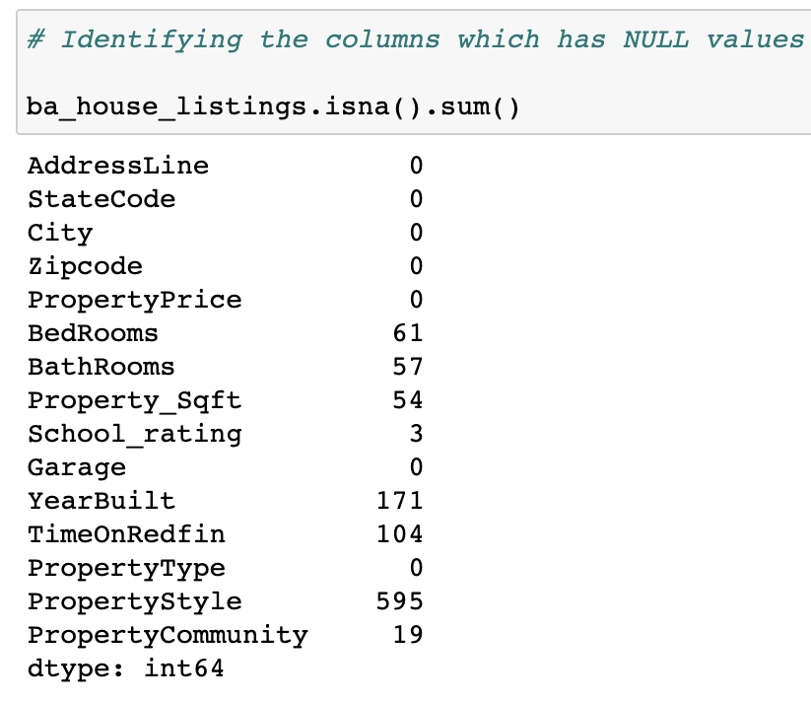
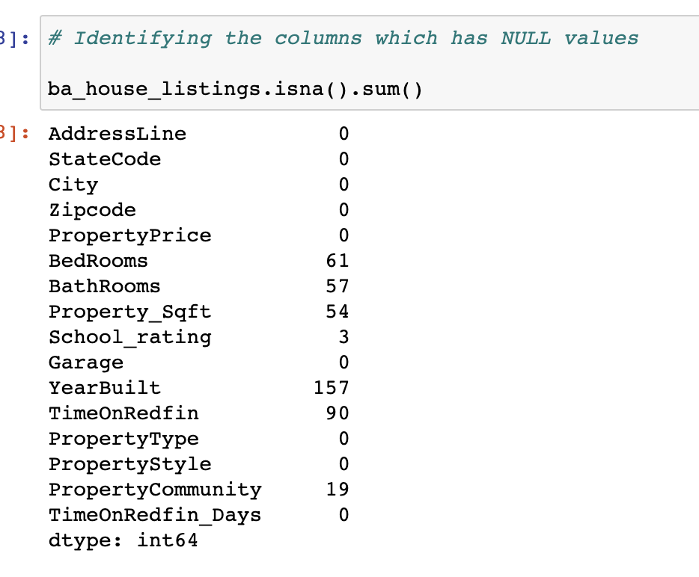
DATA CLEANING:
Handling the missing values through imputation or removal.
Standardizing and formatting the cleaned data.
Transform variables as needed. Deal with duplicates.
Replacing the NULL values in Property Style column with the most occurring style.
Notes:
Pavan. The data contained NUll values as you can see. The property style has the most missing. Imputed with most acoouring. And the rest of the variblaes if changed might skew the data so we left them unchanged. We changed the data types. For example the sqft when scraped is string but we split the data and extracted values. We also calculated price/sqft. From sqft and price

Slide 6
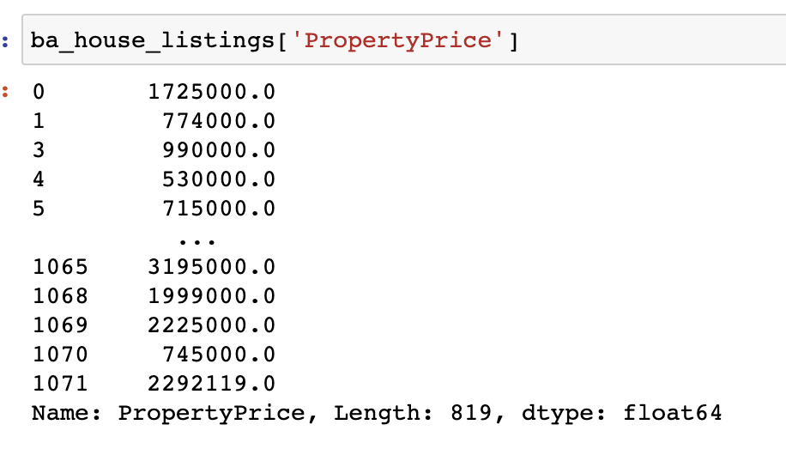
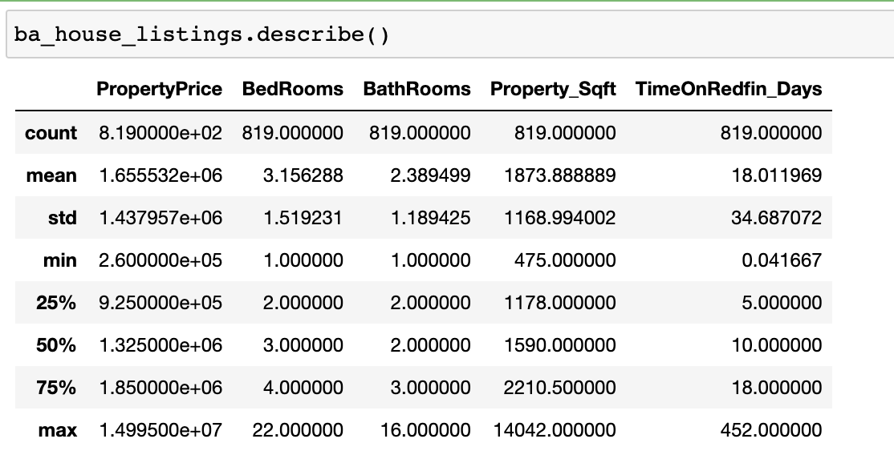
PREPROCESSING:
Replacing the special characters like + and , in the Property Price column.
We conducted a summary statistics analysis on the 'ba_house_listings' Data Frame to gain key insights into the real estate data.
Minimum Property Price: $260,000, Maximum Property Price: $14,995,000, Average Property Price: $1,655,532, Standard Deviation: $1,437,957.
Property_Sqft: Minimum Property Size: 475 sqft, Maximum Property Size: 14,042 sqft, Average Property Size: 1,874 sqft, Standard Deviation: 1,169 sqft
Notes:
Pavan. 1.6M, 18 days , 1879sqft , 875$persqft

Slide 7
Modeling steps
4) Data Analysis and Modeling
5.) Data Visualization
6.) Conclusion
Notes:
Naresh

Slide 8
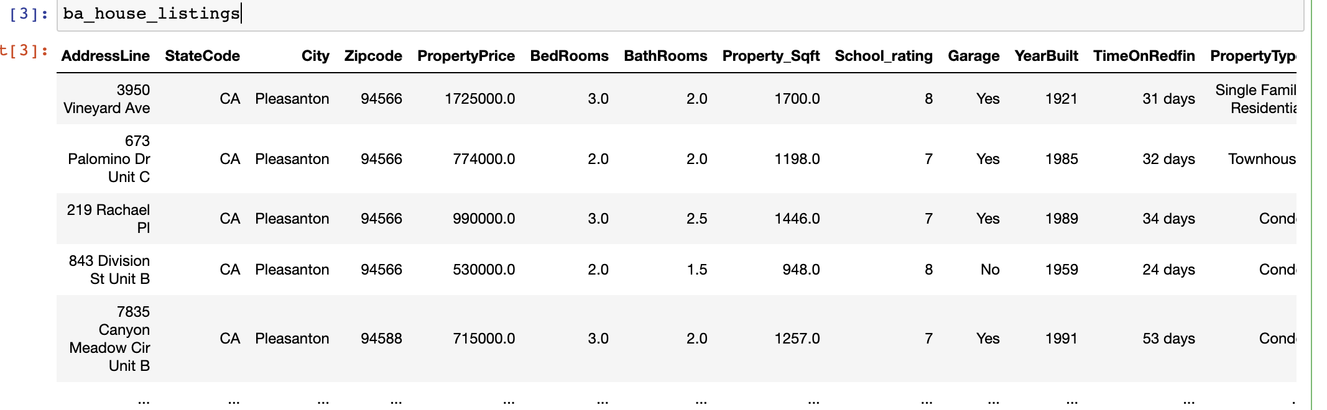
Data Analysis and Modeling:
After removal of duplicates values and dropping index from data set, Data Frame consists the data values across 819 rows and 16 columns.
We defined a list of target cities, including "San-Francisco," "San-Jose," "Pleasanton," "Fremont," "San-Ramon," and "Dublin."
Notes:
Naresh

Slide 9
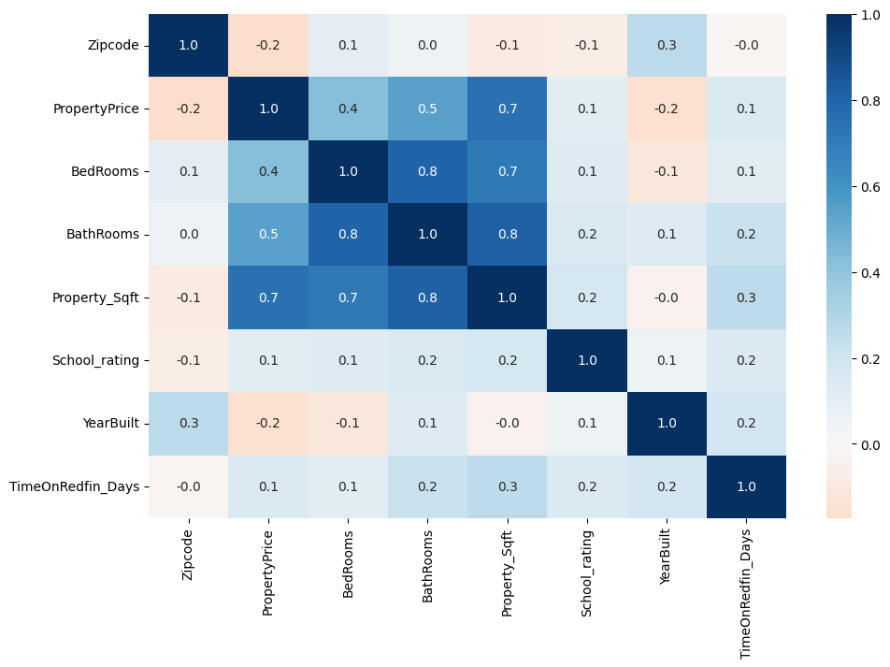
Data Analysis - Correlation Heatmap:
Correlation coefficients range from -1 (strong negative correlation) to 1 (strong positive correlation), with 0 indicating no correlation.
Positive values suggest attributes that tend to increase together, while negative values indicate attributes that tend to move in opposite directions.
By examining the correlation heatmap, we can identify relationships and dependencies between real estate attributes, aiding in data-driven insights and decision-making.
Notes:
Variables with the darkest shades, especially in relation to property price, signify high importance and strong influence on property values. From this heatmap we can see that property square feet is associated with number of bedroom and number of bathrooms.Also the number of bedrooms is correlated with number of bathrooms.Also the property price is correlated with property sq ft #of bedrooms,#of bathrooms

Slide 10
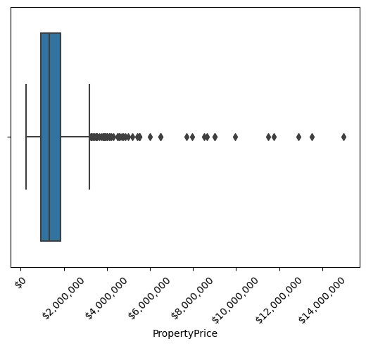
Data Visualization - Property Price Distribution(Box Plot)
We employed data visualization techniques to gain a deeper understanding of property prices within the San Francisco Bay Area.
The box plot (also known as a box-and-whisker plot) visualizes the distribution of property prices in our dataset.
Outliers, depicted as individual points, highlight extreme property price values.
Notes:
Naresh

Slide 11
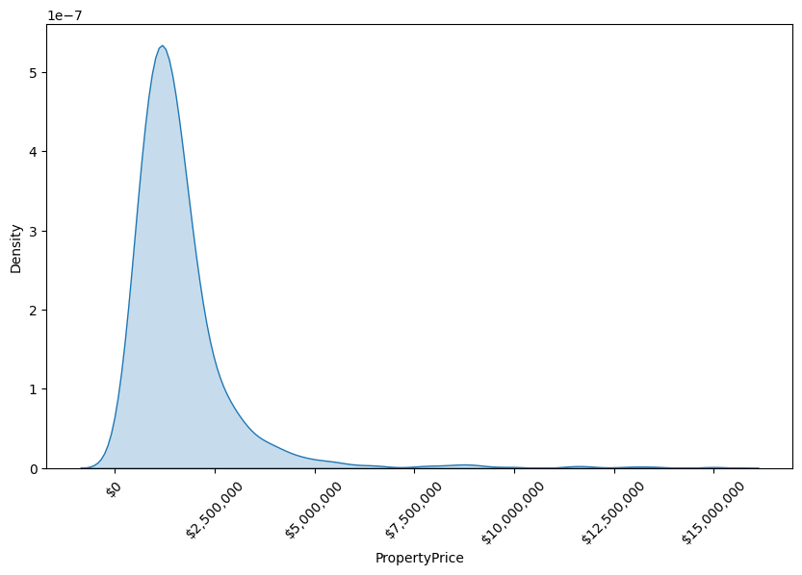
Property Price Distribution (Kernel Density Estimation)
In this visualization, we utilized Kernel Density Estimation (KDE)
By examining this KDE plot, we can gain a more detailed understanding of how property prices are distributed within the dataset. Property prices are expressed in US dollars ($), and the x-axis is formatted for clarity.
Notes:
Naresh

Slide 12
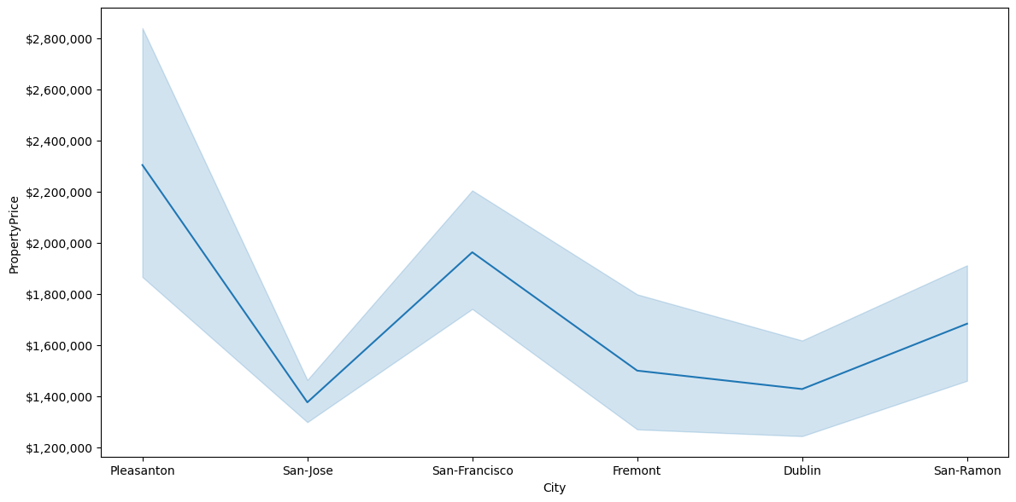
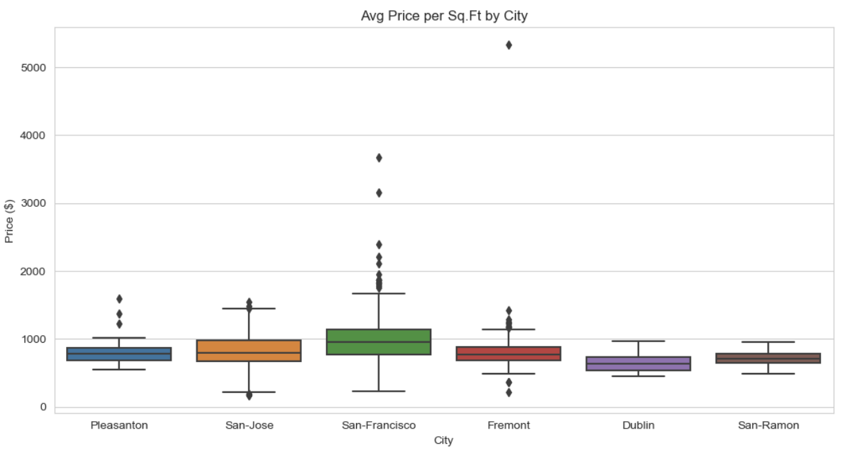
Property Price Variations by City(Line Plot):
This visualization allows us to compare property price trends among different cities in the San Francisco Bay Area.
The varying slopes and patterns in the line plot indicate the diversity of property prices in different locations, providing valuable insights for potential homebuyers and investors.
Notes:
This line plot gives us the insights about how the price are varying among different cities in the bay area.We can see that Pleasanton city has the expensive properties and also the price range varies from starting 1.8 million to 2.5 million.Also even though SF is the fastest growing city we can see that price varies from 1.7million to 2.1 million .There might be factors like property square feet ,school rating and etc which we will be influencing the prices.

Slide 13
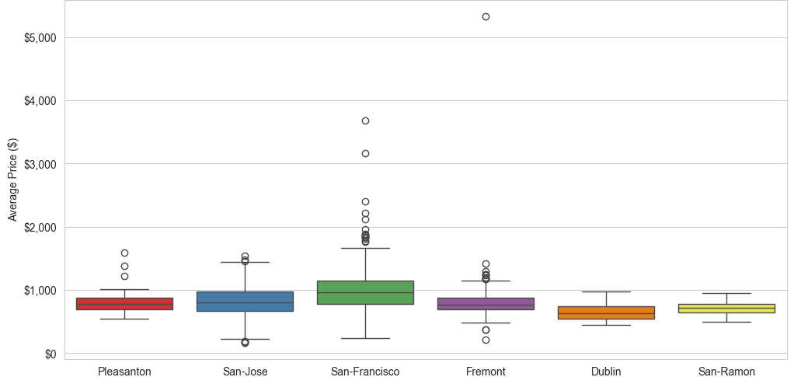
Average Property Price/SqFt By City:
San Francisco properties have highest average property price/sqft and largest price range
Dublin properties have lowest avg. price/sqft
Notes:
-When looking at the average price per square foot, however, San Francisco properties, as expected, have the highest average price,at around $1000 per sq/ft. San Francisco properties also has the largest range of prices
-Dublin properties, on the other hand, have the lowest average price per square foot at around $700 per sqft.

Slide 14
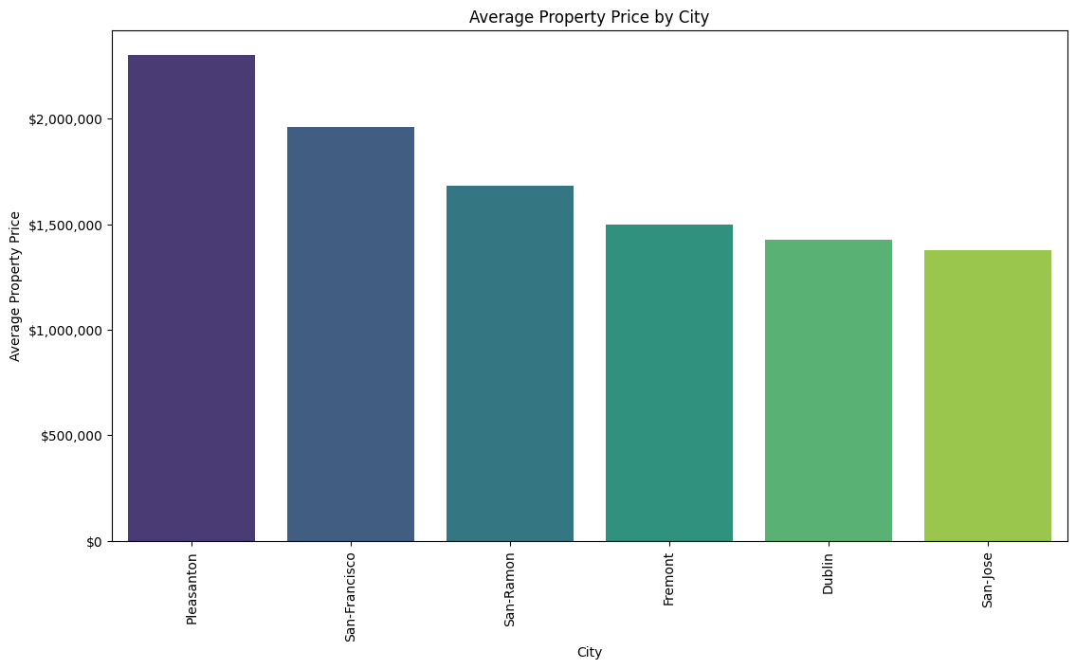
Return on Investment (ROI) by Location - Average Property Prices:
Investors can visualize potential ROI for properties in different locations within the Bay Area
Pleasanton has highest avg. property price, followed by San Francisco
Pleasanton properties also have highest avg. square footage and lowest crime rate, which could account for this
Notes:
Christina
-Next we wanted to look at the Return on investment(ROI) for properties by locations, using the average property prices
-So we created a bar chart that shows each city on the y-axis and the average property price which we converted into dollars on the x-axis
-We found that Pleasanton had the highest average property price of over $2 million followed by San Francisco which is just under that.
-We also found that Pleasanton properties had the highest average square footage as well as the lowest crime rate, which could account for this result.

Slide 15
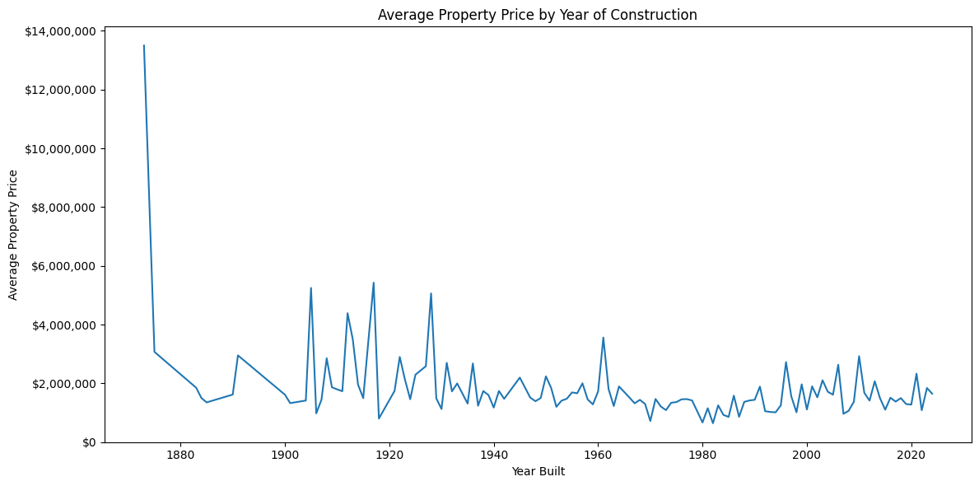
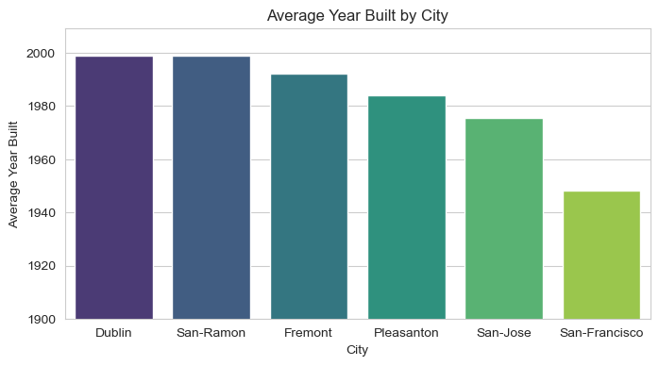
Average Property Price by Year of Construction:(Line Plot)
Properties older than 1930 seem to have higher property prices
Due to location? Recent properties likely built in East Bay not SF
Avg. year built (SF) - 1948
Avg. year built (Dublin) - 1999
SF has high price/sqft
Notes:
-Next we created a line plot to calculate the average property price by year of construction.
-We noticed that properties that were older than around 1930, seemed to have higher property prices on average.
-We thought this could potentially be due to the location of these properties, since more recent properties are likely not being built in San Francisco but rather on the east bay.
-So we created a bar plot to look at the average year built by city, where we found that San Francisco did have the lowest avg year built of 1948 while dublin had the highest of 1999.
-Since San Francisco properties have such a high price/sqft, it makes since that the average property price is higher for older properties, as many of these are likely in San Francisco.

Slide 16
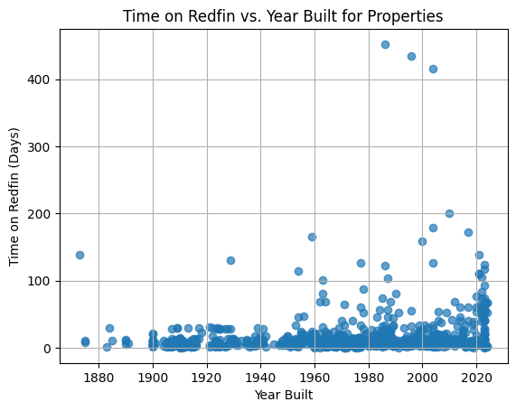
Duration on RedFin by Year of Construction:(Scatter Plot)
This scatter plot enables us to understand how the age and historical context of a property's construction contribute to its sale on Redfin.
Notes:
This scatter plot gives the information about how long the properties were listed on the website for sale and we can observe that most of the properties listed on red fin are sold under 3 months. and the houses built between 2000-2020 there are some house where the duration listing on redfin is more than 100 days.From this we can say that if any customer is willing to sell their property there might be a high chance that it can be sol

Slide 17
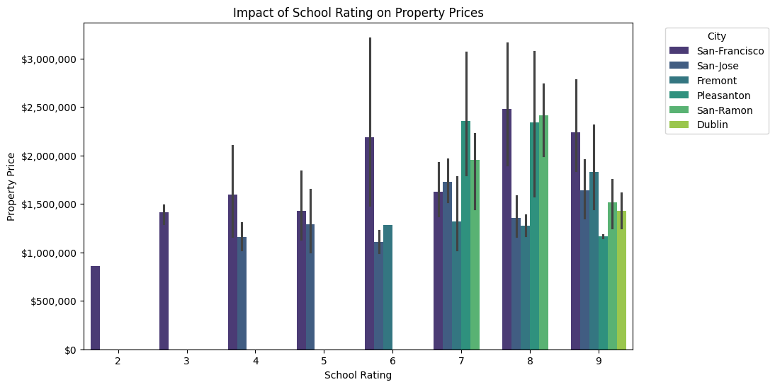
Impact of Proximity to Amenities - School Ratings vs. Property Prices
Properties with higher school ratings tend to have higher property prices, with each city peaking at 7,8, or 9
San Francisco has a wider range of school ratings, while Dublin, San Ramon, and Pleasanton only returned properties with proximity to higher rated schools
Notes:
Aditya

Slide 18
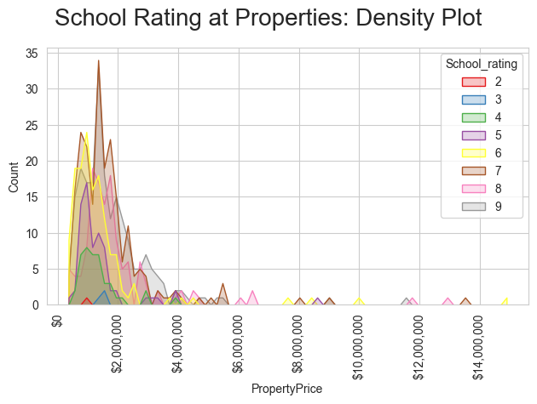
School Rating vs. Property Price: Density Plot
The color-coded density curves illustrate how property prices are distributed based on school rating.
This density plot provides an in-depth understanding of how school ratings impact property prices, enabling potential homebuyers to make informed decisions based on school quality.
Notes:
There are more than 30 plus properties with schools whose rating is 7 and price is distributed from below 2 million to 14 million. We can say that if there are schools with highest rating then the property price is being influenced.

Slide 19
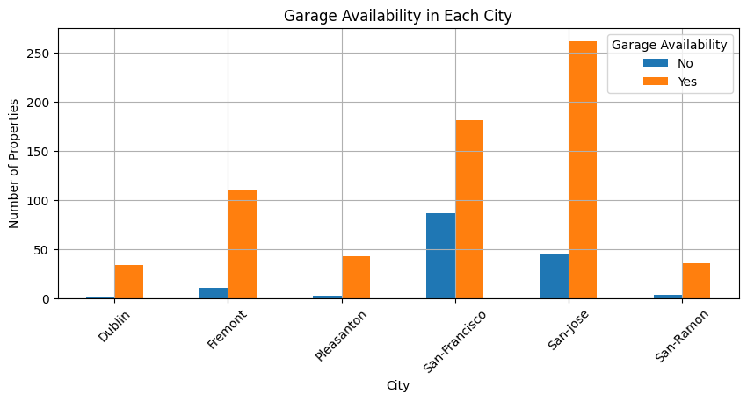
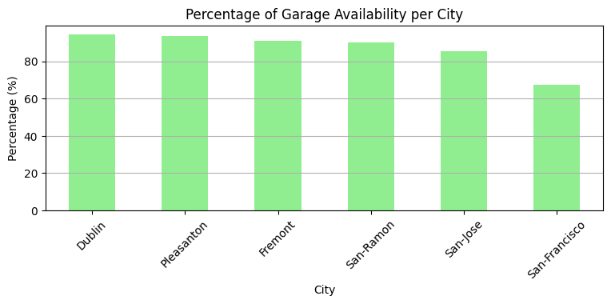
Garage Availability By City:
Most properties have garages; SJ and SF have the most properties with garages
However, if we take total count of properties per each city and plot the percentage of garage availability , SF and SJ have lowest rate of garage availability; Dublin has the highest due to the more listings.
Notes:
We also wanted to look at Garage availability by city. In the first bar chart, we have number of properties on the y axis and cities on the x-axis. The graph shows us that most properties do have garage access, with san jose and san francisco having the most properties with garages. However, this chart doesn’t really account for the disproportionate total amount of properties for each city. In the second bar chart, we can see the percentage of properties with garages by each city. We see that actually san francisco and san jose have the lowest rate of garage availability, while dublin properties are most likely to have a garage.

Slide 20
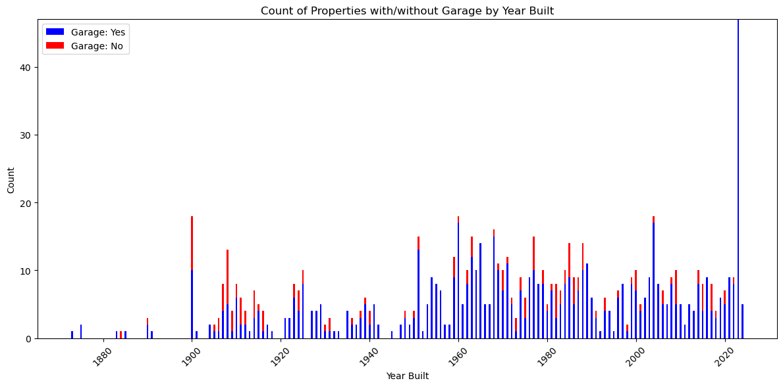
Count of Properties with/without Garage by Year Built
It provides insights into historical trends and preferences for garage availability in the San Francisco Bay Area real estate market.
The chart displays two bars for each year, representing the count of properties with 'Garage: Yes' (in blue) and 'Garage: No' (in red).
Notes:
Preetham

Slide 21
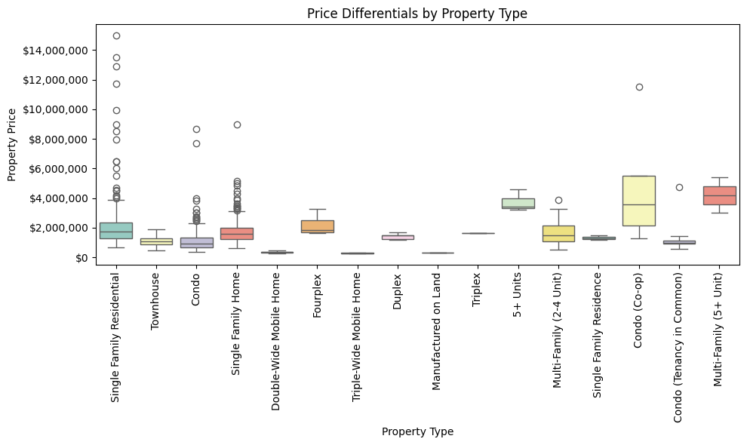
Price Differentials by Property Type: (Box Plot)
Shows range of property prices for different property types; can demonstrate how property type influences pricing
Multi Family or 5+ unit homes have the highest mean property prices; likely have higher square footage
Co-op condos and single family residential homes have the biggest ranges in price; more data for these types
Notes:
-Next, we created a box plot to look at price differentials by property type.
-This plot shows the range of property prices for different property types, which can demonstrate to investors how property type is influencing pricing
-We can see that Multi Family or 5+ unit homes have the highest mean property prices, (around $5 million) which is likely due to the fact that these properties have a higher square footage
-We can also see that Co-op condos and single family residential homes have the biggest ranges in price; and this could potentially be due to us having more data for these types of properties

Slide 22
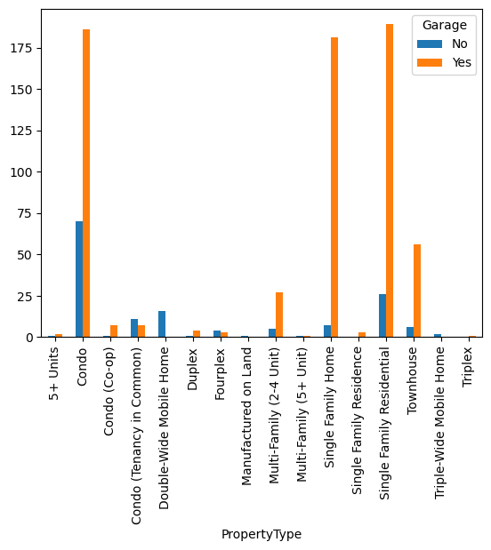
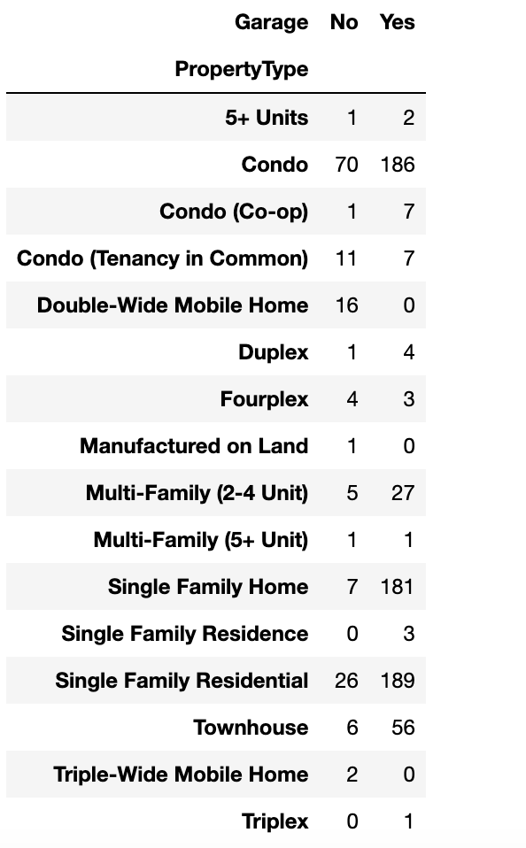
Property Type vs. Garage Availability
It is clear that property types like 'Condo,' 'Single Family Home,' 'Single Family Residential,' and 'Townhouse' typically have 'Yes' for garage availability, while others vary.
This information can be valuable for potential buyers who have specific preferences for garage availability based on property type.
Notes:
Preetham

Slide 23
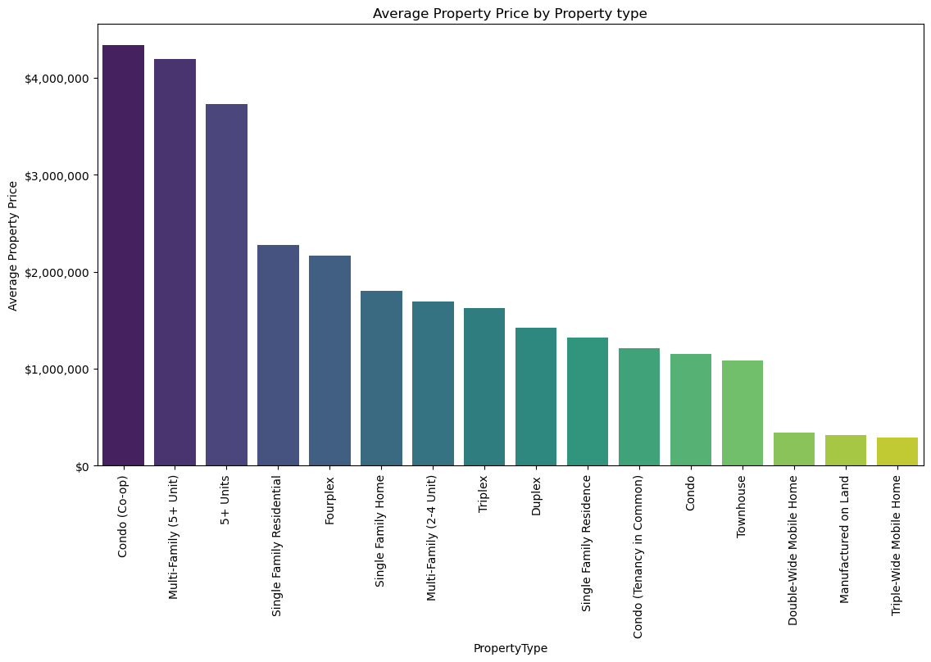
Return on Investment (ROI) by Property Type - Average Property Prices
To visualize the potential Return on Investment (ROI) for properties based on their type, we created a bar chart.
This chart offers a quick and informative overview of average property prices by property type, aiding potential investors in assessing ROI opportunities based on property characteristics.
Notes:
Venkat comparing variou types of properties the avg price of coop is pretty

Slide 24
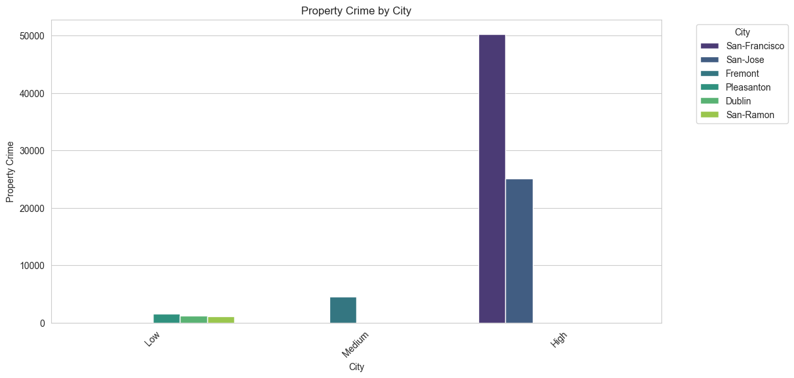
Average Property Price by Crime Rate Category (Colored by City)
The bar plot displays the average property price for different crime rate categories, categorized as 'Low,' 'Medium,' and 'High.
This grouped bar plot allows us to assess the relationship between crime rates and property prices while considering variations across different cities.
Notes:
Venkat

Slide 25
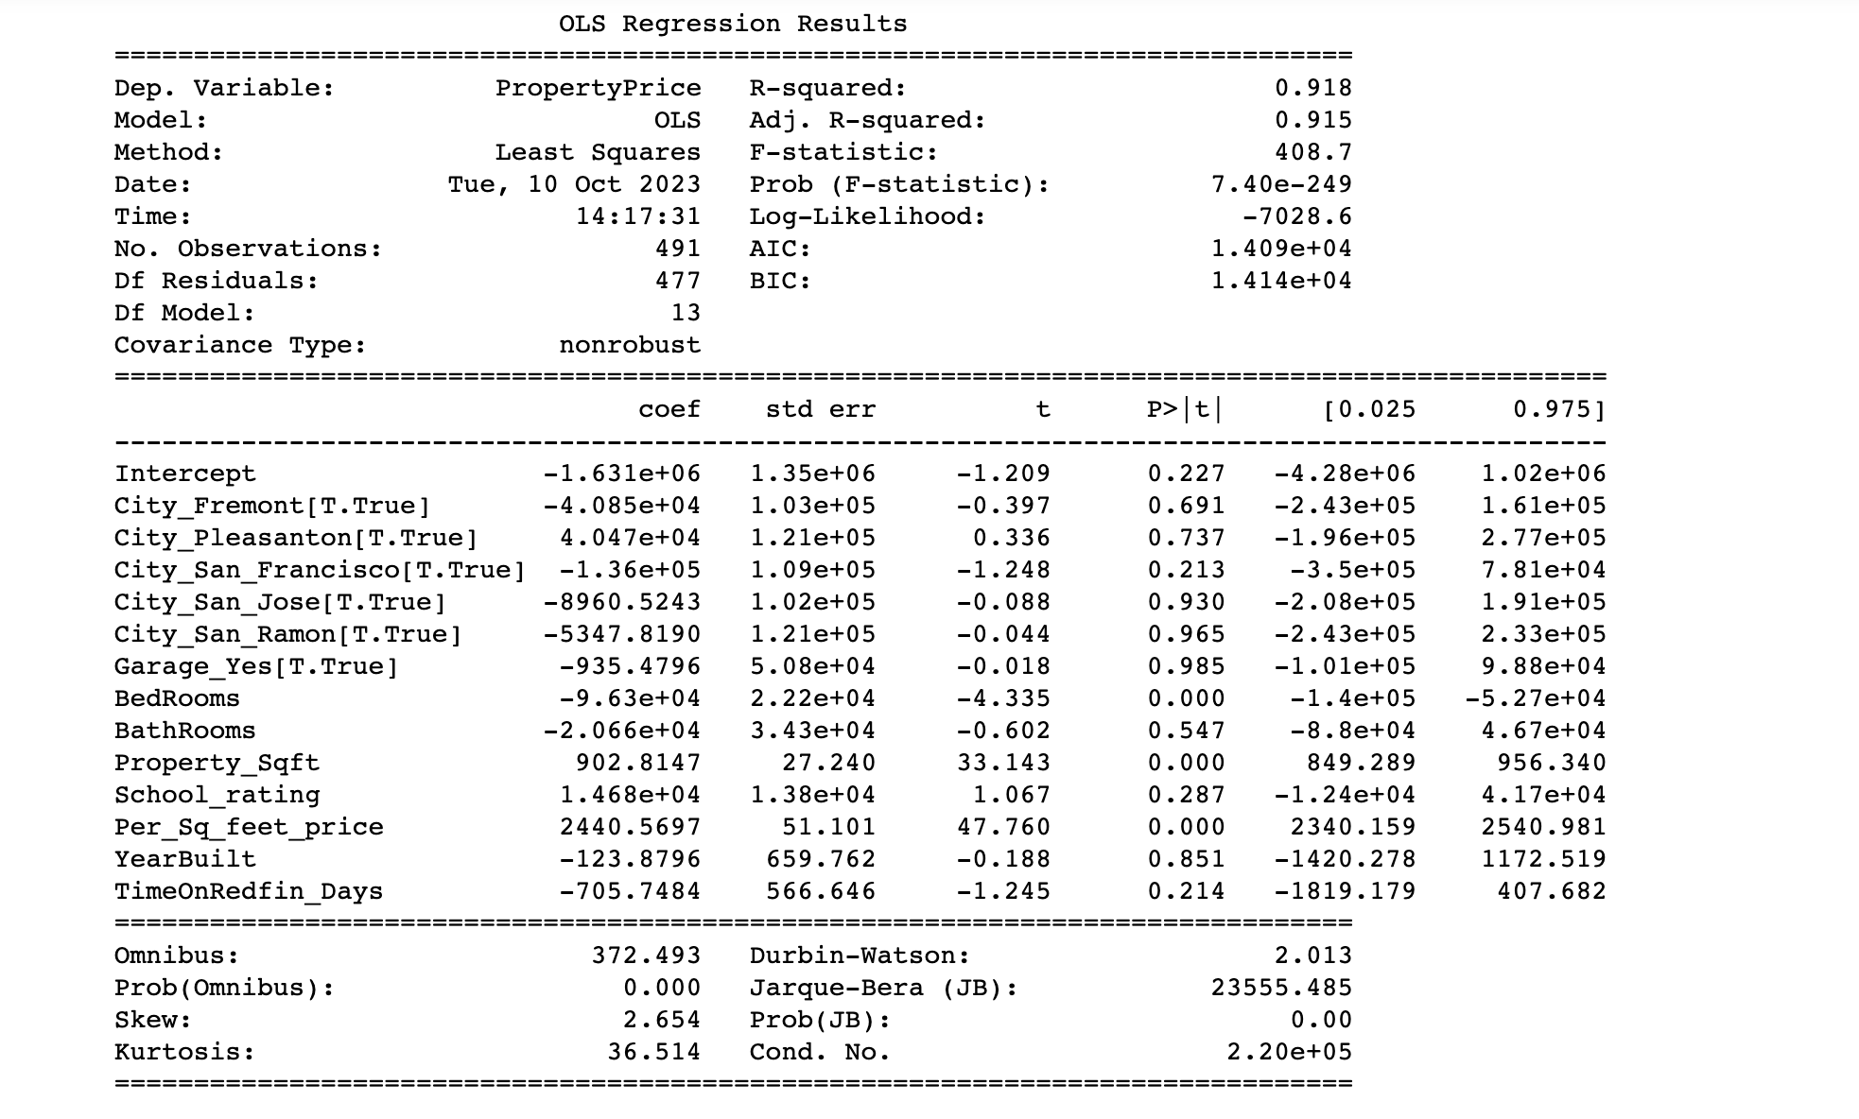
Linear Regression Analysis
The Dependent Variable in the analysis is 'PropertyPrice,' which is the target variable being predicted.
The R-squared value of 0.918 indicates that the model explains 91.8% of the variance in 'PropertyPrice.'
The Adjusted R-squared value of 0.915 takes into account the number of predictors in the model, offering a more accurate measure of model fit.
Notes:
Preetham

Slide 26
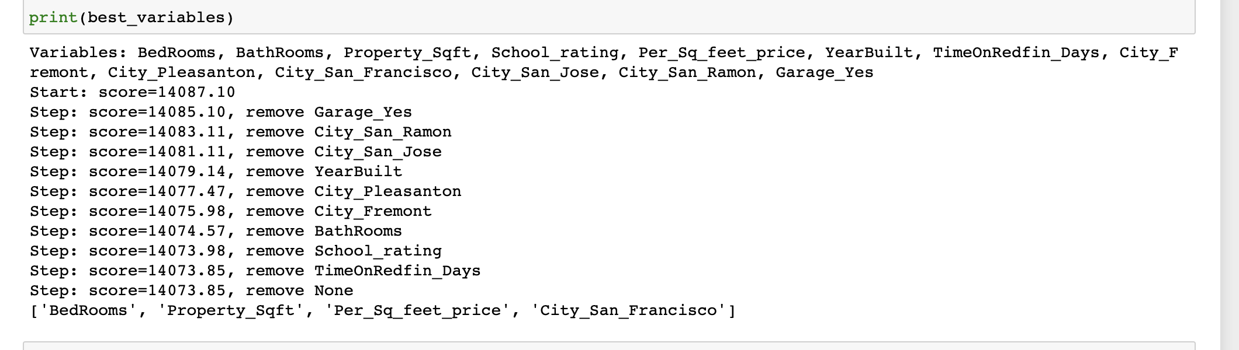
Best Variables:

Slide 27
Insights from analysis:
he linear regression model shows an R-squared value of 0.918, indicating that the model explains approximately 91.8% of the variance in property prices.
Location Matters: Location is a critical factor in property pricing. The data indicates that cities, such as Pleasanton are a good location to own a property.
Property Size: Property size, measured in square footage (Property_Sqft), has a substantial impact on property prices.
The number of bedrooms and bathrooms is positively correlated with property prices. More bedrooms and bathrooms often result in higher property prices.
The analysis indicates that areas with higher property crime rates generally have lower property prices. However, this relationship is more complex and influenced by other factors.
School Quality: School Rating is another significant factor. Properties located in areas with higher-rated schools tend to command higher prices
Garage Availability: Whether a property has a garage can impact its price. Garages are a desirable feature for many buyers as they provide parking and storage space.

Slide 28
THANKS
Notes:
SAI

