Slide 1
Team 5 · Q15
What should the “you may also like”
shelf show, and to whom?
Association rules on Lumen Beauty orders (Sep–Nov 2026)
Nini Rizhamadze · Giulia Scarpa · Milena Moschetti · Thi Thuy Khuc · Lina-Sophie Reinsch · Hai Yen Bui
Team 5 · Q15 · Lumen Beauty · 1/10

Slide 2
The decision at stake
One shelf. Who does it really serve?
65%
of orders are single-product
¥2.2–6.6k
scenario value / month if 5–15%
of serum-only orders add a cream
93%
of history-rule evidence comes
from heavy buyers (6+ orders)
• Founder & merchandising team choose which rules go on the post-purchase shelf.
• Q15 asks us to mine both single orders and whole customer histories — then check whom each shelf serves.
• Yuan upside is modest; the sharper risk is a shelf that mirrors the heaviest buyers.
Team 5 · Q15 · Lumen Beauty · 2/10

Slide 3
Method in one slide
Week 3 association rules · two basket definitions
• Order baskets = products bought together (the moment the shelf appears).
• History baskets = every product one customer bought in the quarter.
• Pairs only. Metrics: support, confidence, lift — with co-purchase count / denominator next to each rule.
• Support & confidence filter frequency; they are not significance tests.
• Thresholds from the shelf decision: ≥14 orders (0.4%) · ≥13 customers for histories (2%).
• Segments by n_orders: light 1–2 · mid 3–5 · heavy 6+ (robust at 4 / 8 / 10).
Team 5 · Q15 · Lumen Beauty · 3/10

Slide 4
Finding: one strong order rule
Serum → Cream · 256 / 3,401 orders · lift 1.75
• At a comparable bar: 30 order rules vs 870 history rules (every possible pair).
• Serum → Cream: 256 orders with both vs ~147 expected by chance; confidence 0.40.
• Direction: Cream → Serum confidence is only 0.33 — show cream after serum.
• Holds for light / mid / heavy (1.79 / 1.93 / 1.72), livestream & store, and first orders (1.80).
• SKU pairs only rank which cream (Vit. C → Hydra Gel / Brightening; 26–27 orders).
Team 5 · Q15 · Lumen Beauty · 4/10

Slide 5
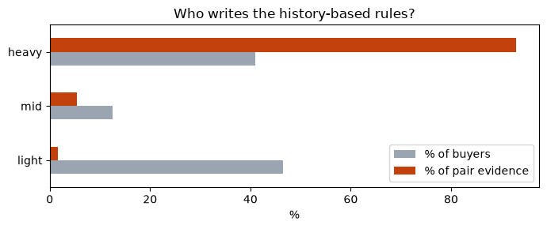
Finding: history shelves serve heavy buyers
Light buyers = 46.5% of buyers, 1.7% of history-rule evidence
• Heavy buyers average 11.7 products → most pair evidence.
• Top history pairs have same-order lift < 1 (substitutes across visits).
• Calling them “bought together” would mislabel the shelf.
• Robust at every heavy cut-off we tried.
Team 5 · Q15 · Lumen Beauty · 5/10

Slide 6
From rule to shelf decision
What a buyer with no history sees — and what would reject the rule
Trigger
Any serum in the current basket
Customers
Everyone — including first-time / light buyers
Shelf position
Slot 1 on the post-purchase shelf: a cream
No history
Same shelf (first-order lift 1.80)
Reject if
A/B add-on < 2% in 6 weeks, or same-order lift ≤ 1 on control
Team 5 · Q15 · Lumen Beauty · 6/10

Slide 7
Monday morning
What the merchandising team does next
• Mine the shelf from single orders — not from purchase histories.
• After any serum, show a cream; rank creams with thin SKU pairs.
• One shelf for all buyers; no separate first-time shelf.
• Remaining slots: products light buyers buy most — not overall bestsellers.
• Pilot from 1 Dec 2026: random half for six weeks; success ≥ 5% cream add-on among serum-only orders.
• Drop the action if treatment add-on < 2% vs control, or light buyers are left behind.
Team 5 · Q15 · Lumen Beauty · 7/10

Slide 8
Ethics tied to this shelf
Bias, labelling, and data minimisation
• Stake: a history shelf would serve light buyers a heavy-buyer catalogue.
• Misinformation risk: do not label cross-visit substitutes as “bought together”.
• Privacy: order-based rules need only the current basket (PIPL minimisation).
• Safeguard: re-mine rules on the control half; report results by buyer type.
• Offer a non-profiled option (Algorithmic Recommendation Provisions, Art. 17).
Team 5 · Q15 · Lumen Beauty · 8/10

Slide 9
What the data cannot tell us
Honest limits before Q&A
• Association ≠ causation; past logs cannot measure the shelf’s own effect.
• ¥2.2–6.6k / month is a scenario — only the A/B test measures lift.
• Light-buyer SKU rules are thin (366 orders); we trust the category rule.
• Live shelf may create the pairs it later mines — hence the control-half re-mine.
Team 5 · Q15 · Lumen Beauty · 9/10

Slide 10
Show a cream after a serum.
Build the shelf from orders, not histories.
One shelf for everyone — including buyers with no history.
Pilot half the traffic for six weeks. Drop it if it fails the kill conditions.
Team 5 · Q15 · Lumen Beauty · 10/10

