Slide 1
Team name: Zhuge Liang
Advisers: Qi Li
Team members: Yuming Zhou
Tong Wu
Xiaoqi Wang
Soundproof Wall Design for Specific Frequencies

Slide 2
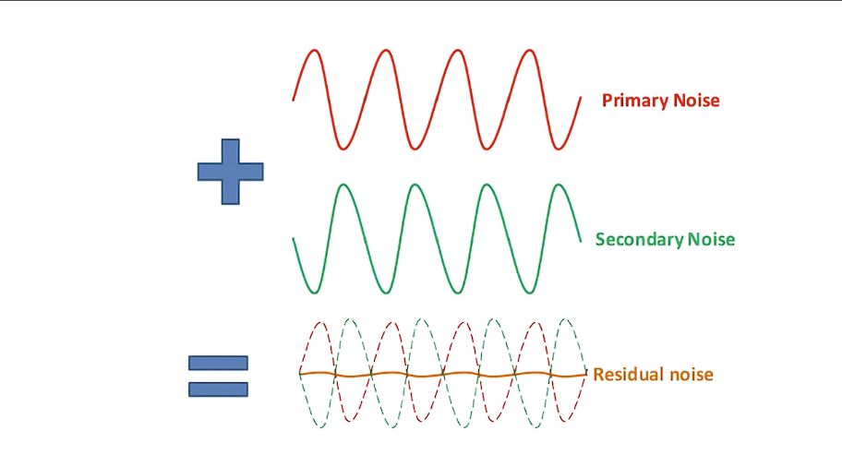
Background & Motivation
Background: Noise reduction materials can be divided into three categories according to their working principle: sound absorption materials, sound insulation materials and damping vibration reduction materials. Sound absorbing materials reduce noise by absorbing sound wave energy, sound insulating materials reduce noise by blocking sound wave propagation, and damping materials control noise by reducing vibration.
Motivation: The motivation mainly stems from the increasingly serious problem of noise pollution in modern society. Noise pollution not only affects people's hearing, sleep and communication, but also accelerates the aging of mechanical structures and buildings. Therefore, the research and development of effective noise reduction materials is of great significance to ensure the sustainable development of economic society.

Slide 3
CONSTRAINTS & GOALS
Constraints: Cost, time-consumption, technical requirements, applicability…
Goals:
Reduce the impact of noise on the environment
Provide more cost-effective solutions for projects with high construction noise

Slide 4
Overview of technical project plan
Step 1:Material Selection
1）Mechanical metamaterials, artificial composite materials/structures with periodicity, constructed through artificial microstructural units
2）Advantages: High degree of freedom, multiple applicability
Step 2:Model construction
For example: thin film acoustic metamaterial structure, honeycomb structure, lattice structure, ultra lightweight porous structure
Step 3:Fabrication
Determination and purchase of materials - Model construction - Experimental testing - Model modification - Submission of results

Slide 5

Validation
Step 1:measurements
Before the installation of the soundproof wall, the sound level meter is used to measure the noise level of the target area, record the noise data of different time periods and different frequencies, and carry out laboratory tests on the selected soundproof material to measure its sound absorption coefficient and sound insulation effect at different frequencies, and record the environmental conditions of the soundproof wall installation area, such as temperature, humidity, wind speed, etc. To assess its impact on sound insulation.
Step 2:analysis
The measured noise data are analyzed to determine the main noise source and frequency range. According to the laboratory test results, the sound insulation effects of different materials at different frequencies are analyzed, the optimal material combination is selected, and the impact of environmental conditions on the performance of the sound insulation wall is evaluated, and the design is adjusted to adapt to the actual environment.
Step 3:validation
Acoustic simulation software is used to establish the calculation model of the sound insulation wall, simulate its sound insulation effect in the actual environment, and compare it with the measurement data for verification. After the installation of the sound insulation wall, field noise measurement is carried out to evaluate its actual sound insulation effect, and comparison is made with the design target. Finally, the overall performance of the sound insulation wall is evaluated according to the field test results. Determine whether the expected goals were achieved and record all data and analysis results.

Slide 6
References
XIE Dong, XIE Xiaoli, YANG Yang, et al. Influence factors of sound insulation performance of common wall and improvement measures[J]. Technical Acoustics, 2023, 42(4): 515-523.Chacón J M, Caminero M A, García-Plaza E, et al. Additive manufacturing of PLA structures using fused deposition modelling: Effect of process parameters on mechanical properties and their optimal selection[J]. Materials & Design, 2017, 124: 143-157.
Yin J F, Cai L, Fang X, Xiao Y, Yang H B, Zhang H J, Zhong J, Zhao H G, Yu D L, Wen J H. Review on research progress of mechanical metamaterials and their applications in vibration and noise control . Advances in Mechanics, 2022, 52(3): 508-586. doi: 10.6052/1000-0992-22-005
Li Siyuan, Yang Wei, and Yang Mingbo Noise reducing polymer materials and their applications. "Application of engineering plastics 32.5 (2004): 4
Continued in Xi'an Design methods for low-frequency noise reduction structures using acoustic metamaterials Dis. Dalian University of Technology, 2020

