Slide 1
Haven't We Met Before? Using Recent Bug-Fixes to Find New Vulnerabilities.
@N1ckDunn

Slide 2
whoami
@N1ckDunn
@nickdunn@infosec.exchange
Coming from software development and architecture
6 years as software developer, architect, team lead, working in secure software for the financial sector
Security consultancy
Began as an in-house penetration tester and code reviewer in online gambling
Moved into security consultancy and worked on:
Code review
Penetration testing
Threat modelling, architecture review
Automating security testing with new tools, scripts, etc.
Notes:
Let’s talk about why this is important to me…
After several years as a developer and architect in the financial sector, I decided that since I got the most enjoyment from security-related projects that I’d worked on that a career in a more security-focussed role would make sense. I moved on to the online gambling sector, where my role as a penetration tester and code reviewer resulted in close work with developers to resolve security issues. It was during this period that I discovered threat modelling and the benefits it can bring, particular when dealing with an unfamiliar system.
As a consultant, the previous software development work was immensely helpful in recognising the pressures that developers face, the nature of the work that they do, while allowing me to bring in the perspective of a security specialist in order to help with discussions upon secure design and code review.

Slide 3
The Workshop – What it is and isn’t
This is one more tool and technique to be added to a broader armoury of code review tools.
It’s been useful to me in a situation where I’ve dealt with robust codebases that have already been subject to multiple other reviews and scanning tools.
It’s not a silver bullet, or magic technique to find bugs without doing any work.
It’s not a replacement for your existing code scanning and code review techniques.
Notes:
I’m sure this doesn’t actually need saying but I’m saying it anyway

Slide 4

Standard Disclaimer
As usual, these techniques can be used for good or evil.
If you discover major issues in open-source projects or libraries, report them/fix them, play nicely, and don’t go down the path of world domination (or minor theft).
Notes:
The workshop techniques are being given to make your (and your client’s) code safer, not to randomly hack stuff, etc. etc.

Slide 5
The Plan
Recap
10 mins
Working on Some Queries
50 mins
Use Cases
30 mins
The Tool
20 mins
Notes:
I explain the process of installing and using weggli for code security reviews.
Then we’ll look at some more creative uses for it and some interesting use cases.
Finally, you’ll do it yourself and we’ll have a quick review and recap.

Slide 6
The Tool – What is Weggli, and When Should I Use it?

Slide 7

Weggli – What it is and When to Use it
Weggli - a fast and robust semantic search tool for C and C++ codebases
It’s written by Felix Willhelm (Google Project Zero)
It’s open source and available on GitHub:
https://github.com/googleprojectzero/weggli
Also, a type of sweet bread roll from Switzerland
Notes:
Weggli is a free tool, written by Felix Willhelm
The associated bread is sweet, and milk-based – popular snack for children (I think). If you attempt to google ‘weggli’, give some additional context to reduce the bread-based aspect of the results.

Slide 8
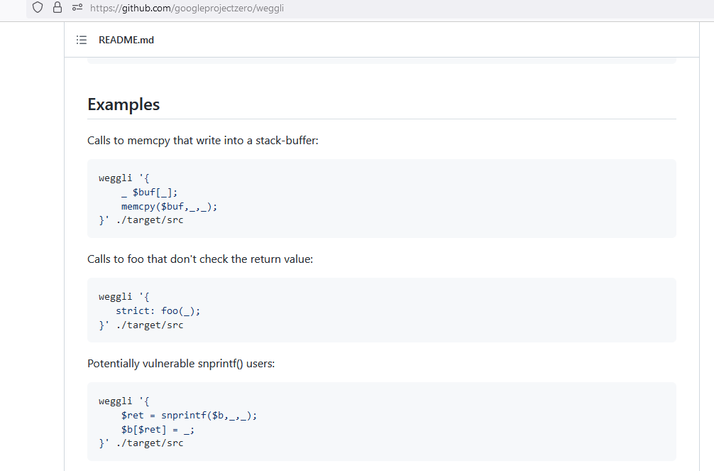
Weggli – Basic Use
Felix’s GitHub page has some instructions and basic examples
Notes:
There is basic documentation online.
Felix’s examples show what is possible and give an outline of how to use it.

Slide 9
Weggli – Basic Use
Let’s break down one of the basic examples to show how it works:
weggli '{
_ $buf[_];
memcpy($buf,_,_);
}' ./target/src
Notes:
Stepping through this:
weggli - fairly obviously the name of the application
‘ - the quote mark denotes the start of the query string
{ - the opening curly brace is the start of the query proper
_ - the underscore marks an arbitrary block of code
$buf - any variables are denoted with a $ sign, so that we can search for it within associated code blocks
memcpy - the surrounding code is written literally
} - the closing curly brace is the end of the query proper
‘ - the quote mark denotes the end of the query string
./target/src - the directory holding the target code

Slide 10

Weggli – Basic Use
From the GitHub examples you may have noticed:
There is an individual query for each vulnerability type
Queries are (vaguely) similar to regex and can span multiple lines
The examples will find issues similar to those found by other code security scanners
Notes:
The examples on the website will find some standard bugs in a similar way to other scanners but more importantly give examples that can act as a template for finding bugs and patterns in a more general way.
The basic examples as they are, can be scripted together but the ones shown on the previous slide will give similar results to a regular scanner.

Slide 11
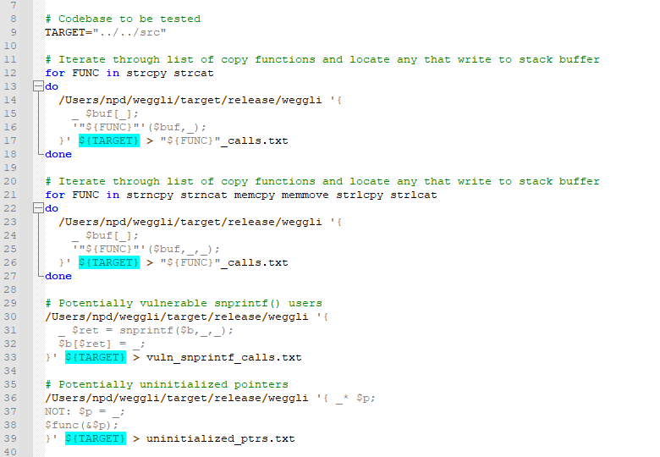
Using Weggli to Supplement Other Scanners…
Before we move onto some interesting uses, Weggli can be scripted to replicate a typical code scanner:
Notes:
Moving on from this we can use Weggli to run Felix’s queries in a scripted way to get similar results to a regular code security scanner (very quickly), and also to find more interesting results.

Slide 12
Some More Interesting Uses
There are currently (mid 2023) very few pages with example uses and ideas. This page has some interesting uses for the tool:
https://dustri.org/b/playing-with-weggli.html
These include:
kmalloc multiplication overflows
Use of sizeof(ptr) instead of sizeof(type of the pointed thing)
Trivial double-frees
Freeing stack-allocated variables
Division by zero
Notes:
The reason I’m showing this page as a demo of good suggestions is because it’s the only one I can find.
If you’re planning to write a script like the one on the previous page, read this page first to get some stuff to use.

Slide 13
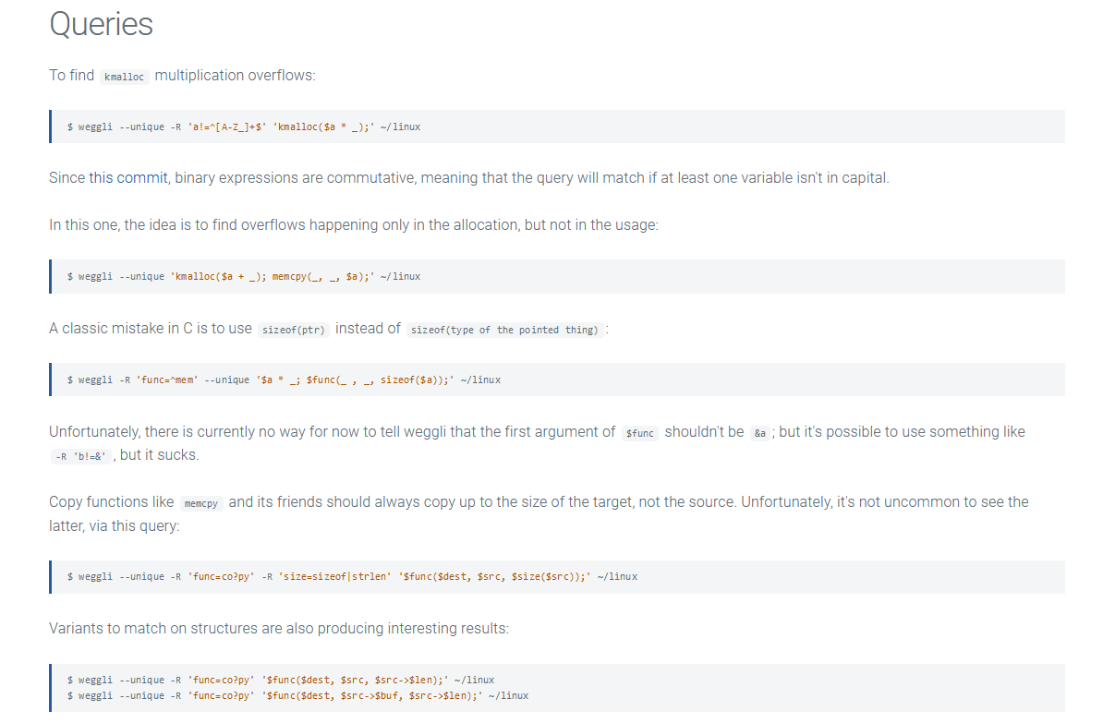
Some More Interesting Uses (continued)

Slide 14
Constructing Interesting Queries
The --unique parameter is needed to enforce whether multiple parameters match the same variable or not:
weggli --unique ‘$x=malloc($a); memcpy($x,_,$b);’ ./code/directory
Example - finding type-confusion frees:
weggli --cpp --unique '$a = new _; $b = (_) $a; delete $b;' ./code/directory
The classic C mistake, using sizeof(ptr), instead of sizeof(type of the pointed thing):
weggli -R 'func=^mem' --unique '$a * _; $func(_ , _, sizeof($a));' ./code/dir
Notes:
It’s important to note that using $varname1 and $varname2 in a query does not enforce that $varname1 and $varbname2 refer to different variables – it’s any variable at all including each other, unless we use the --unique parameter.
If we use the --cpp parameter, then the query will search .cpp files and Objective-C files, otherwise it searches C files, with an extension of .c.

Slide 15
Using the Tool to Supplement Other Scanners and Techniques
The tools flexibility and command line usage mean that:
It can be scripted to perform multiple queries, outputting to separate files, if needed
It can supplement open-source scanners by finding issues relying on specific uses of certain code patterns with multiple variables, etc.
Queries can be specific and identify interesting bugs
This can be used as part of a workflow that takes previous bugs and finds additional unfixed variations of that bug
Notes:
Moving on from this we can use Weggli to run Felix’s queries in a scripted way to get similar results to a regular code security (very quickly), and also to find more interesting results.

Slide 16
Workflow – Identifying Previous Bugs, and Finding Other Instances

Slide 17
High-Level Workflow
Methodology:
Identify recent bugs
Determine which of these:
Have security implications
Have a recognisable pattern
Are likely to have been missed by a standard scanner
Construct query to match the bug that was fixed
Run queries
Analyse results
Notes:
Moving on from this we can use Weggli to run Felix’s queries in a scripted way to get similar results to a regular code security (very quickly), and also to find more interesting results.

Slide 18
High-Level Workflow
Identifying Bugs:
Methods for this will vary according to the project, version control, etc.
In a professional dev environment you will have access to the teams bug reports and bug fixes
For an open-source project you may need to make use of web scraping to obtain a list of fixes from GitHub, BugZilla, etc.
Notes:
Moving on from this we can use Weggli to run Felix’s queries in a scripted way to get similar results to a regular code security (very quickly), and also to find more interesting results.

Slide 19
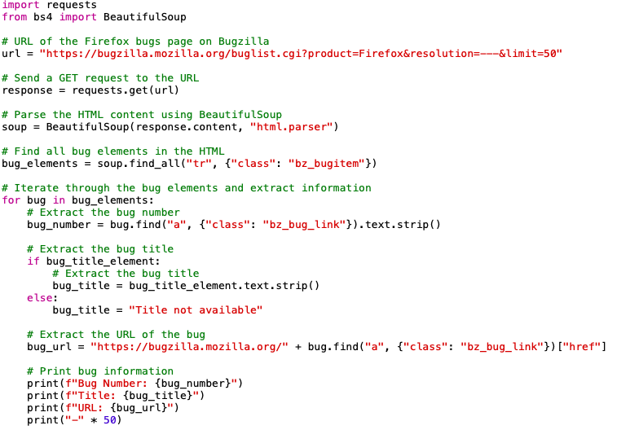
Automated Bug Listing
A script similar to this is suggested for identifying suitable bugs:
Caption
Notes:
Moving on from this we can use Weggli to run Felix’s queries in a scripted way to get similar results to a regular code security (very quickly), and also to find more interesting results.

Slide 20
Use Cases – Some Real-World Examples, and How to Construct a Query

Slide 21
An Example
This code is a modified version of vulnerable code that was encountered in a recent consultancy engagement:
ParamStruct curr_params = media_channel_->GetChannelParameters(source_data);
D_CHECK_GE(curr_params.encodings.size, init_params_.encodings.size);
for (size_t i = 0; i < init_params_.encodings.size; ++i) {
init_params_.encodings[i].id = curr_params.encodings[i].id;
init_params_.encodings[i].data = curr_params.encodings[i].data;
}
media_channel_->SetOutParameters(source_data, curr_params);
Note that the code uses a macro that only performs an action in a debug build, prior to the copy between the two buffers.
Notes:
What I actually promised was finding new bugs, based on similarity to existing bugs…
To explain the debug only check: This was in a piece of code used to replay media files. The debug checks throughout the code would allow better tracking of issues during development. For a production build developers were working under an assumption that occasional missed/dropped packets are fine in a media player, speed is more important to avoid jumpy video/stalled playback.
The check would happen if NDEBUG wasn’t defined.

Slide 22
An Example (continued)
The fix (in Bugzilla) was simple and replaced the debug check with a prod check:
ParamStruct curr_params = media_channel_->GetChannelParameters(source_data);
CHECK_GE(curr_params.encodings.size, init_params_.encodings.size);
for (size_t i = 0; i < init_params_.encodings.size; ++i) {
init_params_.encodings[i].id = curr_params.encodings[i].id;
init_params_.encodings[i].data = curr_params.encodings[i].data;
}
media_channel_->SetOutParameters(source_data, curr_params);
Note that the fixed code uses a macro that performs a greater-than-or-equal-to check, prior to the copy between the two buffers. Bugzilla described this as a fix to prevent RCE.
The fix in line 2, above, replaced the line below:
D_CHECK_GE(curr_params.encodings.size, init_params_.encodings.size);
Notes:
To explain the production check: This was the fix. The production check ensured that the greater than or equal to took place in both debug and production.
The principle thing to notice is the recognisable, searchable pattern for the bug, and the fact it would be missed by regular code scanners.

Slide 23
An Example (continued)
The code from the previous slide caused a suspicion that there could have been other occurrences in the codebase. The following query was constructed to find similar instances:
weggli --cpp --unique '{
D_CHECK_GE($param1, $param2);
for (_; $i<$param2; _) {
}
}'../code/directory
This successfully identified >15 previously unknown instances.
Notes:
To break down the weggli query:
weggli - application executable name
--cpp - the input parameter ensures all cpp file types are checked, including Objective-C
‘{ - the start of the query
D_CHECK_GE - the debug check that must be present for the issue to happen
$param1 - first code param (checked for being smaller)
$param2 - second param being checked
for (_; $i<$param2; _) { - the for loop running against the second (unchecked) parameter
} - the close of the for loop
}'../code/directory - the directory containing the codebase

Slide 24
Your Turn – Basic Setup and Some Exercises

Slide 25
Installing Weggli
Previously, Weggli installation for Mac was dependent on Cargo, but the updated version can be installed directly and simply, without needing to install dependencies. It seems Linux still needs Cargo, then Weggli.
On Mac:
brew install weggli
On Linux:
curl https://sh.rustup.rs -sSf | sh
source “$home/.cargo/env”
rustc --version

Slide 26
Installing Weggli
After installing Cargo:
cargo install weggli
which weggli
weggli -h

Slide 27
Obtaining the Exercises
Download the sample code from:
https://github.com/N1ckDunn/WeggliExercises
Note – this code won’t always compile and doesn’t do anything useful, it’s there to provide searchable content for the bugs in the exercises.

Slide 28
An Introductory Task - Linux Kernel Overflow
BadVibes: Heap-Based Buffer Overflow (CVE-2020-24490).
BleedingTooth is a set of zero-click vulnerabilities in the Linux Bluetooth subsystem.
It allows an unauthenticated remote attacker, within range, to execute arbitrary code with kernel privileges on vulnerable devices.
It results from a failure to check payload length in a ‘Bluetooth advertisement’.
Notes:
This is easily translatable into other situations

Slide 29
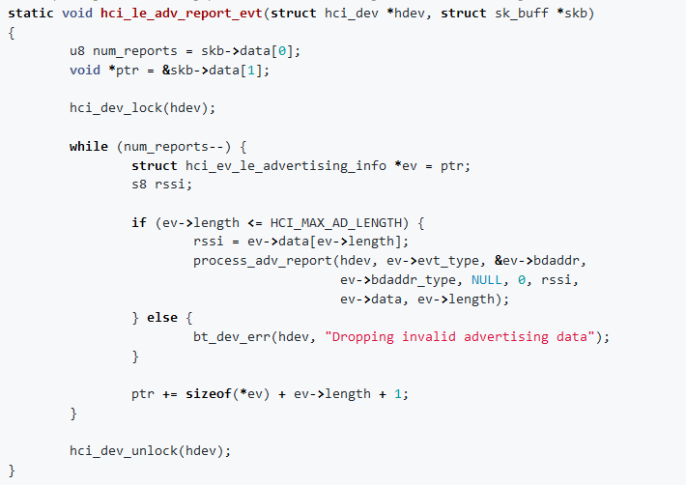
An Introductory Task…
BadVibes: Non-vulnerable method
Notes:
This function is not vulnerable.
hci_le_adv_report_evt called the process_adv_report method after checking that ev->length was greater than or equal to HCI_MAX_AD_LENGTH.

Slide 30
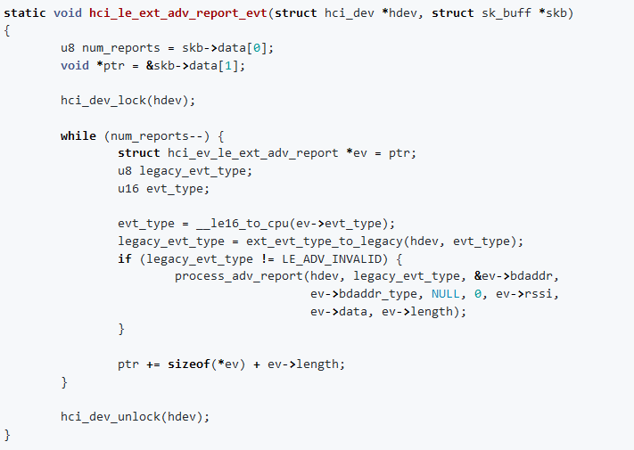
An Introductory Task…
BadVibes: Vulnerable method
Notes:
This is vulnerable (no if statement).
hci_le_ext_adv_report_evt failed to check the length of ev->length before the call.

Slide 31
An Introductory Task…
In the previous two pages we saw a safe method and unsafe method, both calling the process_adv_report method.
hci_le_adv_report_evt called the method after checking that ev->length was greater than or equal to HCI_MAX_AD_LENGTH.
hci_le_ext_adv_report_evt failed to check the length of ev->length before the call.
Since we have a set pattern for the vulnerability, we should be able to create a weggli query to detect whether there are other instances.
The code for this exercise is in the ‘WeggliExercises/bluetooth’ folder in the downloaded exercises.
The task is to find usage of process_adv_report, and determine if any of them are still unsafe.
Notes:
This is easily translatable into other situations

Slide 32
What’s going on? Help!
If anyone is stuck – raise a hand.
If your query is not finding the issue, try smaller queries to identify smaller parts of the target code.
Check the results of your query:
Did it include what you were looking for?
Is the bug fixed, or still present?

Slide 33
Solution
This task required the ‘not’ operator.
The following Weggli query would identify any occurrences of the issue:
weggli ‘{
NOT: if ($param1 <= _){}
process_adv_report(_,_,_,_,_,_,_,_,$param1,_);
}' ./Bluetooth
Notes:
Could try this:
weggli --unique ‘{
NOT: if ($param1 < _){}
process_adv_report(_,_,_,_,_,_,_,_,$param1,_);
}' ./bluetooth

Slide 34
Task 2 – Debug Check for Buffer Overflow
Similar to the earlier ‘debug only’ issue in the example, construct a Weggli query to find repeated or similar occurrences of the following issue:
ParamStruct curr_params = media_channel_->GetChannelParameters(source_data);
D_CHECK_GE(curr_params.encodings.size(), init_params_.encodings.size());
for (size_t i = 0; i < init_params_.encodings.size(); ++i) {
init_params_.encodings[i].id = curr_params.encodings[i].id;
init_params_.encodings[i].data = curr_params.encodings[i].data;
}
media_channel_->SetOutParameters(source_data, curr_params);
As before, the code has a macro that only performs an action in a debug build, prior to the copy between the two buffers.
The code for this exercise is in the ‘WeggliExercises’ folder.

Slide 35
What’s going on? Help!
If anyone is stuck – raise a hand.
Check the results of your query:
Did it include the bug you were looking for?
Did it include other bugs?
Is there a possibility that other bugs could be missing from the results?

Slide 36
Task 2 – Solution and Explanation
You may have noticed that reusing the example query from earlier did not locate the new example.
The important difference (to Weggli) is the presence of braces in the issue:
D_CHECK_GE(curr_params.encodings.size(), init_params_.encodings.size());
for (size_t i = 0; i < init_params_.encodings.size(); ++i) {
The following two query fragments are not equivalent, as far as Weggli queries are concerned:
D_CHECK_GE($param1, $param2);
D_CHECK_GE($param1(), $param2());

Slide 37
Task 2 – Solution and Explanation
The following query can be used to detect the issue:
weggli --unique '{
D_CHECK_GE($param1(), $param2());
for (_; $i<$param2(); _) {};
}' ./WeggliExercises
It is very specific, and so variations, or a script, may be more effective
It may be better to script the queries if you need to find both types (with and without braces, usage of if statements, while statements, etc.)

Slide 38
Task 2 – Solution and Explanation
A script with multiple queries can be used to detect variations of the issue:
weggli --unique '{
D_CHECK_GE($param1(), $param2());
for (_; $i<$param2(); _) {};
}' ./WeggliExercises
weggli --unique '{
D_CHECK_LE($param1(), $param2());
for (_; $i<$param1(); _) {};
}' ./WeggliExercises
weggli --unique '{
D_CHECK_GE($param1, $param2);
for (_; $i<$param2; _) {}
}' ./c-examples

Slide 39
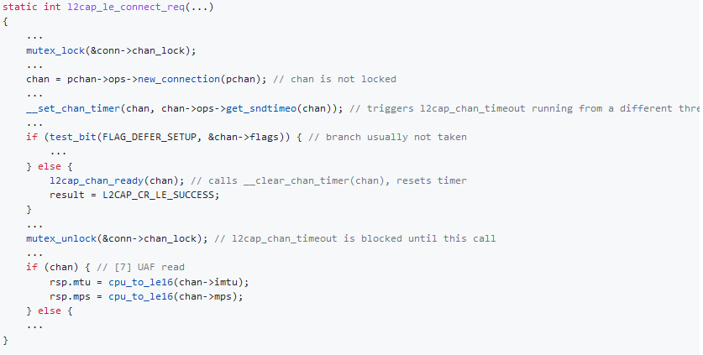
Task 3 – Linux Kernel UAF
This is a UAF in the Linux kernel, recently disclosed (after it was fixed) by Project Zero.
Notes:
There are use-after-free vulnerabilities in the Linux kernel's net/bluetooth/l2cap_core.c's l2cap_connect and l2cap_le_connect_req functions which may allow code execution and leaking kernel memory (respectively) remotely via Bluetooth.

Slide 40
Task 3 – Linux Kernel UAF
The code shows a particular pattern, helpfully marked out by the Project Zero comments, that can be used to build a query.
The code for this exercise is also in the ‘bluetooth’ folder (same as exercise 1).
Write a query to identify any occurrences of the issue (you will find 3, that Google reports have since been fixed).

Slide 41
Task 3 – Solution and Explanation
The following query should find 3 occurrences (including the original from the first slide):
weggli --unique ‘{
mutex_lock(&$param1->chan_lock);
$param2 = $param3->ops->new_connection($param3);
__set_chan_timer($param2, $param2->ops->get_sndtimeo($param2)); mutex_unlock(&$param1->chan_lock);
$param2;
}' ./bluetooth
Note that, like the previous query, it was necessary to include the ‘&’ in order to locate the code.

Slide 42
Task 3 – Solution and Explanation
The query can be built step by step. Start with a fragment to identify a basic recognizable part of the bug:
weggli --unique ‘{
mutex_lock(&$param1->chan_lock);
}' ./bluetooth
From this add further parts to gradually build up the components of the vulnerability:
weggli --unique ‘{
mutex_lock(&$param1->chan_lock);
$param2 = $param3->ops->new_connection($param3);
__set_chan_timer($param2, $param2->ops->get_sndtimeo($param2));
}' ./bluetooth

Slide 43

Review of Exercises
People have developed the necessary skills
Many subsystems will be already analysed
Easier to achieve management buy-in
Notes:
Hopefully you’re familiar with how to build a query by now….

Slide 44
Recap

Slide 45
Workflow and Use Cases for Using Weggli
Use it, if necessary, but only where needed:
The tool can be used as part of a broader workflow:
Web-scraping or querying bug-fixes (e.g. Using the Bugzilla API, parsing GitHub commits, internal dev team bug reports)
Selecting the fixes that may be missed by a regular scanning tool, and have a distinct recognisable pattern or keyword(s)
Querying the codebase to identify other (unfixed) occurrences
If your project satisfies some, or all, of the following criteria, then it may be a useful tool:
Previous bug reports, or previous fixes are available
Open-source components are included in your target
Very large codebase
Codebase regularly scanned with ‘normal’ tools
Notes:
The first criterion is the important one, the next three are not absolutely necessary

Slide 46
In Summary…
Weggli is easier to learn than CodeQL
Weggli can find similar threats to other C and C++ code security scanners – with some scripting it can supplement standard code security scanning
It will reward additional work, and can find families of bugs that are missed by other tools
It can find very specific bugs that would be missed by both commercial and open-source scanners
It can be used to find undetected additional occurrences of open-source bugs

Slide 47
Any Questions?

Slide 48
References
L: www.linkedin.com/npdunn
T: @N1ckDunn
M: @nickdunn@infosec.exchange
Weggli:
https://github.com/googleprojectzero/weggli
https://dustri.org/b/playing-with-weggli.html
BadVibes:
https://google.github.io/security-research/pocs/linux/bleedingtooth/writeup.html#badvibes-heap-based-buffer-overflow-cve-2020-24490
Linux Kernel Bluetooth UAF:
https://github.com/google/security-research/security/advisories/GHSA-pf87-6c9q-jvm4
Diagramming tools:
https://www.microsoft.com/en-us/download/details.aspx?id=49168
http://michenriksen.com/blog/drawio-for-threat-modeling/

