Slide 1
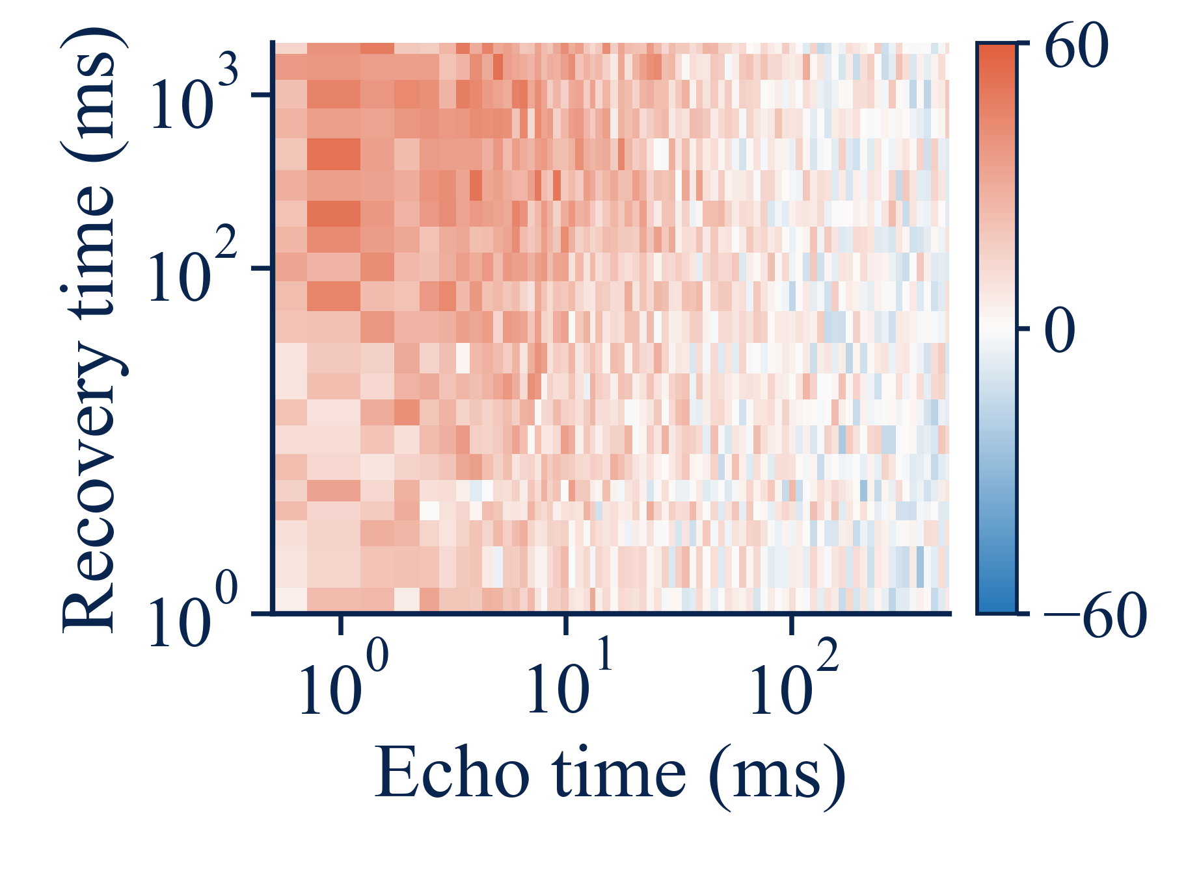
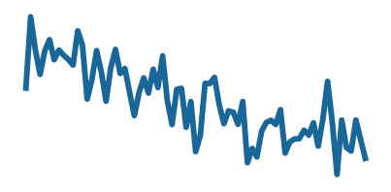
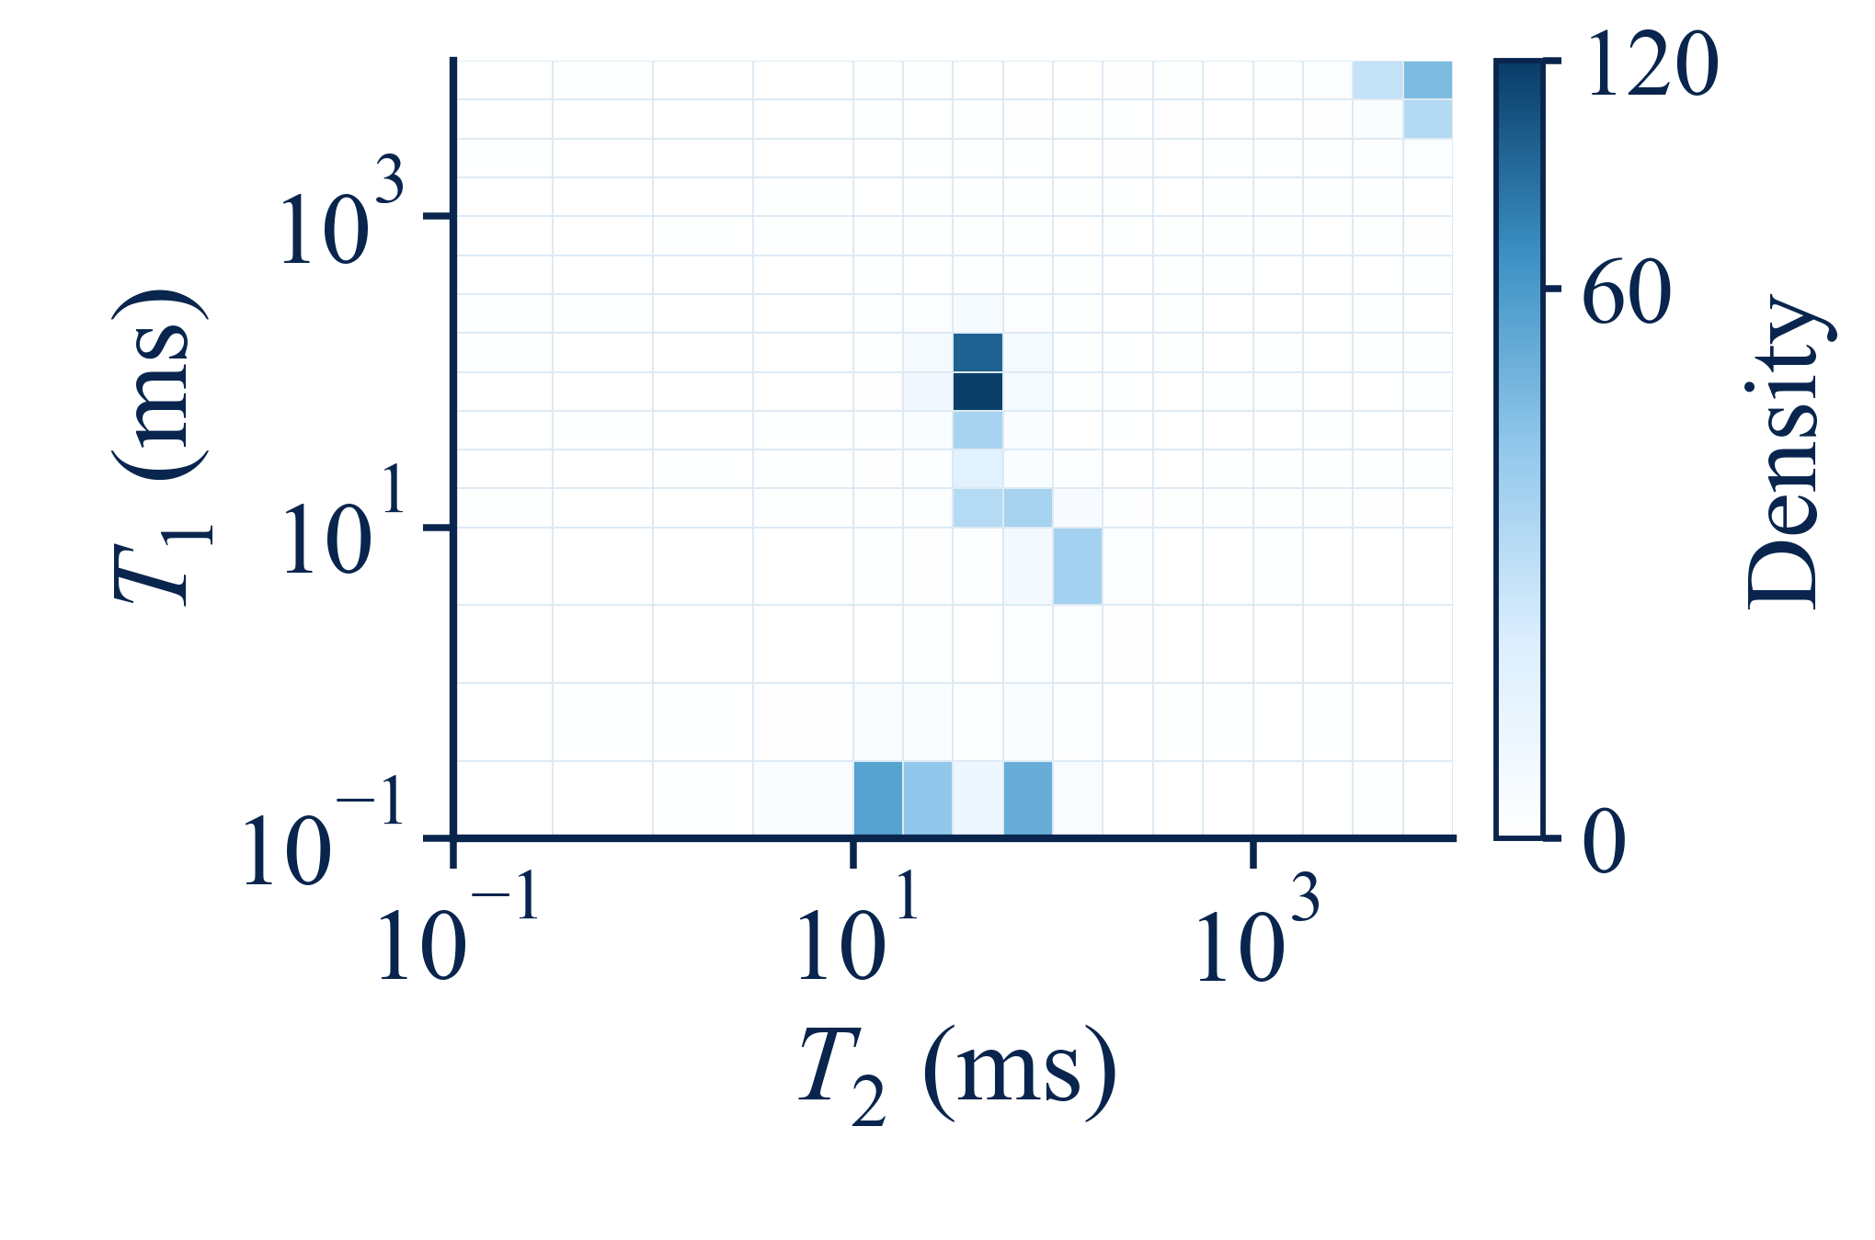

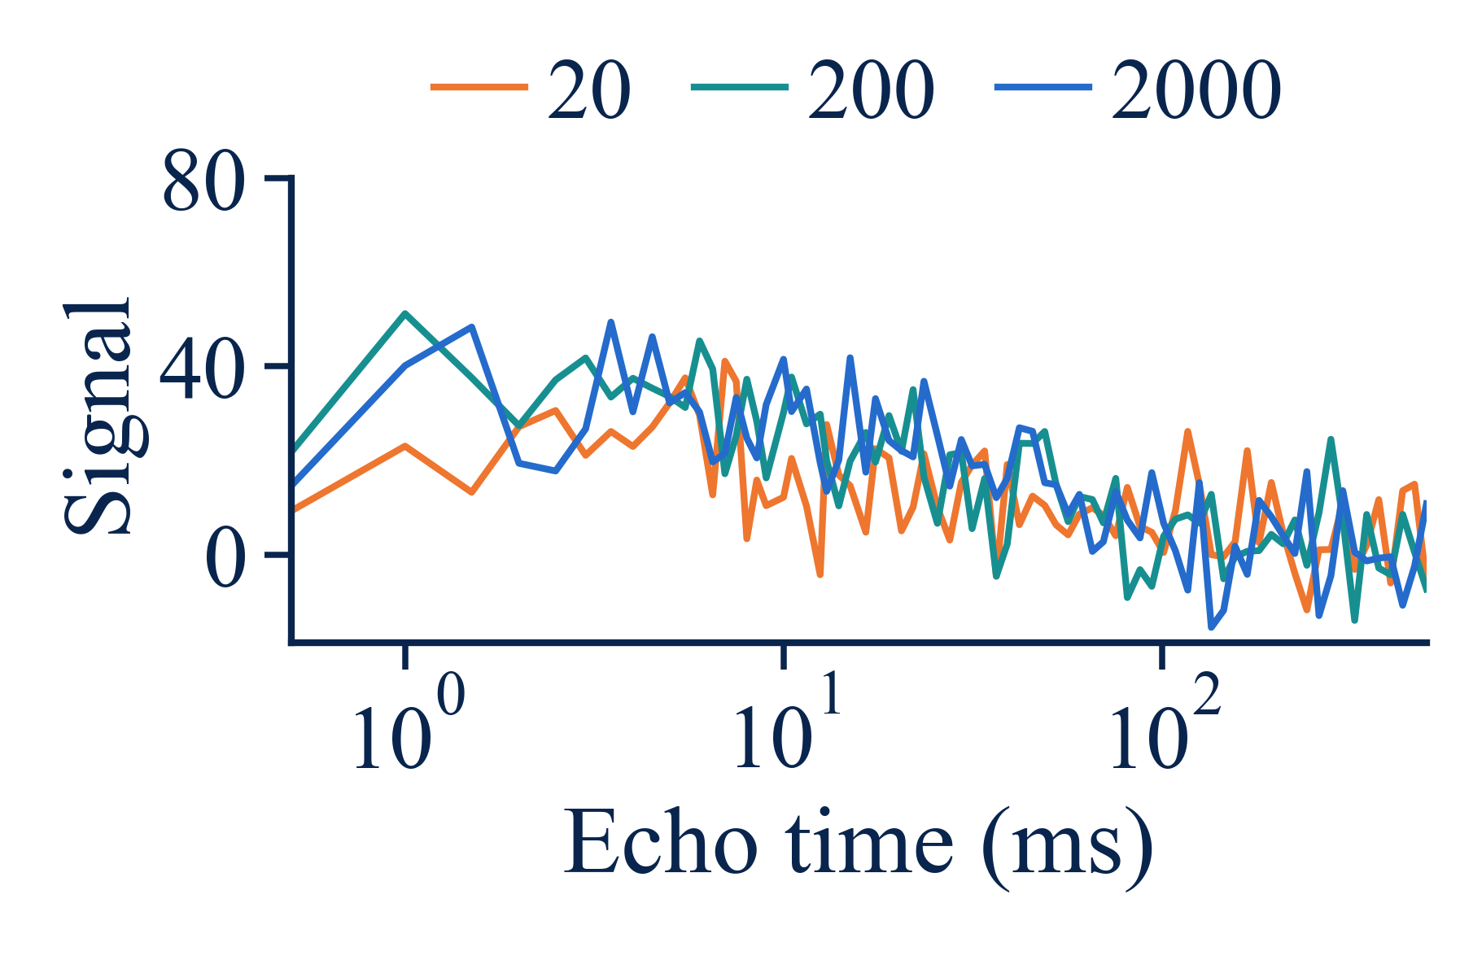
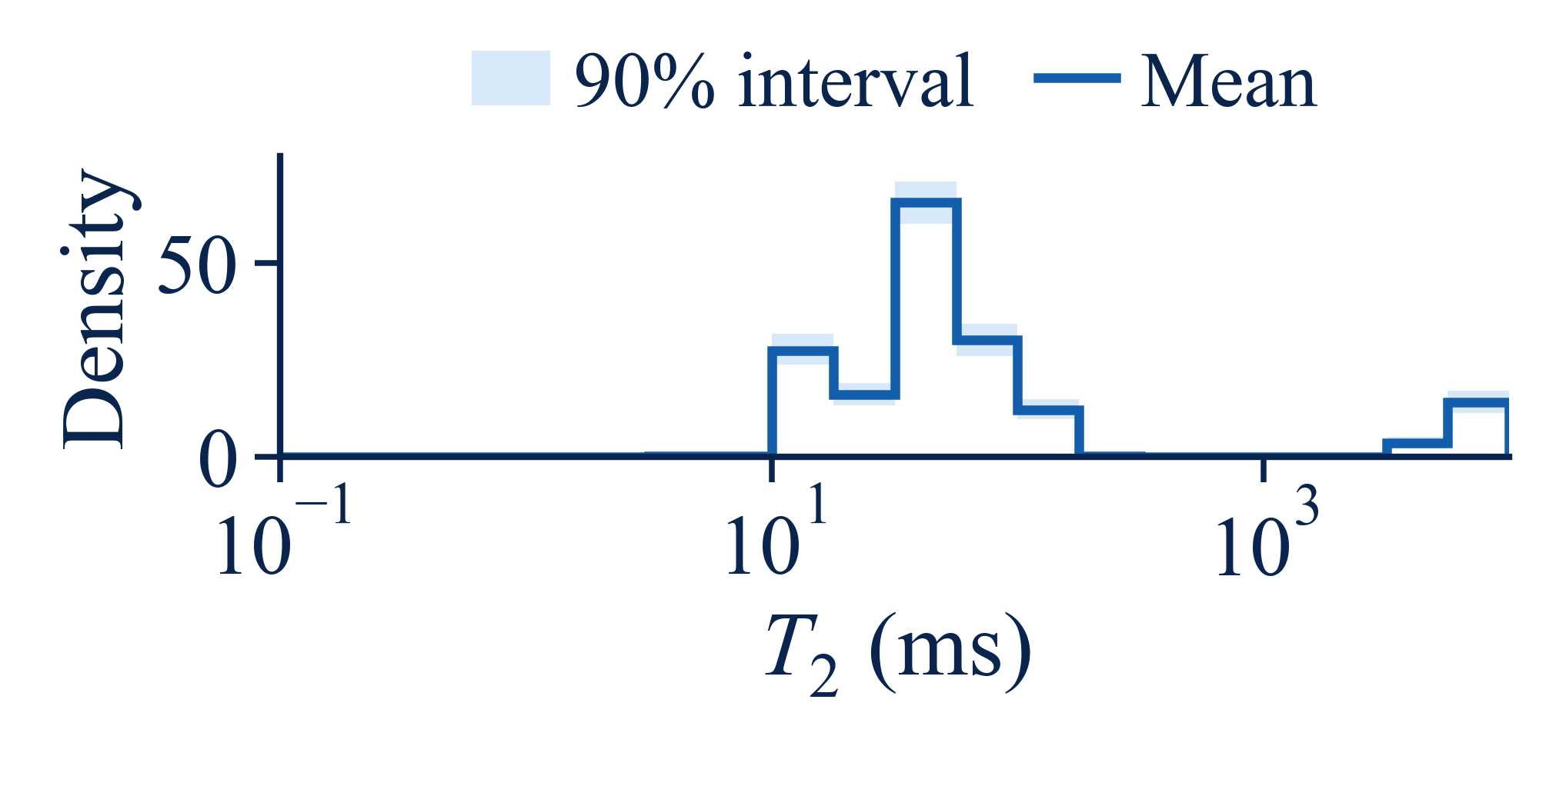
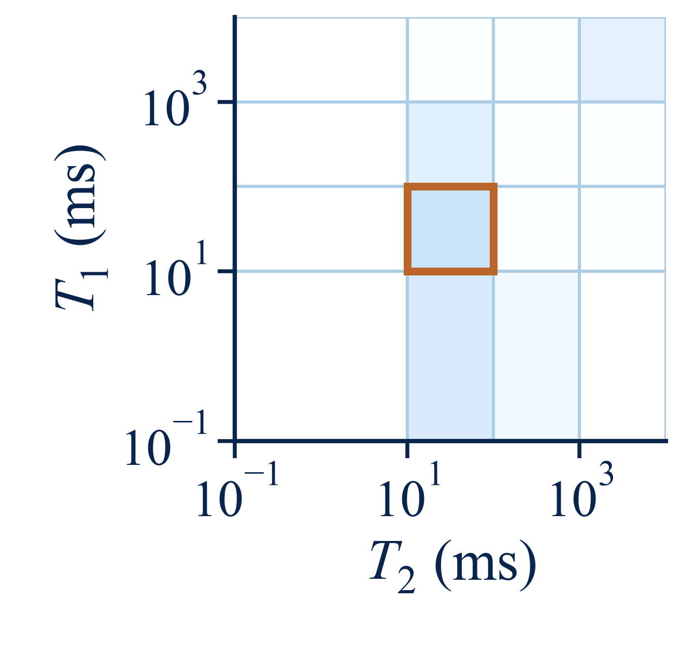
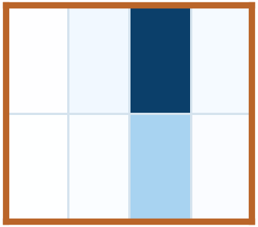
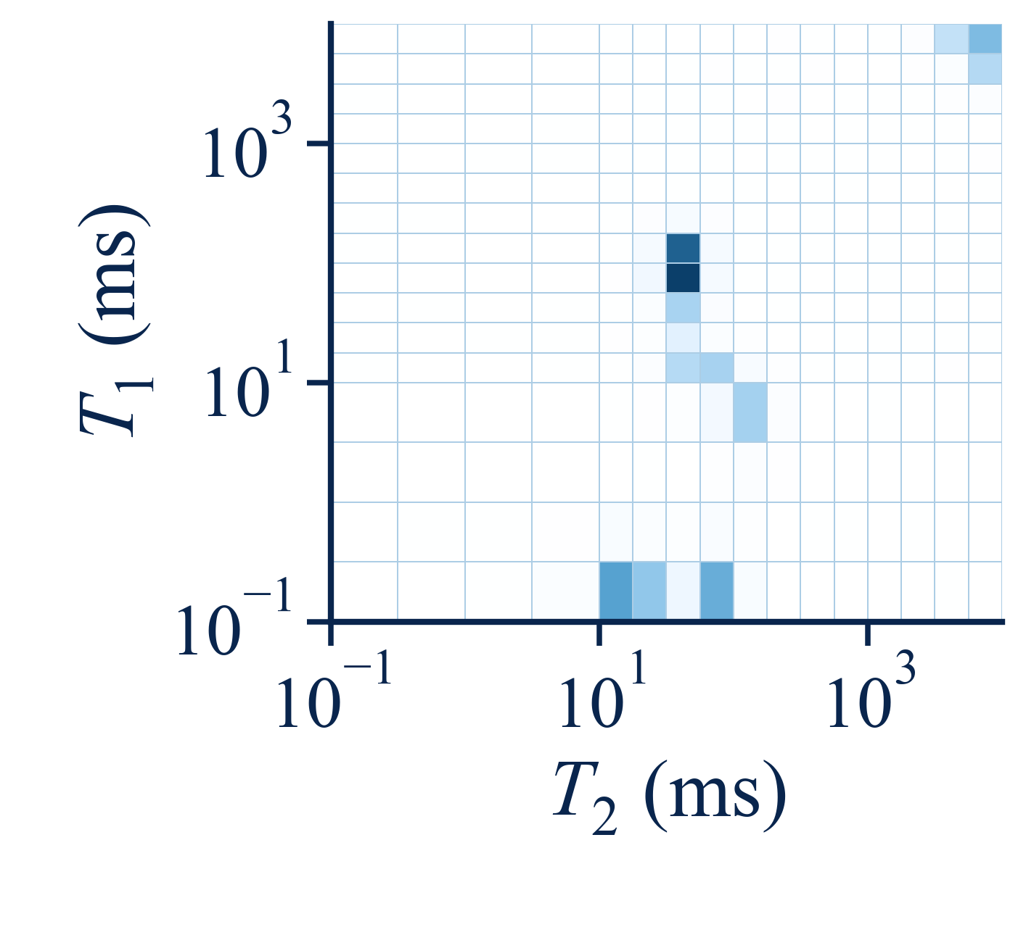
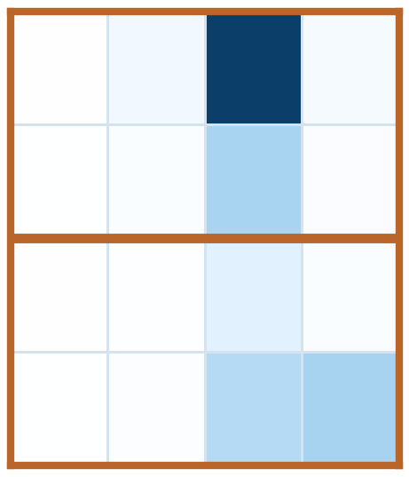


(a)
Probabilistic NMR inversion with a shared conditional flux
From NMR evidence to posterior distribution
NMR evidence
(
B10
· 8.5 m)
Current cells
m
· partition · time
τ
Posterior summaries
Retained evidence
···
E
= (
y
,
K
, Σ)
Mean spectrum
amplitudes · boundaries · reference masses · complete state
Signal
y
Shared conditional flux
r
θ
Kernel
K
r
=
q
+
m
h
θ,B
B
B
θ,B
Noise Σ
c
= (
E
,
m
,
τ
)
Joint whitening
same θ, re-evaluate on each current state
T₂ marginal (90% interval)
+
encoder
Terminal
Reverse
Conditional
Reverse
Posterior
sampling
refinement
samples
Coarse-to-fine reverse process (preset schedule)
(b)
Mass-preserving split for conditional refinement
Fixed τ and
(c)
Cross-resolution training
Posterior distillation across resolutions
other amplitudes
Coarse spectrum (parent cell)
Conditional binary split
Final fine spectrum
Denoising target
Posterior
CIR
Paired states
Online model
Objective
Update
draw
corruption
X
τ
,
PX
τ
r
θ
M
1
x
0
|
E
x
τ
L
den
+
λ
agg
L
agg
θ
M
Fine
Coarse
M
2
forward
Target:
π
τ
(
s
|
M
,
m
−B
,
E
)
Fine teacher
P
sg[
r
θ̄
]
target (no gradient)
M
1
=
sM
M
2
= (1−
s
)
M
x
EMA
θ̄
coarse target
EMA
M
+
M
=
M
τ
EMA after update
1
2
Notes:
The original composition is retained. Decorative translucent artwork was freshly generated with the built-in image_gen tool; prompts are saved with the assets. No source-reference image crops are included. Scientific plots are rendered from real_data/B10_7-7_array1_observed.csv and ReDif_实验CSV/method_outputs.csv using the existing b10_spectra reader. Small cell grids, operator/covariance badges and network glyphs are schematic symbols. Main text, equations, borders and connecting arrows are native editable PowerPoint objects; generated textures and scientific panels are separate images.

