Slide 1
SM
Instruction Cache
Warp Scheduler
Warp Scheduler
Dispatch Unit
Dispatch Unit
Register File (32,768 x 32-bit)
CUDA Core
Core
Core
Core
Core
LD/ST
Dispatch Port
LD/ST
SFU
Operand Collector
Core
Core
Core
Core
LD/ST
FP Unit
INT Unit
LD/ST
Core
Core
Core
Core
LD/ST
Result Queue
LD/ST
SFU
Core
Core
Core
Core
LD/ST
LD/ST
Core
Core
Core
Core
LD/ST
LD/ST
SFU
Core
Core
Core
Core
LD/ST
LD/ST
Core
Core
Core
Core
LD/ST
LD/ST
SFU
Core
Core
Core
Core
LD/ST
LD/ST
Interconnect Network
64 KB Shared Memory / L1 Cache
Uniform Cache
Tex
Tex
Tex
Tex
Texture Cache
PolyMorph Engine
Viewport
Vertex Fetch
Tessellator
Transform
Attribute Setup
Stream Output

Slide 2
GPC
Raster Engine
SM
SM
SM
SM
Polymorph Engine
Polymorph Engine
Polymorph Engine
Polymorph Engine
Graphics Processing Cluster (GPC)

Slide 3
GPC
Raster Engine
GPC
Raster Engine
SM
SM
SM
SM
SM
SM
SM
SM
Memory Controller
Memory Controller
Polymorph Engine
Polymorph Engine
Polymorph Engine
Polymorph Engine
Polymorph Engine
Polymorph Engine
Polymorph Engine
Memory Controller
L2 Cache
Memory Controller
Polymorph Engine
Polymorph Engine
Polymorph Engine
Polymorph Engine
Polymorph Engine
Memory Controller
Memory Controller
SM
SM
SM
SM
SM
SM
GPC
Raster Engine
GPC
Raster Engine

Slide 4
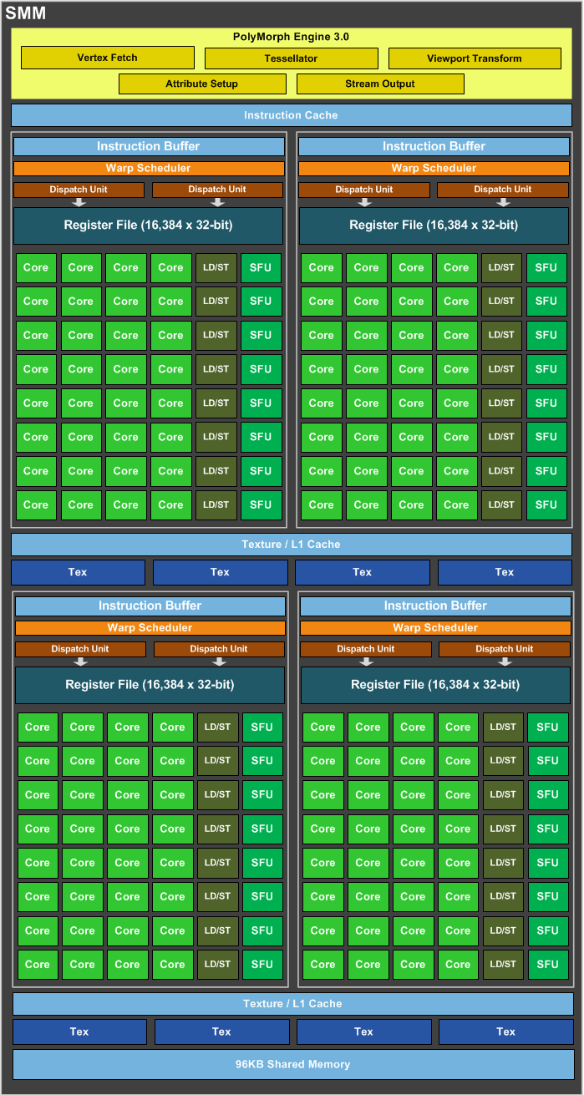

Slide 5
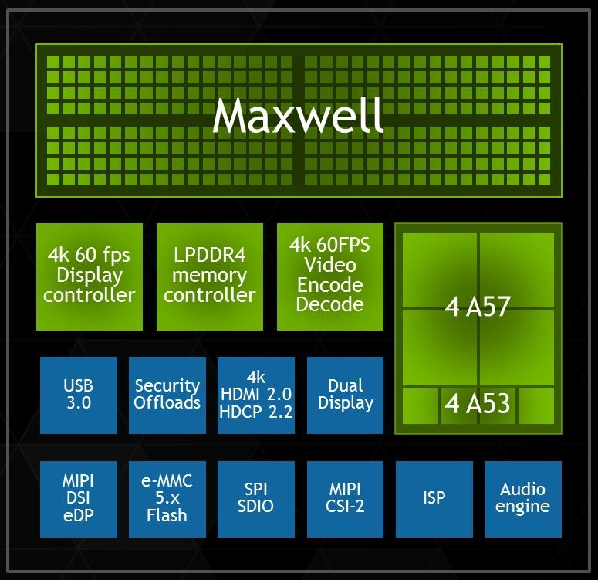
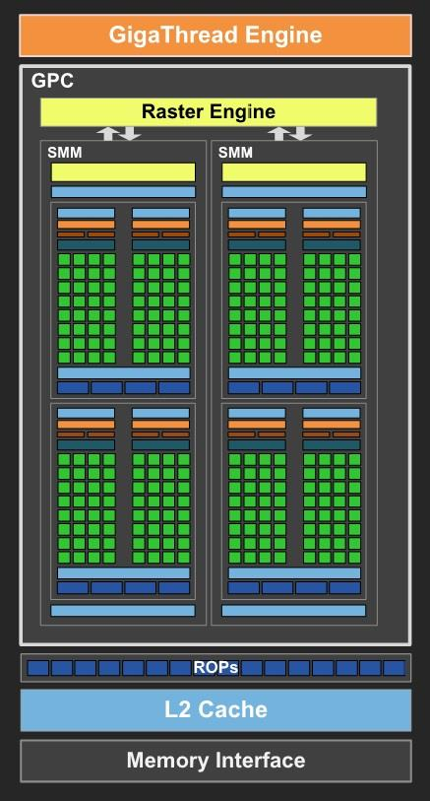
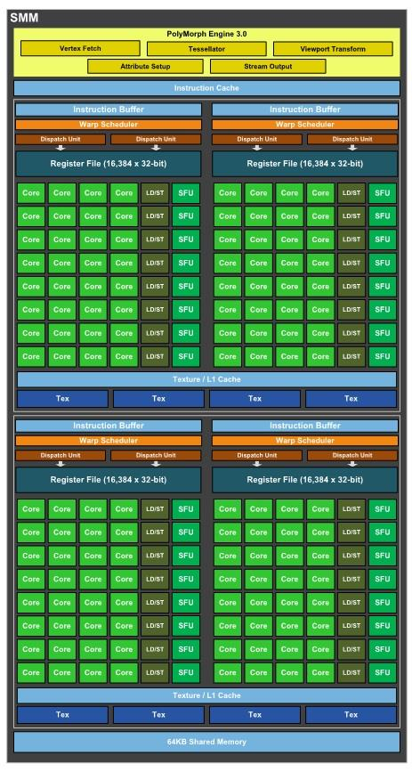

Slide 6
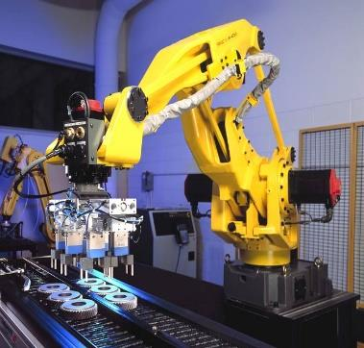
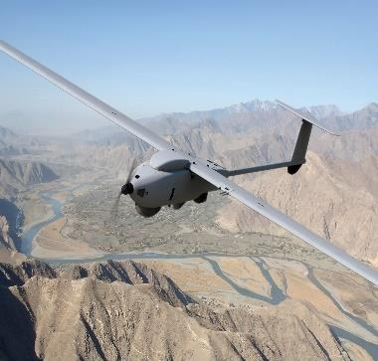
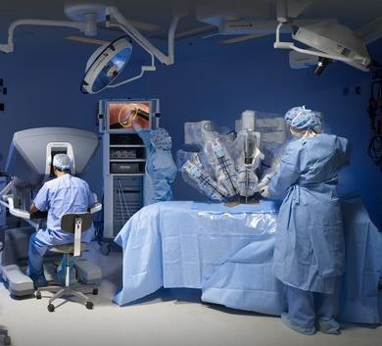
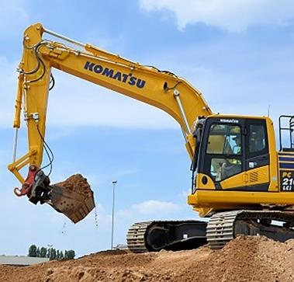

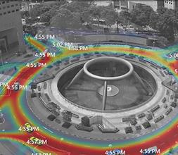
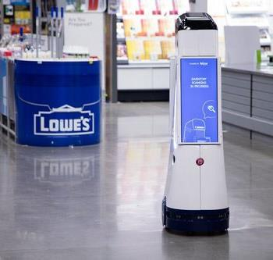
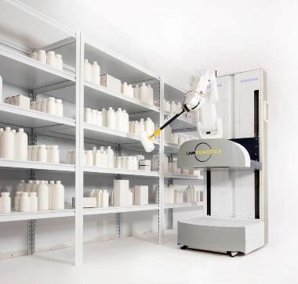
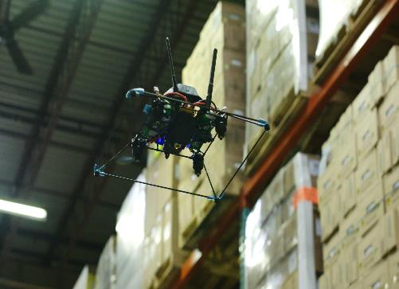
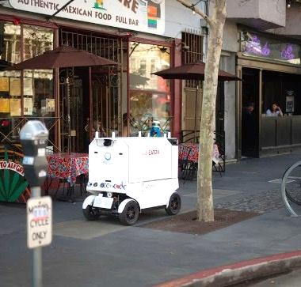

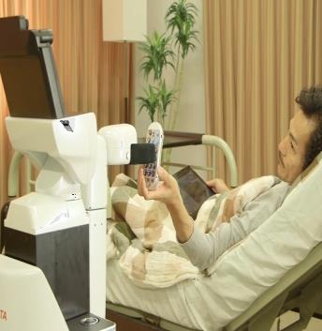
JETSON SUCCESS STORIES
Industrial
Aerospace/Defense
Healthcare
Construction
Agriculture
Smart City
Retail
Logistics
Inventory Mgmt
Delivery
Inspection
Service

Slide 7

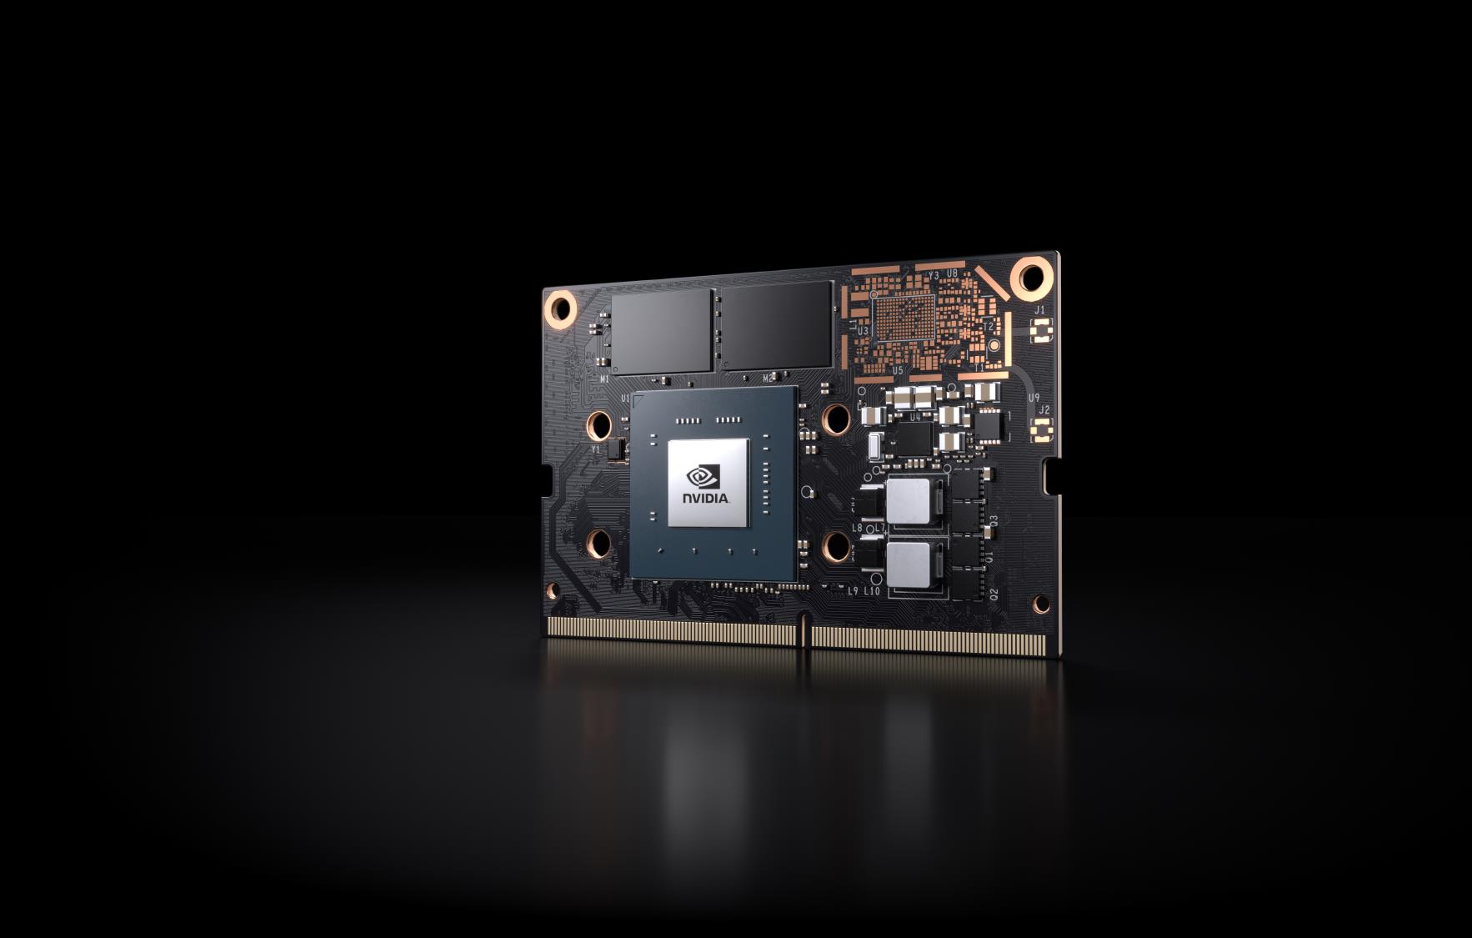

ANNOUNCING:
JETSON NANO
Small, low-power AI Computer
128 CUDA Cores | 4 Core CPU
4 GB Memory
472 GFLOPs
70x45mm
5W | 10W
$129
6

Slide 8

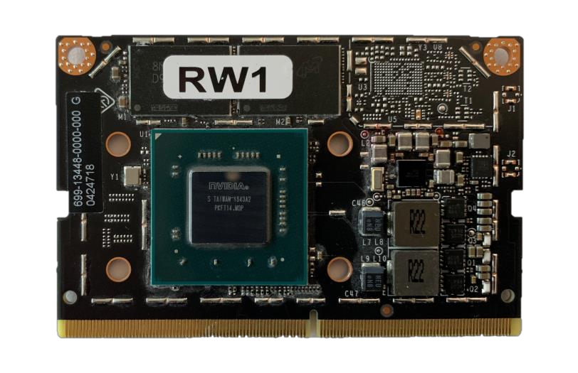
JETSON NANO SPECIFICATIONS
GPU
128 Core Maxwell
472 GFLOPs (FP16)
CPU
4 core ARM A57 @ 1.43 GHz
Memory
4 GB 64 bit LPDDR4 25.6 GB/s
Storage
16 GB eMMC
Video Encode
4K @ 30 | 4x 1080p @ 30 | 8x 720p @ 30
(H.264/H.265)
Video Decode
4K @ 60 | 2x 4K @ 30 | 8x 1080p @ 30 | 16x 720p @
30 | (H.264/H.265)
Camera
12 (3x4 or 4x2) MIPI CSI-2 DPHY 1.1 lanes
(1.5 Gbps)
Display
HDMI 2.0 or DP1.2 | eDP 1.4 | DSI (1 x2)
2 simultaneous
UPHY
1 x1/2/4 PCIE
1 USB 3.0
Other I/Os
1xSDIO / 2xSPI / 3xI2C / UART / I2S / GPIOs
7

Slide 9
JETSON NANO RUNS MODERN AI
Inference
50
40
30
Img/sec
20
10
0
Resnet50
Inception v4
VGG-19
SSD
SSD
SSD
Tiny Yolo
Unet
Super
OpenPose
Mobilenet-v2
Mobilenet-v2
Mobilenet-v2
resolution
(300x300)
(960x544)
(1920x1080)
Coral dev board (Edge TPU)
Raspberry Pi 3 + Intel Neural Compute Stick 2
Jetson Nano
Not supported/DNR
9

Slide 10
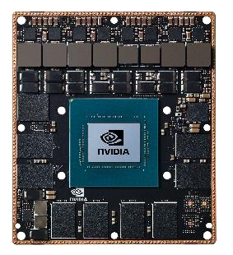
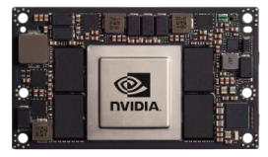
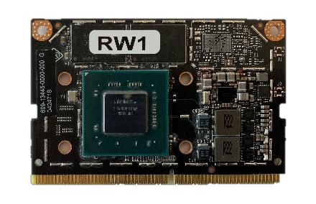
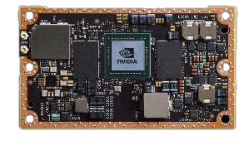
THE JETSON FAMILY
From AI at the Edge to Autonomous Machines
JETSON NANO
JETSON TX1
→
JETSON TX2 4 GB
JETSON TX2 8GB | Industrial
JETSON AGX XAVIER
5 - 10W
7 - 15W
7 – 15W
10 – 30W
0.5 TFLOPS (FP16)
1 – 1.3 TFLOPS (FP16)
1.3 TFLOPS (FP16)
10 TFLOPS (FP16) | 32 TOPS (INT8)
45mm x 70mm
50mm x 87mm
50mm x 87mm
100mm x 87mm
$129
$299
$399 - $749
$1099
AI at the edge
Fully autonomous machines
Multiple devices - Same software
Listed prices are for 1000u+ | Full specs at developer.nvidia.com/jetson
11

Slide 11
JETSON NANO
JETSON TX1
JETSON TX2
JETSON AGX XAVIER
128 Core Maxwell
256 Core Maxwell
256 Core Pascal
512 Core Volta + NVDLA
GPU
0.5 TFLOPs (FP16)
1 TFLOPS (FP16)
1.3 TFLOPS (FP16)
10 TFLOPS (FP16)
32 TFLOPS (INT8)
4 core ARM A57
4 core ARM A57
6 core Denver and A57 @
8 core Carmel ARM CPU @
CPU
(1.5 GHz)
(1.5 / 1.7 GHz)
2GHz (2x) 2MB L2
2.26GHz
Softwa
re
(4x) 2MB L2 + 4MB L3
4 GB 64 bit LPDDR4
4 GB 64 bit LPDDR4
4 GB 128
8 GB 128
16GB 256-bit LPDDR4x @
Memory
25.6 GB/s
25.6 GB/s
bit LPDDR4
bit LPDDR4
2133MHz
51 GB/s
58 GB/s
137 GB/s
Storage
16 GB eMMC
16 GB eMMC
16 GB
32 GB
32 GB eMMC
eMMC
eMMC
Video Encode
4K @ 30 (H.264/H.265)
4K @ 30 (H.264/H.265)
2x 4K @ 30 (HEVC)
8x 4K @ 60 (HEVC)
Video Decode
4K @ 60 (H.264/H.265)
4K @ 60 (H.264/H.265)
2x 4K @ 30 12 bit support
12x 4K @ 30 12-bit support
16 lanes MIPI CSI-2 | 8
Camera
12 (3x4 or 4x2) MIPI CSI-2
12 (3x4 or 6x2) MIPI CSI-2
12 lanes MIPI CSI-2
lanes SLVS-EC
DPHY 1.1 lanes (1.5 Gbps)
DPHY 1.1 lanes (1.5 Gbps)
D-PHY 1.2 (30 Gbps)
D-PHY (40 Gbps)
C-PHY (109 Gbps)
Mechanical
69.6mm x 45mm
87mm x 50mm
87mm x 50mm
100mm x 87mm
260 pin edge connector
400 pin connector
400 pin connector
699 pin connector
Software
Jetpack SDK – Unified software release across all Jetson products
15

Slide 12
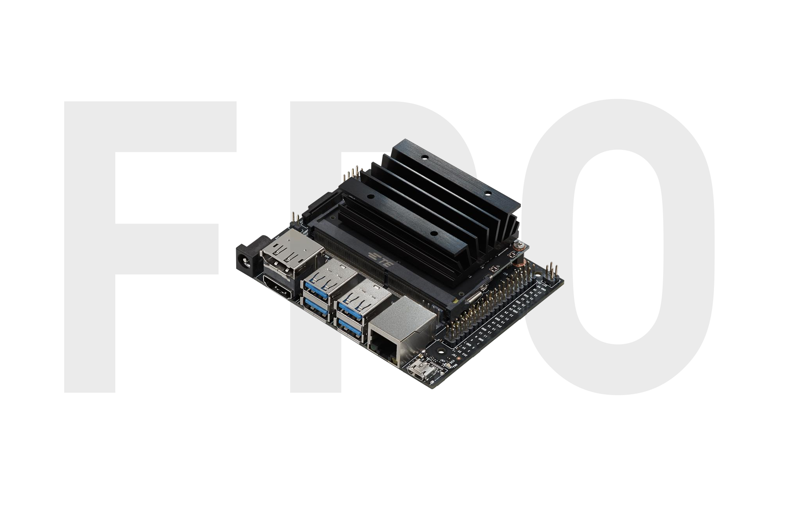
JETSON NANO DEVELOPER KIT
$99 AI Computer
128 CUDA Cores | 4 Core CPU
472 GFLOPs
5W | 10W
Available from nvidia.com and
distributors worldwide
17

Slide 13
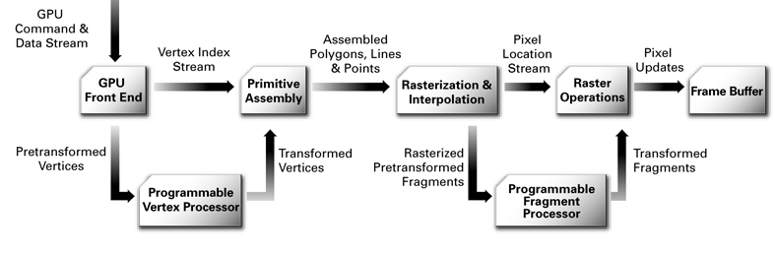
Figure 2.1: Graphics pipeline after shaders inclusion.

Slide 14
GPC
Raster Engine
GPC
Raster Engine
SM
SM
SM
SM
SM
SM
SM
SM
Memory Controller
Memory Controller
PolyMorph Engine
PolyMorph Engine
PolyMorph Engine
PolyMorph Engine
PolyMorph Engine
PolyMorph Engine
PolyMorph Engine
PolyMorph Engine
Memory Controller
Memory Controller
PolyMorph Engine
PolyMorph Engine
PolyMorph Engine
PolyMorph Engine
PolyMorph Engine
Memory Controller
Memory Controller
SM
SM
SM
SM
SM
GPC
Raster Engine

Slide 15
SMM
PolyMorph Engine 3.0
Vertex Fetch
Attribute Setup
Tessellator
Stream Output
Viewport Transform
Instruction Buffer
Instruction Buffer
Instruction Buffer
Dispatch Unit
Warp Scheduler
Dispatch Unit
Dispatch Unit
Warp Scheduler
Dispatch Unit
Register File (16,384 x 32-bit)
Register File (16,384 x 32-bit)
Core
Core
Core
Core
LD/ST
SFU
Core
Core
Core
Core
LD/ST
SFU
Core
Core
Core
Core
LD/ST
SFU
Core
Core
Core
Core
LD/ST
SFU
Core
Core
Core
Core
LD/ST
SFU
Core
Core
Core
Core
LD/ST
SFU
Core
Core
Core
Core
LD/ST
SFU
Core
Core
Core
Core
LD/ST
SFU
Core
Core
Core
Core
LD/ST
SFU
Core
Core
Core
Core
LD/ST
SFU
Core
Core
Core
Core
LD/ST
SFU
Core
Core
Core
Core
LD/ST
SFU
Core
Core
Core
Core
LD/ST
SFU
Core
Core
Core
Core
LD/ST
SFU
Core
Core
Core
Core
LD/ST
SFU
Core
Core
Core
Core
LD/ST
SFU
Tex
Tex
Texture/L1 Cache
Instruction Buffer
Tex
Instruction Buffer
Tex
Dispatch Unit
Warp Scheduler
Dispatch Unit
Dispatch Unit
Warp Scheduler
Dispatch Unit
Register File (16,384 x 32-bit)
Register File (16,384 x 32-bit)
Core
Core
Core
Core
LD/ST
SFU
Core
Core
Core
Core
LD/ST
SFU
Core
Core
Core
Core
LD/ST
SFU
Core
Core
Core
Core
LD/ST
SFU
Core
Core
Core
Core
LD/ST
SFU
Core
Core
Core
Core
LD/ST
SFU
Core
Core
Core
Core
LD/ST
SFU
Core
Core
Core
Core
LD/ST
SFU
Core
Core
Core
Core
LD/ST
SFU
Core
Core
Core
Core
LD/ST
SFU
Core
Core
Core
Core
LD/ST
SFU
Core
Core
Core
Core
LD/ST
SFU
Core
Core
Core
Core
LD/ST
SFU
Core
Core
Core
Core
LD/ST
SFU
Core
Core
Core
Core
LD/ST
SFU
Core
Core
Core
Core
LD/ST
SFU
Tex
Tex
Texture/L1 Cache
Tex
Tex
96KB Shared Memory
Figure 3.12: GM204 SMM Diagram (GM204 also features 4 DP units per SMM, which are
not depicted on this diagram). NVIDIA Corporation [41, pg. 08]

Slide 16
Memory Controller
Memory Controller
Memory Controller
Memory Controller
SMM
SMM
SMM
SMM
GPC
Raster Engine

