Slide 1

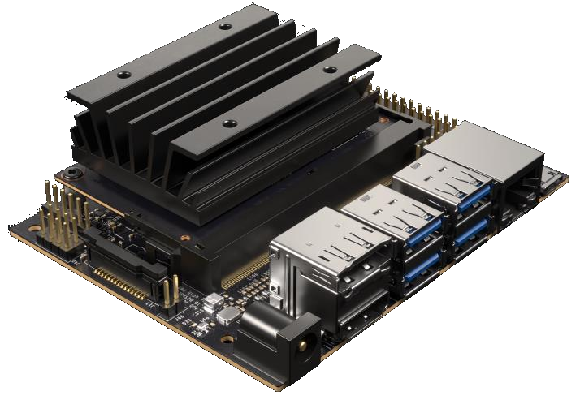
JETSON NANO DEVELOPER KIT
$99 CUDA-X AI Computer
128 CUDA Cores | 4 Core CPU
4GB LPDDR4 Memory
472 GFLOPs
5W | 10W
Accessible and easy to use
4

Slide 2
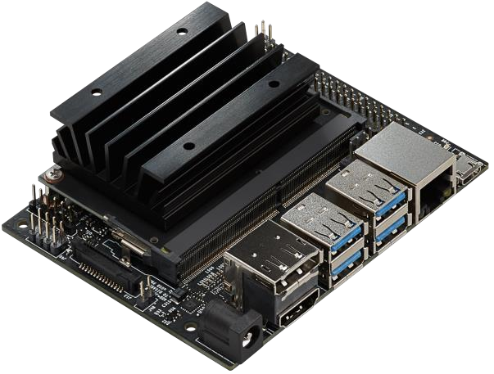








JETSON NANO DEVKIT SPECS
PROCESSOR
INTERFACES
CPU
64-bit Quad-core ARM A57 @ 1.43GHz
USB
(4x) USB 3.0 A (Host) | USB 2.0 Micro B (Device)
Camera
MIPI CSI-2 x2 (15-position Flex Connector)
GPU
128-core NVIDIA Maxwell @ 921MHz
Display
HDMI | DisplayPort
Networking
Gigabit Ethernet (RJ45, PoE)
Memory
4GB 64-bit LPDDR4 @ 1600MHz | 25.6GB/s
Wireless
M.2 Key-E with PCIe x1
Storage
MicroSD card (16GB UHS-1 recommended minimum)
Video Encoder
4Kp30 | (4x) 1080p30 | (2x) 1080p60
40-Pin Header
UART | SPI | I2C | I2S | Audio Clock | GPIOs
Power
5V DC (µUSB, Barrel Jack, PoE) - 5W | 10W
Video Decoder
4Kp60 | (2x) 4Kp30 | (8x) 1080p30 | (4x) 1080p60
Size
80x100mm
Distributors Include:
5

Slide 3
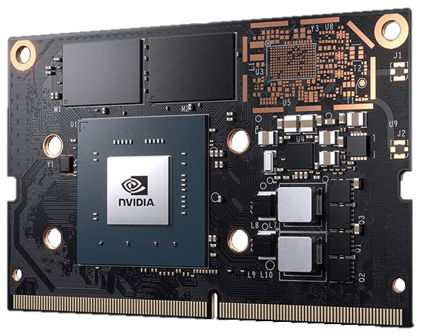

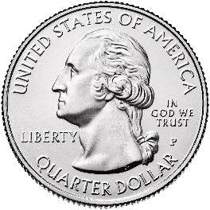
JETSON NANO
Compact AI Compute Module
128 CUDA Cores | 4 Core CPU
4GB LPDDR4 Memory
16GB eMMC 5.1
45x70mm
5W | 10W
$129 (1Ku)
Available June 2019
6

Slide 4
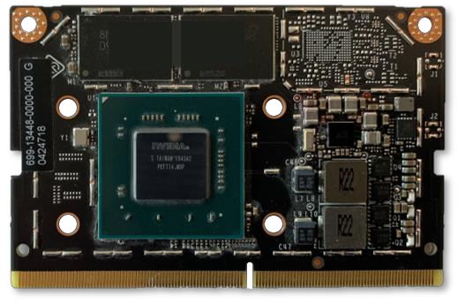
JETSON NANO COMPUTE MODULE
PROCESSOR
INTERFACES
CPU
64-bit Quad-core ARM A57 @ 1.43GHz
USB
USB 3.0 | (3x) USB 2.0
Camera
12 lanes MIPI CSI-2 (up to 4 cameras)
GPU
128-core NVIDIA Maxwell @ 921MHz
Display
HDMI | DP | eDP | DSI
Networking
Gigabit Ethernet
Memory
4GB 64-bit LPDDR4 @ 1600MHz | 25.6GB/s
PCIe
PCIe Gen2 x1/x2/x4
Storage
16GB eMMC 5.1
Video Encoder
4Kp30 | (4x) 1080p30 | (2x) 1080p60
Other I/O
(4x) I2C | (2x) SPI | (3x) UART | (2x) I2S | GPIO
Power
5V DC, 5W | 10W
Video Decoder
4Kp60 | (2x) 4Kp30 | (8x) 1080p30 | (4x) 1080p60
Size
45x70mm, 260-pin SODIMM connector
Production module
available June 2019
7

Slide 5
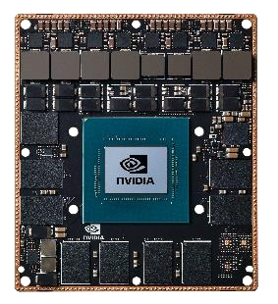
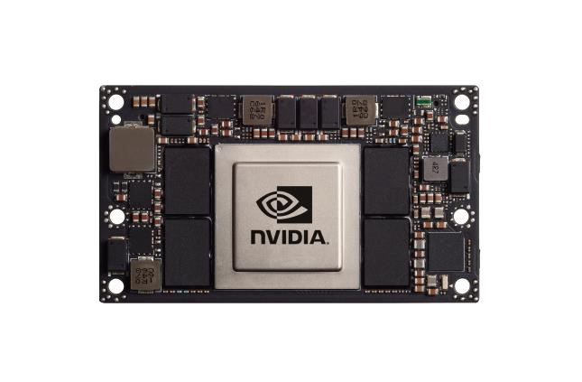
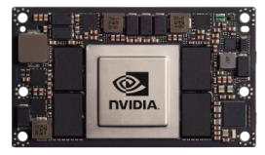
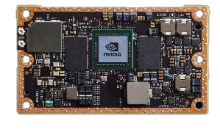
THE JETSON FAMILY
From AI at the Edge to Autonomous Machines
JETSON NANO
JETSON TX1

JETSON TX2 4GB
JETSON TX2 8GB | Industrial
JETSON AGX XAVIER
5—10W
7—15W
7—15W
10—30W
0.5 TFLOPS (FP16)
1—1.3 TFLOPS (FP16)
1.3 TFLOPS (FP16)
11 TFLOPS (FP16) | 32 TOPS (INT8)
45mm x 70mm
50mm x 87mm
50mm x 87mm
100mm x 87mm
$129 / $99 (Devkit)
$299
$399—$749
$1099
AI at the Edge
Fully Autonomous Machines
Multiple Devices — Same Software
8

Slide 6
JETSON NANO RUNS MODERN AI
Inference
40
39
36
30
27
25
20
Img/sec
18
15
14
10
11
10
8
0
ResNet-50
Inception-v4
VGG-19
SSD Mobilenet-
SSD Mobilenet-
SSD Mobilenet-
Tiny YOLO
U-Net
Super
OpenPose
v2 (300x300)
v2 (480x272)
v2 (960x544)
Resolution
TensorFlow
PyTorch
MxNet
TensorFlow
TensorFlow
TensorFlow
Darknet
Caffe
Not supported/Does not run
Jetson Nano
PyTorch
Caffe
developer.nvidia.com/embedded/jetson-nano-dl-inference-benchmarks
13

Slide 7
JETSON NANO RUNS MODERN AI
Inference
50
Coral Dev Board (Edge TPU)
40
Raspberry Pi 3 + Intel Neural Compute Stick 2
Jetson Nano
30
Not supported/DNR
Img/sec
20
10
0
ResNet-50
Inception-v4
VGG-19
SSD Mobilenet-
SSD Mobilenet-
SSD Mobilenet-
Tiny YOLO
U-Net
Super
OpenPose
v2 (300x300)
v2 (480x272)
v2 (960x544)
Resolution
developer.nvidia.com/embedded/jetson-nano-dl-inference-benchmarks
14

