Slide 1

JETSON NANO RUNS MODERN AI
Inference
50
Coral Dev Board (Edge TPU)
40
Raspberry Pi 3 + Intel Neural Compute Stick 2
Jetson Nano
30
Not supported/DNR
Img/sec
20
10
0
ResNet-50
Inception-v4
VGG-19
SSD Mobilenet-
SSD Mobilenet-
SSD Mobilenet-
Tiny YOLO
U-Net
Super
OpenPose
v2 (300x300)
v2 (480x272)
v2 (960x544)
Resolution
developer.nvidia.com/embedded/jetson-nano-dl-inference-benchmarks
14

Slide 2
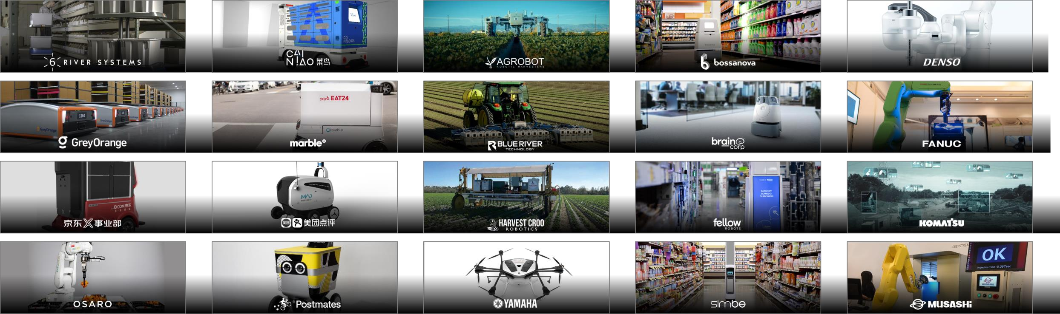
JETSON POWERS AUTONOMOUS MACHINES
WAREHOUSE
DELIVERY
AGRICULTURE
RETAIL
INDUSTRIAL
3

Slide 3

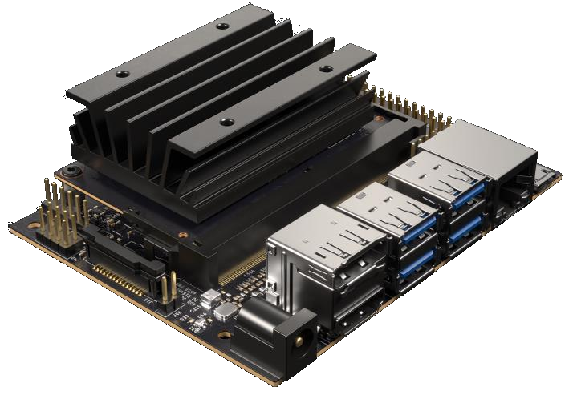
JETSON NANO DEVELOPER KIT
$99 CUDA-X AI Computer
128 CUDA Cores | 4 Core CPU
4GB LPDDR4 Memory
472 GFLOPs
5W | 10W
Accessible and easy to use
4

Slide 4
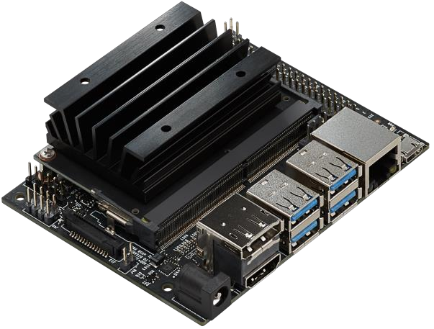







JETSON NANO DEVKIT SPECS
PROCESSOR
INTERFACES
CPU
64-bit Quad-core ARM A57 @ 1.43GHz
USB
(4x) USB 3.0 A (Host) | USB 2.0 Micro B (Device)
Camera
MIPI CSI-2 x2 (15-position Flex Connector)
GPU
128-core NVIDIA Maxwell @ 921MHz
Display
HDMI | DisplayPort
Networking
Gigabit Ethernet (RJ45, PoE)
Memory
4GB 64-bit LPDDR4 @ 1600MHz | 25.6GB/s
Wireless
M.2 Key-E with PCIe x1
Storage
MicroSD card (16GB UHS-1 recommended minimum)
Video Encoder
4Kp30 | (4x) 1080p30 | (2x) 1080p60
40-Pin Header
UART | SPI | I2C | I2S | Audio Clock | GPIOs
Power
5V DC (µUSB, Barrel Jack, PoE) - 5W | 10W
Video Decoder
4Kp60 | (2x) 4Kp30 | (8x) 1080p30 | (4x) 1080p60
Size
80x100mm
Distributors Include:
5

Slide 5
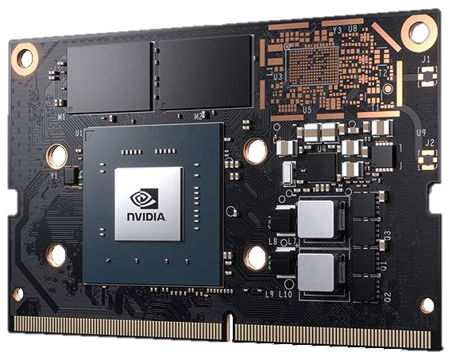

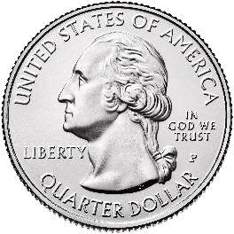
JETSON NANO
Compact AI Compute Module
128 CUDA Cores | 4 Core CPU
4GB LPDDR4 Memory
16GB eMMC 5.1
45x70mm
5W | 10W
$129 (1Ku)
Available June 2019
6

Slide 6
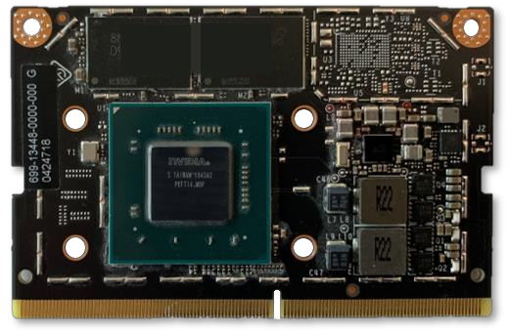
JETSON NANO COMPUTE MODULE
PROCESSOR
INTERFACES
CPU
64-bit Quad-core ARM A57 @ 1.43GHz
USB
USB 3.0 | (3x) USB 2.0
Camera
12 lanes MIPI CSI-2 (up to 4 cameras)
GPU
128-core NVIDIA Maxwell @ 921MHz
Display
HDMI | DP | eDP | DSI
Networking
Gigabit Ethernet
Memory
4GB 64-bit LPDDR4 @ 1600MHz | 25.6GB/s
PCIe
PCIe Gen2 x1/x2/x4
Storage
16GB eMMC 5.1
Video Encoder
4Kp30 | (4x) 1080p30 | (2x) 1080p60
Other I/O
(4x) I2C | (2x) SPI | (3x) UART | (2x) I2S | GPIO
Power
5V DC, 5W | 10W
Video Decoder
4Kp60 | (2x) 4Kp30 | (8x) 1080p30 | (4x) 1080p60
Size
45x70mm, 260-pin SODIMM connector
Production module
available June 2019
7

Slide 7

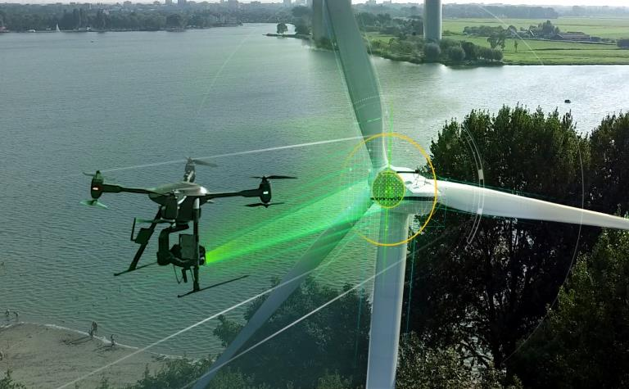
Package Versions
JETPACK 4.2
L4T BSP
32.1
CUDA
10.0.166
Linux Kernel
4.9.140
cuDNN
7.3.1.28
Vulkan
1.1.1
TensorRT
5.0.6.3
OpenGL
4.6
VisionWorks
1.6
OpenGL-ES
3.2.5
EGL
1.5
OpenCV
3.3.1
GLX
1.4
NPP
10.0
X11 ABI
24
Install TensorFlow, PyTorch, Caffe,
Wayland
1.14
Caffe2, MXNet, ROS, and other
GPU-accelerated libraries
L4T Multimedia API
32.1
Argus Camera API
0.97
Available Now For Jetson
GStreamer
1.14.1
developer.nvidia.com/jetpack
Nsight Systems
2019.3
Nsight Graphics
2018.7
Nsight Compute
1.0
Jetson GPIO
1.0
Jetson OS
Ubuntu 18.04
Host OS
Ubuntu 16.04 / 18.04
10

Slide 8
JETSON NANO RUNS MODERN AI
Inference
40
39
36
30
27
25
20
Img/sec
18
15
14
10
11
10
8
0
ResNet-50
Inception-v4
VGG-19
SSD Mobilenet-
SSD Mobilenet-
SSD Mobilenet-
Tiny YOLO
U-Net
Super
OpenPose
v2 (300x300)
v2 (480x272)
v2 (960x544)
Resolution
TensorFlow
PyTorch
MxNet
TensorFlow
TensorFlow
TensorFlow
Darknet
Caffe
Not supported/Does not run
Jetson Nano
PyTorch
Caffe
developer.nvidia.com/embedded/jetson-nano-dl-inference-benchmarks
13

Slide 9
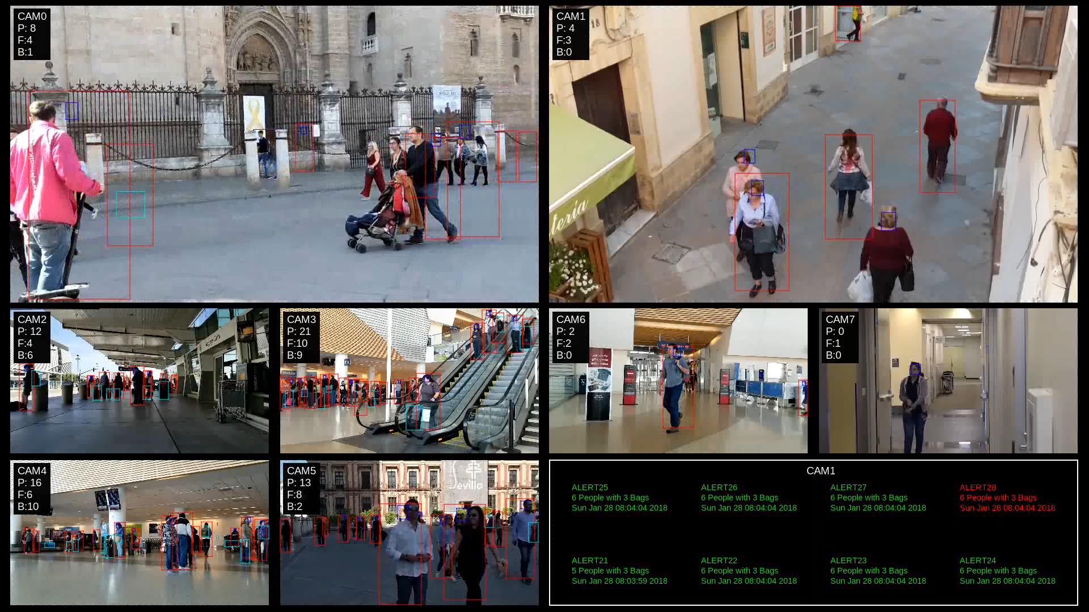
Replace with Final
DEEPSTREAM
15

Slide 10
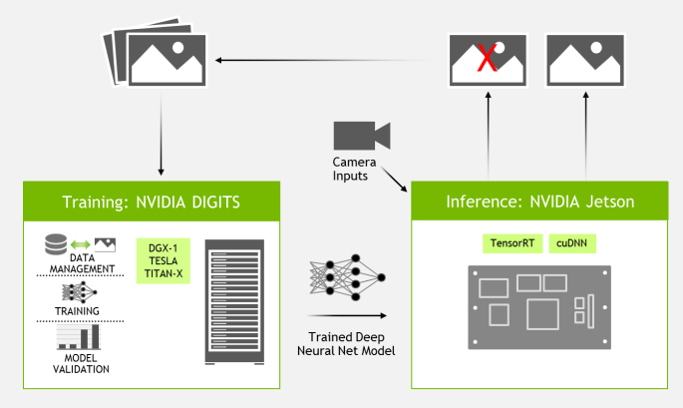
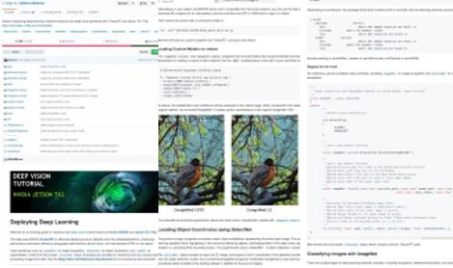
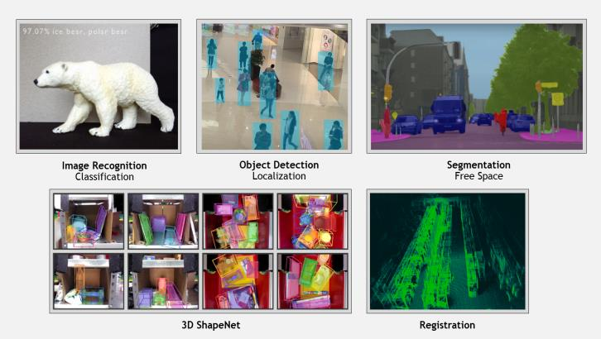
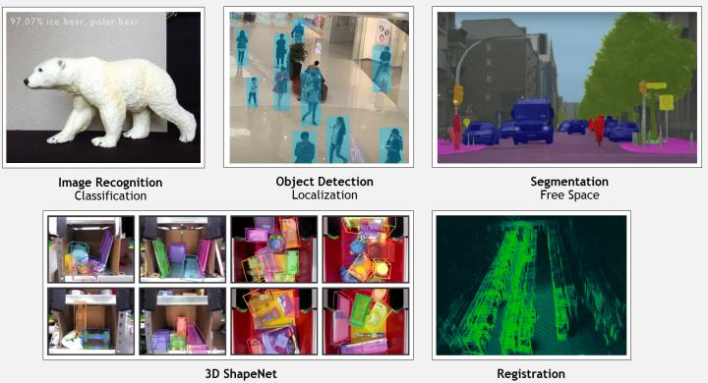
TWO DAYS TO A DEMO
Training + Inference
AI WORKFLOW
TRAINING GUIDES
DEEP VISION PRIMITIVES
Train using DIGITS and cloud/PC
All the steps required to follow to train
Image Recognition, Object Detection
Deploy to the field with Jetson
your own models, including the datasets.
and Segmentation
github.com/dusty-nv/jetson-inference

Slide 11
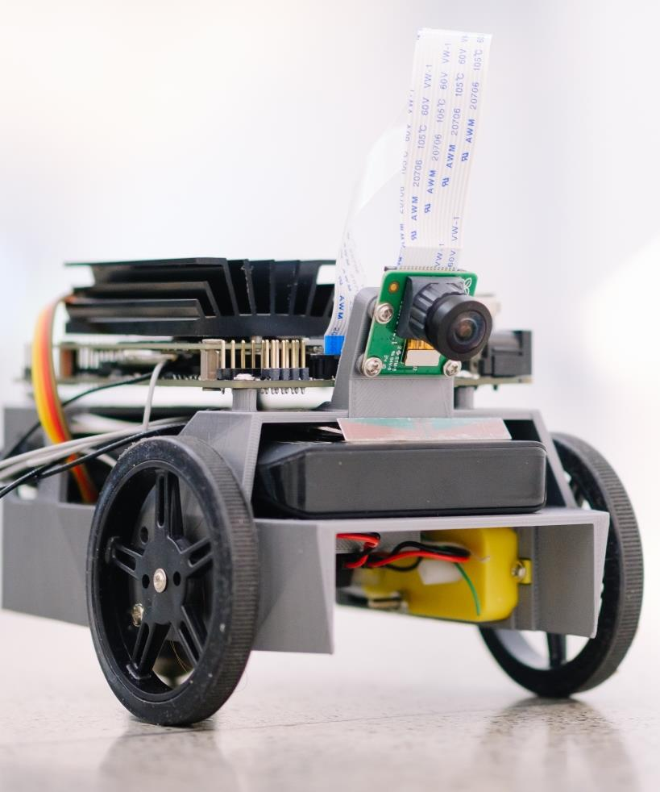
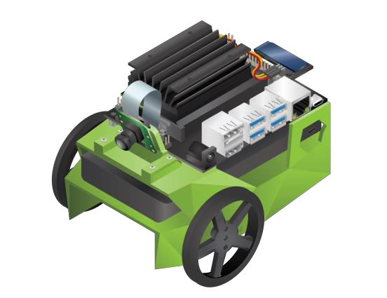
JETBOT
~$250 DIY Autonomous Deep Learning Robotics Kit
Programmable through Jupyter IPython Notebooks
Trainable DNNs for obstacle detection, object
following, path planning, and navigation
ROS support and Gazebo simulator available
Join our upcoming JetBot webinar, May 16 2019
github.com/NVIDIA-AI-IOT/JetBot
29

