Slide 1

UNICEF
Do you know?

Slide 2
目录
01.
Background
CONTENTS
02.
Purpose of the institution
03.
My personal experience
04.
Their fundraising project

Slide 3
01:Background

Slide 4
United Nations International Children's Emergency Fund=UNICEF
And their cultural philosophy is that UNICEF is the main driving force behind a world of children's rights. Our influence on global policymakers and grassroots partners can turn creative ideas into reality. This characteristic sets us apart from other world organizations and organizations working with children.
Its original name was the United Nations International Children's Emergency Relief Fund

Slide 5
Establishment time:
Created on December 11, 1946
Branch 01 source:
Editor of Baidu, UNICEF, Baidu Encyclopedia, December 11, 2021.
https://cn.bing.com/search?q=%E7%99%BE%E5%BA%A6%E7%BF%BB%E8%AF%91&cvid=ce7233a8643948788a784a0504e717fc&aqs=edge.0.69i59j0l8.3111j0j1&pglt=41&FORM=ANNTA1&PC=U531

Slide 6
02.Purpose of the institution

Slide 7
The original purpose was to meet the urgent needs of children in Europe and China after the Second World War.
Since 1950, its work has expanded to meet the long-term needs of children and mothers in all developing countries around the world. In 1953, UNICEF became a permanent member of the United Nations system and was commissioned by the United Nations General Assembly to realize the rights of mothers, children and children to survival, development, protection and participation in all countries of the world.

Slide 8
Branch 02 source:
UNICEF Editor, About UNICEF, UNICEF China website, 10 December 2010
https://www.unicef.cn/about-unicef

Slide 9
03.My personal experience

Slide 10
I started my first donation on December 8, 2021 and I was really moved when I saw the poor looks of those children, and I firmly believed that this fundraising project was real, so I did my best to carry out this project.
It is worth mentioning that if you donate more than or equal to 50 per month, in the third month, UNICEF will mail you a ring and a certificate made of discarded cans, which represent environmental protection and great commemorative significance.

Slide 11
04.Their fundraising project

Slide 12
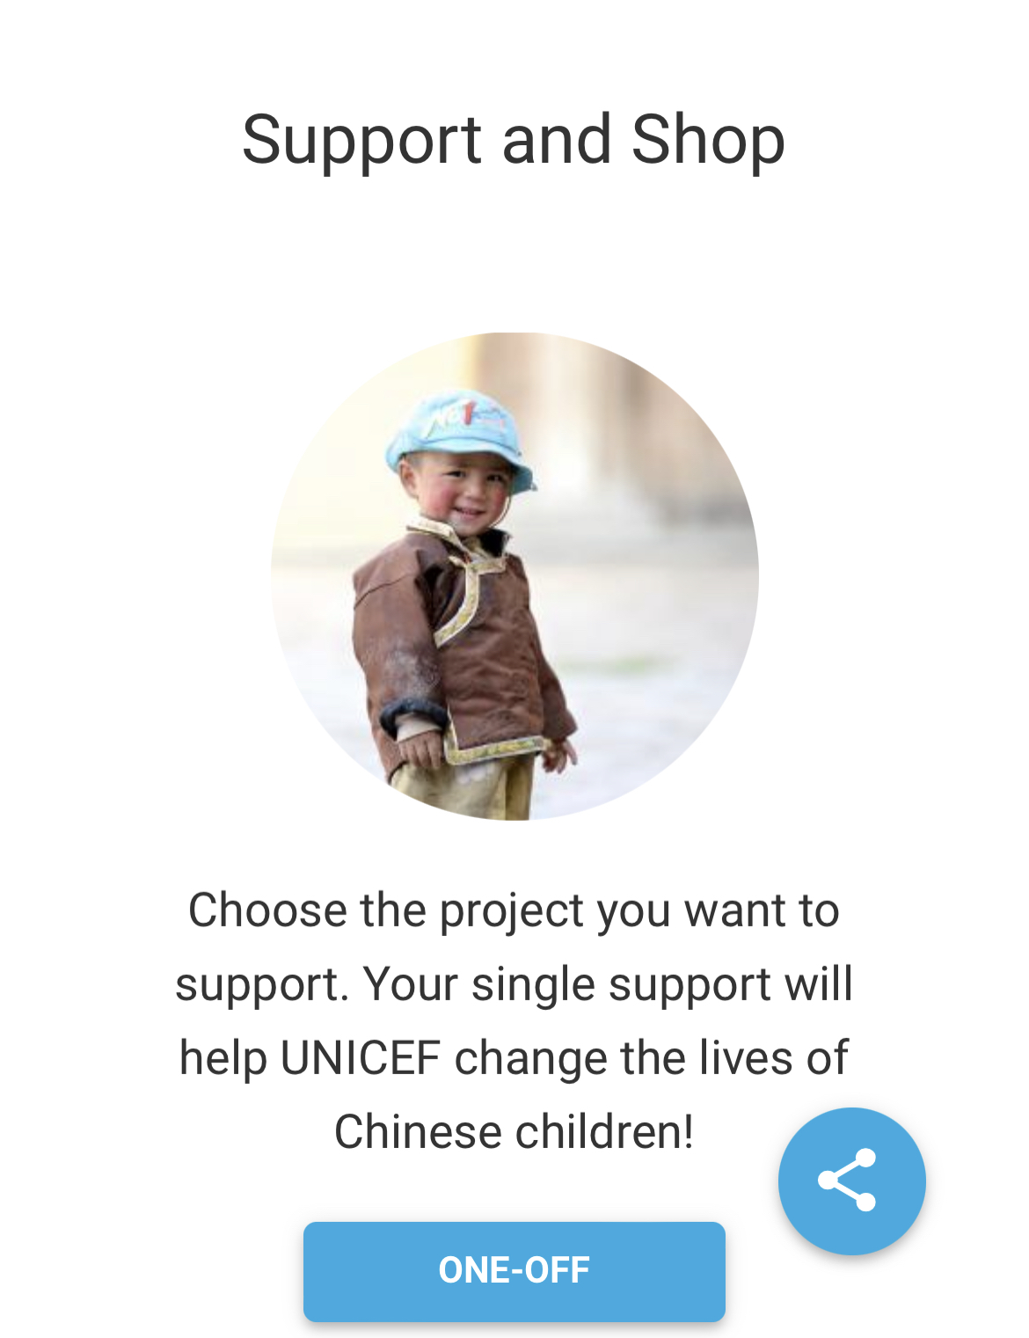
This is one of their four projects, and you can make a single donation to the best of your ability.

Slide 13
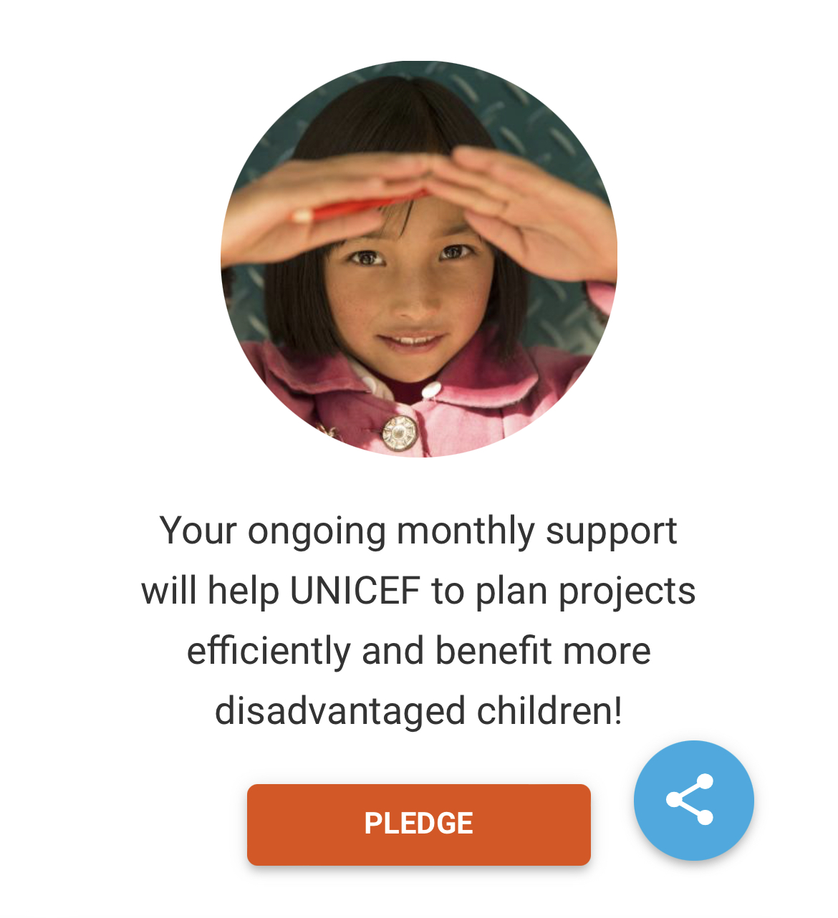
This is one of their four projects, you need to make a donation every month, of course the amount you can decide for yourself, they will charge a fee on a fixed day of the month, you can also cancel at any time.

Slide 14
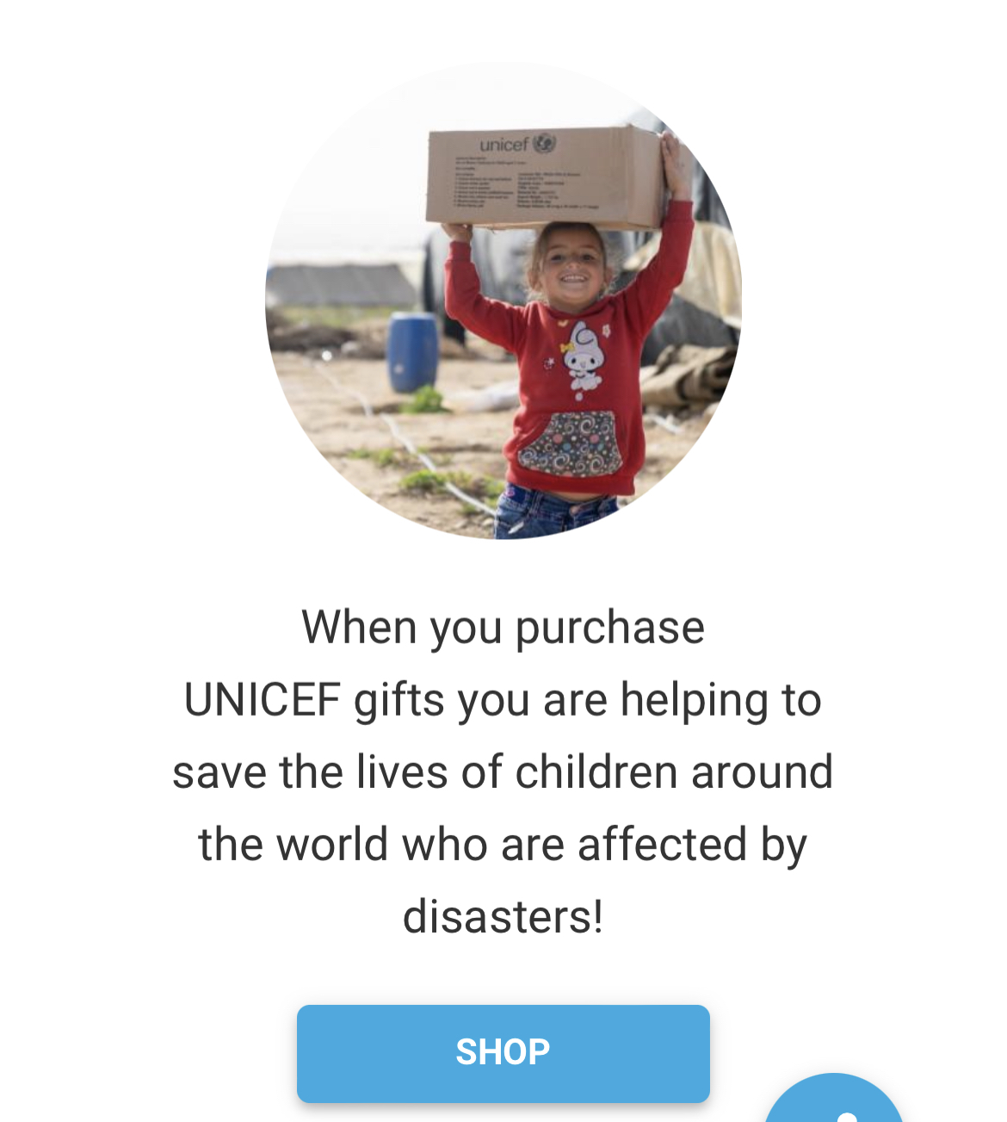
It's a shop and one of four projects where you can buy some supplies and have UNICEF deliver them to these children who have been affected by war and the environment to save them.

Slide 15
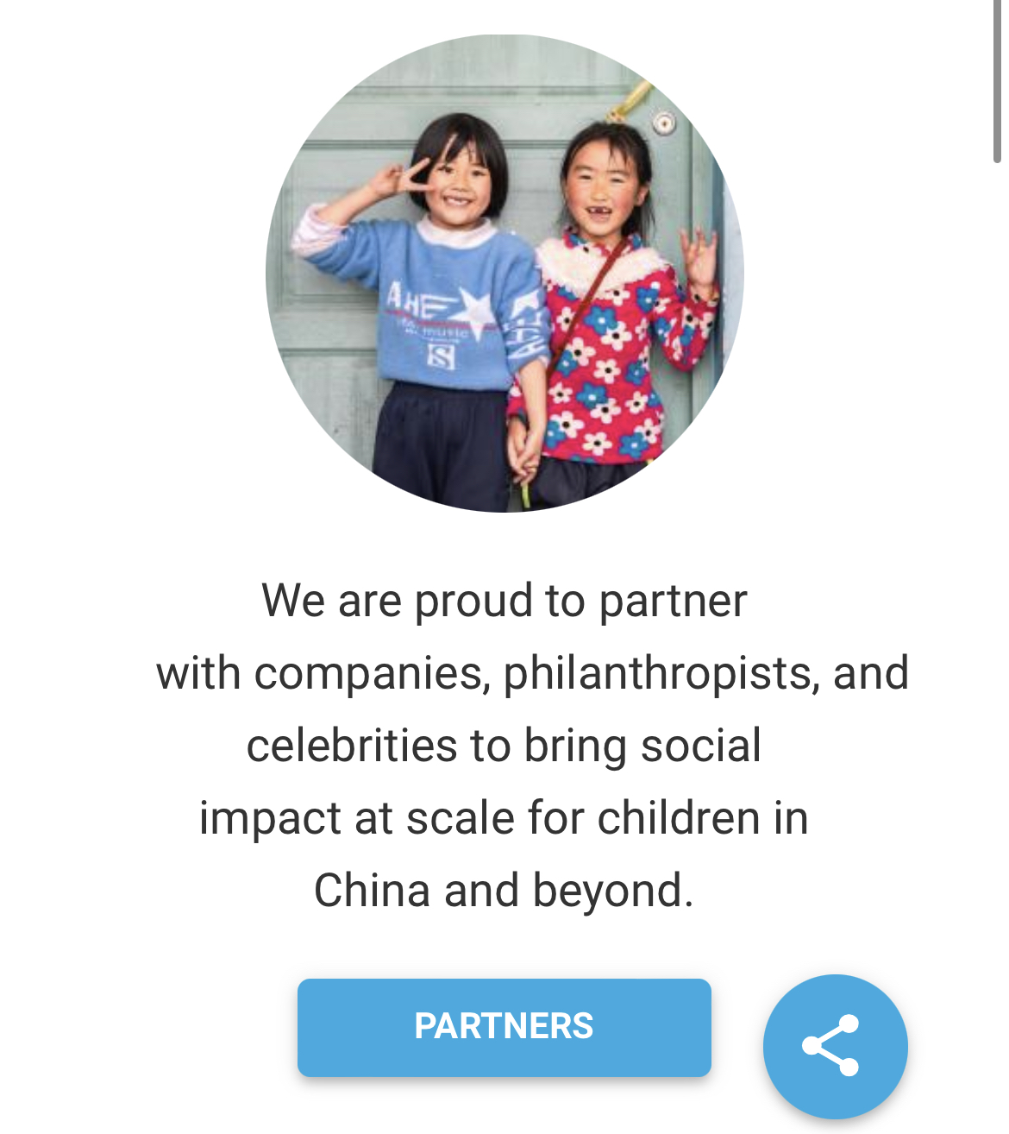
This project, which is probably the biggest of the four, will allow you to work with some philanthropic entrepreneurs to make a bigger impact on your support and help more children.

Slide 16
Branch 01 source:
UNICEF, “Support us,” UNICEF China. 2022. https://www.unicef.cn/support-us. Date accessed: May 20, 2022.

Slide 17
Thank you for listening

