Slide 1

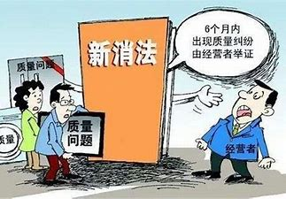
空白演示
CONSUMER PROTECTION AGENCY

Slide 2
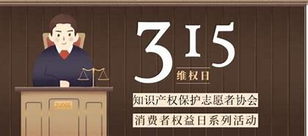
Originally What’s that?
·The organizational structure of the China Consumer Association is a Council. The directors shall be elected through consultation by the relevant government departments, people's organizations, news media, consumer associations (committees) of all provinces, autonomous regions, municipalities directly under the central government and cities specifically designated in the state plan, as well as consumer representatives of all relevant parties. The plenary meeting of the Council shall be held once a year. When it is not in session, the Standing Council shall exercise the functions and powers of the Council. The daily work of the association is undertaken by the permanent office, and the Secretary General and deputy secretary general are in full-time management and responsible to the president. The fund of China Consumer Association is supported by the government and society.
·The China Consumer Association, established with the approval of the State Council in December 1984, is a national social organization that conducts social supervision over goods and services and protects the legitimate rights and interests of consumers. Consumer associations and other consumer organizations are legally established social organizations that exercise social supervision over goods and services and protect the legitimate rights and interests of consumers.

Slide 3
Secondly What do they do?
According to Article 37 of the law of the people's Republic of China on the protection of consumers' rights and interests, consumer associations shall perform the following public welfare duties:
（1） Provide consumers with consumption information and consulting services, improve consumers' ability to safeguard their legitimate rights and interests, and guide civilized, healthy, resource-saving and environment-friendly consumption patterns;
（2） Participate in the formulation of laws, regulations, rules and mandatory standards related to the rights and interests of consumers;
（3） To participate in the supervision and inspection of commodities and services by relevant administrative departments;
（4） Report, inquire and make suggestions to relevant departments on issues related to the legitimate rights and interests of consumers;
（5） Accept complaints from consumers, investigate and mediate complaints;
（6） If the complaint involves the quality of goods and services, it may entrust a qualified appraiser for appraisal, and the appraiser shall inform the appraiser of the appraisal opinions;
（7） With respect to acts that harm the legitimate rights and interests of consumers, support the injured consumers to bring a lawsuit or bring a lawsuit in accordance with this law;
（8） Expose and criticize acts that harm the legitimate rights and interests of consumers through the mass media.
People's governments at all levels shall provide necessary funds and other support to consumer associations in performing their duties.
Consumer associations shall conscientiously perform their duties of protecting the legitimate rights and interests of consumers, listen to consumers' opinions and suggestions, and accept social supervision.
Other consumer organizations established according to law shall carry out activities to protect the legitimate rights and interests of consumers in accordance with the provisions of laws, regulations and their articles of association.

Slide 4
Last What can they bring into our lives?
Improve the awareness and level of enterprises' consumption rights protection, urge them to produce safe products, provide safe services, prevent and reduce potential safety hazards, ensure that consumers' personal rights and property rights are not damaged in the process of consumption, enhance their awareness of resource conservation and environmental protection, ensure environmental safety, safeguard the long-term interests of consumers, pay attention to the protection of vulnerable groups such as the elderly, children and farmers, and take measures to protect their safety rights and interests. Fourth, establish a scientific and reasonable consumption concept, make the consumption behavior meet the requirements of safe consumption, promote the standardized development of the industry through the choice of consumers, and better protect the safety rights and interests of consumers.

Slide 5
Reference
https://baike.baidu.com
https://cca.org.cn
https://www.samr.gov.cn

