Slide 1


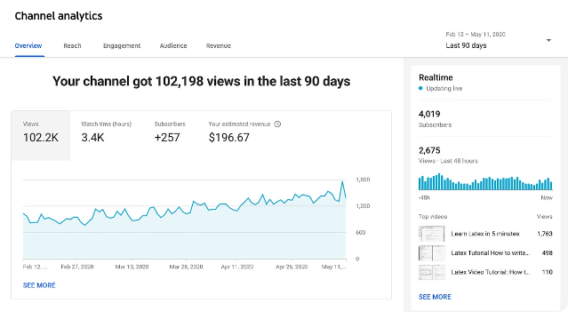
Introduction to the YouTube Songs Data Analysis Project
This project aims to conduct a comprehensive analysis of YouTube song data to gain insights into the performance, popularity, and user engagement of songs on the platform. Using Power BI, the analysis will explore key metrics and trends to inform data-driven decision making.
By Sumit Kumar
SK

Slide 2


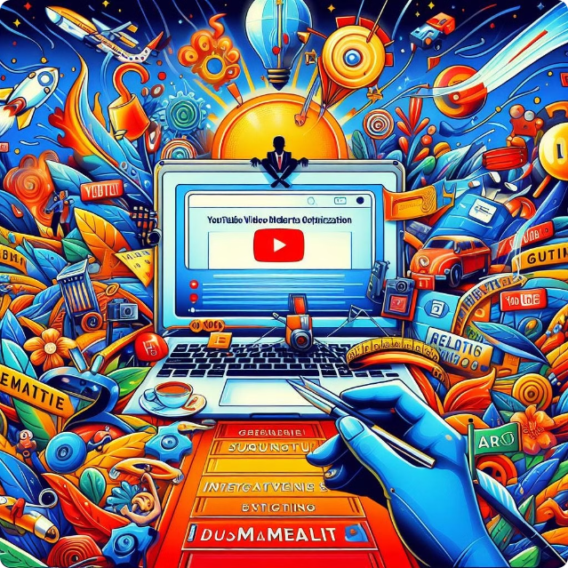
Overview of the Dataset
The dataset includes a wide range of attributes for YouTube songs, such as video ID, channel title, title, description, tags, published date, view count, like count, favorite count, comment count, video duration, video definition, and caption details. This wealth of data provides the foundation for a thorough analysis.

Slide 3

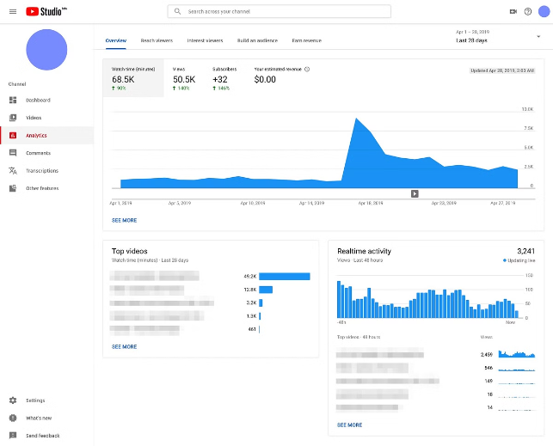
Objectives and Scope of the Analysis
1
Understand Song Performance
Analyze key metrics like views, likes, comments, and favorites to identify top-performing songs and understand factors driving their success.
2
Explore Channel and Content Trends
Investigate the performance and strategies of different YouTube channels to uncover content and engagement patterns.
3
Identify User Engagement Patterns
Identify recurring user behaviors and preferences to inform content optimization and audience targeting.

Slide 4

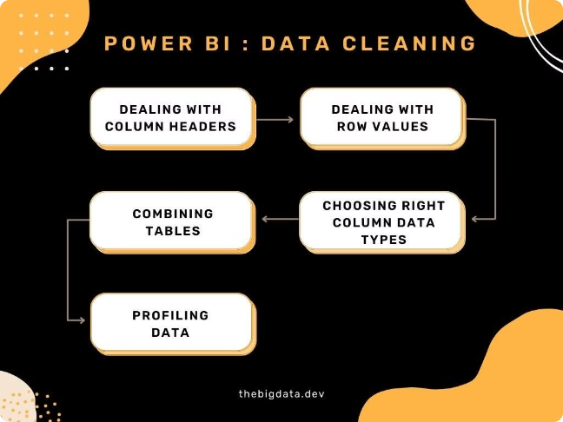
Data Exploration and Cleaning in Power BI
1
Load Data
Import the YouTube songs dataset into Power BI, ensuring all relevant tables and columns are included.
2
Explore Data Structure
Understand the data model, data types, and relationships between tables to identify opportunities for analysis.
3
Clean and Transform
Address data quality issues, handle missing values, and transform the data to a format suitable for analysis.

Slide 5
Creating Measures and Calculated Columns
Calculated Measures
Calculated Columns
Optimize for Analysis
Define custom measures to calculate key performance indicators, such as average views, engagement rate, and conversion ratio.
Create new columns derived from the original data, such as video age, peak popularity, and sentiment analysis.
Ensure the data model is structured in a way that supports efficient querying and visualization of the desired insights.

Slide 6


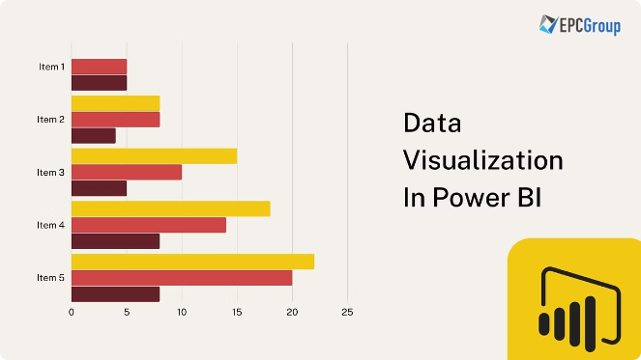



Developing Interactive Visualizations
Charts and Graphs
Create a variety of chart types, such as line charts, bar charts, and scatterplots, to visualize performance trends and relationships.
KPIs and Indicators
Display key performance indicators and metrics using visual elements like gauges, cards, and progress bars.
Geographical Insights
Leverage geographical visualizations, such as maps, to analyze regional variations in song popularity and user engagement.
Hierarchical Insights
Incorporate drill-down capabilities and hierarchical visualizations to enable in-depth exploration of the data.

Slide 7

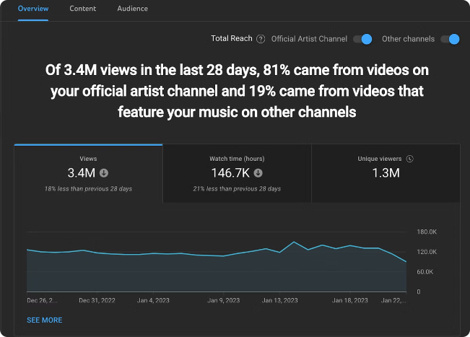
Analyzing Song Performance Metrics
1
View Trends
Examine view counts over time to identify top-performing songs and understand factors that contribute to their popularity.
2
Engagement Metrics
Analyze likes, comments, and favorites to gauge user engagement and sentiment towards different songs.
3
Conversion Insights
Explore the relationship between views, likes, and other engagement metrics to understand conversion rates and audience behavior.

Slide 8
Investigating Channel and Content Trends
Channel Performance
Content Strategies
Competitive Insights
Assess the overall performance of different YouTube channels, including subscriber growth, view counts, and engagement levels.
Identify popular content formats, topics, and tags that drive higher engagement and views across various channels.
Benchmark the performance of different channels and content against industry peers to uncover best practices and opportunities for improvement.

Slide 9

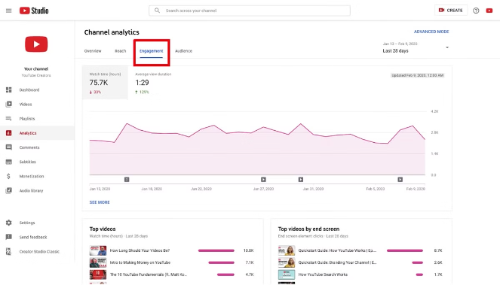
Identifying Patterns in User Engagement
Audience Demographics
Analyze user demographics, such as age, gender, and location, to understand the characteristics of the audience engaging with the content.
Viewing Behaviors
Investigate user viewing patterns, including watch time, session duration, and device preferences, to optimize content delivery and user experience.
Sentiment Analysis
Explore user sentiment through comments and likes to gauge the emotional response to different types of content.
Subscriber Insights
Understand the factors that drive subscriber growth and loyalty, such as content quality, consistency, and community engagement.

Slide 10


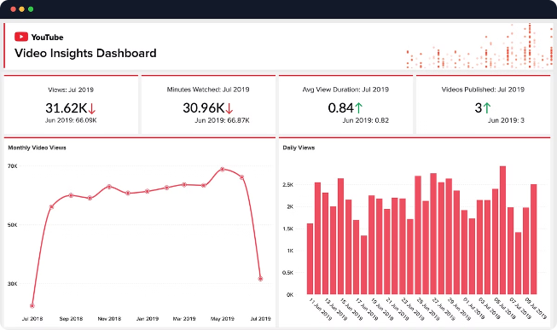


Generating Comprehensive Reports and Insights
Dashboards and Reports
Consolidate the analysis into visually appealing and interactive dashboards that provide a comprehensive view of the YouTube songs data.
Actionable Insights
Derive meaningful insights from the data that can inform content strategy, audience targeting, and platform optimization decisions.
Storytelling and Recommendations
Present the findings in a clear and compelling manner, highlighting key trends, opportunities, and recommendations for improving YouTube song performance.

Slide 11
Thanking You
Sumit Kumar okaysumit07gmail.com

