Slide 1


GlycoSiteMiner Volunteership Summer 2026
GlycoSiteMiner Tool Critique
10th June 2026

Slide 2

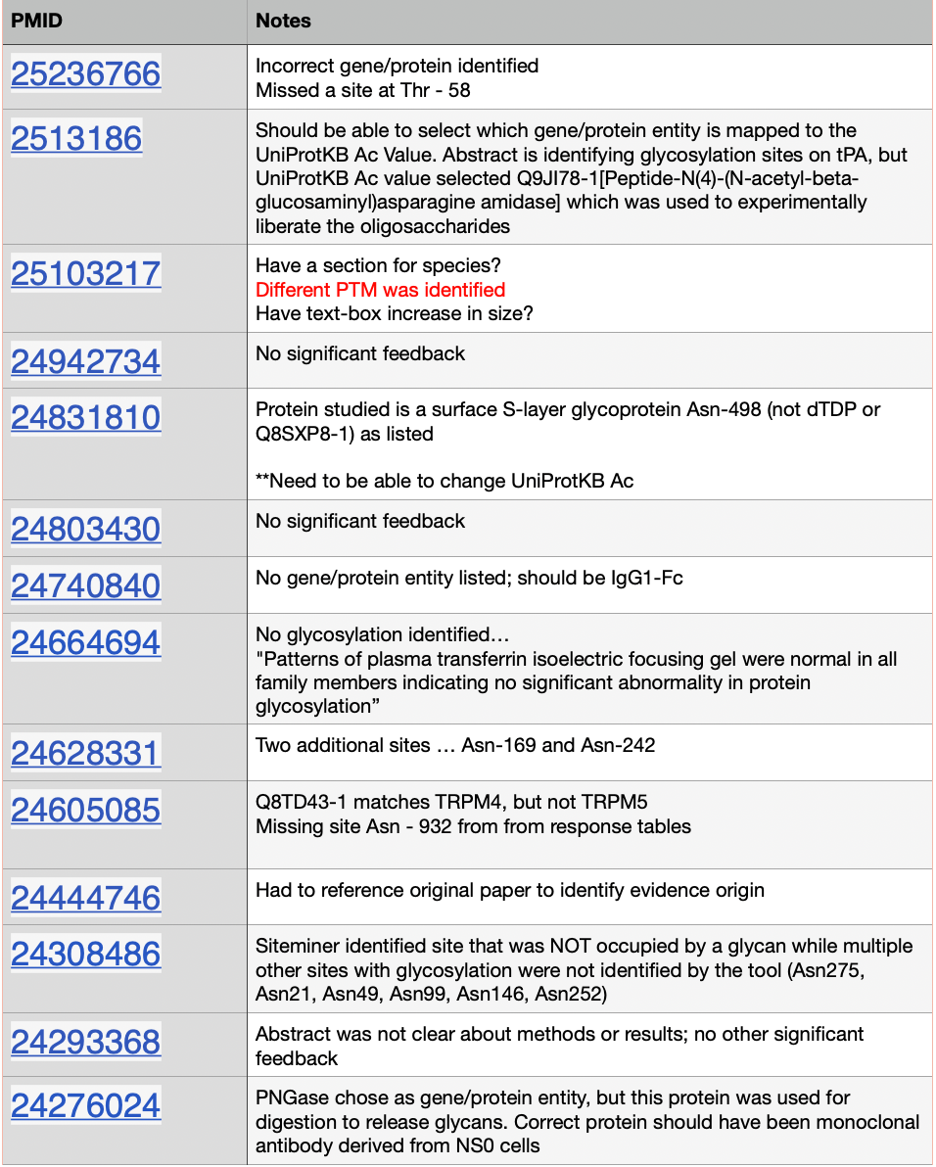
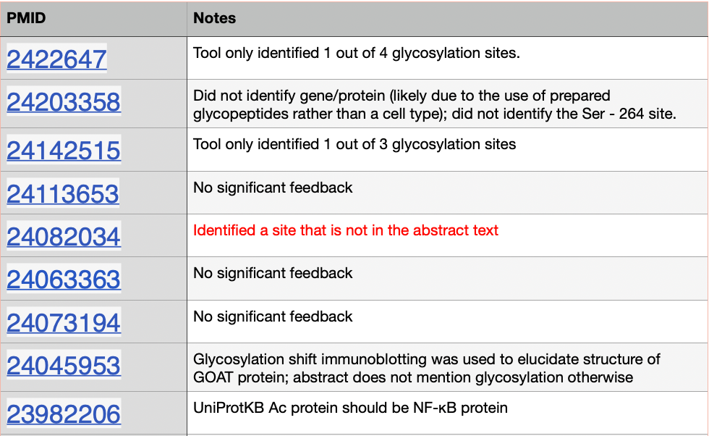
GlycoSiteMiner Critique
Week 1 PMIDs
Observation Summary
Tool Performance
Common Errors:
Misidentifying gene/protein entities
No gene/protein entity identified
Not identifying all listed glycosylation sites
Valuable
Key-words in text is differentiated (bolded font, red text)
GlyGen reference is easily accessible
Curation User Improvements
Ability to highlight text may ease with identifying supporting text
Information needed for evidence not always listed in abstract → provide direct link to study source
Standardize a visual error identifier (e.g., checkbox tool for common errors like “did not identify all sites in abstract”; “selected incorrect gene/protein entity”; etc.)
User should be able to change or suggest UniProtKB Ac for improved response table accuracy
“PMID Curation Log” Google Doc Link
Jovanna Aragon

Slide 3
GlycoSiteMiner Critique
PMIDs reviewed
I reviewed multiple GlycoSiteMiner entries this week
I checked each entry by comparing the highlighted site, the protein name, and the table
What worked
Red highlighted sites made it easier to find the residue
Black highlighted protein names helped me match the site to the right protein
The tables helped me organize the answer step by step
Clear abstracts were easy to complete when the site and protein matched
Problems I noticed
Some sites belonged to a different protein than the UniProt entry
Some abstracts mentioned other changes, not just glycosylation
Some sites were only possible glycosylation sites, not confirmed ones
Direct vs indirect evidence was sometimes confusing
Suggestions
Add a warning when the site and protein do not match
Show the exact sentence that supports the answer
Add a simple “flag for review” option
Add short tooltips for confusing terms
Nahom Gebreselassie

Slide 4
GlycoSiteMiner Critique
Successes:
-qualitative flagging of glycosylation sites in red font
-qualitative flagging of relevant genes / proteins in black
Suggestions (Highest priority)
-feature to flag completely unrelated abstracts (either other PTMs or things like demographic studies, etc.)
-more diverse selections in table 2 in regards to what counts as showing up in GlyGen database (a GlyTouCan ID vs. a GlyGen prediction should not be weighted the same)
-feature to flag other relevant PTMs that are concurrent or solely measured in any given abstract
John McCaffrey

Slide 5





GlycoSiteMiner Critique
~50 PMIDs
reviewed this past week
Critical: data integrity: accession & residue validation
What worked
A SARS-CoV-2 spike abstract pre-loaded P02686 (myelin basic protein) and the P0C604 (olfactory receptor)… wrong accessions silently corrupt the curated dataset.
Cross-check entity → accession and validate residue identity against the canonical sequence (e.g. Thr323 in P0DTC2-1) before a record reaches a curator.
Surfaces candidate sites from abstracts at scale: cuts manual screening time substantially.
Clear N-glycan sequon cases backed by explicit MS evidence were flagged correctly.
GlyTableMaker entries map cleanly to UniProt accessions; validated sites are quick to record.
High priority
Medium priority
“Flag for review” button + reason dropdown → routes to a dev/POC queue, filterable.
Conditional logic: auto-grey / N-A Tables 3–4 when Glycosylated = No (blocks contradictory entries).
In-context guidance: tooltips, FAQ-linked SOP, inline traps (glyco vs phospho/glycation, sequon vs confirmed, O-GlcNAc counts), gold-standard AKT1 example.
Workflow: explicit status, Save vs Mark-complete, filter/sort/search, progress bar, curator assignment.
Save-time validation: block completion on “--select”; require Supporting Text for every “Yes.”
Capture Supporting Text by highlighting the abstract → verbatim quote, no copy-paste errors.
Surface pipeline context per site: matched sentence, predicted mod type (N/O/phospho), confidence; also feeds v2.0 active learning.
Neha Rao

