Slide 1
Uniqueness of NMF
Wu, 2018/03/20

Slide 2
Overview
NMF and it’s application
NMF
Learning parts of objects(Nature’1999)
TopicMF(AAAI’14)
Introduction to Cone
The uniqueness of NMF

Slide 3
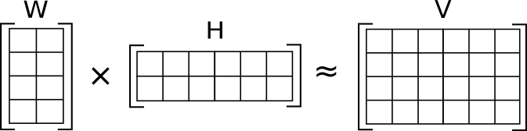
NMF
the matrix V is represented by the two smaller matrices W and H subjecting to W > 0, H > 0

Slide 4
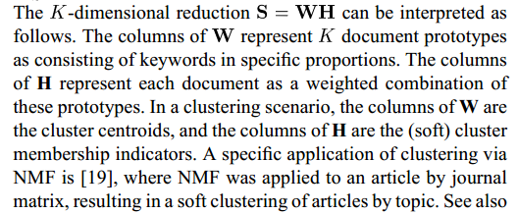
NMF: interpretation

Slide 5
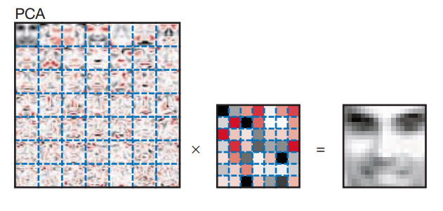
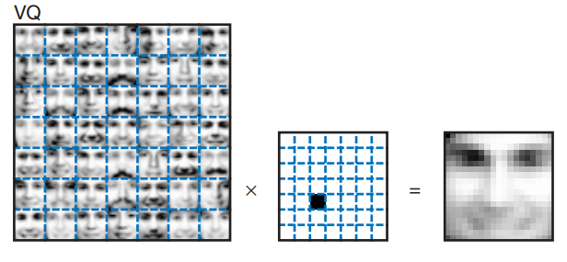
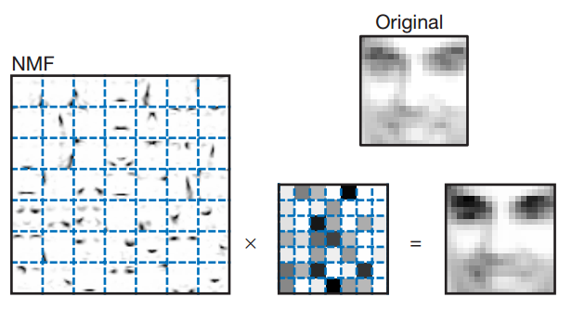
Learning parts of objects
Notes:
Learning parts is interesting

Slide 6
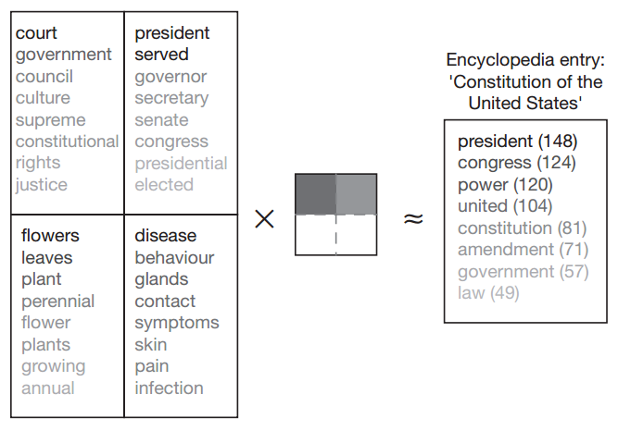
Learning parts of objects

Slide 7
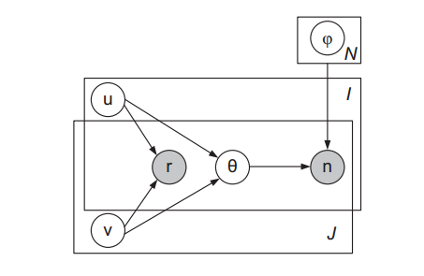

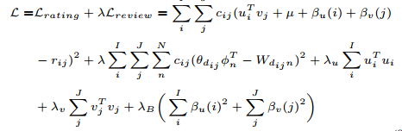
Topic MF

Slide 8
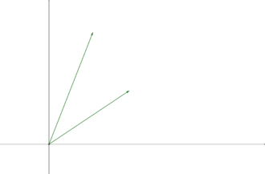
Cone
Cone(linear cone): A subset C of a vector space V is a cone if for each x in C and positive scalars α, the product αx is in C.
A cone: the union of two rays

Slide 9
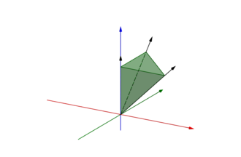
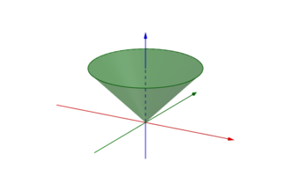
Conex cone
convex cone:
A cone C is a convex cone if αx + βy belongs to C, for any positive scalars α, β, and any x, y in C.

Slide 10
Conical hull
conical combination: a conical combination of a set of vectors is a linear combination of these vectors
Conical hull: The conical hull of the given vectors is identical to the set of all their conical combinations.

Slide 11

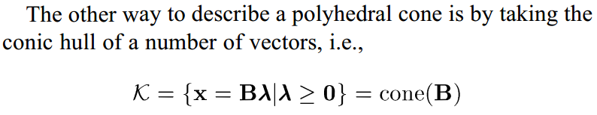
Polyhedral cone
A cone K is called Polyhedral if there is some matrix such that
Notes:
Example: B = [[001],[010],[100]]

Slide 12
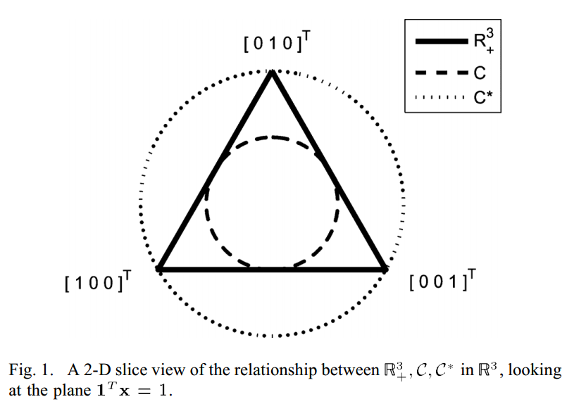



Dual cone
The Dual cone of cone C is the set:
Example:

Slide 13


Dual cone properties
Notes:
Lemma 1

Slide 14
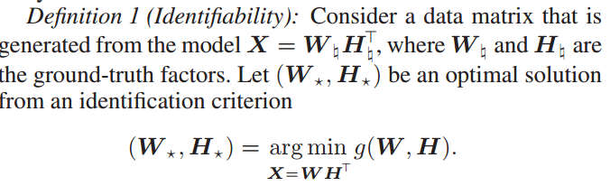
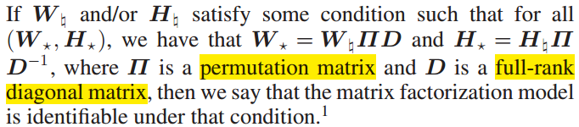
Uniqueness of NMF: Definition

Slide 15
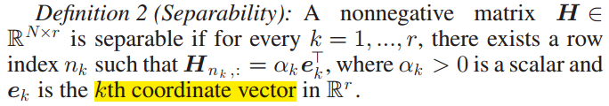
Condition: Separability

Slide 16
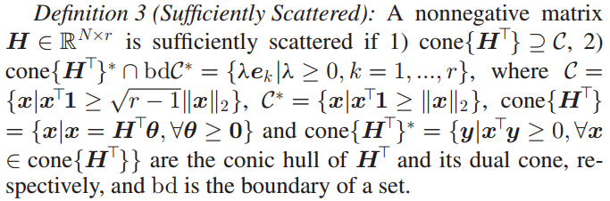
Condition: Sufficiently scattered

Slide 17
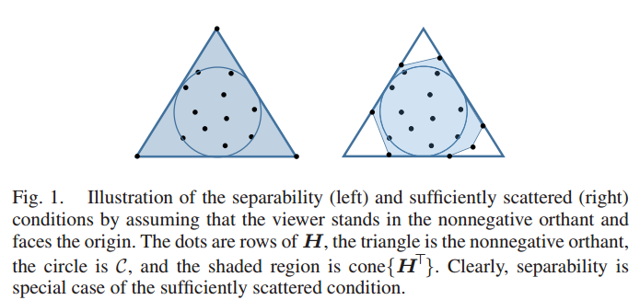
Separability vs sufficiently scattered
Notes:
Full rank of H

Slide 18
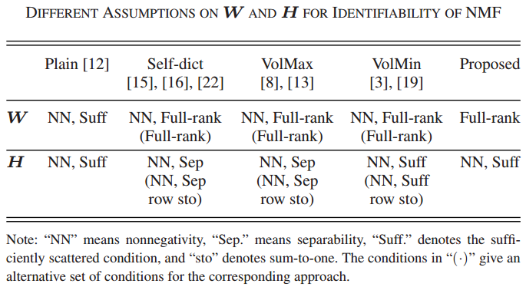
Conditions

Slide 19
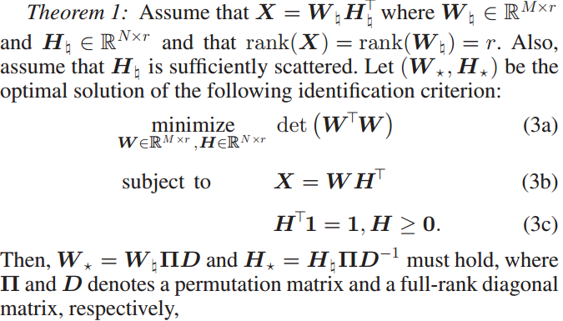
Proposed criterion

Slide 20
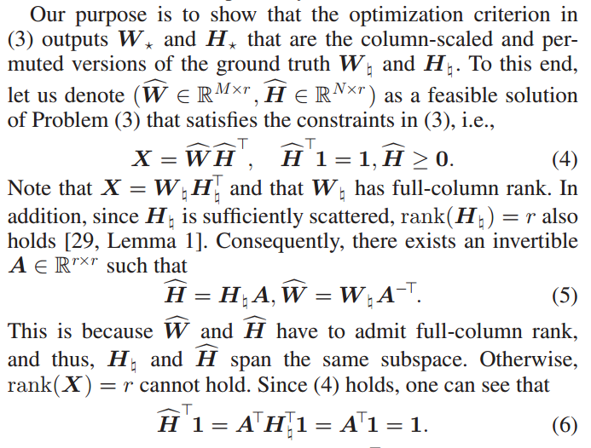
Proof

Slide 21
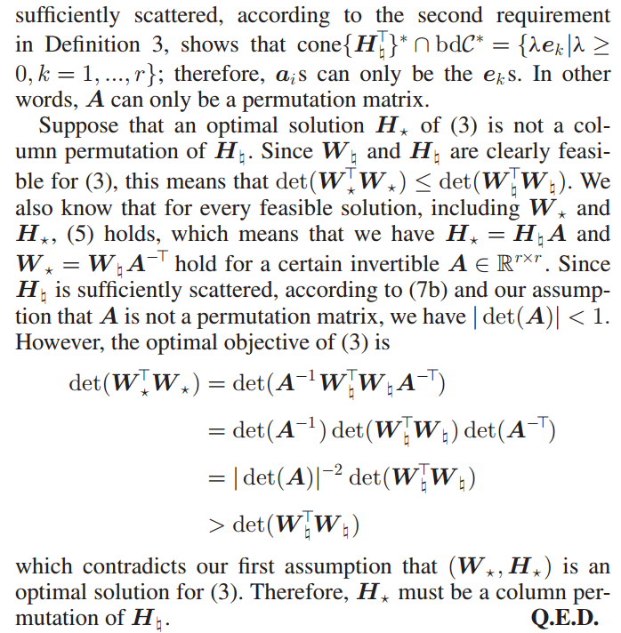
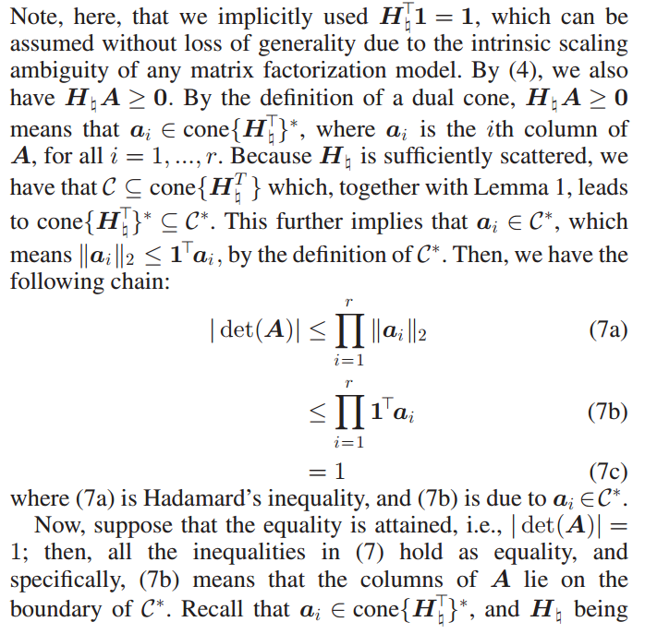
Proof

Slide 22
Conclusion
NMF and it’s application
Learning parts of objects(Nature’1999)
TopicMF(AAAI’14)
Introduction to Cone
Conical hull
Dual cone
The uniqueness of NMF
Separability
Sufficiently scattered.

Slide 23
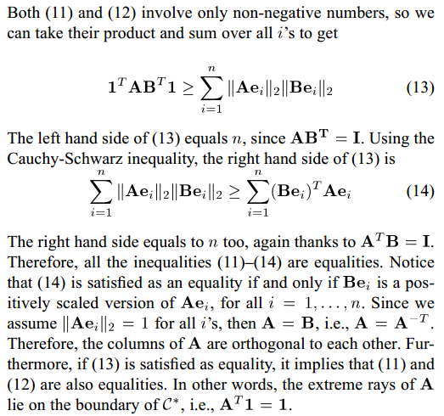
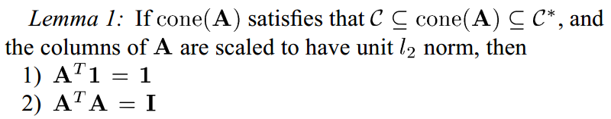
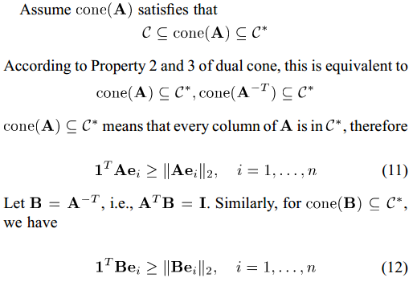
Appendix 1

