Slide 1
Equivariant CNN
Wu, 2018/05/29

Slide 2
Overview
What is Equivariance?
Equivariant CNNs
  Group Equivariant Convolutional Networks (ICML’16)
  Steerable CNNs (ICLR’17)
  Spherical CNNs (ICLR’18, best paper)

Slide 3
Equivariance 1: Capsule
The probability of the visual entity being present is locally invariant.
The instantiation parameters are “equivariant” – as the viewing conditions change and the entity moves over the appearance manifold, the instantiation parameters change by a corresponding amount because they are representing the intrinsic coordinates of the entity on the appearance manifold.
Notes:
Invariant: it does not change as the entity moves over the manifold of possible appearances within the limited domain covered by the capsule.
Equivariant:

Slide 4
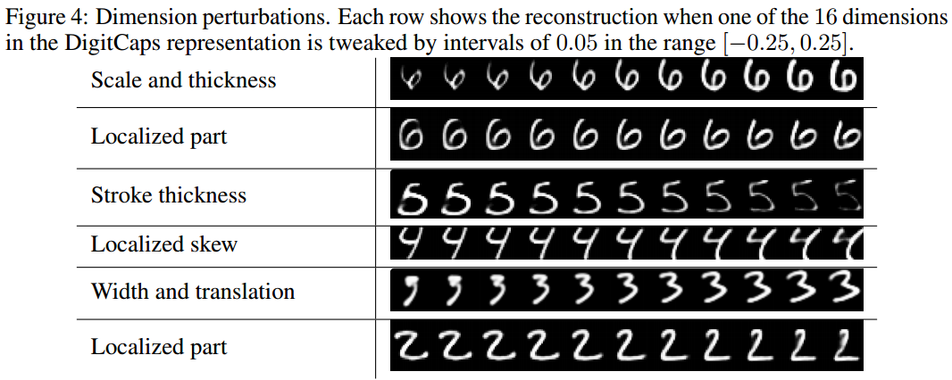
Equivariance 1: Capsule

Slide 5
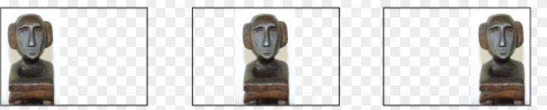
Equivariance 2: Traditional CNN
Equivariance to translation

Slide 6



Equivariance 3: Definition(maybe)
For some group of transformations G and g $ε G$is a symmetry transformation, A network or layer Φ is equivariant means that:
The operators $T$ and $T^{′}$ need not be the same. The only requirement for $T$and $T^{′}$is that
for any two transformations $g$ and $h$, we have $T(gh) = T(g)T(h)$

Slide 7
Group Equivariant Convolutional Networks
ICML’16

Slide 8
Task
Show that traditional CNNs are equivariant to translations but may fail to equivary with more general transformations(like rotation).
Define G-CNN(G-convolution, G-pooling, nonlinearity) that is equivariant to translations and rotations.

Slide 9
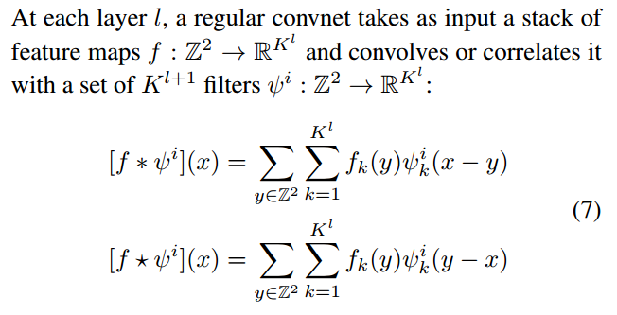
Regular convnet

Slide 10

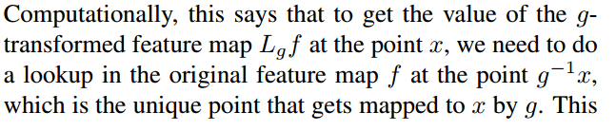

Transformation acting on feature maps
We introduce the following notation for a transformation g acting on a set of feature maps:

Slide 11
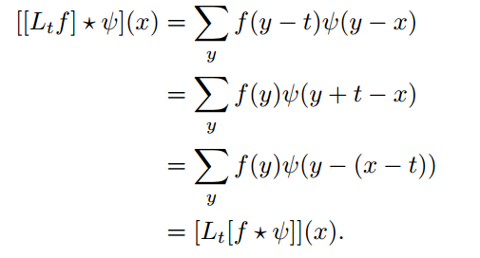
Equivariance of the regular convnet
Using the substitution y = y + t

Slide 12
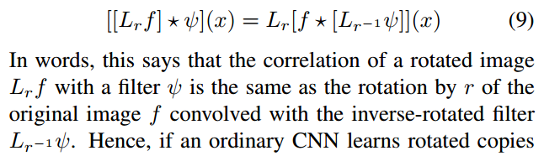
Not Equivariant to rotation

Slide 13
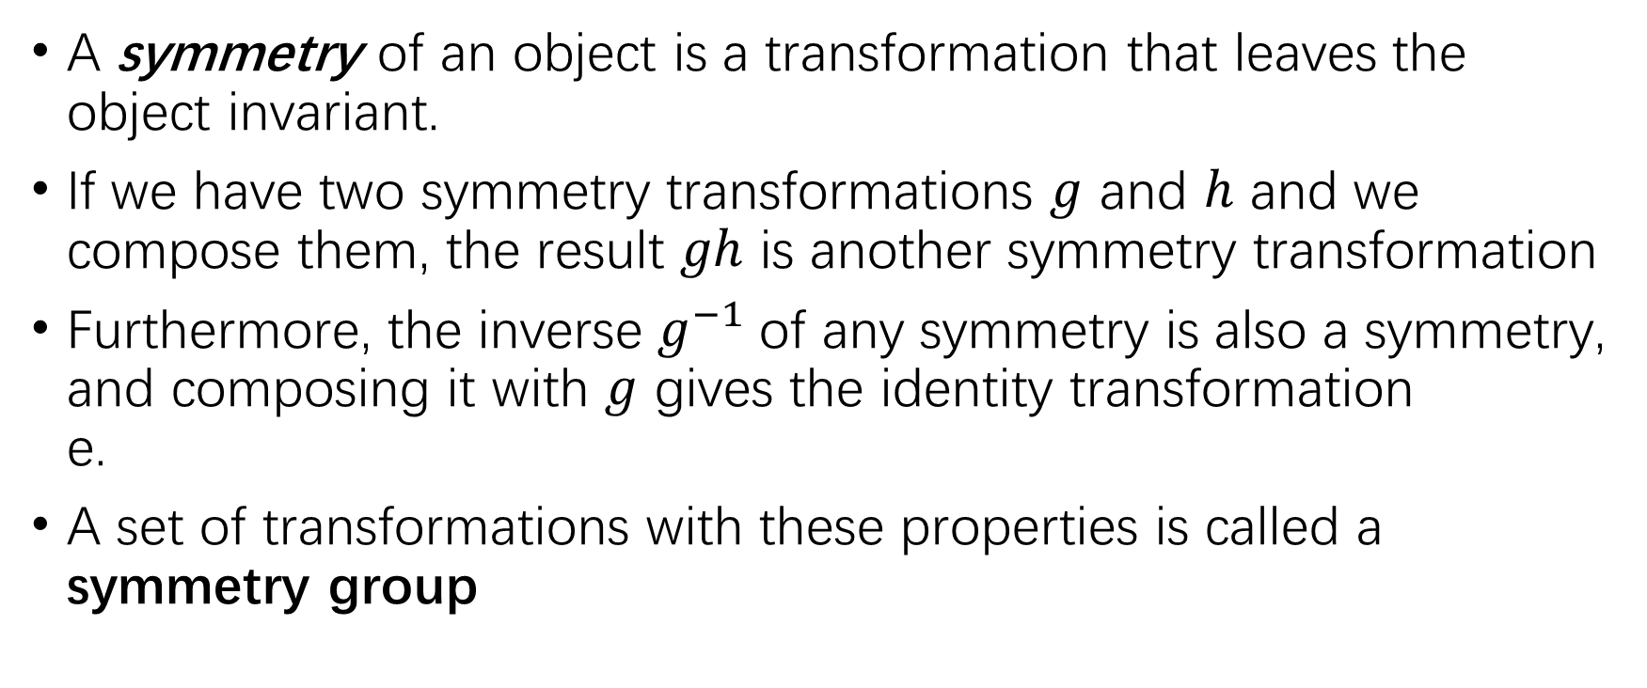
Symmetry groups
A symmetry of an object is a transformation that leaves the object invariant.
If we have two symmetry transformations $g$ and $h$ and we
compose them, the result $gh$ is another symmetry transformation
Furthermore, the inverse $g^{−1}$of any symmetry is also a symmetry,
and composing it with $g$ gives the identity transformation
e.
A set of transformations with these properties is called a
symmetry group

Slide 14
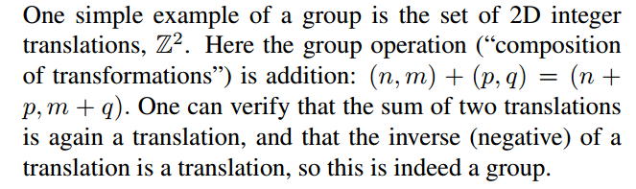

The group $Z^{2}$

Slide 15
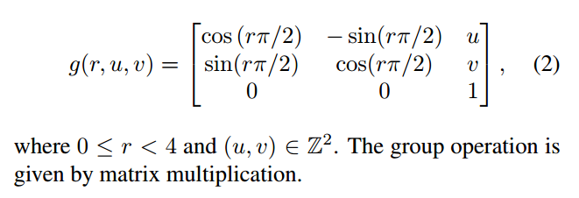
The group p4

Slide 16
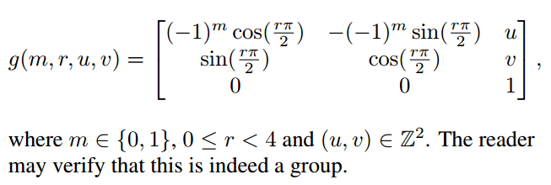
The group p4m

Slide 17
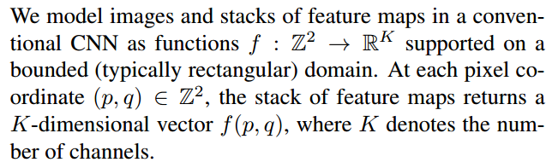

Functions on group $Z^{2}$：regular convnet

Slide 18

Functions on group $Z^{2}$
We introduce the following notation for a transformation g acting on a set of feature maps:

Slide 19


Transformation acting on feature maps
Operator $L_{g}$ is a concrete instantiation of the transformation
operator $T_{g}$ referenced in page 6 and one may verify that:

Slide 20
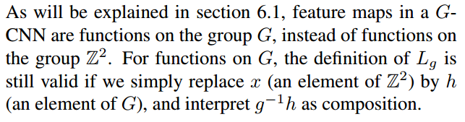
Function on general group G
later

Slide 21
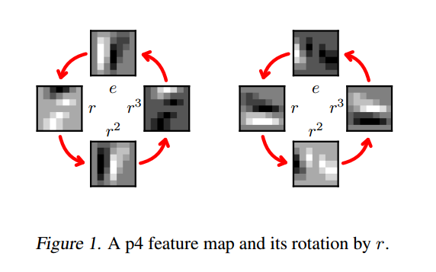
Visualize function on group p4

Slide 22
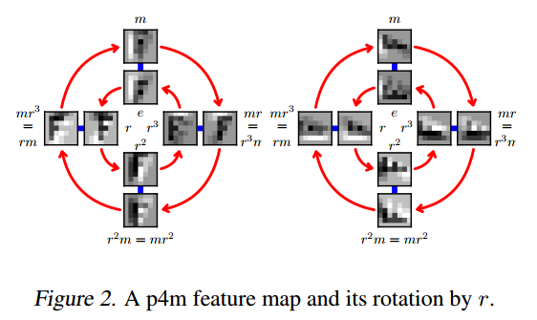
Visualize function on group p4m

Slide 23


Definition: G-Equivariant correlation
First layer
Layers after the first

Slide 24
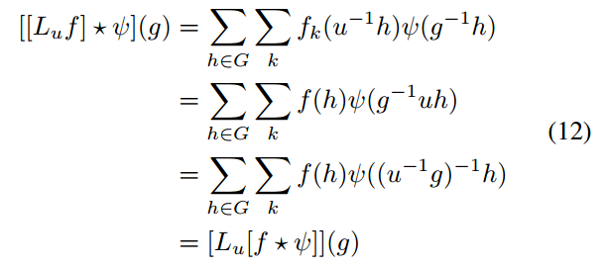
The equivariance of G-convolution

Slide 25
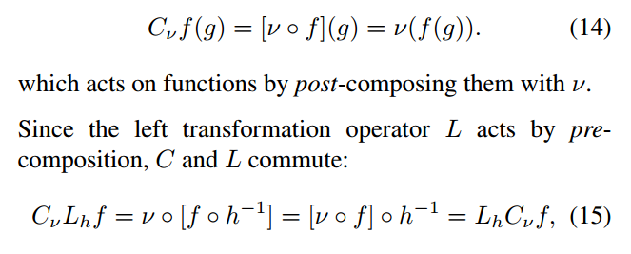

Pointwise nonlinearities
For a nonlinearity $ν : R → R$to a feature map amounts to function composition. We introduce composition operator

Slide 26
Pooling
In order to simplify the analysis, we split the pooling operation into two steps:
  The pooling itself (performed without stride),
  Then, a subsampling step.

Slide 27
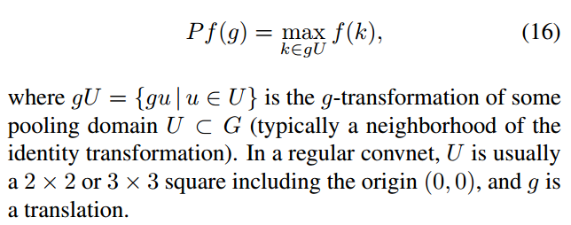
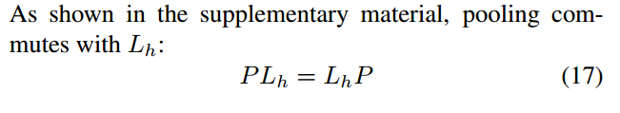

The non-strided max pooling
The non-strided maxpooling operation applied to a feature map $f : G → R$can be modeled as an operator $P$ that acts on $f$ as

Slide 28
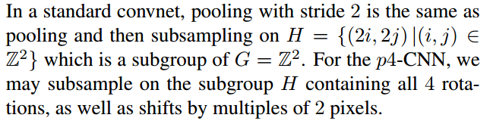
Subsampling
In a G-CNN, the notion of “stride” is generalized by subsampling on a subgroup H ⊂ G.

Slide 29
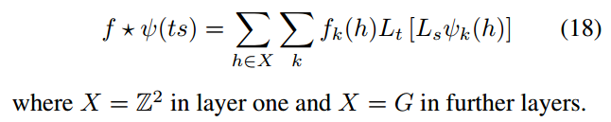

Implementation
For the group $p4$, we can write $g = ts$for t a translation and s a rotation about the origin, while $p4m$ splits into translations and rotation-flips.
Using this split of $G$ and the fact that $L_{g}L_{h} = L_{gh}$, we can rewrite the G-correlation as follows:

Slide 30

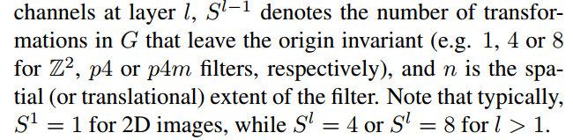
First step: Filter Transformation

Slide 31
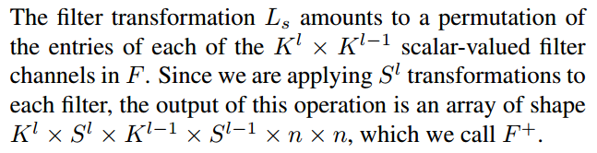
First step: Filter Transformation

Slide 32
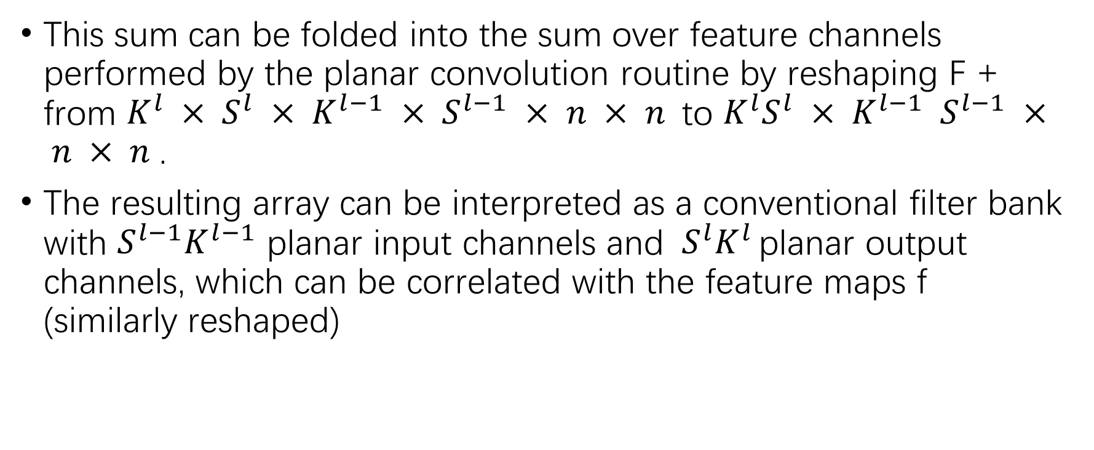
Second step: Planar convolution
This sum can be folded into the sum over feature channels performed by the planar convolution routine by reshaping F + from $K^{l} × S^{l} × K^{l−1} × S^{l−1} × n × n {\text{to} K^{l}S}^{l} × K^{l−1} S^{l−1} × n × n$.
The resulting array can be interpreted as a conventional filter bank with $S^{l−1}K^{l−1}$ planar input channels and${ S}^{l}K^{l }$planar output channels, which can be correlated with the feature maps f (similarly reshaped)

Slide 33
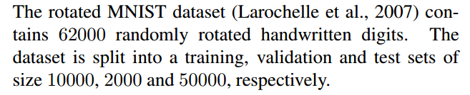
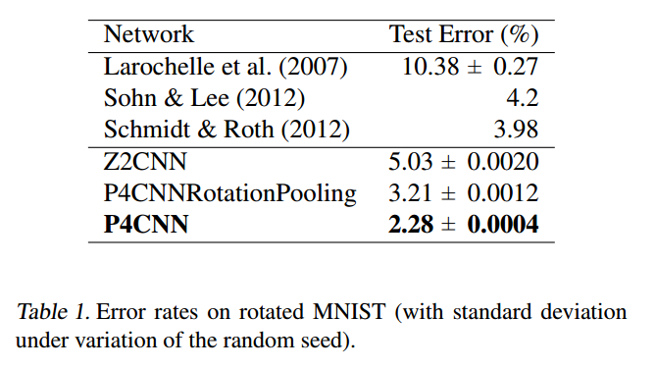
Experiments

Slide 34
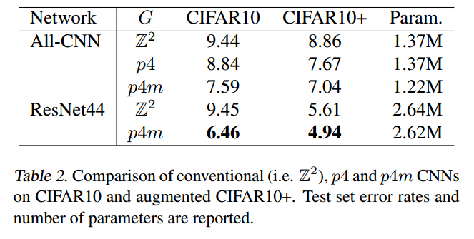
Experiments

Slide 35
GCNN reviews
If one is familiar with group-theoretic notation, I do not think the content of this paper would be new to many practitioners. If one is not familiar, then the paper might be somewhat helpful in introducing the notation, but would not motivate why group theory should be used to describe concepts that are simple enough to not need the heavy weight mathematical framework.

Slide 36
GCNN reviews
The overall contribution is limited in the sense that these are old ideas that have not been favored: practitioners have often concluded that it was more efficient to simply augment the data with the desired transformation, rather than enforce it at the model level.

Slide 37
GCNN vs Capsule

Slide 38
Spherical CNNs
ICLR’18

Slide 39
Task
A number of problems of recent interest have created a demand for models that can analyze spherical images.
Examples include omnidirectional vision for drones, robots, and autonomous cars, molecular regression problems, and global weather and climate modelling.

Slide 40
Contribution
The theory of spherical CNNs. (Similar as GCNN)
The first automatically differentiable implementation of the generalized Fourier transform for S2 and SO(3). Our PyTorch code is easy to use, fast, and memory efficient
The first empirical support for the utility of spherical CNNs for rotation-invariant learning problems.

Slide 41
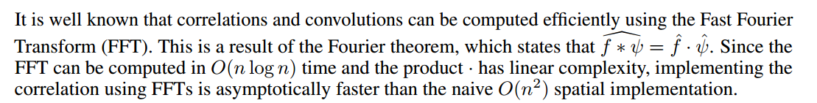
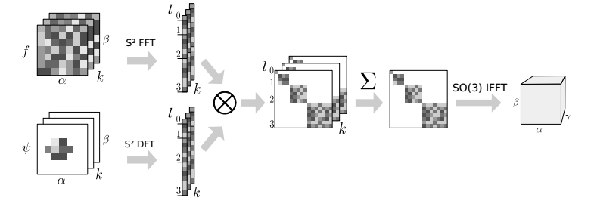
Fast spherical correlation with G-FFT

Slide 42
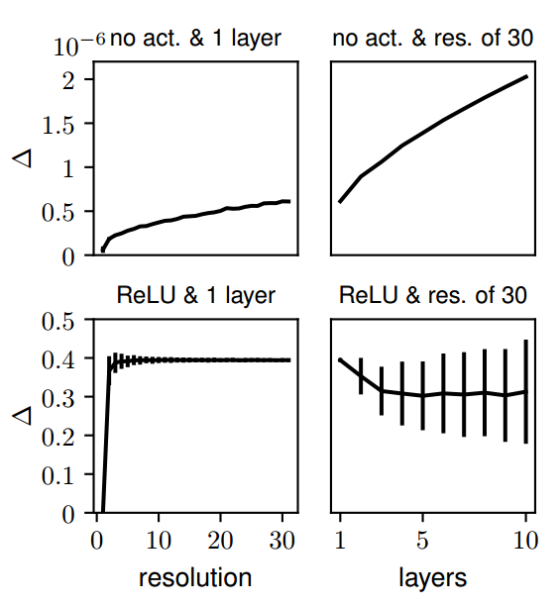
Experiment 1: equivariance error

Slide 43
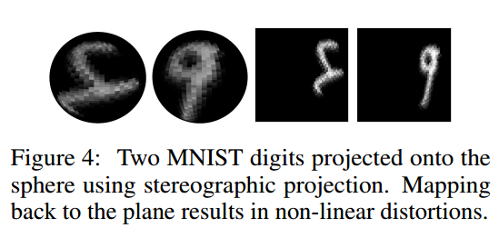
Experiment 2: rotated MNIST on sphere

Slide 44
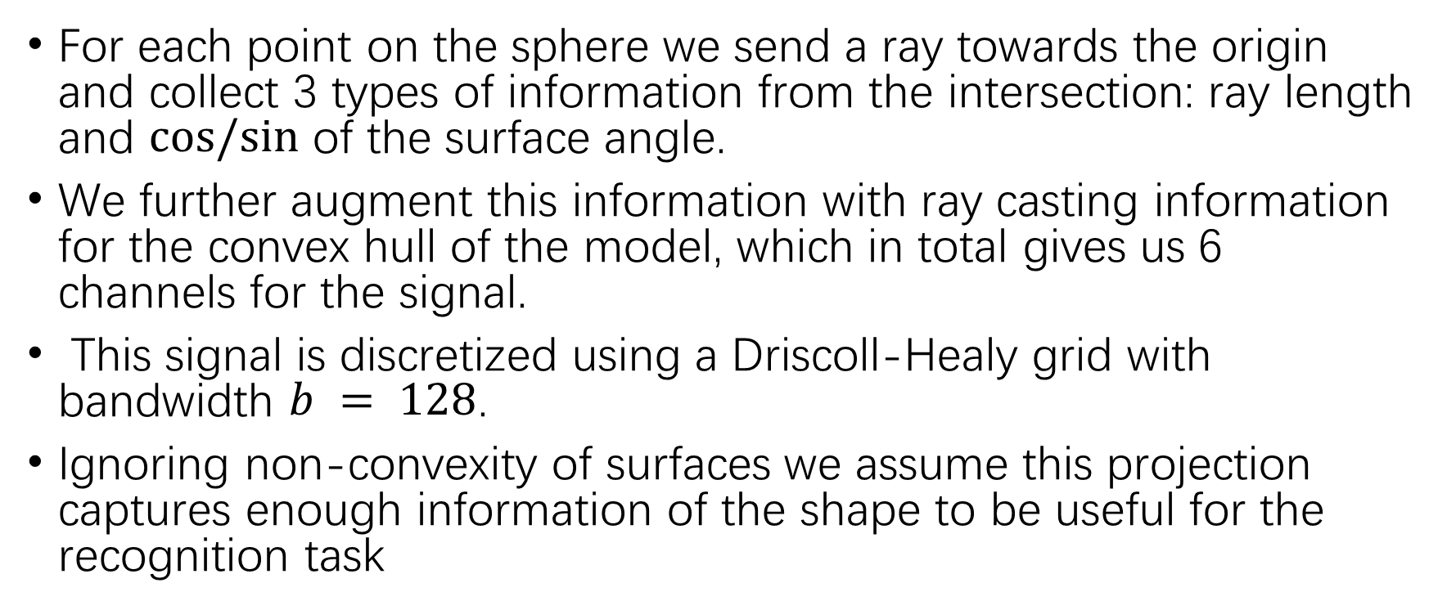
Experiment 3: recognition of 3D objects
For each point on the sphere we send a ray towards the origin and collect 3 types of information from the intersection: ray length and $cos/sin$ of the surface angle.
We further augment this information with ray casting information for the convex hull of the model, which in total gives us 6 channels for the signal.
This signal is discretized using a Driscoll-Healy grid with bandwidth $b = 128$.
Ignoring non-convexity of surfaces we assume this projection captures enough information of the shape to be useful for the recognition task

Slide 45
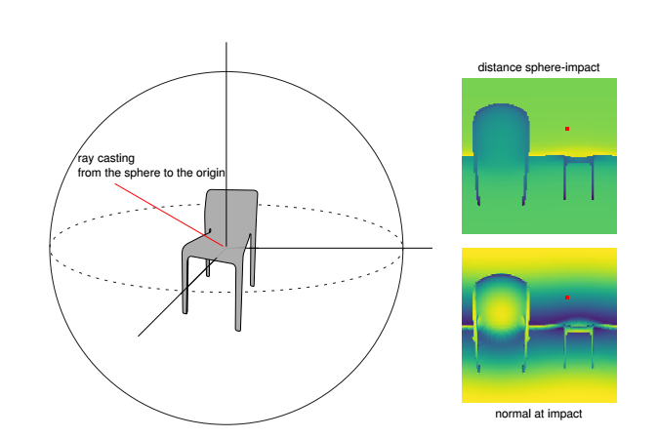
Experiment 3: recognition of 3D objects

Slide 46
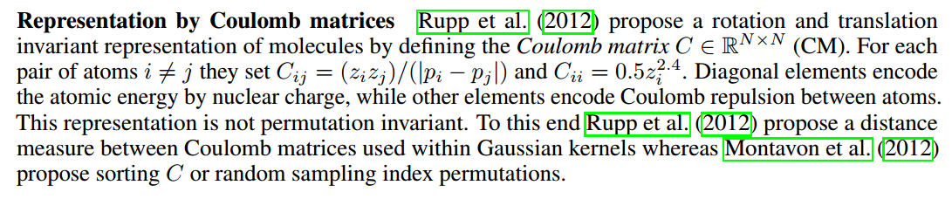
Experiment 4: predict atomization energies from molecular geometry

Slide 47
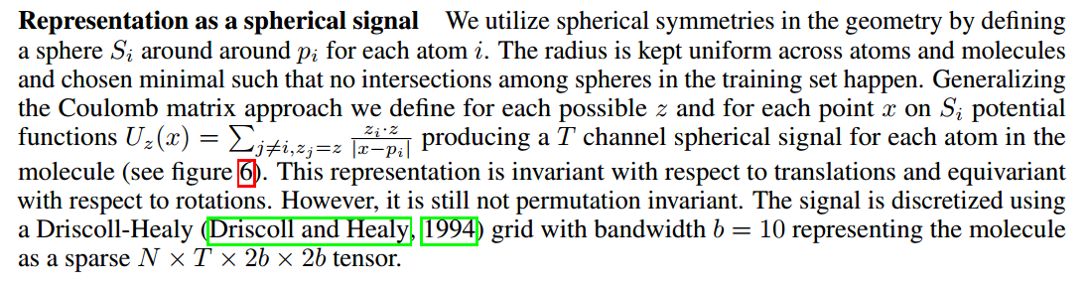
Experiment 4: predict atomization energies from molecular geometry

Slide 48
Steerable CNNs
ICLR’17

Slide 49
Task
The same as Group Equivariant Convolutional Networks

Slide 50
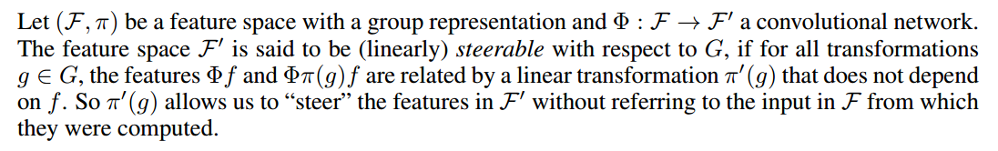
Steerable Representations

Slide 51
Contribution
More strict proof comparing to GCNN
The mathematical theory of steerable representations reveals a type system in which any steerable representation is a composition of elementary feature types, each one associated with a particular kind of symmetry.
We show how the parameter cost of a steerable filter bank depends on the types of the input and output features, and show how to use this knowledge to construct CNNs that utilize parameters effectively.

Slide 52
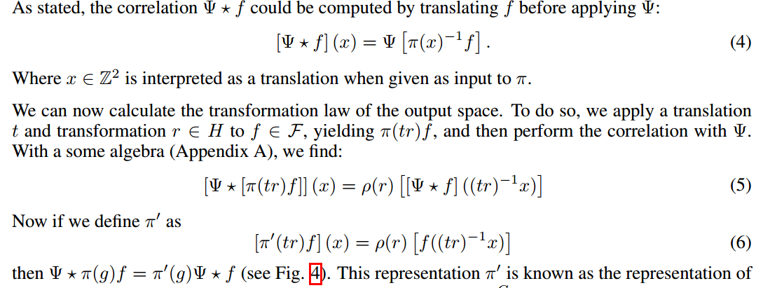
Proof example

